Slide 1


HEVEN OR HELL? GHG IMPLICATIONS OF AN AUTONOMOUS FUTURE
Jennifer Hatch* and Will Gorman^
Economics of Autonomous and Electric Vehicles
National Bureau of Economic Research, Stanford University
June 7th, 2019
* Boston University ^ University of California Berkeley
bu.edu/ise
Notes:
Hi everyone, thanks so much for staying for the last presentation of the day! I’ll try and make it interesting. I think the work I’ve been doing brings in a lot of components from the other presentations we’ve seen during this conference, so hopefully you’ll find some value.

Slide 2
THE THREE REVOLUTIONS IN URBAN TRANSPORTATION
ELECTRIFICATION
What does it mean for power use?
What do these transformations mean for GHG emissions?
What does this mean for infrastructure needs and city welfare?
How large of a grid will we need?
Will growth return to the power business?
AUTOMATION
SHARING
(Sperling, Pike, and Chase, 2018)
bu.edu/ise
Notes:
I’m sure all of you have heard of Dan Sperling’s so-called “three revolutions” in transportation: sharing, electrification, and automation.
-bounding the long-term impacts of these transformations in a way that is policy relevant.
-The problem with these transformations is that they each have numerous, difficult to quantify impacts on the light duty fleet.

Slide 3
PRIOR WORK
EPRI/NRDC (2015)
Brattle (2016)
Morgan Stanley (2015)
Goldman
Sachs (2015)
BAML (2017)
Specificity
Makenzie Wadud & Leiby (2014)
Stephens et al. (2016)
RMI (2016)
World Energy Council (2011)
Brown, Gonder, & Repac (2014)
2025
Time frame for projections
2050
bu.edu/ise
Notes:
There have been many prior studies on the subject.
We reviewed a number of them and found that they were either short term in nature, region or city specific, left out one of the disruptions, or produced such wide-ranging results as to be unhelpful for policy guidance.
Our aim is to do a bit better with a more comprehensive forecasting exercise.

Slide 4
CONCEPTUAL APPROACH
(
)
*
(
Annual Average miles per EV
)
*
(
)
Number of EVs on the road
=
Energy Intensity
EV Power Use
Influenced by ICE-EV competition, policy mandates, vehicle lives, and changes to the “ownership model”
Influenced by development patterns, lifestyle and user preferences, value of time travel, and “ownership model”
Influenced by technological improvements, mandates, and autonomous vehicle penetration
bu.edu/ise
Notes:
Our approach is to try and break through this uncertainty by building a stock turnover model based on a kaya identity framework, allowing us to disaggregate the various changes.
Number of Evs on the road (broken down into Evs, Plug ins, ICE, etc.) * VMT * Energy intensity and that gives us EV power use that can then be converted into GHG emissions

Slide 5
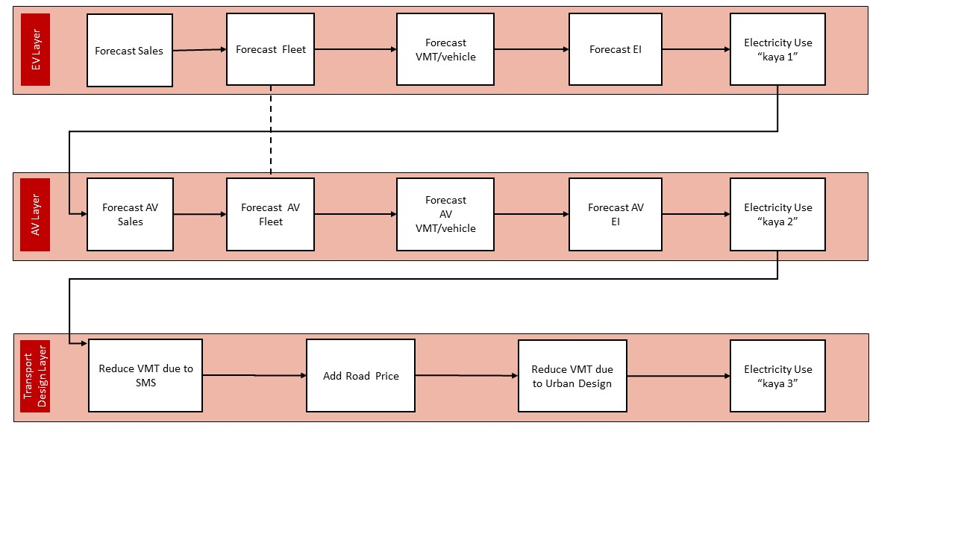
Source: Fox-Penner, Gorman, and Hatch (2018)
bu.edu/ise
Notes:
So the paper we published last summer in Energy policy uses this kaya identity framework to examine these three disruptions in a series of layers, disaggregating the VMT, stock, and energy intensity implictions of each layer

Slide 6
LIFE CYCLE GHG IMPACTS OF AV BUSINESS MODELS
Q1: We know that EVs are generally more carbon intensive to manufacture; what does this do to our GHG results?
Q2: autonomous vehicles imply several new potential business models – what impact do those models have on GHGs?
bu.edu/ise
Notes:
We use this stock model framework in our new work to answer two questions –
So, the first question I got at the AEA was yes, but what about life cycle?
As we’ll see, that isn’t in itself an interesting question, but it becomes interesting when we start to think about business models – namely, how quickly do these vehicles turn over in each business model and what does that mean for total emissions?

Slide 7
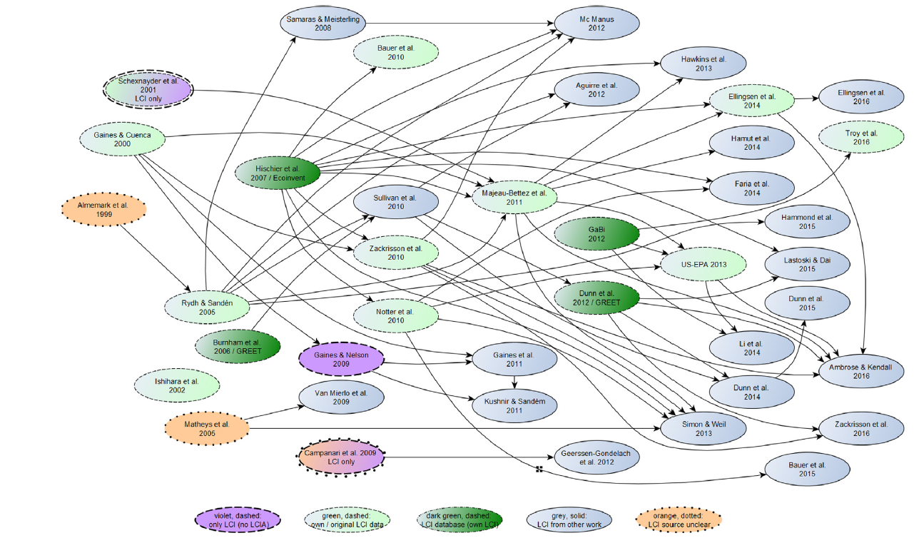
LIFE CYCLE ANALYSIS
Source: Peters, et al. 2017
bu.edu/ise
Notes:
Life cycle analysis: there is this awesome graphic by peters and colleagues that maps out all the LCA work although the literature is quite robust on this subject, there are only a handful of studies from which the data arises: Spoiler – EVs are better for emissions and have been for almost a decade, despite what jonathan lesser says. Anyway, we incorporated life cycle emissions into our model

Slide 8
INCORPORATING BUSINESS MODELS
4 main business models, least to greatest hypothesized emissions:
Sharing/Pooling/Bus → Via, Optimus Ride,
Taxi/Fleet Model → Uber and Lyft
Individual Ownership Model → Long-term OEM goal
Rapid Turnover/Lease Model → Potential long-term as AV evolves
bu.edu/ise
Notes:
4 main business models, least to greatest hypothesized emissions:
Sharing/Pooling/Bus → Via, Optimus Ride,
Taxi/Fleet Model → Uber and Lyft
Individual Ownership Model → Long-term OEM goal
Rapid Turnover/Lease Model → Potential long-term as AV evolves

Slide 9
“If we’re not actively monitoring the metric that truly matters –VMT – we could potentially see a future where vehicle ownership goes down, yet VMT (and energy use) go up.”
- Regina R. Clewlow, U.C. Davis
POOLING AND SHARING
bu.edu/ise
Notes:
As late as 2015 the TRB was saying that impacts of ridesharing were unknowable. In the last year or two, studies have come out saying that ride-hailing increases VMT up to 60-80% over prior numbers. (Henao, Clewlow and Mishra). I would argue that these effects are also transferrable to an individual ownership model AV, and the significant piece here is that having a private driver induces significant travel demand

Slide 10
FLEET VS. INDIVIDUAL OWNERSHIP
Main difference being that the downtime for fleet vehicle is significantly less than the 95% downtime of an individually owned vehicle
Lose benefits of storing things in your car/tailoring preferences
Expect significantly less GHGs with fleet vehicle due to reduction in manufacturing emissions
Fleet model not applicable to rural areas, possibly suburban areas
Reviewed literature to find a replacement calculation of 6.7:1 based on VMT of Taxi fleets (NHWTA 2017, Fournier et al. 2017)
bu.edu/ise
Notes:
This is where a stock turnover model is really useful in gaining visibility into how to manipulate the total LDV fleet
Fleet vs. Individual ownership
Main difference being that the downtime for fleet vehicle is significantly less than the 95% downtime of an individually owned vehicle
Lose benefits of storing things in your car/tailoring
Expect significantly less GHGs with fleet vehicle due to reduction in manufacturing emissions (going to what Jim was saying yesterday, fleet vehicle travels 2-3x as far in its lifetime)
Reviewed literature and ended up conducting a replacement calculation of 6.7:1 based on VMT of Taxi fleets -

Slide 11
RAPID TURNOVER MODEL
Thinking about AVs as comparable to technology improvements
Reasons for:
Cell phones and computers; battery improvement similar to other component cost improvements like semi-conductors
Comfort and luxury updates are an incentive for manufacturing sales
Reasons against:
Cars are a relatively higher household expense now than computers were when they were first available; may be a different type of good
bu.edu/ise

Slide 12
GREENHOUSE GAS EMISSIONS IMPLICATIONS – LCA AND BUSINESS MODELS
bu.edu/ise
Notes:
So we took two cases from our previous paper – a policy case with things like a road tax and efficiency standards implemented, and a stress case, in which vehicles are allowed to

Slide 13
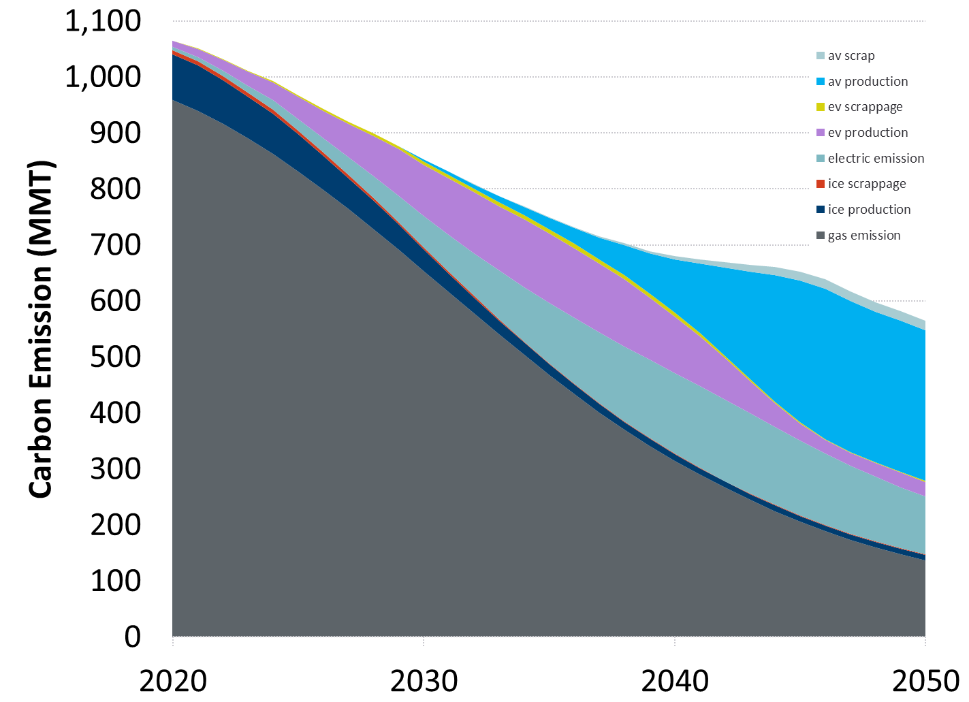
bu.edu/ise
Notes:
This is the policy case with EIA projections

Slide 14
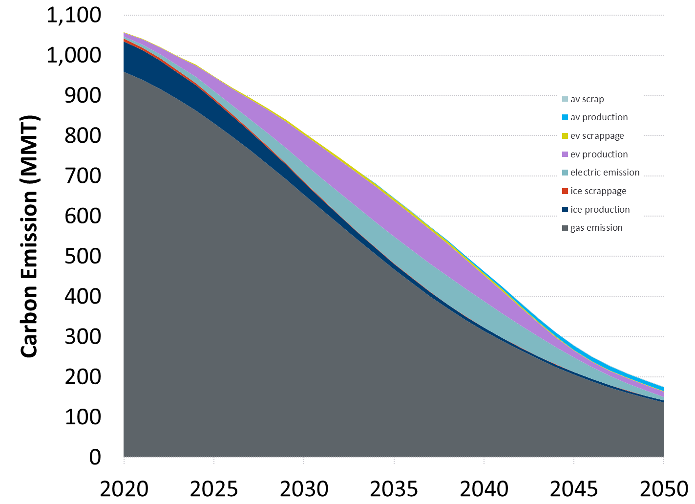
bu.edu/ise
Notes:
Temporal: a) Who needs to plan for Evs over what period of time (will different areas need to plan more quickly) and b) will the load be added during the same hours in the day?
Spatial: What is load distribution now? I can imagine load centers are not currently evenly distributed; how will an increase in Evs change the spatial distribution of load?
AVs EVs? Evidence for no:

Slide 15
PRELIMINARY TAKEAWAYS
Really difficult to reach the needed emissions reductions in the transport sector;
Three things that have an impact on emissions:
electrification (charging infrastructure, policy incentives, battery density, drive train synergies)
Decarbonization of the electric sector (renewable energy policy incentives)
Manufacturing (business models, efficiency improvements)

Slide 16
ADDITIONAL CONSIDERATIONS
Migrating from one state to the next?
E.g., from ICE to EV, from one business model to the next
AV computing and equipment load
Applying different VMT/EI effects to different business models?
Other thoughts?

