Slide 1
The electric vehicle transition and the economics of banning gasoline vehicles
Stephen P. Holland—University of North Carolina Greensboro & NBER
Erin Mansur—Dartmouth College & NBER
Nicholas Z. Muller—Carnegie Mellon University & NBER
Andrew J. Yates—University of North Carolina

Slide 2
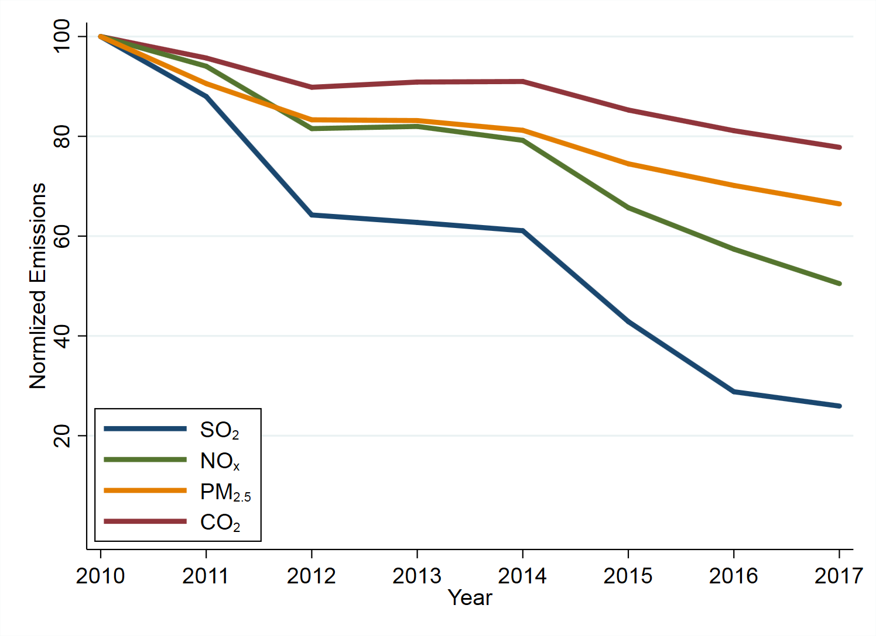
#1: An extraordinary decline in power plant emissions
CO₂
PM_{2.5}
NO_{X}
SO₂
Notes: Total CEMS power plant hourly emissions in 48 states normalized to 100 in 2010.
Source: Holland et al. 2018

Slide 3
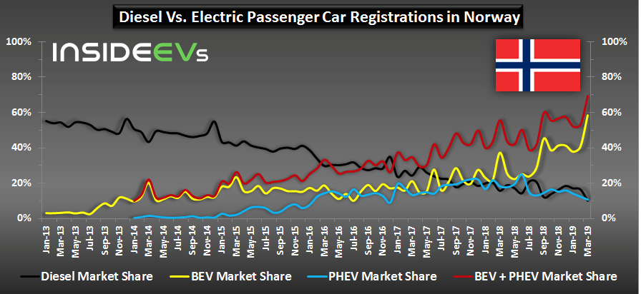
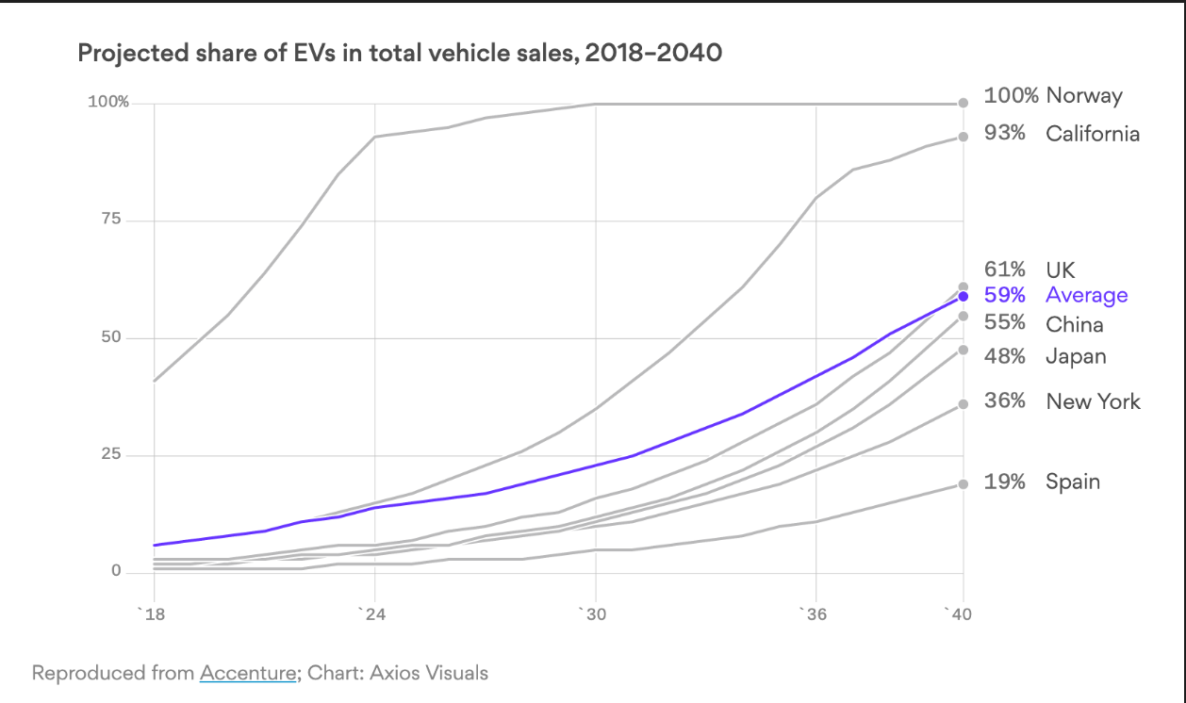
#2: An extraordinary rate of electric vehicle adoption

Slide 4
#2: An extraordinary rate of electric vehicle adoption

Slide 5
Introduction
Two extraordinary facts:
Decline in power plant emissions
Rapid adoption of electric vehicles
Large externalities from conventional cars (~$40 billion)
Substantial public policy for EV adoption
$7500 tax credit per car in US
Huge subsidies in Norway
Gasoline vehicle bans proposed
Norway (2025), India (2030) and Britain and France (2040)
Estimate changing EV damages
Evaluating multipollutant damages from all power plants
Estimate slope of damage-load relationship (Holland et al., 2018)
Modeling the transition:
How should we transition to EVs?
Wait until cleaner? Build in anticipation?
Under what conditions should gasoline cars be banned?

Slide 6
How fast are EV damages falling?
What does extraordinary decline in emissions of different pollutants imply about EV damages?
Two steps:
Calculate damages (in dollars) from each power plant
Estimate econometrically the marginal damage of electricity usage
Holland et al. 2018
CO₂
PM_{2.5}
NO_{X}
SO₂

Slide 7
Methods: Valuation of damages
One Ton SO₂ Emitted from RE Burger Power Plant
CO₂ emissions valued at social cost of carbon
$41 per ton CO₂ grows 3% per year
AP3 model takes
SO₂, NO_{x}, & PM_{2.5} emissions
Pollutant transport model
Ambient concentrations of PM_{2.5}
Mortality responses based on demographics
$8.8 million value of statistical life
Notes:
Coal plant. Retired in 2011

Slide 8
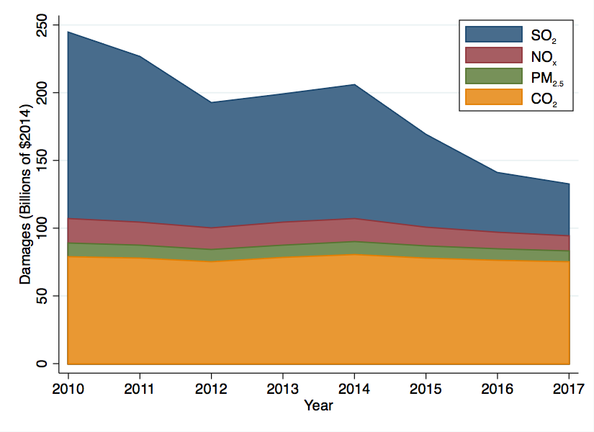
Describing the decline in damages: by pollutant
Damages fall from $245 billion in 2010 to $133 billion in 2017.
-- 45% decline
-- Benefit of $350 per capita.
Notes: Damages in billions of 2014$ aggregated across all CEMS power plants using AP3 damage estimates & social cost of carbon.

Slide 9
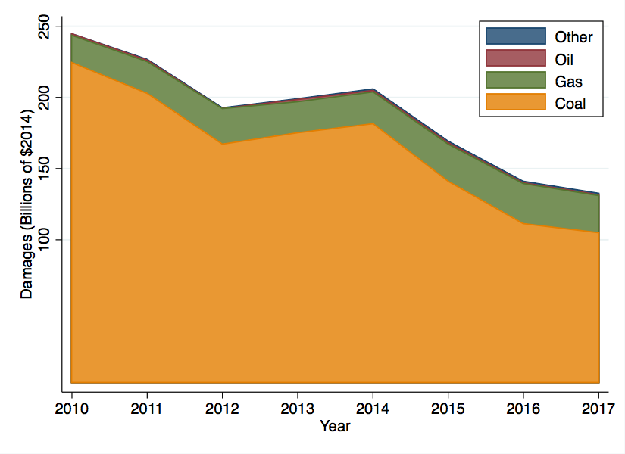
Describing the decline in damages: by fuel
Damages fall from $245 billion in 2010 to $133 billion in 2017.
-- 45% decline
-- Benefit of $350 per capita.
Notes: Damages in billions of 2014$ aggregated across all CEMS power plants using AP3 damage estimates & social cost of carbon.

Slide 10


What does cleaner electricity imply about electrification policy?
Policy depends on marginal damages, e.g., damages from chargin the EV
Cleaner grid $→$EV’s are cleaner
Cleaner grid $→$EV’s not cleaner

Slide 11
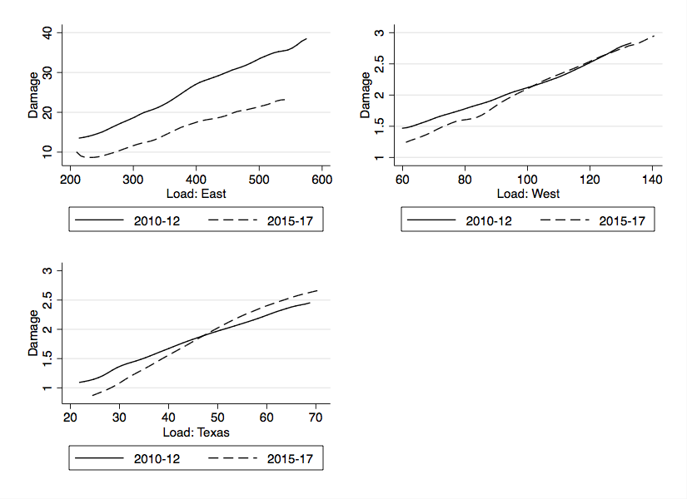
Local polynomial estimates of damage functions
East
West
Texas
Notes: Local polynomial regressions of hourly damages (millions of 2014$) on hourly load (GW) by interconnection.
Load & damage means:
339 & 21 (East); 85 & 2.2 (West);
39 & 1.8 (Texas).

Slide 12
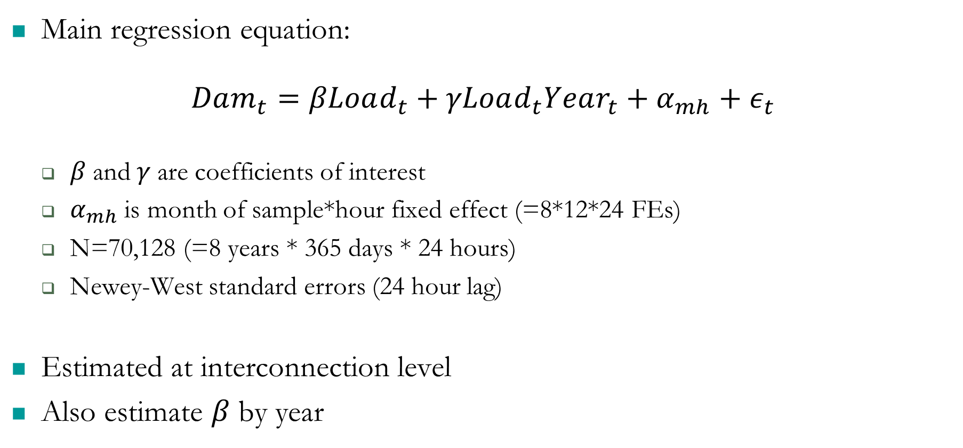
Estimating marginal damages
Main regression equation:
$$Dam_{t}=βLoad_{t}+γLoad_{t}Year_{t}+α_{mh}+ε_{t}$$
$β$ and $γ$ are coefficients of interest
$α_{mh}$ is month of sample*hour fixed effect (=8*12*24 FEs)
N=70,128 (=8 years * 365 days * 24 hours)
Newey-West standard errors (24 hour lag)
Estimated at interconnection level
Also estimate $β$ by year

Slide 13
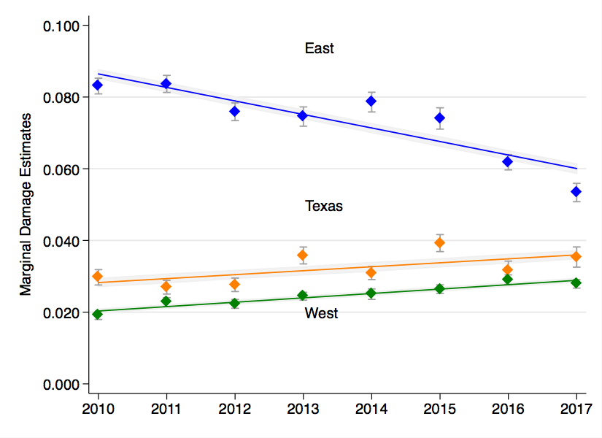
Marginal damage estimates over time
Notes: Marginal damages measured in dollars per kWh. Lines show predicted trends from regressions on full sample.
Point estimates with 95% CI are from annual regressions.
Annual Growth Rates
 | Margin | Average
East | -5.1% | -9.3%
West | +5.1% | -2.7%
Texas | +3.5% | -1.3%
Notes:
East ave: $0.073 range: $0.086 to $0.060
West ave: $0.025 range: $0.020 to $0.021
Texas ave: $0.032 range: $0.028 to $0.033

Slide 14
Implications for electric vehicle policy
Benefit of EV is avoided damage from equivalent gasoline car
Methods
Calculate damages from driving gasoline Ford Focus in each county (AP3 model)
Calculate damages from charging electric Ford Focus in each county (marginal damage)
Benefit is the difference
Results
Benefits increase everywhere
EVs are better on average

Slide 15
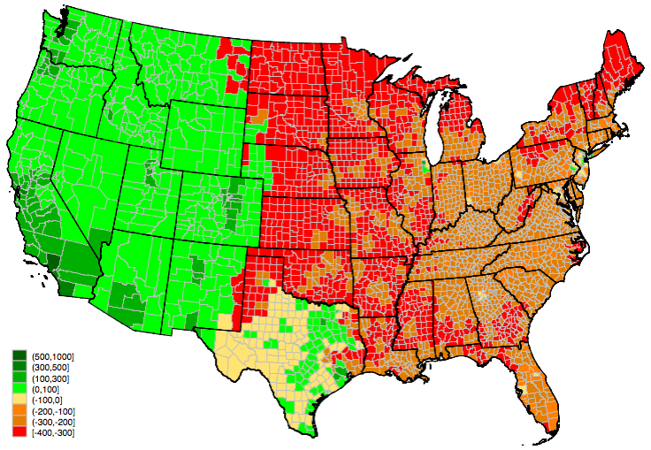
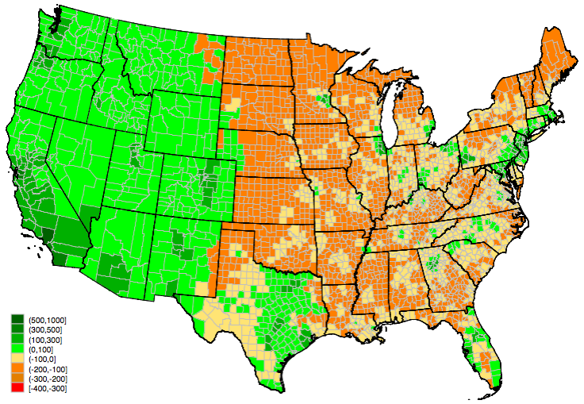
Annual environmental benefit of electric vehicle
2010 damages
2017 damages
National average: -$81
Range: -$390 to +$781
National average: +$72
Range: -$186 to +$939
Notes: Environmental benefit is difference between damages from a gasoline and from an electric Ford Focus over 15,000 annual miles. EPRI charging profile.

Slide 16
The Electric Vehicle Transition
Dynamic aspects of transition
Declining damages from EVs
Declining EV production costs
Exogenous declines (e.g., batteries)
Endogenous learning by doing
Electric & gasoline vehicles are durable goods
Investment in charging infrastructure
How should society transition from gasoline vehicles to electric vehicles?
Under what conditions should gasoline vehicle production be banned?

Slide 17
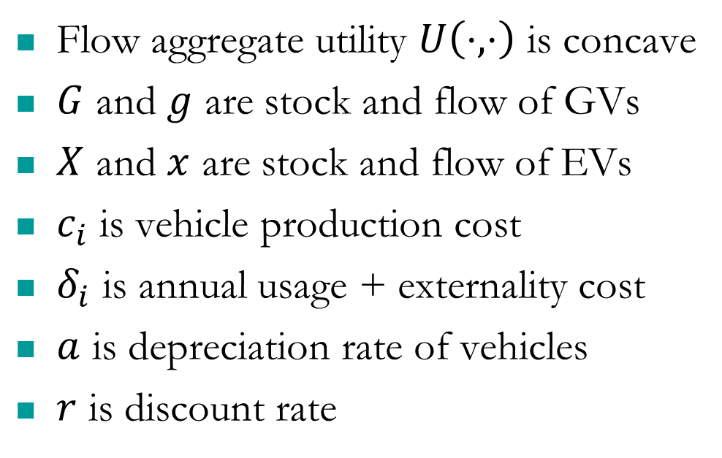

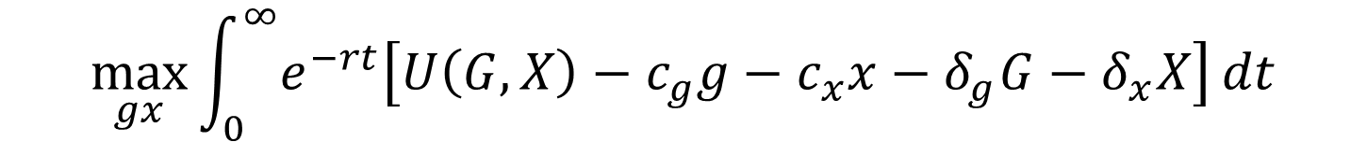
The model: planner’s problem
$$\max_{gx}{\int_{0}^{∞}{e^{−rt}\left[U\left(G,X\right)−c_{g}g−c_{x}x−δ_{g}G−δ_{x}X\right]}dt}$$
s.t. $\dot{G}=−aG+g$
and $\dot{X}=−aX+x$
where: ${\dot{c}}_{g}={\dot{δ}}_{g}=0$
but: ${\dot{c}}_{x}≤0$ and ${\dot{δ}}_{x}≤0$
Initial steady state: gas only
Terminal transversality conditions
Flow aggregate utility $U\left(⋅,⋅\right)$ is concave
$G$ and $g$ are stock and flow of GVs
$X$ and $x$ are stock and flow of EVs
$c_{i}$ is vehicle production cost
$δ_{i}$ is annual usage + externality cost
$a$ is depreciation rate of vehicles
$r$ is discount rate

Slide 18
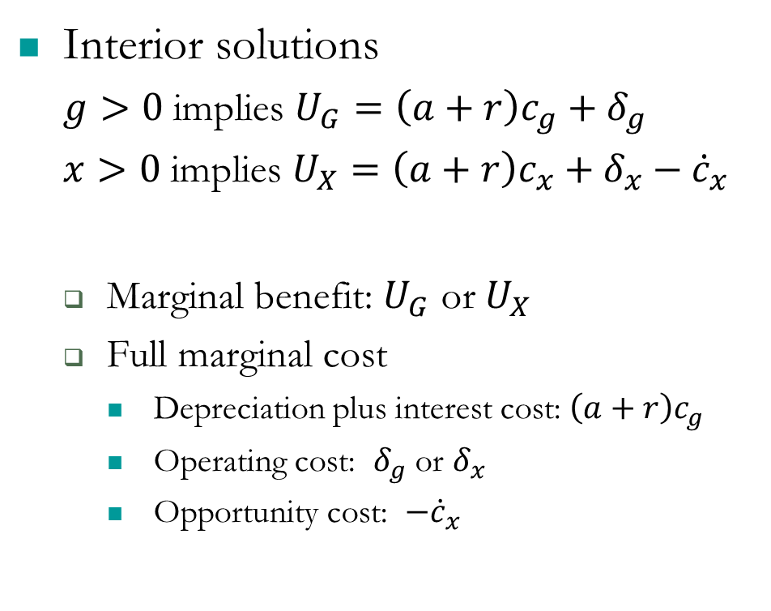
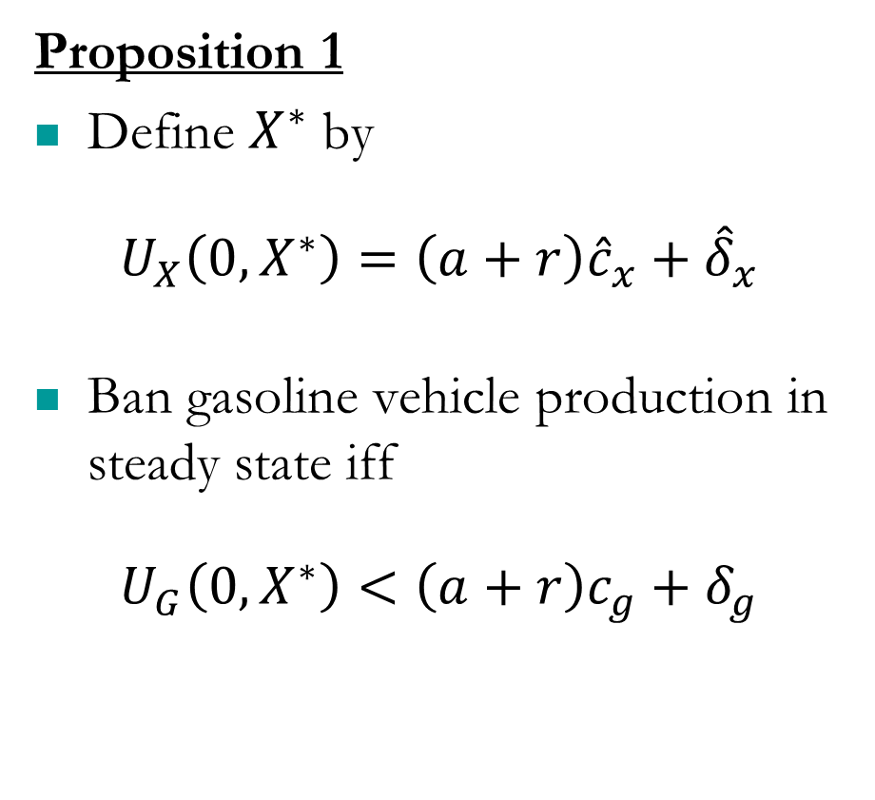
Should GV production be banned?
Proposition 1
Define $X^{∗}$ by
$$U_{X}\left(0,X^{∗}\right)=\left(a+r\right){\hat{c}}_{x}+{\hat{δ}}_{x}$$
Ban gasoline vehicle production in steady state iff
$$U_{G}\left(0,X^{∗}\right)<\left(a+r\right)c_{g}+δ_{g}$$
Interior solutions
$g>0$ implies $U_{G}=\left(a+r\right)c_{g}+δ_{g}$
$x>0$ implies $U_{X}=\left(a+r\right)c_{x}+δ_{x}−{\dot{c}}_{x}$
Marginal benefit: $U_{G}$ or $U_{X}$
Full marginal cost
Depreciation plus interest cost: $\left(a+r\right)c_{g}$
Operating cost: $δ_{g}$ or $δ_{x}$
Opportunity cost: $−{\dot{c}}_{x}$

Slide 19
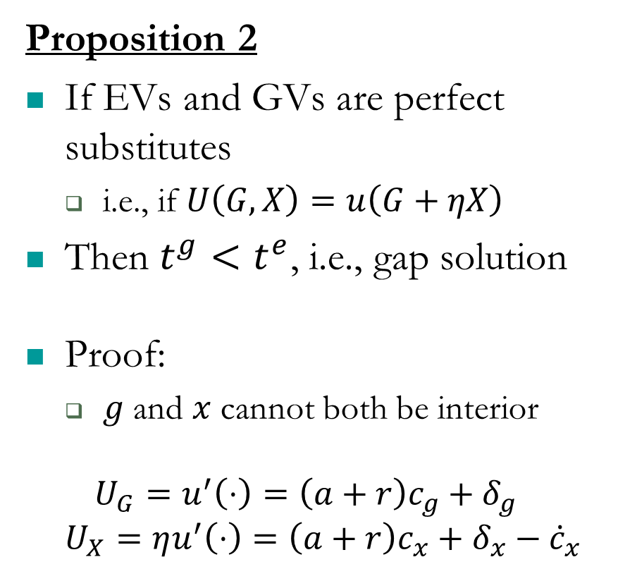
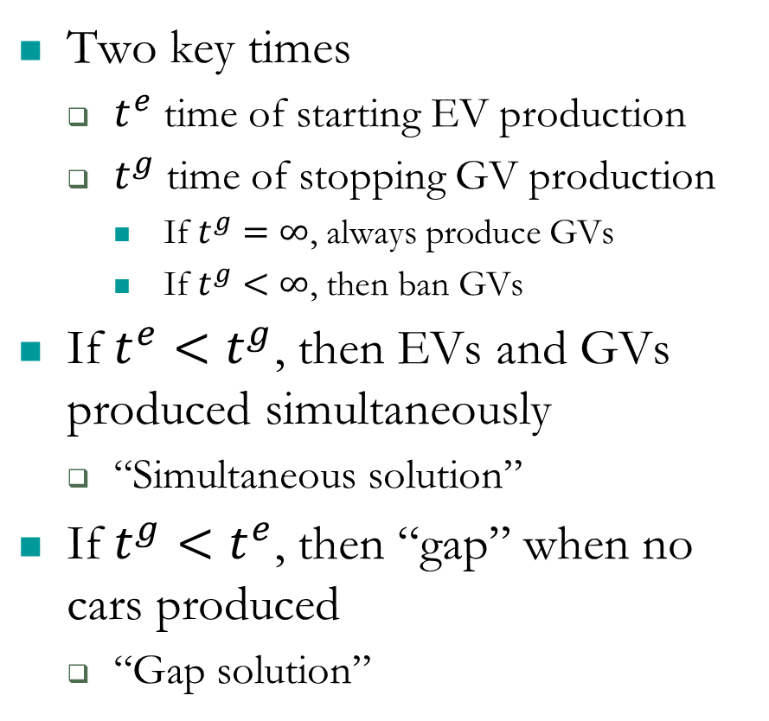
The transition to EV’s: two key times & two solutions
Proposition 2
If EVs and GVs are perfect substitutes
i.e., if $U\left(G,X\right)=u\left(G+ηX\right)$
Then $t^{g}<t^{e}$, i.e., gap solution
Proof:
$g$ and $x$ cannot both be interior
$$U_{G}=u^{′}\left(⋅\right)=\left(a+r\right)c_{g}+δ_{g}$$
$$U_{X}=ηu^{′}\left(⋅\right)=\left(a+r\right)c_{x}+δ_{x}−{\dot{c}}_{x}$$
Two key times
$t^{e}$ time of starting EV production
$t^{g}$ time of stopping GV production
If $t^{g}=∞$, always produce GVs
If $t^{g}<∞$, then ban GVs
If $t^{e}<t^{g}$, then EVs and GVs produced simultaneously
“Simultaneous solution”
If $t^{g}<t^{e}$, then “gap” when no cars produced
“Gap solution”

Slide 20



Prop 3: Characterizing the start of EV production, $t^{e}$
In the simultaneous solution, $t^{e}$ is the solution to:
but at $t^{e}$ gasoline vehicle production is determined by
Combining these implies $t^{e}$ is determined by:
$$U_{X}\left(G^{ss},0\right)=\left(a+r\right)c_{x}(t^{e})+δ_{x}\left(t^{e}\right)−{\dot{c}}_{x}(t^{e})$$
$$U_{G}\left(G^{ss},0\right)=\left(a+r\right)c_{g}+δ_{g}$$
$$\frac{U_{X}\left(G^{ss},0\right)}{U_{G}\left(G^{ss},0\right)}=\frac{\left(a+r\right)c_{x}(t^{e})+δ_{x}\left(t^{e}\right)−{\dot{c}}_{x}(t^{e})}{\left(a+r\right)c_{g}+δ_{g}}$$

Slide 21
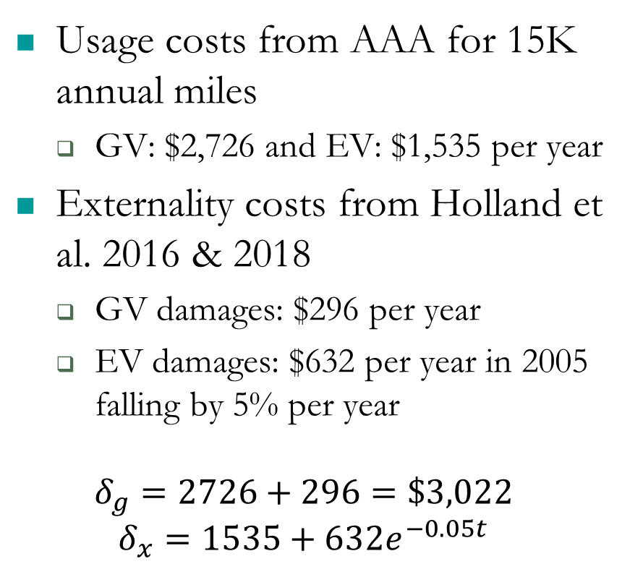
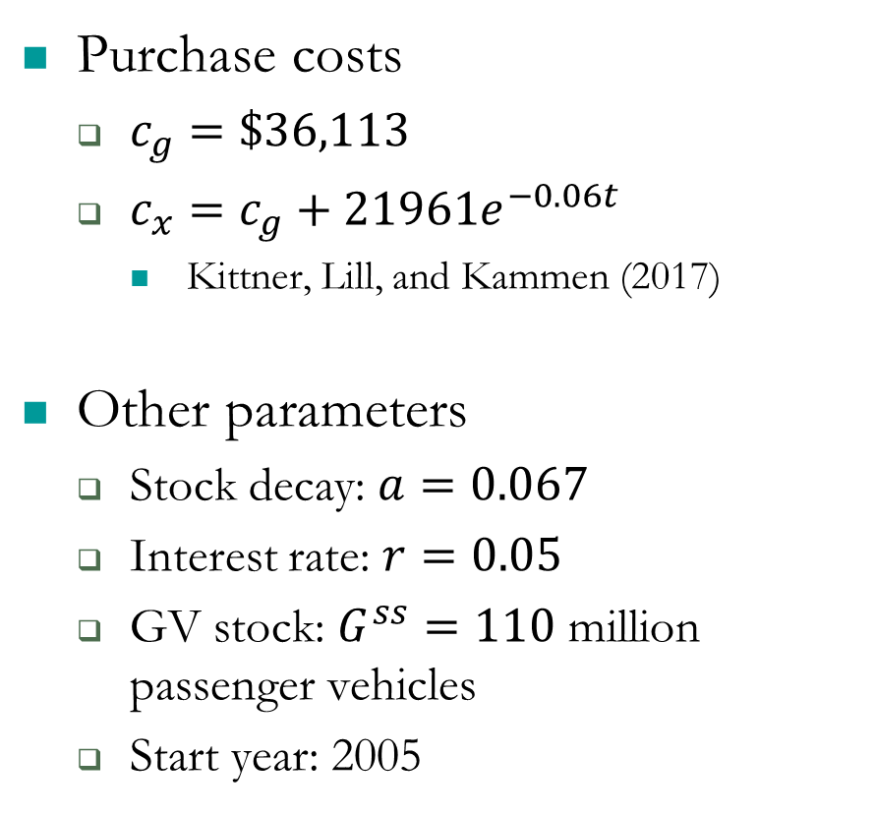
Calibrating the model: costs
Usage costs from AAA for 15K annual miles
GV: $2,726 and EV: $1,535 per year
Externality costs from Holland et al. 2016 & 2018
GV damages: $296 per year
EV damages: $632 per year in 2005 falling by 5% per year
$$δ_{g}=2726+296=\$3,022$$
$$δ_{x}=1535+632e^{−0.05t}$$
Purchase costs
$c_{g}=\$36,113$
$c_{x}=c_{g}+21961e^{−0.06t}$
Kittner, Lill, and Kammen (2017)
Other parameters
Stock decay: $a=0.067$
Interest rate: $r=0.05$
GV stock: $G^{ss}=110$ million passenger vehicles
Start year: 2005
Notes:
.06 has “half life” of 12 years
.05 has “half life” of 14 years

Slide 22

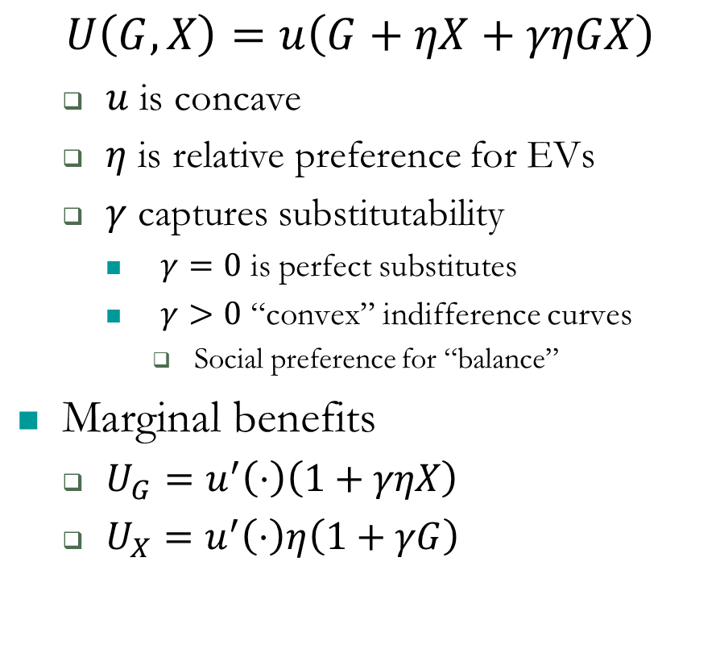
Calibrating the model: Functional form of $U(G,X)$
Other alternatives
Aggregate utility from discrete choice model (discrete continuous?)
Pros: Used for empirical work, realistic
Cons: Unwieldy aggregate utility
Indifference-ratio model
Pros: tractable functional forms
Cons: awkward assumptions
Constant elasticity of substitution
Pros: few parameters
Cons: awkward for corner solutions
$$U\left(G,X\right)=u\left(G+ηX+γηGX\right)$$
$u$ is concave
$η$ is relative preference for EVs
$γ$ captures substitutability
$γ=0$ is perfect substitutes
$γ>0$ “convex” indifference curves
Social preference for “balance”
Marginal benefits
$U_{G}=u^{′}\left(⋅\right)\left(1+γηX\right)$
$U_{X}=u^{′}\left(⋅\right)η\left(1+γG\right)$
Notes:
Move down

Slide 23
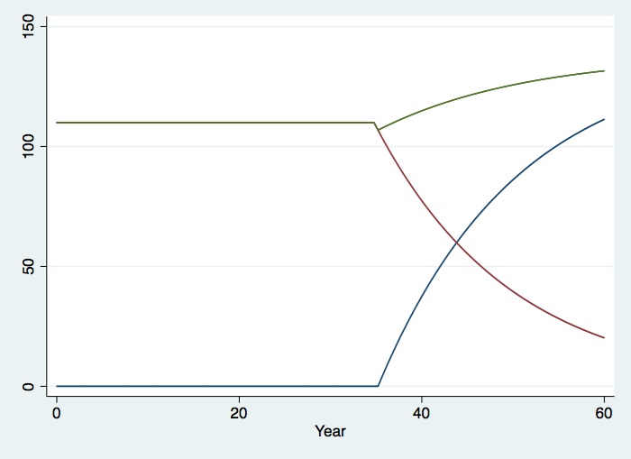
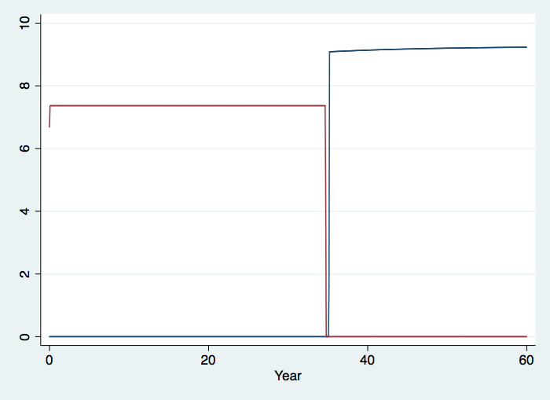

Perfect substitutes (Linear ICs)
Total cars
EV stock
Key parameters
$η=0.85$ and $γ=0$
“Gap” solution & ban GVs
$t^{e}=35.14$
$t^{g}=34.72$
GV stock
EV production
GV Production

Slide 24
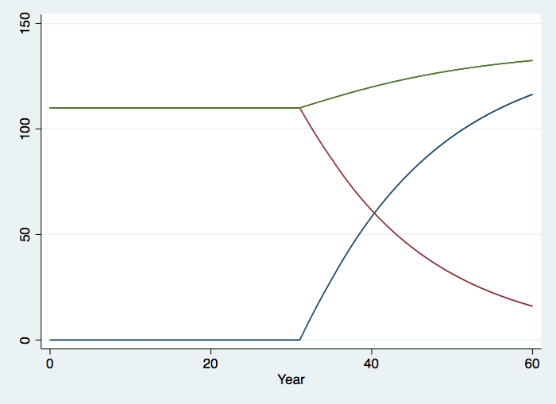
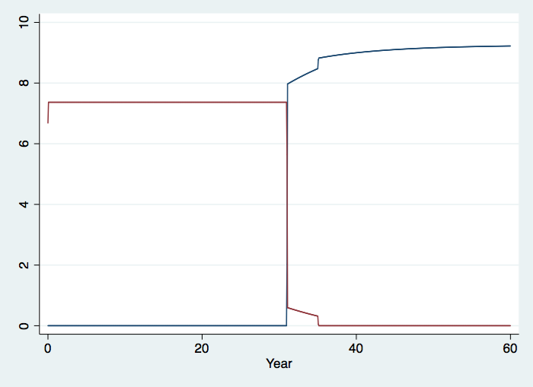
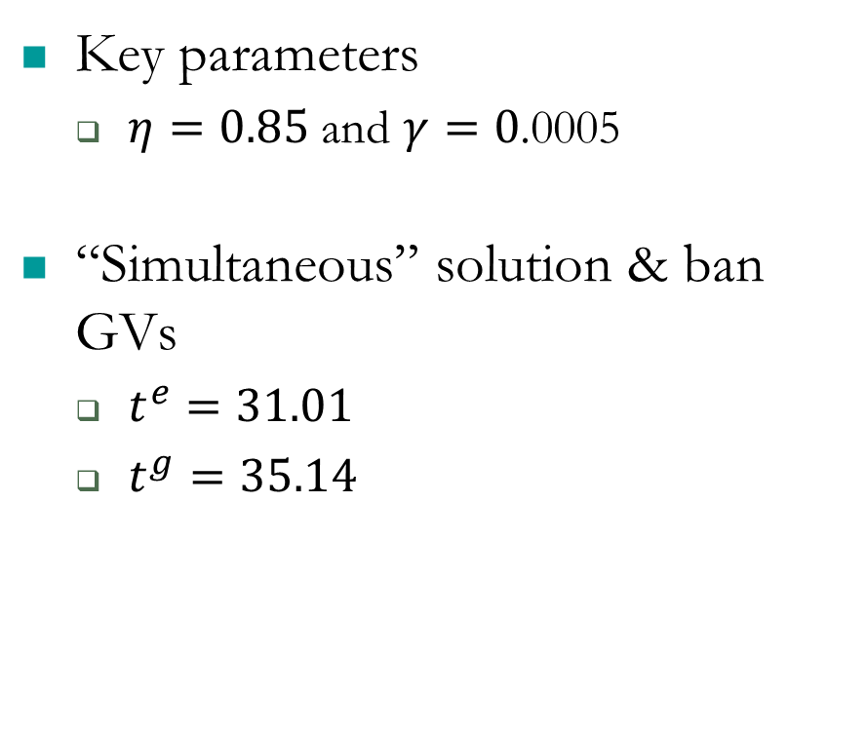
Almost perfect substitutes
Total cars
EV stock
Key parameters
$η=0.85$ and $γ=0$.0005
“Simultaneous” solution & ban GVs
$t^{e}=31.01$
$t^{g}=35.14$
GV stock
EV production
GV Production

Slide 25
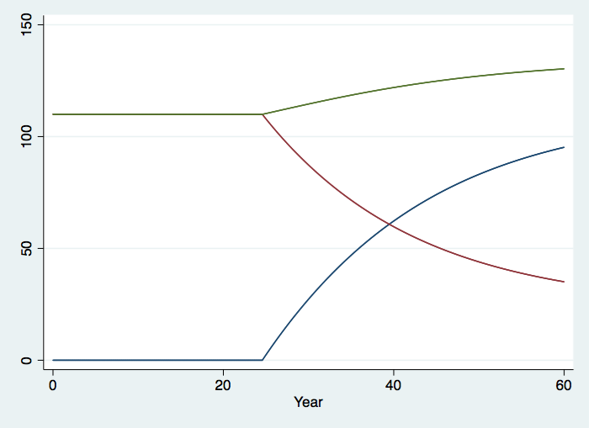
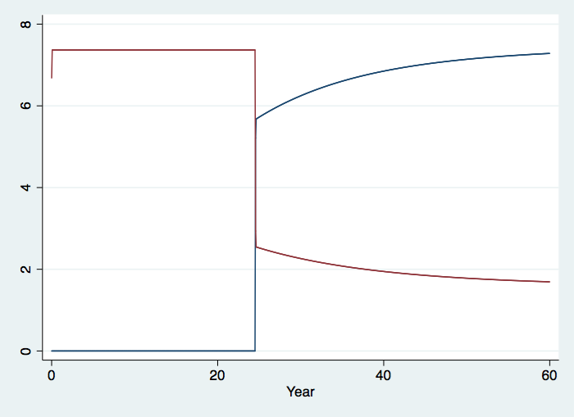

Imperfect substitutes
Total cars
EV stock
Key parameters
$η=0.85$ and $γ=0$.001
“Simultaneous” solution & don’t ban GVs
$t^{e}=24.57$
$t^{g}=∞$
GV stock
EV production
GV Production

Slide 26
Optimal EV purchase subsidies
Note: Optimal transition time is 35.14.

Slide 27
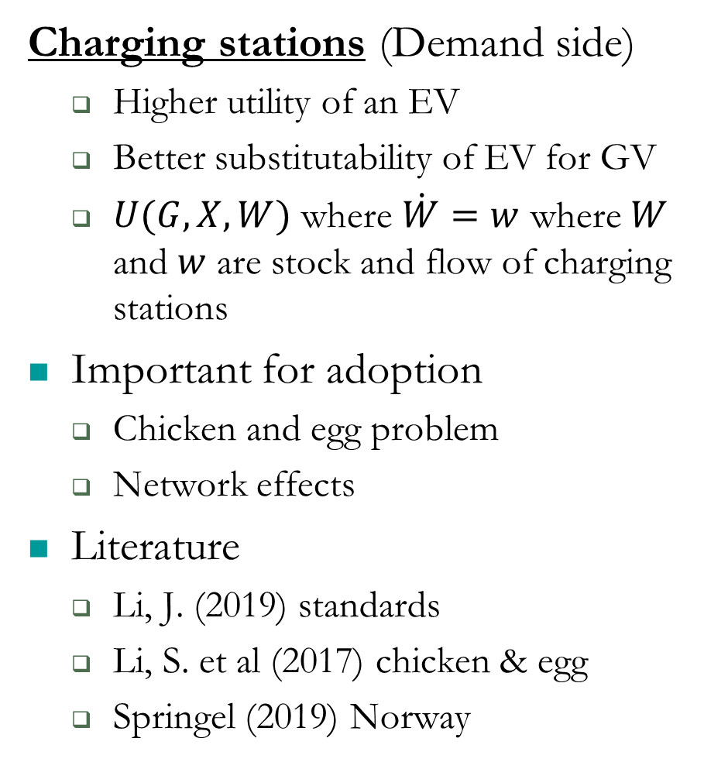
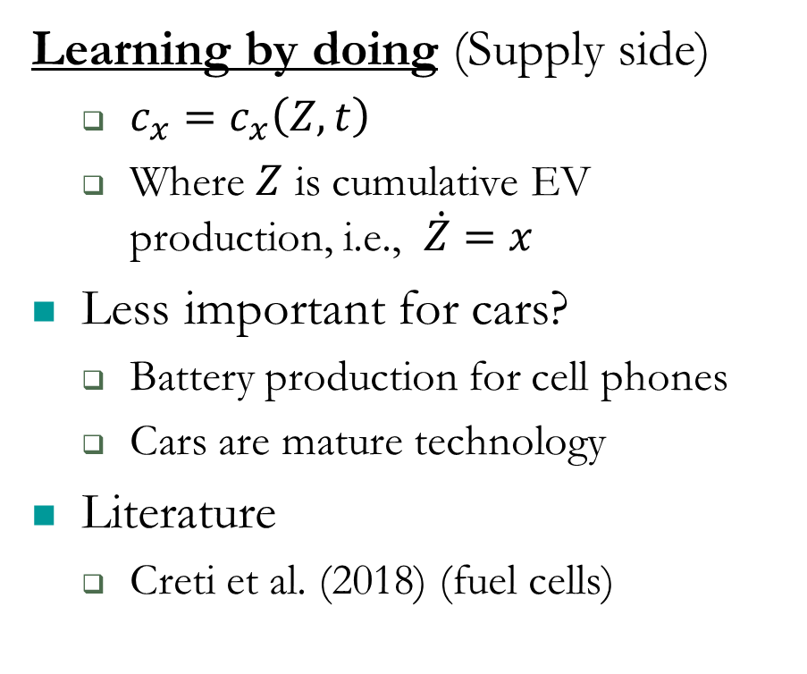
Theoretical extensions
Charging stations (Demand side)
Higher utility of an EV
Better substitutability of EV for GV
$U(G,X,W)$ where $\dot{W}=w$ where $W$ and $w$ are stock and flow of charging stations
Important for adoption
Chicken and egg problem
Network effects
Literature
Li, J. (2019) standards
Li, S. et al (2017) chicken & egg
Springel (2019) Norway
Learning by doing (Supply side)
$c_{x}=c_{x}\left(Z,t\right)$
Where $Z$ is cumulative EV production, i.e., $\dot{Z}=x$
Less important for cars?
Battery production for cell phones
Cars are mature technology
Literature
Creti et al. (2018) (fuel cells)

Slide 28
Summary and conclusions
Transportation sector is major source of air pollution
Transition from GVs to EVs has potential to reduce damages
Electricity is getting cleaner
Average damages down 2% (West & Texas) to 9% (East)
Marginal damages up (West &Texas) but down 5% in East
Transition modeling results
Optimum is sensitive to substitutability of EVs for GVs
Ban GVs only if marginal benefit of first GV (when there are a lot of EVs) is less than the full marginal cost
“Gap” v. “Simultaneous” solution depends on substitutability
Calibration shows a wide range of possible optima
EV subsidies can correct

