Slide 1
Jun 2019
Routing for Autonomous Vehicles
Information Design in the Era of Internet of Things
Yixuan Liu¹
Andrew B. Whinston^{1,2}
¹ McCombs School of Business, University of Texas at Austin
² Department of Computer Science, University of Texas at Austin

Slide 2
Internet of Things
Enterprise of Things
The internet of things has the potential to transform business — from predictive maintenance to better supply chain management and more accurate customer insights.

Slide 3
Rapid manufacturing of new products, dynamic response to product demands, and real-time optimization of manufacturing production and supply chain networks.
Telehealth: live video, store-and-forward technology, remote patient monitoring and mHealth.
Improve customer experience, optimize supply chain operations and create new channels and revenue streams.

Slide 4
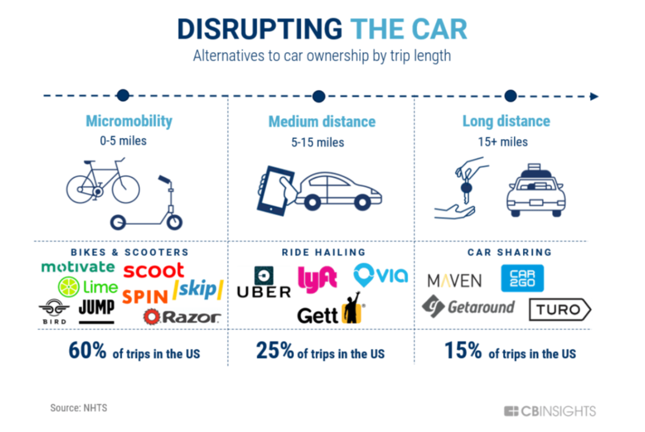
Smart city

Slide 5
Share of worldwide smart city projects
IoT: Smart City projects share breakdown by Type (2017)

Slide 6
Cities around the world are already getting smarter
City Brain in Hangzhou, China
Tech giant Alibaba, which started and expanded out of Hangzhou, is working with the local traffic police.
Collect a range of real time traffic data from video surveillance cameras, microwave detectors to mobile app data.
optimize traffic signal timing in real time
alter traffic lights to let ambulances rush through
report possible car crashes
Notes:
接管杭州128个信号灯路口，试点区域通行时间减少15.3%，高架道路出行时间节省4.6分钟。
在主城区，城市大脑日均事件报警500次以上，准确率达92%；
在萧山，120救护车到达现场时间缩短一半。

Slide 7
Road weather intelligence
Delivery of Ground Truth® is powered by sensors attached to vehicles and existing road infrastructure, measuring critical pieces of data.

Slide 8
Autonomous
Vehicles
IoT
+
[… Imagine you can tap into the self-driving cars’ cameras and you can capture imagery. You still need to figure out what to do with that imagery. Users in a self-driving car could take a picture but it would be so enhanced if we went from say 10 percent of people having a picture to every report having a picture. It would be a great enhancement….]
-Di-Ann Eisnor

Slide 9
Autonomous
Vehicles
IoT
+
Data Collection & Data Distribution
How to distribute data?

Slide 10
Combine economic theory and robotics
Market-Based Multirobot Coordination
In market-based multirobot systems, robots are designed as self-interested agents that operate in a virtual economy.
Auctions
Robots bid for tasks based on their capabilities.
Trader-Bots architecture (Dias, 2004)
Scalability

Slide 11
Information design for traffic management
Traffic navigation apps
No information -> full information
Example
Travel time = $x$ hours w.p. $λ$; 1 hour w.p. $1−λ$
Waze tells you exactly the state of each road
Each vehicle would spend an hour on the road w.p. $1−λ^{2}$; half an hour w.p. $λ^{2}$
There is no Waze
Each vehicle would choose a road at random.
Shorter average travel time for every $λ.$

Slide 12
Price of Anarchy and Braess’ Paradox
Braess’s Paradox is a counterintuitive phenomenon about routing traffic in a congested network.
Building new roads can increase traffic congestion.
Closing existing roads can decrease traffic congestion.
Price of Anarchy (Roughgarden and Tardos, 2002) measures how the efficiency of a system degrades due to selfish behavior of its agents.
Price of Anarchy = Total travel of of Nash flow / Total travel of of the optimal flow
Nash flow can cost arbitrarily more than the optimal (min-cost) flow
even if latency functions are polynomials
1/2
v
$$l\left(x\right)=1$$
$$l\left(x\right)=x$$
s
t
$$l\left(x\right)=1$$
$$l\left(x\right)=x$$
w
1/2
Nash flow = optimal flow
v
$$l\left(x\right)=1$$
$$l\left(x\right)=x$$
s
$$l\left(x\right)=0$$
t
$$l\left(x\right)=1$$
$$l\left(x\right)=x$$
w
Nash flow ≠ optimal flow
Load-dependent travel function $l\left(x\right)$

Slide 13
Informational Braess’ Paradox
Is Braess’ Paradox a “pathological” example, or a pervasive phenomenon in selfish routing networks? (Valiant and Roughgarden, 2006)
Braess ratio: the largest factor by which the removal of one or more edges can improve the latency of traffic in an equilibrium flow.
With high probability as n → ∞, there is a choice of traffic rate such that the Braess ratio of a random network is strictly greater than 1.
Informational Braess’ Paradox (Acemuglu et al., 2017)
Users have differing information sets about the available edges and can only use routes consisting of edges in their information set.
IBP: the possibility that users with expanded information sets experience greater equilibrium cost
IBP does not occur if and only if the network is series of linearly independent (SLI)

Slide 14
Model formulation
Consider an information designer optimizes the information policy to manipulate the beliefs, thus actions, of multiple agents (autonomous vehicles).
Traffic model
A road network modeled by a directed graph $G=\left(V, E\right)$ with vertex set $V$ and edge set $E$.
$k$ source-sink vertex pairs $\left\{s_{1},t_{1}\right\}, …,\left\{s_{k},t_{k}\right\}$.
$r_{i}$: the amount of traffic from $s_{i}$ to $t_{i}$.
$P_{i}$: the set of all $s_{i}−t_{i}$ paths, $P=\bigcup{P_{i}}$
Traffic flow $f :P→ℝ^{+}$. $f_{e}$ denotes the amount of traffic on edge $e$.
Travel time on edge $e$ depends on a state of the world $θ$ and traffic load $f_{e}$: $l_{e}^{θ}(f_{e})$.
Vehicles have the same prior belief: $λ(θ)$.
Total travel cost $TT\left(l^{θ},f\right)=\sum_{e∈E}{l_{e}^{θ}(f_{e})f_{e}}$.

Slide 15
Selfish agents and Nash flow
Definition (Roughgarden and Tardos 2002)
For any small amount of traﬃc $δ$ on path P₁ and any other path P₂ , if $δ$ traﬃc deviates from P₁ and instead chooses P₂ , then its travel time will increase.
Property of Nash flow (Roughgarden and Tardos 2002)
If f is at Nash equilibrium then all $s_{i}−t_{i}$ flow paths (i.e., $s_{i}−t_{i}$ paths to which f assigns a positive amount of flow) have equal travel time.

Slide 16
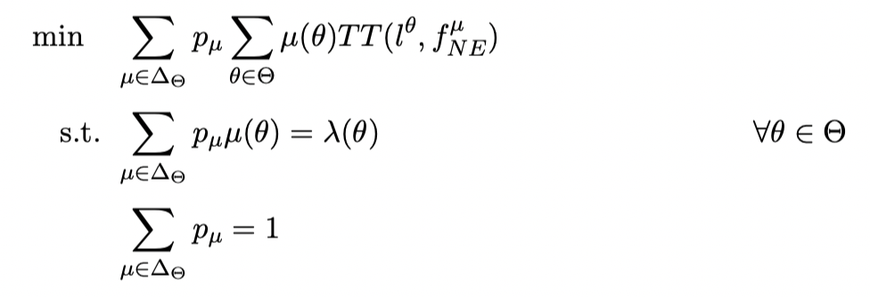
Model formulation (Cont’d)
Information design
The authority provides signals to drivers: ${φ(θ)}_{σ}$ detnoes the probability that the authority sends signal $σ$ when the state of nature is $θ$.
Vehicles, when receiving signal $σ$, update their belief by the Bayesian rule:
Since each signal yields a posterior belief $μ^{σ}$, the authority’s objective is equivalent to determining ${(p_{μ})}_{μ∈∆_{Θ}}≥0$ of finite support specifying a convex decomposition of $λ$.

Slide 17
Sequence of events
(a) The designer commits to an information policy which is common knowledge for all players.
(b) States of the world realize.
(c) Messages are sent out according to the policy.
(d) Vehicles receive the message and update their beliefs and make their routing decision.
(e) Payoffs realize.

Slide 18
Bounds for arbitrary signals
Hardness result (Cole et al., 2005, Bhaskar et al. 2016)
Notes:
By an a-approximation algorithm for a minimization problem, we mean an algorithm that runs in polynomial time and returns a solution no more than e times as costly as an optimal solution.

Slide 19
Information vs. tolling
Tolling (Cole et al., 2005)
Marginal cost tolling minimizes total travel time
Marginal cost tolling may increase total cost (congestion + toll)
Linear/polynomial travel time functions
In every network with linear travel functions, the benefit of taxes cannot exceed that of removing edges.

Slide 20
Future directions
Combination of tolling and information design
Bhaskar et al. 2016: Hardness Results for Signaling
Communication/energy cost of sensors
Sensor nodes are usually simple and may provide rough descriptions of events.
Since mobile sensors are operated by small batteries, one important issue is to conserve their energies.
Minimize communication among static sensors.
Balance the communication load among the static sensors.

Slide 21
Thanks!!

