Slide 1
The Two Margin Problem in Insurance Markets
Michael Geruso Timothy Layton UT Austin and NBER Harvard University and NBER
Grace McCormack Mark Shepard Harvard University Harvard Kennedy School and NBER
December 2018

Slide 2
Motivation
Two flavors of classic adverse selection problem in insurance markets
Intensive margin: Generous vs. skimpy plans (within the market)
Consequence: Skimpy plans dominate the market
Rothschild and Stiglitz; Glazer and McGuire
Extensive margin: Insured vs. uninsured (participation in the market)
Consequences: High gross prices, incomplete take-up of insurance
Akerlof; Einav, Finkelstein, and Cullen

Slide 3
Motivation
Symptoms of both problems observed in the ACA Exchanges:

Slide 4
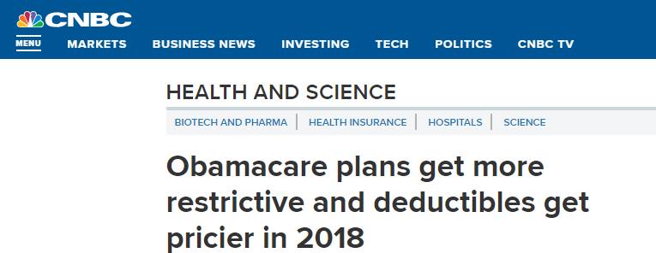
Motivation
Symptoms of both problems observed in the ACA Exchanges:
Dominated by narrow networks and/or skimpy coverage

Slide 5
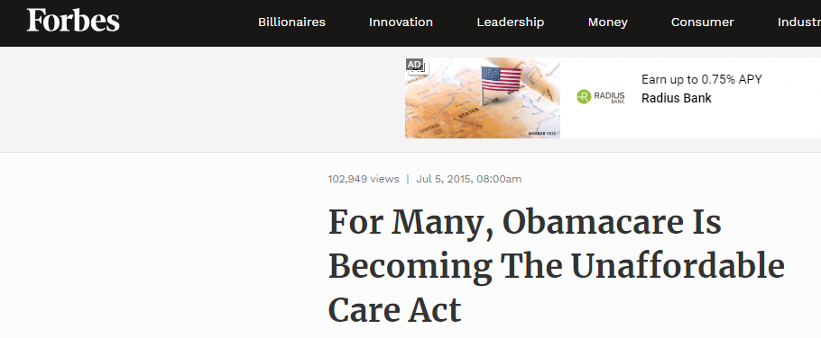
Motivation
Symptoms of both problems observed in the ACA Exchanges:
Perception of high, unaffordable prices – especially for unsubsidized

Slide 6
Motivation
Selection problems have led to discussion about modifications of selection-related policies
2 Intensive Margin examples:
Risk adjustment – States recently given flexibility to weaken transfers
Benefit regulation – Plans not meeting EHB allowed in some states
Under models that focus on intensive margin, these policy modifications seem crazy
Weaker risk adjustment $→$ worse adverse selection between plans
Weaker benefit reg $→$ selection-induced quality death spiral stops early
But under models/frameworks that focus on extensive margin, it seems crazy not to make these modifications (Einav, Finkelstein, and Tebaldi 2018; Geruso and Layton 2017)
Weaker risk adjustment $→$ $↓$ price of low-cost plans, $↑$ enrollment in market
Weaker benefit reg $→ ↓$ price of low-cost plans, $↑$ enrollment in market
$→$ Need a framework that includes both margins simultaneously

Slide 7
Why Expand the Existing Framework?
This paper: How do the two margins of adverse selection interact?
Simultaneous market failures: Extensive/intensive selection
In the simplest case, Theorem of the Second Best tells us we can’t address each in isolation
Optimal intensive margin policies may depend on extensive margin policies, and vice versa
Requires a two margin model - Need to treat two margins together to understand how an intensive margin (H/L) policy (RA/EHB) might affect uninsurance margin (L/U) and vice versa
Current policy activity is running ahead of our standard framework
E.g., for 2019 CMS allows states to weaken risk adjustment in ACA markets.
New plans not meeting EHB being allowed in some states
Also movement on extensive margin: State mandates, “lock-in” proposals, marketing efforts
Notes:
Add:
Is it possible to help one margin of selection without hurting the other using the tools that are in the typical policy toolkit?
Cite Einav, Finkelstein, and Tebaldi and Geruso and Layton as examples of how when one considers the extensive margin consequences of an intensive margin policy, the policy often seems like a bad idea

Slide 8
Overview of Paper
Present graphical model with intensive + extensive margin selection
Goal: Simplest framework capturing both intensive and extensive margin selection $→$ Competitive market with two plans (H and L) + an outside option (U)
Graphical model a la Einav, Finkelstein, Cullen (2010) to make conceptual points
C.f., Other (more sophisticated) work allowing for plan differentiation + outside option [Azevedo & Gottlieb 2017, Tebaldi 2017, Saltzman 2018]
Use model to illustrate often surprising unintended consequences of policies targeted at one margin of selection
E.g. “Mandate penalty” on uninsurance $→$ intensive margin unravelling to L
Intuition: Newly insured are healthy and tend to sort into L $→$ lowers $P_{L}$
Show that graphical framework can easily be applied empirically (analogous to EFC) using only demand and cost curves
Complicated structural modeling not necessary
Use well-identified Massachusetts demand and cost curves from Finkelstein, Hendren, and Shepard (2017) to perform counterfactual sims
Show that unintended consequences are sometimes first-order in terms of welfare
Notes:
Improve this slide in future talks

Slide 9
Outline
Model and Graphical Analysis
Policy Implications: Two Margins of Selection
Empirical Simulations

Slide 10
1. Model and Graphical Framework

Slide 11
Setup and Model
Starting point: Einav, Finkelstein, Cullen (2010) framework (“EFC”)
Insurance market with one plan (H) + outside option (U)
Competitive equilibrium: P_{H} = AC_{H}
Selection market: Average costs (AC_{H}) depends on price (P_{H})
EFC Analysis: Rank people on WTP (demand) for insurance (W_{H}) by a (decreasing) index $s∈\left[0,1\right]$
Define type-specific costs (“marginal costs”): $C_{H}\left(s\right)=E\left[C_{iH} | s_{i}=s\right]$
AC_{H} = Avg. of C_{H} over all consumers who buy H (i.e., W_{H}(s) ≥ P_{H})
Graph WTP, AC_{H}, and C_{H} to analyze equilibrium and welfare

Slide 12
EFC (2010) Model with Adverse Selection
$
WTP (demand)
W_{H}
Average cost in H (adverse selection → AC_{H} slopes down)
P_{H}*
AC_{H}(s)
Type-specific costs (“marginal cost”)
Welfare loss from adverse selection
C_{H}(s)
s
Buy H
Uninsured
$$s_{}^{∗}\left(P_{H}^{∗}\right)$$

Slide 13
Extending EFC to Two Plans: Vertical Model
Two plans (H, L) compete in exchange with an outside option (U)
Each plan sets single community rated price (P_{H} and P_{L})
Flat subsidy Subs for consumers: P_{j}^{cons} = P_{j} – Subs
Vertical model (H > L > U)
Vertical ranking: W_{H,i} > W_{L,i} ≥ 0 = W_{U,i} for all consumers
Single index of WTP heterogeneity (1-s): W_{L}’(1-s) > 0 and ∆W_{HL}’(1-s) > 0 (increasing differences)
Implication: Highest WTP types buy H; middle buy L; lowest get U
Insurer costs:
C_{j}(s) = Expected costs of type-s enrollee in plan j
AC_{j}(P)= Average costs of enrollees in plan j at prices P, = 1/D_{j}(P) ∫ C_{j}(s)ds
Competitive equilibrium: P_{j} = AC_{j}(P) for j = {H, L}
Notes:
Would be good to simplify this slide – way too much
Also, can we switch to no-subsidy case – want to keep WH and WL as the key stats

Slide 14
Vertical Model: Demand, Consumer Sorting
$
W_{H}
W_{L}
s
Notes:
Use this to explain the vertical model:
Recap the vertical assumptions on WH and WL (from previous slide) – should we have a whole slide for this or not?
Start by explaining that WL determines demand for any insurance (H+L) → intersection of WL and PL is marginal type b/n L and U
Then explain DH – demand for H given option of L. Determined by extra WTP for H vs. L and by PL. Intersection of DH with PH determines marginal type b/n H and L (which is quantity of H unless the market upravels and no one buys L)
Note that the vertical model assumption shows up as W_H being a line instead of a cloud. If the assumption were relaxed, either W_H or W_L could be a line, but not both. To show them both as lines, there would have to be 2 separate pictures and 2 separate WTP indices.

Slide 15
What does vertical model do?
$
W_{H}
W_{L}
s
Notes:
Use this to explain the vertical model:
Recap the vertical assumptions on WH and WL (from previous slide) – should we have a whole slide for this or not?
Start by explaining that WL determines demand for any insurance (H+L) → intersection of WL and PL is marginal type b/n L and U
Then explain DH – demand for H given option of L. Determined by extra WTP for H vs. L and by PL. Intersection of DH with PH determines marginal type b/n H and L (which is quantity of H unless the market upravels and no one buys L)
Note that the vertical model assumption shows up as W_H being a line instead of a cloud. If the assumption were relaxed, either W_H or W_L could be a line, but not both. To show them both as lines, there would have to be 2 separate pictures and 2 separate WTP indices.

Slide 16
Vertical Model: Demand, Consumer Sorting
$
W_{H}
W_{L}
s
Notes:
Use this to explain the vertical model:
Recap the vertical assumptions on WH and WL (from previous slide) – should we have a whole slide for this or not?
Start by explaining that WL determines demand for any insurance (H+L) → intersection of WL and PL is marginal type b/n L and U
Then explain DH – demand for H given option of L. Determined by extra WTP for H vs. L and by PL. Intersection of DH with PH determines marginal type b/n H and L (which is quantity of H unless the market upravels and no one buys L)
Note that the vertical model assumption shows up as W_H being a line instead of a cloud. If the assumption were relaxed, either W_H or W_L could be a line, but not both. To show them both as lines, there would have to be 2 separate pictures and 2 separate WTP indices.

Slide 17
Vertical Model: Demand, Consumer Sorting
$
W_{H}
W_{L}
W_{L}(s) = P_{L} determines type indifferent between L and U (= $s_{LU}$)
P_{L}
Buy L
Uninsured
s
$$s_{LU}$$
Notes:
Use this to explain the vertical model:
Recap the vertical assumptions on WH and WL (from previous slide) – should we have a whole slide for this or not?
Start by explaining that WL determines demand for any insurance (H+L) → intersection of WL and PL is marginal type b/n L and U
Then explain DH – demand for H given option of L. Determined by extra WTP for H vs. L and by PL. Intersection of DH with PH determines marginal type b/n H and L (which is quantity of H unless the market upravels and no one buys L)
IMPORTANT: Say WH and WL rather than DH and DL – otherwise, people will get confused about what is demand (a curve that determines quantity) and what is WTP (a primitive). In particular, WH is NOT the demand curve for H, nor is WL the demand curve for L. This is important and people (notably Amy) will definitely get confused! We can clarify on the previous slide that in subsidized settings, Wj is the augmented WTP with the subsidy added on.

Slide 18
Vertical Model: Demand, Consumer Sorting
$
W_{H}
W_{L}= D_{L}
W_{L}(s) = P_{L} determines type indifferent between L and U (= $s_{LU}$)
P_{L}
Buy L
Uninsured
s
$$s_{LU}$$
Notes:
Note that D_L is fixed and equal to W_L. (if there are subsidies, then W_L /neq D_L. instead, D_L = W_L + subsidy)
While the L vs. U s-type cutoff changes as P_L changes, the relationship between P_L and the L vs. U s-type cutoff is fixed and does not depend on the price vector.

Slide 19
Vertical Model: Demand, Consumer Sorting
$
W_{H}
Prefer H to L if: W_{H} – W_{L} > P_{H} – P_{L}
(W_{H} – W_{L}) + P_{L} > P_{H}
D_{H}(P_{L}) $≡$
D_{H}(P_{L})
D_{H}(P_{L}) is demand for H given the option of buying L at P_{L}
→ Buy H if D_{H}(P_{L}) > P_{H}
P_{H}
W_{L}= D_{L}
P_{L}
Buy H
Buy L
Uninsured
s
$$s_{HL}$$
$$s_{LU}$$
Notes:
D_H is not equal to W_H, however
The H vs. L cutoff does not only depend on P_H (as captured by W_H) but also depends on P_L as shown in the choice condition above
Presence of L causes some people for whom W_H > P_H to choose L because W_H – W_L < P_H – P_L
This leads to D_H < W_H for some consumers
Choice condition tells us how to find H vs. L cutoff as function of W_H, W_L, and P_L
Here, the H vs. L cutoff s-type is a function of both P_L and P_H
This makes D_H a plane in the 3-dimensional (s, P_L, P_H)-space
Hard to draw
What we can draw, is D_H for a given P_L. This is what we do, drawing D_H curve as a dashed line to indicate its dependence on P_L

Slide 20
Vertical Model: Equilibrium
$
W_{H}
Prefer H to L if: W_{H} – W_{L} > P_{H} – P_{L}
(W_{H} – W_{L}) + P_{L} > P_{H}
D_{H}(P_{L}) $≡$
D_{H}(P_{L})
P_{H}
Note that D_{H}(P_{L}) changes as P_{L} changes
W_{L}= D_{L}
P_{L}
Buy H
Buy L
Uninsured
s
$$s_{HL}$$
$$s_{LU}$$

Slide 21
Vertical Model: Equilibrium
$
W_{H}
Prefer H to L if: W_{H} – W_{L} > P_{H} – P_{L}
(W_{H} – W_{L}) + P_{L} > P_{H}
D_{H}(P_{L}) $≡$
D_{H}(P_{L})
P_{H}
Note that D_{H}(P_{L}) changes as P_{L} changes
W_{L}= D_{L}
P_{L}
Buy H
s
Buy L
Uninsured
$$s_{HL}$$
$$s_{LU}$$

Slide 22
Vertical Model: Equilibrium
$
W_{H}
Prefer H to L if: W_{H} – W_{L} > P_{H} – P_{L}
(W_{H} – W_{L}) + P_{L} > P_{H}
D_{H}(P_{L}) $≡$
D_{H}(P_{L})
P_{H}
Note that D_{H}(P_{L}) changes as P_{L} changes
W_{L}= D_{L}
P_{L}
Buy H
Buy L
s
Uninsured
$$s_{HL}$$
$$s_{LU}$$
Notes:
Use this to explain the vertical model:
Recap the vertical assumptions on WH and WL (from previous slide) – should we have a whole slide for this or not?
Start by explaining that WL determines demand for any insurance (H+L) → intersection of WL and PL is marginal type b/n L and U
Then explain DH – demand for H given option of L. Determined by extra WTP for H vs. L and by PL. Intersection of DH with PH determines marginal type b/n H and L (which is quantity of H unless the market upravels and no one buys L)
IMPORTANT: Say WH and WL rather than DH and DL – otherwise, people will get confused about what is demand (a curve that determines quantity) and what is WTP (a primitive). In particular, WH is NOT the demand curve for H, nor is WL the demand curve for L. This is important and people (notably Amy) will definitely get confused! We can clarify on the previous slide that in subsidized settings, Wj is the augmented WTP with the subsidy added on.

Slide 23
Vertical Model: Equilibrium
$
W_{H}
Prefer H to L if: W_{H} – W_{L} > P_{H} – P_{L}
(W_{H} – W_{L}) + P_{L} > P_{H}
D_{H}(P_{L}) $≡$
D_{H}(P_{L})
P_{H}
Note that D_{H}(P_{L}) changes as P_{L} changes
W_{L}= D_{L}
P_{L}
Buy H
Buy L
Uninsured
s
$$s_{HL}$$
$$s_{LU}$$
Notes:
Use this to explain the vertical model:
Recap the vertical assumptions on WH and WL (from previous slide) – should we have a whole slide for this or not?
Start by explaining that WL determines demand for any insurance (H+L) → intersection of WL and PL is marginal type b/n L and U
Then explain DH – demand for H given option of L. Determined by extra WTP for H vs. L and by PL. Intersection of DH with PH determines marginal type b/n H and L (which is quantity of H unless the market upravels and no one buys L)
IMPORTANT: Say WH and WL rather than DH and DL – otherwise, people will get confused about what is demand (a curve that determines quantity) and what is WTP (a primitive). In particular, WH is NOT the demand curve for H, nor is WL the demand curve for L. This is important and people (notably Amy) will definitely get confused! We can clarify on the previous slide that in subsidized settings, Wj is the augmented WTP with the subsidy added on.

Slide 24
Vertical Model: Costs

Slide 25
Vertical Model: Type-Specific Costs
$
Type-specific costs in H and L (model primitives)
Causal cost difference b/n plans (for a given consumer type)
C_{H}(s)
C_{L}(s)
s
Notes:
Cost curve represents average cost for all consumers of given s-type (WTP for L)
Gap between c_H and c_L gives causal cost difference for given s-type
Assuming constant cost advantage (does not vary with s) for simplicity

Slide 26
Vertical Model: Average Cost Curves
$
Average cost in H plan (as a function of $s_{HL}$)
AC_{H}($s_{HL}$)
AC_{H} slopes down under adverse selection
C_{H}(s)
C_{L}(s)
s
Notes:
Average cost curve, AC_H, gives average cost in H plan for each H vs. L cutoff s-type
(Note that geometry isn’t quite right here: AC_H shouldn’t be linear)
Important to note that AC_H is fixed, does not depend on P_L
While AC_H depends on P_H (which depends on P_L), the relationship between AC_H and s_HL does not depend on prices

Slide 27
Vertical Model: Average Cost Curves
$
What about Average Cost in L plan?
P_{H}
AC_{H}($s_{HL}$)
AC_{L}($s_{LU}$| P_{H})
= Average cost in L plan
(as a function of $s_{LU}$ and for a given P_{H})
C_{H}(s)
AC_{L} slopes down and starts from a lower point under adverse selection
C_{L}(s)
s
Buy H
Buy L
$$s_{HL}$$
Notes:
AC_L, on the other hand, is not fixed
AC_L gives the average cost in L as a function of the L vs. U cutoff s-type
But, AC_L also depends on the H vs L cutoff s-type
So the relationship between AC_L and the L vs. U cutoff s-type differs for different values of the s_HL cutoff s-type
This is because not all consumers to the left of the s_LU cutoff s-type choose L
Only the consumers between s_HL and s_LU choose L
So, AC_L starts at c_L(s=s_HL): That is the first person to enroll in L for a given s_HL cutoff s-type
AC_L then gives the average cost in L for each potential value of the L vs. U cutoff s-type, s_LU

Slide 28
Vertical Model: Average Cost Curves
$
Now note that as $s_{HL}$ changes,
$AC_{L}$ changes
P_{H}
AC_{H}($s_{HL}$)
AC_{L}($s_{LU}$| P_{H})
C_{H}(s)
C_{L}(s)
s
Buy H
Buy L
$$s_{HL}$$
Notes:
Make the point that dashed lines are dependent on equilibrium PL or PH determined by the other curve intersection → Equilibrium is determined by fixed point of system of 2 equations
AC_L is also an equilibrium object → AC_L depends on PH → This also leads to the interaction

Slide 29
Vertical Model: Average Cost Curves
$
Now note that as $s_{HL}$ changes,
$AC_{L}$ changes
P_{H}
AC_{H}($s_{HL}$)
AC_{L}($s_{LU}$| P_{H})
C_{H}(s)
C_{L}(s)
s
Buy H
Buy L
$$s_{HL}$$
Notes:
Make the point that dashed lines are dependent on equilibrium PL or PH determined by the other curve intersection → Equilibrium is determined by fixed point of system of 2 equations
AC_L is also an equilibrium object → AC_L depends on PH → This also leads to the interaction

Slide 30
Vertical Model: Average Cost Curves
$
Now note that as $s_{HL}$ changes,
$AC_{L}$ changes
P_{H}
AC_{H}($s_{HL}$)
AC_{L}($s_{LU}$| P_{H})
C_{H}(s)
C_{L}(s)
s
Buy H
Buy L
$$s_{HL}$$
Notes:
Make the point that dashed lines are dependent on equilibrium PL or PH determined by the other curve intersection → Equilibrium is determined by fixed point of system of 2 equations
AC_L is also an equilibrium object → AC_L depends on PH → This also leads to the interaction

Slide 31
Vertical Model: Average Cost Curves
$
Now note that as $s_{HL}$ changes,
$AC_{L}$ changes
P_{H}
AC_{H}($s_{HL}$)
AC_{L}($s_{LU}$| P_{H})
C_{H}(s)
C_{L}(s)
s
Buy H
Buy L
$$s_{HL}$$
Notes:
Make the point that dashed lines are dependent on equilibrium PL or PH determined by the other curve intersection → Equilibrium is determined by fixed point of system of 2 equations
AC_L is also an equilibrium object → AC_L depends on PH → This also leads to the interaction

Slide 32
Vertical Model: Average Cost Curves
$
Now note that as $s_{HL}$ changes,
$AC_{L}$ changes
P_{H}
AC_{H}($s_{HL}$)
AC_{L}($s_{LU}$| P_{H})
C_{H}(s)
C_{L}(s)
s
Buy H
Buy L
$$s_{HL}$$
Notes:
Make the point that dashed lines are dependent on equilibrium PL or PH determined by the other curve intersection → Equilibrium is determined by fixed point of system of 2 equations
AC_L is also an equilibrium object → AC_L depends on PH → This also leads to the interaction

Slide 33
Vertical Model: Average Cost Curves
$
Now note that as $s_{HL}$ changes,
$AC_{L}$ changes
P_{H}
AC_{H}($s_{HL}$)
AC_{L}($s_{LU}$| P_{H})
C_{H}(s)
C_{L}(s)
s
Buy H
Buy L
$$s_{HL}$$
Notes:
Make the point that dashed lines are dependent on equilibrium PL or PH determined by the other curve intersection → Equilibrium is determined by fixed point of system of 2 equations
AC_L is also an equilibrium object → AC_L depends on PH → This also leads to the interaction

Slide 34
Vertical Model: Equilibrium
Notes:
Use this to explain the vertical model:
Recap the vertical assumptions on WH and WL (from previous slide) – should we have a whole slide for this or not?
Start by explaining that WL determines demand for any insurance (H+L) → intersection of WL and PL is marginal type b/n L and U
Then explain DH – demand for H given option of L. Determined by extra WTP for H vs. L and by PL. Intersection of DH with PH determines marginal type b/n H and L (which is quantity of H unless the market upravels and no one buys L)
IMPORTANT: Say WH and WL rather than DH and DL – otherwise, people will get confused about what is demand (a curve that determines quantity) and what is WTP (a primitive). In particular, WH is NOT the demand curve for H, nor is WL the demand curve for L. This is important and people (notably Amy) will definitely get confused! We can clarify on the previous slide that in subsidized settings, Wj is the augmented WTP with the subsidy added on.

Slide 35
Vertical Model: Equilibrium
Shown that
$AC_{H}$ and $D_{L}$ are fixed
$D_{H}$ depends on price of $L$
$AC_{L}$ depends on consumer sorting between H and L, and thus on $P_{H}$
Implication: $D_{H}$ and $AC_{L}$ determined in equilibrium
$P_{L}^{∗}$ is a function of $P_{H}$
$P_{H}^{∗}$ is a function of $P_{L}$
So, what does the equilibration process look like?

Slide 36
Equilibrium: Jointly determining $P_{L}$ and $P_{H}$
$
Now, we bring it all together
s
Notes:
Make sure to mention that DH’ is an equilibrium object → Depends on PL
This is a key reason for the interaction of extensive margin selection → Policies that affect PL will also affect DH

Slide 37
Equilibrium: Jointly determining $P_{L}$ and $P_{H}$
$
Now, we bring it all together
P_{H}*(P_{L})
AC_{H}(s_{HL})
D_{H}(P_{L})
AC_{L}(s_{LU} | P_{H})
P_{L}*(P_{H})
D_{L}
s
Buy H
Buy L
Buy L
Uninsured
$$s_{HL}(P)$$
$$s_{LU}(P)$$
Notes:
Make sure to mention that DH’ is an equilibrium object → Depends on PL
This is a key reason for the interaction of extensive margin selection → Policies that affect PL will also affect DH

Slide 38
Equilibrium: Jointly determining $P_{L}$ and $P_{H}$
$
But, $D_{H}$ and $AC_{L}$ are jointly determined, equilibrium objects
P_{H}*(P_{L})
AC_{H}(s_{HL})
D_{H}(P_{L})
AC_{L}(s_{LU} | P_{H})
P_{L}*(P_{H})
D_{L}
s
Buy H
Buy L
Buy L
Uninsured
$$s_{HL}(P)$$
$$s_{LU}(P)$$
Notes:
Make sure to mention that DH’ is an equilibrium object → Depends on PL
This is a key reason for the interaction of extensive margin selection → Policies that affect PL will also affect DH

Slide 39
Equilibrium: Jointly determining $P_{L}$ and $P_{H}$
$
But, $D_{H}$ and $AC_{L}$ are jointly determined, equilibrium objects
P_{H}*(P_{L})
D_{H}(P_{L})
AC_{H}(s_{HL})
Equilibrating
AC_{L}(s_{LU} | P_{H})
P_{L}*(P_{H})
D_{L}
s
Buy H
Buy L
Buy L
Uninsured
$$s_{HL}(P)$$
$$s_{LU}(P)$$
Notes:
Make sure to mention that DH’ is an equilibrium object → Depends on PL
This is a key reason for the interaction of extensive margin selection → Policies that affect PL will also affect DH

Slide 40
Equilibrium: Jointly determining $P_{L}$ and $P_{H}$
$
But, $D_{H}$ and $AC_{L}$ are jointly determined, equilibrium objects
P_{H}*(P_{L})
D_{H}(P_{L})
AC_{H}(s_{HL})
Equilibrating
AC_{L}(s_{LU} | P_{H})
D_{L}
P_{L}*(P_{H})
s
Buy H
Buy L
Buy L
Uninsured
$$s_{HL}(P)$$
$$s_{LU}(P)$$
Notes:
Make sure to mention that DH’ is an equilibrium object → Depends on PL
This is a key reason for the interaction of extensive margin selection → Policies that affect PL will also affect DH

Slide 41
Equilibrium: Jointly determining $P_{L}$ and $P_{H}$
$
But, $D_{H}$ and $AC_{L}$ are jointly determined, equilibrium objects
P_{H}*(P_{L})
D_{H}(P_{L})
AC_{H}(s_{HL})
Equilibrating
AC_{L}(s_{LU} | P_{H})
D_{L}
P_{L}*(P_{H})
s
Buy H
Buy L
Buy L
Uninsured
$$s_{HL}(P)$$
$$s_{LU}(P)$$
Notes:
Make sure to mention that DH’ is an equilibrium object → Depends on PL
This is a key reason for the interaction of extensive margin selection → Policies that affect PL will also affect DH

Slide 42
Equilibrium: Jointly determining $P_{L}$ and $P_{H}$
$
But, $D_{H}$ and $AC_{L}$ are jointly determined, equilibrium objects
P_{H}*(P_{L})
D_{H}(P_{L})
AC_{H}(s_{HL})
Equilibrating
AC_{L}(s_{LU} | P_{H})
D_{L}
P_{L}*(P_{H})
s
Buy H
Buy L
Buy L
Uninsured
$$s_{HL}(P)$$
$$s_{LU}(P)$$
Notes:
Make sure to mention that DH’ is an equilibrium object → Depends on PL
This is a key reason for the interaction of extensive margin selection → Policies that affect PL will also affect DH

Slide 43
Equilibrium: Jointly determining $P_{L}$ and $P_{H}$
$
But, $D_{H}$ and $AC_{L}$ are jointly determined, equilibrium objects
P_{H}*(P_{L})
D_{H}(P_{L})
AC_{H}(s_{HL})
Equilibrating
AC_{L}(s_{LU} | P_{H})
P_{L}*(P_{H})
D_{L}
s
Buy H
Buy L
Buy L
Uninsured
$$s_{HL}(P)$$
$$s_{LU}(P)$$
Notes:
Make sure to mention that DH’ is an equilibrium object → Depends on PL
This is a key reason for the interaction of extensive margin selection → Policies that affect PL will also affect DH

Slide 44
Equilibrium: Jointly determining $P_{L}$ and $P_{H}$
$
But, $D_{H}$ and $AC_{L}$ are jointly determined, equilibrium objects
P_{H}*(P_{L})
D_{H}(P_{L})
AC_{H}(s_{HL})
Equilibrating
AC_{L}(s_{LU} | P_{H})
P_{L}*(P_{H})
D_{L}
s
Buy H
Buy L
Buy L
Uninsured
$$s_{HL}(P)$$
$$s_{LU}(P)$$
Notes:
Make sure to mention that DH’ is an equilibrium object → Depends on PL
This is a key reason for the interaction of extensive margin selection → Policies that affect PL will also affect DH

Slide 45
Equilibrium: Jointly determining $P_{L}$ and $P_{H}$
$
But, $D_{H}$ and $AC_{L}$ are jointly determined, equilibrium objects
P_{H}*(P_{L})
D_{H}(P_{L})
AC_{H}(s_{HL})
Equilibrating
P_{L}*(P_{H})
AC_{L}(s_{LU} | P_{H})
D_{L}
s
Buy H
Buy L
Buy L
Uninsured
$$s_{HL}(P)$$
$$s_{LU}(P)$$
Notes:
Make sure to mention that DH’ is an equilibrium object → Depends on PL
This is a key reason for the interaction of extensive margin selection → Policies that affect PL will also affect DH

Slide 46
Equilibrium: Jointly determining $P_{L}$ and $P_{H}$
$
But, $D_{H}$ and $AC_{L}$ are jointly determined, equilibrium objects
P_{H}*(P_{L})
D_{H}(P_{L})
AC_{H}(s_{HL})
Equilibrating
P_{L}*(P_{H})
AC_{L}(s_{LU} | P_{H})
D_{L}
s
Buy H
Buy L
Buy L
Uninsured
$$s_{HL}(P)$$
$$s_{LU}(P)$$
Notes:
Make sure to mention that DH’ is an equilibrium object → Depends on PL
This is a key reason for the interaction of extensive margin selection → Policies that affect PL will also affect DH

Slide 47
Equilibrium: Jointly determining $P_{L}$ and $P_{H}$
$
But, $D_{H}$ and $AC_{L}$ are jointly determined, equilibrium objects
P_{H}*(P_{L}*)
D_{H}(P_{L})
AC_{H}(s_{HL})
Equilibrating
P_{L}*(P_{H}*)
AC_{L}(s_{LU} | P_{H})
D_{L}
s
Buy H
Buy L
Buy L
Uninsured
$$s_{HL}^{∗}(P^{∗})$$
$$s_{LU}^{∗}(P^{∗})$$
Notes:
Make sure to mention that DH’ is an equilibrium object → Depends on PL
This is a key reason for the interaction of extensive margin selection → Policies that affect PL will also affect DH

Slide 48
Vertical Model: Decomposing Eqm Price Diff
$
$$P_{H}^{∗}$$
AC_{H}(s_{HL})
Difference due to adverse selection
AC_{L}(s_{LU} | P_{H})
Difference due to causal plan effect
$$P_{L}^{∗}$$
C_{H}(s)
C_{L}(s)
s
Buy H
Buy L
Uninsured
$$s_{HL}^{∗}$$
$$s_{LU}^{∗}$$
Notes:
Make the point that dashed lines are dependent on equilibrium PL or PH determined by the other curve intersection → Equilibrium is determined by fixed point of system of 2 equations
AC_L is also an equilibrium object → AC_L depends on PH → This also leads to the interaction

Slide 49
Summary: Equilibrium in Vertical H-L-U Model
Build on EFC (2010) framework to show competitive equilibrium in the vertical H-L-U model graphically
Need demand and average cost curves for both H and L
Equilibrium occurs where D_{H} = AC_{H} and D_{L} = AC_{L}
New feature: D_{H} and AC_{L} are equilibrium objects that are affected by the price of the other plan
Lower P_{L} → Reduces demand for H (D_{H})
Lower P_{H} → Reduces average cost of L (AC_{L})
This creates the interactions b/n selection margins central to our paper
Can also use the framework to analyze market welfare
Show with linear curves, pure cream-skimming ($c_{L}=c_{H}$) L for simplicity

Slide 50
Welfare (case with pure cream-skimming L)
$
Foregone Surplus: Intensive Margin
Foregone Surplus: Extensive Margin
D_{H}
Market Surplus
D_{L}
C_{H}
= C_{L}
s
Buy H
Buy L
Uninsured
$$s_{HL}^{∗}$$
$$s_{LU}^{∗}$$
Notes:
If wanted to model case with cost-saving L, would need to allow for C_L lower → alternatively, could use D_H(s) – delta_C(s) instead of the D_H curve and this would all be correct.
Shoud use true social costs (accounting for externalitites, etc)

Slide 51
Welfare (case with pure cream-skimming L)
$
Sufficient statistics for welfare analysis:
$W_{H}$, $W_{L}$, $C_{H}$, $C_{L}$ and $s_{HL}^{∗}$, $s_{LU}^{∗}$
(not quite: also need $C_{U}$)
W_{H}
W_{L}
C_{H}
= C_{L}
s
Buy H
Buy L
Uninsured
$$s_{HL}^{∗}$$
$$s_{LU}^{∗}$$
Notes:
If wanted to model case with cost-saving L, would need to allow for C_L lower → alternatively, could use D_H(s) – delta_C(s) instead of the D_H curve and this would all be correct.
Shoud use true social costs (accounting for externalitites, etc)

Slide 52
2. Policy Applications: Two Margins of Selection

Slide 53
Policy Application: Mandate
$
P_{H}*(P_{L})
AC_{H}(s_{HL})
D_{H}(P_{L})
AC_{L}(s_{LU} | P_{H})
P_{L}*(P_{H})
D_{L}
s
Buy H
Buy L
Buy L
Uninsured
$$s_{HL}^{∗}(ΔP^{∗})$$
$$s_{LU}^{∗}(P^{∗})$$
Notes:
Make sure to mention that DH’ is an equilibrium object → Depends on PL
This is a key reason for the interaction of extensive margin selection → Policies that affect PL will also affect DH

Slide 54
Policy Application: Mandate
$
Direct effect: Shift D_{L} upward → Reduce uninsured
P_{H}*(P_{L})
AC_{H}(s_{HL})
D_{H}(P_{L})
AC_{L}(s_{LU} | P_{H})
P_{L}*(P_{H})
D_{L}
s
Buy H
Buy L
Buy L
Uninsured
$$s_{HL}^{∗}(ΔP^{∗})$$
$$s_{LU}^{∗}(P^{∗})$$
Notes:
Make sure to mention that DH’ is an equilibrium object → Depends on PL
This is a key reason for the interaction of extensive margin selection → Policies that affect PL will also affect DH

Slide 55
Policy Application: Mandate
$
Direct effect: Shift D_{L} upward → Reduce uninsured
P_{H}*(P_{L})
AC_{H}(s_{HL})
D_{H}(P_{L})
D_{L}
P_{L}*(P_{H})
AC_{L}(s_{LU} | P_{H})
s
Buy H
Buy L
Buy L
Uninsured
$$s_{HL}^{∗}(ΔP^{∗})$$
$$s_{LU}^{∗}(P^{∗})$$
Notes:
Make sure to mention that DH’ is an equilibrium object → Depends on PL
This is a key reason for the interaction of extensive margin selection → Policies that affect PL will also affect DH

Slide 56
Policy Application: Mandate
$
Direct effect: Shift D_{L} upward → Reduce uninsured
P_{H}*(P_{L})
AC_{H}(s_{HL})
D_{H}(P_{L})
D_{L}
P_{L}*(P_{H})
AC_{L}(s_{LU} | P_{H})
s
Buy H
Buy L
Buy L
Switch
U to L
$$s_{HL}^{∗}(ΔP^{∗})$$
$$s_{LU}^{∗}(P^{∗})$$
$$s_{LU}^{′}=1$$
Notes:
Make sure to mention that DH’ is an equilibrium object → Depends on PL
This is a key reason for the interaction of extensive margin selection → Policies that affect PL will also affect DH

Slide 57
Policy Application: Mandate
$
Indirect effect: Lower $P_{L}$
P_{H}*(P_{L})
AC_{H}(s_{HL})
D_{H}(P_{L})
D_{L}
P_{L}*(P_{H})
AC_{L}(s_{LU} | P_{H})
P_{L}’
s
Buy H
Buy L
Buy L
Switch
U to L
$$s_{HL}^{∗}(ΔP^{∗})$$
$$s_{LU}^{∗}(P^{∗})$$
$$s_{LU}^{′}=1$$
Notes:
Make sure to mention that DH’ is an equilibrium object → Depends on PL
This is a key reason for the interaction of extensive margin selection → Policies that affect PL will also affect DH

Slide 58
Policy Application: Mandate
$
Indirect effect: Lower $P_{L}$ Lower $D_{H}$ $→$ Shift from H to L
P_{H}*(P_{L})
AC_{H}(s_{HL})
D_{H}(P_{L})
D_{L}
P_{L}*(P_{H})
AC_{L}(s_{LU} | P_{H})
P_{L}’
s
Buy H
Buy L
Buy L
Switch
U to L
$$s_{HL}^{∗}(ΔP^{∗})$$
$$s_{LU}^{∗}(P^{∗})$$
$$s_{LU}^{′}=1$$
Notes:
Make sure to mention that DH’ is an equilibrium object → Depends on PL
This is a key reason for the interaction of extensive margin selection → Policies that affect PL will also affect DH

Slide 59
Policy Application: Mandate
$
Indirect effect: Lower $P_{L}$ Lower $D_{H}$ $→$ Shift from H to L
P_{H}’
P_{H}*(P_{L})
AC_{H}(s_{HL})
D_{H}(P_{L})
D_{L}
P_{L}*(P_{H})
AC_{L}(s_{LU} | P_{H})
P_{L}’
s
Switch
H to L
Buy L
Buy L
Switch
U to L
$$s_{HL}^{′}$$
$$s_{HL}^{∗}(ΔP^{∗})$$
$$s_{LU}^{∗}(P^{∗})$$
$$s_{LU}^{′}=1$$
Notes:
Make sure to mention that DH’ is an equilibrium object → Depends on PL
This is a key reason for the interaction of extensive margin selection → Policies that affect PL will also affect DH

Slide 60
Mandate: Welfare Tradeoff
$
Foregone Surplus: Intensive Margin
Foregone Surplus: Extensive Margin
D_{H}
Market Surplus
D_{L}
C_{H}
= C_{L}
s
Buy H
Buy L
Uninsured
$$s_{HL}^{∗}$$
$$s_{LU}^{∗}$$
Notes:
If wanted to model case with cost-saving L, would need to allow for C_L lower → alternatively, could use D_H(s) – delta_C(s) instead of the D_H curve and this would all be correct.

Slide 61
Mandate: Welfare Tradeoff
$
Strong Mandate: Brings uninsured into the market (extensive margin), but shifts consumers from H to L (intensive margin)
(–)
D_{H}
D_{L}
(+)
Intensive/Extensive Margin Tradeoff
C_{H}
= C_{L}
s
Buy H
Switch
H to L
Buy L
Switch
U to L

Slide 62
Other implications of model
Mandate: extensive/intensive margin tradeoff is unambiguous
Mandate decreases uninsurance rate, but decreases H mkt share
Ambiguous with mandate + risk adjustment
Risk adjustment: extensive/intensive margin trade-off is ambiguous
Two effects:
Direct effect: Transfer of money from L to H raises price of L
Indirect (substitution) effect: Smaller $ΔP$ causes sickest L enrollees to enroll in H instead
Price of H always decreases, price of L ambiguous
Can also be applied to setting with advantageous selection
Traditional Medicare vs. MA High vs. MA Low
(work-in progress)

Slide 63
3. Empirical Simulations

Slide 64
Empirical application
Given demand and cost curves for H and L plans, equilibrium can be found iteratively using “reaction function” approach
Find breakeven $P_{H}$ for each $P_{L}$ and vice versa using large grid of $P_{H},P_{L}$
Find $P_{H}^{∗}(P_{L}^{∗})$ and $P_{L}^{∗}(P_{H}^{∗})$
When multiple breakeven price vectors, choose vector consistent with Riley equilibrium concept (Handel, Hendel, and Whinston)

Slide 65
Competitive Reaction Functions
P_{H}
Whole market buys L
P_{H}*(P_{L})
Whole market buys H
P_{H}*
P_{L}*(P_{H})
P_{L}*(.) upward sloping b/c of favorable selection (with H)
P_{H}*(.) downward sloping b/c of adverse selection*
P_{L}*
P_{L}
* True for any stable equilibrium

Slide 66
Empirical application
Given demand and cost curves for H and L plans, equilibrium can be found iteratively using “reaction function” approach
Find breakeven $P_{H}$ for each $P_{L}$ and vice versa using large grid of $P_{H},P_{L}$
Find $P_{H}^{∗}(P_{L}^{∗})$ and $P_{L}^{∗}(P_{H}^{∗})$
When multiple breakeven price vectors, choose vector consistent with Riley equilibrium concept (Handel, Hendel, and Whinston)
Simulate alternate policies for mandate penalty, risk adjustment, benefit regulation
Consider two subsidy schemes: (1) ACA-like subsidies (linked to P_{L}), (2) Fixed subsidies (do not adjust with prices)
Risk adjustment sim: Multiple ACA transfer by $α$
Estimate welfare in equilibrium for each counterfactual simulation using WTP and cost curves
Equilibrium gives cutoff s-types
Cutoff s-types, WTP curves, and cost curves are (almost) suff statistics for welfare (discussion of social cost of uninsurance below)

Slide 67
Massachusetts Connector
Demand and cost curves for H and L plans from Finkelstein, Hendren, and Shepard (2017)
Use subsidy RDs in pre-ACA Massachusetts exchange to estimate vertical model demand & cost curves for H and L plans
Show results where L is pure cream-skimmer (consistent with FHS) and where L has 15% cost advantage

Slide 68
FHS (2017) demand estimation
1
94%
76%
.8
58%
.6
70%
.4
56%
RD = -0.24
(0.07)
RD = -0.20
44%
%Δ = -26%
(0.05)
.2
RD = -0.14
%Δ = -27%
(0.04)
%Δ = -24%
0
P_{min}=$0
P_{min} = $39
P_{min} = $77
P_{min} = $116
135
150
200
250
300
Income, % of FPL

Slide 69
FHS (2017) cost estimation
420
RD = 47.3
RD = 32.4
RD = 6.2
(7.7)
(8.7)
(11.9)
%Δ = +15%
%Δ = +9%
%Δ = +2%
380
$ / month
340
300
133
150
200
250
300
Notes:
Nice thing about the FHS RD is that it gives us 4 points of the demand curve, allowing us to not rely 100% on linearity assumptions
For L curve, “in-sample” from s=0.36 to s=0.94
For HL curve, “in-sample” from s=0.31 to s=0.80
Still need to extrapolate from s=0 to s=0.3 and from s=.8 or .9 to 1
Go linear on right and “enhanced” on lef

Slide 70
Demand and cost curves

Slide 71
Massachusetts Connector
Demand and cost curves for H and L plans from Finkelstein, Hendren, and Shepard (2017)
Use subsidy RDs in pre-ACA Massachusetts exchange to estimate vertical model demand & cost curves for H and L plans
Show results where L is pure cream-skimmer (consistent with FHS) and where L has 10% cost advantage
Setting is ideal for estimating necessary curves
Clear difference in “quality” (i.e. consumer valuation) of L plan and group of H plans
Exogenous variation in price of L and price of H (due to differential incremental subsidies)
But no exogenous variation in policies: Instead of showing reduced form evidence of eq’m consequences of policies, use curves to sim policies
Also do simulations adding higher income, unsubsidized population using demand curves from Hackmann, Kolstad, and Kowalski

Slide 72
4. Policy Simulations with ACA Subsidies

Slide 73
Stronger Mandate Penalty

Slide 74
Strengthen Risk Adjustment
Share H
Share H
Share U
Share U
Share L
Share L

Slide 75
Additional findings
Similar results when we add high-income, unsubsidizied consumers to the market
Mandate sims
Risk adjustment sims
Benefit regulation (elimination of L from choice set) increases H market share and decreases uninsurance rate
Intuition: Elimination of L links subsidy to (higher) price of H. Higher subsidy leads to more enrollment in insurance

Slide 76
5. Policy Simulations with Fixed Subsidies

Slide 77
Strengthen Mandate Penalty
Share L
Share L
Share H
Share U
Share U
Share H

Slide 78
Strengthen Risk Adjustment
Share U
Share H
Share U
Share H
Share L
Share L

Slide 79
Additional findings
Similar results for other fixed subsidy amounts where the market is affected by risk adjustment and/or the mandate penalty
Benefit regulation (elimination of L from choice set) increases H market share and increases uninsurance rate
Intuition: Elimination of L moves some market share from L to H but forces others out of market (Finkelstein 2004; Acevedo and Gottlieb 2017)

Slide 80
6. Welfare

Slide 81
Uncompensated care and welfare
Documented policies simultaneously induce some to increase quality of coverage and others to decrease quality of coverage
Suggests that welfare consequences are often ambiguous
Welfare analysis is necessary
Demand and cost curves for H and L plus equilibrium $s_{HL}^{∗}$ and $s_{LU}^{∗}$ are almost, but not quite, sufficient statistics for welfare
Missing piece is the social cost of uninsurance
Likely to be non-trivial, especially in Massachusetts where safety net is strong (FHS 2017)
Don’t observe cost of uninsurance, so show welfare consequences of policies assuming social cost of uninsurance proportional to cost in H, with proportion = $φ$
Allow $φ$ to vary from 0 (no cost of uninsurance) to 1 (cost of uninsurance = cost in H)
Important note: FHS WTP curves everywhere below cost curve

Slide 82
Welfare, ACA subsidies, Strengthen mandate
* Darker lines reflect higher cost of uninsurance * Welfare decreasing in the mandate for all values of $φ$ * Incremental WTP for H vs. L of consumers moving from H to L much larger than absolute WTP for L of consumers moving from U to L

Slide 83
Welfare – Fixed subsidy, no adv, $c_{U}=100+0.5c_{H}$
High
Mandate penalty
Low
Alpha = strength of RA transfers

Slide 84
Welfare – Fixed subsidy, no adv, $c_{U}=100+0.5c_{H}$
High
With strong risk adjustment, welfare increasing in mandate penalty
Mandate penalty
Low
Alpha = strength of RA transfers

Slide 85
Welfare – Fixed subsidy, no adv, $c_{U}=100+0.5c_{H}$
High
With strong risk adjustment, welfare increasing in mandate penalty
Mandate penalty
With weak risk adjustment, welfare decreasing in mandate penalty
Low
Alpha = strength of RA transfers

Slide 86
Welfare – Fixed subsidy, no adv, $c_{U}=100+0.5c_{H}$
High
For all values of mandate penalty, welfare weakly increasing in strength of risk adjustment
Mandate penalty
Low
Alpha = strength of RA transfers

Slide 87
Welfare – Fixed subsidy, no adv, $c_{U}=100+0.5c_{H}$
High
Mandate penalty
Best outcomes in terms of welfare come with strong risk adjustment + strong mandate
(does not hold in other cases)
Low
Alpha = strength of RA transfers
Additional heat maps

Slide 88
Conclusion
There are important interactions between intensive and extensive margin selection, especially when considering unsubsidized pop
Policies targeted at extensive margin selection problems affect – and often exacerbate – intensive margin selection (and vice versa)
Policy implications:
With a fixed budget, difficult to improve one margin w/o hurting other
Stronger mandate may need to be paired w/ stronger RA, and vice versa
ACA price-linked subsidies may protect against trade-off for some policies
Research implications:
Evaluations of policies can’t ignore one margin or other
Relatively easy to model both margins, even without complex modeling

Slide 89
Thank You!

Slide 90
Appendix Slides

Slide 91
Risk Adjustment: Case #1 (direct effect larger)
$
D_{H}’(P_{L})
P_{H}*(P_{L})
P_{H}’(P_{L})
AC_{H}(s_{H})
AC_{L}(s*_{LU} | P_{H})
P_{L}’(P_{H})
P_{L}*(P_{H})
D_{L}
s
Buy H
Switch
L to H
Buy L
Switch
L to U
Uninsured
$$s_{HL}^{∗}(ΔP^{∗})$$
$$s_{HL}^{′}(ΔP^{′})$$
$$s_{LU}^{′}(P^{′})$$
$$s_{LU}^{∗}(P^{∗})$$

Slide 92
Risk Adjustment: Case #2 (indirect effect larger)
$
D_{H}’(P_{L})
P_{H}*(P_{L})
P_{H}’(P_{L})
AC_{H}(s_{H})
P_{L}’(P_{H})
P_{L}*(P_{H})
AC_{L}(s*_{LU} | P_{H})
D_{L}
s
Buy H
Switch
H to L
Buy L
Switch
U to L
Uninsured
$$s_{HL}^{∗}(ΔP^{∗})$$
$$s_{HL}^{′}(ΔP^{′})$$
$$s_{LU}^{∗}(P^{∗})$$
$$s_{LU}^{′}(P^{′})$$

Slide 93
Riley Equilibrium Notion
HHW use following definition of Riley equilibrium: A price configuration is an RE if there is no strictly profitable deviation that would remain strictly profitable regardless of reactions by rivals that introduce new “safe” policy offers, where a safe policy offer is one that will not lose money regardless of any additional contracts that enter the market after it.
Our modified definition: A price configuration is an RE if there is no weakly profitable deviation resulting in non-zero demand that would remain weakly profitable with non-zero demand regardless of reactions by rivals that introduce new “safe” policy offers, where a safe policy offer is one that will not lose money regardless of any additional contracts that enter the market after it.
In terms of deviation: A price config is RE if there is no Riley Deviation where Riley Deviation is a weakly profitable price config that results in non-zero demand and makes non-zero profits for which no other (retaliation) price pair exists such that if offered would result in the deviation price pair earning negative profits and the retaliation price pair making non-negative profits.
Formal definition of Riley deviation: A deviation $S^{′}$ that is weakly profitable and results in non-zero demand where when $S∪S′$ is offered and for which there is no safe reaction $S′′$ that makes $S′$ incur losses (with market offering $S∪S^{′}∪S^{′′}$)
Back

Slide 94
400
Insurer
Price
300
Public
Subsidies
Four Other
Plans
$ per month
200
100
CeltiCare
Enrollee
Premium
0
135
150
200
250
300
Income, % of FPL
Back
Notes:
Figure 2b: Prices, Subsidies, and Premiums in 2011

Slide 95
Stronger Mandate Penalty (w/ high income)
Back
Share L
Share L
Share H
Share H
Share U
Share U

Slide 96
Risk Adjustment (w/ high income)
Back
Share H
Share H
Share U
Share U
Share L
Share L

Slide 97
P_{H}*(P_{L})
P_{L}*(P_{H})
$$s_{HL}^{∗}(ΔP^{∗})$$
$$s_{LU}^{∗}(P^{∗})$$

Slide 98
P_{H}*(P_{L})
P_{L}*(P_{H})
$$s_{HL}^{∗}(ΔP^{∗})$$
$$s_{LU}^{∗}(P^{∗})$$

Slide 99
Benefit regulation
 | ACA subsidies, no unsubsidized |  |  | ACA subsidies, w/ unsubsidized |  |  | Fixed Subsidy = Avg Monthly Cost
 | With L Plan | No L Plan |  | With L Plan | No L Plan |  | With L Plan | No L Plan
Price of L | N/A | N/A |  | 352 | N/A |  | 310 | N/A
Price of H | 380 | 380 |  | 379 | 364 |  | 357 | 394
Share in H | 0.7 | 0.7 |  | 0.48 | 0.77 |  | 0.24 | 0.63
Share in L | 0 | 0 |  | 0.24 | 0 |  | 0.76 | 0
Share in U | 0.3 | 0.3 |  | 0.27 | 0.23 |  | 0 | 0.37
Subsidy | 325 | 325 |  | 297 | 309 |  | 321.55 | 321.55
Welfare Phi=1 | -205.22 | -205.22 |  | -209.96 | -202.57 |  | -212.62 | -209.91
Phi=0.75 | -191.46 | -191.46 |  | -196.73 | -192.63 |  | -212.62 | -191.33
Phi=0.5 | -177.69 | -177.69 |  | -183.51 | -182.68 |  | -212.62 | -172.76
Phi=0.25 | -163.93 | -163.93 |  | -170.28 | -172.74 |  | -212.62 | -154.19
Phi=0 | -150.17 | -150.17 |  | -157.05 | -162.79 |  | -212.62 | -135.62
 | Fixed Subsidy = $300/month |  |  | Fixed Subsidy = $275/month |  |  | Fixed Subsidy = $250/month
 | With L Plan | No L Plan |  | With L Plan | No L Plan |  | With L Plan | No L Plan
Price of L | N/A | N/A |  | N/A | N/A |  | N/A | N/A
Price of H | 431 | 431 |  | 453 | 453 |  | 463 | 463
Share in H | 0.26 | 0.41 |  | 0.28 | 0.28 |  | 0.21 | 0.21
Share in L | 0.18 | 0 |  | 0 | 0 |  | 0 | 0
Share in U | 0.56 | 0.59 |  | 0.72 | 0.72 |  | 0.79 | 0.79
Subsidy | 300 | 300 |  | 275 | 275 |  | 250 | 250
Welfare Phi=1 | -223.45 | -231.20 |  | -252.00 | -252.02 |  | -253.47 | -264.66
Phi=0.75 | -191.42 | -195.31 |  | -202.85 | -202.85 |  | -200.31 | -208.70
Phi=0.5 | -159.39 | -159.41 |  | -153.70 | -153.69 |  | -147.15 | -152.75
Phi=0.25 | -127.37 | -123.52 |  | -104.56 | -104.53 |  | -93.98 | -96.80
Phi=0 | -95.34 | -87.62 |  | -55.41 | -55.37 |  | -40.82 | -40.84

Slide 100
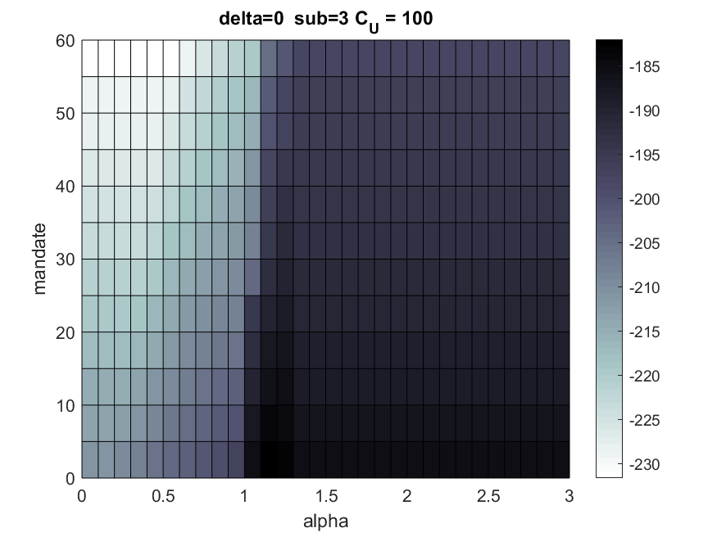
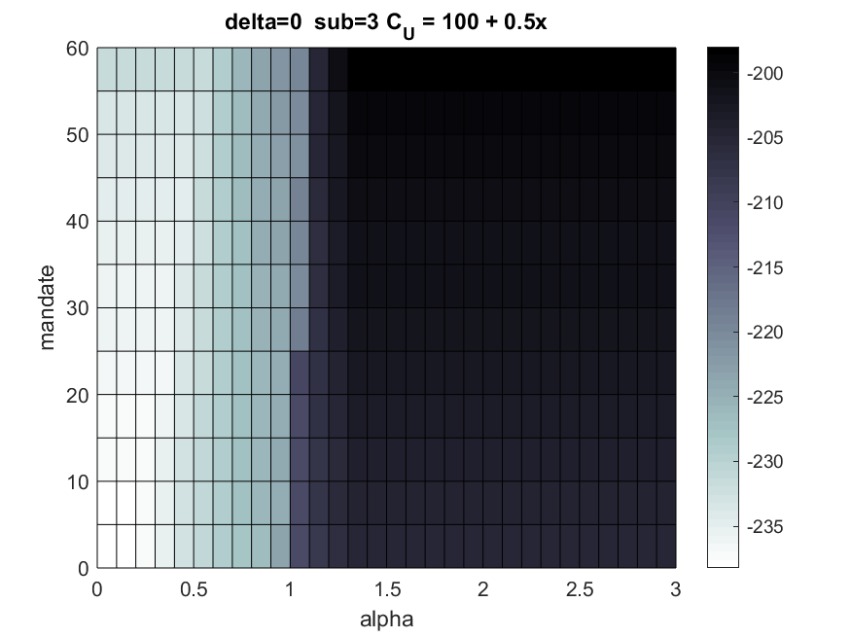
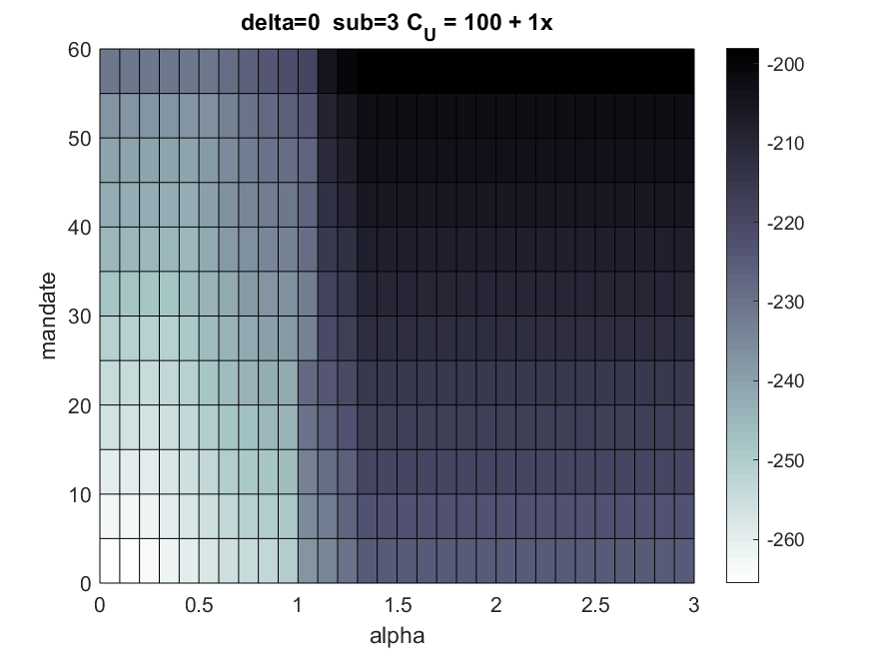
Welfare heat maps – ACA Subsidies
$$φ=0$$
$$φ=0.5$$
$$φ=1$$
Mandate penalty
Mandate penalty
Mandate penalty
alpha
Back
Alpha = strength of RA transfers

