Slide 1
Long Run Environmental Accounting in the U.S. Economy
NBER Conference on Environmental and Energy Policy and the Economy
May 16th, 2019
N.Z. Muller
Carnegie Mellon University, NBER,
Wilton E. Scott Institute for Energy Innovation

Slide 2
Motivation
The National Income and Product Accounts (NIPAs) track performance of an economic system.
Developed first in the early 1930s (Kuznets).
Widely used, but long-recognized that measures such as GDP are incomplete.
  Leisure time.
  Home production.
  Environment and natural resources.
Many previous papers in this space.
  Nordhaus, Tobin, 1973; NAS NRC, 1999; Bartelmus, 2009; Muller, Mendelsohn, Nordhaus, 2011; Muller, 2013, 2014.
What defines extant literature is either (1) static estimates, or (2) short time series.

Slide 3
What this paper does.
This paper conducts environmental accounts over 60 years in the U.S. economy: 1957 - 2016.
Why long-run environmental accounting?
  Macro-environmental models: income, population, technology (Ehrlich and Holdren, 1971).
  Neoclassical growth models: population growth and technological change (Solow, 1956).
  Income and population tend to change gradually.
  Technology changes in fits and starts – often with long periods between innovations.
Long-run analyses required to study growth and env. impacts.

Slide 4
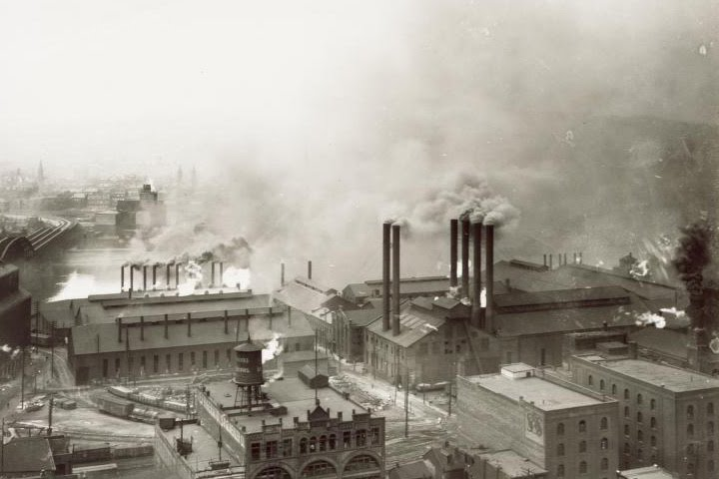
Pollution Intensity of Output:
Early 20th Century.
Steel Manufacturing in
Pittsburgh, PA, USA
Gordon, 2016
images.library.pitt.edu

Slide 5

Pollution Intensity of Output:
1970s.
Mobile Sources
Los Angeles, CA, USA
Gordon, 2016
Source: California Sun

Slide 6

Pollution Intensity of Output:
Early 21st Century.
Pittsburgh, Modern Era
McCumber, 2008
Gordon, 2016

Slide 7
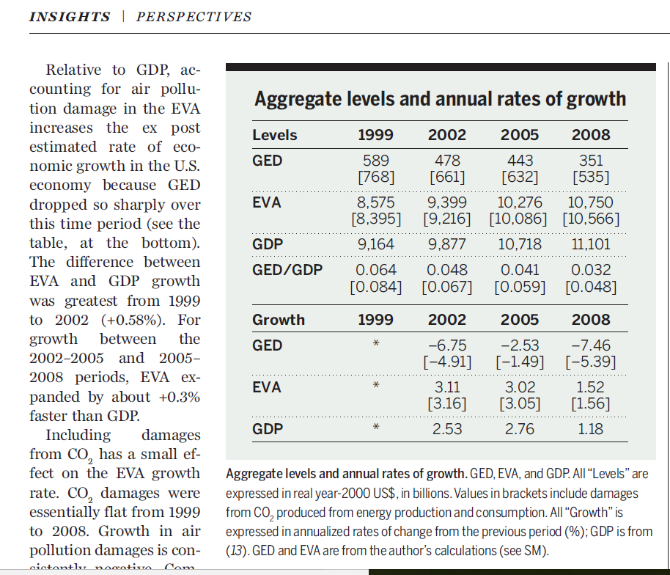
What this paper does.
Explores the hypothesis that long-run U.S. economic growth depends critically on how output is measured.
USBEA GDP data from 1957 – 2016.
Deducts air pollution damage from GDP 1957 – 2016.
Focus is on air pollution because…
  Excellent data availability.
  Potential for correction air quality to make large difference in accounts (NAS NRC, 1999; Muller, 2014).

Slide 8
What this paper finds.
From 1957 – 2016, annual average fine particulate matter (PM_{2.5}) fell from 54 ug/m³ to under 10 ug/m³.
PM_{2.5} damages increased (per capita) from 1957 to mid 1970’s when the Clean Air Act was implemented.
Thereafter, real PM_{2.5} damages fell, while real GDP increased.

Slide 9
Summary of Results.
Source: Muller, 2019

Slide 10
What this paper finds.
From 1957 – 2016, annual average fine particulate matter (PM_{2.5}) fell from 54 ug/m³ to under 10 ug/m³.
PM_{2.5} damages increased (per capita) from 1957 to mid 1970’s when the Clean Air Act was implemented.
Thereafter, real PM_{2.5} damages fell, while real GDP increased.
The business cycle plays a clear role:
  PM_{2.5} ambient levels.
  PM_{2.5} damages.

Slide 11
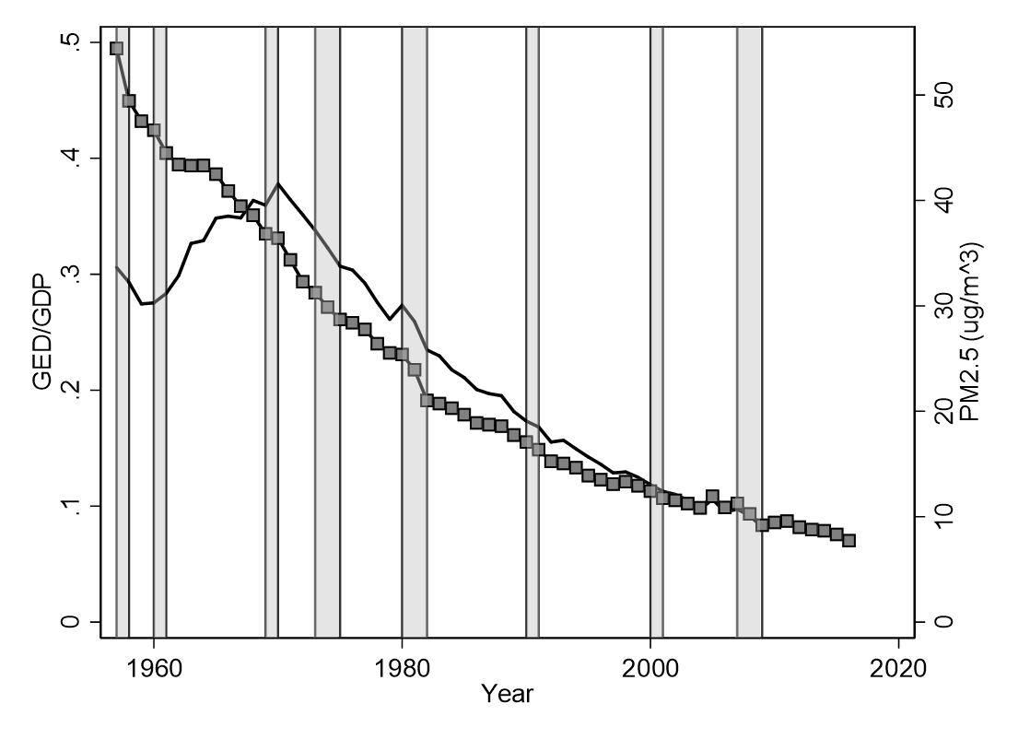
Summary of Results.
Great
Recession
Tech
Bubble
Double-dip
recession
Energy
Crisis
Solid: GED/GDP.
Square: ambient PM_{2.5}
Source: Muller, 2019

Slide 12
What this paper finds.
From 1957 – 2016, annual average fine particulate matter (PM_{2.5}) fell from 54 ug/m³ to under 10 ug/m³.
PM_{2.5} damages increased (per capita) from 1957 to mid 1970’s when the Clean Air Act was implemented.
Thereafter, real PM_{2.5} damages fell, while real GDP increased.
The business cycle plays a clear role:
  PM_{2.5} ambient levels.
  PM_{2.5} damages.
Growth in the U.S. economy was less rapid prior to 1970, and more rapid after 1970 than official accounts suggest.

Slide 13
Summary of Results.
Source: Muller, 2019

Slide 14
Outline for the Talk.
Motivation.
Summary of Results.
Conceptual Model.
Methods and Data.
Results.
Conclusions and Remaining Work.

Slide 15
Outline for the Talk.
Motivation.
Summary of Results.
Conceptual Model.
Methods and Data.
Results.
Conclusions and Remaining Work.

Slide 16
Conceptual Model.
National Income Accounting Identity.
Y_{t}^{m} = C_{t} + I_{t} + G_{t} + X_{t}
  C_{t} = consumption of market goods and services.
  I_{t} = net investment.
  G_{t} = government expenditure.
  X_{t} = net exports.
Augmentation occurs in two areas.
  A_{t} = γ_{t}C_{t}
    Fraction of consumption allocated to abatement of pollution: (0 ≤ γ ≤ 1).
  D_{t} = (α_{t} - β_{t}γ_{t})C_{t}
    α_{t} pre-abatement pollution intensity; β_{t} sensitivity of damage to abatement.
    Net damages, inclusive of abatement/mitigation.

Slide 17
Conceptual Model.
Y_{t}^{e} = C_{t} (1- γ_{t} - (α_{t} - β_{t}γ_{t})) + I_{t} + G_{t} + X_{t}
When does growth in market output equal growth in augmented output?
Rates are equal when the rate of change in (D_{t} + A_{t}) equals the GDP growth rate.
If (D_{t} + A_{t}) rises more rapidly than GDP, real rate less than GDP rate.
If (D_{t} + A_{t}) rises less rapidly than GDP, real rate exceeds GDP rate.

Slide 18
Outline for the Talk.
Motivation.
Summary of Results.
Conceptual Model.
Methods and Data.
Results.
Conclusions and Remaining Work.

Slide 19
Empirical Accounting Approach.
Gross External Damage (GED) = premature mortality damage from PM_{2.5} exposure.
GED: common approaches to attribution of mortality risk to PM_{2.5} exposure and valuation of mortality risk (USEPA, 1999; 2010; 2011; Fann et al., 2009; Levy, Baxter, Schwartz, 2009).
Environmentally-Adjusted Value Added (EVA) = GDP - GED
Deduction of GED from EVA reflects guidance from literature (Nordhaus and Tobin, 1973; Nordhaus, 2006; Abraham and Mackie, 2006).
Next: the air pollution data.

Slide 20

PM_{2.5} from TSP Readings:
1957 - 1980.
Early air pollution monitoring network gathered TSP data in a sample of cities (Clay, et al., 2016).
Monitoring network for TSP overlaps with current network for PM_{2.5} from 1999 to 2016.
Regress PM_{2.5} on TSP.
  ${PM}_{i,t}^{2.5}=β_{0}+β_{1}{TSP}_{i,t}+β_{2}Y_{t}+θ_{i}+ε_{i,t}$
Great Recession
Tech Bubble
Double-dip
recession
Energy
Crisis
Solid: TSP monitor;
Dash: PM_{2.5} estimate.

Slide 21
PM_{2.5} from Satellite Observations:
1980 - 2016.
Use 1º x 1º latitude, longitude satellite-based estimates of annual average PM_{2.5} provided by (Meng, et al., 2019).
Geolocated grid, compute population-weighted state average PM_{2.5} concentrations.
Cross-validate against monitoring data from 1999 to 2016.
Circles: satellite;
squares = monitor

Slide 22
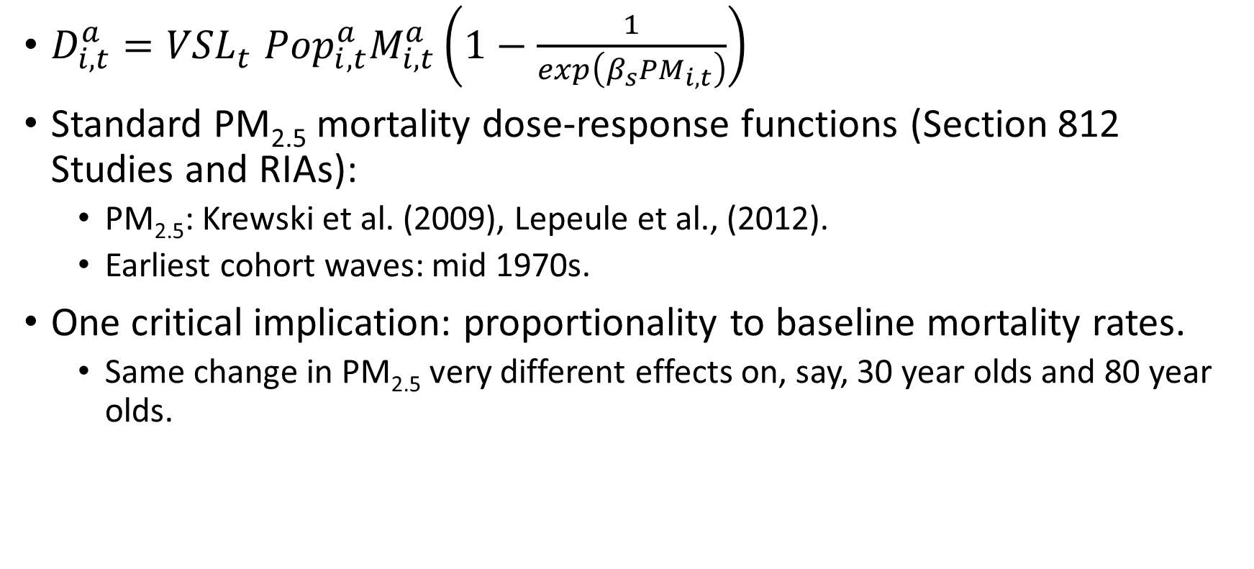
Key Assumptions: PM_{2.5} Exposure-Mortality.
$D_{i,t}^{a}={VSL}_{t}^{}{{Pop}_{i,t}^{a}M}_{i,t}^{a}\left(1−\frac{1}{exp\left(β_{s}{PM}_{i,t}\right)}\right)$
Standard PM_{2.5} mortality dose-response functions (Section 812 Studies and RIAs):
  PM_{2.5}: Krewski et al. (2009), Lepeule et al., (2012).
  Earliest cohort waves: mid 1970s.
One critical implication: proportionality to baseline mortality rates.
  Same change in PM_{2.5} very different effects on, say, 30 year olds and 80 year olds.

Slide 23
Key Assumptions: Valuation of Mortality Risk.
USEPA’s VSL of $7.4 x 10⁶ ($2006).
In the long run context, income changes are very important.
How does this parameter vary with income?
  Costa and Kahn (2004) provide decadal VSLs from 1940 to 1980.
  USEPA: Kleckner and Neumann (1994) = 0.4.
  Adjust VSL intertemporally, not cross-sectionally.

Slide 24
Key Assumptions: Valuation of Mortality Risk.
Great Recession
Tech Bubble
Double-dip
recession
Solid: variable income elasticity.
Dash: income elasticity = 0.4.
Dash-dot: income elasticity = 1.0
Energy
Crisis

Slide 25
Outline for the Talk.
Motivation.
Summary of Results.
Conceptual Model.
Methods and Data.
Results.
Conclusions and Remaining Work.

Slide 26
Results
Deaths.
  Demographics.
Pollution Intensity.
  Decades.
Growth.
  GED
  EVA – GDP Differential
  The Business Cycle.

Slide 27
Deaths from PM_{2.5}.
Great Recession
Tech Bubble
Double-dip
recession
Energy
Crisis
Source: Muller, 2019

Slide 28
Results
Deaths in U.S. from PM_{2.5} in 1957.
  430,000
  Average PM_{2.5} 54 ug/m^{3.}
  25% of all mortality.
Deaths in China from PM_{2.5} in 2014.
  1.6 million (Rohde and Muller, 2015).
  Average PM_{2.5} 52 ug/m^{3.}
  17% of all mortality.
Difference due to higher baseline rate in U.S. in 1957 (0.0099) than China in 2014 (0.0072).

Slide 29
Fraction of Deaths from PM_{2.5} Among Seniors.
Great
Recession
Tech Bubble
Double-dip
recession
Energy
Crisis
Source: Muller, 2019

Slide 30
Fraction of Deaths from PM_{2.5} Among Seniors.
Great
Recession
Tech Bubble
Double-dip
recession
Energy
Crisis
Solid: Senior population share.
Dash: Share of total PM_{2.5} deaths
among 65+.
Source: Muller, 2019

Slide 31
Results
Deaths.
  Demographics.
Pollution Intensity.
  Decades.
Growth.
  GED
  EVA – GDP Differential
  The Business Cycle.

Slide 32
Pollution Intensity of Output.
 | Total sample | 1960s | 1970s | 1980s | 1990s | 2000s | 2010s
GDP | 1.94^{A} | 2.62 | 2.12 | 2.15 | 2.00 | 0.96 | 1.52
 | (2.130)^{B} | (2.548) | (2.459) | (2.542) | (1.566) | (2.048) | (0.583)
EVA | 2.45 | 1.93 | 3.61 | 3.20 | 2.68 | 1.44 | 1.67
 | (2.394) | (2.400) | (3.302) | (2.791) | (1.643) | (1.996) | (0.742)
EVA – GDP | 0.51 | -0.69 | 1.49 | 1.05 | 0.69 | 0.48 | 0.15
 | (1.440) | (1.986) | (1.628) | (1.280) | (0.522) | (0.676) | (0.339)
GED | -0.41 | 4.15 | -1.06 | -1.42 | -1.72 | -3.00 | -0.24
 | (5.335) | (6.067) | (3.444) | (4.518) | (3.016) | (7.018) | (3.698)
GED/GDP | 0.21^{C} | 0.32 | 0.32 | 0.22 | 0.15 | 0.10 | 0.08
 | (0.100) | (0.0328) | (0.0384) | (0.0294) | (0.0169) | (0.0110) | (0.00476)
N | 60 | 12 | 10 | 10 | 10 | 10 | 8

Slide 33
Growth.
 | Total sample | 1960s | 1970s | 1980s | 1990s | 2000s | 2010s
GDP | 1.94^{A} | 2.62 | 2.12 | 2.15 | 2.00 | 0.96 | 1.52
 | (2.130)^{B} | (2.548) | (2.459) | (2.542) | (1.566) | (2.048) | (0.583)
EVA | 2.45 | 1.93 | 3.61 | 3.20 | 2.68 | 1.44 | 1.67
 | (2.394) | (2.400) | (3.302) | (2.791) | (1.643) | (1.996) | (0.742)
EVA – GDP | 0.51 | -0.69 | 1.49 | 1.05 | 0.69 | 0.48 | 0.15
 | (1.440) | (1.986) | (1.628) | (1.280) | (0.522) | (0.676) | (0.339)
GED | -0.41 | 4.15 | -1.06 | -1.42 | -1.72 | -3.00 | -0.24
 | (5.335) | (6.067) | (3.444) | (4.518) | (3.016) | (7.018) | (3.698)
GED/GDP | 0.21^{C} | 0.32 | 0.32 | 0.22 | 0.15 | 0.10 | 0.08
 | (0.100) | (0.0328) | (0.0384) | (0.0294) | (0.0169) | (0.0110) | (0.00476)
N | 60 | 12 | 10 | 10 | 10 | 10 | 8

Slide 34
Growth.
 | Total sample | 1960s | 1970s | 1980s | 1990s | 2000s | 2010s
GDP | 1.94^{A} | 2.62 | 2.12 | 2.15 | 2.00 | 0.96 | 1.52
 | (2.130)^{B} | (2.548) | (2.459) | (2.542) | (1.566) | (2.048) | (0.583)
EVA | 2.45 | 1.93 | 3.61 | 3.20 | 2.68 | 1.44 | 1.67
 | (2.394) | (2.400) | (3.302) | (2.791) | (1.643) | (1.996) | (0.742)
EVA – GDP | 0.51 | -0.69 | 1.49 | 1.05 | 0.69 | 0.48 | 0.15
 | (1.440) | (1.986) | (1.628) | (1.280) | (0.522) | (0.676) | (0.339)
GED | -0.41 | 4.15 | -1.06 | -1.42 | -1.72 | -3.00 | -0.24
 | (5.335) | (6.067) | (3.444) | (4.518) | (3.016) | (7.018) | (3.698)
GED/GDP | 0.21^{C} | 0.32 | 0.32 | 0.22 | 0.15 | 0.10 | 0.08
 | (0.100) | (0.0328) | (0.0384) | (0.0294) | (0.0169) | (0.0110) | (0.00476)
N | 60 | 12 | 10 | 10 | 10 | 10 | 8

Slide 35
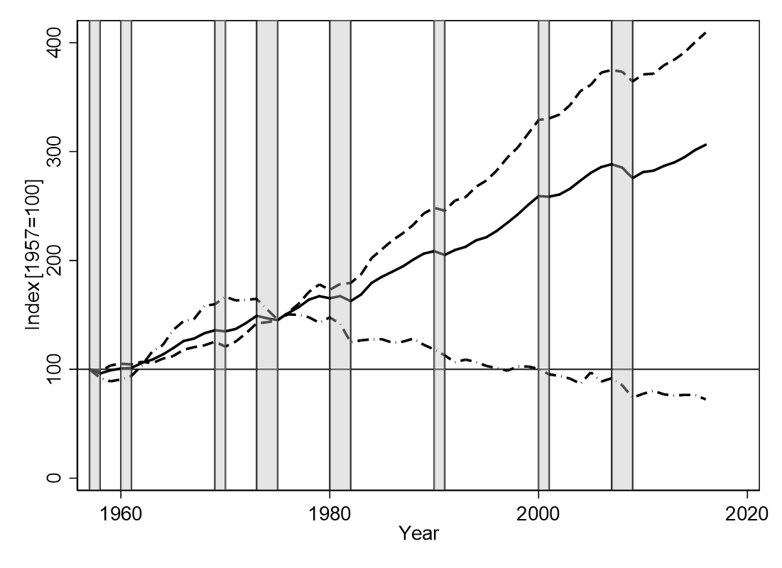
Growth and the Business Cycle.
Great
Recession
Tech
Bubble
Double-dip
recession
Energy
Crisis
Solid: GDP
Dash: EVA
Dash-dot: GED
Source: Muller, 2019

Slide 36
Growth and the Business Cycle.
 | Total sample | Recession | Not Recession | Energy Crisis | Great Recession
GDP | 1.94^{A} | -0.32 | 2.85 | 1.52 | -1.19
 | (2.130)^{B} | (2.134) | (1.289) | (4.318) | (2.151)
EVA | 2.45 | 0.39 | 3.28 | 3.72 | -0.73
 | (2.394) | (2.524) | (1.781) | (4.276) | (1.525)
EVA – GDP | 0.51 | 0.72 | 0.42 | 2.20 | 0.46
 | (1.440) | (1.571) | (1.394) | (0.0427) | (0.662)
GED | -0.41 | -3.00 | 0.64 | -2.67 | -5.65
 | (5.335) | (5.516) | (4.947) | (4.576) | (8.568)
GED/GDP | 0.21^{C} | 0.24 | 0.20 | 0.33 | 0.09
 | (0.100) | (0.0967) | (0.0994) | (0.0106) | (0.00776)
N | 61 | 18 | 43 | 2 | 3

Slide 37
Outline for the Talk.
Motivation.
Summary of Results.
Conceptual Model.
Methods and Data.
Results.
Conclusions.

Slide 38
Summary of Results.
The trajectory of abatement and damages dictates relative growth of EVA and GDP.
The air pollution intensity of the U.S. economy has fallen a lot!

Slide 39
Summary of Results.
Source: Muller, 2019

Slide 40
Summary of Results.
The trajectory of abatement and damages dictates relative growth of EVA and GDP.
The air pollution intensity of the U.S. economy has fallen a lot!
The turning point came with implementation of the Clean Air Act.
Regression analysis emphasizes importance of the business cycle, Title I (NAAQS) standards in the Clean Air Act.

Slide 41
Summary of Results: Growth.
Robert Gordon, Thomas Piketty other prominent economists demonstrate “slowdown” in U.S. growth post 1970s.
This paper argues partially due to mis-measurement.

Slide 42
Thank you.
Nick Muller
nzm@andrew.cmu.edu

Slide 43
Growth in Pennsylvania State PCE.
Solid = GDP
Dash = EVA
Dash-dot = GED
Source: Muller, 2019

Slide 44
Growth in West Virginia State PCE.
Solid = GDP
Dash = EVA
Dash-dot = GED
Source: Muller, 2019

Slide 45
The Role of Home Heating.
Solid = Coal & Wood Home Heating Share
Dash = TSP
Source: Muller, 2019

Slide 46
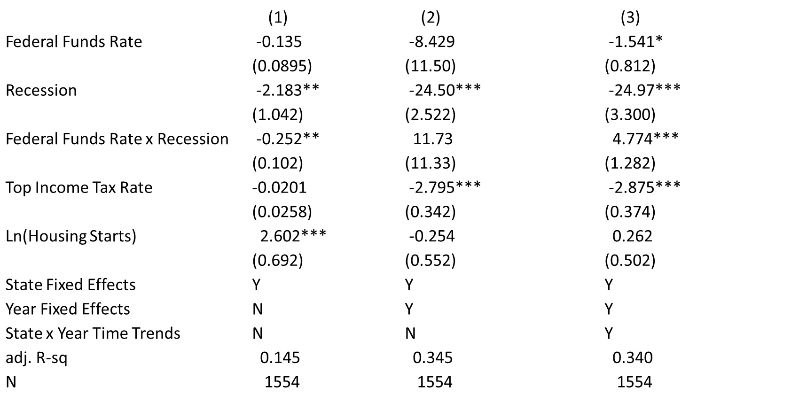
Determinants of GED Growth: Macro Factors

Slide 47
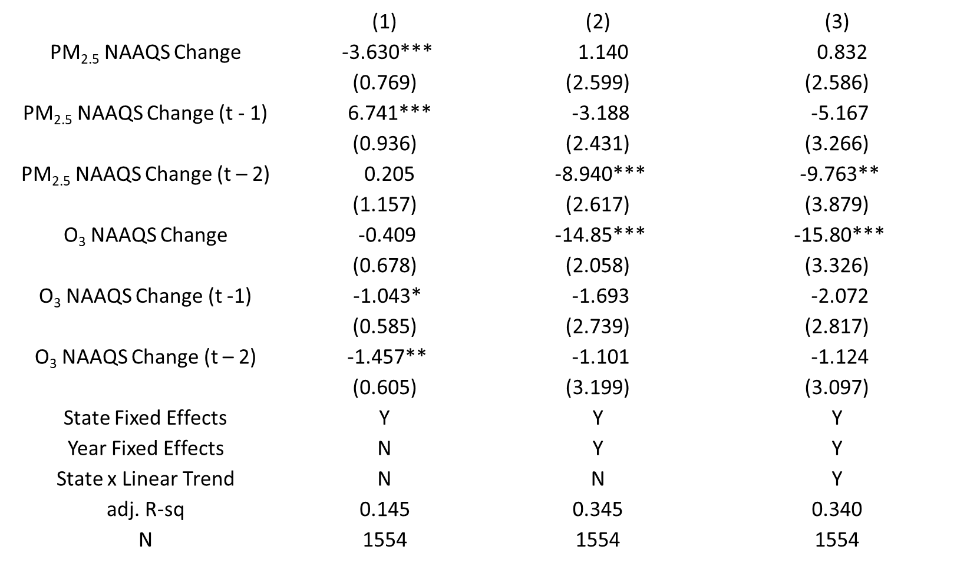
Determinants of GED Growth: Env. Policy.

Slide 48
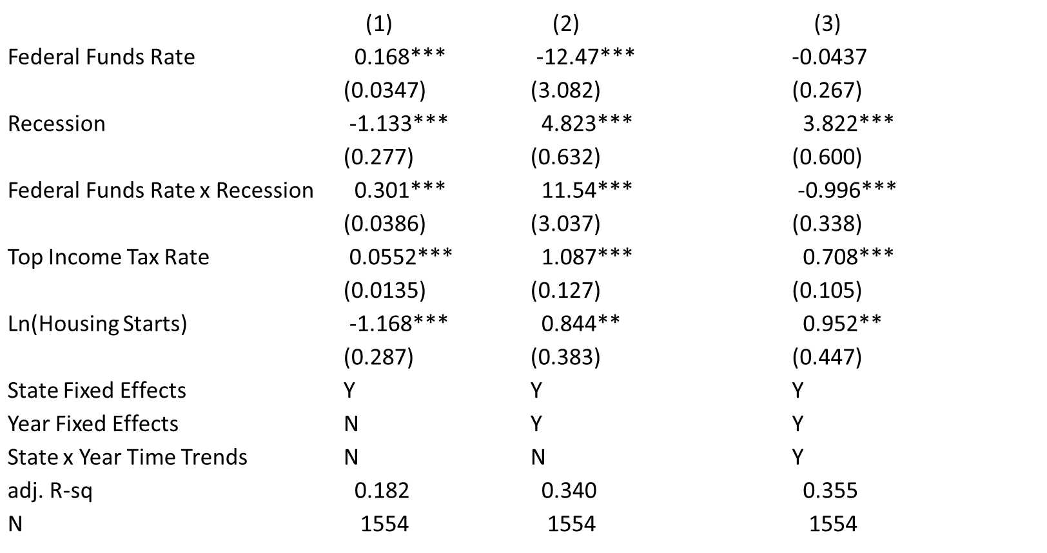
Determinants of EVA-GDP Growth:
Macro Factors.

Slide 49
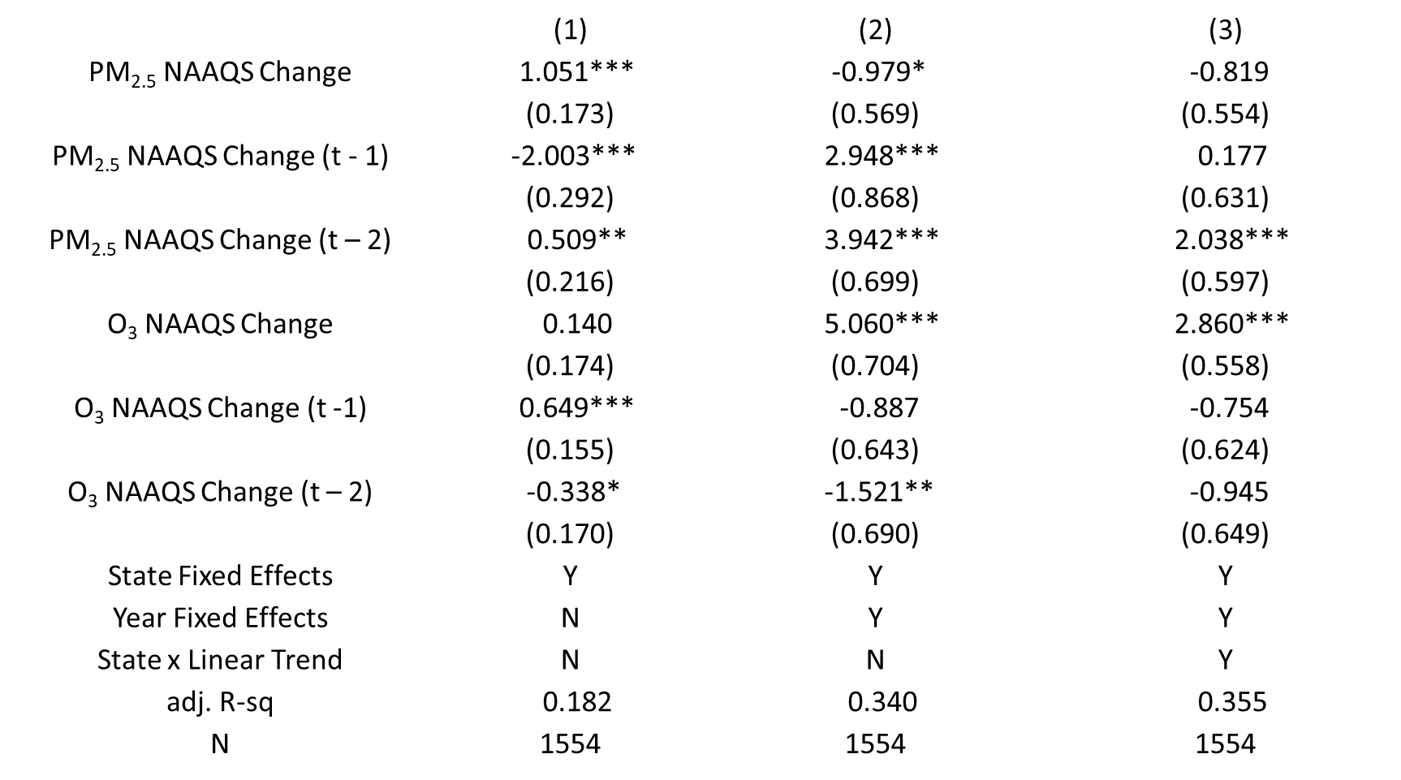
Determinants of EVA-GDP Growth:
Environmental Policy.

Slide 50
Deaths from PM_{2.5} in 1957.
Bounding exercise on 435,000 deaths in 1957.
  About 25% of all deaths (CDC, Census).
  Average PM_{2.5} = 54 ug/m³.
In 2014, China incurred 1.6M deaths from PM_{2.5} (Rohde, Muller, 2015).
  About 17% of all deaths.
  Average PM_{2.5} = 52 ug/m³.
What about the functional form of the dose-response relationship?
  Krewski et al., (2009) report both log-linear and log-log.
  What difference does this make?
Source: Muller, 2019

Slide 51
Other critical data.
Dept. of Commerce, U.S. Bureau of Economic Analysis.
  State GDP 1980 – 2016.
  State Personal Consumption Expenditures (PCE): 1998 - 2016.
    Imputation prior to 1998, by state.
  National GDP: 1957 – 2016.
At the state level of analysis, exposure-based GED related to PCE.
  Do not know precise origin of ambient PM_{2.5}.
  Cannot “charge” to state GDP.
  Deduction from consumption.
Nationally, the two are negligibly different.

Slide 52
Growth in North Dakota State PCE.
Solid = GDP
Dash = EVA
Dash-dot = GED
Source: Muller, 2019

Slide 53
Summary of Results.
Great
Recession
Tech
Bubble
Double-dip
recession
Energy
Crisis
Solid: GDP
Dash: EVA
Dash-dot: GED
Source: Muller, 2019

