Slide 1
AI Policy Considerations
Jason Furman
Harvard Kennedy School and Peterson Institute for International Economics
NBER Conference on the Economics of Artificial Intelligence
Toronto, Canada
September 14, 2018

Slide 2
AI policy considerations
We need more AI: Productivity growth is too low
Base policy on the present: The world is changing more slowly and less predictably than we think
Should not have AI policy considerations: Domain specific regulation
Compare human to machines: If you have AI policy considerations, compare humans to machines
AI is—and will continue to—raise novel issues in multiple policy domains

Slide 3
AI policy considerations
We need more AI
Base policy on the present
Should not have AI policy considerations
Compare human to machines
AI is—and will continue to—raise novel issues in multiple policy domains

Slide 4
Productivity growth has slowed in all of the advanced economies
1. We need more AI
Source: Conference Board, Total Economy Database; author’s calculations.

Slide 5
Private investment may not be sufficient for AI
1. We need more AI
Spillovers (like any area of R&D)
Cybersecurity, and spillovers from data
Defining property rights for data
Increasing returns and strategic competition internationally???

Slide 6
Some policies to promote AI
1. We need more AI
Tax incentives for private R&D
Basic research
Cybersecurity and privacy rules
National effort???

Slide 7
AI policy considerations
We need more AI
Base policy on the present
Should not have AI policy considerations
Compare human to machines
AI is—and will continue to—raise novel issues in multiple policy domains

Slide 8
This is also what we thought in 1980…
2. Base Policy on the Present
New York Times, September 1980

Slide 9
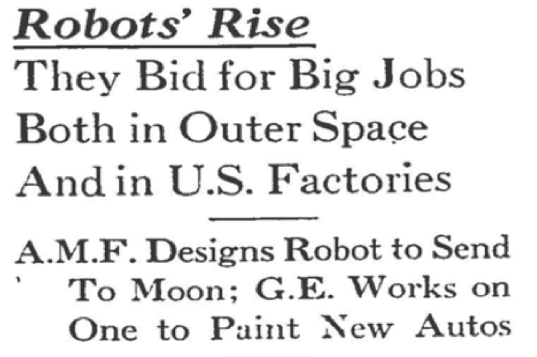
And in 1960…
2. Base Policy on the Present
“But these machines, nevertheless, are true robots—automatic devices that perform human functions or operate with seemingly human intelligence.”

Slide 10
And in 1935…
2. Base Policy on the Present
Washington Post, January 1935

Slide 11
And in 1812
2. Base Policy on the Present
Reward Poster for Luddite Attacks Near Leeds, March 1812

Slide 12
Some issues about designing policies for the future of work
2. Base Policy on the Present
The large majority of employment is still in traditional employment relationships that would be recognizable to someone in 1980 or 1990.
Some evidence that jobs are changing less quickly than in the past.
Predictions are fraught: the share of jobs requiring social interaction grew while STEM jobs fell from 1980 to 2012 (Deming 2017)
Can’t do RCTs on the future!

Slide 13
But we really do need policies for the recent past of work: “now more than everism”
2. Base Policy on the Present

Slide 14
AI policy considerations
We need more AI
Base policy on the present
Should not have AI policy considerations
Compare human to machines
AI is—and will continue to—raise novel issues in multiple policy domains

Slide 15
The problems with AI-specific regulation
3. Should not have AI policy considerations
AI is a tool and we don’t have tool-specific regulators. (Imagine a regulator for regressions.)
Domain-specific regulators would benefit from more AI-specific knowledge, but AI regulators could never know enough about each domain.
Perils of coordinating between an AI regulator and a domain-specific regulator.
Permissionless innovation is central to technological progress.
Predictions are fraught: the share of jobs requiring social interaction grew while STEM jobs fell from 1980 to 2012 (Deming 2017)
Can’t do RCTs on the future!

Slide 16
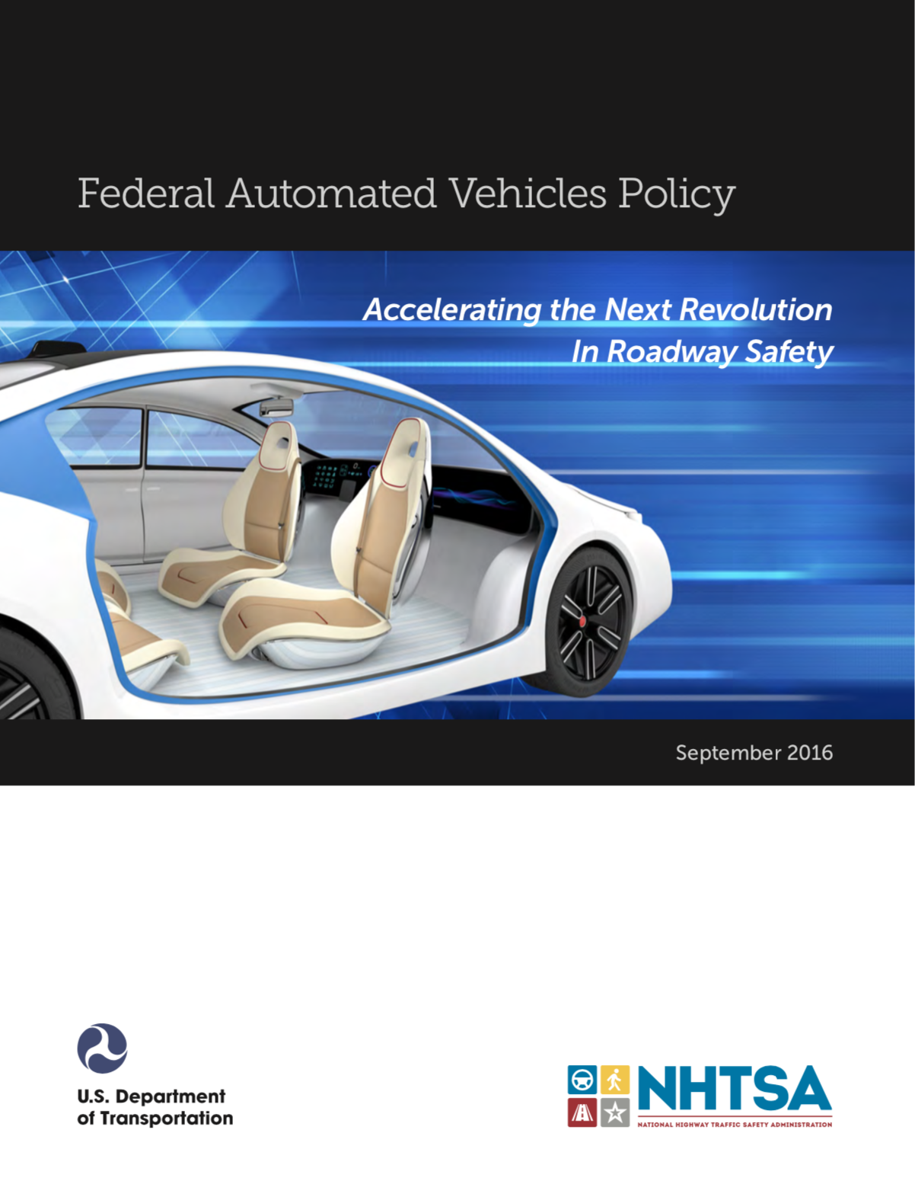
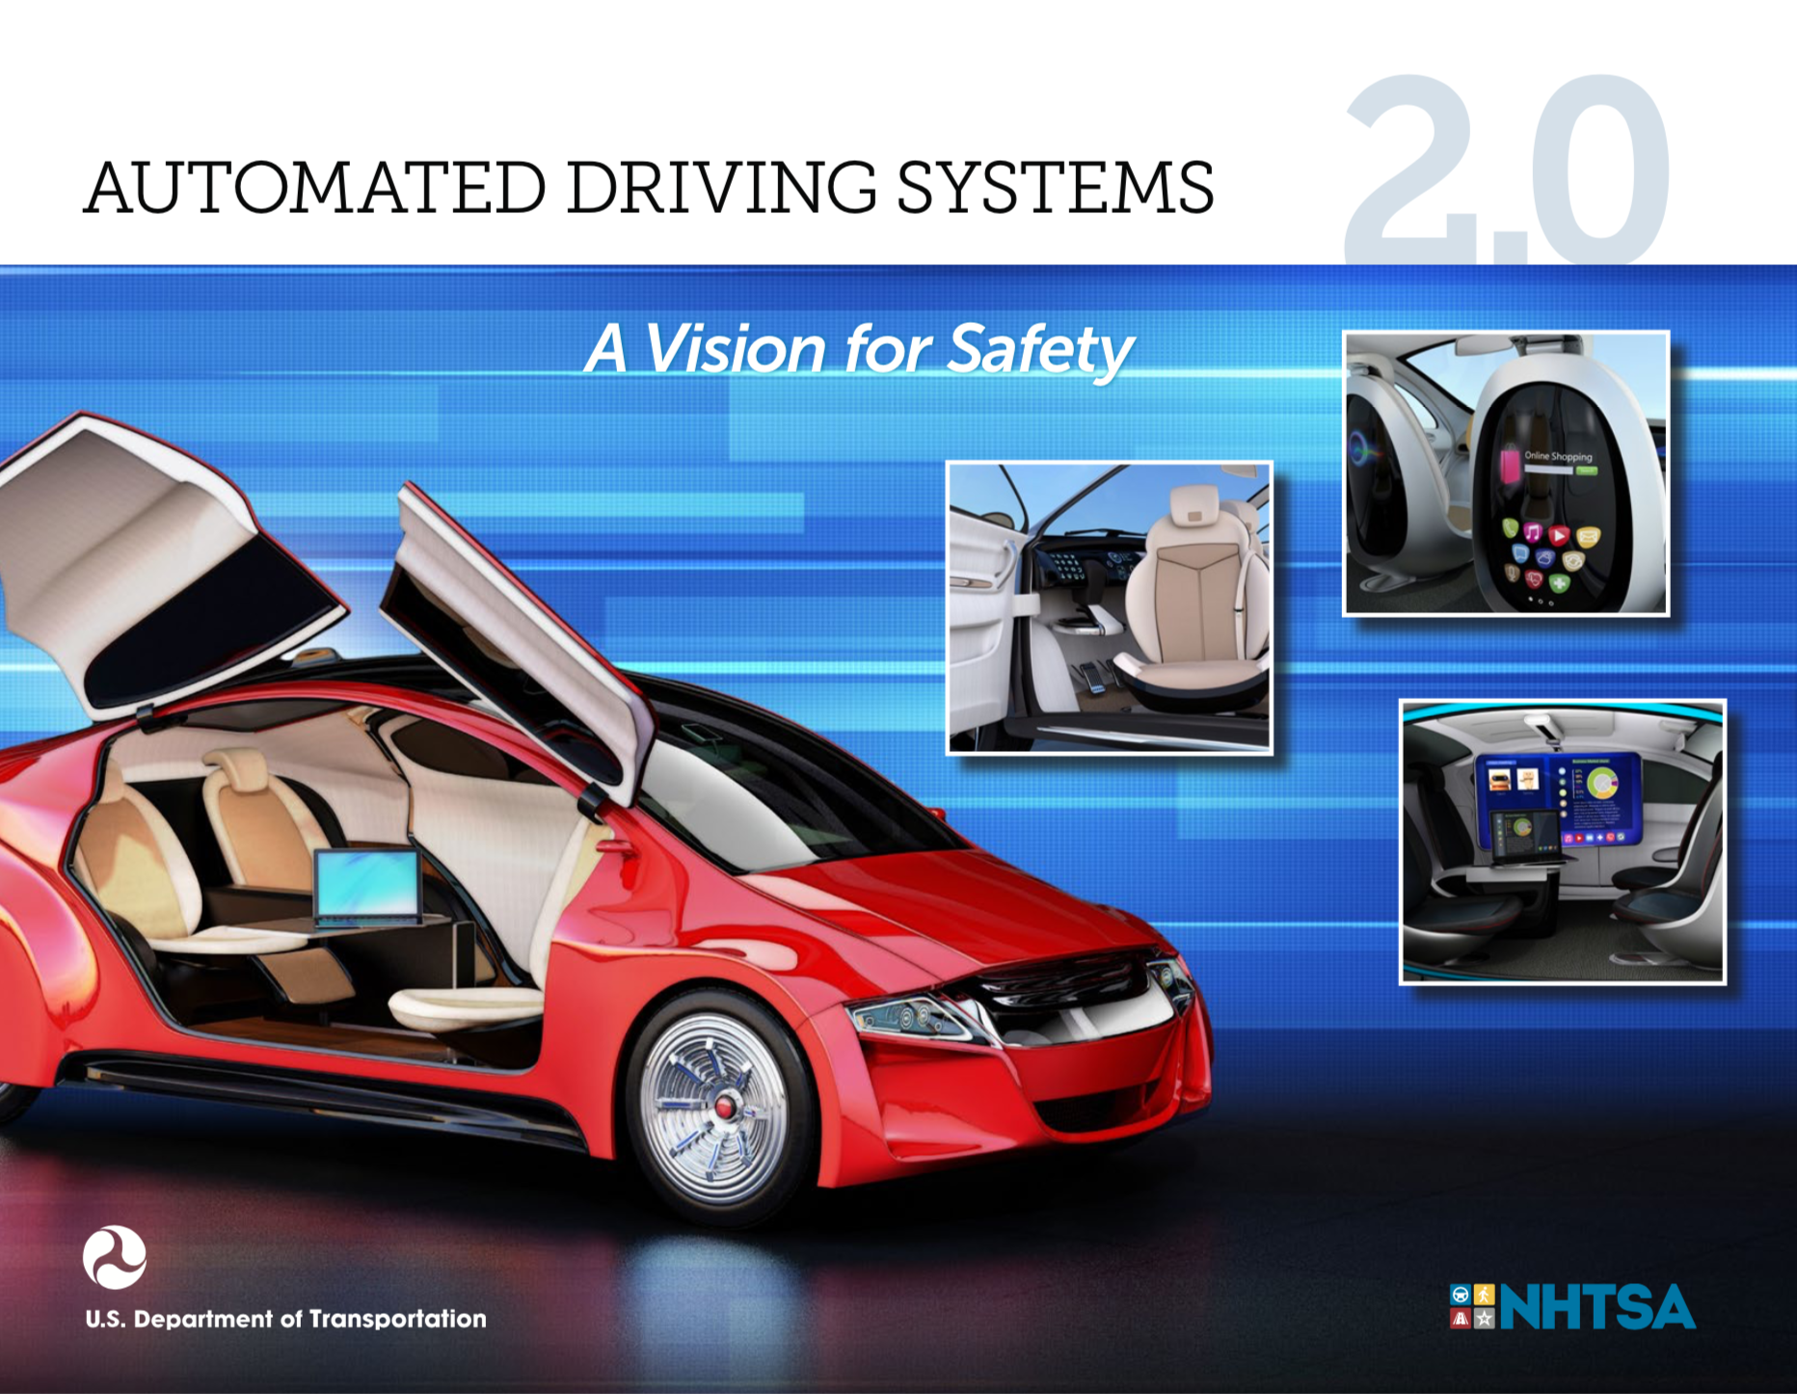
Example: automated vehicles
3. Should not have AI policy considerations
September 2016
September 2017

Slide 17
National Highway Traffic Safety Administration (NHTSA) is the domain-specific authority
3. Should not have AI policy considerations
Mandates specific safety features
Investigates safety issues and orders recalls
Tests and provides information
Provides guidance and standards
Public information & works with states

Slide 18
A long history of auto innovations related to safety and convenience
3. Should not have AI policy considerations
Mandatory include: seat belts, air bags, electronic stability control, rear visibility cameras, LATCH, tire pressure monitors
Optional include: automatic transmission, antilock brakes, cruise control, adaptive cruise control, forward collision warning, active avoidance systems
Almost all of the innovations were developed by automakers and subsequently standardized/regulated by NHTSA and, in some cases, made mandatory.

Slide 19
Obama administration policy on autonomous vehicles
3. Should not have AI policy considerations
Vehicle Performance Guidance for Automated Vehicles
Model State Policy
NHTSA’s Current Regulatory Tools
New Tools and Authorities
The Trump administration built on these rules with a plan it called “2.0”: extended to Level 3 automation, walked back from some of the new tools/authorities, dropped some of the guidelines in areas like ethics/privacy, fleshed out other guidelines.

Slide 20
AI policy considerations
We need more AI
Base policy on the present
Should not have AI policy considerations
Compare human to machines
AI is—and will continue to—raise novel issues in multiple policy domains

Slide 21
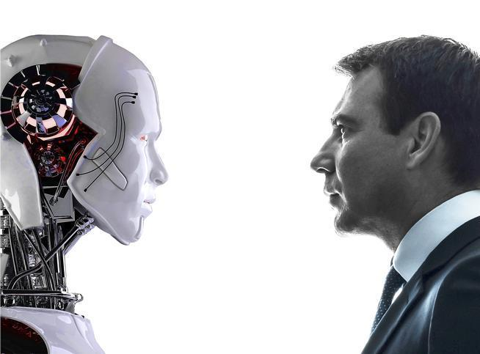
Machines vs. Humans: Which is better?
4. Compare humans to machines
vs.
Source: denverpost.com.

Slide 22
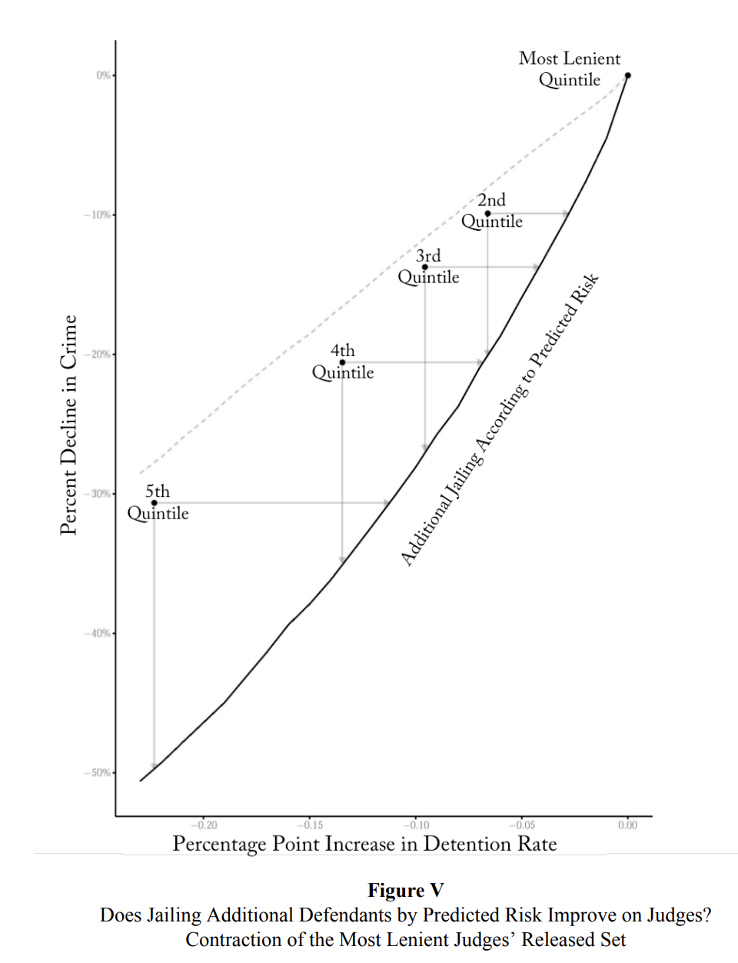
Machines can often do better than biased, inefficient and suboptimal humans
4. Compare humans to machines
Source: Kleinberg et al (2017).

Slide 23
Should we wait until automated vehicles are as safe as humans to deploy them?
4. Compare humans to machines
No, that would be waiting too long:
Safety-convenience tradeoff: Our auto policies trade off safety vs. convenience (otherwise the speed limit would be 5 mph). Automated vehicles are much more convenient and thus worth a safety cost.
Dynamic considerations: Deploying more autonomous technology today allows more learning to develop safer future technologies.

Slide 24
AI policy considerations
We need more AI
Base policy on the present
Should not have AI policy considerations
Compare human to machines
AI is—and will continue to—raise novel issues in multiple policy domains

Slide 25
Digital competition or concentration?
5. AI is—and will continue to—raise novel issues in multiple policy domains
Digital technologies can reduce fixed costs and thus barriers to entry…
…But, digital platform markets have led to competition for the market: direct and indirect network effects (Rochet and Tirole, 2003; 2006)

Slide 26
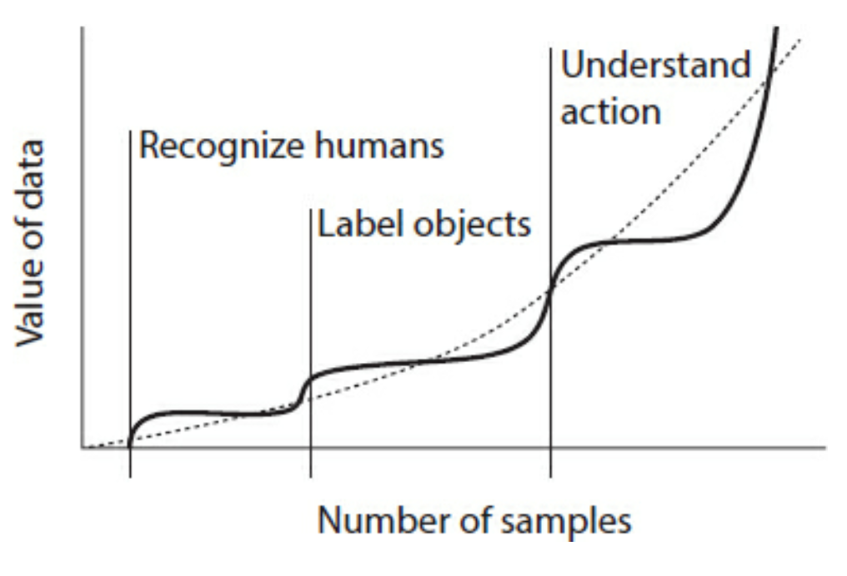
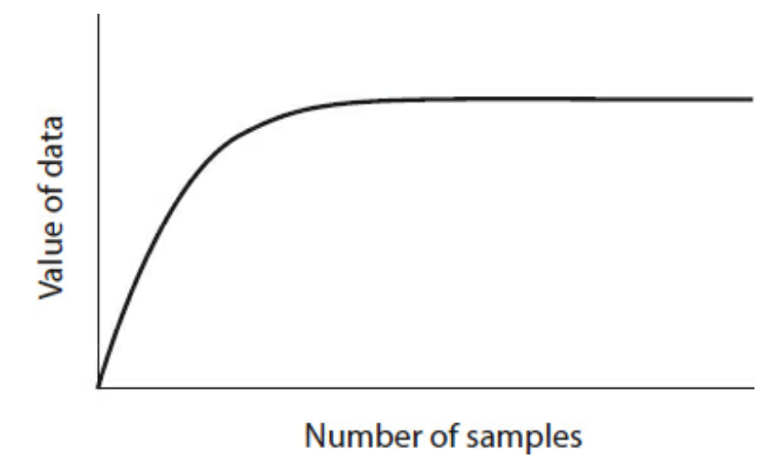
A key question for AI/ML: what are the returns to scale in data?
5. AI is—and will continue to—raise novel issues in multiple policy domains
OR
Source: Posner and Weil (2018).

Slide 27
Is algorithmic collusion a new threat?
5. AI is—and will continue to—raise novel issues in multiple policy domains
Forms of tacit collusion (Ezrachi and Stucke 2016):
Messenger
Hub and spoke
Predictable agent
Digital eye

Slide 28
Concluding considerations on uncertainty
More research is surely needed-–can’t wait for the third annual conference.
But, more research is always needed but policy can never wait for certainty.
In the technological space a view that the speed of innovation renders regulation and antitrust enforcement irrelevant of counterproductive—may often be true.
But, some private changes are irreversible and the cost of errors may not be symmetric. For example, it is easier to block an acquisition—and potentially approve it later—than to reverse it once it is done.

Slide 29
AI Policy Considerations
Jason Furman
Harvard Kennedy School and Peterson Institute for International Economics
NBER Conference on the Economics of Artificial Intelligence
Toronto, Canada
September 14, 2018

