Slide 1
Fiscal Difficulties of Cities, the Labor Market, and Health Care*
John Hsu, Harvard Medical School
Joseph P. Newhouse, Harvard and NBER Lindsay Overhage, MGH
Samuel H. Zuvekas, AHRQ

Slide 2
Our Question
How do cities in fiscal difficulty adapt?
Because of the constitutional protection of pensions and the difficulty of terminating unionized employees, adaptation may well occur through employment changes such as hiring freezes and changes in health insurance, especially retiree health insurance

Slide 3
Our Question Continued
We therefore seek to identify cities in fiscal difficulty, those that are not, and compare effects on employment, health insurance, health care, and health

Slide 4
Theory
We estimate a reduced form and theory does not allow us to sign effects
There can be both demand- and supply-side reactions and there may be multiple effects
For example, a city may offer an early retirement package, in which case both the money and time cost of medical care could change, potentially in opposite directions
A change in time cost may affect health habits

Slide 5
Theory, cont.
Theory is also of little help with respect to specifying leads and lags

Slide 6
Summary of Methods
We identified cities whose bonds have been downgraded and a set of control group cities
We matched these cities with sampling units from the Medical Expenditure Panel Survey (MEPS)
We looked at labor market, health care, and health outcomes; we did not prespecify those we expected to be affected

Slide 7
Methods
We used Moody’s to identify cities with bond downgrades in the 1995-2010 period
Although Moody’s could not give us a complete list of municipal bond ratings, the Statistical Abstract published ratings for the 80 largest cities in this period and Moody’s identified for us the 7 cities that declared bankruptcy
We also searched for press reports of downgrades; this yielded 613 more cities

Slide 8
Methods, cont.
We matched this list of cities with sampling units from the household component of the Medical Expenditure Panel Survey (MEPS)
MEPS is a national probability sample that focuses on health and health care, but also collects information on employment status; this allows us to identify municipal employees
MEPS’ sample size was ~8,000-9,000 families 1996-2000* and ~13,000 after that

Slide 9
Methods, cont.
This yielded a sample of 30 cities with downgrades (“Shock cities”) and 31 Control group cities; we applied MEPS sampling weights and then tried to improve balance with propensity scores, which were a function of the year of the downgrade, population, population², and census region

Slide 10
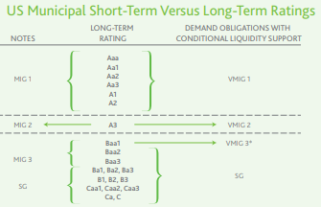
Moody’s Ratings

Slide 11

Moody’s Qualitative Descriptions

Slide 12
Methods, cont.
Our main analysis focuses on 23 Shock cities that were downgraded to a rating of Aa3 or lower; eliminating those whose after-downgrade rating was higher reduced the sample size by about half
If we had set the cutoff at Baa1 or lower (“acceptable credit quality”), we would have reduced the sample size around 80%

Slide 13
Methods, cont.
After matching this group of cities to MEPS sampling units, we were left with a sample of 722 employees and retirees in the Shock group and 1988 in the Control group
We show raw results by year for the 4 years before and after the shock and difference-in-difference results with demographic covariates, washing out the year of the shock and the year before and after it

Slide 14
Overview of Results
The rate of separation of local government employees (retired, quit, fired) appears to fall in the year of the downgrade and remains low for the three subsequent years before rebounding in the fourth

Slide 15
Overview of Results, cont.
Other outcomes are not significantly different between the two groups of cities
There is suggestive evidence of a greater proportion of employees and retirees, as well as that group plus dependents, having a period of fair or poor health after the shock, but that result cannot survive a correction for multiple comparisons

Slide 16
Characteristics of the Sample
Propensity Score Weighted |  |  |  |  | Unweighted
 | CONTROL n=1988 |  | SHOCK n=722 |  | CONTROL n=1988 |  | SHOCK n=722
 | Mean | Std. Error | Mean | Std. Error | Mean | Std. Error | Mean | Std. Error
Age (years) | 48.09 | 1.09 | 47.93 | 0.97 | 47.57 | 0.81 | 47.13 | 0.84
Female | 0.62 | 0.02 | 0.52 | 0.03 | 0.62 | 0.02 | 0.55 | 0.01
Race/Ethnicity
Hispanic | 0.12 | 0.03 | 0.13 | 0.03 | 0.21 | 0.05 | 0.21 | 0.06
Black | 0.28 | 0.04 | 0.38 | 0.08 | 0.37 | 0.04 | 0.46 | 0.10
White | 0.55 | 0.05 | 0.43 | 0.06 | 0.35 | 0.05 | 0.28 | 0.05
Education Level
Less than HS | 0.08 | 0.01 | 0.09 | 0.02 | 0.13 | 0.02 | 0.12 | 0.02
HS diploma | 0.24 | 0.04 | 0.28 | 0.05 | 0.26 | 0.03 | 0.30 | 0.05
Some college | 0.22 | 0.03 | 0.22 | 0.03 | 0.23 | 0.02 | 0.24 | 0.02
Bachelor’s | 0.25 | 0.02 | 0.19 | 0.02 | 0.21 | 0.01 | 0.17 | 0.02
≥ Masters | 0.21 | 0.02 | 0.21 | 0.03 | 0.17 | 0.02 | 0.18 | 0.03
Married | 0.48 | 0.03 | 0.47 | 0.04 | 0.49 | 0.03 | 0.47 | 0.03
Region
Northeast | 0.17 | 0.11 | 0.19 | 0.08 | 0.12 | 0.08 | 0.15 | 0.07
Midwest | 0.16 | 0.07 | 0.27 | 0.14 | 0.14 | 0.06 | 0.29 | 0.16
South | 0.40 | 0.10 | 0.32 | 0.17 | 0.43 | 0.11 | 0.33 | 0.18
West | 0.27 | 0.09 | 0.22 | 0.14 | 0.32 | 0.11 | 0.23 | 0.14
Census population | 1,031,022 | 181,920 | 850,956 | 266,769 | 1,199,592 | 238,141 | 953,855 | 315,642

Slide 17
Degree of Balance
Even in the unweighted sample the Shock group is more female, black, less well educated, and more likely to be in the Midwest, and weighting increases several of these discrepancies
Most of the change from the unweighted sample is from the MEPS sampling weights; propensity score weights change little

Slide 18
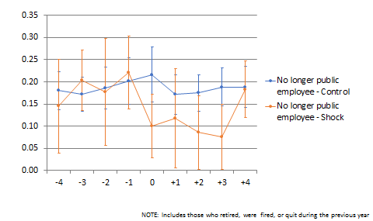
The Rate of Separation Fell at the Time of the Shock

Slide 19
Difference-in-Difference Analyses
 | No Longer Public Employee, Years -3, -2, +2, +3 |  |  |  | No Longer Public Employee, Years -4, -3, -2, +2, +3, +4
 | Coefficient | Std. Error | t | P>|t| | Coeff | Std. Error | t | P>|t|
1.post | -0.006 | 0.006 | -0.920 | 0.360 | 0.012 | 0.012 | -1.090 | 0.281
1.treat | 0.008 | 0.044 | 0.170 | 0.864 | 0.038 | 0.038 | -0.270 | 0.788
Post*treat | -0.089 | 0.049 | -1.810 | 0.075 | -0.053 | 0.049 | -1.090 | 0.282
Includes covariates shown in
“Characteristics of the Sample” slide

Slide 20
Difference-in-Difference Analyses, cont.
The DiD analyses are sensitive to the inclusion of the 4th year after the shock
We did not rerun the DiD analyses including the washout years, but doing so would surely have yielded a nominally significant result, not correcting for multiple comparisons

Slide 21
Other Outcomes
We treated the ~10 percentage point change in the rate of separation as causal and went on to explore its effect on other outcomes
We found no measurable effects on health insurance, health care utilization, or spending
We found a suggestive effect on one health outcome

Slide 22
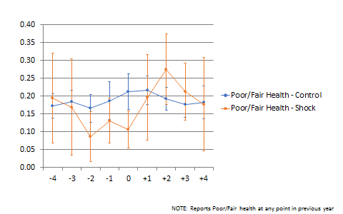
Proportion in Fair or Poor Health at Some Time in the Year*
Raw Data

Slide 23
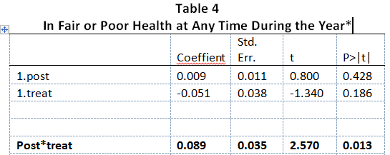
Proportion in Fair or Poor Health at Some Time in the Year*
Includes covariates shown in
“Characteristics of the Sample” slide

Slide 24
Closing Thoughts
The prior result could certainly not survive a multiple comparison correction, but it seems worth testing on other data
We looked at whether this effect operated through physical or mental health; null results
Cities in decline may be stressful to live in - think Case and Deaton - even though this sample all had or had had municipal jobs

Slide 25
Closing Thoughts, cont.
Future possibilities
Use financial statements rather than bond ratings as indicators of fiscal ills
Other data sets worth exploring include the insurance module of the MEPS, the CPS, the ACS, and the HRS

