Slide 1
Retirement Options and Outcomes for Public Employees
Leslie E. Papke
Department of Economics
Michigan State University
August 10, 2018

Slide 2
Overview
1. Identifying state/local public employees in the HRS
2. This analysis: background/related literature
3. Data & Econometric Method
4. Results & next steps

Slide 3
State and local public employees in the HRS
Total individual observations in a given wave (difference between stage and prior stage in parentheses)
Year (Wave) | Stage 1 | Stage 2 | Stage 3 | Stage 4/Final
1992 (1) | 1276 | 1320 (+44) | 1320 | 1320
1994 (2) | 983 | 1049 (+66) | 1049 | 1051 (+2)
1996 (3) | 766 | 852 (+86) | 852 | 853 (+1)
1998 (4) | 936 | 1088 (+152) | 1088 | 1089 (+1)
2000 (5) | 714 | 907 (+192) | 907 | 910 (+3)
2002 (6) | 533 | 805 (+272) | 805 | 807 (+2)
2004 (7) | 765 | 1254 (+489) | 1254 | 1263 (+9)
2006 (8) | 1114 | 1192 (+78) | 1195 (+3) | 1215 (+20)
2008 (9) | 963 | 1085 (+122) | 1120 (+35) | 1135 (+15)
2010 (10) | 1584 | 1584 | 1695 (+111) | 1701 (+6)
2012 (11) | 1346 | 1346 | 1422 (+76) | 1433 (+11)
2014 (12) | 1061 | 1061 | 1119 (+58) | 1119

Slide 4
State/local Public Employees
by total number of survey years in public employment

Slide 5
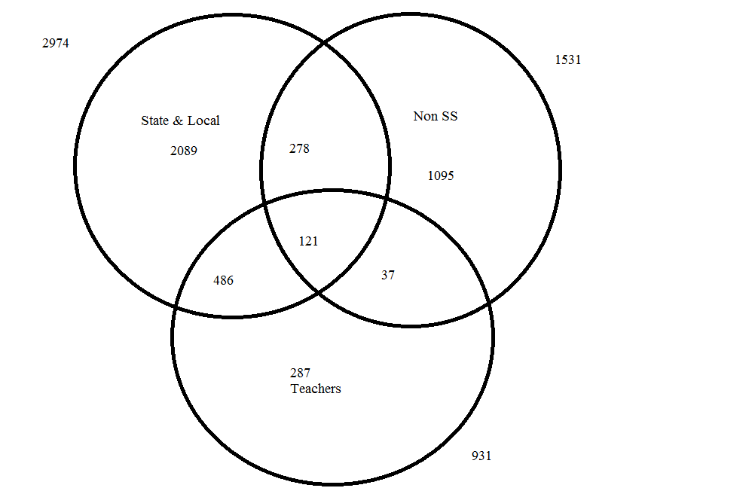

Slide 6
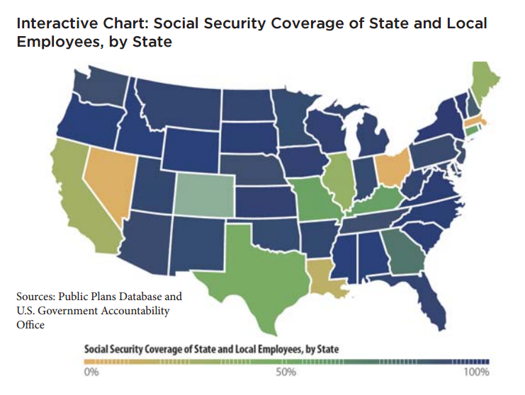
Social Security Coverage
State and local employees, by state
Social Security coverage among state and local government employees varies widely, from one percent of payroll (in Ohio) to 99 percent (in New York and Vermont). Other states with large portions of the public sector workforce who do not participate in Social Security include Colorado, Massachusetts, and Nevada.

Slide 7
2. This analysis
Explore sensitivity of retirement decisions to
State pension plan generosity
Early and normal retirement eligibility
Social Security coverage
12 waves of HRS respondents – RAND P version plus
Pension Estimation Program - ER/ NR eligibility & wealth
Industry/occupation codes – identify teachers
Geographic codes – state variation
Public Plans Database – plan financial health

Slide 8
Related work using HRS:
Coile and Gruber (2007)
Impact of Social Security and private pension incentives on male retirement. Create forward-looking measure of incentives to continued work: peak value
Shoven and Slavov (2014)
Impact of employer-provided HI on retirement decisions of public employees. Focus on period of pre-Medicare eligibility for two groups ages 55-59, 60-64. Uses multinomial logit to examine first exit to retirement or to part time work.

Slide 9
Data and Econometric Method
Health and Retirement Study
4 cohorts ages 51-61 at entry in 1992, 1998, 2004, 2010
14 waves from 1992 to 2014, every 2 years
Public employment status determined at entry
Self-reports of retirement with later wave confirmation
Restricted data
Pension Estimation Program (PEP)
Industry and occupation codes
Geographic codes
Public Plans Database
Included plans cover 95% of public employees
Coverage and financial health

Slide 10
Summary statistics
At entry into survey
 | Mean | Std. Dev. | Min | Max
Retired from st/local | 0.48 | 0.50 | 0 | 1
Left w/o retiring | 0.13 | 0.34 | 0 | 1
Age | 55.09 | 4.53 | 50 | 84
Female | 0.58 | 0.49 | 0 | 1
Married | 0.71 | 0.46 | 0 | 1
Tenure | 15.58 | 9.84 | 1 | 48.5
White | 0.71 | 0.45 | 0 | 1
Black | 0.23 | 0.42 | 0 | 1
Hispanic | 0.09 | 0.29 | 0 | 1
Fair/poor health | 0.13 | 0.33 | 0 | 1
Less than HS | 0.11 | 0.31 | 0 | 1
High School | 0.23 | 0.42 | 0 | 1
Some College | 0.21 | 0.41 | 0 | 1
College | 0.16 | 0.37 | 0 | 1
College + | 0.3 | 0.46 | 0 | 1
Teacher | 0.28 | 0.45 | 0 | 1
Earnings ($2012) | 49,356 | 39,309 | 0 | 506,098

Slide 11
Summary statistics
At retirement
PV_Vested/Def’d | 151,900 | 225,000 | 0 | 4,731,000
ER age | 57.93 | 4.31 | 51
NR age | 60.18 | 4.22 | 51 | 80
PV_ER ($2012) | 213,700 | 26,610 | 0 | 4,731,000
PV_NR ($2012) | 390,200 | 31,550 | 0 | 5,483,000
Employee cont. % | 3.36 | 4.53 | 0 | 25
Zero EE cont. % | 0.48 | 0.50 | 0 | 1
Offered ER | 0.10 | 0.30 | 0 | 1
Total Assets ($2012) | 340,500 | 609,800 | -119,300 | 13,330,000
SScov | 0.84 | 0.36 | 0 | 1
UAAL_GASB | 9,047,529 | 1,550,000 | -1,680,000 | 93,500,000

Slide 12
Econometric method
Proportional Hazards Model with time varying covariates:
pension wealth and eligibility for ER/NR options
Social Security coverage in public sector job
Employer-provided health insurance in retirement
Demographic characteristics
Jenkins (1995): shows this implies a binary response model for retirement at age t conditional on not having retired prior to age t.
Response probability has complementary log-log form

Slide 13
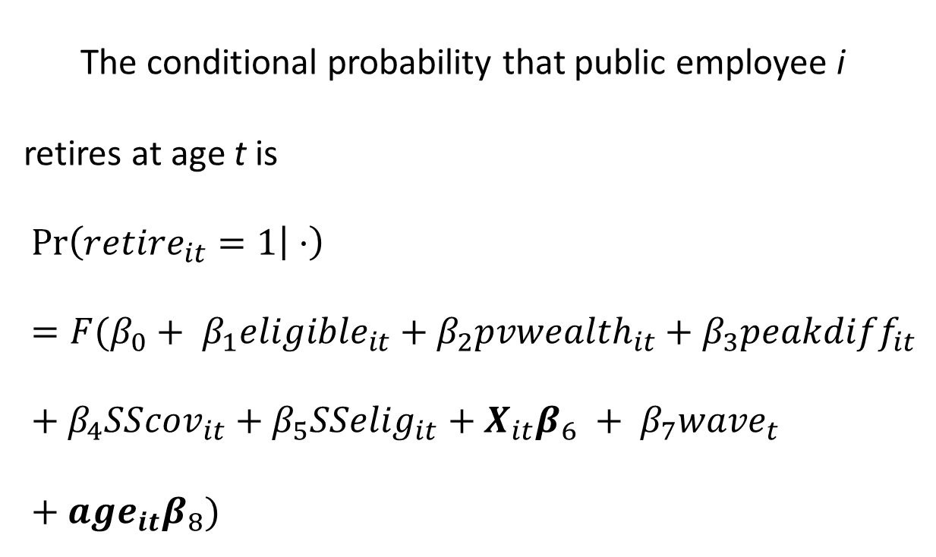
The conditional probability that public employee i retires at age t is
$$\operatorname{Pr}\left({retire}_{it}=1 | ·\right)=F(β_{0}+ β_{1}{eligible}_{it}+β_{2}{pvwealth}_{it}+β_{3}peakdiff_{it}+β_{4}{SScov}_{it}+β_{5}{SSelig}_{it}+X_{it}β_{6} + {β_{7}wave}_{t}+{age}_{it}β_{8})$$

Slide 14
Baseline hazard

Slide 15
Impact of retirement options
On probability of retiring from the public sector
 | (1) | (2) | (3) | (4) | (5)
Ret. Health Ins. | .034*** (.006) | .032*** (.007) | .020 (.015) | .022 (.015) | .021 (.019)
SS Cov |  | -.008 (.011) |  | -.020 (.028) | -.041 (.037)
Elig SS |  | .045** (.019) |  | .061* (.037) | .068* (.042)
Elig ER |  |  | .118*** (.041) | .113*** (.041) | .131*** (.051)
ER wealth |  |  | .002 (.002) | .002 (.002) | .003 (.002)
Elig NR |  |  | .095*** (.036) | .093** (.037) | .079* (.041)
NR wealth |  |  | .001 (.003) | .001 (.003) | .002 (.003)
Peakdiff |  |  | -.006** (.003) | -.006** (.003) | -.006* (.003)
DC balances |  |  | -.002 (.003) | -.003 (.003) | -.002 (.004)
Offered EO |  |  | .044* (.027) | .042 (.028) | .048 (.031)
UAAL |  |  |  |  | -.001** (.001)

Slide 16
Summary of major findings
Retiree health insurance increases retirement probability by .034
Eligibility for early retirement: .113 ↑
Eligibility for normal retirement: .093 ↑
Present value of pension wealth statistically insignificant; small positive effect of peak value
Eligibility to claim SS benefits: .061 ↑
Early out options offered: .04 ↑
Very small negative effect of plan UAAL

Slide 17
Going forward
Public employees retire at young ages
Appears that retirement option eligibility criteria shift hazard more than wealth but
Improve sample size for pension data
Improve Social Security measures
Use competing risks analysis to accommodate exit but not to retirement

