Slide 1
Do Discrete Choice Approaches to Valuing Urban Amenities Yield Different Results than Hedonic Models?
Paramita Sinha (RTI International), Martha Caulkins (UMD) and Maureen Cropper (UMD and RFF)
NBER March 9, 2018
Notes:
When economists wish to value amenities that vary across cities—such as climate amenities or air pollution—they use one of two approaches: They either estimate a discrete choice model of choice of residential location (as BKT do to value air pollution) or they using hedonic wage and property value functions, arguing that urban amenities are capitalized into wages and housing prices. (Albouy et al. the most recent example of this approach.)
What we do in this paper is to use the same dataset—data from the 2000 PUMS—to estimate the value of urban amenities using these two approaches. We find that they give very different results and offer possible explanations as to why they do.

Slide 2
Motivation for the Study
Previous studies note that discrete location choice models yield higher MWTP for urban amenities than the continuous hedonic approach
  Cragg and Kahn (1999) observed this in the context of climate amenities
  Discrete model of choice of state yields higher |MWTP| for July and February temperature than the marginal prices implied by hedonic price functions
Bayer, Keohane and Timmins (2009) find MWTP to reduce PM is higher using a discrete choice model
  MWTP for PM using a model of location choice across MSAs is 3 times larger than values capitalized into per capita incomes, housing prices
  They attribute this to failure of the hedonic approach to incorporate moving costs
Notes:
2

Slide 3
Objectives of This Study
Use 2000 PUMS to estimate MWTP for winter, summer temperature using discrete choice and hedonic approaches
  Random parameters model of location choice among 284 MSAs
  Hedonic approach combines wage and price indices from national wage, housing equations into Quality of Life (QOL) indices
  These used to estimate local linear regressions for winter, summer temperature, holding other amenities constant
How do results from both approaches compare:
  In terms of mean MWTP for winter, summer temperature
  In terms of MWTP conditional on location (Is MWTP for warmer winters higher in Fargo or Atlanta?)
Explain any differences in results
Notes:
Goal is to use the same dataset with the same set of amenities to apply to both approaches. Note that we will incorporate moving costs into the discrete choice approach and we will necessarily use the data in different ways. But, the idea is to make the comparison as even as possible. Note that we also want to explain why the results differ—and they do differ.
QOL approach follows Albouy et al. (2016) and Bieri, Kuminoff and Pope (2013). Local linear regression—in the spirit of Bajari and Benkard (2005) and Bajari and Kahn (2005) describe how marginal hedonic prices vary by city.
3

Slide 4
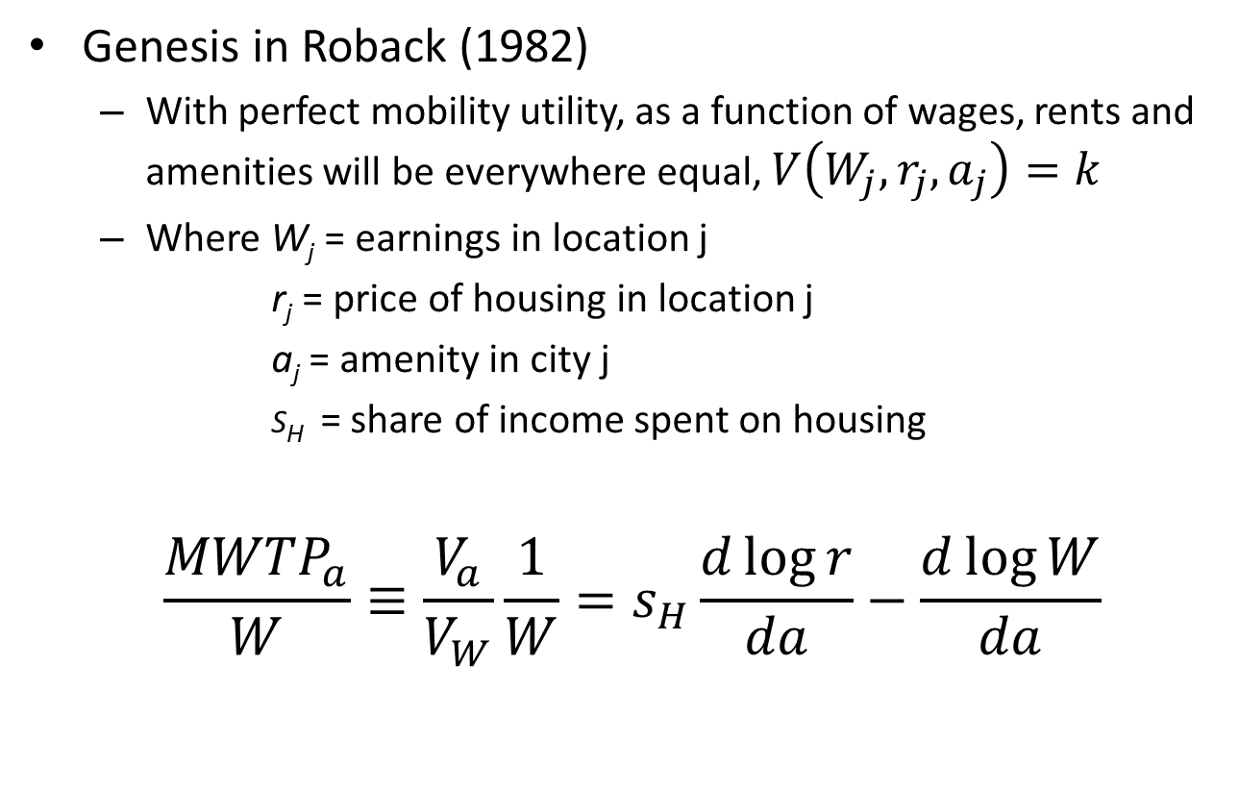
Hedonic Approach
Genesis in Roback (1982)
  With perfect mobility utility, as a function of wages, rents and amenities will be everywhere equal, $V\left(W_{j},r_{j},a_{j}\right)=k$
  Where W_{j} = earnings in location j
  r_{j} = price of housing in location j
  a_{j} = amenity in city j
  s_{H} = share of income spent on housing
$$\frac{{MWTP}_{a}}{W}≡\frac{V_{a}}{V_{W}}\frac{1}{W}=s_{H}\frac{d\log{r}}{da}−\frac{d\log{W}}{da}$$
Notes:
Note that we refer to the weights in this equation as the traditional or “Roback” weights
4

Slide 5
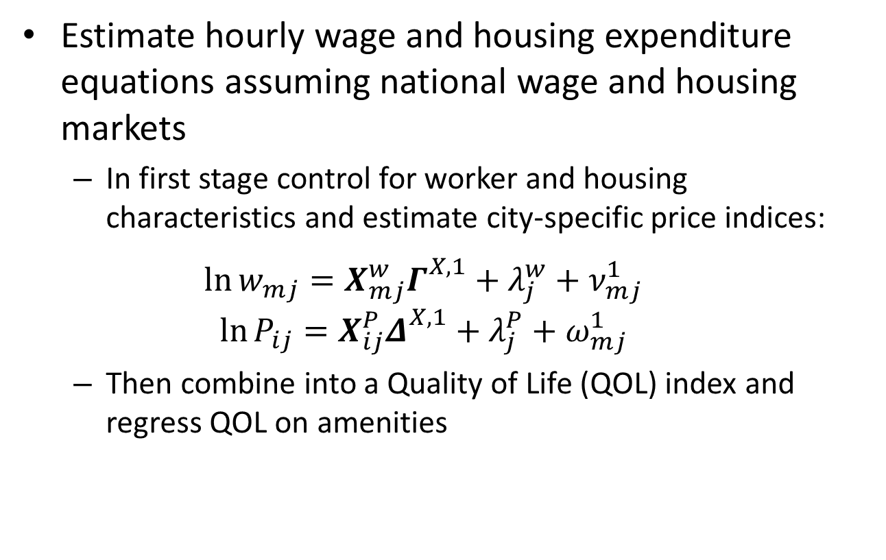

Hedonic Approach - II
Estimate hourly wage and housing expenditure equations assuming national wage and housing markets
  In first stage control for worker and housing characteristics and estimate city-specific price indices:
  $$\ln{w_{mj}}=X_{mj}^{w}Γ_{}^{X,1}+λ_{j}^{w}+ν_{mj}^{1}$$
  $$\ln{P_{ij}}=X_{ij}^{P}Δ_{}^{X,1}+λ_{j}^{P}+ω_{mj}^{1}$$
  Then combine into a Quality of Life (QOL) index and regress QOL on amenities
 | $${QOL}_{j}≡sHλ_{j}^{P}−λ_{j}^{w}=A_{j}θ+ξ_{j}$$ | (1)
Notes:
Note verbally that the literature traditionally estimated individual equations for wages (usually the hourly wage) and housing prices (as in Blomquist et al. ). But, the more recent literature estimates location-specific fixed effects and then combines them into a QOL index.
Define terms: w_{m} is hourly wage for worker m and P_{i} is monthly housing expenditure for household i
5

Slide 6
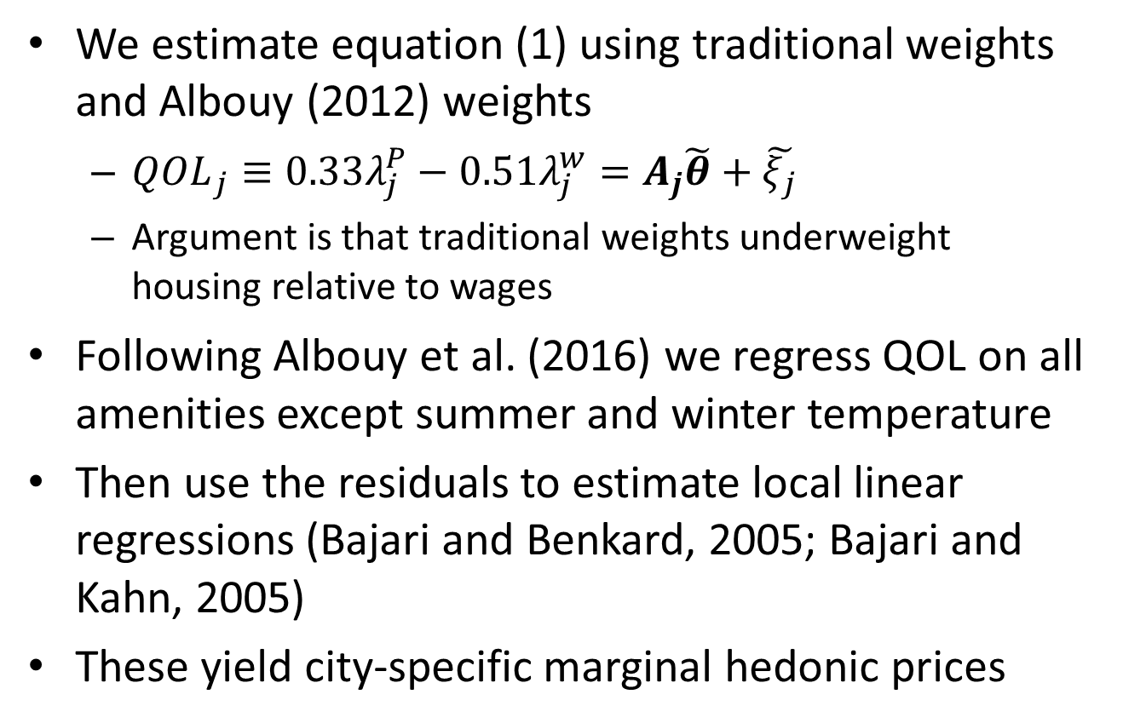
Hedonic Approach - III
We estimate equation (1) using traditional weights and Albouy (2012) weights
  ${QOL}_{j}≡0.33λ_{j}^{P}−0.51λ_{j}^{w}=A_{j}\tilde{θ}+\tilde{ξ_{j}}$
  Argument is that traditional weights underweight housing relative to wages
Following Albouy et al. (2016) we regress QOL on all amenities except summer and winter temperature
Then use the residuals to estimate local linear regressions (Bajari and Benkard, 2005; Bajari and Kahn, 2005)
These yield city-specific marginal hedonic prices
Notes:
6

Slide 7
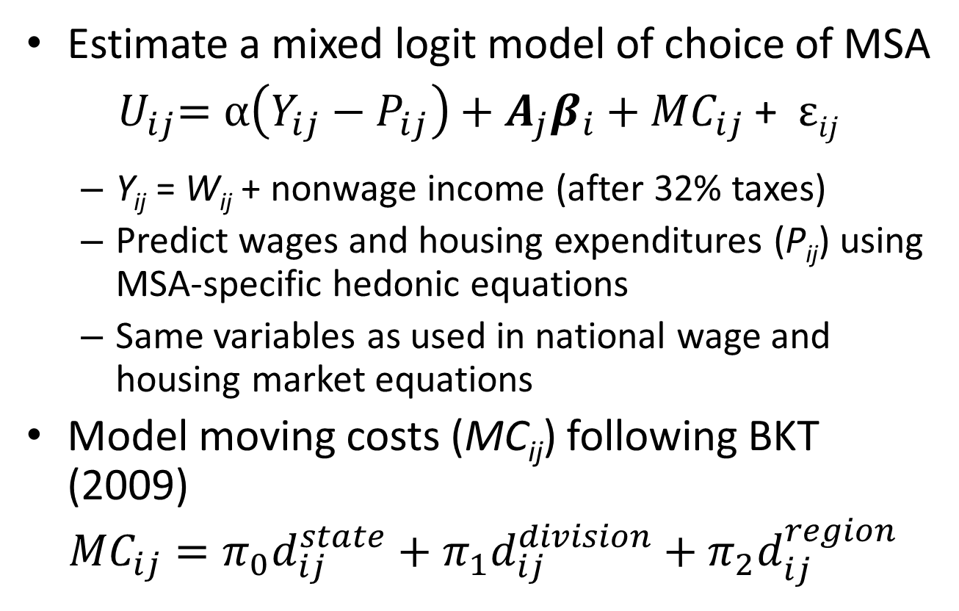
Discrete Choice Approach
Estimate a mixed logit model of choice of MSA
${ U}_{ij}=α\left(Y_{ij}−P_{ij}\right)+A_{j}β_{i}+{MC}_{ij}$ + ε$ij$
  Y_{ij} = W_{ij} + nonwage income (after 32% taxes)
  Predict wages and housing expenditures (P_{ij}) using MSA-specific hedonic equations
  Same variables as used in national wage and housing market equations
Model moving costs (MC_{ij}) following BKT (2009)
$${MC}_{ij}=π_{0}d_{ij}^{state}+π_{1}d_{ij}^{division}+π_{2}d_{ij}^{region}$$
Notes:
7

Slide 8
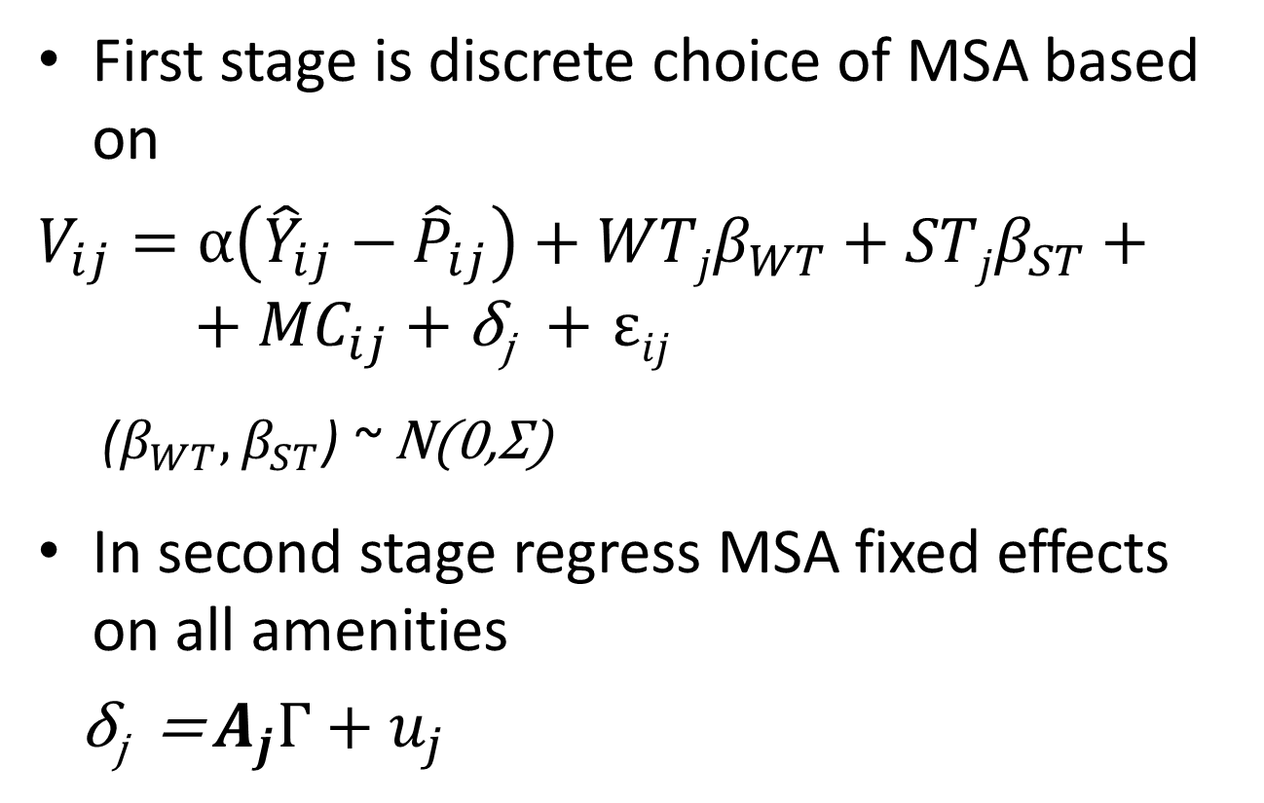
Estimate Model in Two Stages
First stage is discrete choice of MSA based on
$V_{ij}=α\left({\hat{Y}}_{ij}−{\hat{P}}_{ij}\right)+WTjβ_{WT}+{STjβ}_{ST}+ + {MC}_{ij}$ + δ_{j} + ε$ij$
  ($β_{WT}{,β}_{ST}$) ~ N(0,Σ)
In second stage regress MSA fixed effects on all amenities
δ_{j} = $A_{j}Γ+u_{j}$
Notes:
8

Slide 9
Model Estimation
First stage is a mixed logit model estimated using 60 out of 284 MSAs in the choice set
  Although McFadden sampling procedure does not hold for mixed logit model, we face a trade-off between sample size and size of choice set
  Results stabilize at when 60 MSAs randomly sampled
Joint distribution of WT, ST coefficients calculated for each sample household, conditional on location
  Conditional mean of WT, ST coefficients averaged over households living in each MSA and divided by α
  Measures mean MWTP in neighborhood of current temperature
Plot these v. temperature to examine taste sorting
Notes:
Cite vonHaefen and Domanski (2013) paper re: size of choice set.
9

Slide 10
Household Data
Hedonic wage and housing cost regressions
  Estimated using workers and households in 284 MSAs in the 2000 Census PUMS
  Same data used to estimate…
    national hedonic regressions (for hedonic analysis)
    MSA-specific hedonic equations for predicting wages and housing expenditures in the discrete choice model
For discrete choice models use 2.5% sample of PUMS households
  Head must be born in USA; over age 16
  Heads in military, agriculture, forestry, fishing excluded
  Model also estimated separately for households with heads 25-55; heads > 55
  Focus on prime-aged headed households to compare with hedonic model
Notes:
Note that we are using the data differently in the discrete choice model: We estimate separate wage and housing price indices for each MSA, whereas the hedonic approach assumes national labor and housing markets. I’ll come back to this at the end of the presentation.

Slide 11
Household Summary Statistics
 | Prime-Aged |  |  | Greater than 55
 | (N: 33,180) |  |  | (N: 17,643)
Variable | Mean | Std. Dev. |  | Mean | Std. Dev.
Age of hh head | 40.76 | 8.18 |  | 69.61 | 9.43
Total hh income | $69,188 | $59,658 |  | $56,827 | $57,624
Percentage of hh income from wages | 92.73 |  |  | 45.55
Percentage of hhs with zero wage income | 2.18 |  |  | 47.20
Percentage of hh heads who have left:
State of birth | 40.95 |  |  | 47.32
Census division of birth | 31.12 |  |  | 36.68
Census region of birth | 24.86 |  |  | 30.40
Notes:
Take away message: prime-aged households differ significantly from the rest of the population; they are most appropriate for comparison with the continuous hedonic model given their reliance on wage income.

Slide 12
Amenity Variables in the Models
Climate Variables
Winter Temperature
Summer Temperature
Annual Snowfall
Summer Precipitation
July Humidity
Annual Sunshine
Non-Climate Variables
Population Density
PM2.5 Concentration
Elevation
Distance to Coast
Visibility
Violent Crime Rate
Park Area
Transportation Score
Education Score
Arts Score
Healthcare Score
Recreation Score

Slide 13
Discrete Choice Estimation Results
 | Model M.2 |  |  | Model M.4
 | Base Model |  |  | Omit Moving Costs
PANEL A: 1st Stage Ests.
Variable | Coef. | SE |  | Coef. | SE
Std. Dev: Avg Winter Temperature | 0.0592 | 0.0026 |  | 0.0011 | 0.0128
Std. Dev: Avg Summer Temperature | 0.0612 | 0.0066 |  | 0.0352 | 0.0215
Correlation Coefficient | -0.6993 | 0.0776 |  | -0.9433 | 0.1297
PANEL B: 2nd Stage Ests.
Variable | Coef. | SE | MWTP | Coef. | SE | MWTP
Mean: Avg Winter Temperature | 0.0210 | 0.0057 | $382 | 0.0171 | 0.0055 | $326
Mean: Avg Summer Temperature | -0.0286 | 0.0098 | -$522 | -0.0178 | 0.0110 | -$339
Notes:
A logical question is whether this is due to incorporating moving costs in the discrete choice model: What happens when we omit them?
The answer is that mean |MWTP| changes, but not enough to bring the estimates in line with the hedonic estimates. And, the sorting pattern is very different when moving costs are omitted: There is no significant taste dispersion—especially for WT.

Slide 14
MWTP for Winter Temperature by Metropolitan Area
(Base Discrete Choice Model – Model M.1)
Notes:
People in the West North Central division actually like cold weather, while people in the South Atlantic division are WTP the most for warmer winters. People in the Pacific division also have high MWTP for milder winters.

Slide 15
MWTP for Summer Temperature by Metropolitan Area
(Base Discrete Choice Model – Model M.1)
Notes:
Because of the negative correlation between the coefficients on WT and ST in the discrete choice model, people who prefer milder winters also prefer milder/cooler summers.

Slide 16
Discrete Choice Model : Impact of Moving Costs
Notes:
Note the importance of moving costs in identifying sorting patterns.

Slide 17
MWTP for Temperature, Hedonic Models
Bandwidth | Winter Temperature |  | Summer Temperature
 | Traditional | Albouy | Traditional | Albouy
0.5 | $95 ($58) | $76 ($58) | -$231 ($181) | -$245 ($233)
0.7 | $77 ($39) | $63 ($29) | -$186 ($109) | -$194 ($122)
0.9 | $68 ($27) | $57 ($17) | -$148 ($81) | -$169 ($69)
Note: Table shows mean MWTP based on local linear regressions, weighted by population.
Numbers in parentheses are standard deviations in MWTP across cities.

Slide 18
MWTP for Winter Temperature by Metropolitan Area
(Local Linear Hedonic Model, Traditional Weights, Bandwidth = 0.7)
Notes:
The sorting pattern is essentially the opposite in the hedonic model when traditional weights are used.

Slide 19
MWTP for Winter Temperature by Metropolitan Area
(Local Linear Hedonic Model, Adjusted Weights, Bandwidth = 0.7)
Notes:
And is somewhere between the two when the Albouy weights are used.

Slide 20
MWTP for Summer Temperature by Metropolitan Area
(Local Linear Hedonic Model, Traditional Weights, Bandwidth = 0.7)
Notes:
Once again, the sorting pattern is very different using the hedonic approach. (Here with traditional weights.)

Slide 21
MWTP for Summer Temperature by Metropolitan Area
(Local Linear Hedonic Model, Adjusted Weights, Bandwidth = 0.7)
Notes:
And is also different with Albouy weights.

Slide 22
Summary of Results
Mean MWTP for temperature differs by approach
  |Mean MWTP| for winter and summer temperature higher with discrete choice than hedonic approach
  4 times higher for WT; twice as high for ST
  This result cannot be explained by removing moving costs from the discrete choice model
MWTP conditional on location also differs
  Discrete choice model suggests MWTP for winter temperature increases with temperature
  Traditional hedonic model suggests the opposite
  Results using adjusted hedonic weights are U-shaped
  Sorting patterns also differ for summer temperature

Slide 23
Why Do the Approaches Yield Different Results?
Moving costs make some difference to MWTP for climate amenities in the discrete choice model
  But MWTP for warmer winter still 2-3 times larger using discrete choice than hedonic approach
  And, sorting patterns are very different when moving costs are removed
Hedonic and discrete choice approaches use data very differently
  Hedonic approach assumes national labor and housing markets; discrete choice approach assumes MSA-specific markets
  Discrete choice approach is a quantity-based approach—estimates the probability that a location is chosen; sum of probabilities is market share
  Hedonic approach is price-based

Slide 24
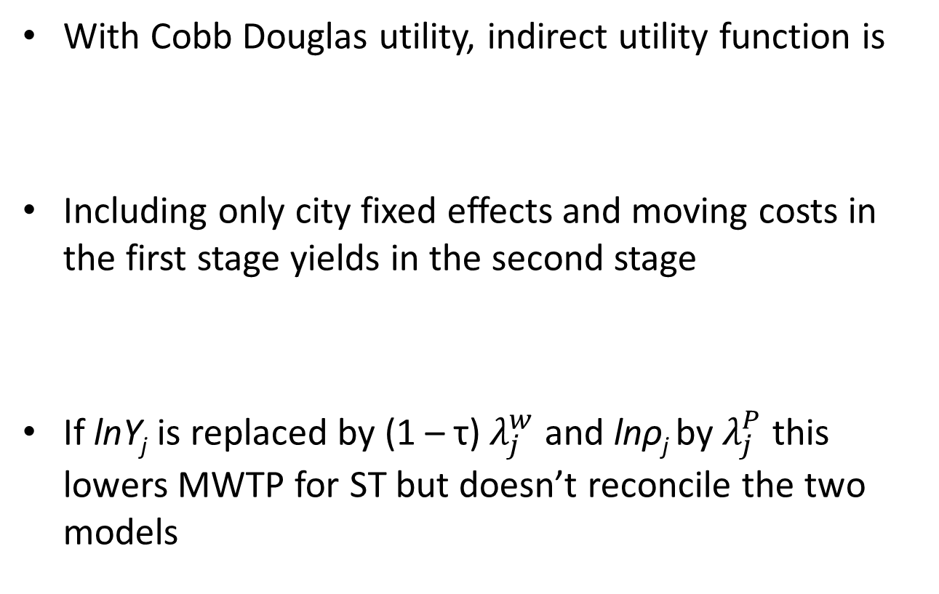

Discrete Choice with National Labor and Housing Markets
With Cobb Douglas utility, indirect utility function is
Including only city fixed effects and moving costs in the first stage yields in the second stage
If lnY_{j} is replaced by (1 – τ)$λ_{j}^{w}$ and lnρ_{j} by $λ_{j}^{P}$ this lowers MWTP for ST but doesn’t reconcile the two models
 | $lnV_{ij}$ $=α_{0}+{MC}_{ij}+α_{Y}lnY_{ij}−α_{H}lnρ_{j}+A_{j}β_{i}+ ξ_{j}+ ε_{ij}$
 | $$δ_{j}= α_{Y}lnY_{j}−α_{H}lnρ_{j} {{+ A}_{j}β}_{}+ξ_{j}$$
Notes:
24

Slide 25
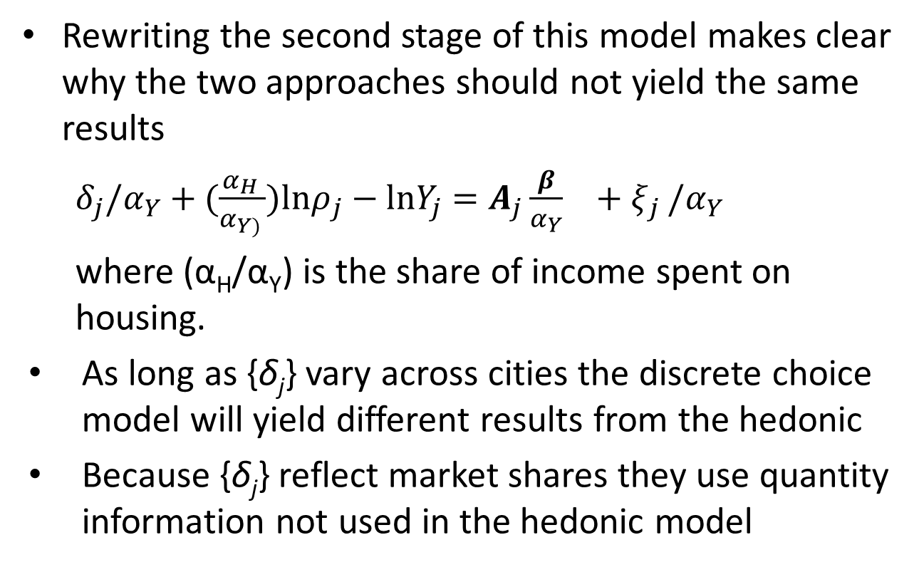
Prices v. Quantities
Rewriting the second stage of this model makes clear why the two approaches should not yield the same results
  $δ_{j}/α_{Y}+(\frac{α_{H }}{α_{Y) }})lnρ_{j}−lnY_{j}=A_{j}{\frac{β}{α_{Y}}}_{}+ξ_{j }/α_{Y}$
  where (α_{H}/α_{Y}) is the share of income spent on housing.
As long as {δ_{j}} vary across cities the discrete choice model will yield different results from the hedonic
Because {δ_{j}} reflect market shares they use quantity information not used in the hedonic model
Notes:
25

