Slide 1
Meaningful information for domestic economies in the light of globalisation
CRIW – March 2018
Silke Stapel Weber
John Verrinder
(Eurostat)

Slide 2
Globalisation challenges
Attributing global production chains to individual countries
Chasing the idea of "domestic production"
Asymmetry of information between global MNEs and national statistical authorities
Sharing of information
Factors driving MNE restructuring
Business drivers; accounting transparency (BEPS); tax reforms (Europe, US); BREXIT…

Slide 3
EU Statistical infrastructure
Balancing at "international level"
Large Cases Units (LCUs)
Cooperation of macroeconomic and business statisticians
Euro Groups Register
Linked to national business registers
European profiling
Feedback to business registers and accounts
Early Warning System
How to quickly identify MNE restructuring?

Slide 4
Alternative (existing) indicators
Within the national accounts system
Gross National Income
Gross/net national disposable income
Household disposable income
Actual (Household/NPISH) Individual Consumption
Headline measure (per capita) in PPP terms
Further explanations for Luxembourg and Ireland

Slide 5
Alternative indicators
Taxation revenues
Reconciling taxation data with income and production data
Growth rates
Debate over deflator for income
Deflator for Actual Individual Consumption
International income growth measure
National level indicators
Recommendations in Ireland – non-financial enterprises by ownership, GNI*, BOP measures

Slide 6
Experimental data
Combine national accounts and Foreign Affiliated Trade Statistics (FATS) data
Two dimensions:
Foreign controlled affiliates inside the EU
EU enterprises having affiliates outside the EU
Value added and employment created by affiliates of foreign controlled enterprises

Slide 7
Share of total economy value added created by affiliates of foreign controlled enterprises, by region of foreign control, 2014

Slide 8
Share of total economy value added created by affiliates of EU28 controlled enterprises, by country of foreign control, 2014

Slide 9
Share of total economy value added created by affiliates of extra-EU28 controlled enterprises, by country of foreign control, 2014

Slide 10
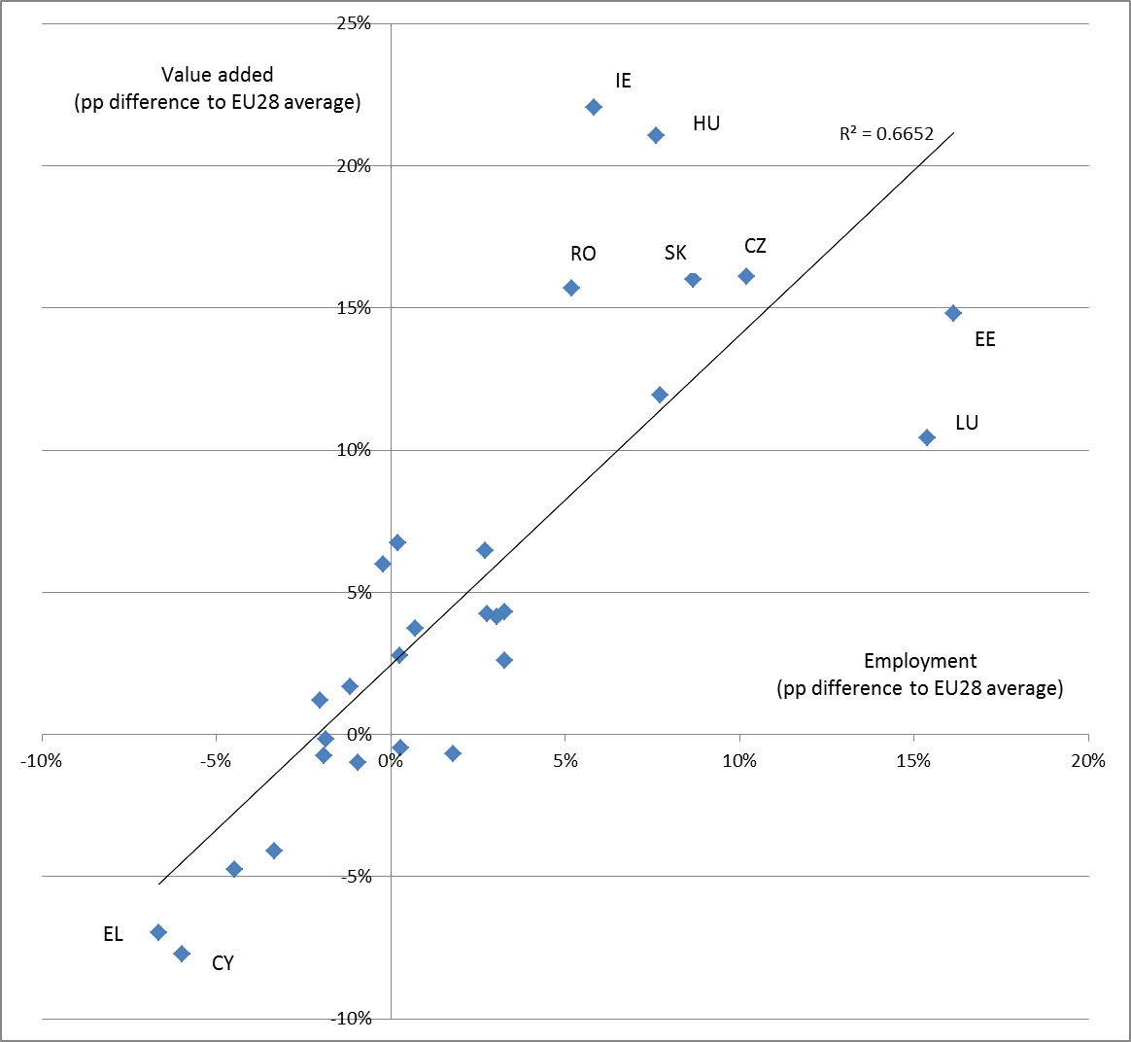
Foreign controlled value added shares versus foreign controlled employment shares, 2014

Slide 11
A new initiative…
Importance of GNI data for the EU budget
New EU pilot project has started in 2018 to assess the treatment of a small number of (profiled) MNEs in the national accounts of the countries concerned (value added)
Based on existing work on business statistics, coordination with BOP experts
Work over 2018/19, lead up to benchmark revisions in most EU countries

