Slide 1
Internet Geography and Economic Outcomes

Slide 2
How should a young researcher think about studying the economic geography of the Internet?
The literature (roughly) divides into two areas (see references…)
  The impact of the deployment and diffusion of the Internet. As digital diffuses across space, how does it shape economic and business behavior? The research uses the variety of experiences across geography to define a unit of observation. Geographic variance also can provide an important element in a plausible natural experiment.
  The deployment and competitive conditions that shape the supply of Internet infrastructure. How does competition to supply digital services vary across geographic space? The research uses the variety of experiences across geography to define the unit of observation, treating distinct local areas as independent observations.
The references include both. Both are interesting and important. Today’s talk most focuses on the first, merely due to lack of time.

Slide 3

Many digitization studies share a philosophical outlook.
This is an era of economic upheaval & experimentation.
  Many new business models, new applications. Unexpected effects.
  Might (not) be good for the country, but it IS good for research.
Imaginative data collection yields rewards.
  Scraping what you need from online sources. Learn to scrape.
  Buying necessary data from trade associations. Know who acts.
  Getting permission to use proprietary data from firms. If you can.
  Combining with public sources, such as Census or BLS. Read widely.
Quirky details can matter for the statistician.
  Know what happened and why. Look for unspotted opportunity. Look for natural experiments, and for underexploited diff in diffs.

Slide 4
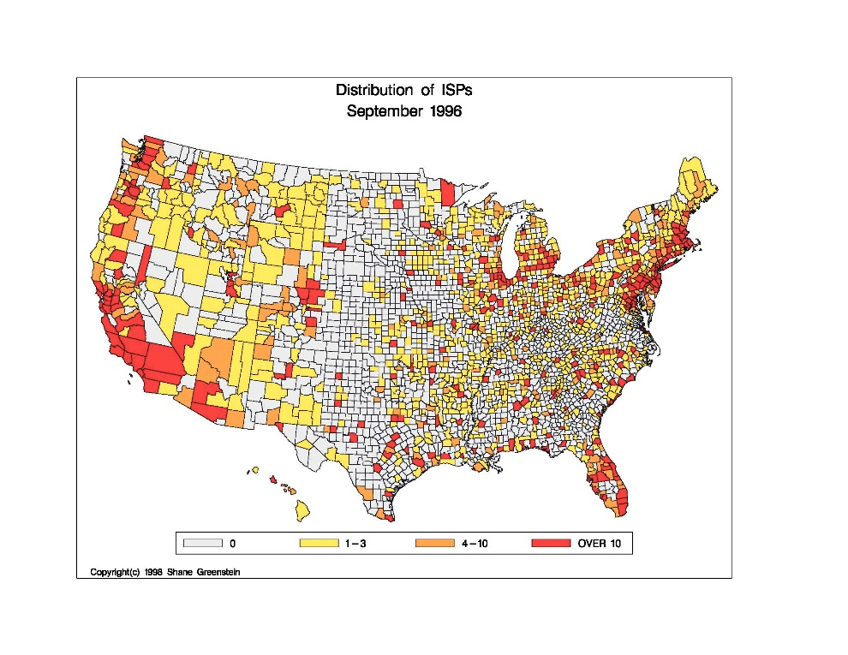
Illustrate with (autobiographical) story of two maps. Old example. Easy to understand.
New and early. Started in 1995.
  New industry. Looked interesting.
City/county. How stuff works.
  Area codes and prefixes are attached to switches, which have locations.
Who cares? An obvious audience.
  Few policy lawyers in DC travel west of Appalachians. Have no idea what is happening around the country.
Mapping software for statistics.
  County maps rarely used. Right way to summarize ten thousand words. (Red/orange/yellow good colors too.)
It made for a good seminar.
  Appealed to old & durable policy concerns about universal service.

Slide 5
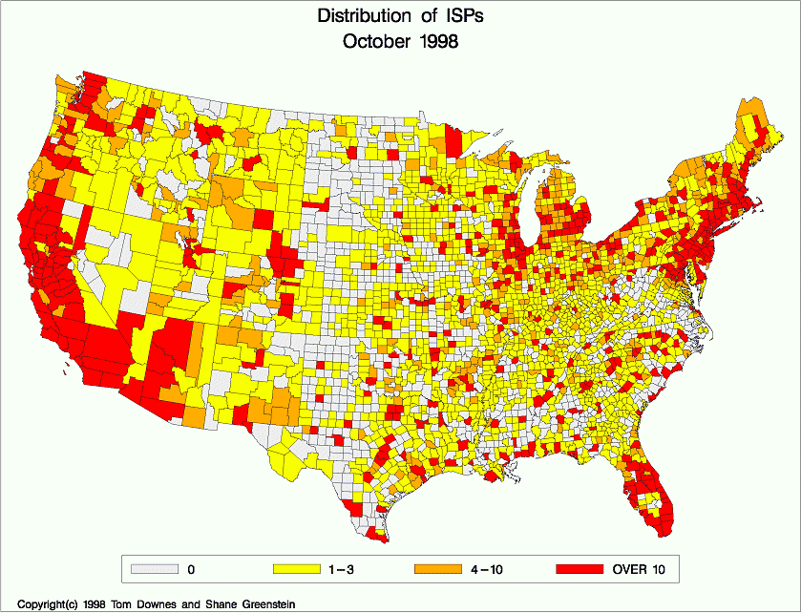
What happened? Sometimes it is better to be lucky than good.
New and early. Owned the topic.
  Endogenous variable was interesting.
City/county. How stuff works.
  It was clever. If nothing else, my senior colleagues were entertained.
Who cares? Everyone cared.
  Spoke to interests of multiple audiences. Policy makers understood the economics. Economists understood current events.
Mapping software for statistics.
  One picture helped communicate an important part of the story. Statistical analysis filled in the rest.
To our astonishment, ISPs grew quickly.
  And we got a lot of attention. (It helped me get a job in the same city as my wife.)

Slide 6

What is the takeaway from that story? Some (loose) lessons to pass on…
Don’t ever set out to write a diffusion or adoption study unless you are pretty sure it will keep growing.
Know how stuff works. Look for plausibly exogenous geographic variation and natural experiments, but don’t expect to really find anything perfect.
Ask a research question where at least one person cares about the answer. Even better if more than one (non-academic) audience cares.
Find an endogenous variable that is interesting by itself, because even if the exogenous variables do not explain much of it, you will get credit for a novel endogenous variable.
Use the best software you can find to summarize a story in a picture.
Use the best econometrics you can, and go forward with courage.
Motivate the research question, and work hard to summarize the main question and findings. Your audience might not “get it” at first.
Explain it to your (older) colleagues the same way you would explain it to your father and mother, because, well, that is how old they are.

Slide 7

That is a long introduction to the four themes for the first part of this presentation…
Know how stuff works.
Expect things to change.
Exploit plausibly exogenous geographic variance.
Construct plausible natural experiments.

Slide 8
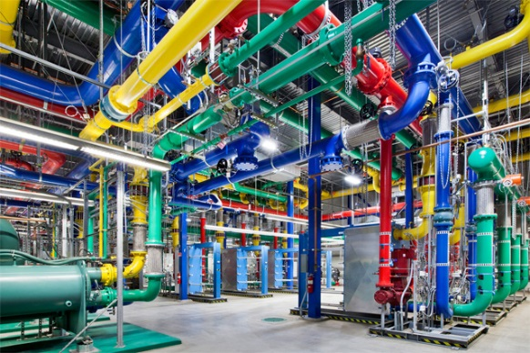
Know how stuff works. The Internet is not a series of tubes.
But what is the “Internet?”
  It is a voluntary set of agreements to abide by a set of “suggested” software protocols for internetworking. As approved by the Internet Engineering Task Force, whose activities are funded by the Internet Society, a non-profit.
  No government mandate. No international treaty to compel use/settlement.
In popular language, the Internet is a standard and ubiquitous bundle of components that producers assemble together to deliver services.
  TCP/IP, WWW (e.g., HTML, URL, etc), web servers & browsers, searchable pages, software languages and extensions (e.g., Java), portfolio of minimally necessary software apps (e.g., email, text reader, pdf reader), and platforms (e.g., Facebook, Google Search, AWS, and so on.)
Some details will be useful for your work, but you never know which details. Provides exogenous variation, ideas for instruments, etc. Spend time reading Wikipedia entry, talk to industry participants. Keep notes in your journals.
  Example: Greenstein/Nagle counted Apache servers by pinging port 80. IP addresses have locations, countries, and firms identifiers. How much is there?

Slide 9


Expect it to change. Consider two snap shots of the US. Expect it to change as much in next 15 yrs.
Dial-up era, c 2001.
  A few national backbones.
  Ubiquitous dial-up connections available. Half households online.
  Web traffic dominates network traffic.
  Electronic commerce offered by every major retailer and more.
  Electronic media offered by every news source/entertainer. Free for all. Yahoo dominated.
  Internet architecture almost unchanged from mid 1990s.
  Dot-com boom just ended.
Broadband era, c 2016
  Ubiquitous CDNs deliver 90% of traffic
  Broadband connections available in urban areas. 75% of households. Wired/wireless.
    Many connect with smart phone only.
  Video traffic dominates network traffic.
    Netflix 1/3 of traffic. Youtube is 10%.
  Electronic commerce offered by everyone, but dominated by Amazon.
  Electronic media by many. Search dominated by Google. Newsfeeds dominated by Facebook.
  Growing overlay of cloud, data centers, gaming centers, data exchange, int’l lines, and more.
  Startup boom for smartphone apps still ongoing.
The next fifteen years will give you many opportunities! Look for them!

Slide 10

Exploit plausibly exogenous geographic variance. Learn to recognize it…(See the reading list…)
Variance in deployment of new capability upends local markets.
  Craigslist changed local newspaper second-hand ticket markets
  As dial-up Internet deployed, it changed airline capacity allocation
  As businesses invested in the Internet, local labor markets changed
  As science-based businesses wired up, their labs collaborated more
  As the Internet first diffused, second-tier universities collaborated more
  That is only the beginning. Many researchable topics….
This all happened recently. Good data available. You have some hope of constructing panel data about important economic outcomes.
  Endogeneity always a concern. Deployment/adoption a function of same things that generate effects? Technique helps: Matching estimators. Propensity scores. Correction for selection. And more!
  Instruments a challenge: what causes early/late adoption, but is independent of outcome? Go forward with courage! Many examples to learn from.

Slide 11

Construct plausible exogenous natural experiments… Again, see the reading list….
Potentially sets up treatment/control or a diff-in-diff.
  Craig’s deployment across space possessed no underlying logic. Exogenous?
  Territories for broadband firms – DSL and cable modems – fixed, and the competition between them results from accident of matches.
  State boundaries and sales taxes are fixed.
    Boundary cities are very useful – e.g., KC in Mo & KS.
    Many matching “sister cities” in mid range sizes, based on propensity scores.
  Municipalities & state governments change different political parties.
    It has nothing to do with tech or broadband.
  Types of producers and industrial users not evenly distributed across space.
  Commercial internet “started” in 1995, so investment begins at zero, so some places experience a big boom in investment and others do not.
The history goes back even prior to 1995, and sometimes is helpful.
  Some papers used original architecture of the Internet as an instrument.

Slide 12

Let’s examine two papers…
Both look at the consequences of diffusion/adoption for economic activity….

Slide 13


Seamans and Zhu

Slide 14

What is the research question?
How did the spread of Craigslist affect the pricing of newspapers, and the prices of classified ads?
  Using the spread of Craigslist as random and exogenous, so it can compare “treated” and “untreated” newspapers.
How many of you have ever used Craigslist?

Slide 15
Why is that interesting?
Not much understanding about adjustment in a multi-sided market good.
  Only a few empirical studies up until this one.
Dramatic events. Billions at stake.
Essential for understanding restructuring of local newspaper markets. Helps clarify what happened and why.
  News papers were losing readers to new content, and losing ads to Craigslist and other sources.
Template for a useful empirical exercise.
What else interested you?

Slide 16
Background
Before any of these started, the researchers had a pretty good inclination that Craig was crazy. Many newspaper people hated him.
  “Public service mission.” Passed up billions of dollars. Why is this useful?
  What may not be good for newspapers can still be good for the econometrician. This is a gift to researchers.
  Many local markets. Mostly similar listings everywhere. Gradual growth.
  Good possibility that the first stage (diffusion over space) and second stage (consequences for local markets) were not closely linked.
Many academics did not appreciate what was happening. But if you were paying attention….
  The young showed the old guard. (What you take for granted may seem novel to many readers.)
  Explain it to your older colleagues the same way you would explain it to your father and mother…

Slide 17
Data
Usual data about newspaper. What do they know?
  Circulation and differentiation
  Classified & display ad rates
  Whether there is an online editor/manager
  Differentiation (different sections).
Internet Archive helpful (Take note).
They present simple descriptive stats in T2 for entered and non-entered. Why? How does that motivate the analsysis of the paper?
  Follow with simple diff-in-diff (w/o controls) in T3. Why is that the natural next step after seeing the descriptive statistics?

Slide 18
Results
What is the message of Table 3 for classified ads?
  Why do they not show all the coefficients?
  Newspapers w/big classified sections?
    Classified ad, price, circulation, differentiate, display ad.
  In column 1 is -0.23 large? How do you know?
What is the message of Table 4?
  Delay in the effects. Two or more years.
Why table 5? What does the entry equation tell you?
Why Table 6? Why do a falsification test, based on “eventual entry?”
Why that calculation of $5B on p. 490? It is not precise. Why did the editors allow for it (and ask for it)?

Slide 19
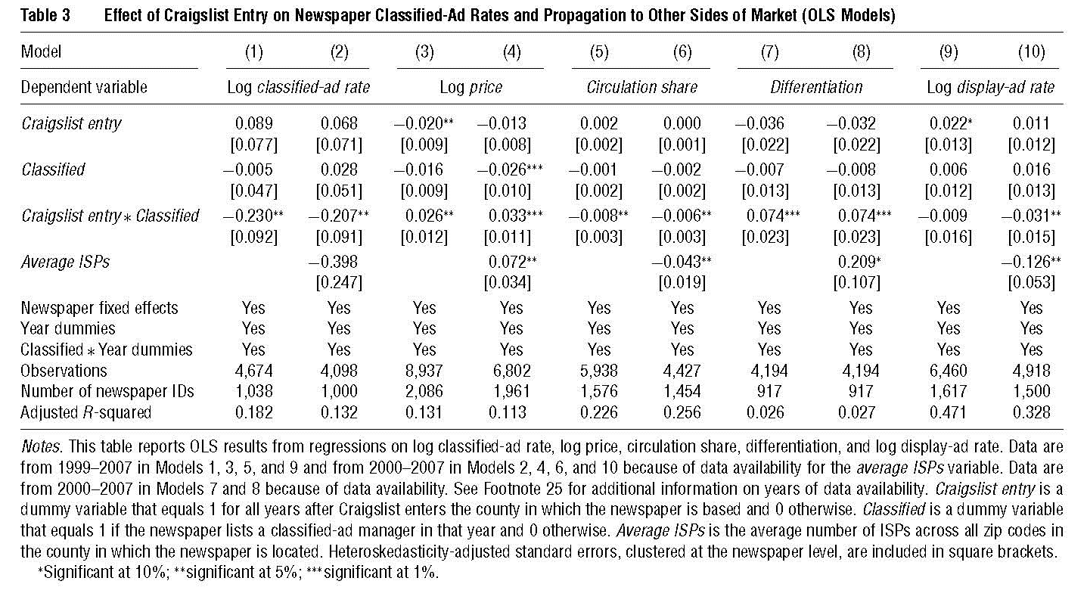

Slide 20
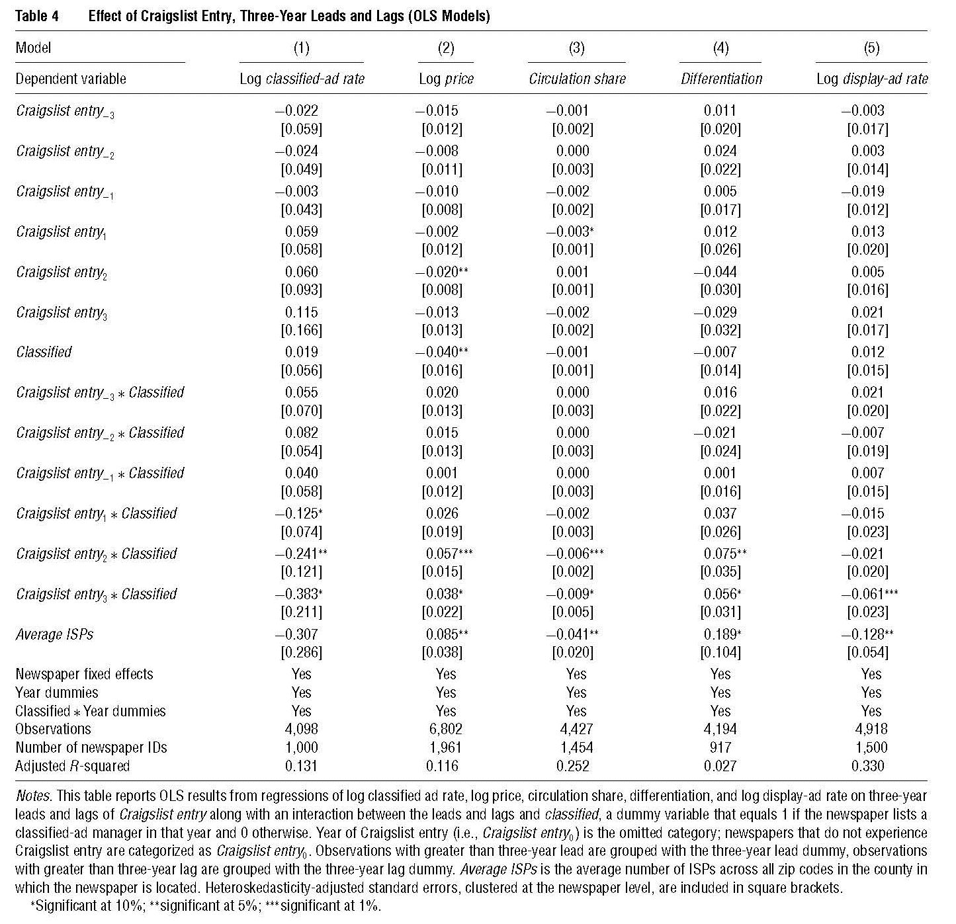

Slide 21
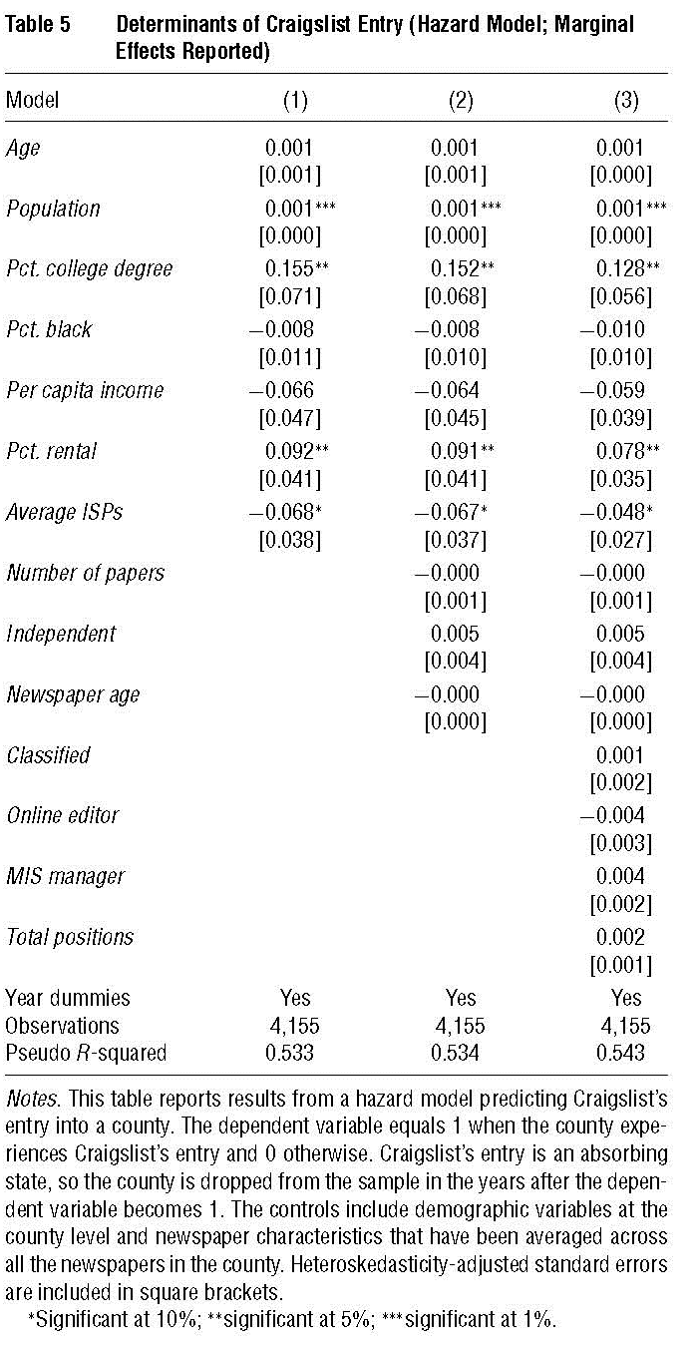
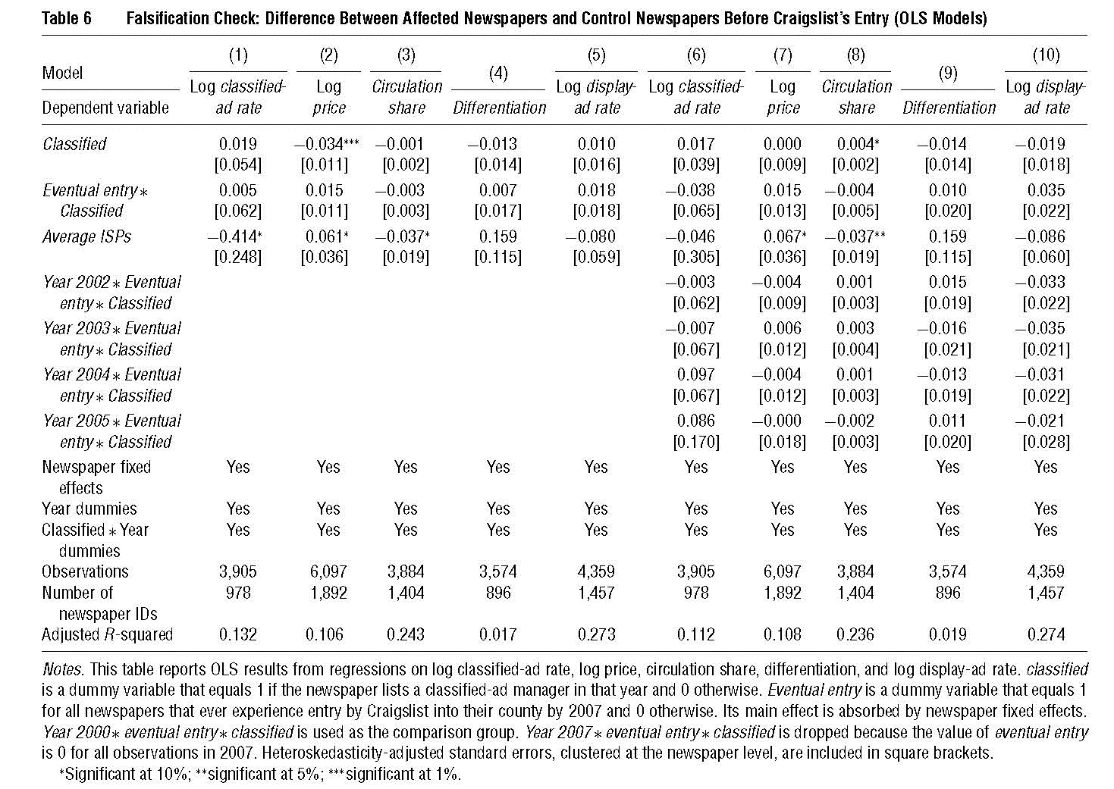

Slide 22
The headlines
After entry, price of classified ads declines at newspapers, subscription prices increases, circulation declines, and newspapers become more differentiated.
  Classified rates decline before display ads
Gains to advertisers from the spread of Craigslist amounted to $5B between 2000 and 2007. A big number!!!
Strong evidence – from a battery of tests – for a causal link between Craigslist and these changes in newspaper markets.
What else struck you?

Slide 23
Where should the literature go from here?
More in Craigslist’s spread?
  Yes, affects many different markets. Tickets sales, help wanted ads, real estate vacancy rates, content in newspapers, and STDs. What else?
Spread of other things w/geographic features?
  The tricky problem: some things spread everywhere almost at once. Then you get a diff, but what is the second diff? Heterogeneity in pre-existing features of areas.
What else will the Internet Archive help with?
Great template. Look for other events that took a while to spread and now we have luxury of looking back on them to see the havoc they wrought.
  Many facets of electronic commerce.

Slide 24



Forman, Goldfarb and Greenstein

Slide 25
What is the question?
Did the diffusion of the internet contribute to a change in the distribution of wages across locations in the US?

Slide 26
Why do we care?
Why care? Explain change in wage distribution? Worth any effort.
  Considerable IT literature suggests biased technical change, but 1990s optimism – death of distance – suggests opposite.
    Nobody had examined Internet as key driver. Remember: your parents are NOT digitally literate..
  IT boom of late 90s worth hundreds of billions in GDP.
  Add to the (surprisingly thin) literature on how the Internet’s diffusion changed the economy…
Aside: A mutual friend of ours used to tell us about the “big issues: Inequality, growth, market power, unemployment, inflation, business cycles, etc.”

Slide 27
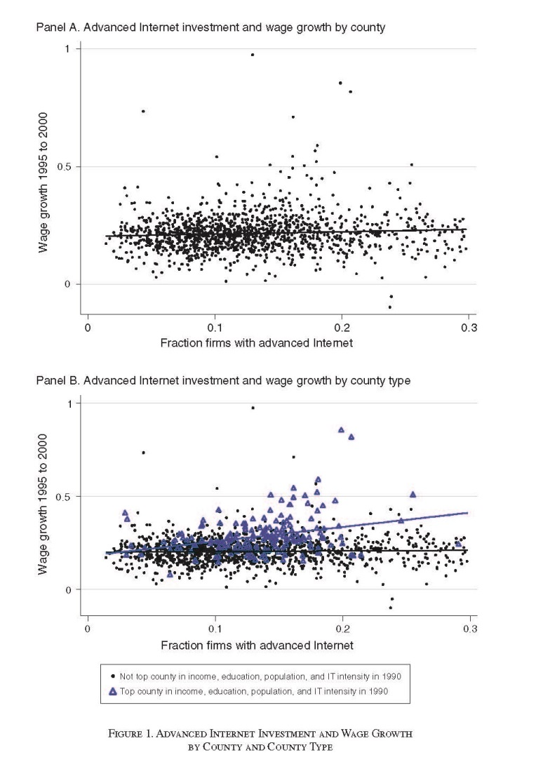
What are the key findings?
Statistical facts establish a puzzle. Internet everywhere, but payoff is not.
  Big kick associated with counties that were already doing well – in terms of income.
  Big kick at counties with high income, education, population, and IT-intensive.
    NOT others without this combo.
    Internet explains over one half of the difference between quadruple combo group and elsewhere.
  Right timing.” Counties that later adopted did not grow faster from 1990 to 1994, also did not grow after 2000.
    Robust to controls for omitted variables, & IV.
Why did the authors put such a simple picture in the introduction?

Slide 28
Data section
Why tell story about Internet in the data section?
  “Surprise” sets up statistics about timing. (Academics are familiar with their own experience, and infamously unfamiliar with how everyone else lives.)
Why no model? Is one necessary to motivate education, population size, existing infrastructure?
Why describe endogenous variable in detail?
Why did the authors use county level information?
  What are the strengths and weaknesses of that choice?
  What would an ideal experiment use?
What did the editor want? They wanted us to explain it to older colleagues the same way we would have explained it to our parents…

Slide 29
Statistics
What are the endogeneity issues with basic estimation equations?
  Why would a false positive arise? How to test for it?
How does equation (2) test for the role of the Internet in fostering inequality?
What does an instrument need to do in this setting? Why is IV challenging to execute (and never 100% satisfying)?
(2) log(Yi 00) − log(Yi 95) = α1 Xi + β Interneti
+ ϕ1(Interneti × HighIncomei)
+ ϕ2(Interneti × HighEducationi)
+ ϕ3(Interneti × HighPopulationi)
+ ϕ4(Interneti × HighITIntensityi)
+ ϕ5(Interneti × HighAllFactorsi) + εi.

Slide 30
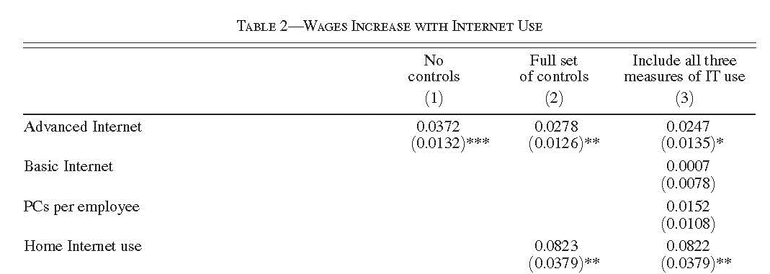
If you had put together this data and gotten this answer, what would have been your reaction?

Slide 31
Results
Why are the results presented in this order?
  Why walk through results in Table 2 even though it does not work well?
  Why more than one column in table 3?
  Why does IV come later in Table 4, and not in the earliest regressions?
Why the additional findings about employment in Table 5?
Why robustness checks in appendix, but not the paper?
    Timing. Rust belt effect. Neighboring county effect.
Why does this add up to a *puzzle*?
  What is better – partial results for a novel & important question or precise incremental contribution?

Slide 32
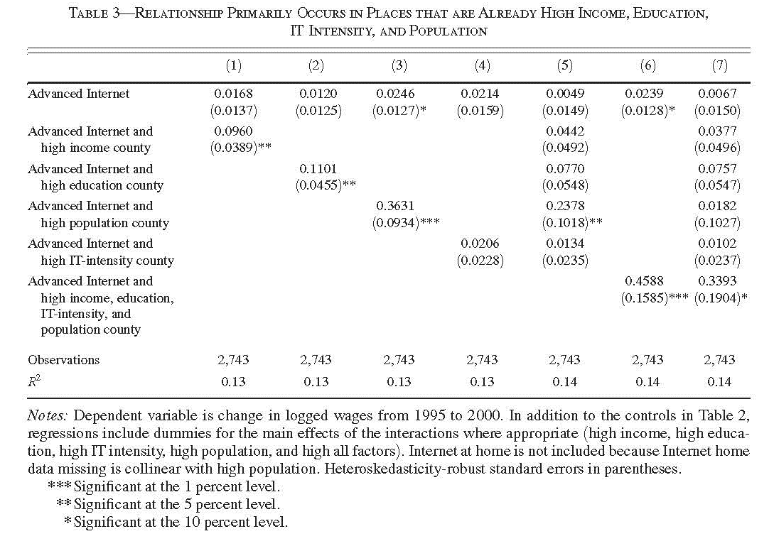
What does basic theory tell us about what matters? Income, education, agglomeration…

Slide 33

The IV estimates do not work particularly well. Why did the editor accept it nonetheless?

Slide 34
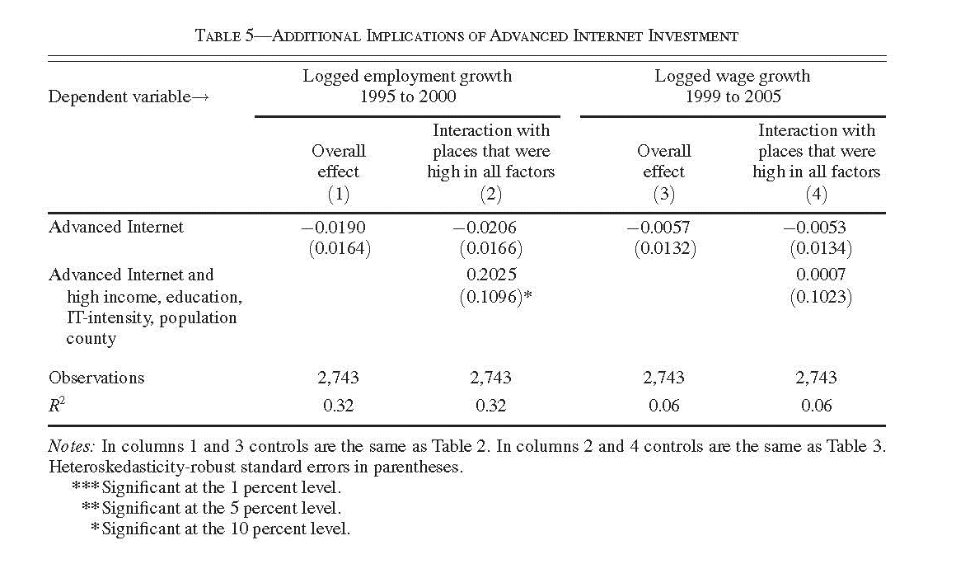
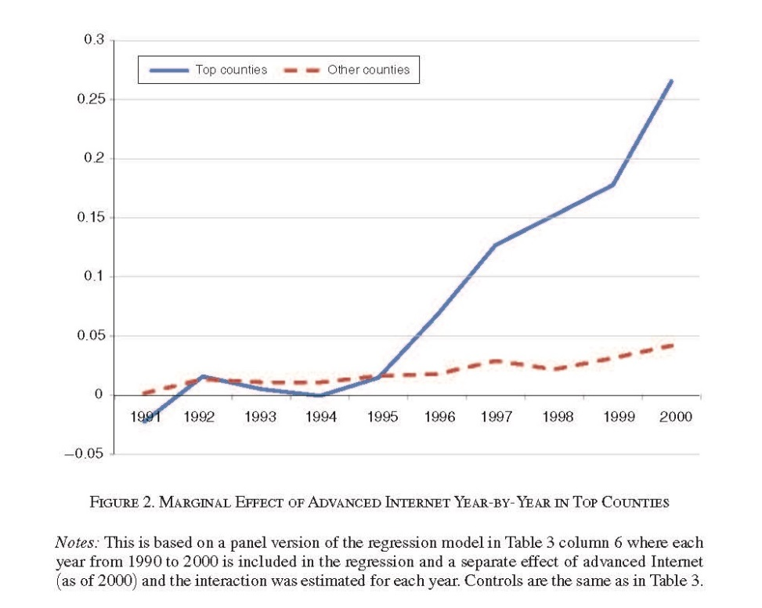
Bring additional evidence to the story. Employment, placebo tests, & more.

Slide 35
What should research do next?
Is it interesting to know whether Internet changed income distribution in the most recent decade? Yes, but…
  It is not an investment from zero. Figuring out the right “diff” is the hard part. What is the best “natural” experiment to help understand?
Link back to biased technological change and traditional sources of growth, such as productivity and agglomeration economies.
  Introducing regional economies into discussion. Regional economies do look different, specialize in different industries and activities, etc.
  Introducing occupational and skill differences and distribution within occupation in a region and b/w regions.

Slide 36
Some open topics in this line of research…
Smart phone diffusion. Diffused everywhere; impact differ across locations? E.g., strong evidence that “network effects in demand” shape adoption.
Quality of user experience. It has improved, but not everywhere at the same rate; how to measure it, and how to measure its impact?
International comparisons. Identify important effects, find general patterns, develop insightful contrasts…. Big question: Differences in availability, quality, price → consequences?
The many dimensions of the payoff puzzle: The Internet is everywhere, but employment and entrepreneurship is not… e.g., look at local labor markets for software talent → consequences for investment and productivity?
Public finance of tax subsidies: Today many cities are providing tax breaks in order to get data centers and other infrastructure. Costs and benefits?
Most of all, decide for yourself. Nothing I suggest will be as good as anything you notice on your own…

Slide 37
Summary: rules of thumb to live by…
Don’t ever set out to write a diffusion or adoption study unless you are pretty sure it will keep growing.
Know how stuff works. Look for plausibly exogenous geographic variation and natural experiments, but don’t expect to really find anything perfect.
Ask a research question where at least one person cares about the answer. Even better if more than one (non-academic) audience cares.
Find an endogenous variable that is interesting by itself, because even if the exogenous variables do not explain much of it, you will get credit for a novel endogenous variable.
Use the best software you can find to summarize a story in a picture.
Use the best econometrics you can, and go forward with courage.
Motivate the research question, and work hard to summarize the main question and findings. Your audience might not “get it” at first.
Explain it to your (older) colleagues the same way you would explain it to your father and mother, because, well, that is how old they are.

Slide 38

Good luck!
Thanks for your attention!

