Slide 1
Economics of Digitization PhD Workshop
Welcome!

Slide 2
Digital Economics
Avi Goldfarb
University of Toronto and NBER
(Based on work with Catherine Tucker)

Slide 3
Definitions
Digital technology is the representation of information in bits.
This has reduced the cost of storage, computation, and transmission of data.
Digital economics examines whether and how digital technology changes markets.

Slide 4
What is different?
“What is different if information is represented in bits?”
“What is easier to do when information in represented in bits relative to when information is represented in atoms?”

Slide 5
Organizing the literature

Slide 6
Three distinct changes
Thus far, the literature has emphasized three distinct changes:
Zero marginal costs of production of information.
i.e. digital goods are non-rival.
Low cost of transportation of information.
discussed in Shane Greenstein’s session.
Low search costs for information.
the focus of Susan Athey’s session.

Slide 7
Three distinct changes
Thus far, the literature has emphasized three distinct changes:
Zero marginal costs of production of information.
i.e. digital goods are non-rival.
Low cost of transportation of information.
discussed in Shane Greenstein’s session.
Low search costs for information.
the focus of Susan Athey’s session.
These are not the only relevant changes. Scholars have studied switching costs, menu costs, prediction costs, etc.

Slide 8
An alternative organization
Digital industrial organization
Price dispersion, competition, product variety, trust and reputation, copyright, consumer privacy.
Digital organizational economics
Centralization vs decentralization.
Digital public finance
Taxes and jurisdiction.
Digital international economics
Trade in data, exchange rate pass-through, homogenization, cross-border regulation.
Digital urban economics
Agglomeration vs dispersion, commuting.
Digital labor economics
Job search, vacancies and unemployment, peer-to-peer labor markets.
Digital development economics
Price dispersion in commodity markets, international labor markets.
Digital health economics
Electronic medical records and medical productivity, patient privacy, liability.
Digital financial economics
Manipulation of financial markets, digital finance platforms, high speed trading, blockchain

Slide 9
Another organization
Public
Public goods
Government sector
Private
Productivity and supply
Purchasing and use
Unpriced time during leisure

Slide 10
1. Zero MC of production

Slide 11
Data
Privacy
Open source/Wikipedia
Public goods
Government information
Copyright and “Piracy”
Bundling
Inequality
Machine learning/artificial intelligence and prediction technology

Slide 12
Economics with zero MC
Old ideas are interesting again!
Copyright (and piracy)
Media revenues fall (Waldfogel, Smith/Telang, Zentner).
In the static model, piracy is good for welfare (Waldfogel).
Production costs fall so media quality and variety may be rising (Waldfogel).
Privacy
People care about privacy, privacy regulation hurts innovation (Goldfarb and Tucker)
Public goods
Open source and Wikipedia. Why contribute? Biases in open platforms? (Greenstein/Zhu, Lerner/Tirole)
Information role of government, a new life for the labeling/disclosure literature? (Jin/Leslie, Ippolito/Matthios)
Inequality
Scalability of innovation without need for many employees.
Bundling
Bundling models got interesting again! (Brynjolfsson)
Information and data-driven decisions
Labor/leisure tradeoffs
Zero MC often means zero price. How should we value that? (Brynjolfsson/Oh, Wallsten)
Consumer/producer roles
User generated content, social media

Slide 13
2. Low cost of transportation

Slide 14
Market definition and scope of competition
Homogenization
Online sales of physical goods
Online sales of digital goods
Collaboration
Agglomeration vs dispersion
Centralization vs decentralization
Taxes and jurisdiction

Slide 15
Distribution and communication
For many goods, the marginal cost of distribution approaches zero.
The marginal difference in cost between many kinds of nearby and distant communication approaches zero.
Cairncross: The Death of Distance
The internet means that isolated individuals and companies can plug into the global economy.
Friedman: The World is Flat
The internet and ICTs level the playing field across locations.
There is no advantage to location for consumers or firms.
He emphasizes firms more
McLuhan: The Global Village
Information is available everywhere, in the same form.
This can create a “global culture”.

Slide 16
Is distance dead?
Distribution costs for digital products are near zero. Therefore, distance should not predict consumption of digital products.
Caircross (1997)
Communication costs are near zero over long distances. Therefore, distance should not predict knowledge.
Friedman (2005)
Empirical tests:
In retail: e.g. Brynjolfsson, Hu, and Rahman (2009)
In trade of digital goods: e.g. Blum and Goldfarb (2006)
In finance: e.g. Eichengreen, Lafarguette, and Mehl (2016)
In business internet use: Forman, Goldfarb, and Greenstein (2005)

Slide 17
So…Why isn’t distance dead?
Offline options matter
Balasubramanian (1998), Brynjolfsson, Hu, and Rahman (2009), Forman, Ghose, and Goldfarb (2009), Choi and Bell (2011), Lieber and Syversson (2012), Gentzkow and Shapiro (2011), Sinai and Waldfogel (2004)
Government policy
Taxes: Goolsbee (2000), Ellison and Ellison (2009), Anderson et al (2011), Einav et al (2014)
Copyright policy: Gomez Herrera and Martens (2014)
Privacy policy, cultural policy (play and download limits), etc.
Trust is easier locally
Jin and Kato (2007), Douglas, Hortacsu, and Martinez-Jerez (2009)
Spatial correlation in tastes (local culture)
Blum and Goldfarb (2006), Sinai and Waldfogel (2004), Gandal (2006), Gentzkow and Shapiro (2011)
Social networks are disproportionately local
Gaspar and Glaeser (1998), Hampton and Wellman (2002), Forman, Ghose, and Weisenfeld (2008), Agrawal and Goldfarb (2008), Agrawal, Catalini, and Goldfarb (2015)

Slide 18
So…Why isn’t distance dead?
Offline options matter
Balasubramanian (1998), Brynjolfsson, Hu, and Rahman (2009), Forman, Ghose, and Goldfarb (2009), Choi and Bell (2011), Lieber and Syversson (2012), Gentzkow and Shapiro (2011), Sinai and Waldfogel (2004)
Government policy
Taxes: Goolsbee (2000), Ellison and Ellison (2009), Anderson et al (2011), Einav et al (2014)
Copyright policy: Gomez Herrera and Martens (2014)
Privacy policy, cultural policy (play and download limits), etc.
Trust is easier locally
Jin and Kato (2007), Douglas, Hortacsu, and Martinez-Jerez (2009)
Spatial correlation in tastes (local culture)
Blum and Goldfarb (2006), Sinai and Waldfogel (2004), Gandal (2006), Gentzkow and Shapiro (2011)
Social networks are disproportionately local
Gaspar and Glaeser (1998), Hampton and Wellman (2002), Forman, Ghose, and Weisenfeld (2008), Agrawal and Goldfarb (2008), Agrawal, Catalini, and Goldfarb (2015)
BROADLY, THE ONLINE CHANNEL OVERCOMES SOME FRICTIONS TO DISTANT ECONOMIC TRANSACTIONS, BUT NOT ALL

Slide 19
3. Low cost of search

Slide 20
Price dispersion
Efficiency
Matching
Two-sided markets and peer-to-peer markets
Targeting

Slide 21
If the internet lowered search costs…
Internet technology should reduce prices
Life insurance: Brown and Goolsbee (2002)
Books and CDs: Brynjolfsson and Smith (2000)
Internet technology should lower price dispersion
It might have: Brynjolfsson and Smith (2000)
It is still substantial: Baye, Morgan, and Scholten (2004)
Internet technology should reduce unemployment and vacancies
Mixed evidence: Autor (2001), Kuhn and Skuterud (2004), Stevenson (2008), Kuhn and Mansoor (2014)
The types of products offered should change
Theory: Bar Isaac, Caruana, and Cunat (2012)
Long tail: Brynjolfsson, Hu, and Simester (2009), Fleder and Hosanagar (2009)
The search algorithm should matter
Easy quality search reduces price sensitivity: Lynch and Ariely (2000)
Manipulation of the search process to raise margins: Ellison and Ellison (2009), Hossain and Morgan (2006).
The search algorithm affects matching: Hitsch, Hortacsu, and Ariely (2010)

Slide 22
Combining of zero MC, distance, search

Slide 23
Combinations of the above
Reputation (Mike Luca’s session)
Low cost of transportation and low cost of search generate extra value for mechanisms that credibly communicate reputation.
Zero MC of production of information makes user generated reputation mechanisms scalable.
Product variety
Low cost of search means can find the “long tail”. Zero MC of production means can store the long tail, but also sell lots of superstar products.

Slide 24
Understanding digital economics

Slide 25
The focus of digital economics
Three ways to think about digital for economists:
Digital is a lab for testing existing models.
Digital motivates new models.
Digital makes some existing models more salient and important to understand. While these models might have been below the radar, now they matter.

Slide 26
The focus of digital economics
Three ways to think about digital for economists:
Digital is a lab for testing existing models
Digital motivates new models.
Digital makes some existing models more salient and important to understand. While these models might have been below the radar, now they matter.

Slide 27
Importance of (already-established) theory
Empirical work has dominated the published research, and the NBER Digitization Conference.
Still, theory motivates the most influential papers.
Key models are pre-internet papers:
Hotelling (1929), Stigler (1961), Becker (1965), Akerlof (1970), Diamond (1971), Spence (1973), Butters (1977), Holmstrom (1979), Salop (1979), Varian (1980), Klein and Leffler (1981), Rosen (1981), Grossman-Shapiro (1984), etc.

Slide 28
Importance of (already-established) theory
Empirical work has dominated the published research, and the NBER Digitization Conference.
Still, theory motivates the most influential papers.
Key models are pre-internet papers:
Hotelling (1929), Stigler (1961), Becker (1965), Akerlof (1970), Diamond (1971), Spence (1973), Butters (1977), Holmstrom (1979), Salop (1979), Varian (1980), Klein and Leffler (1981), Rosen (1981), Grossman-Shapiro (1984), etc.
Generally, the key question is what happens to markets when the marginal cost of some, but not all, activities approaches zero?

Slide 29
The rest of this talk…
Walk through three papers that highlight various aspects of digital economics research.
What is different about online advertising? synthesizes the advertising literature to examine reasons to study digital at all.
Does the internet defy the law of gravity? shows how digital questions are informed by, and inform, research in other economic areas.
The Private Impact of Public Maps: Landsat Satellite Imagery and Gold Exploration shows that some of the best “digital economics” research uses prior technologies to understand how digital might change things going forward.
All emphasize established theory with links to search, zero MC, and/or distance.

Slide 30
What is different about online advertising?

Slide 31
An example: Online advertising
What’s different?

Slide 32
An example: Online advertising
What’s not different?

Slide 33
Models of targeting
Targeting and competition between advertisers
Iyer, Soberman, and Villas Boas (2005), Gal-Or and Gal-Or (2005): Targeted advertising to soften competition between advertisers
Targeting and media revenue
Athey, Calvano, and Gans (2011), Levin and Milgrom (2010): Too much targeting can hurt revenue.
Bergemann and Bonatti (2011): Online media can increase price of offline media
Targeting, price discrimination, and privacy
Hermalin and Katz (2006), Taylor (2004): Price discrimination can lead to market unraveling.

Slide 34
How does this manifest itself in the literature?
Auctions
Online advertising effectiveness
Antitrust
Privacy

Slide 35
How does this manifest itself in the literature?
Auctions
Targeting makes a new pricing model is possible. A rich auction literature guides us to the right mechanism.
Online advertising effectiveness
Measurement is possible because of the one-to-one nature of online advertising.
Antitrust
Economies of scale argument is about targeting.
Privacy
Targeting leads to privacy concerns. Asymmetric information models help us understand why consumers might want to keep information private.

Slide 36
Some detail: Privacy
There is an excellent JEL (2016) article on the topic by Acquisti, Taylor, and Wagman.
An early literature in economics had a Chicago-style flavor.
U Chicago conference led to Journal of Legal Studies (1980) special issue, with articles by Posner, Becker, Stigler, etc.
Oversimplified: Privacy only helps those with something to hide.
Literature revived in early 2000s (largely in the context of advertising and price discrimination)
Initially theory: Reapplied information economics ideas within the framing of privacy (Hermalin-Katz, Acquisti-Varian, Taylor).
Then empirics: Consumers care about privacy (Acquisti, Goldfarb-Tucker). Privacy regulation hurts advertisers (Goldfarb-Tucker).
Empirics go hand-in-hand with targeting. Privacy is only valuable to firms if it enhances targeting.

Slide 37
Why is the cost of targeting lower?

Slide 38
Does the internet defy the law of gravity?

Slide 39
Key result?

Slide 40
Framing 1: Is Distance Dead?
As discussed earlier…
Distribution costs for digital products are near zero. Therefore, distance should not predict consumption of digital products.
Cairncross (1997)
Communication costs are near zero over long distances. Therefore, distance should not predict knowledge of goods that are digitally communicated.
Friedman (2005)
This is one of the earliest and most comprehensive streams of digitization research.
Brynjolfsson et al (2009), Blum & Goldfarb (2006), Agrawal et al (2014), Forman et al (2005), Balasubramanian (1998), Brynjolfsson et al (2009), Forman et al (2009), Choi and Bell (2011), Lieber & Syversson (2012), Gentzkow & Shapiro (2011), Goolsbee (2000), Ellison & Ellison (2009), Anderson et al (2011), Einav et al (2014), Gomez Herrera and Martens (2014), Goldfarb and Tucker (2011), Jin and Kato (2007), Gaspar & Glaeser (1998), Hampton & Wellman (2002), Forman et al (2008), Agrawal & Goldfarb (2008), Douglas et al (2009), Sinai & Waldfogel (2004), Gandal (2006), Gentzkow & Shapiro (2011)

Slide 41
Framing 2: What causes trade?
“Gravity” models of trade
Empirical result: Countries that are large and close trade more (plus same-country bias)
Early emphasis on transportation costs
Here, evidence to support the importance of spatial correlation in tastes.

Slide 42
Which do you prefer?

Slide 43
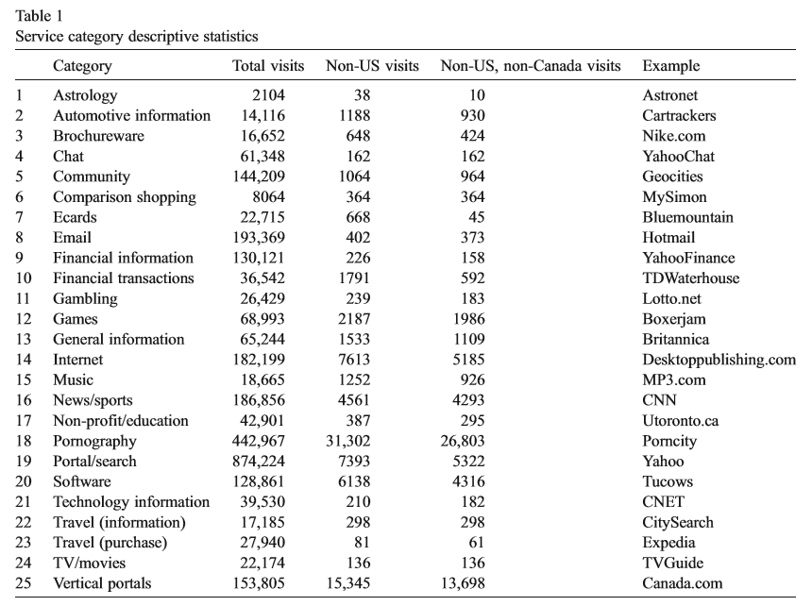

Slide 44
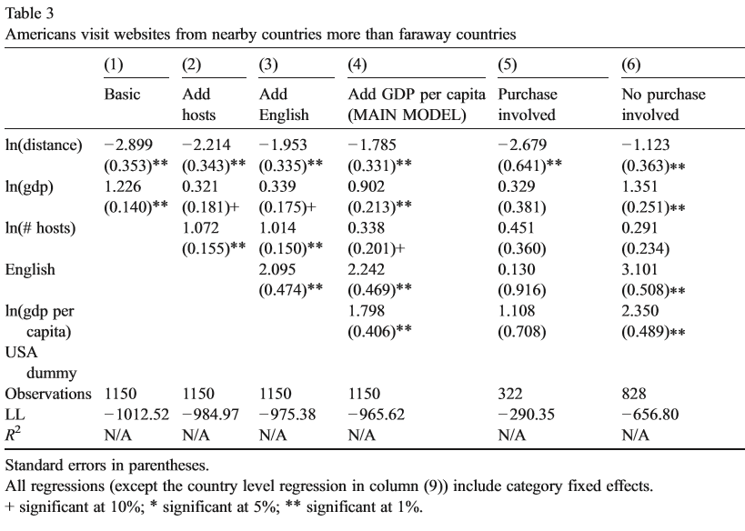

Slide 45
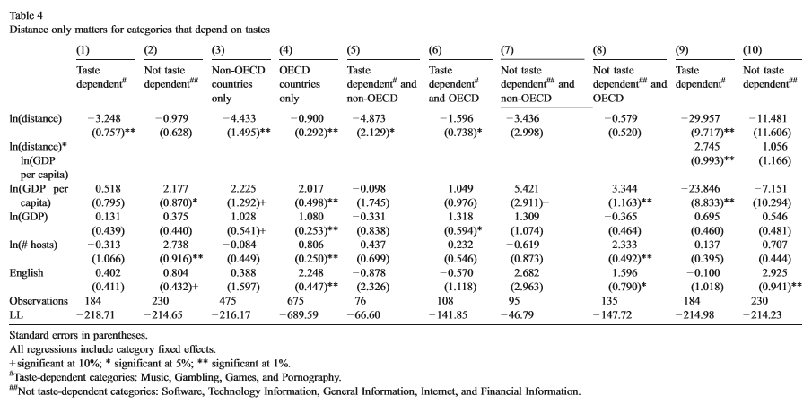

Slide 46
Thoughts?

Slide 47
What have we learned since?
Cultural proximity is a good predictor of trade:
Felbermayr & Toubl (2010 EER) measure cultural proximity in the Eurovision Song Contest TV show and show it predicts trade in a theory-grounded gravity model.
Martens (with various coauthors) replicates basic Blum-Goldfarb result with better data.
Distance matters within countries:
Hortacsu, Martinez-Jerez, and Douglas (2009 AEJ Micro) show distance matters because of location-specific goods (tickets), culture, and the possibility of direct contract enforcement.
Ferreira and Waldfogel (2013 EJ) show domestic music consumption is large and has increased since arrival of the internet.
Culture and distance matter in many online contexts:
Pro-social lending (Burtch, Ghose, Wattal 2014 MISQ)
Crowdfunding (Agrawal, Catalini, Goldfarb 2015 JEMS)
Foreign exchange markets (Eichengreen, Lafarguette, Mehl 2016 NBER WP)
Distance does matter LESS online:
Lendle et al (EJ 2016) compare Ebay with international trade and show distance matters less on Ebay, “most likely due to online technologies that reduce information frictions associated with geographic distance.”

Slide 48
The Private Impact of Public Maps: Landsat Satellite Imagery and Gold Exploration

Slide 49
What is the research question?

Slide 50
Non-digital contexts to study digitization
An advantage of digitization as a research area is the ubiquity of data.
A disadvantage is that it is new. Long run effects are hard to identify. Outcomes are often unobservable.
Therefore, it is not unusual for the digitization meetings to include a paper that does not involve the use of information stored in bits.
Each identifies of the following examples identifies a core question for understanding the impact of digitization and looks to other contexts to inform the impact:
Petra Moser and coauthors on copyright.
Heidi Williams on intellectual property, innovation, and the human genome.
Jin-Hyuk Kim and Liad Wagman on privacy protection in financial markets.
Abhishek Nagaraj on open information…

Slide 51
Ideal data to study openness?

Slide 52
NASA Satellite Mapping Program—Landsat
Detailed satellite-based mapping, including some mineral detection.
Exploits variation in the timing of mapping to compare gold discoveries in difference-in-difference framework.
Key identification assumptions: Timing of mapping was random with respect to gold and clouds are random with respect to location of gold.

Slide 53
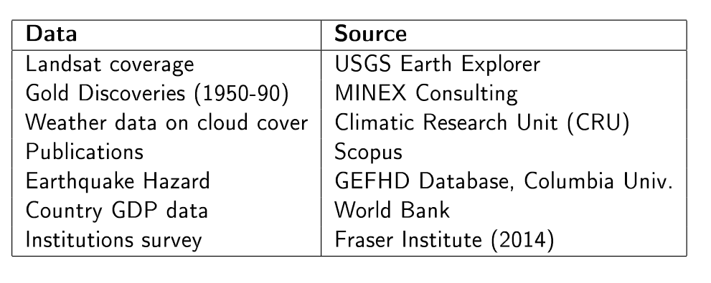

Slide 54
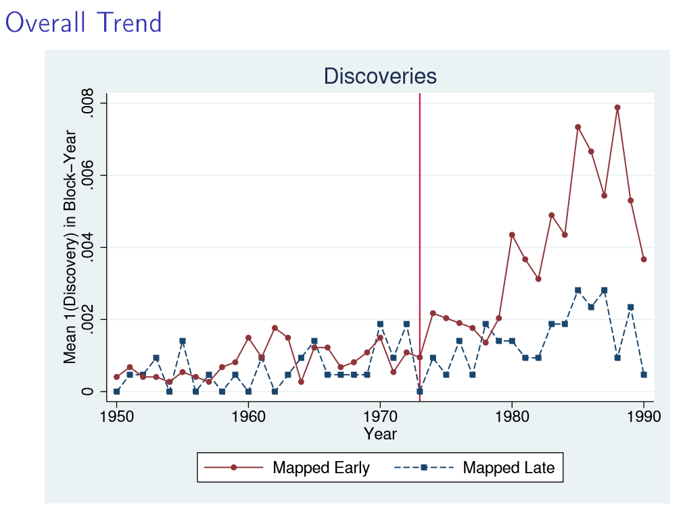

Slide 55
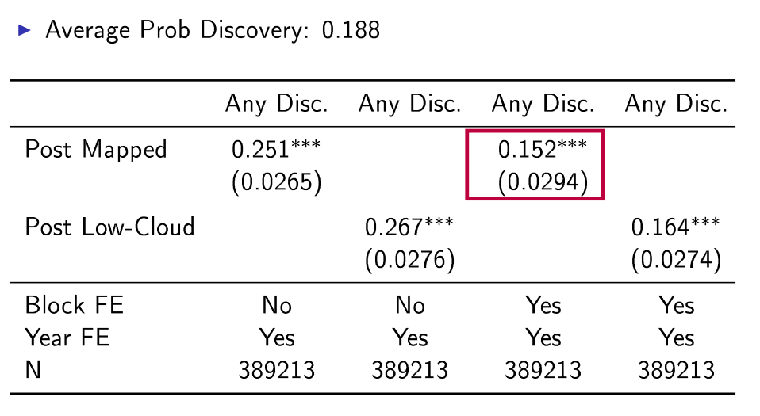

Slide 56
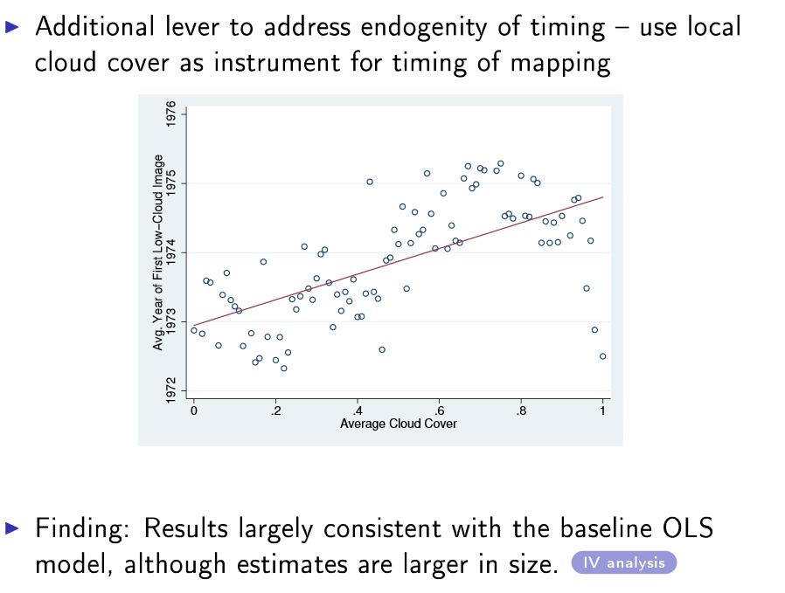

Slide 57
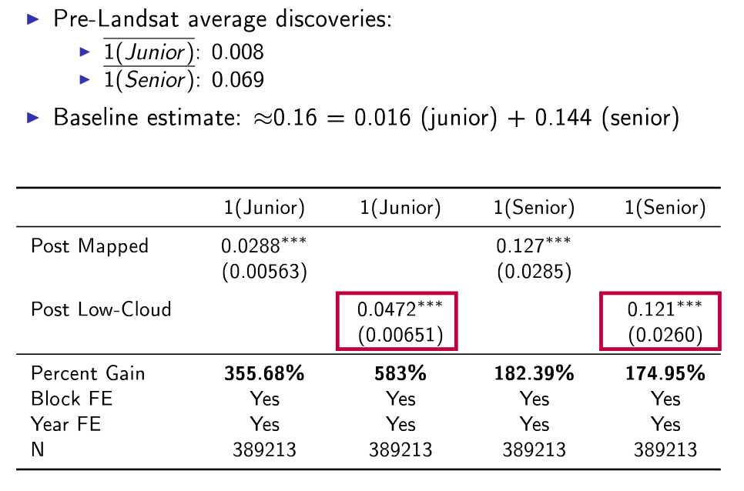
Mechanism: Helps capital constrained firms

Slide 58
Implications for digitization?

Slide 59
Wrap-Up

Slide 60
Frameworks are useful

Slide 61
Think about what changes
Zero marginal costs of production of information.
i.e. digital goods are non-rival.
Low cost of transportation of information.
discussed in Shane Greenstein’s session.
Low search costs for information.
the focus of Susan Athey’s session.
These suggest other changes, like the cost of targeting, the importance of distance for trade, the benefits and cost of openness, the importance of privacy, the ability to predict, etc.

Slide 62
The opportunity
In my own research, I try to think through what the new technology enables.
This involves thinking through “what’s different?” and “what’s not different?”
Often this can be see as a reduction in some kind of economic friction, or, in other words, a reduction in some kind of cost.
You are in a nice position: Technology is changing rapidly and the literature has not caught up.

Slide 63
What’s next?

Slide 64
What’s next?
Peer-to-peer markets
Mobile
Currency
Employer-Employee interactions
Development economics
Artificial intelligence
???

Slide 65
I look forward to hearing your ideas over the next few days!
And in the future…
agoldfarb@rotman.utoronto.ca
@avicgoldfarb
QUESTIONS?

