Slide 1
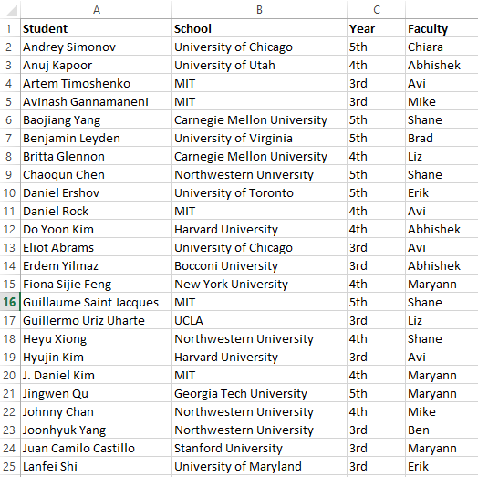
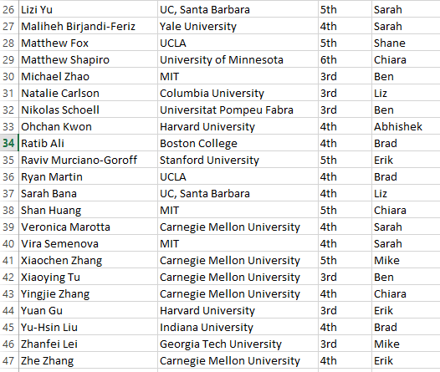

Slide 2
The market for digitization economists
Avi Goldfarb and Shane Greenstein
March 2, 2017

Slide 3
Types of jobs
Economics department
Business School
  Business economics
  Strategy
  Information systems
  Entrepreneurship
  Operations
Policy school
Government
Private sector
  Also some have landed in Library, Public Health, Medicine, Engineering, etc.

Slide 4
Some examples (from this conference)
Person | Position | Employer
Avi Goldfarb | B. school-Marketing | Toronto
Shane Greenstein | B. school-Tech. & Operations | Harvard
Susan Athey | B. school-Economics | Stanford
Mike Luca | B. school-Negotns & Organzns | Harvard
Abhishek Nagaraj | B. school-Strategy | Berkeley
Elizabeth Lyons | Policy school | UCSD
Chiara Farronato | B. school-IS/Tech. & operations | Harvard
Sarah Moshary | Economics dept. | Penn
Ben Shiller | Economics dept. | Brandeis
Erik Brynjolfsson | B. school-Information tech. | MIT
Brad Larsen | Economics dept. | Stanford
Maryann Feldman | Policy school | UNC
Petra Moser | Economics dept. | NYU
Mike Bailey | Private sector | Facebook
Person | Position | Employer
Joan Calzada | Economics dept. | Barcelona
Ricard Gil | B. school-Economics | Hopkins
Tom Blake | Private sector | Ebay
Kane Sweeney | Private sector | Ebay
Steve Tadelis | B. school/Private sector | Berkeley
Felix Eggers | B. school-Marketing | Groningen
Jeff Prince | B. school-Economics | Indiana
Joel Waldfogel | B. school-Strategy/entreprshp | Minnesota
Joshua Gans | B. school-Strategy | Toronto
Shawn Cole | B. school-Finance | Harvard
Nilesh Fernando | Economics dept. | Notre Dame
Susan Lu | B. School-Operations mngmt | Purdue
Abraham Seidmann | B. School-Information systems | Rochester
Jeff McCullough | Public health-Health mngmt | Minnesota

Slide 5
Some more examples (past years)
Person | Position | Employer
Heidi Williams | Economics dept. | MIT
Sam Ransbotham | B. School-Information systems | Boston Col.
Frank Nagle | B. school-Strategy | USC
Lorin Hitt | B. School-Information systems | Penn
Justin Rao | Private sector | Microsoft
Catherine Tucker | B. school-Marketing | MIT
Randall Lewis | Private sector | Netflix
Dean Eckles | B. school-Marketing | MIT
Shai Bernstein | B. school-Finance | Stanford
Mo Xiao | B. school-Economics | Arizona
Greg Lewis | Private sector | Microsoft
Ryan McDevitt | B. school-Economics | Duke
Gordon Burtch | B. school-Information systems | Minnesota
Mike Smith | Policy school-info. Systems | CMU
Person | Position | Employer
Rahul Telang | Policy school-info. Systems | CMU
Pai-Ling Yin | B. school-Entrepreneurship | USC
Rachel Soloveichik | Government | BEA
Peter Newberry | Economics dept. | Penn State
Kevin Williams | B. school-Economics | Yale
Kristina McElheran | B. school-Strategy | Toronto
Sonny Tambe | B. School-Info. systems | NYU
Amalia Miller | Economics dept. | Virginia
Chris Forman | B. School- Strategy and IS | Cornell
Nan Li | B. school-Accounting | Toronto
Pat Bajari | Private sector | Amazon
Chris Nosko | Private sector | Amazon
Imke Reimers | Economics dept. | Northeastern
Stephan Seiler | B. school-Marketing | Stanford

Slide 6
Past digitization PhD camp student outcomes
Harvard Strategy
U Arizona MIS
Indiana Operations
Columbia U Strategy
Columbia Marketing
Cornell Medical School
U Toulouse Economics
USC Data Science & Operations
Harvard Marketing
Berkeley Strategy

Slide 7
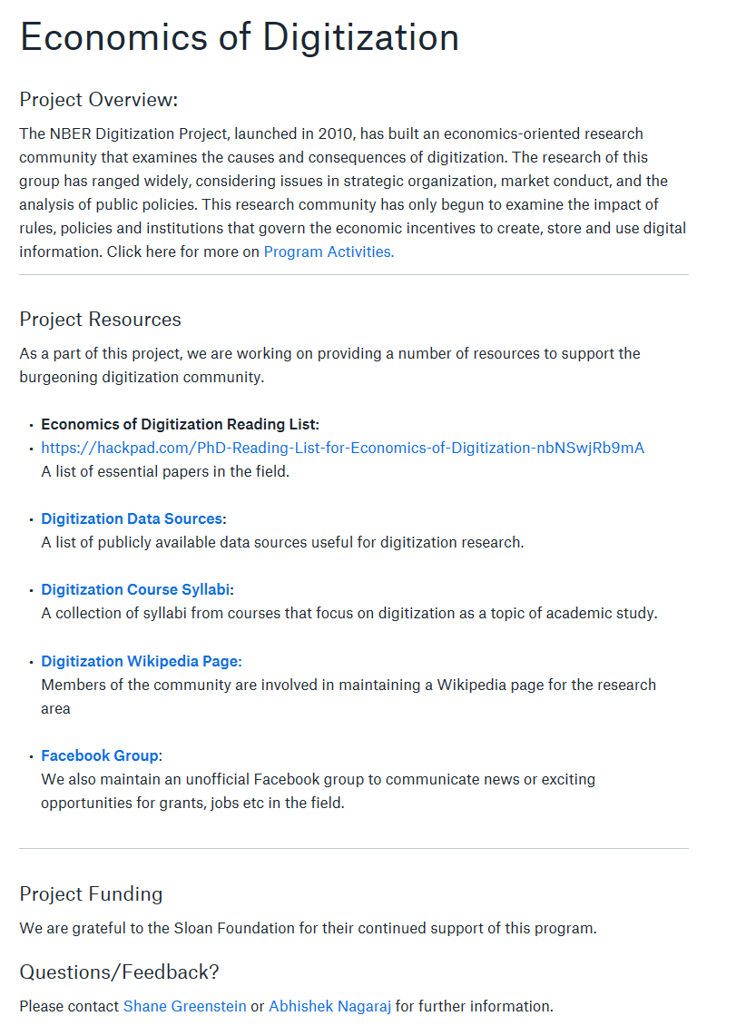
Resources
Economics of digitization website: bit.ly/econdigitization
List of program activities
Hackpad reading list
Data Sources
Course syllabi
Wikipedia page
Facebook group

Slide 8
General advice
Search widely.
  This research area is applicable to an unusually large number of opportunities.
  Examine the reading lists on the digitization home page to decide what you’d be willing to teach.
Show interest in the job. Don’t make it seem like they are a consolation prize.
  Credible signals are best: e.g. skim the basic textbook before the interview (or at least the flyout).
  Use the reading lists to have a clear vision of what it takes to teach a course in the topic. Some schools may want to hire you explicitly in order to teach economics of digitization as it applies to marketing/strategy/IS/....
  Some practice teaching can help too. Or some TAship in an MBA classroom.
Show interest in the research and activities of the people who are interviewing you.
  Look them up and try to find common areas of interest.
Don’t be shy about being an economist though.
  You have a particular perspective that can contribute to the broader research area of marketing, strategy, policy, etc.

Slide 9
Prep for marketing
Marketing is split between “quant”, “behavioral”, and “strategy”. Most research-oriented groups have mainly quant and behavioral. About half of the quants are economists (the rest are statisticians and computer scientists).
  Schools that have hired economists include Minnesota, UCLA, Penn, Harvard, MIT, Duke, USC, McGill, etc., and especially Chicago, Northwestern, Berkeley, Stanford, Rochester, Yale, and Toronto.
The main job market is early.
  Applications are due July 1, flyouts in the fall, offers before Thanksgiving.
  Some schools also hire on the econ market, but it is a thinner group.
Key journals of relevance to economists are Marketing Science, Management Science (marketing section), Quantitative Marketing and Economics, (to a lesser extent) Journal of Marketing Research
  You should skim through a Marketing Science or QME before your interview. You will find the methods largely familiar (and perhaps some of the papers too from NBER Digitization or IO)
Econ. PhDs have had substantial success, and can continue to publish in economics.
  Most econ. PhDs with tenure at top schools have at least one top 5 econ publication and also publications in Marketing Science and/or QME.
The traditional textbook is Kotler’s Marketing Management. It isn’t too informative about the research, but it does give the basic language for teaching of “3 C’s and 4 P’s”.

Slide 10
Prep for information systems
IS includes economists, behavioral types (psychology, sociology, and communications), and computer scientists. Many research-oriented groups have several economics types.
  Schools that have hired economists include Minnesota, McGill, NYU, Georgia Tech, Cornell, Irvine, Rochester, Purdue, Penn, Boston College, etc..
The main job market is largely simultaneous with economics, with the main meeting in early December (“WISE”/”ICIS”)
Many business schools do not have an IS department. Even those that hire in IS often have IS as part of Operations Management.
Key journals of relevance to economists are Management Science (information systems section), Information Systems Research, and MISQ
  You should skim through a Management Science for IS articles before your interview. You will find the methods largely familiar as identification-focused empirics motivated by theory. Chris Forman is currently editor for IS at Management Science.
Gallaugher’s Information Systems: A Manager’s Guide to Harnessing Technology will give you a taste of some of the key ideas.

Slide 11
Prep for strategy
Strategy is generally split between economics, sociology, and traditional strategy. Research-oriented groups could focus on one, two, or all three.
  Schools that have hired economists include Toronto, Minnesota, Harvard, MIT, USC, Northwestern, etc.
The main job market is simultaneous with economics, but there is an August meeting that most job market candidates attend and have “informal” conversations with hiring schools. There is no clear centralized interview conference. Instead, it is often direct from application to flyout.
  Some schools also hire on the econ market, but it is a thinner group.
  There is a PhD student conference for those interested in technology called the “CCC” that is a useful lever to get in the door.
Key journal of relevance to economists are Management Science (business strategy section and technology and entrepreneurship section), also Strategic Management Journal and (to a lesser extent) Journal of Economics and Management Strategy. For technology strategy, other journals include Research Policy and Industrial and Corporate Change
  You should skim through a Management Science for strategy and technology articles before your interview. You will find the methods largely familiar as identification-focused empirics motivated by theory.
Econ. PhDs have had substantial success, and some continue to publish in economics (especially in the technology strategy world).
  The NBER Innovation group contains many economists with strategy appointments.
You should (at least!) be familiar with Porter’s Five Forces and the idea of competitive advantage as well as Christensen on Disruption.

Slide 12
Prep for private sector and government
This is a very broad space with a wide variety of possible roles.
Research vs strategy/policy/management.
Private sector: Digital company (Amazon, Ebay, Google, Facebook, Pandora, Netflix, etc.), financial services, economic consulting, etc.
  More from Mike Luca in a few minutes
Government: Central bank, Census, BLS, BEA, Regulator (FTC, DoJ, CFPB, FCC, European Commission, etc.), etc. US and International.

Slide 13
List of related conferences
NBER Summer Digitization Meetings
NBER Winter Digitization Meetings
Workshop on Information Systems and Economics (WISE)
ZEW Conference on the Economics of Information and Communication Technologies
IDEI-TSE-IAST Conference on the Economics of Intellectual Property, Software, and the Internet
Searle Conference on Internet Search and Innovation
NET Institute
Workshop on the Economics of Information Security
Workshop on Health Information Technology and Economics (WHITE)
Statistical Challenges in Ecommerce Research (SCECR)
Various “Big Data” and “Digital” one-off conferences in marketing, strategy, IS, economics, etc.
Also friendly to digitization: CCC, DRUID, SMS, IIOC, EARIE, TPRC, Marketing Science, QME.

Slide 14

FYI

Slide 15
Prep for other academic positions
Policy, Library, Public health, Medicine, etc.
Groups are idiosyncratic.
  Know the school (especially if you get an interview).
  Identify the key researchers.
  Identify the journal(s) they publish in (in and out of economics).
  Try to (quickly!) skim the relevant first year course material.

Slide 16
Advice for advisors
If possible, separate letters for econ. departments and other places.
The letters should not say “any econ. department outside the top 25 or any business school including the top 5.”
Encourage meeting with faculty in the relevant field early (or at least before the job market). If nothing else, this helps identify relevant timelines.
  Faculty should consider introducing students to colleagues from other specialties early and often. Though, as students, you should take initiative on this too!
Support attending the relevant conferences.

Slide 17
Wrap-up
Basic common sense: People want to know you are keen to be there.
Credible signals of that keenness are useful.
Still, they want your skills as an economist. Otherwise, they’d hire someone from their own Ph.D. programs.

Slide 18
Research collaboration with technology companies
Mike Luca

