Slide 1
Search and Information on the Internet
Susan Athey
Stanford GSB

Slide 2
Finding Information
Digitization makes everything findable in principle
Users can’t actually find anything without intermediation
Search engines (general, price)
Store layout and organization
Ranking of offers
Fine details matter in short run and long run

Slide 3
Some Themes
Search engines and platforms affect the consideration set
Suppliers respond to incentives created by search
Feedback effects can be subtle

Slide 4
Price search

Slide 5
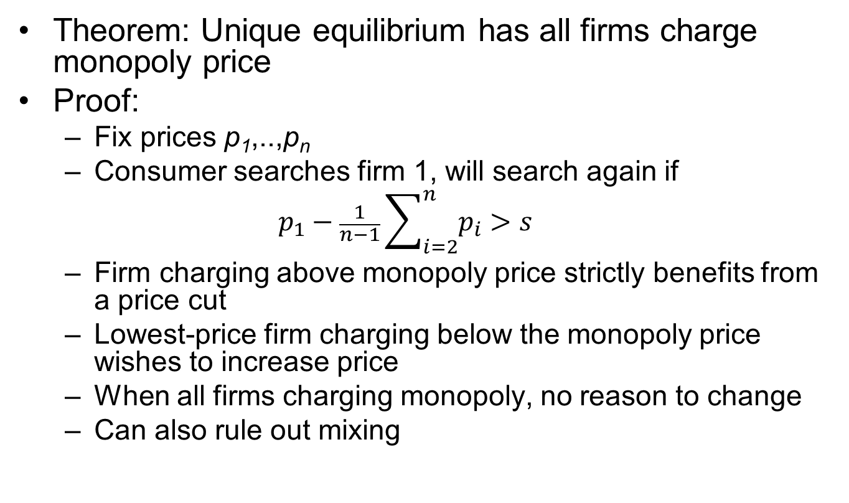
Diamond’s Search Model
Theorem: Unique equilibrium has all firms charge monopoly price
Proof:
Fix prices p₁,..,p_{n}
Consumer searches firm 1, will search again if
$$p_{1}−\frac{1}{n−1}\sum_{i=2}^{n}{p_{i}>s}$$
Firm charging above monopoly price strictly benefits from a price cut
Lowest-price firm charging below the monopoly price wishes to increase price
When all firms charging monopoly, no reason to change
Can also rule out mixing

Slide 6
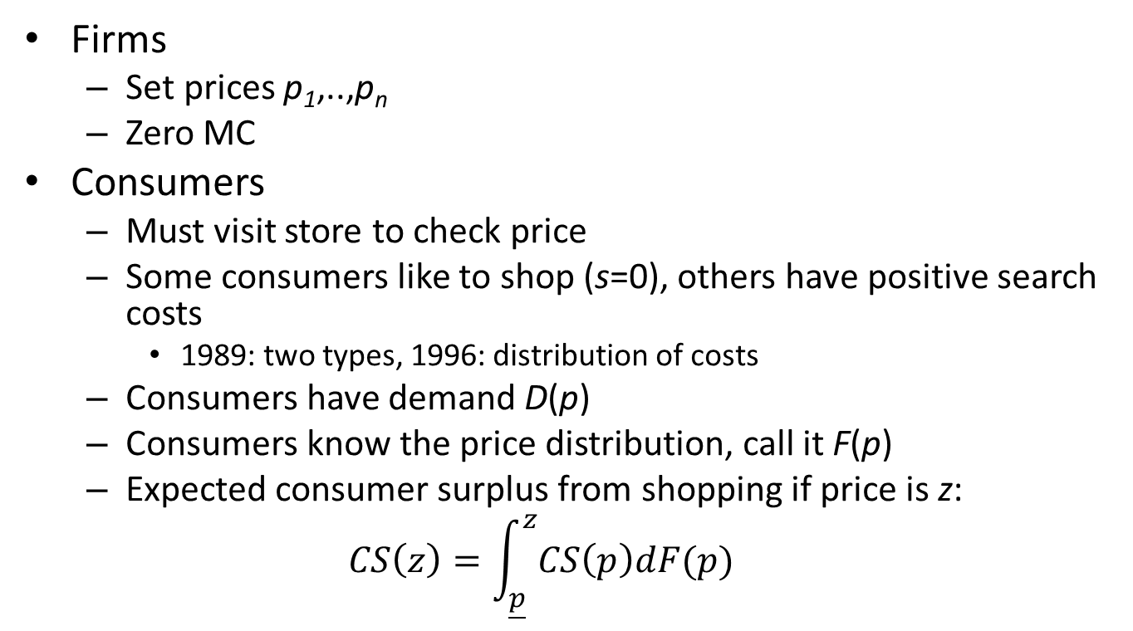
Stahl model with heterogeneous costs
Firms
Set prices p₁,..,p_{n}
Zero MC
Consumers
Must visit store to check price
Some consumers like to shop (s=0), others have positive search costs
1989: two types, 1996: distribution of costs
Consumers have demand D(p)
Consumers know the price distribution, call it F(p)
Expected consumer surplus from shopping if price is z:
$$CS\left(z\right)=\int_{\underline{p}}^{z}{CS\left(p\right)dF(p)}$$

Slide 7
Stahl model with heterogeneous costs
Firm behavior
Suppose for the moment consumers (exogenously) shop if they see price above r
Stores must play mixed strategy with smooth distribution
If atom at a given price, no other firm wants to charge that price; can charge a little less and get consumers to search
You get the atom of negative-search-cost shoppers
Firms never charge more than monopoly price
Mixed strategy makes firms indifferent between a range of prices
Trade off lower price and pick up the shoppers, versus higher price which gives closer to monopoly profits for non-shoppers
Shape of price distribution depends on distribution of search costs

Slide 8
Stahl model with heterogeneous costs
Behavior of model as fraction shoppers goes from zero to 1
Results go from Monopoly to Bertrand (Diamond)

Slide 9
Critiques and Directions on Price Dispersion Literature
Need both prices and quantities
Supermarket data is suggestive
Hi-lo pricing
Very large fraction of sales occur at low prices
Ghose & Yao (2010) revisit
Data from government procurement system with an offline and online component
Need more work on “why”
Ellison & Ellison—information structure and search costs are endogenous
Hossain & Morgan: field experiments on bounded rationality

Slide 10
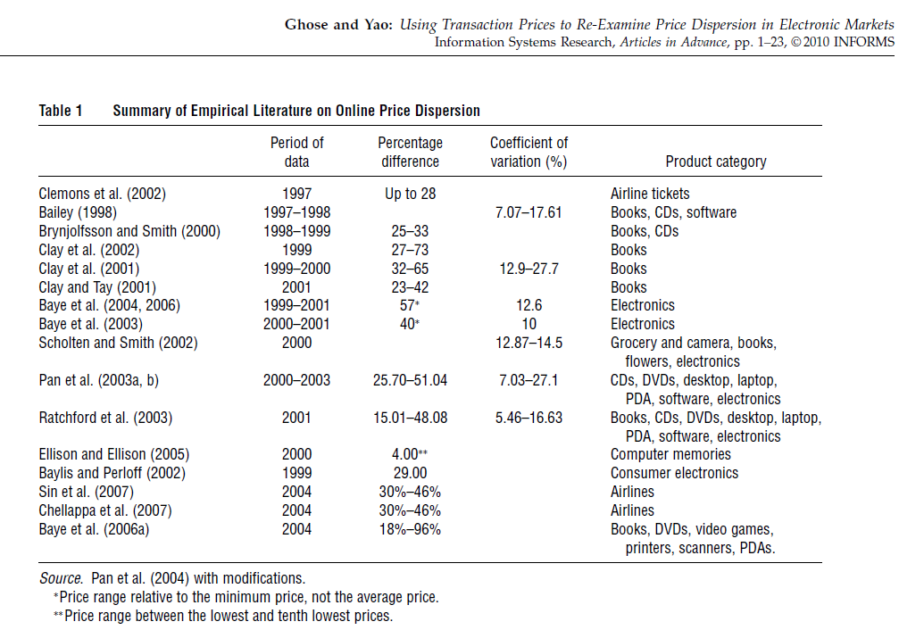

Slide 11
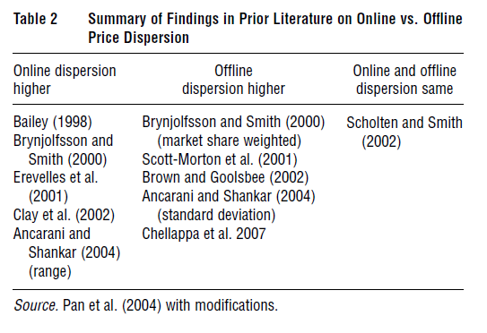

Slide 12
Online v. Offline Internet Pricing
Search costs reduced
Typically leads to compressed price distribution
Can any price dispersion persist?
Changing price almost costless
Models with price dispersion typically require simultaneous choices
Otherwise undercut your competitor
Competitors see prices
Potential benefits for collusion, especially if algorithms used to match
Ellison & Snyder (2013) document pricing dynamics

Slide 13
Case Study: Books & CDs
Brynjolffson and Smith (2000)
Products
Matched sample of 20 book and 20 CD titles, mix of popular and general selection titles
Retailers
16 Internet outlets, 16 conventional outlets (in 6 different states)
Product data
prices, tax/shipping & handling, availability, delivery time
Time frame: 1998 - 2000
~12,000 price observations

Slide 14
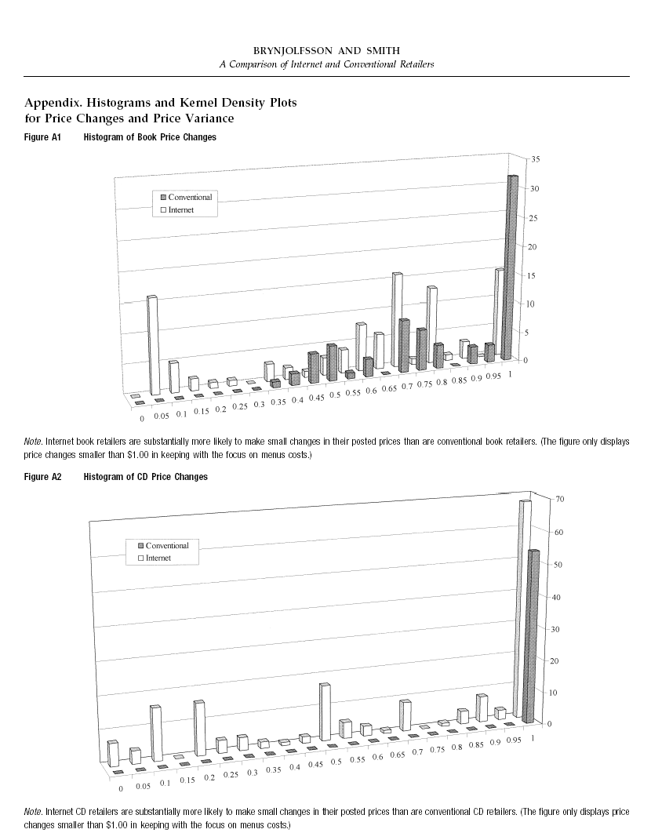

Slide 15
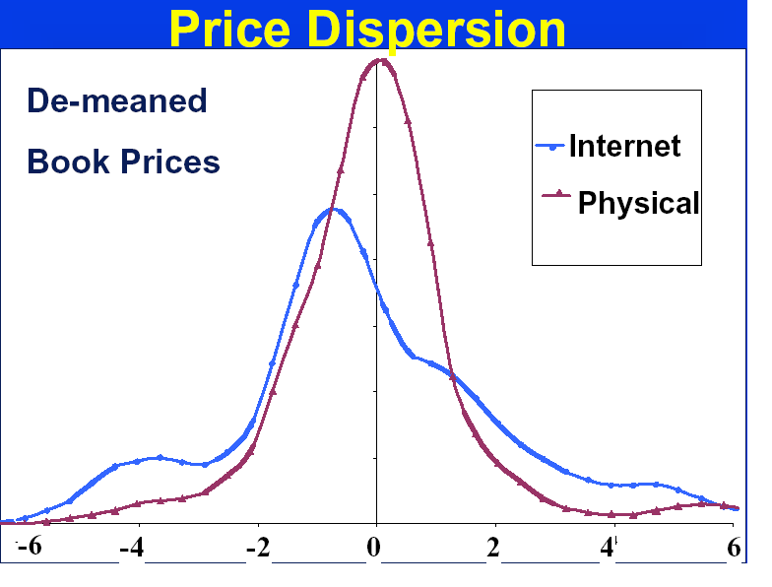
Source: Brynjolffson and Smith

Slide 16
Price Search Engines
Make search costs trivial
Who uses search engines?
Price sensitive consumers
Price search engine paradox
Perfect price search engine for perfectly substitutable alternatives -> zero profits for sellers
Why list on price search engine?

Slide 17
Bait and Switch
In some markets, price search engines account for huge fraction of market
Ex: Computer parts
Ellison and Ellison (2009) analyze this market
Bottom line
How do firms profit in this environment?
Bait and Switch!
More generally, obfuscation

Slide 18
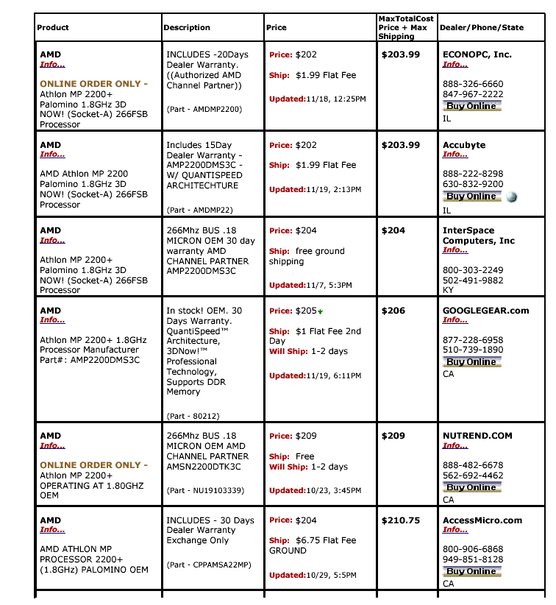

Slide 19
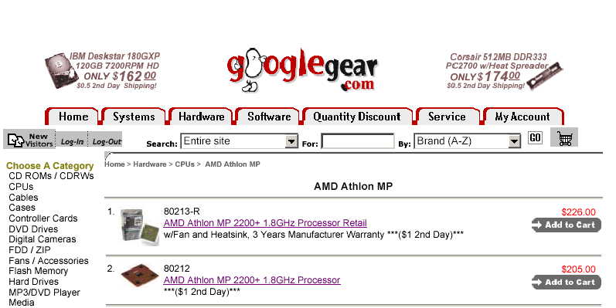

Slide 20
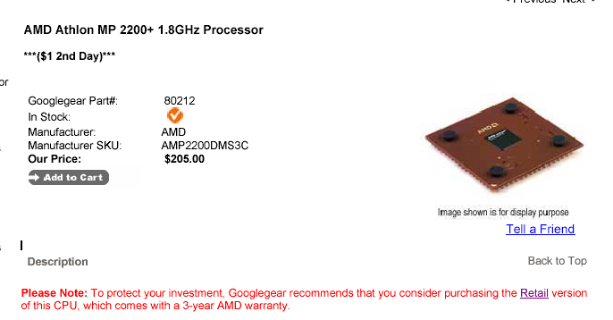

Slide 21
Cross-price elasticities
Cross-price elasticities for memory modules
Price Product
Low q Mid q High q
P_{low} -51.8 -25.2* -19.0*
P_{mid} -1.0 -6.6* -0.3
P_{hi} 0.4 -1.5 -8.6*
Interpretation
Elasticities of demand for low-, intermediate-, and high quality memory modules with respect to the prices of the three goods.
* denotes significance at the 1% level.
Why do demand for mid-quality and high quality products go down when price of low-quality goes up?

Slide 22
Behavioral economics
Are people rational in price shopping?
Lee & Malmendier (2010) show that in 2003, prices were $10 higher on eBay for a game in auctions than in posted prices
Einav, Kuchler, Levin and Sundaresan (2011) look at cases in which an eBay seller offered the same good by auction and posted price. Auction prices were typically 10-20% lower
Follow-up work shows auction prices declining over time

Slide 23
Shrouded Attributes and Add-on Pricing
Do people respond to shipping fees?
Hossain and Morgan (2006), Brown, Hossain and Morgan (2009), and Tyan (2005)
Field experiments and observational data
eBay auction prices do not fully adjust to reflect differences in shipping fees.
Einav, Kuchler, Levin and Sundaresan (2011) examine cases where sellers auctioned identical items with different shipping fees.
For each $1 increase in shipping fee, auction prices adjust down by only about $0.40 to $0.80.
Fees and prices can be less salient even when transparent

Slide 24
Add-on Pricing: Theory
Add-on pricing
Late fees, telephone charges in hotels, gasoline charges on rental cars
Buying apps, data after purchasing device
In-app purchases
Key way to monetize when goods are free
Lal and Matutes (1994)
Add-on prices irrelevant because base good price falls to compensate as a result of competition
Anticipation of add-ons lowers price of base good (to zero?)

Slide 25
Add-on Pricing: Price Discrimination Theory
Ellison (2005): Price discrimination theory of add-ons
Model:
Differentiated firms
Base good and add-on
High types and low types (value of income)
Firms announce price of base good but learning price of add-on requires costly search
Results
If low and high types similar, add-on pricing is irrelevant
If low and high types different, hold up high types by charging high price for add-on; low types do not purchase add-ons
Not announcing add-on price in advance implies that firm is "committed" to charge high price ex post
Commitment softens competition
Reducing base price just attracts cheapskates; but firm doesn't gain much and may lose (loss leader) by attracting them
Structure of contract induces adverse selection
Notes
NOBODY IS FOOLED OR IRRATIONAL! Just different types of consumers
But, some of high types could also be "irrational," unaware of add-on pricing

Slide 26
Future Research on Pricing?
Probably not great projects:
Documenting examples of dispersion
Documenting examples of price discrimination
Documenting systematic gaps across a few channels or outlets
Future work
Measuring importance of phenomena as a whole
Micro data on consumer behavior, to uncover WHY patterns exist
Implications of pricing models for platform competition, vertical and horizontal integration, innovation, and market structure (e.g. add-ons)
Measurement of welfare effects
Structural models of optimal policies, including alternative structures
Automated pricing
Methodology
Large data sets, not case studies (e.g. eBay internal versus external data)
Field experiments (large scale)
Structural modeling
Descriptive evidence on new questions

Slide 27
Consumer Search Using Web Browsing and Purchasing Behavior
De Los Santos, Hortacsu, and Wildenbeest (AER)
Use data from comScore
Searching for online books (homogeneous)
Testable predictions of sequential v. fixed sample size search model
In both models, consumers search sequentially
How do they select how many to visit? Sequential says they update based on observations

Slide 28
Consumer Search Findings
36% do not pick lowest price store
Consumers more likely to sample Amazon
No impact of relative price position within a bookstore of propensity to continue searching
Inconsistent with sequential search
Use fixed sample size model
Allow for product differentiation and asymmetric sampling (preference for Amazon)
Only learn about price from costly search
Get implied elasticities, compare to standard discrete choice
Find consumers are more elastic when incorporating search
Ignoring search, consumers should respond to all prices, and model must find insensitivity as the reason not to

Slide 29
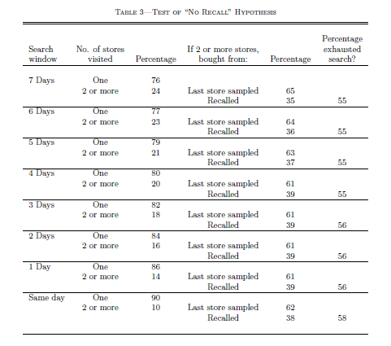
No Recall

Slide 30
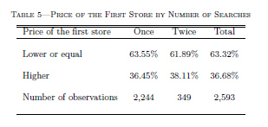
Price Dependence: No relationship between number of searches and the price discovery pattern

Slide 31
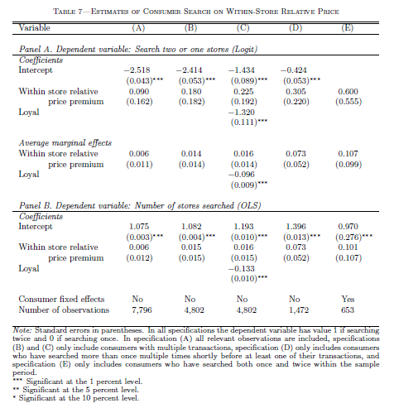

Slide 32
Structural Model
Motivated by reduced form evidence
Use a fixed sample size search strategy
Model:
Sample size
Search prices
Make choice
Use a logit model conditional on sample

Slide 33
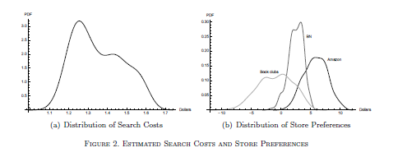

Slide 34
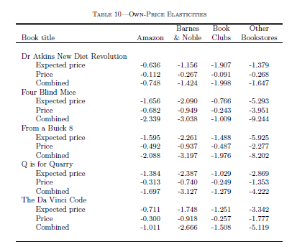
What implications does this have for how one would interpret field experiments on pricing?

Slide 35
Search Costs and the Design of Marketplaces and Platforms

Slide 36




Platforms and Intermediation
Platform markets
Media markets, credit cards, dating, video games, operating systems…
Two groups of customers, externalities (typically indirect network effects)
Platform can help internalize externalities
How is matching done?
Platform: Uber, Zeel
Buyer-seller: eBay, AirBnb, Rover, Urbansitter
Auction-based platforms
Online advertising
Used cars
eBay
Market design matters
Participation is crucial

Slide 37
Auction-Based Platforms
Like other two-sided markets, except…
Auction matches buyers and sellers, determines transaction price
Method for sorting as well as a method for platform to extract revenue
Limits discretion of market-maker
Still, rules, reserve prices and fees play an important role in determining the size and distribution of “the pie”
Matching Algorithms
Auction
Buyers
Sellers
Acquired Traffic

Slide 38
Theory
Lewis, Romanyuk and Wang
What happens on an auction-based marketplace platform if search costs decline?
Redistributes surplus, e.g. away from less attractive products, and can decrease overall seller welfare
More broadly
How ranking and discovery are done affects outcomes
Changing search affects entry and other investments on both sides of market
How do you measure, balance supply and demand?

Slide 39
How Much Does Position Matter in Internet Search?
Causation versus Correlation:
Best links in top position.
They get clicked more, but is that because of position or because they are the best links?
Gold standard for position effects: Randomized Experiment
Take 1% of page views and rerank results
Compare metrics for control and treatment group
Exclude “navigational” queries
Athey (2013)

Slide 41
Decomposing Clicks-Through Rate Into Relevance and Position

Slide 42

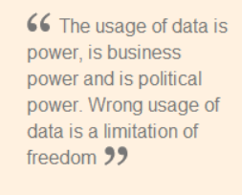
Prominence matters in Search: Policy
“the [European] Commission has cited four areas of concern: 1) unequal treatment of third-party vertical search links; 2) copying content from vertical search engines; 3) search agreements with partners; and 4) AdWords API restrictions.”
European Commission Vice President Joaquin Alumnia lists as one of 4 concerns with Google:
“the way in which Google’s vertical search services are displayed within general search services as compared to services of competitors.”

Slide 43
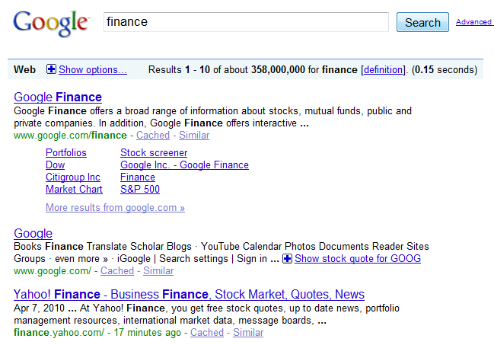
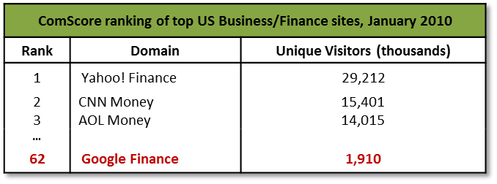
Google executive responding in 2007 to the fact that Google finance was introduced in the #1 position, despite being ranked below 50 in popularity:
“[When w]e roll[ed] out Google Finance, we did put the Google link first. It seems only fair right, we do all the work for the search page and all these other things, so we do put it first. . . . But that has actually been our policy since then because of Finance. So for Google Maps again, it’s the first link.”

Slide 44
Endogenous Clicking Behavior and Market Design for Internet Search
Athey & Ellison, QJE 2011 & extensions

Slide 45
Balancing Constituents in Search Advertising: Endogenous Ad Clicking and Ad Footprint
Model
Users
Number of searches fixed
Search costs of clicking on ads, heterogeneous across consumers
Quality of ad = probability of making a match between user and advertiser
Users rational: use Bayesian updating to calculate quality conditional on information
Rationally anticipate higher avg quality when reserve price is higher
Opportunity cost of ad space: when algo content is pushed down the page, users see less benefit from it
Advertisers
Entry /budget fixed in short run; choose bids
Profit when user makes a purchase; probability of match (per click) goes up when reserve price rises
Extension of Athey and Ellison, QJE 2011

Slide 46
Athey-Ellison (2011) Results
Eqm bidding → ads ranked by quality
Propensity to click depends on perceived quality (top down)
Market design considerations altered to economize on consumer search and convey information to consumers
Total welfare and consumer welfare are proportional
Consumers search in proportion to perceived quality of ads, which is proportional to value created for producers
Platform profits in conflict with advertiser profits
Optimal reserve prices derived
Reduced use of click-through weighting incentives more accurate ad text, economizes on consumer search
Asymmetries lead to non-existence of efficient equilibria

Slide 47
Balancing Constituents in Search Advertising: Endogenous Ad Clicking and Ad Footprint
Impact of raising reserve prices
Initially, allows better-quality algo results to appear
Eventually, ads are better than algo and users harmed
Advertisers and medium-term revenue in conflict
Users
Revenue
Advertisers

Slide 48
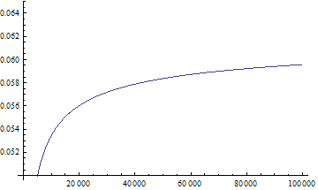
Balancing Constituents in Search Advertising: Long Run Participation Determined by Medium-Run Welfare
Long run competition for advertisers
Advertiser choices
Entry, campaign management:
Compare costs to profit conditional on entry/investment
Shift limited budgets, campaign management resources to most profitable platform
Comparative statics
Platform with more users attracts more advertisers
Diminishing marginal returns to additional advertisers in terms of efficiency and revenue
Both depend primarily on best few advertisers (top order statistics)
Platform with more users can provide the same total profit to advertisers (users x advertiser profit per user) at higher reserve prices
Long run competition for users
Number of searches depends on
Perceived average quality (#, quality of ads)
Idiosyncratic preferences or convenience
Comparative Statics
Platform with better baseline quality typically more willing to distort page quality
Revenue per User Search
Number of searches

Slide 49
Click-Weighting: Tradeoffs Between Efficiency and Revenue
Athey and Nekipelov, 2011

Slide 50
Click-weighted generalized second-price auction
Pay per click v. pay per position/impression
Selling impressions in different positions leads to thin markets
Selling clicks reduces transaction costs, makes heterogeneous goods homogeneous, thickens market
“Conflation” (Levin and Milgrom, 2010)
Price for position m determined using m + 1st revenue per impression
Multiply per-click bid by “clickability” score, s, to get per-impression bid
“Clickability” is the click-through rate if ad were to be shown in top position
Pay minimum to maintain position
Per-Click Bid | Rank Score: Estimated Revenue Bid (normalized to 1st position) | Price Per Click | Estimated Revenue (including position discounts α_{i})
b₁ | b₁s₁ | b₂ (s₂ /s₁) | b₂s₂
b₂ | b₂s₂ | b₃(s₃ /s₂) | α₂b₃s₃
b₃ | b₃s₃ | R/s₃ | α₃R

Slide 51
More Accurate Click Prediction Increases Efficiency, But Can Decrease Revenue
Per-Click Bid | Estimated Revenue Bid (normalized to 1st position) | Price Per Click | Platform Revenue (including position discounts) | Expected Clicks (including position discounts)
“Coarse” click predictor with two bidders with equal bids, avg. clickability
b | b s | b | b s | s
b | b s | R/s | α₂ R | α₂ s
“Granular” click predictor identifies user types: Half of users like A better so true score is (1+d) s for A and (1−d) s for B Half of users like B better so true score is (1+d) s for B and (1−d) s for A
b | b (1+d) s | b (1−d) /(1+d) | b (1−d) s | (1+d) s
b | b (1−d) s | R/((1−d) s) | α₂ R | α₂(1−d) s
Differences in outcomes: “Granular” – “Coarse”
 |  |  | −d s | (1−α₂)d s

Slide 52
A Structural Model for Counterfactual Analysis
Many auction design issues involve tradeoffs
Bidder-facing experiments expensive
With a calibrated model, you can quantify the magnitudes and make predictions about long-term bidder responses
Athey-Nekipelov (2011)
The same bid applies to many user queries
Model the uncertainty faced by advertisers
Establish existence & uniqueness of equilibrium
Develop structural model, show identification, statistical properties
Estimate bidder values using historical data from Microsoft
Develop computational algorithm to compute equilibrium bids using homotopy method, apply to do counterfactual simulations
Shows that under uncertainty, GSP is inefficient, but revenue comparison with Vickrey is ambiguous

Slide 53
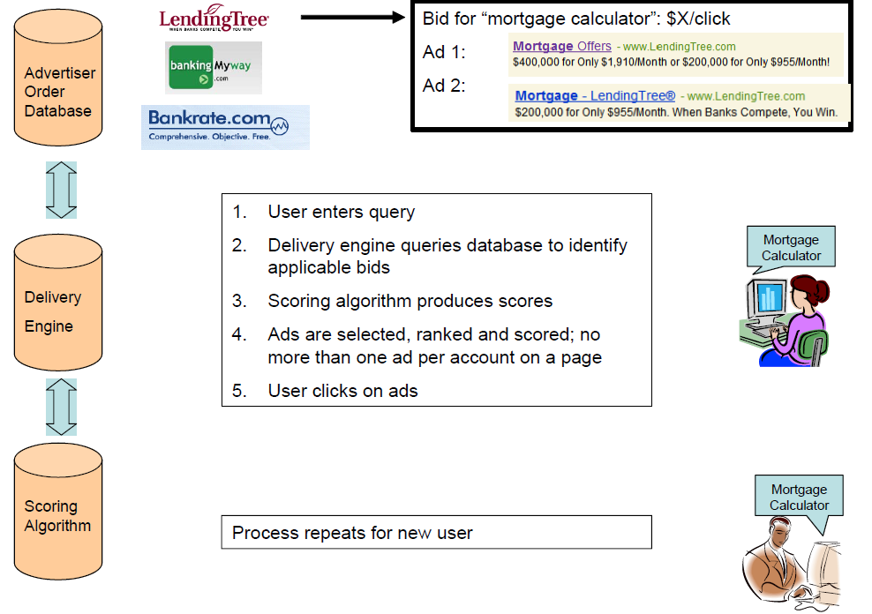

Slide 54
Reformulate Problem
This is just classic monopsonist problem
Can also relate it to more standard uniform-price auction objective function
Can estimate these quantities from search engine data by simulating impact of hypothetical bid changes

Slide 55
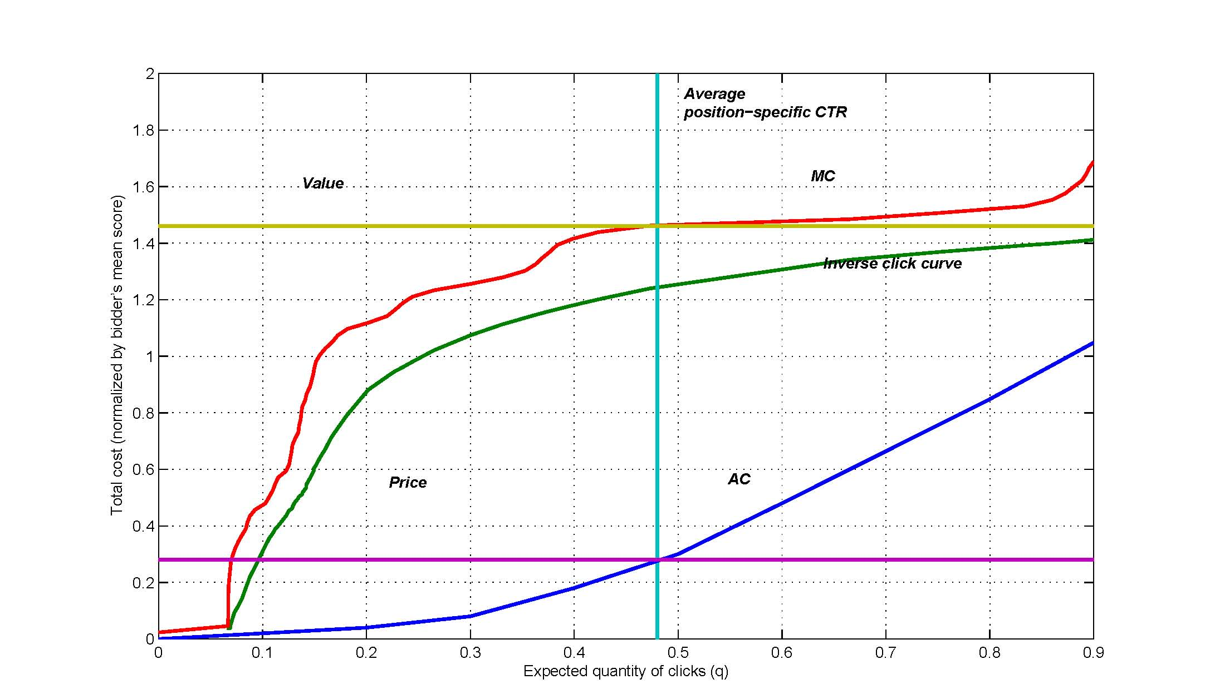
Estimates of AC(q), MC(q), and implied value for a high-value search phrase

Slide 56
Counterfactual Analysis
Once values known, can recompute equilibrium
See paper for existence/uniqueness, computational algorithm
See paper: Vickrey v. GSP (inefficiencies)

Slide 57
Reducing Click Prediction Accuracy Has Competing Effects: Reduced Welfare, Increased Revenue
Algorithm: | Before Coarsening | After Coarsening | After Coarsening
Bids: | Original | Original | Counterfactual
Welfare | 6.959 | 6.713 | 6.715
Revenue | 2.091 | 2.034 | 2.136
Advertiser Profit | 4.869 | 4.679 | 4.579
Revenue falls in short run experiment
Revenue rises when bids adjust
Athey & Nekipelov, 2011
Crucial role for advertiser modeling:
Short and long run revenue predictions go in opposite directions.

Slide 58
Search Frictions and Platform Design in Local Service Marketplaces
Trends
Marketplaces for local services (Uber, AirBnb, TaskRabbit, Zeel, Rover, UrbanSitter, etc.)
Market design shifts to emphasis on availability, responsiveness, low frictions
Farronato (2014) Task Rabbit
Model: workers search for jobs, respond to success rate
When demand doubles, workers work more, prices stay fixed. Supply highly elastic. If work was held constant, match rates would fall by 15%.
Fradkin (2014) AirBnb
Match rates < 40%
Use of filters within city/date >80%
>50% of requests rejected

Slide 59
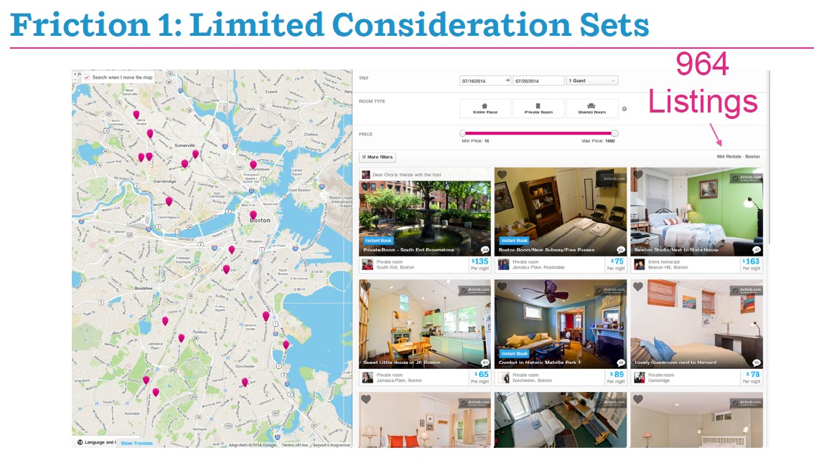

Slide 60
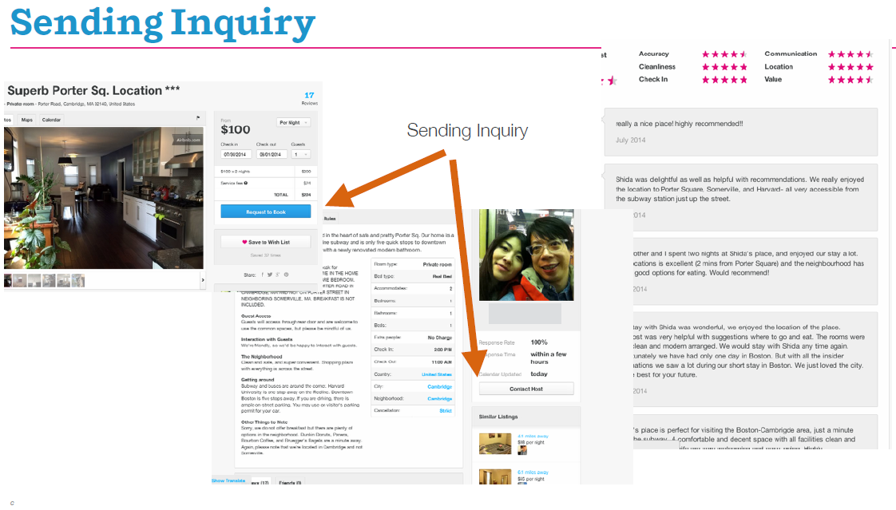

Slide 61
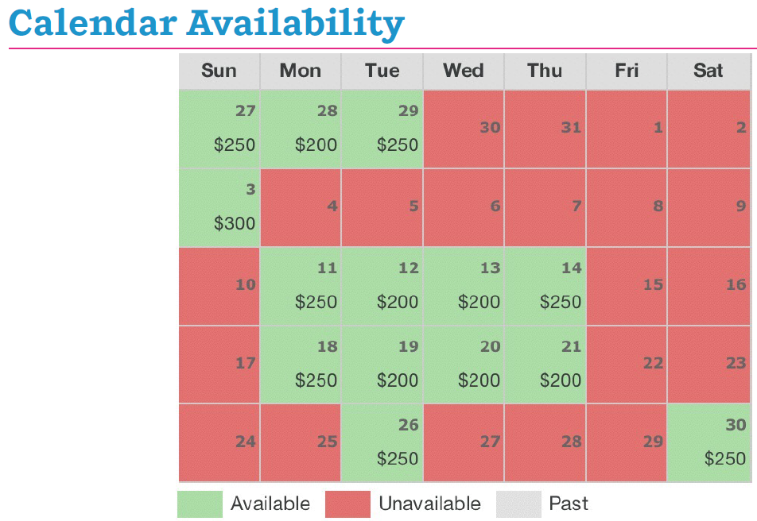

Slide 67
Summary of Model & Counterfactuals
Use model to predict effect of search algorithm improvements
Field experiments overstate effect, since improved search makes treated individuals get better listings, hurting availability for control individuals

Slide 68
Search on eBay
Consumer Price Search and Platform Design in Internet Commerce (Dinerstein, Einav, Levin and Sundaresan, 2014)
eBay re-organized search
Before: matches ranked by relevance
After: Prompted for specific product, then get results, ranked by price

Slide 69
Overview
Search costs play an important role in explaining retail prices
They help explain observed price dispersion and why retailers selling homogenous goods nevertheless can enjoy markups
Internet search costs, at least physical ones, are very low
General view that price competition has increased, reducing seller margins
Yet there is a lot of price dispersion – still because of search costs?
Platform design affects consumer search and price competition
Price search engines, Amazon, eBay, etc. generally want to facilitate price search and encourage competition between retailers
Retailers may resist this, e.g. by obfuscating (Ellison and Ellison 2009)
This paper: study price search and platform design, using browsing data + simple econometric model of price search and competition

Slide 70
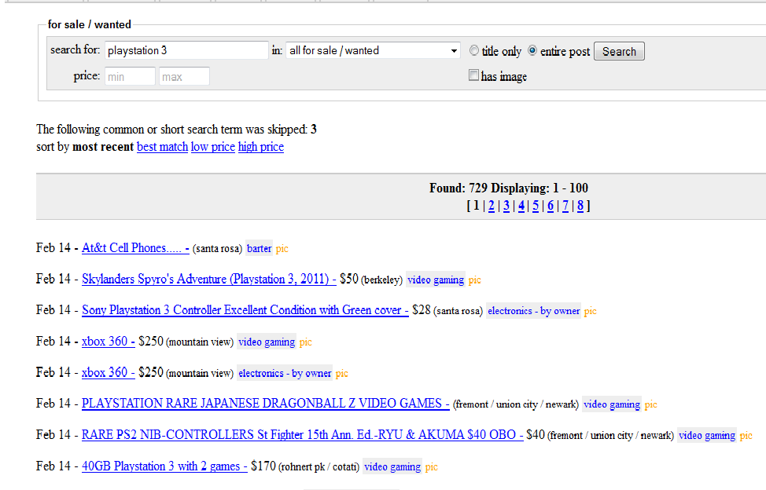
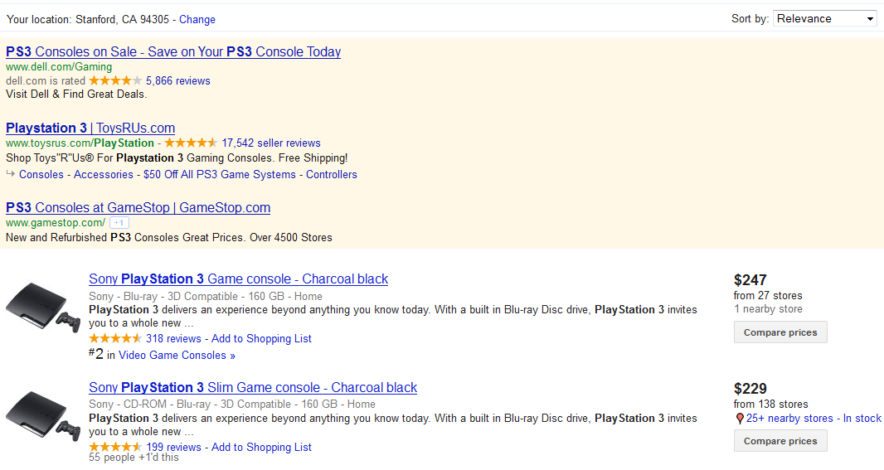

Different Approaches to Search Design
Craigslist
Google Shopping
Amazon

Slide 71
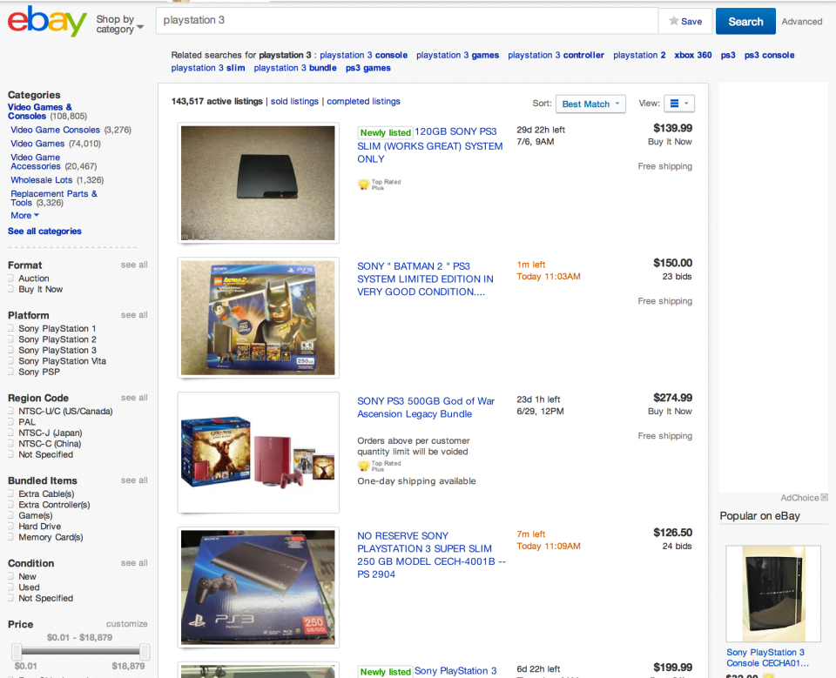
eBay’s Platform Change: Before

Slide 72
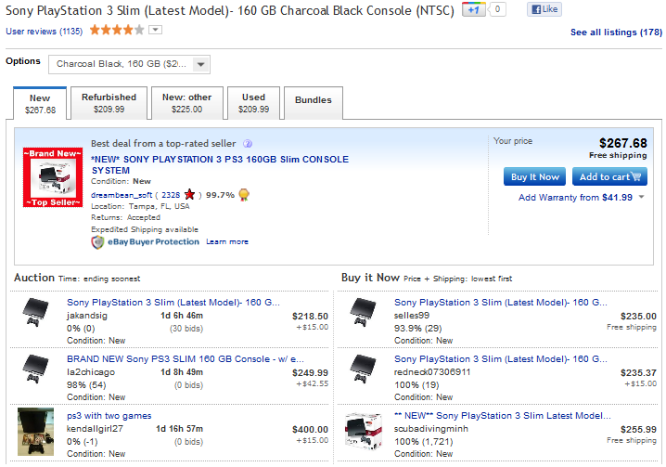
eBay’s Platform Change: After
“Product page” introduced May 18, 2011, was default from July 2, 2011.

Slide 73
Effects of the Platform Redesign
 | Cell Phones | Digital Cameras | Text Books | Vid. Game Systems | Video Games | iPhone 4
Number of Listings | 23.3 | 40.6 | 16.3 | 35.4 | 38.9 | 29.5
75th/25th posted price | 1.22 | 1.32 | 1.61 | 1.39 | 1.47 | 1.28
Transaction Prices
Before | 412.3 | 1,162.5 | 51.0 | 222.6 | 45.7 | 676.7
After | 403.8 | 980.1 | 42.9 | 257.2 | 42.2 | 554.8
 | -2.1% | -15.7% | -15.9% | 15.5% | -7.7% | -18.0%
Price Percentile of Purchased Items
Before | 40.1 | 31.8 | 29.8 | 17.3 | 27.8 | 37.4
After | 37.8 | 24.9 | 20.8 | 19.7 | 19.2 | 33.1
 | -2.3 | -6.9 | -9.1 | +2.4 | -8.6 | -4.3
Posted Prices
Before | 562.5 | 1,418.3 | 68.0 | 290.0 | 48.6 | 749.2
After | 462.9 | 1,170.8 | 63.1 | 285.1 | 48.1 | 567.7
 | -17.7% | -17.5% | -7.2% | -1.7% | -0.9% | -24.2%
Statistics for each category are averages across top 10 products in the category
Before period is April 6-May 18, 2011; After period is August 1-September 20

Slide 74
Effect of Platform Change (Halo Reach only)

Slide 75
Effect of Platform Change (Halo Reach only)

Slide 76
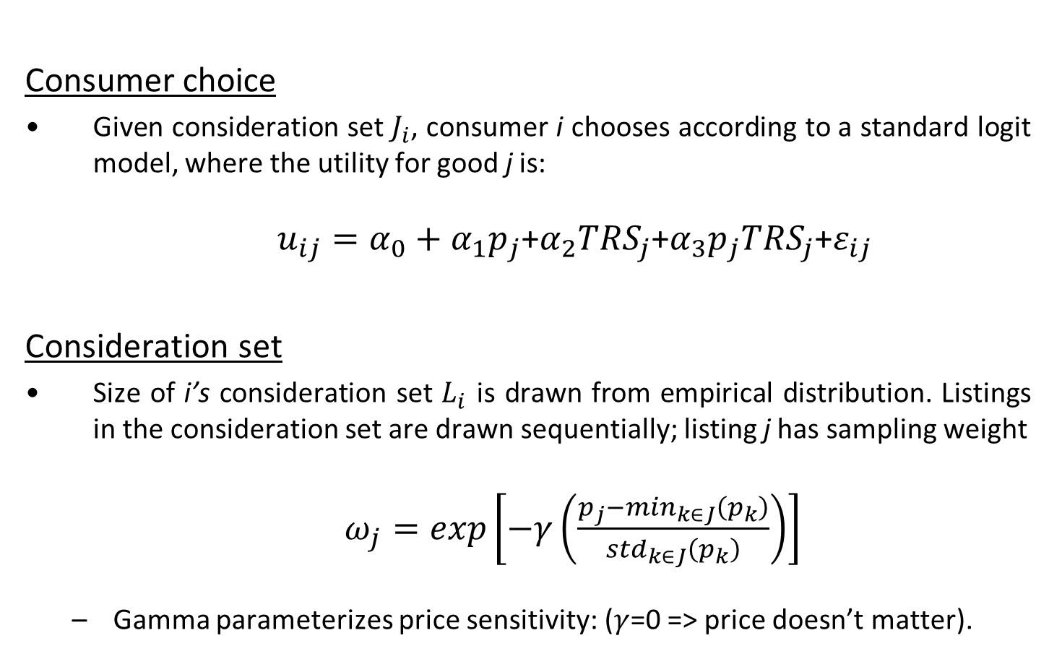
Model: Consumer Search & Choice
Consumer choice
Given consideration set $J_{i}$, consumer i chooses according to a standard logit model, where the utility for good j is:
$u_{ij}=α_{0}+α_{1}p_{j}$+$α_{2}{TRS}_{j}$+$α_{3}p_{j}{TRS}_{j}$+$ε_{ij}$
Consideration set
Size of i’s consideration set $L_{i}$ is drawn from empirical distribution. Listings in the consideration set are drawn sequentially; listing j has sampling weight
$ω_{j}=exp\left[−γ\left(\frac{p_{j}−\min_{k∈J}\left(p_{k}\right)}{{std}_{k∈J}\left(p_{k}\right)}\right)\right]$
Gamma parameterizes price sensitivity: ($γ$=0 => price doesn’t matter).

Slide 77
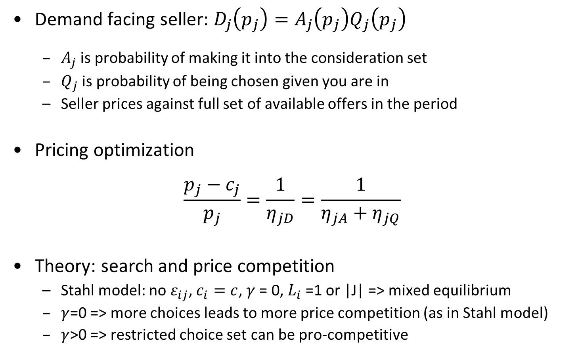
Model: Price Competition
Demand facing seller: $D_{j}\left(p_{j}\right)=A_{j}\left(p_{j}\right)Q_{j}\left(p_{j}\right)$
$A_{j}$ is probability of making it into the consideration set
$Q_{j}$ is probability of being chosen given you are in
Seller prices against full set of available offers in the period
Pricing optimization
$$\frac{p_{j}−c_{j}}{p_{j}}=\frac{1}{η_{jD}}=\frac{1}{η_{jA}+η_{jQ}}$$
Theory: search and price competition
Stahl model: no $ε_{ij}$, $c_{i}=c$, $γ$ = 0, $L_{i}$=1 or |J| => mixed equilibrium
$γ$=0 => more choices leads to more price competition (as in Stahl model)
$γ$>0 => restricted choice set can be pro-competitive

Slide 78
Model Estimates (using “before” data)
Demand parameters
 | Constant | 5.58 (0.54)
 | Price | -0.25 (0.02)
 | Top-Rated Seller (TRS) | 2.84 (1.34)
 | Price*TRS | -0.06 (0.04)
Implied price elasticities ("supply side")
 | Average Own-Price Elasticity | -10.97
 | Average Own-Price TRS Elasticity (Non-TRS) | -10.09
 | Average Own-Price TRS Elasticity (TRS) | -12.73
Pricing
 | Median Price - Cost (TRS) | 3.23
 | Median Price - Cost (Non-TRS) | 4.06
Purchase Rates
 | Observed | 0.103
 | Predicted | 0.106

Slide 79
Modeling the Platform Change
Fix the demand parameters and the cost distribution
Change L distribution to match empirical distribution (increased)
Adjust number of sellers on the platform (related?)
Increase gamma from 0 to 0.81
 |  |  | Before | After
 |  |  | (estimated) | (predicted)
Implied price elasticities ("supply side")
 | Average Own-Price Elasticity |  | -10.97 | -13.13
 | Average Own-Price TRS Elasticity (Non-TRS) |  | -10.09 | -12.24
 | Average Own-Price TRS Elasticity (TRS) |  | -12.73 | -14.85
Pricing
 | Median Price - Cost (TRS) |  | 3.23 | 2.70
 | Median Price - Cost (Non-TRS) |  | 4.06 | 3.23
Purchase Rates
 | Observed |  | 0.103 | 0.130
 | Predicted |  | 0.106 | 0.123

Slide 80
Increase in Price Elasticity of Demand

Slide 81
Evaluating the Platform Change

Slide 82
Evaluating the Platform Change
Here, we calculate pricing equilibrium based on estimated model
 | Median margin (TRS) $US |  | Median margin (non-TRS) $US | Purchase rate
“Before” Design | 3.23 |  | 4.06 | 0.11
Change in Size of Consideration Set | 3.23 |  | 4.06 | 0.11
Change in Gamma | 2.89 |  | 3.34 | 0.12
Change in Number of Sellers | 3.23 |  | 4.06 | 0.11
“After” Design | 2.70 |  | 3.23 | 0.12

Slide 83
eBay’s A/B Test
eBay ran an A/B test in the summer of 2012 (8/6-26/2012)
The test turned off (for the treated group) the most common way for a buyer to reach the product pages
Randomization at the user-session level
The test had a treatment group and a control, each accounting for 10% of traffic
The test found that revenues were 1.5% higher across the site for the treatment group and 10% higher in the relevant categories, leading eBay to subsequently implement the treatment for the entire US site

Slide 84
A/B Experiment
Test cannot include price equilibrium effects

Slide 85
Conclusion
Internet markets for well-defined retail products should look pretty close to textbook Bertrand competition, but they don’t always ...
Simple model that incorporates price search and potential seller differentiation as well as cost heterogeneity to try to explain observed outcomes, and analyze platform design
Two main findings
Search frictions and perceived differentiation help explain existence of mark-up, but frictions don’t really explain wide price dispersion
Search design can be important in creating price competition, by selecting choice sets and making “effective” demand more price elastic

Slide 86
Information Intermediation

Slide 87
The Economic Impact of Aggregators
Aggregators can substitute for the home page of a newspaper
Google search sends users to GN instead of directly to news sites; readers also go to GN directly
Less than half of GN visits result in visits to newspapers.
Readers can headlines & read snippets without clicking on articles
Fact: Over half of page views on Google news do not result in a visit to a news website
Aggregators can complement newspapers
Send traffic to online news sites. On the order of 10-15% comes from aggregators according to Murdoch
But would users go to news outlets without Google News?
Changes in the composition of news consumption
Reduces search costs
Makes users aware of new sites, potentially leading to long term loyalty
Decrease concentration of browsing
Fickle readers are less valuable (targeting, etc.)
Leads to lower advertising prices (Athey, Gans and Calvano, 2011)
Decrease visits to news outlet home pages
Curation role of newspapers declines
Google news is a substitute for newspaper editors in terms of choosing which articles to highlight for users

Slide 88
Summary: Aggregators
Aggregators (Athey, Mobius, & Pal, 2016):
Complement news overall in the short run
See also Chiou and Tucker, 2012; Calzada & Gil, 2016
Substitute for large outlets
Change the composition of browsing; users have a hard time finding substitutes for breaking, “scarce” news
Affect distribution of browsing and thus ultimately the market structure for news
Redistribute users
To a much wider variety of outlets
Away from large outlets and towards small outlets
This is a theme for intermediaries: allows small firms to compete with large ones
Welfare ambiguous

Slide 89
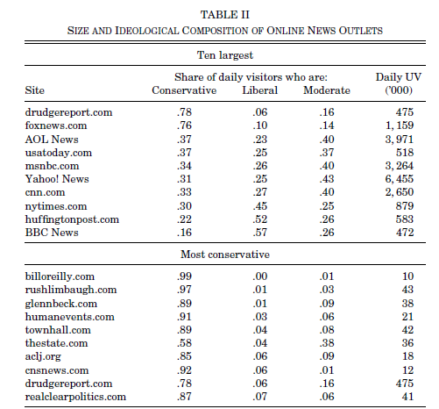
Gentzkow and Shapiro, 2011

Slide 90
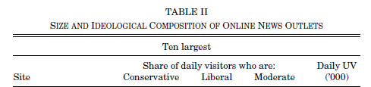
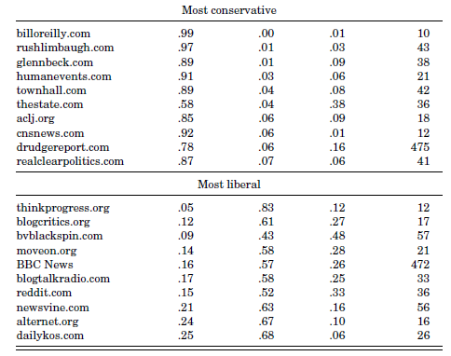
Gentzkow and Shapiro, 2011

Slide 91
Gentzkow and Shapiro, 2011

Slide 92
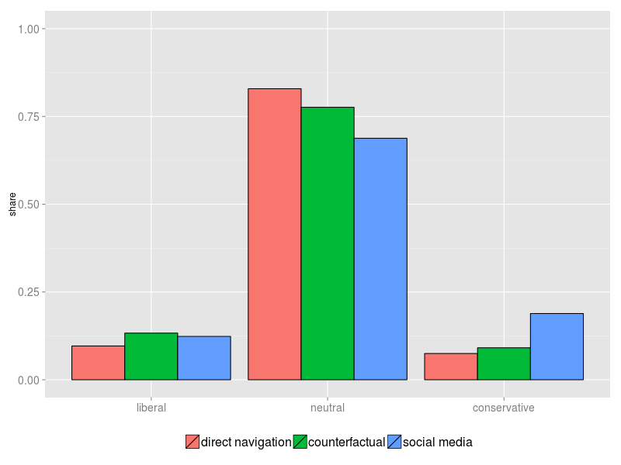
Political bias: potentially biased topics only
Counterfactual: topic decomposition. Green bars show what DN consumption would look like if topic mix was the same as SM.
Athey, Mobius & Pal, 2014, pilot sample

Slide 93
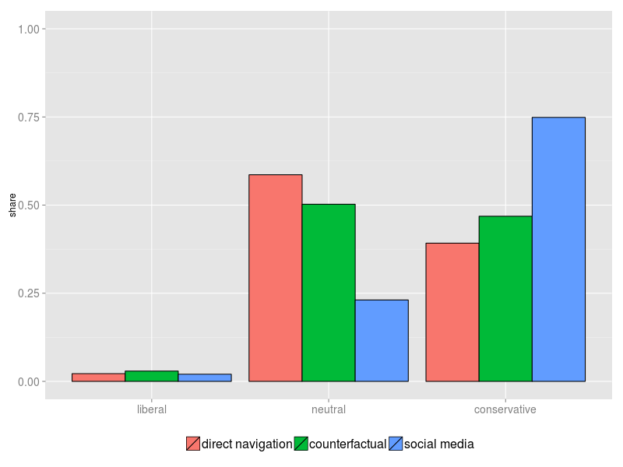
Political bias: conservatives only
Counterfactual: topic decomposition
Athey, Mobius & Pal, 2014, pilot sample

Slide 94
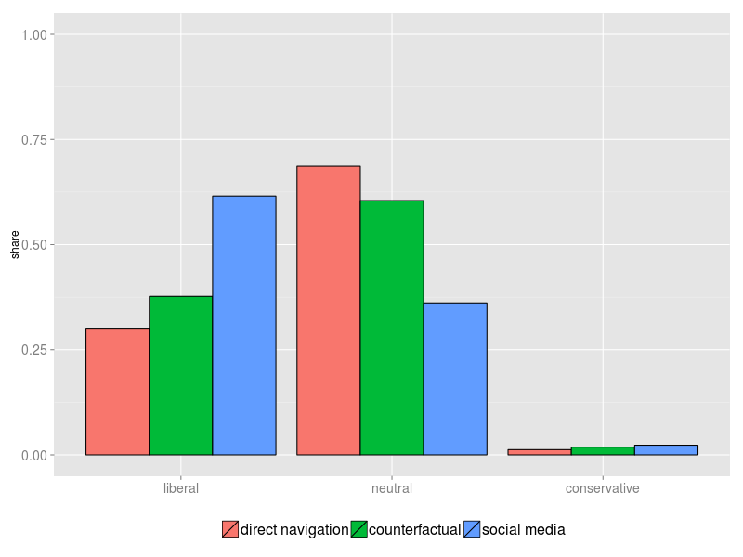
Political bias: liberals only
Counterfactual: topic decomposition
Athey, Mobius & Pal, 2014, pilot sample

Slide 95
Political bias: summary
SM is more biased than DN
Particularly striking for conservatives and liberals
Outlets vary a lot in their audience and coverage of topics
We also have done additional analysis to show that political bias is more a function of topic than of outlet
Evidence in favor of “filter bubble”
Need to account for limited set of articles potentially biased when analyzing the filter bubble

