Slide 1
Has Moore’s Law Been Repealed? Empirical Analysis of Innovation in Semiconductors
Ken Flamm
March 2017

Slide 2
Semiconductors are important
See Jorgenson, Oliner, Sichel, Aizcorbe, Byrne, Corrado, Doms etc.
Technological foundation of IT industries
Historically, measured poorly in official price indexes
Measurement situation got better for a while in late 1990s, early 2000s
Problem is now getting worse, not better
Private data is getting worse
US public data non-existent

Slide 3
“Moore’s Law” is Industry Bumper Sticker for One Very Important Source of Technological Innovation in Semconductor Manufacturing
Refers to effect on manufacturing cost of regular, predictable adoption of new fabrication technology which shrank chip size as patterned on surface of silicon wafer
Predictably lowered cost per transistor by 20-30% annually for commodity chips
Lowered cost for most types of chips
Most chip designs eventually migrated to new technology eventually
Not the only source of innovation in semiconductor manufacturing
Additional innovation in semiconductor circuit design and functionality
Will discuss evidence suggesting Moore’s Law has recently slowed, and is effectively approaching end
Will link to available price data for industry

Slide 4
“Moore’s Law” is Shorthand for Economics of Semiconductor Industry
mfg cost: $/element = $ processing cost x silicon area area yielded silicon element
Intel’s 2015 version:

Slide 5
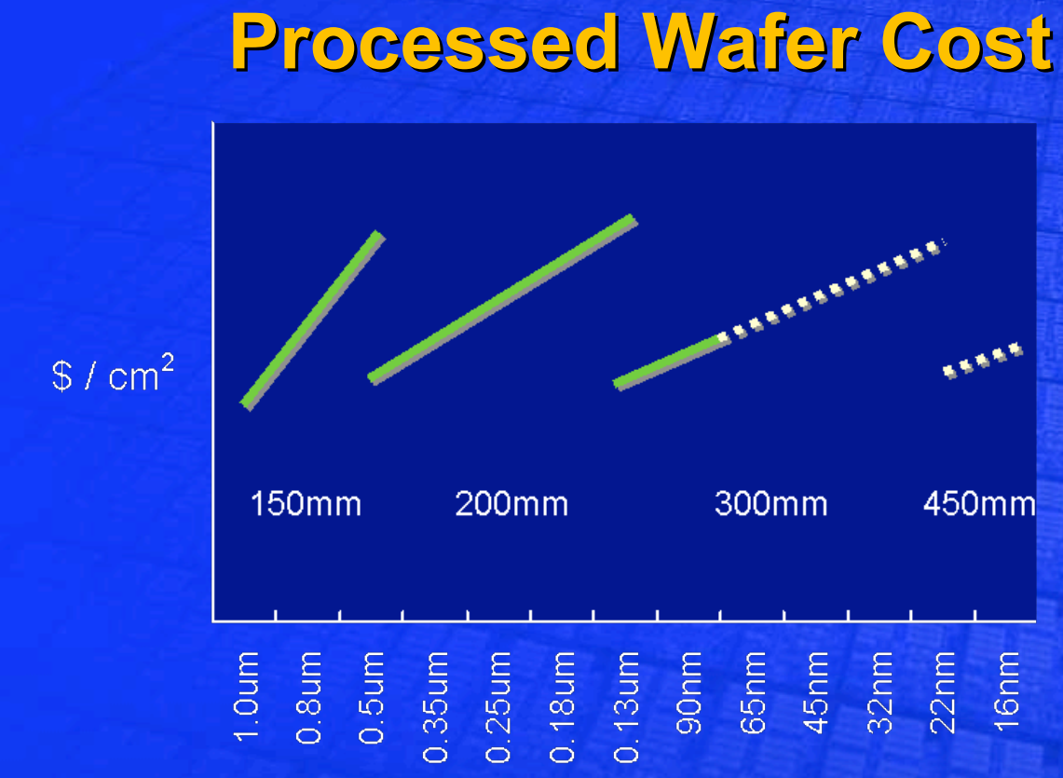
Wafer Processing Cost
Intel view, 2005:
Chips are fabricated on silicon wafers
Processing cost / area ≈ close to constant, in historical long run
Index of patterning process is “critical feature size”
Measured in nanometers (nm)
But 450mm wafers didn’t happen
Processing cost/ area increasing
Since 90nm technology “node”

Slide 6
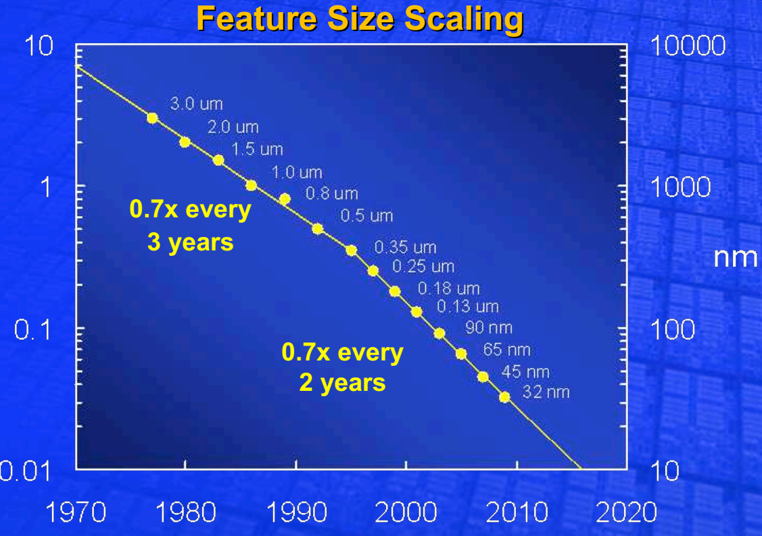
Silicon area/transistor
Silicon wafer area/transistor ≈ 50% reduction every new process tech node
Every new process has “critical feature size” 30% smaller than last process
.7 x .7 = .49 ≈ .5
Double the density of electronics
New process (technology node) every T every N years
N ≈ 3 prior to 1995
N≈ 2 1995+
Intel slide, 2005➔
2-year cadence didn’t last forever!
N ≈ 3+, 2014+

Slide 7
Implications
Assume historical pattern
Last “reset” occurred at 130nm ~ 2002
Cost/transistor drops ≈ 21% annually when T=3
Drops faster at 29% annually when T=2

Slide 8
Implications for Price Measurements
One very simple way to think about it
ΔP = Pass-through rate x ΔCost
Pass-through = 1 in perfectly competitive industry
< = > 1 in imperfectly competitive industry
Frequently measure empirical pass-through rates around 1 in electronics industries
Benchmark ideal for “pretty competitive” industry:
Price decreases reflect cost declines
Pass-through close to 1 would imply 20-30% decline in price of given electronic circuit design if moved to to leading edge technology generation
Additional innovation would imply even larger declines in quality-adjusted prices
Moore’s Law as “floor” on average quality-adjusted price decline: 20-30%

Slide 9
But wait, there’s more…
Pure reduction in manufacturing cost shouldn’t require any special quality adjustment in measuring price index, but…
Smaller transistors also switched faster
Smaller transistors also drew less power
Cheaper transistors and smaller size made it economic to add additional functionality to chip
Additional benefits add value, increase decline in quality-adjusted price, make quality-adjustment necessary

Slide 10
And…
Faster ended in 2004
Lower power now requires tradeoffs
Don’t get it for free with smaller/denser any more
Log(Processor Speed)

Slide 11
Do we see a deceleration in chip prices?
Memory chips
Micron Tech:
--“technology- driven growth slows due to scaling limits”
--16nm will be last
technology node
for flash memory

Slide 12
Outsourced semiconductor manufacturing (1/4 – 1/3 of industry output)
Fabless design companies major players now in US chip industry
Qualcomm, Broadcom, Nvidia, AMD, etc.
Quality-adjusted price index for chips fabricated at “foundries”
Byrne, Kovak, & Michaels, 2016

Slide 13
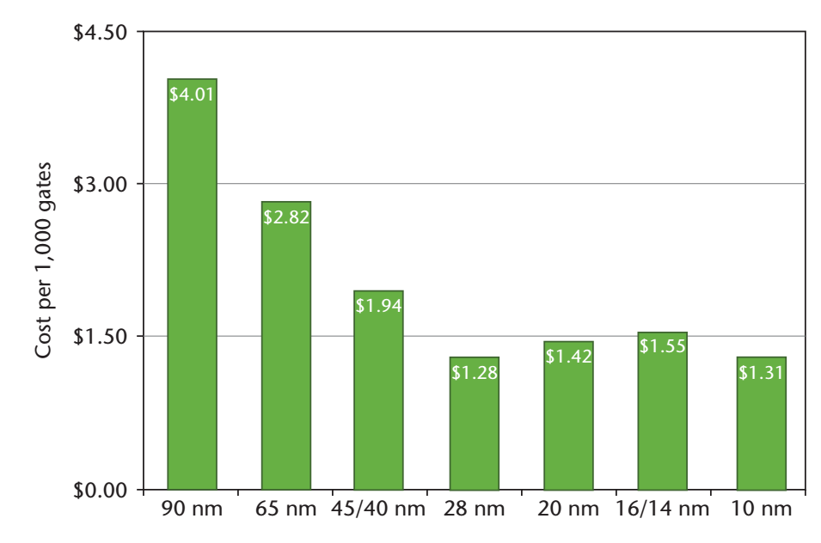
Fabless Chip Designers Now Say Transistor Cost is Pretty Flat

Slide 14
Is Intel an Exception?
Reasons to think they could be:
Scale economies at company level
$5-$10B for a leading edge fab now
Only 4 companies in world currently investing in leading edge fab technology
Intel, Samsung, TSMC, Global Foundries
Latter two are “pure” foundries, aggregating outsourced designs of others
But we just saw what was happening to foundry prices, so not a good explanation
Scale economies at product level
Fixed design and photomask costs have increased exponentially at recent tech nodes
Fancy “computational lithography” with multiple photomask steps for single chip feature pattern
immersion in liquid, phase shift masks, computer modeling of lens system now required at recent tech nodes
Masks extremely expensive, twice as many process steps required at 22nm vs. 90nm (per Intel)
Intel has enormous volumes– maybe 300-400 million processors a year (in 2014) using a small number of basic designs/mask sets
Smaller fry do not have this advantage

Slide 15
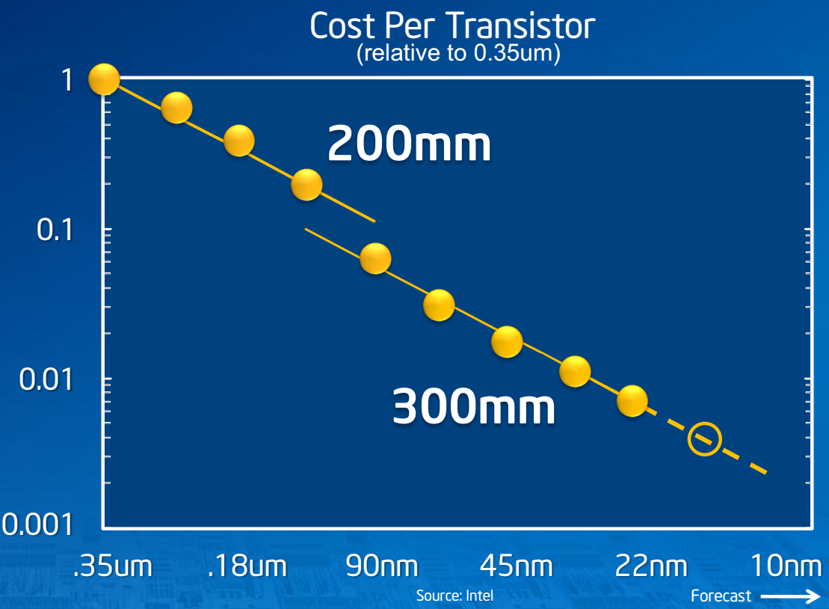
Is Intel an Exception?
2012 Answer: Maybe not…
Fabrication cost per transistor per Intel Investor Meeting, 2012:

Slide 16
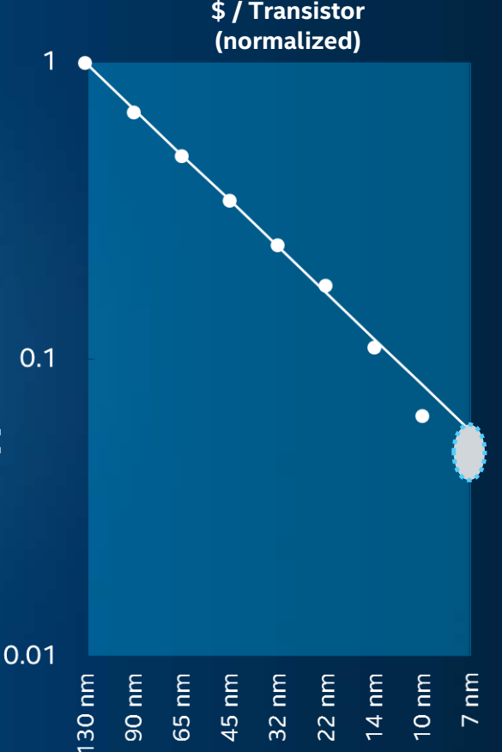
Is Intel an Exception?
Intel Investor Meeting, 2015:
2015 Intel answer: YES!
Can only speculate on reasons for restatement…?

Slide 17
Is Intel an Exception?
Doesn’t look that way in Intel 1K tray price data sheets
If you take Intel tray chip prices and do a hedonic price regression on a very complete set of chip characteristics, you get something like:

Slide 18
Similar Pattern in Other Processor Price Indexes
Note: improved retail price indexes coming soon

Slide 19
Counter-point (Byrne, Oliner, Sichel, 2015-6)
Intel list price data is unreliable after 2006
Trim post-introductory list price data after 2006, only use initial price
Use SPEC CPU Benchmark scores instead of detailed chip characteristics in hedonics
Get ~40% annual decline throughout post-2000 period

Slide 20
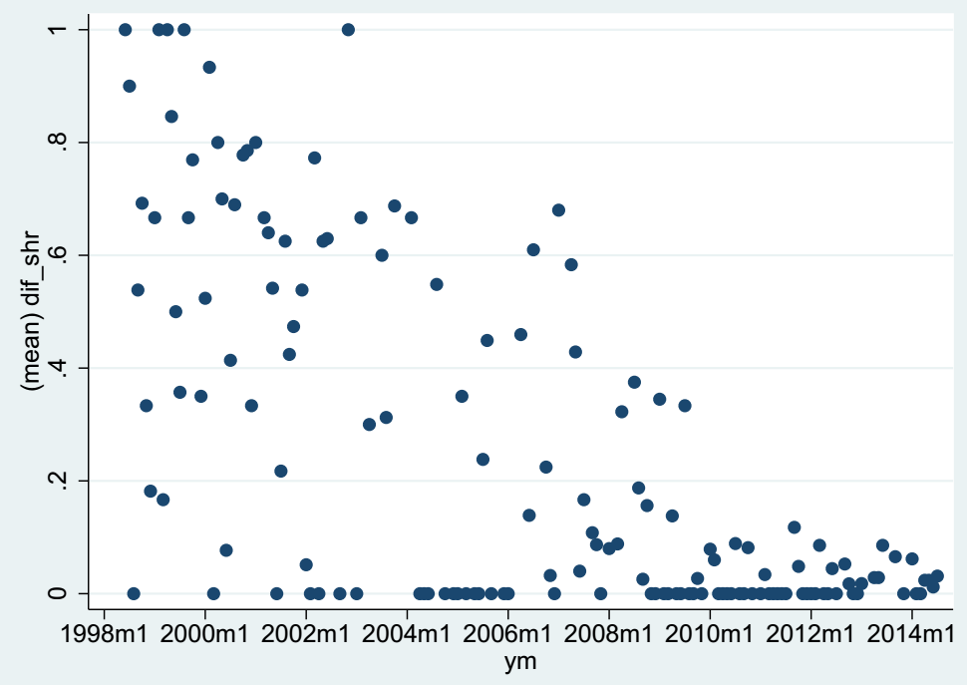
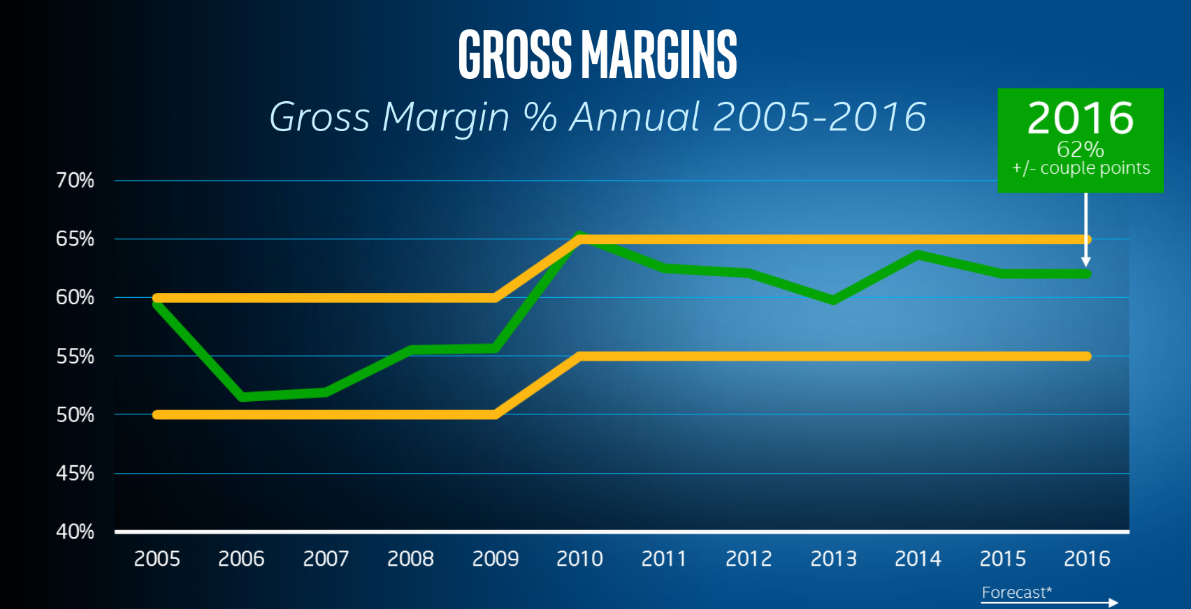
Counter-counter point
No sudden change in Intel pricing practice after 2006
Break, if any, after 2010– coincided with Intel margin elevation effort
Can test econometrically by looking at relation between Intel list 1K tray and observed retail price, test for shift after 2006…
no shift, list prices look real
Fraction of Intel Desktop Processor Prices Changing From One Price List to the Next
From Intel Investor Meeting, 2015:

Slide 21
What about CPU Quality Metrics?
Have recently been told that BOS ~ constant decline rate after 2000 is result of use of SPEC Benchmarks instead of CPU characteristics in hedonic model, not trimming of incumbent models from sample
But fundamental performance equation in computer architecture literature says benchmark performance should be well approximated by loglinear model using processor characteristics
Should include processor speed, # cores & threads, autoparallelization used in compiler, possibly on-chip cache sizes
Alternative specifications should be nested and tested statistically
Estimation of time trend in SPEC CPU benchmarks shows decline in performance improvement rate after 2006
(autoparallelization switch on in compiler used as control in estimating time trend)

Slide 22
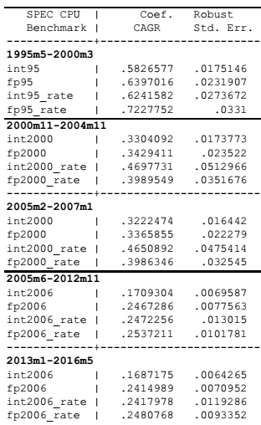
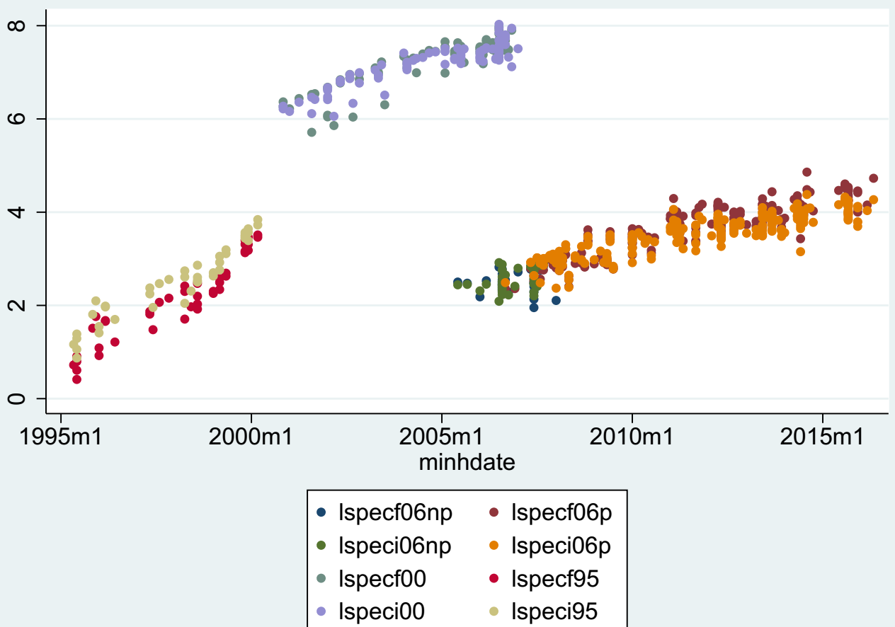
Desktop CPU Quality Metrics
Ln(Median Intel Desktop CPU Score)

Slide 23
Conclusion
Clear evidence of slowdown in price declines for high volume chip types
This is NOT the end of innovation in semiconductors
Just an important general purpose manufacturing technology dynamic within semiconductors, delivered a 20-30% annual cost decline for 40 years
Current focus in memory chips is 3-D device manufacturing using present technology nodes
Focus in mobile chips is clever software/firmware to reduce power use, better device integration
Intel has doubled down on Moore’s Law, so debate goes on
Can Moore’s Law last forever another decade?
Quoth the raven: “Never Moore”
Apologies to Poe, couldn’t find a funny Moore cartoon

