Slide 1
BEAs ICT Prices: Historical Analysis and Future Plans
Ana Aizcorbe & Dave Wasshausen
Conference on Research on Income and Wealth
Washington, DC
March10-11, 2017
Bob Kornfeld
Bureau of Economic Analysis
March 4, 2014

Slide 2
BEA ICT Prices
Recent focus on harmonizing accounts with international guidelines and promoting international consistency
Renewed emphasis on improving quality adjusted prices for information and communication technology products.
Digital Economy work with NTIA and ESA
New funding from NTIA
Motivated by recent research

Slide 3
Historical Overview: BEA ICT Prices
BEA’s collaborative work with IBM 1980’s
Experimental PPIs in the late 80’s
Semiconductors 1990’s
PCs late 1990’s
Photocopying equipment early 2000’s
Software early 2000’s
Purchased and own-account (function points)

Slide 4
BEA Computer Prices

Slide 5
BEA Computer Prices: Historical Documentation
Improve documentation tracks, by component, how BEA models changed over time, and when BEA adopts PPIs
Original form of chosen equation for mainframes:
1996 Comprehensive Revision the model was modified as follows:
PPI for large scale and mid-range fully incorporated 1998

Slide 6
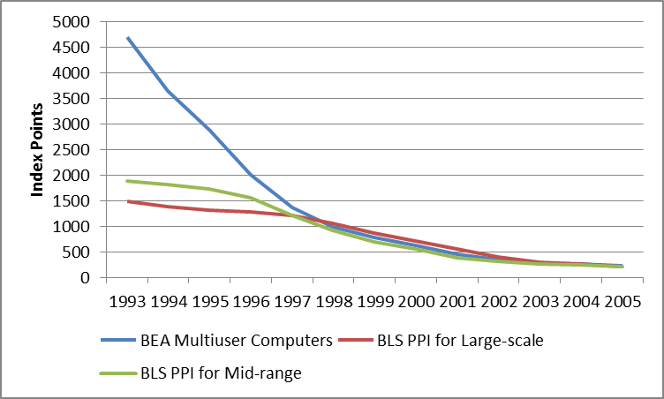
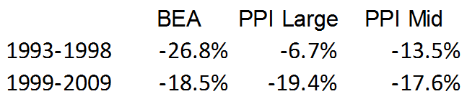
BEA Multiuser Computers Price Index

Slide 7
Communications Equipment Price Index

Slide 8
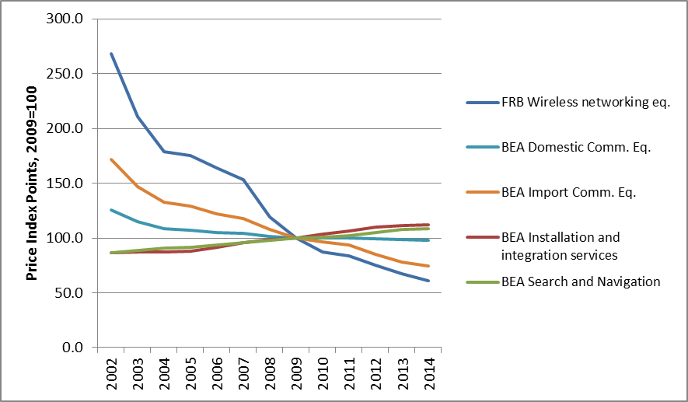
BEA Communications Equipment Price Index

Slide 9
BEA Software Price Indexes
BEA adjustment for prepackaged software reflects historical differences between BEA hedonic and various matched-model price indexes.
Input-cost measure includes compensation and intermediate inputs (including depreciation)

Slide 10
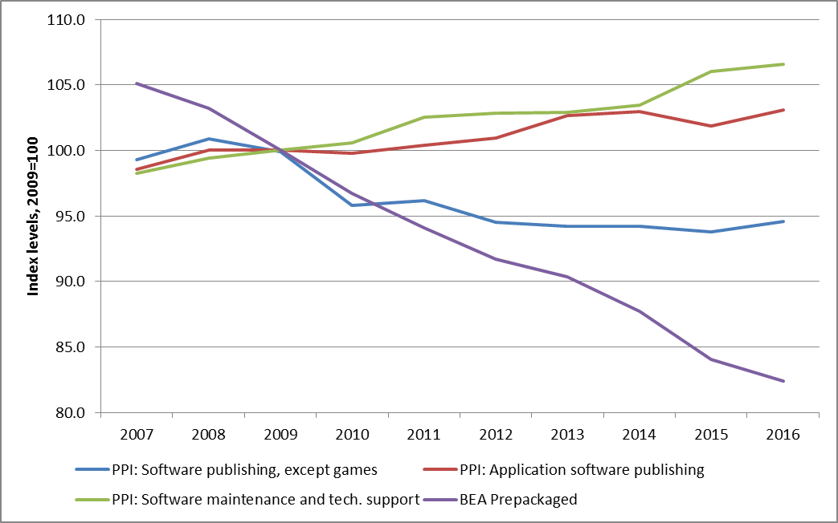
BEA Prepackaged Software Price Index

Slide 11
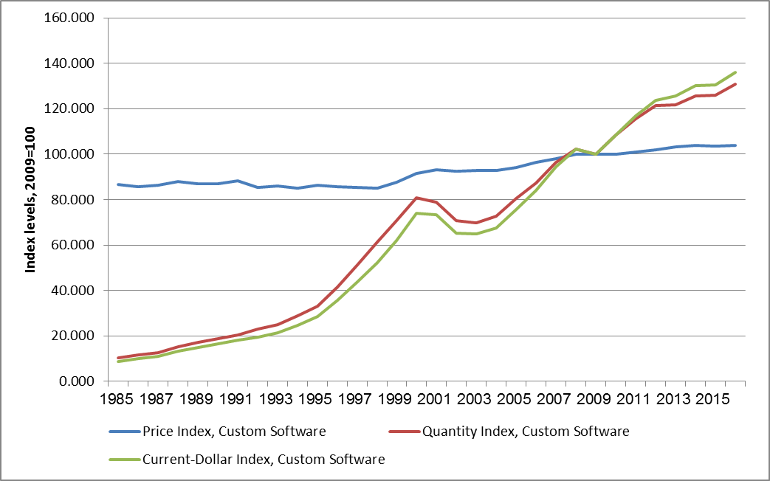
BEA Custom Software: Price, Quantity & Expenditure

Slide 12
Looking Forward: Custom and OA Software
Almost $270 billion in fixed investment in 2015
Prices primarily reflect input-costs
Recently purchased an extensive database tracking prices, functionality, and quality
8000 observations, spanning years 2006-2014
Average annual rate of decline of price per FP is about 5%

Slide 13
Looking Forward: Packaged Software
BEA adjustment is old and will be updated with the 2018 CR
Trade-offs between using aggregate vs detailed PPIs for software publishing

Slide 14
Looking Forward: Communication Eq
Planning to collaborate with FRB with an aim toward taking over selected FRB price indexes
As part of 2012 I-O Benchmark, update deflation-level categories to more closely align with current products

Slide 15
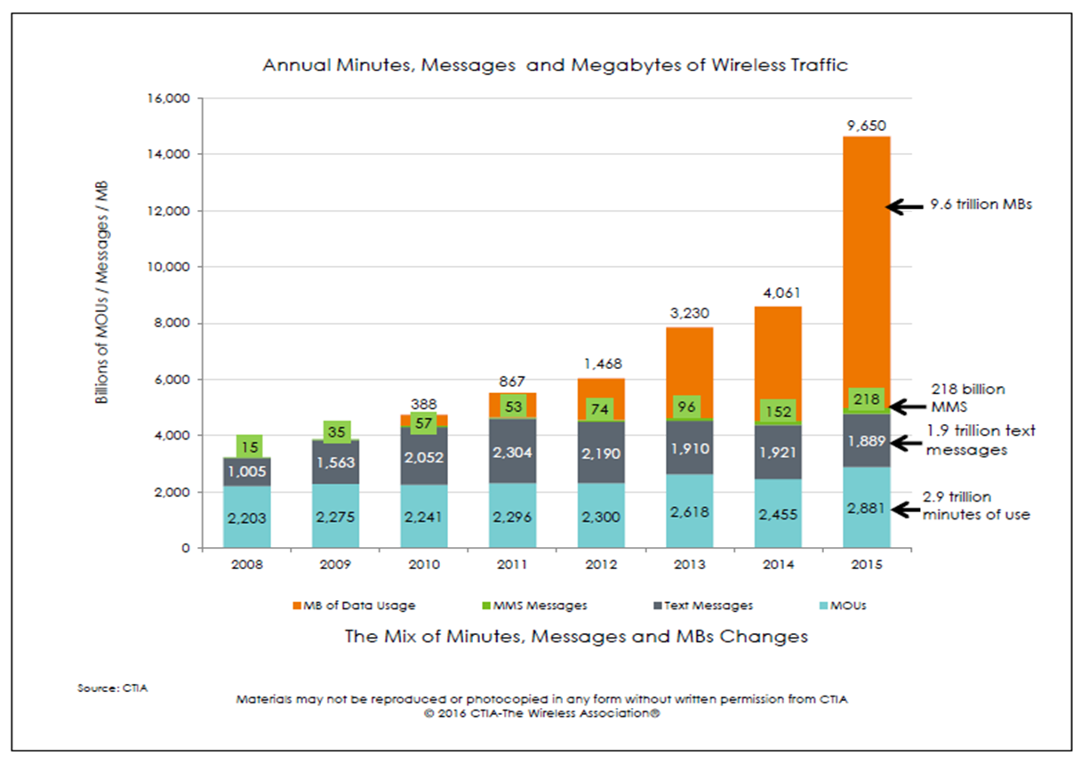
Looking Forward: Wireless Services

Slide 16
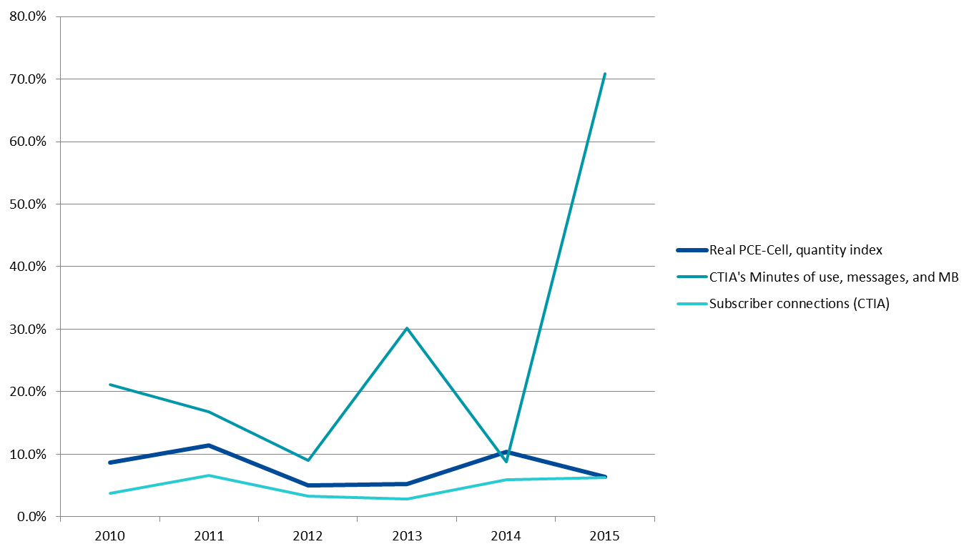
Looking Forward: Wireless Services

Slide 17
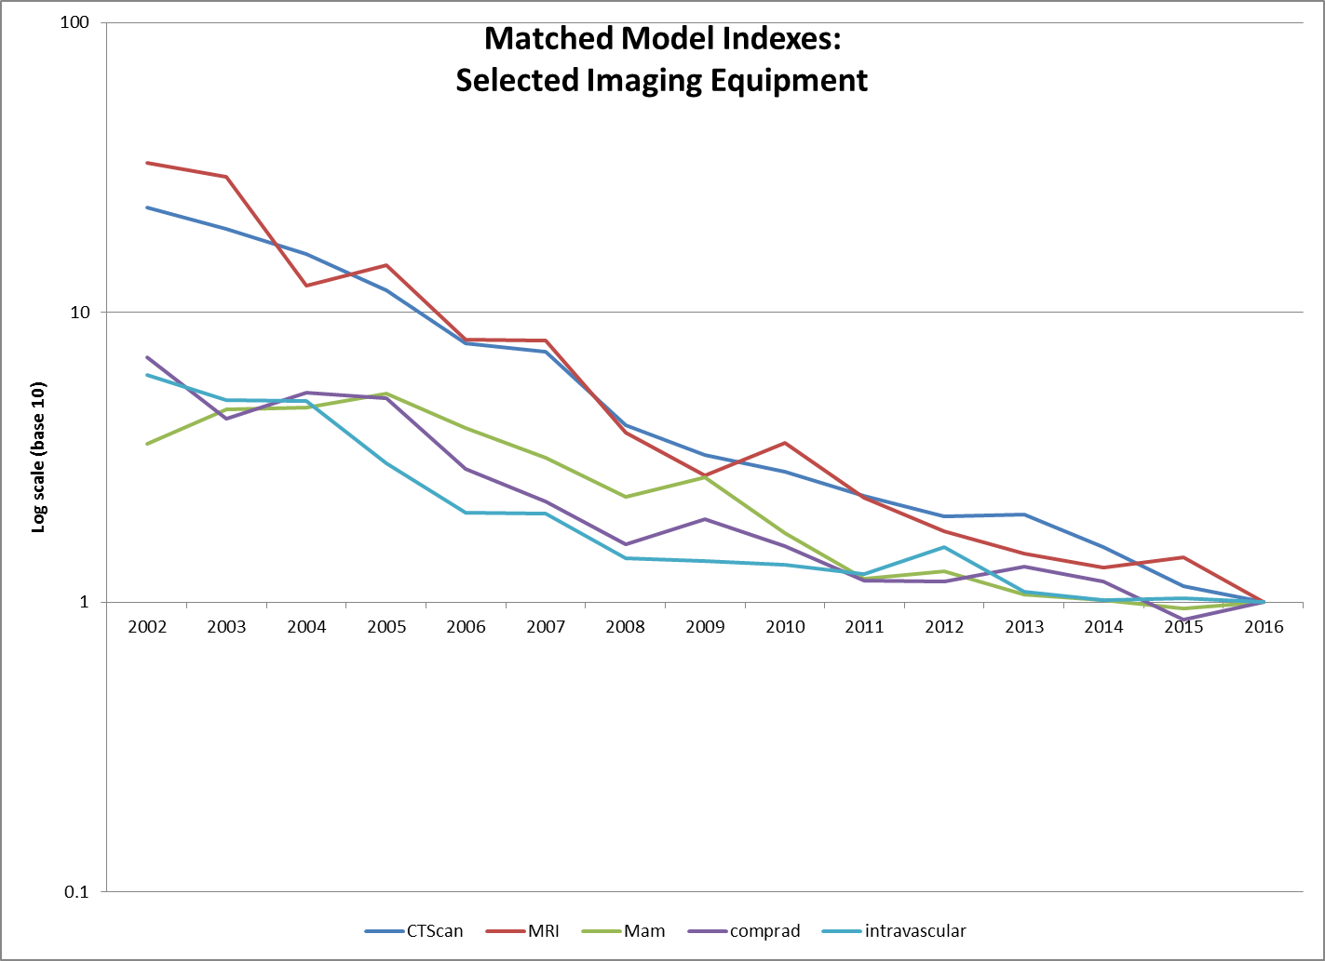
Looking Forward: Medical Equipment
Source: Authors’ calculations based on ECRI data

Slide 18
Looking Forward: Medical Equipment
Price Change for Selected Imaging Equipment Categories vs Aggregate PPI, 2010-2016
(compound annual growth rates)
BLS Producer Price Indexes |  |  |  |  |  |  |  | 2010-2016
 | X-Ray and Electromedical Equipment |  |  |  |  |  |  | -0.49%
 |  | Irradiation Equipment |  |  |  |  |  | 0.08%
 |  | Electromedical Equipment |  |  |  |  |  | -0.58%
ECRI Matched Model Indexes
 |  | Scanning Systems, Magnetic Resonance Imaging |  |  |  |  |  | -18.99%
 |  | Scanning Systems, Computed Tomography |  |  |  |  |  | -23.03%
 |  | Radiographic Systems, Digital, Mammographic |  |  |  |  |  | -10.90%
 |  | Image Digitization Systems, Computed Radiography |  |  |  |  |  | -11.55%
 |  | Scanning Systems, Ultrasonic, Intravascular |  |  |  |  |  | -11.52%
Source: Authors’ calculations based on BLS PPIs and ECRI data

Slide 19
Conclusion
Improving BEA ICT prices is a high priority
Current and future activities:
Research and development
Collaboration
Efficient use of resources
Joint products and papers

