Slide 1
How innovative are innovators?—
A multidimensional perspective
Wesley M. Cohen
Duke University and NBER
You-Na Lee
Georgia Tech
John P. Walsh
Georgia Tech
NBER, Washington
March 10, 2017

Slide 2
Background and motivation
Background: Widespread and growing use of surveys to measure innovation
  Major effort to date: Europe’s Community Innovation Survey, w/ more recent NSF’s BRDIS effort
Challenges of interpretation
  What do respondents mean when they report innovation? (New color toothpaste? The first 3D printer?)
  Are the reported innovations important?—
  If important, in what sense?
=> Can innovation surveys achieve greater interpretability and precision?
=> Can they be designed to provide a basis for understanding impacts on social welfare
Notes:
A new color toothpaste or the first 3-D printer?
What respondents mean will affect interpretation of findings

Slide 3
Agenda
Where and how innovations surveys fit into the measurement of innovation.
Our approach
  Focus on key characteristics of a specific innovation
Data and descriptives
Illustrative applications of survey data that reflect this approach
  Interpretability
  Offering insights and raising questions

Slide 4
Where does an innovation survey fit in?
Conventionally employed data
  R&D
  Patents
Critical starting point: Invention v. innovation
  Invention
    A discovery or creation of a novel artifact (tangible or intangible)
  Innovation
    Introduction to the market (i.e., commercialization) of a new product, process or service

Slide 5
R&D `
Widely accessible source of audited/vetted data
Measure of a key input
  Limitations
    Inputs internal to the firm other than R&D
      Mansfield (1968): R&D~50% of cost of innovation
      Process innovation due to learning by doing
    Flow vs. stock: Challenges in estimating the knowledge stock
    About half of firms’ innovations acquired from outside sources (Arora et al., 2016)
    Other issues
      Neglect of small firm R&D
      R&D spillovers

Slide 6
Patents `
Widely accessible, vetted and curated data
  Patent data lend themselves to creative use and measure construction; some of the measures resemble measures constructed in current paper
A measure of invention, not innovation
As a measure of invention?
  Patent propensity varies across industries and across firms within industries
As a measure of innovation
  Relatively few patents are commercialized
  Correspondence between patents and innovations variable (e.g., complex v. discrete product industries)

Slide 7
What do surveys bring to the measurement party?
Types of surveys related to innovative activity
  R&D and its correlates
  Surveys of inventors of patented inventions
  Surveys tracking innovation, notably the Community Innovation Survey (CIS)
We focus on the latter
Argument
  Innovation surveys can fill an important hole (i.e., innovation) and complement the other types of data
  Another virtue: Innovation surveys are a more flexible vehicle (depending on timing)

Slide 8
Approach

Slide 9
Approach I: “Division of Innovative Labor” (DoIL) innovation survey (Arora, Cohen and Walsh, 2016)
New-to-the-firm (NTF): “In 2009, have you earned revenue from any new or significantly improved goods or services in [INDUSTRY] introduced since 2007, where “new” means new to your firm?”
=> Respondent’s most important innovation
  “Of all the new or significantly improved products or services you brought to market in [RESPONDENT INDUSTRY] during the three years, 2007-2009, think of the one that accounts for the most revenue.”
  “Did you introduce this innovation in your industry before any other company?” (New-to-the-market, NTM)
  → If YES, then respondent is an “innovator”
  Note focus on an identified line of business (i.e., business unit)

Slide 10
CIS framing `
CIS asks questions about innovation at the firm level
Revenues and innovation
  What percent of the firm’s total turnover in 2014 was from world-first product innovations intro’d between 2012 and 2014”?
Examples of other questions
  Types of partners
  Licensing
  Barriers to innovation

Slide 11
Approach II: Multidimensional perspective
Collect data on the characteristics of innovations per se.
Why not just jump to outcomes?
Useful for managers and policy makers to know what kinds of innovation are worth supporting.
Poses question:
  What features to focus on?
  =>Those with potential social welfare impact.
But mapping from features to impacts not straightforward
  E.g., self-service shopping, high temperature superconducting materials

Slide 12
Data
Sample frame
  Dun and Bradstreet, stratified by industry (28 3-4 digit NAICS in manufacturing and selected service inds., including software and engineering services), firm size (6 strata) and startup status
Sample
  > 22,000 firms
  Oversampled large and startup firms and innovative industries
Phone survey: marketing or business mgrs (this is an innovation, not an R&D, survey)
6,685 responses (30.3% response rate)
For paper, excluded out of population and tiny firms (< 10 employees) => 5,871 in sample.
  Manufacturing sector: 5,157
  Selected service sector industries: 714

Slide 13
Innovation rates
Manufacturing
  New-to-the-firm: 42%
  New-to-the-market: 16%
Selected service industries
  New-to-the-firm: 47%
  New-to-the-market: 18%
In line with Germany and UK CIS
But what do these numbers mean?
Are the innovations important?
In what sense?

Slide 14
A proposal: The dimensions
Technological significance: How technologically different?
Utility: How pervasive the need for this relative to current offerings? How acute?
Distance: Implementation gap; Innovation and innovating firm specific
Uniqueness: Anyone else coming up with a similar idea?
Replicability: How easy to knock off.
Others?
=>All of these can be argued to impact social welfare, but: Do they? How? When? (i.e., under what conditions?)

Slide 15
Construction of the survey-based measures of dimensions
Technological significance
  Is there a patent on either the innovator’s innovation or, if acquired from the outside, did the outside entity have a patent? (PATENT)
Utility:
  % business unit sales accounted for by the respondent’s most important product (INNO SALES)
Distance:
  To commercialize the product, did the respondent:
  Develop new sales and distribution channels?
  Invest in new types of equipment or hire employees with distinct skills?
  (Whether both reported: NEW CAPAB)

Slide 16
Measures (cont.)
Replicability:
  The number of firms that “have intro’d or are likely to introduce a competing innovation” (TECH RIVALS)
    A measure of the intensity of technological competition
Other measures
  Innovation rate: % of firms within an industry that introduced a New-to-the-Market (NTM) innovation (INNO RATE)
  Imitation rate: % of firms that reported New-to-the Firm (NTF) innovation, but no NTM innovation (IMIT RATE)

Slide 17
Bad news and good news
The survey not designed for the purpose at hand, but to characterize the “division of innovative labor”—the degree and nature of firms’ reliance on outside sources for their innovations.
All but one of the measures conflate features of the innovation with realized or expected market payoffs to the innovation.
  So, can’ t cleanly address questions such as: what’s the effect of “distance” on economic return.
Upside: Most of the measures reflect realized or expected market outcomes tied to dimensions, providing basis for addressing the question of whether a reported innovations are economically important and in what sense.

Slide 18
Illustrative Application:
Interpretability wrt Importance

Slide 19
Tightening the screws: How important are the reported innovations in Mfg.
Recall unadjusted Inno Rate for Mfg.: 16%
But only 8% of respondents report innovations garner at least 11% of b.u. sales
Applying “distance” measure
  8% report innovations that required new equip/personnel capabilities
  6% report innovations requiring development of new sales and distribution channels
  4% report both capabilities are needed

Slide 20
Correlations across measures at industry level (N=32 industries with GTE 10 innovator obs.)

Slide 21
Variation in characteristics of innovation across industries
(%’s; blue=highest tercile; purple=lowest tercile)
All three chem. inds. GTE median wrt Inno Rate and patenting
Pharma stands out wrt Innovation Sales, versus Chems and Plastics that are both below median.
=>Suggests drug companies focused on blockbusters while other
chemical industries pursue more incremental innovations.
All three are low wrt to investment in new capabilities
But medical equipment high on investment in new capabilities

Slide 22
More illustrative applications:
Revealing patterns that suggest ideas and pose questions

Slide 23
Illustration I: Value of innovation in services and mfg
Innovation rates across mfg and service sectors similar: 16% and 18%
But, avg. sales due to most important innovations differ sharply:
  19% (mfg) vs. 27% (service)
=> Higher incidence of high value innovations in services
Probing further by comparing mfg with software--

Slide 24
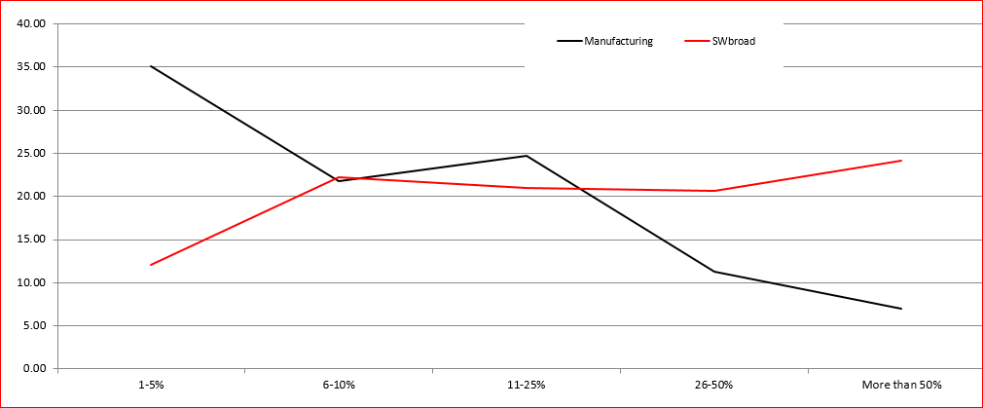
Sales due to innovation:
% Business unit sales from focal innovation for innovators (Mfg N = 929; SW N = 56)
Notes:
45%--red, last two categories
Less than 20% for last two categories for the black.

Slide 25
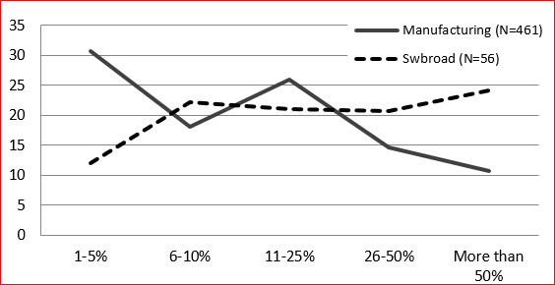
Same pattern when comparing SW with more innovation intensive mfg industries

Slide 26
Why?
Perhaps new SW products can reach a larger market than new manufactured products due to ability for SW to reach customers via the web, while commercializing a new manufactured product is more cumbersome.
Within-industry correlations
  Inno Sales and New Capab
    Mfg: r = 0.15
    Services: r = 0.30
  Inno Sales and development of new sales & distn channels
    Mfg: r = 0.12
    Services: r = 0.43

Slide 27
Illustration 2: Competition and innovation
Proposal: Distinguish industries on basis of centrality of innovation to competition
  E.g., Is competition expressed mainly via innovation or largely via price or advertising?
Empirical strategy: Divide the 32 mfg inds at median of % of sales due to NTF products.
Correls. between innovation rate and Tech Rivals
  Innovation intensive inds: r = 0.39
  Not innovation intensive: r = -0.07

Slide 28
Competition and innovation (cont.)
In industries where firms compete mainly via innovation, perhaps more “neck-and-neck” competition—Competition stimulates innovation
Otherwise, little relationship
=>Does the link between competition and innovation depend upon the nature of competition within industries, and notably the importance of innovation for competition?
Notes:
What about link between % of firms that develop new capabilities and the average % of sales due to innovation in the two types of industries?
Innovation intensive: r = 0.45
Not innovation intensive: r = -0.12
Correls. between innovation rate and Tech Rivals
Innovation intensive inds: r = 0.39 (p=0.1194)
Not innovation intensive: r = -0.07 (p=0.8080)
What about link between % of firms that develop new capabilities and the average % of sales due to innovation in the two types of industries?
Innovation intensive: r = 0.45 (p=0.0692)
Not innovation intensive: r = -0.12 (p=0.6718)

Slide 29
Illustration 3: Innovation-level indicators of value and the “importance” of outside sources in the DoIL
For companies that acquire their innovations from an outside source, Arora et al. (2016) compares the value of the innovation across sources
Indicators of value (all dummies)
  NTM Sales > 50% of total
  New Equipment/Skills
  New Sales/Distribution
  Patent
Notes:
Indicators already described.
Some regressions.
But key: Customers more, specialists less
But suppliers ass’d less with new equip.
And Patent high on Tech

Slide 30
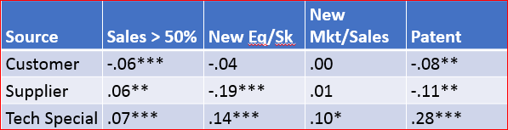
Innovation-level indicators of value and the “importance” of outside sources in the DoIL
(Note: reference group is internally generated innovation)
Across these measures of innovativeness, Value of innovatons acq’d from Tech Specialists > Customers
Shows a benefit of linking innovation survey items to specific innovation.

Slide 31
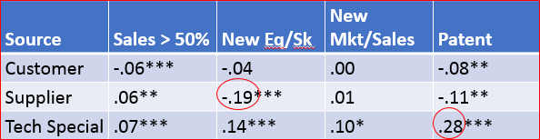
Innovation-level indicators of value and the “importance” of outside sources in the DoIL
Also note that the empirical relationships with sources vary across dimensions.
  Tech specialists have strong positive relationship with PATENT (Tech Sig)
  In contrast, suppliers have strong negative relationship with New Equipment/Skills (Distance)

Slide 32
Conclusions
Greater interpretability of “innovation” and analytic opportunities possible with innovation surveys
Proposed approach
  Focus on characteristics of a specific innovation in an identified line of business
    Measure the characteristics of the innovation that may affect social welfare.
Such data improve interpretability and can fill an important gap wrt available measures, enabling novel analyses that promise to advance our understanding of innovation.
Only a first step

Slide 33
Thank you

Slide 34
Extra slides

Slide 35
Comparison with CIS
Both surveys start from similar definition of innovation
But, rather than focus on firm as a whole as does Oslo and CIS, DoIL survey focuses on:
  Single line of business
  The most important (NTM) innovation in that line of business
Follow-on questions concern this “most important” innovation.
=> Benefits
  Precision
  Allows for assessment of significance of the identified innovation
Notes:
CIS questions (CIS, harmonized, July 2014)
During the prior three years, 2012-2014, “did your enterprise introduce”:
Product innovations: “New or significantly improved goods”
Were any of your product innovations:
“New to your market”
“Only new to your enterprise”
A “first” in your country, Europe or the world?”
So, question not framed in terms of firm as a whole.

Slide 36
Key CIS questions (CIS, harmonized, July 2014)
During the prior three years, 2012-2014, “did your enterprise introduce”:
  Product innovations: “New or significantly improved goods”
  Were any of your product innovations:
    “New to your market”
    “Only to your enterprise”
    A “first” in your country, Europe or the world?”

Slide 37
Selected CIS estimates of innovation rates (~2007-2009) among mfg. firms, and DoIL survey estimates for U.S.
New-to-the-firm
  Germany: 49%
  UK: 34%
  France: 28%
  DoIL for U.S.: 42%
New-to-the-market innovation
  Germany: 23%
  UK: 17%
  France: 19%
  DoIL for U.S.:16%

Slide 38
Innovation rates across surveys: % of resps. introducing NTF or NTM innovs. (mfg only)
Survey | NTF % | NTM/NTF %
DoIL (2010) | 42 | 38
UK CIS (2009) | 34 | 51
German CIS (2009) | 49 | 45
*NTF – New to the Firm
**NTM – New to the Market

Slide 39
Validating Innovation Measures:
Industry Correlations across Measures
External Indicators | ACS NTF | ACS NTM
BRDIS NTF | .72 | .76
Europe-wide CIS NTM | .71 | .72
BRDIS R&D Performers | .72 | .72
CIS Innovative Activity | .70 | .68
BRDIS RDI* | .59 | .52
Rs’ any patent application (PATSTAT) | .72 | .74
Rs’ patent count (PATSTAT) | .54 | .47
Rs’ forward citation count (PATSTAT) | .56 | .49

