Slide 1
The Rise of Cloud Computing: Minding Your P’s and Q’s
David Byrne, Federal Reserve Board
Carol Corrado, Conference Board
Dan Sichel, Wellesley College and NBER
March 11, 2017
CRIW/NBER Conference “Measuring and Accounting for Innovation in the 21st Century”

Slide 2
Our paper in 17-syllable Haiku
Cloud grows super fast
Hard to measure P’s and Q’s
Let us not miss it

Slide 3
Summary
National accountants and economists need to get a handle on nomenclature and classifications for cloud.
Prices of cloud service products have been falling rapidly, especially since the beginning of 2014
GDP may be missing some cloud-related investment

Slide 4
Definition of the Cloud (NIST, 2011)
Cloud computing is a model for enabling
ubiquitous,
convenient,
on-demand
network access
to a shared pool of configurable computing resources
that can be rapidly provisioned and released …

Slide 5
Classifications: Cloud Service Products
Infrastructure as a service (IaaS)
Platform as a service (PaaS)
Function as service (FaaS)
Software as a service (SaaS)
Focusing on business purchases so mostly intermediate input of purchased services

Slide 6
P’s and Q’s of the Cloud
Start with P’s

Slide 7
Data for Prices
Collected prices and characteristics for cloud service products
Products
Compute (renting virtual machines)
Storage (renting storage in the cloud)
Database (running user-developed applications on database software in cloud)
Vendors
Amazon Web Services (AWS), began posting prices 2009
Microsoft Azure, began posting prices early 2014
Google Cloud, began posting prices late 2014
Web scraped using Web Archive (“Wayback” Machine)

Slide 8
Data for Prices
For AWS from 2009:Q1 to 2016:Q4
Product | # Price observations
Compute (EC2) | 4,079
Database (RDS) | 5,340
Storage (S3) | 445

Slide 9
Methodology
Compute and Database:
Hedonic adjacent-quarter regressions
Storage:
Matched-model

Slide 10
Prices of AWS Cloud Service Products (percent change, annual rate)
 | 2009:Q1-2013:Q4 | 2014:Q1-2016:Q4
Compute | -5.1 | -10.5
Database | -3.3* | -22.6
Storage | -12.1 | -25.1
* Sample for RDS starts 2010:Q2

Slide 11
Q’s for the Cloud
By many measures, cloud has exploded

Slide 12
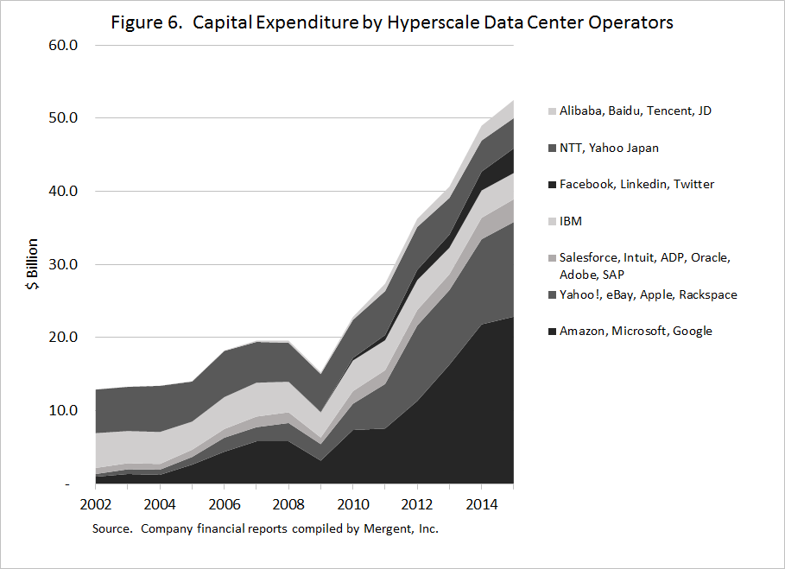
Capital Expenditures by IT Service Providers has rocketed
Puzzling, given weak IT investment in official data

Slide 13
Possible Resolution: Own-Account Investment by IT Service Providers
Very large purchases of electronic components by IT service providers ($58.6 billion in 2015)
Likely building own servers and equipment
If so, significant amount of own-account investment
Could amount to $117 billion nominal in 2015
Would boost real GDP growth from 2005 to 2015 by 0.05 percentage point a year

Slide 14
Conclusion
Developing nomenclature and classification for cloud is important
Prices for cloud service products have fallen rapidly, especially since 2014
Provides additional evidence that innovation in tech sector continues to be very rapid
GDP may be missing significant amount of own-account investment in ICT by cloud service providers

