Slide 1
Measuring the Impact of Household Innovation using Administrative Data Miranda and Zolas The Link between University R&D, Human Capital and Business Startups Goldschlag, Jarmin, Lane, and Zolas NBER-CRIW Conference: Measuring and Accounting for Innovation in the 21st Century Discussant: Scott Stern, MIT, HBS and NBER

Slide 2
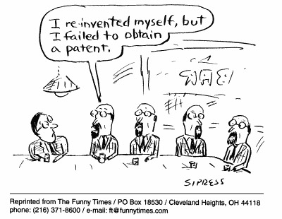

Slide 3
Measuring the Impact of Household Innovation Using Administrative Data Miranda and Zolas The Link between University R&D, Human Capital and Business Startups Goldschlag, Jarmin, Lane, and Zolas NBER-CRIW Conference: Measuring and Accounting for Innovation in the 21st Century Discussant: Scott Stern, MIT and NBER

Slide 4

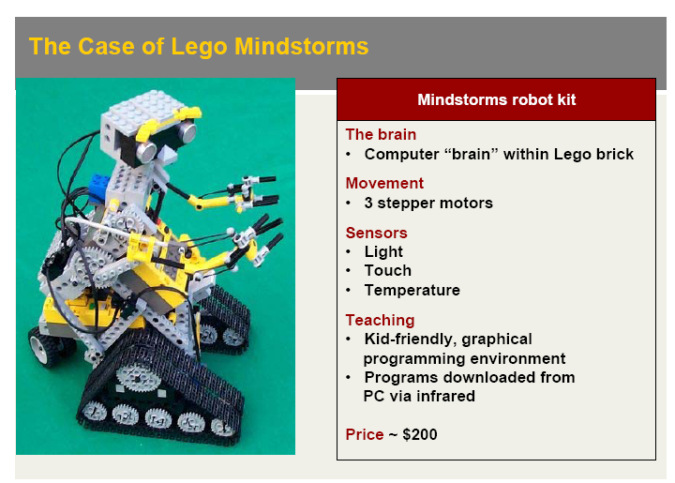

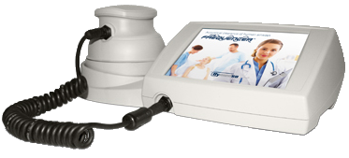
From User Innovation to Household Innovation…
Eric von Hippel

Slide 6

Dark Matter?

Slide 7
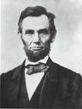
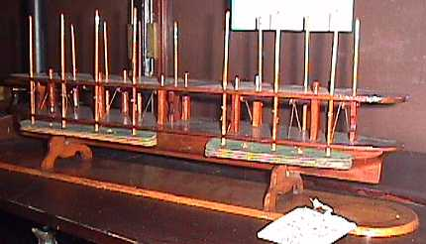
Abraham Lincoln, A Patented Household Innovator!
Before then any man might instantly use what another had invented; so that the inventor had no special advantage from his own invention. The patent system changed this; secured to the inventor, for a limited time, the exclusive use of his invention; and thereby added the fuel of interest to the fire of genius, in the discovery and production of new and useful things.
Abraham Lincoln, 1859
Patent 6469,
Device to Lift Boats over Shoals
Notes:
Politicians love patents …e.g. Abe Lincoln had a patent!

Slide 8
The Miranda-Zolas Approach
Create a systematic link between measured household innovation (independent inventors and patents held by nonemployee businesses), inventor characteristics, and business dynamics
Estimate three overall measures
Incidence rate of “patented” household innovation
Nature and demographics of such innovation
Innovation impact in terms of citation and revenue
Key Findings (as emphasized by author)
Patented household innovation is a meaningful phenomena
Household innovators are US-born, and tend to either be old or very young
Impactful (but not too impactful) innovation
Modest revenue per patent for nonemployee businesses (~ $10K), aggregating to ~$8B of overall revenue

Slide 11
Key Comments
Do Household Innovators Patent (and if not, why not)?
The Low Returns to Household Innovation Patenting
Household Innovation or Innovation Contracting?

Slide 12
Taken literally, less than 1 in 2000 household innovations (which EvH takes as a conservative estimate) are patented….

Slide 13
Taken literally, the ROI on Household Innovation is -50%, with more than $16B of effort and less than $8B in revenue….

Slide 14
Is this just a form of technical consulting?
Particularly for the older (semi-retired?)….

Slide 15
Measuring the Impact of Household Innovation Using Administrative Data Miranda and Zolas The Link between University R&D, Human Capital and Business Startups Goldschlag, Jarmin, Lane, and Zolas NBER-CRIW Conference: Measuring and Accounting for Innovation in the 21st Century Discussant: Scott Stern, MIT and NBER

Slide 16




University Research and Growth Entrepreneurship

Slide 17
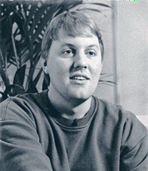
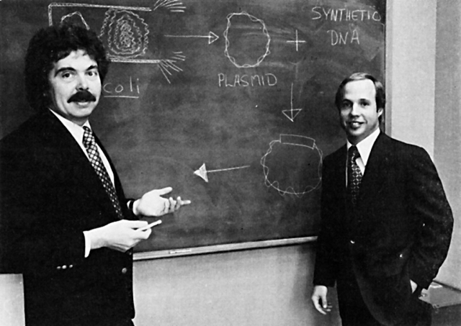
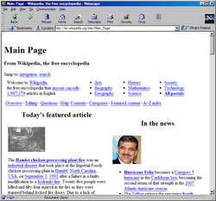

The Special Role of Research-Trained Human Capital

Slide 18
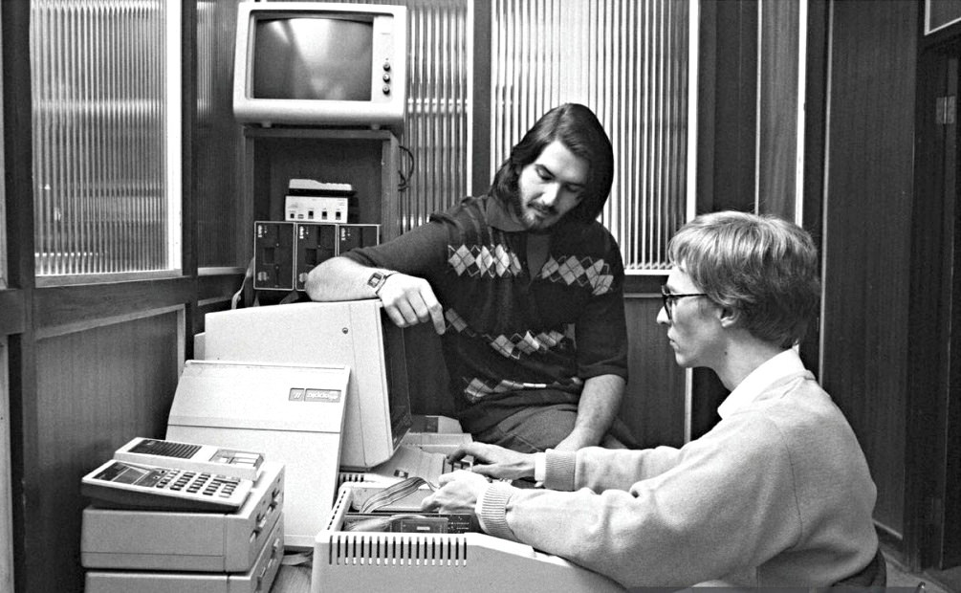
Though….

Slide 19
Long line of research about the role of STEM background, science and engineering knowledge, and university ecosystems in growth start-ups….

Slide 20
The GLJZ Approach
Combine Startup Firm History Film (an age0 version of the LBD) with the detailed administrative records from UMETRICS, which records all payments made to workers at 14 large research universities
For each worker, create flags for whether they worked in R&D-active, high-tech, university, or university-research-grant (UMETRICS).
Estimate whether all workers (whether in UMETRICS or not) are research-grant-funded, using UMETRICS sample as training with machine learning methods
Comparison of logistic, decision tree, and random forest
Characterize the research-oriented human capital of start-up employees, and link research-oriented human capital measures to firm survivability and growth

Slide 23
Key Comments
What are we trying to explain?
The Promise and Perils of Predictive Analytics and Machine Learning on Administrative Datasets
Human capital or university-based entrepreneurial ecosystems?

Slide 24
What are we trying to explain?
Massive body of research emphasizing the role of human capital (and STEM or engineering orientation) in high-potential start-up firms
Stanford Project on Emerging Companies (SPEC; , MIT Alumni Suryey (e.g., Eesley, Roberts, and Hsu), numerous European surveys, Zucker and Darby, etc.
Also a massive body of research on academic entrepeneurship and technology transfer from universities
Shane, Thursby and Thursby, Feldman, Murray, Powell, etc…..
The paper is simultaneously about incorporating indicators of STEM/R&D orientation into start-up employment composition (which might be useful), or specifically about impact of research training (UMETRICS)….

Slide 25
The Promise and Perils of ML on Admin Datasets
This paper is among the first government projects to attempt to specifically use recent (and rapidly emerging) advances in predictive analytics / machine learning to “fill in” a regressor (“research-trained”) that is only observed for a portion of the sample. This is very promising!
But, predictive analytics models (in general) and ML models in particular are a tool and need to be wielded carefully

Slide 26





Three Steps to Measuring Entrepreneurial Quality (at or near the time of founding)
Business Registrations
“Digital Signatures” of
Growth Potential
“Success” outcomes can be mapped to initial “digital signatures”

Slide 27
How do the “digital signatures” of companies predict growth? (NB: Prediction NOT causal)
 | Change in the Probability of Growth
Has Short Name | 248%
Firm Named after Founder | -70%
Corporation (Not Partnership or LLC) | 405%
Trademark in First Year | 501%
Patent and No Delaware Registration | 3,534%
No Patent and Delaware Registration | 4,470%
Both Patent and Delaware Reg. | 19,640%
Sectoral Controls | Included
State Controls | Included

Slide 28
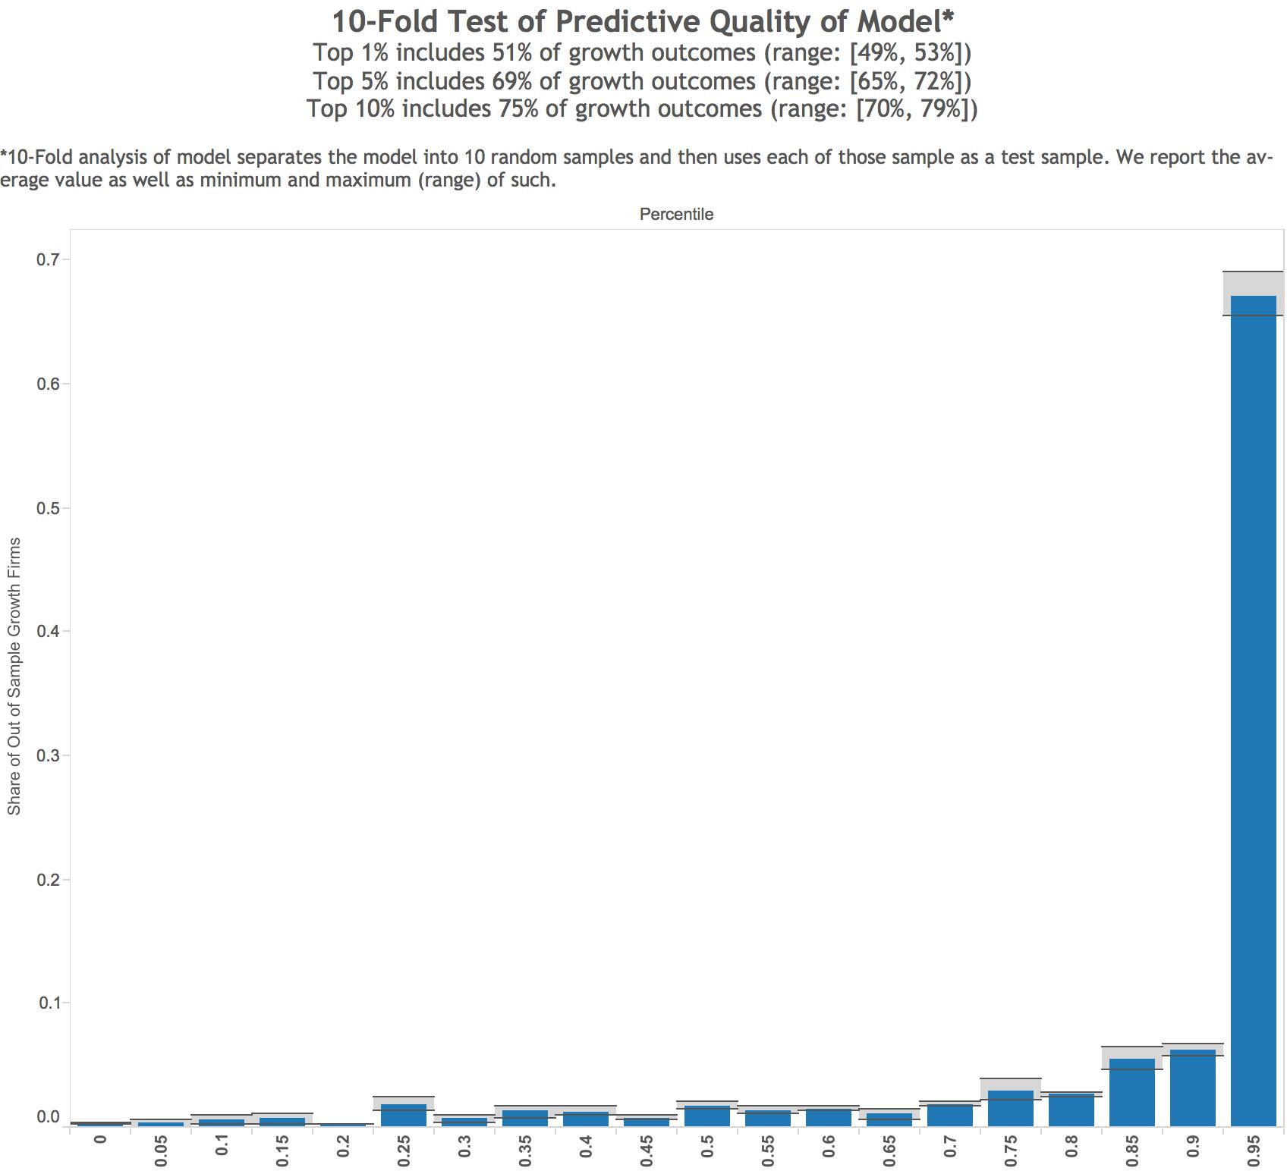

A New View of the Skew
Notes:
Out of sample tests show method works
To test the predictive capability of the model and evaluate the skewness of entrepreneurial growth potential, compare estimated probabilities of growth outcomes to realized ones (in a ten-fold cross validation in out of sample test
65-72% of realized growth events fall within top 5% of the model’s estimated entrepreneurial quality distribution
51% of realized growth events fall within top 1% of the distribution of EQ
10-80% in top 10% of the distribution
Model highly predictive. EQ highly skewed.
Characteristics are highly predictive of a very rare outcome
Show skewed nature of growth outcome
Indicate that distribution of initial quality is itself skewed from the start
(It is not that all firms start out equal and some happen to grow) [[growth potential is a key dimension of heterogeneity among newly founded firms]]]

Slide 29
The Promise and Perils of ML on Admin Datasets
This paper is among the first government projects to attempt to specifically use recent (and rapidly emerging) advances in predictive analytics / machine learning to “fill in” a regressor (“research-trained”) that is only observed for a portion of the sample. This is very promising!
But, predictive analytics models (in general) and ML models in particular are a tool and need to be wielded carefully
In the present case, we have a proprietary dataset (UMETRICS) on an admittedly non-random sample of universities for only a limited number of years
Is this the “right” training sample for a population-level predictive analytic of “research-trained” (and what exactly does this mean in any case)?
Relatively low power in prediction and as an explanatory variable reduce confidence in potential for identifying distinctive signature

Slide 30

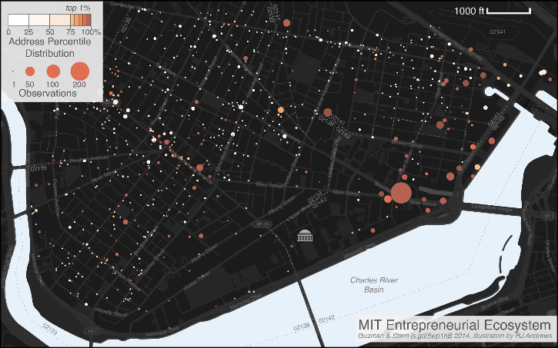
Is this directly about “research-trained” or about university entrepreneurial ecosystems?

Slide 31
Summary
These two papers take advantage of the extension of large administrative datasets connecting innovation inputs and outputs to business activity to offer large-scale evidence on the role of household innovation and the research human capital of start-ups respectively
On household innovation, a promising approach (trace it through patenting by individuals with non-employee businesses!) yields a TINY level of activity and also a low level of impact
On research human capital, work is at an early stage, and question is how to tightly link indicators of research orientation to meaningful distinctions among firms and in terms of performance….

Slide 32
Thank you!

