Slide 1
ICT and innovation: a work in progress
Pierre Mohnen, Michael Polder, George van Leeuwen
CRIW: Measuring and accounting for innovation in the 21st century
March 10-11 2017, Washington, DC

Slide 2
Background
Adoption of new technology
Knowledge generation
Performance change

Slide 3
Productivity literature
Growth accounting literature
ICT (Jorgenson, Van Ark et al)
R&D and intangibles (CHS)
Firm-level evidence:
ICT, organizational practices, human capital (Brynjolfsson, Bresnahan)
R&D, innovation (Griliches, CDM)
Not much evidence on ICT vis-à-vis innovation (technological and non-technological)
interaction between ICT and intangibles: Corrado, Haskel, Jona-Lasinio
Firm-level evidence?

Slide 4
Complementarity
Activities are complements if doing (more of) any one of them increases the returns to doing (more of) the others (Milgrom-Roberts)
R&D and innovation is about generating knowledge
⬄
ICT is about gathering, documenting and sharing information
Where does this show up?
(Combinations of) business practices
Adoption
Performance effects

Slide 5
Data sources
Innovation and R&D (e.g. product, process, organizational innovation; R&D expenditures) Supplementary R&D information ICT investment (hardware) ICT usage variables (e.g. broadband, e-commerce) Production structure (employment, capital proxy, wages etc.) | Community Innovation Survey R&D survey Investment survey Enterprise ICT usage survey Structural Business Statistics (SBS)

Slide 6
Operationalization
Different measures of ICT
Different measures of knowledge
Note: mostly binary variables
Work in progress:
 | innovation | ICT
1. | Product, process, organizational innovation | E-commerce
2. | R&D, organizational innovation | ICT hardware investment

Slide 7
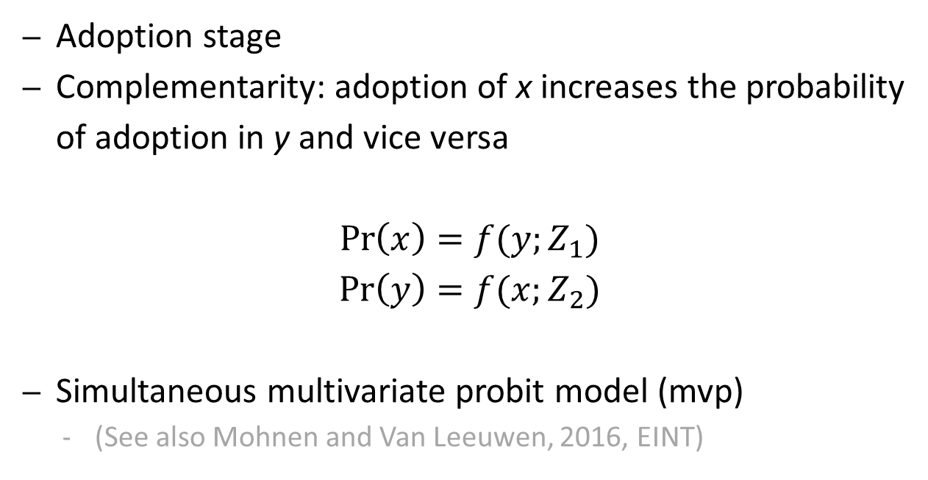
Model and results: work in progress
Adoption stage
Complementarity: adoption of x increases the probability of adoption in y and vice versa
$$\operatorname{Pr}\left(x\right)=f(y;Z_{1})$$
$$\operatorname{Pr}\left(y\right)=f(x;Z_{2})$$
Simultaneous multivariate probit model (mvp)
(See also Mohnen and Van Leeuwen, 2016, EINT)

Slide 8
Preliminary results (mfg)
MVP Lewbel model N = 3 (SML, # draws = 50) Number of obs = 6706
Wald chi2(30) = 1230.12
Log likelihood = -13030.94 Prob > chi2 = 0.0000
Y1 = ICT; Y2 = R&D; Y3 = ORGANIZATIONAL INNOVATION
------------------------------------------------------------------------------
| Coef. Std. Err. z P>|z| [95% Conf. Interval]
-------------+----------------------------------------------------------------
y1 |
emp | .0356443 .0162173 2.20 0.028 .003859 .0674296
exp_status | .3413278 .0478612 7.13 0.000 .2475216 .435134
age | .0007395 .0012508 0.59 0.554 -.001712 .003191
-------------+----------------------------------------------------------------
y2 |
emp | .1922355 .0142526 13.49 0.000 .1643009 .2201701
exp_status | .640274 .0344079 18.61 0.000 .5728358 .7077121
age | -.000081 .0010327 -0.08 0.938 -.0021049 .001943
-------------+----------------------------------------------------------------
y3 |
emp | .1281188 .0092554 13.84 0.000 .1099786 .146259
exp_status | .1474136 .0269518 5.47 0.000 .0945892 .2002381
age | -.0015371 .0007902 -1.95 0.052 -.0030859 .0000116
-------------+----------------------------------------------------------------
/alfa21 | .2618777 .0235034 11.14 0.000 .215812 .3079434
-------------+----------------------------------------------------------------
/alfa31 | .1315966 .0179423 7.33 0.000 .0964304 .1667629
-------------+----------------------------------------------------------------
/alfa32 | .280353 .0154398 18.16 0.000 .2500915 .3106145
-------------+----------------------------------------------------------------

Slide 9
Preliminary results (serv)
MVP Lewbel model N = 3 (SML, # draws = 50) Number of obs = 10668
Wald chi2(30) = 1473.34
Log likelihood = -23473.66 Prob > chi2 = 0.0000
Y1 = ICT; Y2 = R&D; Y3 = ORGANIZATIONAL INNOVATION
------------------------------------------------------------------------------
| Coef. Std. Err. z P>|z| [95% Conf. Interval]
-------------+----------------------------------------------------------------
y1 |
lnwp | -.0263083 .0119708 -2.20 0.028 -.0497707 -.0028459
exp_status | .4478155 .0263014 17.03 0.000 .3962657 .4993653
age | -.0005292 .0009858 -0.54 0.591 -.0024613 .001403
-------------+----------------------------------------------------------------
y2 |
lnwp | .1319428 .0087358 15.10 0.000 .1148209 .1490647
exp_status | .2991051 .0192576 15.53 0.000 .2613609 .3368494
age | -.0018788 .0007305 -2.57 0.010 -.0033105 -.0004472
-------------+----------------------------------------------------------------
y3 |
lnwp | .0896821 .007694 11.66 0.000 .0746022 .104762
exp_status | .1169285 .0149301 7.83 0.000 .087666 .146191
age | -.0017695 .0005155 -3.43 0.001 -.0027798 -.0007592
_cons | -.3533053 .0527545 -6.70 0.000 -.4567021 -.2499084
-------------+----------------------------------------------------------------
/alfa21 | .3291984 .0164247 20.04 0.000 .2970066 .3613901
-------------+----------------------------------------------------------------
/alfa31 | .1925714 .0145139 13.27 0.000 .1641247 .2210181
-------------+----------------------------------------------------------------
/alfa32 | .3910813 .0121002 32.32 0.000 .3673653 .4147972
-------------+----------------------------------------------------------------

Slide 10
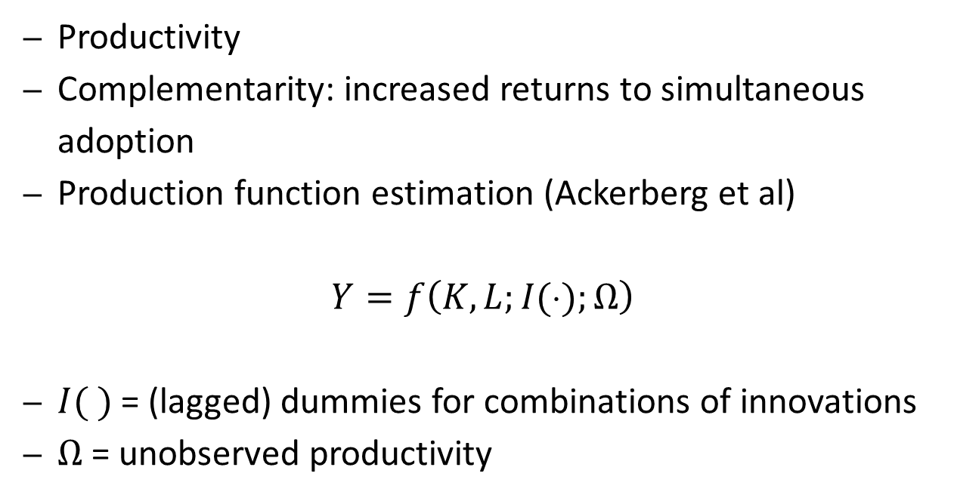
Model and results: work in progress
Productivity
Complementarity: increased returns to simultaneous adoption
Production function estimation (Ackerberg et al)
$$Y=f\left(K,L;I(⋅);Ω\right)$$
$I( )$ = (lagged) dummies for combinations of innovations
$Ω$ = unobserved productivity

Slide 11
Model and results: work in progress
Group = (ICT, R&D, ORG)
----------------------
group | med(lp)
----------+-----------
000 | 52.86
001 | 53.68
010 | 61.07
100 | 65.44
011 | 63.22
101 | 64.42
110 | 69.05
111 | 68.14
----------------------

Slide 12
Model and results: work in progress
 | manufacturing (N = 1770) |  | services (N = 2509)
I) Production function
Constant | 3,001 | *** | 3,001 | ***
Capital | 0,249 | *** | 0,280 | ***
Labour | 0,786 | *** | 0,570 | ***
II) Innovation (prod, proc, org, ec)
d0001 | -0,009 |  | -0,002
d0010 | 0,003 |  | 0,093 | ***
d0011 | -0,110 | *** | -0,026
d0100 | -0,072 | *** | -0,018
d0101 | -0,032 |  | 0,042
d0110 | -0,171 | *** | -0,099 | ***
d0111 | 0,023 |  | 0,159 | ***
d1000 | 0,023 |  | 0,148 | ***
d1001 | -0,025 |  | 0,047
d1010 | 0,033 |  | 0,145 | ***
d1011 | 0,041 |  | 0,095
d1100 | 0,055 | *** | -0,022
d1101 | 0,073 | *** | 0,003
d1110 | 0,024 |  | 0,127 | ***
d1111 | 0,055 | *** | 0,202 | ***

Slide 13
Model and results: work in progress
Manufacturing |  | product | process | organizational | e-commerce
product
process |  | COMP
organizational |  | COMP | n.s.
e-commerce |  | n.s. | COMP | COMP
Services |  | product | process | organizational | e-commerce
product
process |  | SUBS
organizational |  | COMP | COMP
e-commerce |  | SUBS | COMP | COMP
Kodde-Palm test for complementarity/substitutability

Slide 14
Wrap up and to do
We find significant complementarities at the firm-level between different types of innovation and ICT,
… both at the adoption stage and in the performance equation
… both in manufacturing and in services
Next we want to
Work on performance equation for ICT/R&D/ORG model
Work on integrated model
Look at ways to include software investment (data for more recent years)
…

Slide 15
Frequencies
Group (mfg)
ICT, R&D, ORG Freq. Percent Cum.
------------+-----------------------------------
0 | 1,555 23.19 23.19
1 | 436 6.50 29.69
10 | 1,321 19.70 49.39
11 | 1,357 20.24 69.62
100 | 406 6.05 75.68
101 | 156 2.33 78.00
110 | 651 9.71 87.71
111 | 824 12.29 100.00
------------+-----------------------------------
Total | 6,706 100.00

Slide 16
Preliminary results
Manufacturing
 | PRODUCT |  | PROCESS |  | ORGANIZATIONAL |  | E-COMMERCE
 | coef |  | coef |  | coef |  | coef
product innovation | -- |  | 0,447 | *** | 0,100 | * | 0,112 | ***
process innovation | 0,447 | *** | -- |  | 0,425 | *** | -0,032 | *
organizational innovation | 0,100 | ** | 0,425 | *** | -- |  | 0,036
e-commerce innovation | 0,112 | *** | -0,032 | * | 0,036 |  | --
broadband intensity | 0,160 |  | -0,105 |  | 0,424 | *** | -0,008
R&D performer | 1,315 | *** | 0,428 | *** | -- |  | --
Services
 | PRODUCT |  | PROCESS |  | ORGANIZATIONAL |  | E-COMMERCE
 | coef |  | coef |  | coef |  | coef
product innovation | -- |  | 0,626 | *** | 0,239 | *** | 0,106 | ***
process innovation | 0,626 | *** | -- |  | 0,459 | *** | 0,055 | ***
organizational innovation | 0,239 | *** | 0,459 | *** | -- |  | 0,062 | ***
e-commerce innovation | 0,106 | *** | 0,055 | *** | 0,062 | *** | --
broadband intensity | 0,427 | *** | -0,054 |  | 0,257 | *** | 0,074 | *
R&D performer | 1,134 | *** | 0,640 | *** | -- |  | --

Slide 17
Preliminary results
Manufacturing
 | PRODUCT |  | PROCESS |  | ORGANIZATIONAL |  | E-COMMERCE
 | coef |  | coef |  | coef |  | coef
product innovation | -- |  | 0,447 | *** | 0,100 | * | 0,112 | ***
process innovation | 0,447 | *** | -- |  | 0,425 | *** | -0,032 | *
organizational innovation | 0,100 | ** | 0,425 | *** | -- |  | 0,036
e-commerce innovation | 0,112 | *** | -0,032 | * | 0,036 |  | --
broadband intensity | 0,160 |  | -0,105 |  | 0,424 | *** | -0,008
R&D performer | 1,315 | *** | 0,428 | *** | -- |  | --
Services
 | PRODUCT |  | PROCESS |  | ORGANIZATIONAL |  | E-COMMERCE
 | coef |  | coef |  | coef |  | coef
product innovation | -- |  | 0,626 | *** | 0,239 | *** | 0,106 | ***
process innovation | 0,626 | *** | -- |  | 0,459 | *** | 0,055 | ***
organizational innovation | 0,239 | *** | 0,459 | *** | -- |  | 0,062 | ***
e-commerce innovation | 0,106 | *** | 0,055 | *** | 0,062 | *** | --
broadband intensity | 0,427 | *** | -0,054 |  | 0,257 | *** | 0,074 | *
R&D performer | 1,134 | *** | 0,640 | *** | -- |  | --

