Slide 1
NBER-CRIW Conference: Measuring and Accounting for Innovation in the 21st Century Next Steps Scott Stern, MIT, HBS and NBER

Slide 2
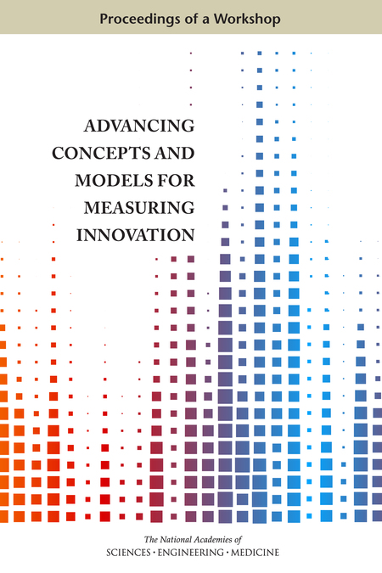
Key Comments
Connecting Phenomena to Measurement
The Potential for Predictive Analytics
Alternative Facts

Slide 3
What is innovation?

Slide 4
What is innovation?
An innovation is the implementation of a new or significantly improved product (good or service), or process, a new marketing method, or a new organisational method in business practices, workplace organisation or external relations (OECD/Eurostat 2005, para 146)

Slide 5
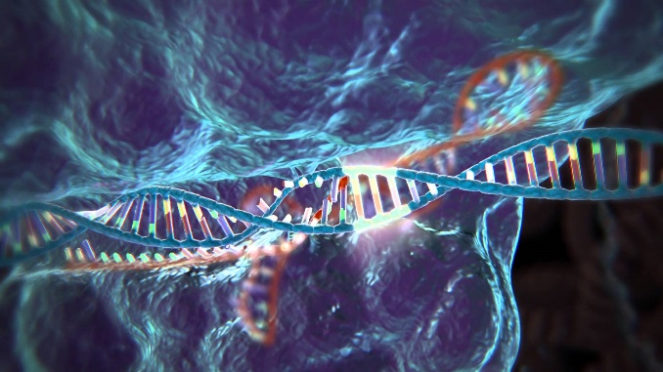

Slide 6
Key Comments
Connecting Phenomena to Measurement
The Potential for Predictive Analytics
Alternative Facts

Slide 7
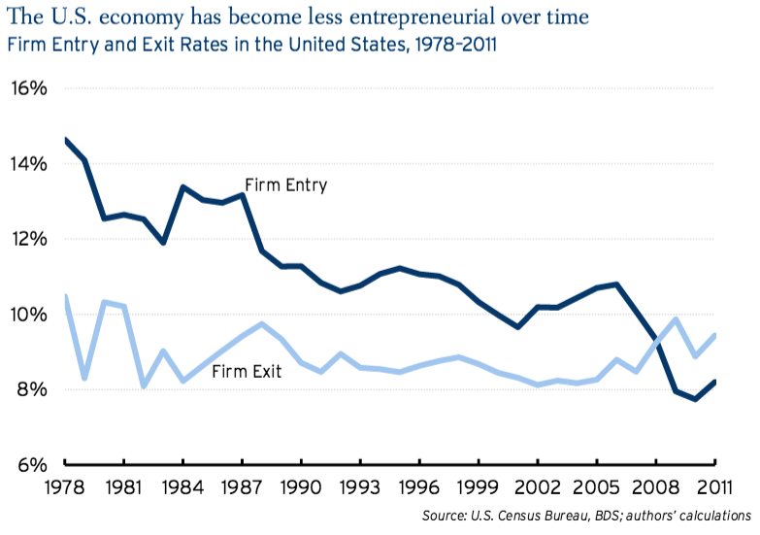
While quantity-based measures of entrepreneurship and dynamism are on the decline, funding and salience of high-growth businesses seems to be on the rise!
Quantity Based Measures
Decker, Haltiwanger, Jarmin, and Miranda (2013,2015)
Haltiwanger, Jarmin, Kulick, and Miranda (2015)
Hathaway and Litan (2014a, 2014b)
Funding of Venture-Backed Firms
Notes:
Quantity-based measures (BDS) document a 30 year decline in entrepreneurship and business dynamism , with only a very modest leveling off (and uptick in high-tech)
Outcome-based measures (PWC/NVCA MoneyTree Report) indicate high-growth entrepreneurship is on the rise
early stage angel and VC funding on a significant upswing (unit just recently)
Growing number of students joining startups
Fear of bubble
The Business Dynamics Statistics (BDS) provides annual measures of business dynamics (such as job creation and destruction, establishment births and deaths, and firm startups and shutdowns) for the economy and aggregated by establishment and firm characteristics. The BDS is created from the Longitudinal Business Database (LBD), a confidential database available to qualified researchers through secure Federal Statistical Research Data Centers. The use of the LBD as its source data permits tracking establishments and firms over time.

Slide 8
Three Steps to Measuring Entrepreneurial Quality (at or near the time of founding)
Business Registrations
“Digital Signatures” of
Growth Potential
“Success” outcomes can be mapped to initial “digital signatures”

Slide 9
How do the “digital signatures” of companies predict growth? (NB: Prediction NOT causal)
 | Change in the Probability of Growth
Has Short Name | 248%
Firm Named after Founder | -70%
Corporation (Not Partnership or LLC) | 405%
Trademark in First Year | 501%
Patent and No Delaware Registration | 3,534%
No Patent and Delaware Registration | 4,470%
Both Patent and Delaware Reg. | 19,640%
Sectoral Controls | Included
State Controls | Included

Slide 10
Address-Level Visualization of Silicon Valley

Slide 12
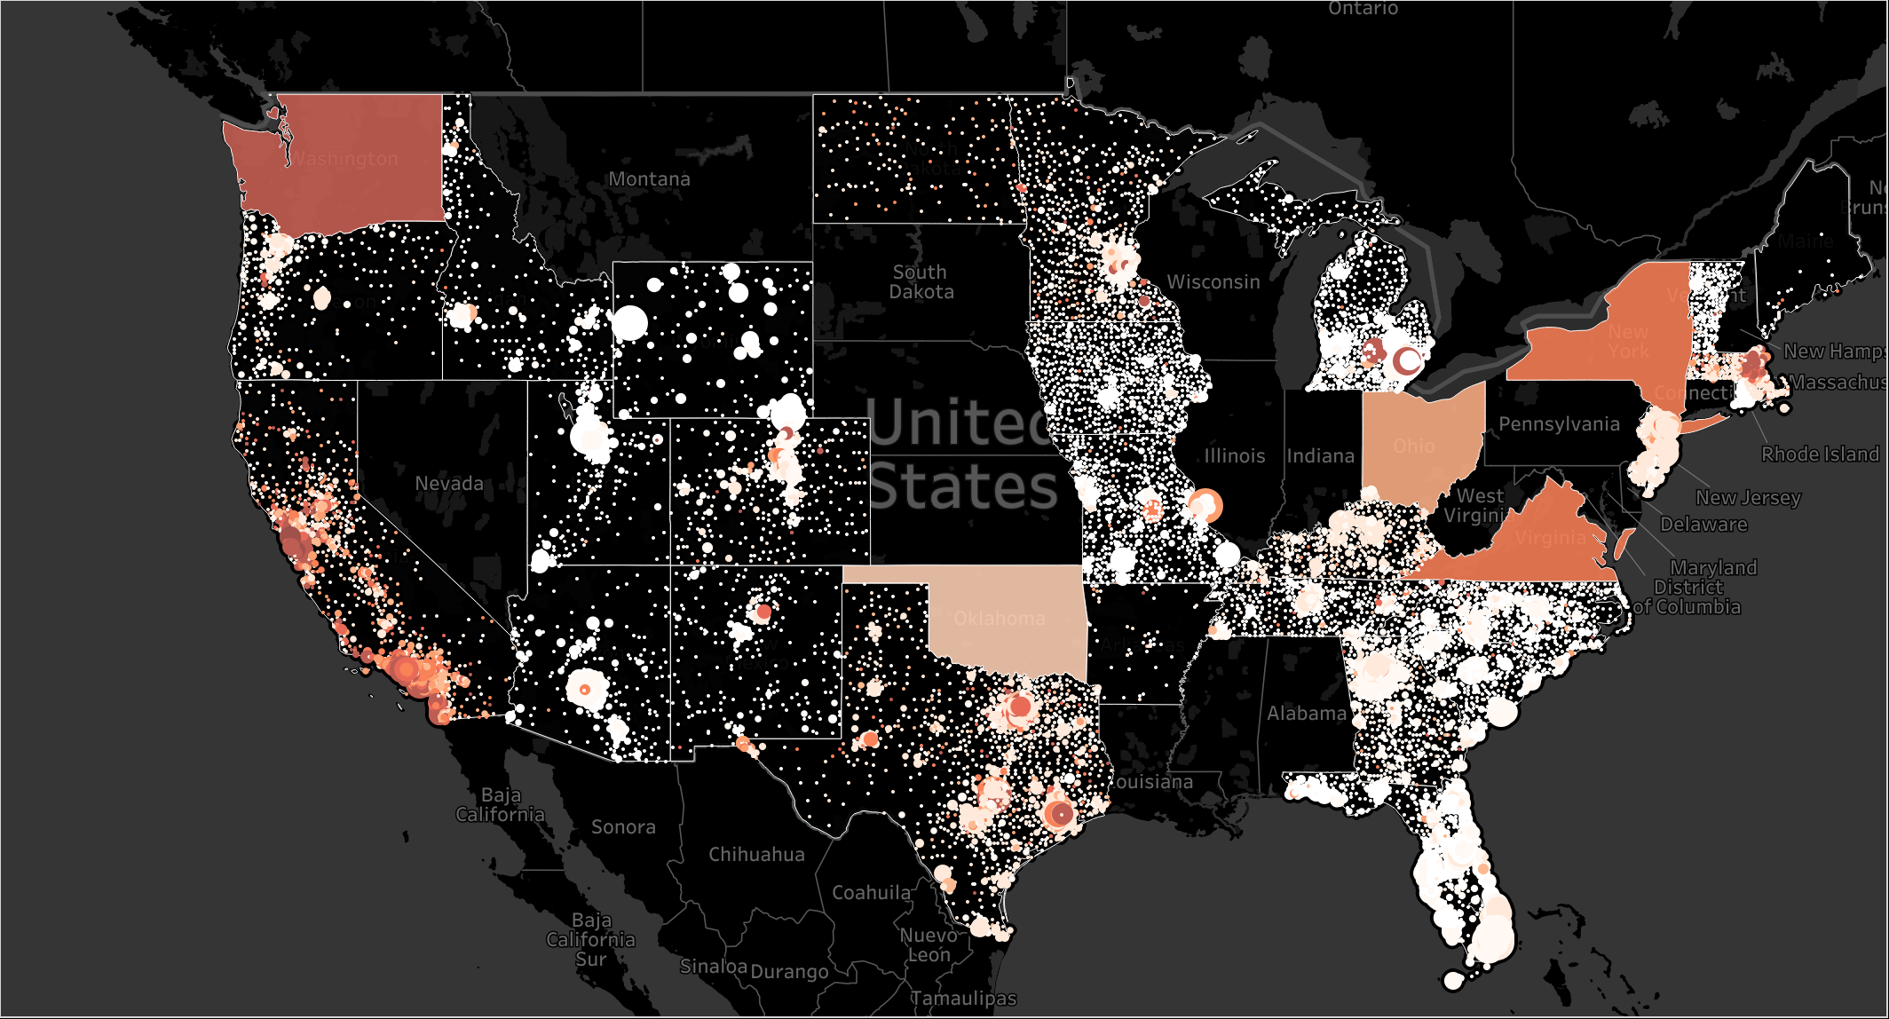
The State of American Entrepreneurship, 2015

Slide 13
Key Comments
Connecting Phenomena to Measurement
The Potential for Predictive Analytics
Alternative Facts

Slide 15
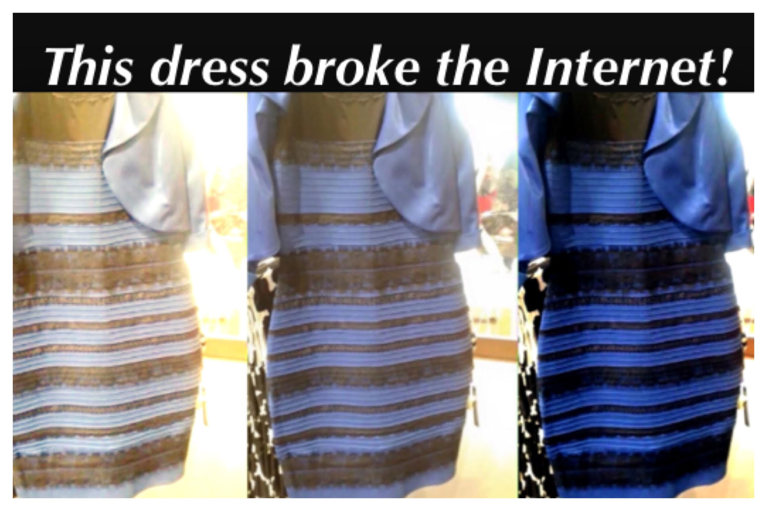

Slide 16
Thank you!

