Slide 1
Accounting’s Relevance Lost and Implications for Innovation Measurement
Baruch Lev
blev@stern.nyu.edu
March 2017

Slide 2
The End of Accounting

Slide 3
The Fast Declining Association Between Corporate Market Values and Key Financial Variables

Slide 4
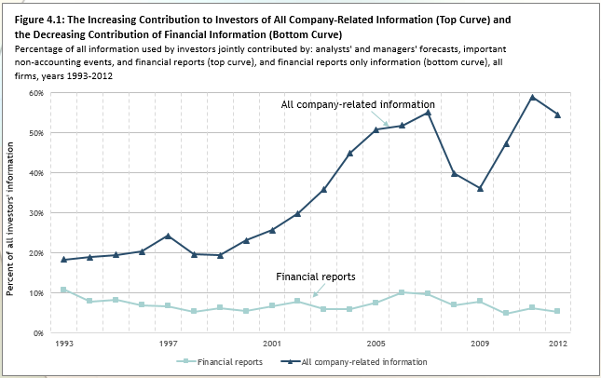
More Bad News: Financial Reports Provide a Negligible Portion of Investors’ Information

Slide 5
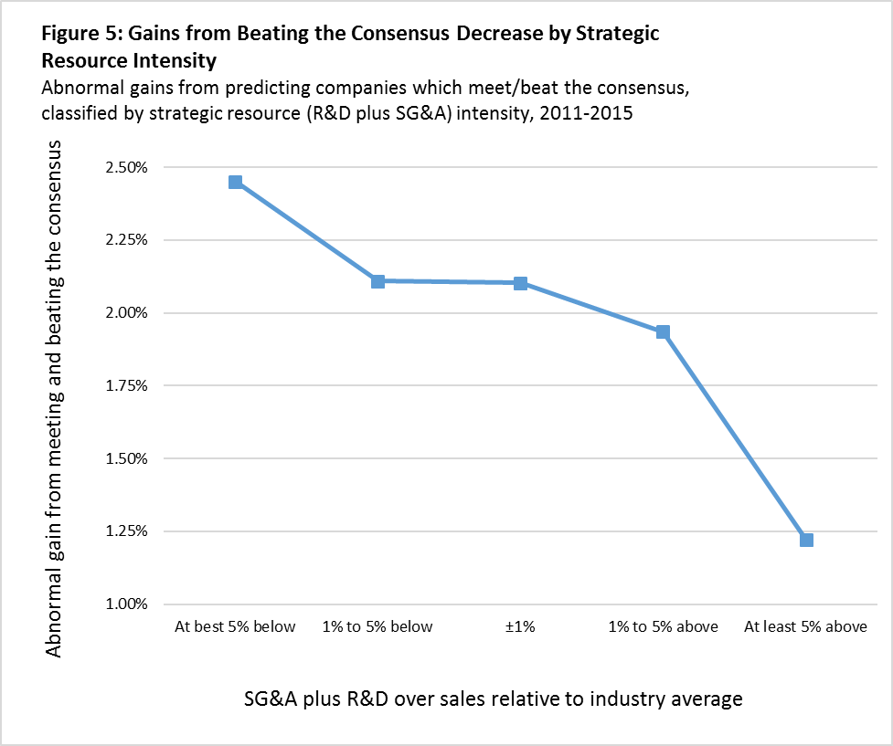
Intangibles Are A Major Culprit in Accounting’s Loss of Relevance

Slide 6
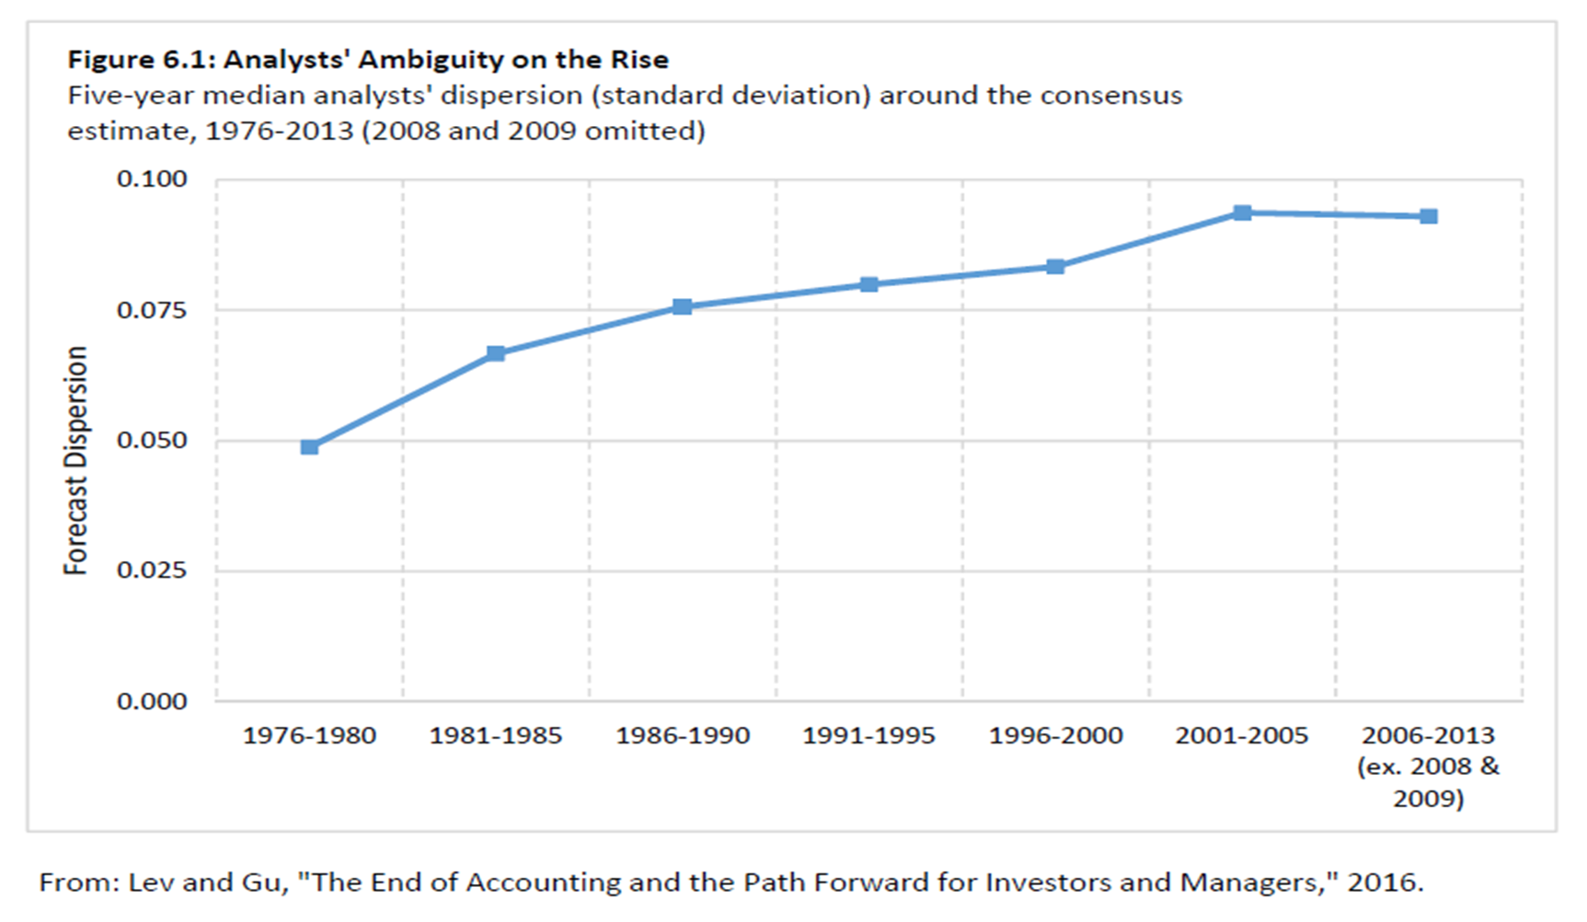
Accounting’s Loss of Relevance Has Serious Capital Market and Economic Consequences: Investors Uncertainty on the Rise

Slide 7
And Share Price Informativeness Declining

Slide 8
What Do Financial Reports Say About Innovation?
Practically Nothing
The only innovation input disclosed in the income statement is R&D, but it’s so opaque and ill-defined that it increases investors’ uncertainty.
All other innovation inputs (IT, brand enhancement, employee training) are buried in cost of sales and SG&A.
Acquired intangibles (patents, brands, in-process R&D) are capitalized and reported on the balance sheet.
No information about innovation outputs.
Certain innovation-related information is provided outside the accounting system in conference calls and investors’ meetings (pharma product pipeline, innovation revenues).

Slide 9
R&D Enhancing Investors’ Uncertainty
 | (1) | (2) | (3) | (4)
VARIABLES | Real_Vol | Real_Vol | Imp_Vol | Imp_Vol
RD | 0.385*** | 0.234*** | 0.270*** | 0.080**
 | (0.033) | (0.041) | (0.034) | (0.034)
PostAIPA | 0.020** | 0.005 | 0.003 | 0.012
 | (0.009) | (0.009) | (0.010) | (0.008)
PostAIPA#RD | -0.166*** | -0.101*** | -0.100*** | -0.129***
 | (0.038) | (0.039) | (0.037) | (0.041)
CAPX | 0.031 | 0.129** | 0.132*** | 0.204***
 | (0.056) | (0.065) | (0.047) | (0.050)
Size | -0.060*** | -0.035*** | -0.049*** | -0.016***
 | (0.002) | (0.006) | (0.003) | (0.005)
Age | -0.034*** | -0.097*** | -0.034*** | -0.103***
 | (0.004) | (0.014) | (0.004) | (0.013)
Leverage | 0.081*** | 0.075*** | 0.026* | 0.045***
 | (0.017) | (0.021) | (0.014) | (0.017)
ROA | -0.151*** | -0.132*** | -0.133*** | -0.115***
 | (0.019) | (0.022) | (0.017) | (0.017)
Loss | 0.109*** | 0.063*** | 0.086*** | 0.045***
 | (0.008) | (0.008) | (0.007) | (0.007)
TobinQ | -0.009*** | -0.003 | -0.000 | 0.004***
 | (0.002) | (0.002) | (0.001) | (0.001)
LnAF | 0.031*** | -0.006 | 0.017*** | -0.009
 | (0.004) | (0.006) | (0.005) | (0.006)
IO | -0.170*** | -0.116*** | -0.138*** | -0.104***
 | (0.012) | (0.018) | (0.012) | (0.015)
MF | -0.012*** | -0.016*** | -0.017*** | -0.005
 | (0.004) | (0.005) | (0.004) | (0.003)
Fix Effects | FF48, Year | Firm, Year | FF48, Year | Firm, Year
Observations | 16,597 | 16,597 | 10,264 | 10,264
R-squared | 0.609 | 0.732 | 0.718 | 0.844

