Slide 1
Discussion, 2017 CRIW conference Measuring and Accounting for Innovation in the 21st Century Papers by: Dominique Guellec, Caroline Paunov, Digital Innovation and the Distribution of Income Lucia Foster, Cheryl Grim, John Haltiwanger, Zoltan Wolf Innovation, Productivity Growth and Productivity Dispersion
Discussion by Jonathan Haskel, Imperial College Business School

Slide 2
Guellec/Paunov “Digital innovation and the distribution of income”
Paper wide-ranging on key issue of inequality and innovation. Sketches a model, reviews data and discusses policy
Model sketch: blend of Rosen superstar plus rent-sharing
Digital innovation has large fixed costs & ability to scale/build networks
=> industries get concentrated + monopoly rents + high risk premia
Twists demand to top earners/rent-sharing for top earners => high incomes at the top
Data: mix of Compustat firm-level + STAN industry-level data
Studies (a) labour shares of value added and (b) wages of top executives
Concentration (share of sales in industry) is higher in ICT-intensive inds relative to heavy industry (Fig 7)
Time series correlation between US profit rates (Compustat) and pre-tax share of top 1%
US labour share fallen by more in high R&D intensity industries (figure 15)
Country-ind-year data: labour share falling by more in patent-intensive inds (table 1)
Firm-year-industry data: executive pay higher in high Herfindahl inds and high creative destruction inds
Policy
Hard to tax mobile intangible capital
Do some innovation policies favour incumbents? E.g. R&D tax credits
Review competition policy in network industries

Slide 3
Overall comments
Thrust of paper seems right (to me): namely
Under-reporting of intangibles (Lev, 2001)
transition of economy from tangible to ICT to intangible (Machlup, 1962, Nakamura, 2001, Corrado, Hulten, Sichel, 2005, 2009)
Consequences of that shift for income inequality via scale properties of intangibles and the labour/task types this asset is a sub/comp to (Autor, 2016, Haskel, Lawrence, Leamer, Slaughter, JEP, 2012, Haskel and Westlake, 2017)
But needs some clarification
Measurement
Theory
Empirical work

Slide 4
Overall comments, contd
Measurement
Paper asserts labour and capital shares affected by ICT/intangibles. But need to acknowledge that such shares depend on how intangibles are incorporated or not into value added. Perhaps add discussion e.g. following CHS?
Effect on firm profit rates: if profit rate is profit flow as a proportion of firm capital, need to understand how Compustat does and doesn’t measure intangible capital. Perhaps add discussion of asymmetric treatment (Lev, Hao/Hulten, Corrado/Hulten)
Theory and data
Theory needs to address scope of market competition for labour and how ICT/intangibles and labour types complement/substitute each other

Slide 5
Overall comments, contd
Correlations reported are between wages in firm i and conditions in that firm’s industry
Theory needs to address scope of market competition for labour and how intangibles and labour types complement/substitute each other
Competition: is the industry the market? Are wages of finance professors high because wages in the education industry are high? So not sure how to interpret a relation between a CEO in firm i and their own industry? Not sure also what Herfindahl means in an SIC? So should you be studying factor bias or sector bias?
Relation between ICT/intangibles and workers. HLLS: “in the music industry is ICT more like a microphone or a mixing desk?”
HLLS. Talent in the acting and coffee shop industries. Talented workers working with ICT/intangibles are more productive in acting than talented workers coffee shops. So market size or microphones favour the talented, but not all actor wages rise.
Autor. Output depends on tasks. Tasks can be helped or replaced by ICT e.g. ICT replaces routine tasks but makes non-routine more productive (repetitive assembly v research). But then workers of different skills sort into tasks. If skilled are more productive in all tasks they might start doing medium level tasks, so wages might in fact rise? Still the case that although car assembly can be automated, labour does the task in India.

Slide 6
Foster, Grim, Haltiwanger, Wolf “Innovation, Productivity Growth and Productivity Dispersion”
Productivity spreads, growth and innovation
Uses economy-wide firm-level data to study entry, exit, productivity growth and productivity dispersion
Data are LBD + revenue information (merger of business register data for firms/estabs with revenue information at tax reporting unit level); productivity is real gross revenue per employee.
Can measure start-up rates (share of employment of young or brand new firms)
Innovation= rise in entry and young firm activity
Hi-tech and non-tech (STEM intensive and not, roughly ICT intensive plus biotech)
Motivation: Gort and Klepper, Economic Journal 1982 (very widely cited)

Slide 7
US tire industry as illustration of Gort/Klepper data (Jovanovic/MacDonald (JPE, 1994))
Common feature across industries: large entry then shakeout of firms
Why is there a shakeout?
Gort/Klepper: just before shakeout, innovation rises and laggards cannot imitate leaders, they exit
Jovanovic/MacD: technical innovation lowers costs but increases optimal scale (else no shakeout)
Gort/Klepper didn’t have broad data and couldn’t study prod dispersion and growth. Paper uses wide database for “tech” and “non-tech” industries
Idea: look for episodes of entry/young firm activity, then study subsequent prod dispersion and growth

Slide 8
Findings
Coefficients from regression of prod dispersion and growth on entry by high-tech and non-tech
First years after entry dispersion ↑, growth ↓
Later years, dispersion ↓, growth ↑
Notes
Effect on prod growth takes time to work through
True also in non-tech industries
Olley-Pakes style decompositions indicate falling covariance terms 1990s to 2013
Story
1990s: high productivity growth. Data show much entry, rising dispersion, large contribution of reallocation
2000s: lower prod growth. Entry fell, reallocation declined.
Anomaly: in 2000s, prod dispersion carries on rising
Discussion: what models might help understand this?

Slide 9
Comments
“Chicken and egg” questions (p.20 of paper): innovation, prod growth/entry/exit/reallocation all jointly determined
GK informal model is a mix of external shocks to innovative opportunities plus knowledge spillovers plus internal dynamics that affect productivity.
Paper here studies response to entry wave.
Raises question of what drives the process? An exogenous scientific discovery, say from public sector, then commercialised? Some clarification of what, if any, the external shocks that drive these industry dynamics might be.
Revisit GK discussion: nature of innovation changes in their model?
Stages I: internal learning-by-doing from few incumbents
Stage II: external info e.g. firms in related markets, supply chain etc.
Stage III+: back to internal learning. Tech change slows down as innovations are more “minor” e.g. minor modifications of products
Heterogeneity in the dataset?
How industry-specific is the innovation/prod growth/prod dispersion nexus? Do we have way of expressing that heterogeneity, if any, in a useful way?
Is the industry the right unit for analysis or the market? Are industry dynamics the same as market dynamics?
Most business start-ups don’t do patent, R&D etc, so invisible to usual measures. Do we need a time use survey for firms? Look at financial market data e.g. borrowing as indicator of entrepreneurship?
What do we make of the current productivity slowdown? Clarify (for me) the change in post Great Recession behaviour. Are the lags from the “innovation shock” to productivity growth getting longer: or wide dispersion lasts for longer?

Slide 10
Spares
Foster, Grim, Haltiwanger, Wolf “Innovation, Productivity Growth and Productivity Dispersion”

Slide 11
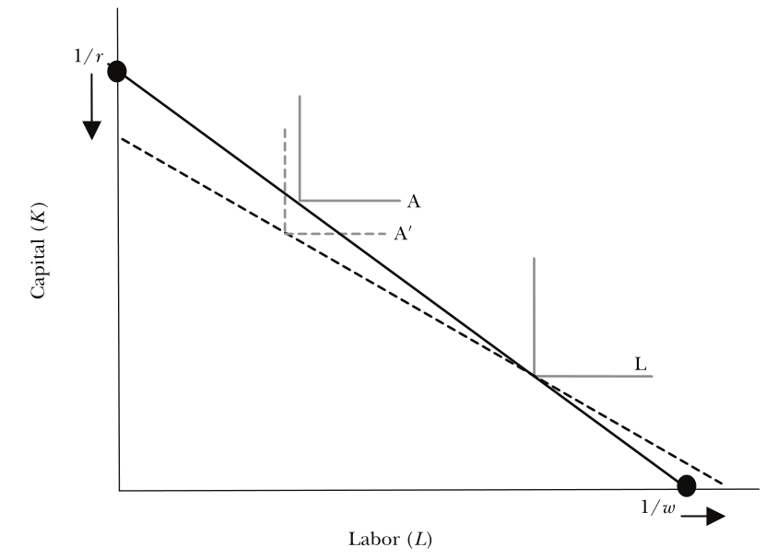
Classic model where the industry is not the market: Heckscher–Ohlin
Ind A is cap intensive, L lab inten
Unit value isoquant in A shifts in when
Price of cap inten goods rises (e.g. Asia make T shirts)
Technology of cap inten improves (e.g. TFP rise)
Wages fall, cap rental rises to restore zero-profit equilibrium
Wage inequality depends on sector bias, not factor bias
Overturn sector/factor bias?
Within-industry frictions => rent-sharing
Talent/task complementarity differs across industries
Source: Haskel, Lawrence, Leamer, Slaughter, 2012

Slide 12
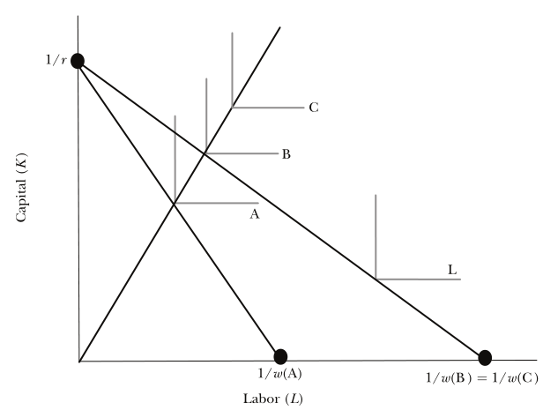
Richer Heckscher–Ohlin model (Leamer, 1995, Haskel, Lawrence, Leamer, Slaughter JEP 2012)
Talented workers are more productive working in cap intensive industry (Actors or musicians in movies or bands v actors/musicians waiting on tables)
Talent level A (high) earn high w since highly productivity
Talent B (med) earn same in Hollywood or on tables
Talent C (low) not talented enough be profitable in Hollywoood)
Computers/technical change (= econ forces underlying creative destruction) effect depends on how affects talent/capital complementarity
Mixing desk: brings A closer to B => equality
Microphone: A further from B => inequality
Empirical implications of ICT depend on
Sector bias as before
Skill complimentarity etc.
Source: Haskel, Lawrence, Leamer, Slaughter, 2012

Slide 13
Other comments
Would help reader to state equations estimated
Information asymmetry/attribution bias for managers discussed in Haskel/Westlake
Policy issues very very hard. Agree that anti-trust is not well worked out in this area.
Sutton. If fixed costs are high, but market size is large, many firms might have a go. Are we sure that concentration is necessarily high?

Slide 14
Foster, Grim, Haltiwanger, Wolf “Innovation, Productivity Growth and Productivity Dispersion”
Productivity spreads, growth and innovation
Uses economy-wide firm-level data to study entry, exit, productivity growth and productivity dispersion
Very nice motivation: Gort/Klepper story
Entry of new firms to disrupt/innovation in a sector e.g. cars in 20th Centry,, information
Stage 1: entry with no settled technology or business model =>
wide productivity spread
Prod growth might slow until winning technology emerges
Productivity/market share covariance term ?
Stage 2: exit
Narrower productivity spread
Prod growth rises as winning technology emerges
Productivity/market share covariance term rises as low market share exitors leave

Slide 15
Gort/Klepper “Time Paths in the Diffusion of Product Innovations” EJ 1982
Evolutionary theory of new products
I. commercialisation of new product by few producers
II. Entry, copying
III. Net entry low/zero
IV. Exit
V. mature prod market
Theory: Innovation throughout, but character changes.
Stages I: internal learning-by-doing from few incumbents
Stage II: external info e.g. firms in related markets, supply chain etc.
Stage III+: back to internal learning. Tech change slows down as innovations are more “minor” e.g. minor modifications of products
Notes:
“GK p.632. The central issue, of course, is what determines Pt, the probability of entry. Our hypothesis is that it basically depends upon the ways in which returns can be maximised on a component of organisation capital, namely, information on new product technology. We distinguish organisation capital from human capital in that the returns to the latter can be appropriated by the individual employees who possess such capital. In contrast, organisation capital belongs to the firm either because it has legal title to it, as in the case of a patent, or because it depends upon the interdependent actions or information of more than one employee. Information on new product technology may take a wide variety of forms, including knowledge and skills relating to production processes and market characteristics for the new product.

