Slide 1
Trends in U.S. Trade in Information and Communications Technology (ICT) Services and in ICT-Enabled Services
Alexis Grimm
March 11, 2017
Notes:
Briefly explain what BEA is.
I am going to discuss is the development of a statistical product that is a compliment to BEA’s standard presentation of international trade in services.
This topic was the subject of a May 2016 Survey of Current Business Article, but statistics have since been refined and revised.

Slide 2
Outline
BEA’s trade in services initiative
Measuring “digital” trade
BEA’s approach
ICT and potentially ICT-enabled services dataset
Exports, imports, and trade balance
By service type
By region and by country
Conclusion
Notes:
BEA’s trade in services initiative
- the impetus for constructing the data set we will discuss today
Measuring “digital” trade
- importance and challenges
BEA’s approach
- adopting practical suggestion from the statistical community and calculating ICT and potentially ICT-enabled services
ICT and potentially ICT-enabled services dataset
- Results of our application of calculating ICT and potentially ICT enabled services. I’ll present the series for:
Exports, imports, and trade balance
By service type
By region and by country
Conclusion
- overall takeaways for these data
- possible research applications

Slide 3
BEA’s Trade in Services Initiative
Expansion of trade in services detail
Geography (partner country)
Type of service
Industry of transactor
Mode of delivery
October 2016
Expanded geographic detail for annual statistics
Added ICT and potentially ICT-enabled services
Future
Expand geographic detail for quarterly statistics in June 2018
Expand service-type detail in June 2019
Notes:
Before we begin, briefly explain part of the motivation for producing the dataset we are discussing today…
In FY 2016, BEA received approval for additional funding to expand the detail it publishes for its trade in services statistics.
…
BEA is currently considering ways that it can expand detail further and eliciting feedback from stakeholders. BEA has already redesigned its primary trade in service survey to collect more detailed information on trade in intellectual property.
One of the possibilities BEA is looking into is to see whether it would be possible to collect information on companies that could help us determine what proportion of services are delivered digitally rather than just having the potential to be delivered digitally? This could mean redesigning our surveys to collect this information, finding an outside data source, or developing alternative estimation techniques.

Slide 4
Measuring “Digital” Trade in Services
Measuring the digital economy has become more important to researchers and policymakers in recent years
Popular concern about offshoring of ICT-enabled services
Challenges in measuring “digital” trade in services
Many names and definitions
Difficult to measure with existing data
Difficult for companies to report
Notes:
More important
- Services have become more tradable electronically as information and communications technologies (ICT) have improved
- Potentially helps to link economies in global value chains. (ICT services may have enabled services trade to a point where companies establish foreign operations with which they trade in GVCs.)
- Governments are developing policies to regulate digital trade that may inhibit trade, e.g. localization requirements
- BEA has received requests from data users to estimate “digital” trade in services
In particular, many are concerned that ICT is enabling offshoring ICT-enabled services, which may decrease U.S. employment
- In the conclusion to this presentation we’ll see how BEA’s measure of “digital” trade that we are discussing here may shed light on this concern
Challenges
Definitions
Digital trade
Digitally-enabled trade
Digitally-intensive trade
Cross-border e-commerce
ICT (Information and Communications Technology)-enabled trade in services
The DOC has recognized the need for standardizing these definitions and to develop comparable statistics
Measurement
BEA does not currently collect data on how services are delivered (explain briefly that much of BEA’s services trade data are estimated based on survey responses from companies engaged in trade)
Companies may not be able to report well
Companies may not be able to report mode of delivery well, especially because some services are delivered via multiple modes

Slide 5
BEA’s Approach
UNCTAD interagency report
Information and Communications Technology (ICT) services - services that are used to facilitate information processing and communication
ICT-enabled services - services with outputs that are delivered remotely over ICT networks
Potentially ICT-enabled services - services with outputs that can predominantly be delivered remotely over ICT networks
Notes:
The statistical community has offered a solution that will shed light on the value of “digital” trade that takes advantage of the data that BEA does collect.
United Nations Commission on Trade and Development (UNCTAD) commissioned a report from an interagency group (Partnership on Measuring ICT for Development and its Task Group on Measuring Trade in ICT Services and ICT-enabled Services (TGServ). TGServ members are: UNCTAD, UNSD, WTO, OECD, UNESCWA, ITU and World Bank.)
The report provided guidance on how statistical agencies should produce internationally comparable statistics on ICT and ICT-enabled services has been developed by the United Nations Conference on Trade and Development (UNCTAD) Task Group on Measuring Trade in ICT Services and ICT-Enabled Services. The task group’s October 2015 report is the first to offer a detailed classification of ICT-enabled services based on existing international statistical guidelines for compiling trade in services statistics, including the United Nations’ Manual on Statistics of International Trade in Services (MSITS) and the International Monetary Fund’s Balance of Payments and International Investment Position Manual, 6th edition.
The definitions are from International Trade in ICT Services and ICT-Enabled Services: Proposed Indicators from the Partnership on Measuring ICT for Development. (United Nations Conference on Trade and Development (UNCTAD) Division on Technology and Logistics, Science, Technology and ICT Branch, ICT Analysis Section, October 2015). http://unctad.org/en/PublicationsLibrary/tn_unctad_ict4d03_en.pdf
Unlike with ICT services, it is not possible to separately identify ICT-enabled services using the EBOPS 2010 classification because the EBOPS classification system is based on the types of services traded and not the mode of delivery of the service. UNCTAD therefore recommends measuring a related concept, potentially ICT-enabled services, which includes services types that can be predominantly delivered remotely over ICT networks, a subset of which are actually delivered via that method.

Slide 6
ICT and Potentially ICT-Enabled Services
ICT services
Notes:
*****Slides 4-9 are animations of the same slide*****
BEA publishes 9 broad categories of services.

Slide 7
ICT and Potentially ICT-Enabled Services
ICT services
Notes:
*****Slides 4-9 are animations of the same slide*****
BEA publishes 9 broad categories of services.

Slide 8
ICT and Potentially ICT-Enabled Services
ICT services
Notes:
*****Slides 4-9 are animations of the same slide*****
ICT services is the sum of CIP associated with computer software, telecommunications services, and computer services.
Challenge in taking these series back to 1999: These estimates were calculated back to 1999 using published data. CIP computer software was not separately collected until 2006. I estimated it using it’s share of the set of all categories of CIP that were not individually published pre-2006.
UNCTAD paper: why is information not included? From paragraph 16:
Information services (EBOPS 2010 9.3) are currently included in the BPM6 standard component 9 Telecommunications, computer, and nformation services, but are not part of the economic activities covered by the OECD’s ICT sector definition. Information services, such as news agency services and library and information retrieval services, are commonly delivered online. They make use of ICT systems but do not comprise ICT systems. Therefore they do not correspond to the ICT sector definition which stipulates that "the products of the candidate industry must be intended to enable the function of information processing and communication by electronic means"

Slide 9
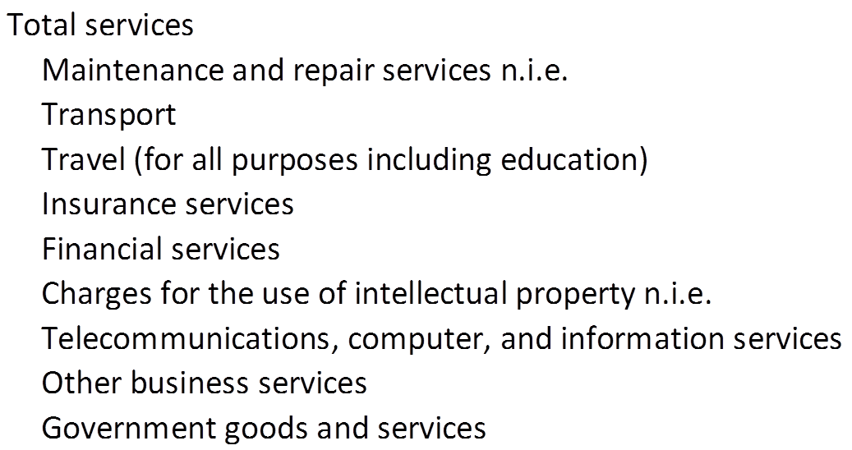
ICT and Potentially ICT-Enabled Services
ICT services
Potentially ICT-enabled services - services with outputs that can predominantly be delivered remotely over ICT networks
Notes:
*****Slides 4-9 are animations of the same slide*****
9 broad categories again

Slide 10
ICT and Potentially ICT-Enabled Services
ICT services
Potentially ICT-enabled services - services with outputs that can predominantly be delivered remotely over ICT networks
Notes:
*****Slides 4-9 are animations of the same slide*****
Challenge in taking these series back to 1999: certain components within the category technical, trade-related, and other business services (architectural and engineering, industrial engineering, training, and other business services n.i.e.), a subcategory of other business services were not separately collected until 2006. I estimated them using their share of the set of all categories of technical, trade-related, and other business services that were not individually published pre-2006.
Less detail is available by country/affiliation, especially prior to 2006, so the country-level estimates were only taken back to 2006. For country level estimates, some services types are not separately available in BEA’s published data (“other” technical trade-related and other business services includes two services types that are potentially ICT-enabled and three that are not), so a slightly different definition was used to estimate potentially ICT-enabled services for 2006-2012. Starting in 2013, we began calculating potentially ICT-enabled services by country/affiliation using the same definition as for all countries.
Potentially ICT-enabled services include those categories in green and some of the services types included in other business services (R&D; professional and management consulting; architectural and engineering; industrial engineering; training services; and other business services n.i.e.).
Potentially ICT-enabled services include ICT services.

Slide 11
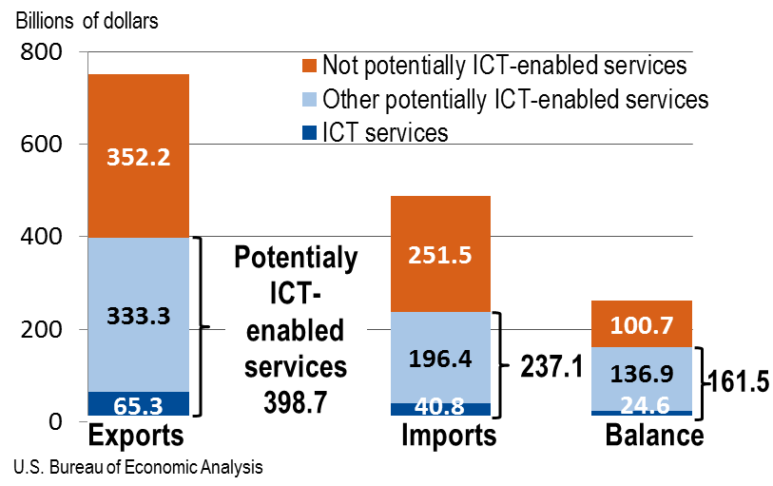
ICT and Potentially ICT-enabled Services Trade, 2015
Notes:
As of 2016, these measures of trade in services are part of BEA’s official trade in services statistics. Data available on BEA’s website.
*Potentially ICT-enabled services include ICT services.
Potentially ICT-enabled services > not potentially ICT-enabled services in 2015 for exports, and < for imports.
The U.S. surplus in potentially ICT-enabled services > surplus in not potentially ICT-enabled services.

Slide 12
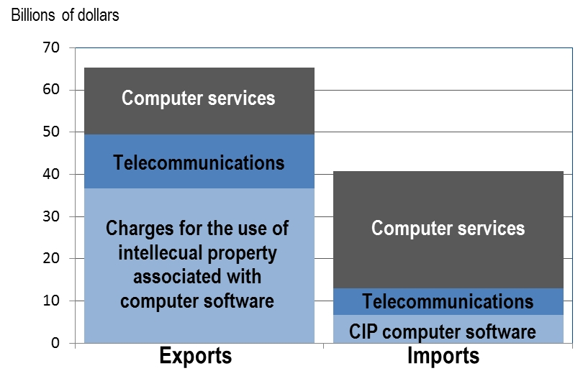
ICT Services Trade by Type, 2015
Notes:
Different mix of components in exports vs. imports.
Category ranks:
Exports – CIP-computer software, computer services, telecom
Imports – Computer services, CIP-computer software, telecom

Slide 13
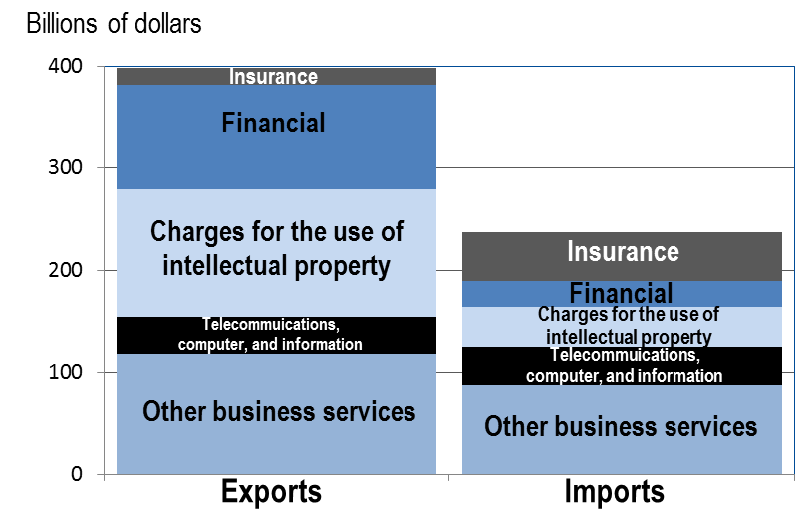
Potentially ICT-Enabled Services Trade by Type, 2015
Notes:
Different mix of components in exports vs. imports.
Category ranks:
Exports – CIP, OBS, Financial, Telecom, Insurance
Imports – OBS, Insurance, CIP, Telecom, Financial

Slide 14
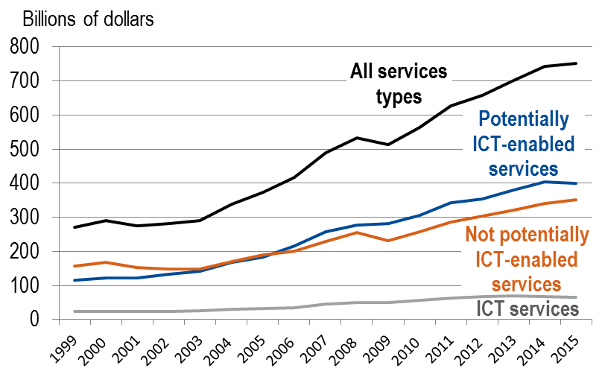
Exports of ICT and Potentially ICT-Enabled Services, 1999-2015
Notes:
For this and the next slide:
Data for 1996-2006 are estimated using published data under a slightly different definition than for the years 2007-2015. For ICT services, the value of computer services was estimated based on its share of total CIP in 2006. For potentially ICT-enabled services, values within “technical, trade-related, and other business services” are estimated based on their share of total “technical, trade-related, and other business services” less operating leasing in 2006.
Exports of ICT services increased XXX.
Exports of potentially ICT-enabled services surpassed exports of not potentially ICT-enabled services in 2006.
Exports of potentially ICT-enabled services have increased nearly 250 percent since 1999 while exports of all other services have increased 125 percent. Potentially ICT-enabled trade has possibly grown faster due to improvements in ICT technology.

Slide 15
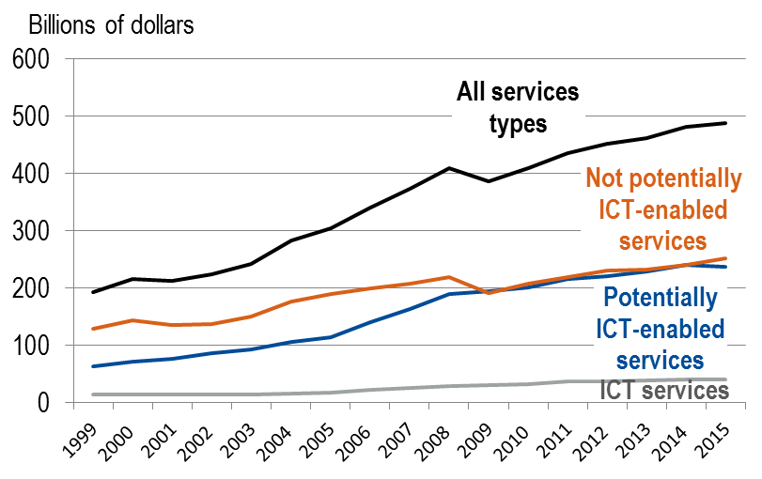
Imports of ICT and Potentially ICT-Enabled Services, 1999-2015
Notes:
Imports of potentially ICT-enabled services passed exports of not potentially ICT-enabled services in 2009, but were lower once again since 2010.
Imports of potentially ICT-enabled services have increased more than 250 percent since 1999 while exports of all other services have increased ~180 percent.

Slide 16
Trade in ICT and Potentially ICT-Enabled Services by Type, 1999-2015
Charges for the use of intellectual property
Telecom, computer, and information
Other business services
Insurance
Financial
Notes:
Exports- Nearly equal shares of the increase from OBS (30%), Financial (29%), and CIP (27%).
Financial and insurance services each grew more than 400%.
Imports- Largest contributors to the increase: OBS (40%), Insurance (22%), CIP (15%).
Insurance services grew more than 400%; OBS grew nearly 350%.

Slide 17
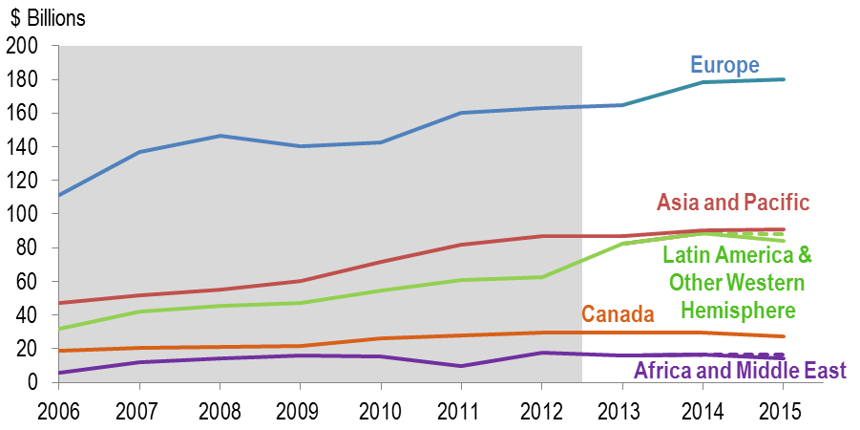
Exports of Potentially ICT-Enabled Services by Region, 2006-2015
Values for 2006-2012 (in the shaded region) are estimated using a slightly different definition than for 2013-2015.
For 2015, values for Latin America and Other Western Hemisphere and Africa and Middle East are suppressed, so they are shown here as a range between a lower (solid) and upper bound (dashed).
Notes:
For this slide and the next slide:
Data for 2006-2012 are dashed because they are estimated based on published data using a slightly different definition than for the years 2013-2015. These values include all of the services type “other technical, trade-related, and other business services,” when only part of it is considered potentially ICT-enabled.
In the years 2013-2015, the solid lines represent unsuppressed estimates using the preferred definition. The dotted lines are lower and upper bounds that establish a range of values around the true value of potentially ICT-enabled services that uses that same definition.
Many of the regional estimates are suppressed in BEA’s official statistics in 2013-2015 to avoid the disclosure of data of individual companies. For these cases, I estimated lower and upper bounds based on the unsuppressed data.
The largest contributors to the increase were Europe (38%), Latin America and OWH (29-31%), and Asia and Pacific (24%).
Latin America’s Increase in 2013 was mostly due to an increase in financial services. CIP, telecom, and PMC also had large increases.

Slide 18
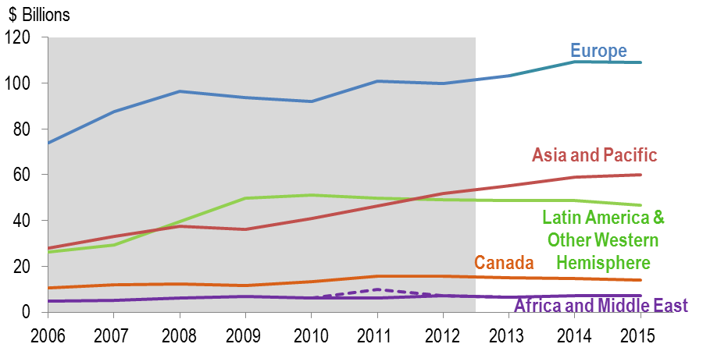
Imports of Potentially ICT-Enabled Services by Region, 2006-2015
Values for 2006-2012 (in the shaded region) are estimated using a slightly different definition than for 2013-2015.
For 2011, the value for Africa and Middle East is suppressed, so it is shown here as a range between a lower (solid) and upper bound (dashed).
Notes:
The largest contributors to the increase were Europe (37%), Asia and Pacific (33%), and Latin America and OWH (21%).

Slide 19
Exports and Imports of Potentially ICT-Enabled Services for the Top Ten Countries, 2015
(D) Suppressed to avoid the disclosure of data of individual companies.
Notes:
***** This slide is just used to show that the (D)’s are filled in on the next two slides*****
Many of the country-level estimates are suppressed in BEA’s official statistics in 2015 to avoid the disclosure of data of individual companies (the cells with “(D)”’s here). I made some estimates of the values based on the unsuppressed data (next slide)…

Slide 20
Exports and Imports of Potentially ICT-Enabled Services for the Top Ten Countries, 2015
1. Values for 2015 are calculated lower bounds.
Notes:
For those countries that had suppressed values in 2015, I calculated a lower bound estimate that is the sum of the components of potentially ICT-enabled services that are not suppressed.
In the right-hand columns of each panel are potentially ICT-enabled services’ share of total trade in services. Certain countries trade very intensely in potentially ICT-enabled services. For exports, Ireland and UK Islands, Caribbean and for imports, Bermuda and India.

Slide 21
Exports and Imports of Potentially ICT-Enabled Services for the Top Ten Countries, 2015
(D) Suppressed to avoid the disclosure of data of individual companies.
NA Not available
Growth rates shown are percentage compound annual growth rates.
1. Values for 2015 are calculated lower bounds.
Notes:
Improvements in and increased use of ICT services may have contributed to higher growth for some countries.

Slide 22
Conclusion
Trade in ICT and potentially ICT-enabled services offer insight into the extent to which ICT may be used to facilitate trade in services
Trade in ICT and potentially ICT-enabled services have grown faster than total services, possibly reflecting improved ICT technology
Popular concern about offshoring of ICT-enabled services
The United States runs a surplus in ICT and potentially ICT-enabled services
Research has shown that factors other than wages attract ICT and ICT-enabled services trade (e.g. Doh et al., 2009)
These data could potentially be used to examine:
How improvements in ICT networks have impacted trade between the U.S. and its trading partners
How ICT networks support global value chains for U.S. multinationals
How policies that affect how data are shared and stored could impact trade in services to/from the United States
Notes:
Reminder that we are not looking at the value of trade that is traded digitally, but the value of trade that we think could be predominantly traded digitally.
Popular concern - In particular, researchers and policymakers are concerned that ICT is enabling offshoring ICT-enabled services, which may decrease U.S. employment
- BEA’s estimates of potentially ICT-enabled services show that the United States runs a surplus in ICT and potentially ICT-enabled trade
- Research has shown that factors other than wages or availability of specialized labor attract ICT and ICT-enabled services (e.g. Doh et al. (2009))

