Slide 1
Comments CRIW March 11, 2017
Shane Greenstein
Harvard Business School

Slide 2
Thanks for asking me to discuss
I love this topic, even when papers are in process in days leading up to conference.
Why? B/c important & interesting topics. Great to read careful research by the best in the world.
A discussant can do one of three things:
Summarize the paper for the authors and let the audience listen in.
Summarize the paper for the audience and let the authors listen in.
Go on a riff and raise questions (typically citing the discussant’s prior work).
The first two are especially challenging for a discussant when the presenters are still working on their slides an hour before the presentation...
So I will go on a riff. Put these discussions in broader context of issues in this realm.
While this is serious business, we can still have a little fun.
Two topics in need of attention:
The CPI for Broadband (2/3rd of my time).
Data centers (1/3rd of my time).

Slide 3
Is that English?
Definition: riff
1. a rapid energetic often improvised verbal outpouring

Slide 4
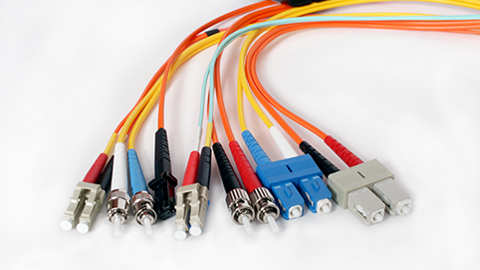
The first topic in need of attention.
The broadband CPI

Slide 5
Yep, the deflators matter. Hurrah for noticing and trying to do something about it.
Lot’s of talk about PPIs, and the need to update them.
Let’s get a fact out there. CPI for Internet access has not declined recently.
CPI for Internet (broadband) access, 8/2007-8/16: 5.3% rise (73.1 → 77.0)
Since the mid 2000s, this index has (for all intent and purposes, even with lags) been a broadband price index.
Benchmark against a comparison.
CPI for PCs from same period: 58.7% decline (106.9 → 44.2)
CPI for telephone equipment, same years: 44.2% decline (38.2 → 21.3)
CPI for wireless telephone services, same years: 14.9% decline (64.4 → 54.8)
What is happening in broadband services that makes it so different?

Slide 6
Why should we care? Demand complementarity.
Broadband is one part of many activities that user consumes during every online session.
The leading content firms today take advantage of broadband in a way that the prior generation of leading content firms did not.
The quality of the content is rising, at least as measured by turnover in user preferences for sites.
Picture of change in top twenty web sites, around rise of streaming (Boik, Greenstein & Prince, 2016).
Less than half the time online, and it changes dramatically in a short time.
Note: Only one revenue-generating good (Netflix).

Slide 7
Improvements in broadband raise the value of content and vice versa.
Everywhere. 75% of US households have a broadband.
Enables the high “utilization” of other IT assets in most of the economy.
Quite a bit of variance at local level. Reduction in prior variance across the US.
What that means? Quality of the user experience continues to improve, and in many dimensions.
Responsiveness is higher in interactive activities.
Supports more gadgets.
Streaming, video, more engaging experience.
Has broadband improved? (Prettier than the FCC data, which shows the same thing)
https://ispspeedindex.netflix.com/country/us/

Slide 8
Netflix index (of speed) has almost doubled in just over four years

Slide 9
Maybe broadband needs quality adjustment for speed/bandwidth?
Perhaps broadband needs to be quality-adjustment for speed upgrades?
Advantages: Simple. Precedent. And doing something looks better than doing nothing.
Disadvantages: In mixes a “production-side” and “demand-side” approach to adjusting prices, so we are not really sure what it means. (Let’s not brush aside such a concern).
But, hey, that adjustment worked in PCs. Should it work here?
My experience suggests this will be feasible, but inadequate.
Greenstein & McDevitt (2011, 2011) examined the dial-up/Broadband upgrade, and many broadband upgrades in the late 2000s, and the gains were modest.
And the work was very tedious, so I am hesitant to do this again…
What is going on? Numerator is small due to diffusion lags (i.e., few upgrads a yr), & denominator is big due to the size of the US economy (i.e., many households).
Forecast….If that is all you do, the adjustment will be modest.

Slide 10
Maybe we ought to look elsewhere other than quality adjustment.
What does a user get for their purchase? Immediately get Google, Facebook…
In the days of walled-garden approaches from AOL, the user bought an experience.
Today users buy access to a lot of different services. But the BLS definition presumes users pay for “the connection.” Only. Does not consider what user gets for their money.
As if there is nothing complementary coming next. Improvement in services provided by Google, YouTube, Facebook, Amazon, and much more, don’t count. New entry does not count anywhere.
Definition no longer corresponds with commonly understood economic transaction.
It is nobody’s responsibility to get the right price deflator when technology changes in something other than “Internet access”.
We also make an excuse for it by labeling Google, Facebook, and others as multi-sided platforms (which is how they view their own business) and lose sight of the complementarity in demand.

Slide 11
Accounting for complementarity in demand in price indices is challenging.
Challenging computation. What is the price-equivalent decline in access prices for the entry of Facebook and YouTube and the improvement of Google over this period?
The challenge, broadly construed: a range of complements in demand are changing. Use is “bursty” and “plastic” – it fills in moments in leisure time.
Utilization is a clever way to address. But it is indirect.
Please acknowledge the issue with complementarity.
A concern. If utilization of IT goods takes away from utilization of the television, is it is wash? Or are we counting a gain merely because we are not counting the loss in television utilization?
Whether you like it or not, the FCC is not going to do anything about this. And it matters: out of sight and out of mind leads to bad technology policy

Slide 12
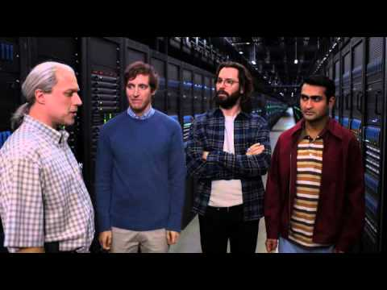
The second topic in need of attention
Data Centers

Slide 13
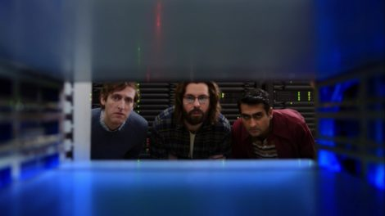
Seen next to data centers, the cloud is part of a larger continuum of options
The cloud is super interesting. Common & growing in finance, medical, insurance, logistics, transportation, electronic commerce, electronic publishing & many parts of economy.
There are many myths and misconceptions about data centers.
Partially driven by popular portrayals.
This picture is from the HBO comedy show “Silicon Valley.”
(If you have not seen this episode, do yourself a favor and do so. Or just watch the three minute clip on YouTube. You will not stop laughing.)
“This is where one of the boxes for your company will go…”

Slide 14
Yep, the cloud matters. Hurray for noticing and measuring!
Firms face large array of choices today.
Build to own. Build to partially own and partially rent. Collocation (rent somebody else’s facilities). Go to full or partially supplied services from AWS/Microsoft/Google, etc.
Many centers (built at the end of the dot-com boom) are reaching the end of their twenty year leases, and are obsolete. And firms have enough cash now to do something about it.
Why is that interesting?
Data centers are in the midst of a building boom right now. AWS/Cloud is part of enormous restructuring in IT. Nowhere near done.
AWS has a majority of startups, but large firms tend to use other options.
Migration b/w cloud and colocation and own centers will be a choice for many years….
So let’s put cloud in bigger context…

Slide 15
Three factors shape demand for owning a data center (& the cloud…)
Performance
Especially latency. Speed related to the length of the wires. Connect to backbone.
Many computing tasks can use hardware more efficiently.
Managerial monitoring
Location inside the centers shapes cooling, access to electricity, shaking, and so on.
Liability. Privacy. Mission critical. Managerial instincts to not be dependent on others.
Co-invention. Programming large scale uses to meet specific needs.
Location (cost factors)
Fixed costs: Land, taxes, construction costs.
Variable costs: Electricity, labor, electricity, security, electricity – AC and powering devices.
Quote size of a center in terms of electricity b/c computing/storage range is moving target.

Slide 16
Trading off the three considerations
If a buyer wants maximum performance, namely, low latency…
Will build to own, and locate in building right next door. Total control over operations.
Expensive. Next door. Maximum Land costs, construction costs, electricity.
If the buyer wants easy monitoring…
Will still insist close location for a drive within an hour, but locate next to backbone.
Options over controlling the space. May own or rent/collocation.
Still expensive, but not maximum. Warehouse district.
If the buyer wants to save expense…
May sacrifice latency, and may or may not give up monitoring rights and control, and more.
Cheap. Footloose. Go where it is cheaper.

Slide 17
Illustration of tradeoffs
If the buyer wants low latency…
5mw data center in downtown Chicago costs $300m (or more)
Super expensive in Santa Clara, central San Francisco, Manhattan, DC, central Boston…
If the buyer wants easy monitoring
In Chicago, locate 5mw data center next to hwy 80, hour south. $260-280m.
Same tradeoffs in most major cities… Richmond CA, Northern NJ, Ashburn VA…
If the buyer wants the cheapest location.
5mw data center goes anywhere. $240m or perhaps lower.
Central Washington St and Oregon have natural advantages due to climate & electricity prices.
Iowa and Nebraska look good too, especially with some tax breaks to reduce construction costs.
By this logic, everything eventually should move to Canada and Norway.

Slide 18
Some questions
Data center substitutes for servers that used to be in basement, or PC on desk.
Exactly how do we think through that capital replacement?
One comes from operating budget and one comes from capital budget.
Do the determinants in price of data centers & cloud move in concert?
Performance/managerial trade-offs, and they play a role in the cost of inputs.
Concern that bundled services and software in a cloud purchase is different…
Not straightforward b/c owning/renting/cloud are not so different, or not?
The performance is a moving target, by definition. Constantly under improvement.
How should we think about the old formulas for service flows from stocks?
Whether you like it or not, this will become the single source of government information about this activity. Why not think about this in the same terms as the firms who make the investment?

Slide 19
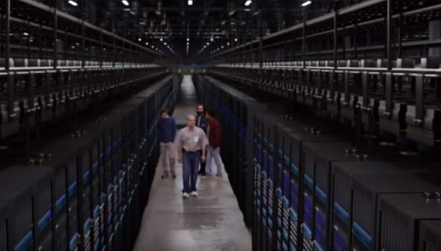
Big theme
Hope you found it informative.
Thanks for your attention!

