Slide 1
The Link Between University R&D, Human Capital and Business Startups
Nathan Goldschlag
US Census Bureau
Ron Jarmin
US Census Bureau
Julia Lane
New York University
Nikolas Zolas
US Census Bureau
NBER CRIW Conference
March 10-11, 2017
Disclaimer: Any opinions and conclusions expressed herein are those of the authors and do not necessarily represent the views of the U.S. Census Bureau. All results have been reviewed to ensure that no confidential information is disclosed. This work draws on collaborations with many coauthors.

Slide 2
Motivation
Ultimate goal: estimate the contribution of research spending on local and national economic activity
Focus of this paper: link between research spending, human capital and startup growth and survival
Motivating observations:
Declining dynamism in economy
Declining worker flows in economy
Transmission of knowledge important (e.g. noncompetes)
What is role of experience, research training and mobility across firms, particularly young firms

Slide 3
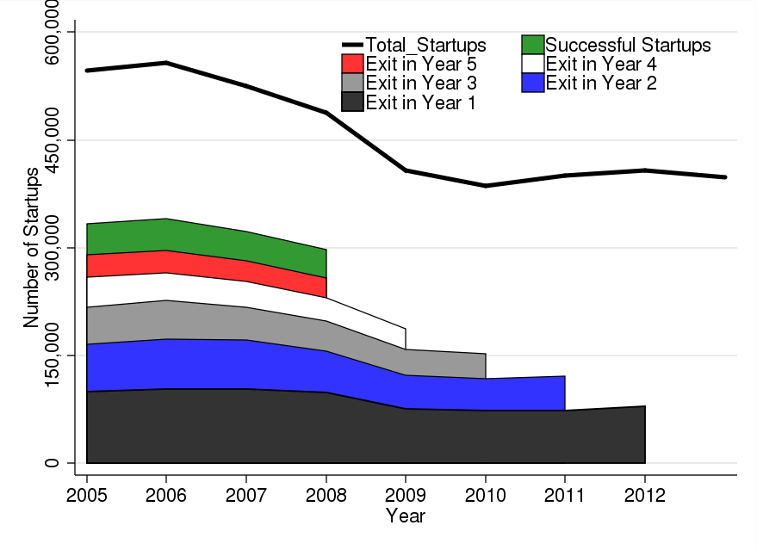
Basic Survival and Startup Facts
More than 50% of startups fail before Year 5
Fewer than 90% of startups fail to hire more than ten employees by Year 5

Slide 4
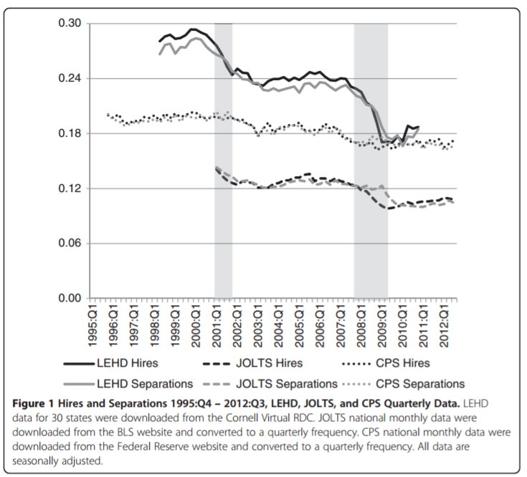
Basic Job Flow Facts
Hyatt, H.R. & Spletzer, J.R. IZA J Labor Econ (2013) 2: 5. doi:10.1186/2193-8997-2-5

Slide 5
Contribution and Findings
Data and measurement
New measures of human capital at individual level
New approach to capturing human capital composition at firm level
New data on startups
New data on individuals employed at startups
Findings
Increased human capital leads to increased survival and growth for startups

Slide 6
Outline
Approach
Data
Methods and Analysis
Results
Conclusion and Next Steps

Slide 7
Outline
Approach
Data
Methods and Analysis
Results
Conclusion and Next Steps

Slide 8
Approach
Can think about startup outcomes as being determined by
$$Y_{ft}=f\left(A_{ft},K_{ft},L_{ft},X_{ft}\right)$$
with varying degrees of exogeneity
Capital Outlays (K): Investments, Financing, Equipment, Technology
Labor (L): Human capital
External factors (X): Macroeconomic conditions, Industry factors, Geographic factors, Productivity Shocks
We attempt to fill in the gaps of these variables, specifically for human capital, using new linked microdata

Slide 9
New Measures of Human Capital
Measures of Human Capital | Source | Method | Scope
Years of Education | ACS, Decennial 2000, 2010 | Imputation | Entire LEHD
R&D Experience | BRDIS/SIRD | Firm Classifications | Entire LEHD, W2
High-Tech Experience | Hecker (2005) | Industry Classifications | Entire LEHD, W2
University | IPEDS/Carnegie Institute | Firm Classifications | Entire LEHD, W2
Research-Trained | W2, UMETRICS, LEHD, BR, LBD | Machine Learning | Entire LEHD, W2

Slide 10
Outline
Approach
Data
Methods and Analysis
Results
Conclusion and Next Steps

Slide 11
Data
Grant-funded researchers
UMETRICS
Individual Demographics
Individual Characteristics File (ICF)
Firms and establishments
Longitudinal Business Database (LBD) and Business Register (BR)
Jobs and Earnings
Longitudinal Employee-Household Dynamics (LEHD) and W2
University attributes
Carnegie Institute University data and Integrated Postsecondary Education System (IPEDS)

Slide 12
UMETRICS
Institution
STAR
Agency Budget
Award
Record
Acquisition
And Analysis
Agency
Award
Direct
Benefit
Analysis
State
Funding
Institution
Endowment
Funding
Papers
Intellectual
Property
Benefit
Analysis
Financial System
Research
Project
Disbursement
Patents
Start-Up
Innovation
Analysis
HR System
Procurement
System
Subcontracting
System
Personnel
Vendor
Contractor
Jobs,
Purchases,
Contracts
Benefit
Analysis
Hire
Buy
Engage
Existing
Institutional
Reporting
Detailed
Characterization
and
Summary
State
Download
Notes:
Flowchart based on university reporting systems, but portable to other HR/Finance systems. Presented to and validated by pilot FDP universities

Slide 13
Main Infrastructure Files
Start-Up Worker History File (2005-2014)
All employees affiliated with startups at time t=0
Contains earnings history, EIN codes, R&D/High-Tech/University Indicators
Panel dataset organized by PIK-EIN-Year (690M+ observations, 40M Unique Persons)
Start-Up Firm History File (2005-2014)
All new non-farm firms and establishments with positive payroll
Contains employment, payroll, Entry/Exit years, IPO, industry and geography codes
Constructed distance measures for each startup from NIH and NSF research allotments to universities
Combination of files allows us to assess impact of human capital and research funding on startup outcomes

Slide 14
Outline
Approach
Data
Methods and Analysis
Results
Conclusion and Next Steps

Slide 15
R&D and High Tech
R&D Firm (BRDIS/SIRD)
420,000 EIN-Year observations
74,000 EINs
ICF
Demographics for 260M individuals
High-Tech Industry (Hecker)
61 NAICS six-digit industries
Link by EIN-Year
Link by PIK
Link by NAICS
Startup Worker History File
690.4M Total PIK-EIN-Year Observations
48.3M Observations for Startups at time t=0
Link by EIN
Link by PIK-EIN-Year
University (IPUMS/Carnegie)
130 EINs
Research Experienced
140,000 actual UMETRICS
190,000 predicted (ML) UMETRICS
 | Startup Count | Survive to Next Period | Successful Startups | High-Growth
All | 5.3M | 3.4M | 170,000 | 29,000
At least 1 R&D Firm Employee | 1.6M | 1.36M | 120,000 | 20,000
At least 1 High-Tech Employee | 900,000 | 780,000 | 75,000 | 12,000
At least 1 University Employee | 400,000 | 360,000 | 41,000 | 6,300
At least 1 Research-Experience Employee | 35,000 | 32,000 | 5,400 | 700

Slide 16
Construction of human capital measures
Year | Combined EHF-ECF-W2 Observations | W2 Observations | Additional Observations from LEHD | EHF-ECF Observations | Additional Observations from W2
2005 | 271.8M | 237.9M | 33.9M | 209.4M | 62.4M
2006 | 278M | 243.1M | 34.9M | 214.7M | 63.3M
2007 | 278.6M | 244M | 34.6M | 216M | 62.6M
2008 | 267.9M | 235.2M | 32.8M | 207.5M | 60.4M
2009 | 242.9M | 214.3M | 28.6M | 186.9M | 56M
2010 | 241.8M | 208.7M | 33M | 191.7M | 50.1M
2011 | 245.4M | 212.7M | 32.7M | 196.6M | 48.8M
2012 | 256.5M | 223.6M | 32.9M | 202.2M | 54.2M
2013 | 257.9M | 229.2M | 28.7M | 208.7M | 49.1M
2014 | 262.9M | 232.3M | 30.6M | 216.4M | 46.5M
Overall | 2603.7M | 2280.9M | 322.8M | 2050.2M | 553.5M

Slide 17
R&D and High Tech
R&D Firm (BRDIS/SIRD)
420,000 EIN-Year observations
74,000 EINs
ICF
Demographics for 260M individuals
High-Tech Industry (Hecker)
61 NAICS six-digit industries
Link by EIN-Year
Link by PIK
Link by NAICS
Startup Worker History File
690.4M Total PIK-EIN-Year Observations
48.3M Observations for Startups at time t=0
Link by EIN
Link by PIK-EIN-Year
University (IPUMS/Carnegie)
130 EINs
Research Experienced
140,000 actual UMETRICS
190,000 predicted (ML) UMETRICS
 | Startup Count | Survive to Next Period | Successful Startups | High-Growth
All | 5.3M | 3.4M | 170,000 | 29,000
At least 1 R&D Firm Employee | 1.6M | 1.36M | 120,000 | 20,000
At least 1 High-Tech Employee | 900,000 | 780,000 | 75,000 | 12,000
At least 1 University Employee | 400,000 | 360,000 | 41,000 | 6,300
At least 1 Research-Experience Employee | 35,000 | 32,000 | 5,400 | 700

Slide 18
Model Research Training: Intuition
Practice of science similar across institutions
Have universe data on all grants and all individuals paid on grants in 14 institutions (20% of federally funded R&D)
Have data on demographics, earnings and employment in all institutions
=> Use machine learning techniques

Slide 19
Model Research Training Empirical Application
Training set: 1.4M person-university pairs from 14 UMETRICS universities representing about 20% of federally funded university R&D
Out-of-sample set: 6.8M person-university pairs from 130 top research universities representing about 90% of federally funded university R&D
Feature set includes measures of pre, post, during employment history, demographics, and university characteristics (including funding $)

Slide 20
Learning Frames
Why we think it will work
Grant trained individuals at UMETRICS institutions are significantly different (Zolas et al., 2015)
 | Research Trained | Not Research trained
Proportion Female | 50.5 | 54.1
Proportion White | 73.2 | 77.2
Proportion Hispanic | 4.3 | 4.9
Proportion Black | 5.7 | 9.3
Proportion Asian | 14.1 | 6.2
Proportion Foreign-Born | 21.8 | 11.4
Year of Birth | 1977.7 | 1975.6
Proportion in Professional/Scientific Services | 18.4 | 14.3
Professional/Scientific Earnings, t+1 | 42,500 | 33,700
Source: W2 and UMETRICS data. Note: Each of these are significantly different at p<0.001.

Slide 21
Learning Results
 | Random Forest
Feature Set | Chi-Squared | Decision Tree | Impurity | Hand-Curated
Estimators | 50 | 50 | 50 | 50
Maximum Depth | 50 | 50 | 50 | 50
In-Sample Accuracy | 99.703 | 97.277 | 99.950 | 99.924
In-Sample Precision | 99.990 | 98.971 | 99.991 | 99.981
In-Sample Recall | 97.443 | 77.248 | 99.580 | 99.365
Mean 10-Fold Precision | 99.849 | 70.816 | 99.806 | 62.222
Mean University-Fold Precision | 51.900 | 79.570 | 41.646 | 42.934
Source: UMETRICS, W2, LEHD, LBD, ICF and BR. Note: Fewer than 50 estimators and lower maximum depth results in significant loss of precision and accuracy while additional estimators and depth yield little additional quality improvements and entail significant additional computational resources. The hand-curated set includes demographic variables and demeaned earnings for individuals during their time at the university.
Accuracy scores across feature sets > 97
Precision scores > 98 and recall scores > 77
Quality holds up in cross validation, mean 10-fold precision > 60
Results likely under-count research trained individuals

Slide 22
University and Research Trained
R&D Firm (BRDIS/SIRD)
420,000 EIN-Year observations
74,000 EINs
ICF
Demographics for 260M individuals
High-Tech Industry (Hecker)
61 NAICS six-digit industries
Link by EIN-Year
Link by PIK
Link by NAICS
Startup Worker History File
690.4M Total PIK-EIN-Year Observations
48.3M Observations for Startups at time t=0
Link by EIN
Link by PIK-EIN-Year
University (IPUMS/Carnegie)
130 EINs
Research Experienced
140,000 actual UMETRICS
190,000 predicted (ML) UMETRICS
 | Startup Count | Survive to Next Period | Successful Startups | High-Growth
All | 5.3M | 3.4M | 170,000 | 29,000
At least 1 R&D Firm Employee | 1.6M | 1.36M | 120,000 | 20,000
At least 1 High-Tech Employee | 900,000 | 780,000 | 75,000 | 12,000
At least 1 University Employee | 400,000 | 360,000 | 41,000 | 6,300
At least 1 Research-Experience Employee | 35,000 | 32,000 | 5,400 | 700

Slide 23
Outline
Approach
Data
Methods and Analysis
Results
Conclusion and Next Steps

Slide 24
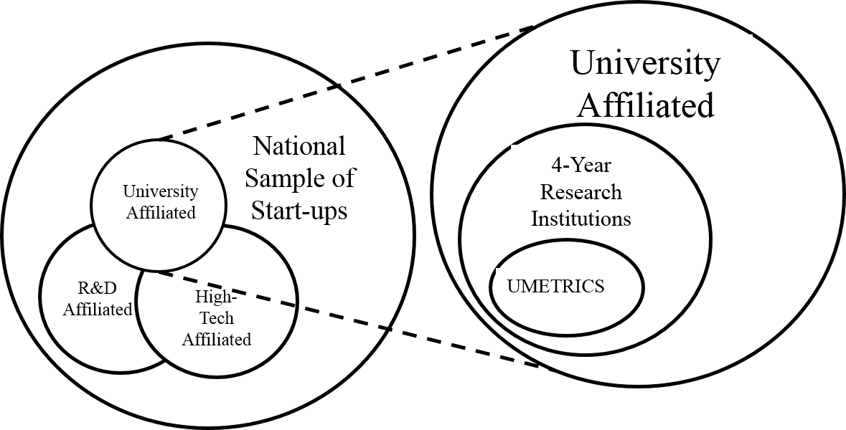
Overlapping Human Capital
 | Former High-Tech Employees | Former R&D Employees | Former University Employees
All Startups | 10% | 17% | 2%
High-tech Startups | 94% | 26% | 4%
Industrial Startups | 16% | 20% | 3%
Source: Startup Worker History and Startup Firm History Files.

Slide 25
Descriptive Regressions
$$Y_{f}= α+ β_{1}\ln{{EARN}_{f0}}+ \sum_{k=1}^{9}{δ_{k}{SIZE}_{kf0}}+ β_{2}\ln{\overline{{AGE}_{f0}}}+ β_{3}\ln{{FEMALE}_{f0}}+$$
$β_{4}\ln{{FOREIGN}_{f0}}+ β_{5}\ln{{RD}_{f0}}+ β_{6}\ln{{HT}_{f0}}+β_{7}\ln{{UNI}_{f0}}+$
$β_{8}\ln{{Research Experience (UM)}_{f0}}+ ε$
For startup f , outcomes $Y_{f}$ include:
Survival to age 5 with 10+ employees in year 5
High Growth - top decile of employment/revenue growth distribution to year 5
Other notes:
All worker type counts +=1
Use inverse hyperbolic sine transformation: $\ln\left(x\right)→\log{{(x+(x^{2}+1)}^{1/2}}$
All specifications include industry fixed effects and zip-year fixed effects
Standard errors clustered at the industry-year level

Slide 26
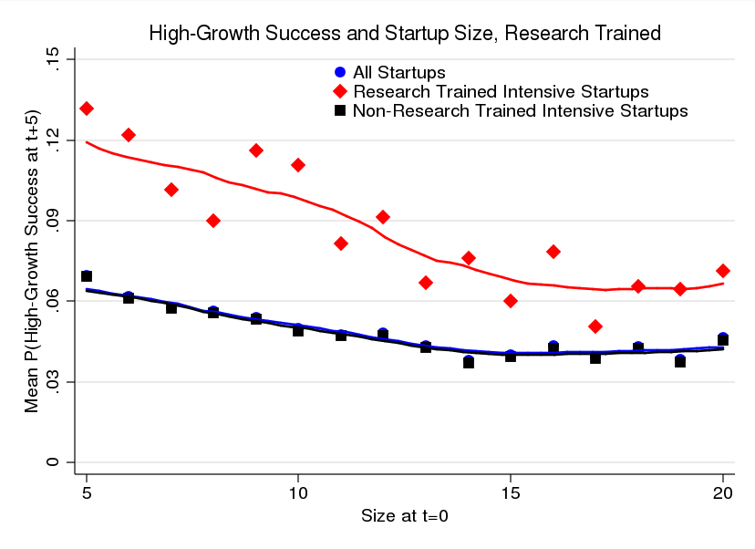
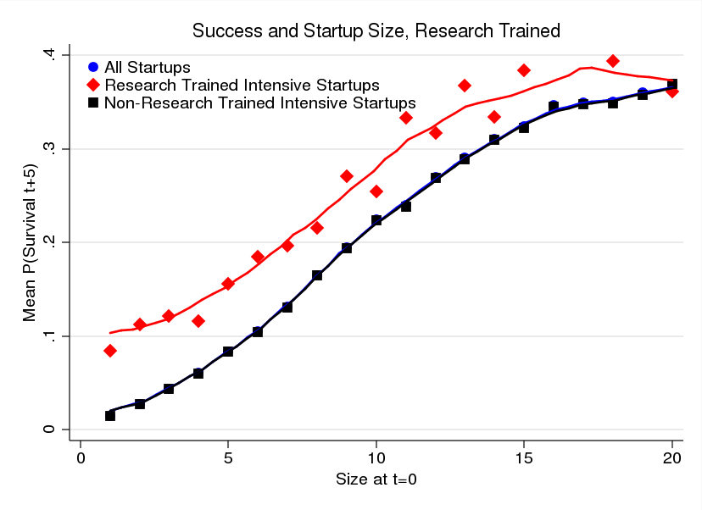
Success and High Growth Human Capital Composition

Slide 27
Success Outcomes
Mean Success Rate for All Startups is 6.6%
Human Capital Type | Coefficient | Mean # of Workers at Startup | % Benefit Relative to Mean from gain of 1 additional worker type
Research Experienced | 0.02778*** | 0.009 | 41.85%
R&D Firm | 0.026*** | 1.378 | 39.16%
High-Tech Worker | 0.0198*** | 0.544 | 29.82%
University Affiliated | 0.022*** | 0.171 | 33.14%
Startup success rate increases by nearly 42% from adding one additional research-experienced worker
Being classified as high-growth increases by almost 50%

Slide 28
High-Growth Outcomes
Mean High-Growth Success Rate for All Startups is 1.2%
Human Capital Type | Coefficient | Mean # of Workers at Startup | % Benefit Relative to Mean from gain of 1 additional worker type
Research Experienced | 0.0167*** | 0.009 | 140.0%
R&D Firm | 0.0107*** | 1.378 | 89.46%
High-Tech Worker | 0.0079*** | 0.544 | 66.05%
University Affiliated | 0.0086*** | 0.171 | 72.41%
High-Growth Success rate more than doubles when you add one research-experienced worker
Results are consistent across startup firm types (industrial and high-tech) with greater importance placed on high-tech workers in the high-tech sector

Slide 29
Outline
Approach
Data
Methods and Analysis
Results
Conclusion and Next Steps

Slide 30
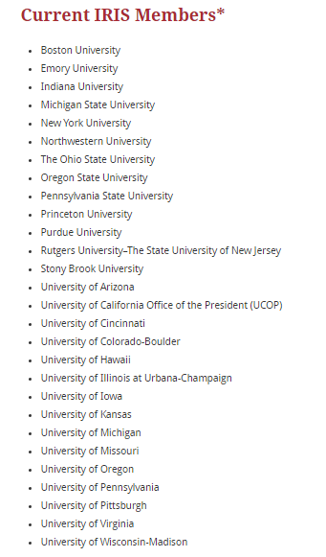
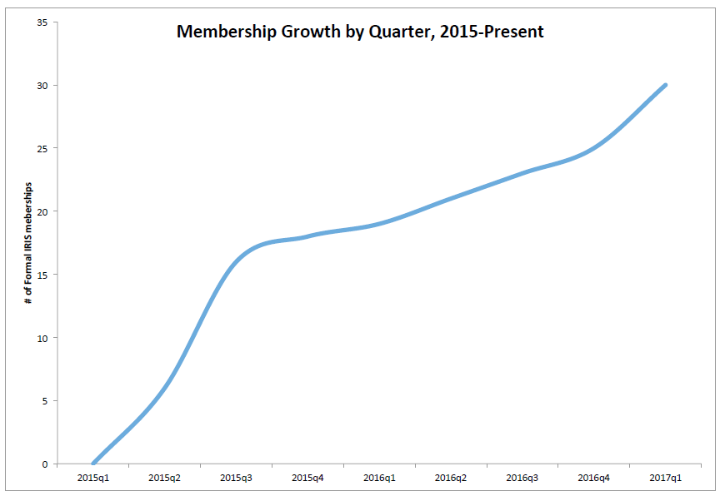
Additional universities

Slide 31
Conclusion
Introduced new measures of human capital - research training, extended with machine learning
Investigated human capital composition of startups
Next steps:
Additional robustness checks,
Linking to productivity,
Explore worker flows
Explore exogenous shocks – e.g. tech transfer office differences across universities

