Slide 1
Highly-Skilled Scientists and Their Effects on Universities and Research Fields Fabian Waldinger (University of Warwick)

Slide 2
Star Scientists Matter – But Identifying Causal Effects is Difficult
High-skilled are regarded as particularly important for economic growth and as source for localized knowledge spillovers
Credibly identifying the effects of highly-skilled scientists on universities is challenging because scientists endogenously choose to work in better universities, more promising research fields, and so on
To understand causal mechanisms that go beyond correlations one needs to use some kind of exogenous variation
In my work I have used the dismissal of scientists in Nazi Germany to identify various parameters of the “knowledge production function”

Slide 3
Overview of Talk
Show aggregate effects of “star scientists” on universities (Waldinger, 2015) and research fields (Moser, Voena, and Waldinger, 2014)
Show evidence on peer effects or “spillovers” at the local level (Waldinger, 2012) and at the level of research fields (Moser, Voena, and Waldinger, 2014)
Show effects of “star scientists” on PhD students (Waldinger, 2010)

Slide 4
Section 1: Overall Effects - Germany
Just two months after the Nazi government came into power they dismissed all scientists of Jewish origin and with opposing political views from German (and Austrian) universities
Overall more than 1,000 academics were dismissed, among them Nobel Laureates Albert Einstein, Max Born, James Franck, Fritz Haber, John von Neumann and many others
In Waldinger (2015) I study long-run effects on German and Austrian universities (i.e. geographical effects)

Slide 5
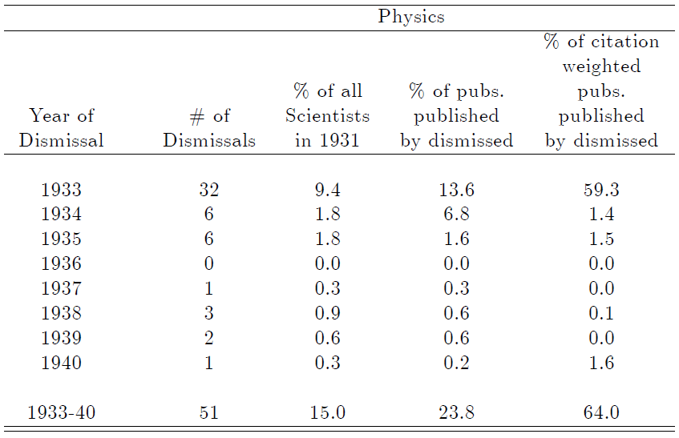
Dismissal of Physicists

Slide 6
Dismissal of Physicists

Slide 7
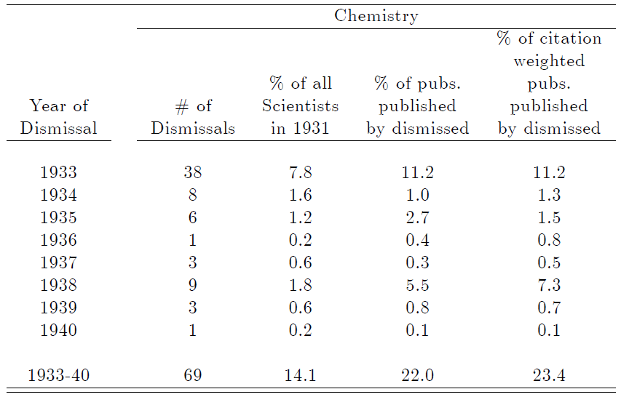
Dismissal of Chemists

Slide 8
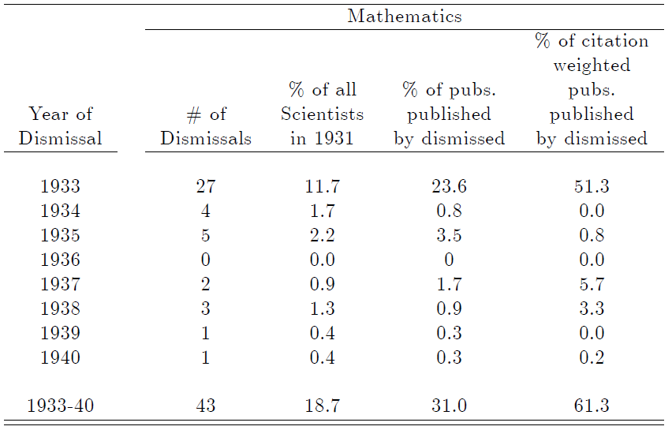
Dismissal of Mathematicians

Slide 9
Dismissals Reduced Total Department Quality in the Long-Run

Slide 10
High-Quality Scientists Are Important

Slide 11
Quality of Hires Drive the Long-Run Effects

Slide 12
Section 1: Overall Effects – USA
Many of the dismissed migrated to the United States
In Moser, Voena, and Waldinger (2014) we study overall effects of the migration of these high-quality chemists to the United States
The US received chemists such as Carl Neuberg the “father” of modern biochemistry
The location of where the migrants end up is endogenous: use research fields to measure overall impacts
Compare research fields that receive a chemist from Germany to research fields where other German chemists were working who did not migrate to the United States

Slide 13
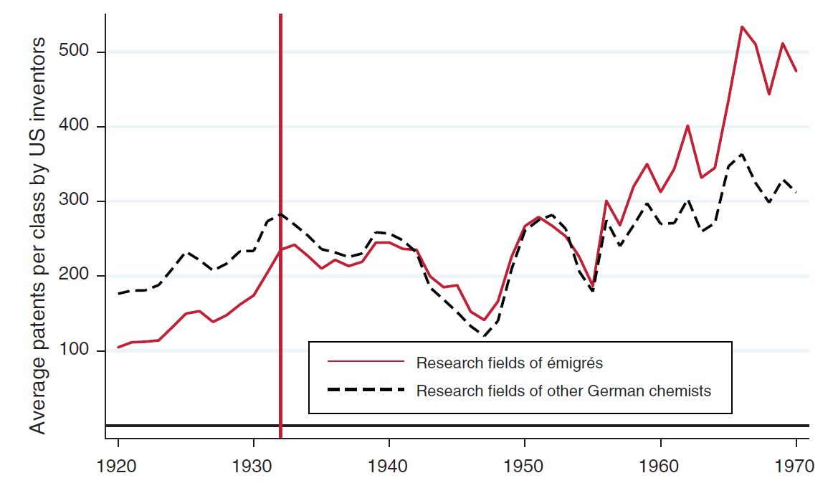
US Chemists in Research Fields with Emigres Patent More

Slide 14
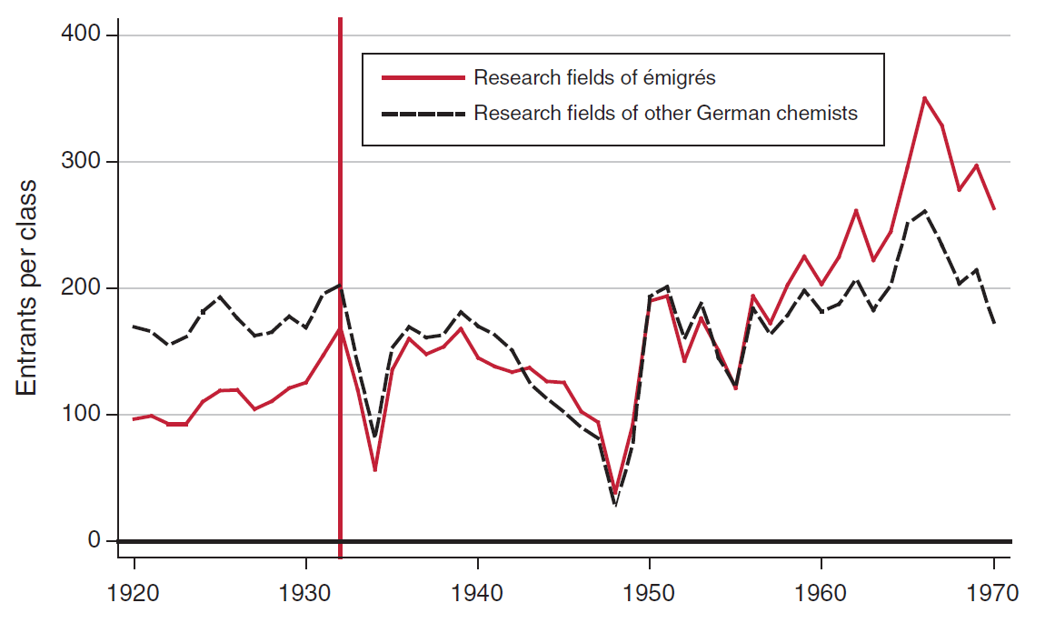
New Entrants Drive the Overall Increase in Patenting by US Chemists

Slide 15
Section 2: Spillovers/Peer Effects
An alternative mechanism (to hiring and entry) for finding these long-run effects could be localized spillovers or “peer effects”
Credibly identifying peer effects among the high-skilled is very challenging because high-skilled scientists choose to work with better peers and because common shocks are easily mistaken as peer effects.
In Waldinger (2012) I study localized peer effects in German universities using the dismissal of scientists as exogenous variation in the quantity and quality of peers.

Slide 16
Dismissals Reduced Department Size

Slide 17
Dismissals Lowered Department Quality

Slide 18
Did Dismissal Affect Peer Productivity?

Slide 19
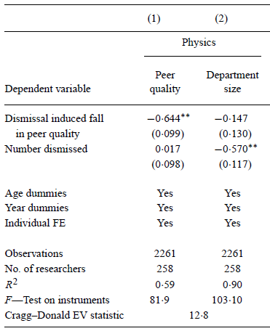
First Stages

Slide 20
First Stages

Slide 21
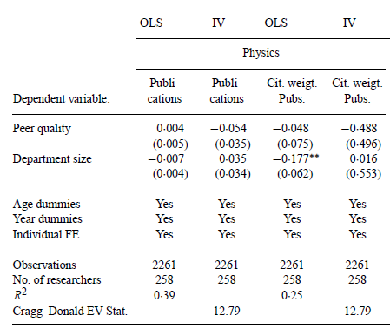
Effects of Number and Quality of Peers

Slide 22
Effects of Number and Quality of Peers

Slide 23
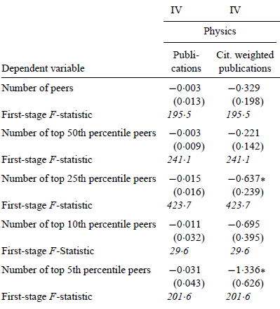
Even High-Quality Peers Do Not Matter

Slide 24
Chemists Migrating from Germany to US
What happened to “peers” in the United States?
Study incumbents who already worked in research fields of émigrés, compared to other incumbents who worked in research fields where other German chemists were working.

Slide 25
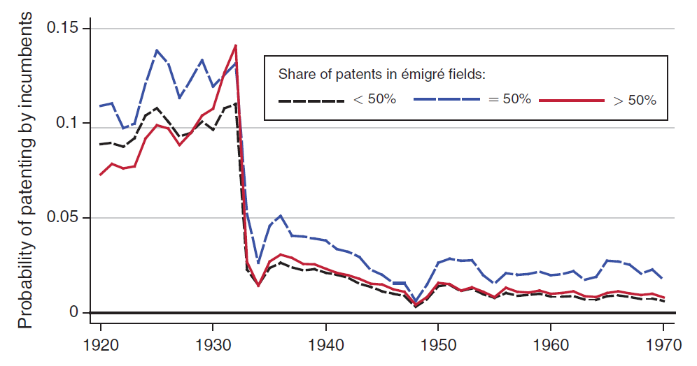
Incumbent Chemists with Patents in Emigre Classes do not Benefit

Slide 26
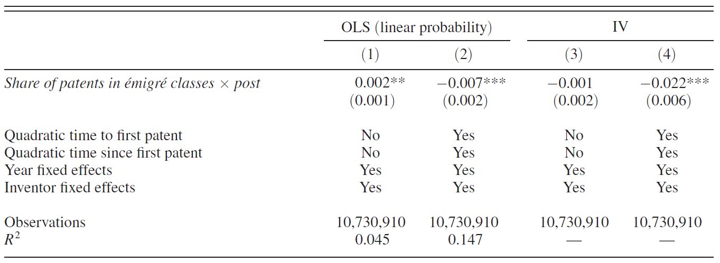
Incumbent Chemists with Patents in Emigre Classes do not Benefit

Slide 27
Section 2: Spillovers/Peer Effects
To my own surprise localized spillovers or “peer effects” seem to matter much less than hiring/entry.
Do high-skilled scientists only affect hiring/entry?
Investigate effects on PhD students

Slide 28
Section 3: Effects on PhD Students
In Waldinger (2010) I study effects on PhD students of dismissed mathematicians
Identification: Dismissal of, mostly Jewish, scientists in Nazi Germany Some students experience a sudden decline in advisor quality while students in other departments do not

Slide 29
Students in Departments with Dismissals Become Less Likely to Publish Dissertation

Slide 30
Summary of Findings and Open Questions
Overall effects of highly skilled scientists: They matter!
Mostly because the attract other scientists (see also Agrawal and Oettl, 2015) and train students and other young scientists
Peer effects/localized spillovers are very small or non-existent
(see also Borjas and Doran, 2012, Jaravel, Petkova, and Bell, 2015, Corelissen, Dustmann, and Schönberg, 2015)
Open Questions:
Why do high-quality peers affect hiring despite having no (or very small effects) on productivity? Reputation effects?
Why do a lot of papers find 0 effects for co-workers in high-skilled professions but positive effects in low-skilled professions? Do high-skilled mostly collaborate outside “firm” boundaries?

