Slide 1
The impact of adoption and Diffusion

Slide 2
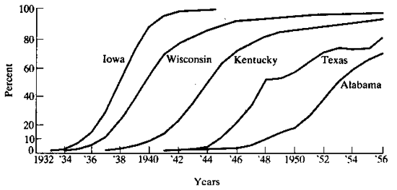
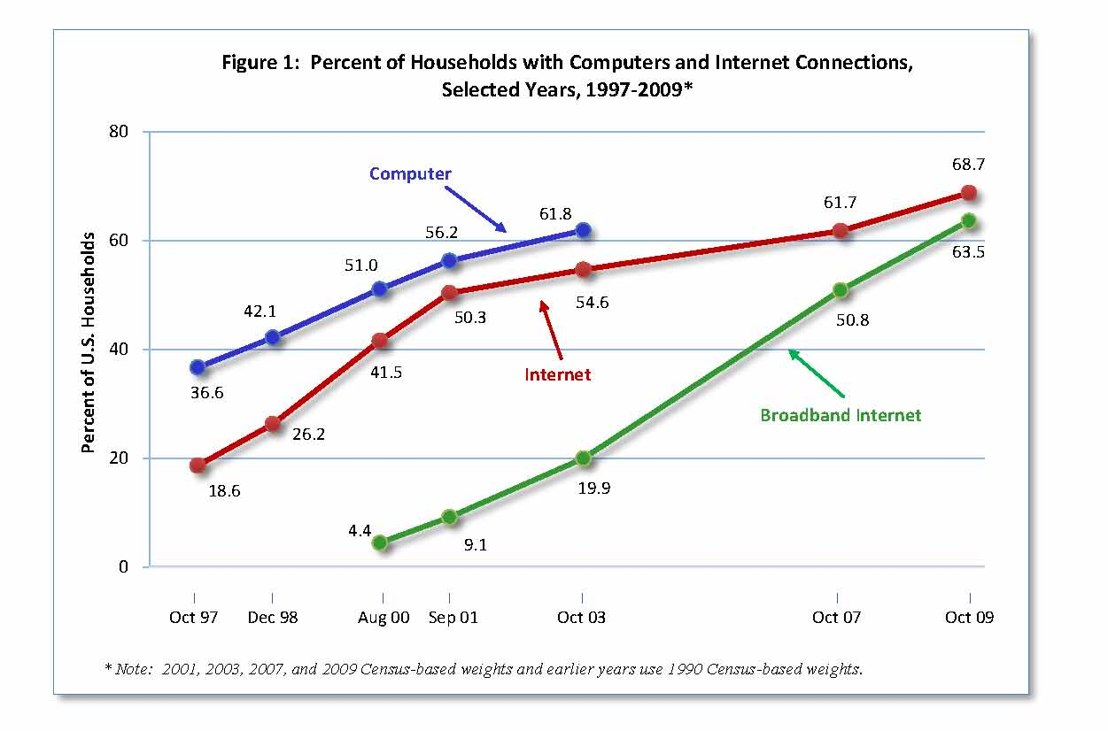
Diffusion studies have a long tradition in economics.
Historical inventions motivates traditional approach
Hybrid crop seed replacing earlier seed at different rates across states.
The s-curve model
Policy takes a keen interest in adoption and diffusion
Internet access in households tracks progress.
Linked to growth and equality of opportunity

Slide 3

Yet, you do not see many studies of diffusion in the digitization literature…
Diffusion, deployment, & adoption lost its academic appeal a few decades ago.
Why doesn’t everyone buy? Too descriptive.
Who acts sooner? Younger, richer, more educated, urban…. Is this useful?
Another adoption study? Ho-hum. If you insist doing one, at least have something new to say....
Consequences from use of IT caught the interest of many researchers. Why?
Naïve enthusiasm.
Or as Springsteen said in Blinded by the light, “Mama always told me not to look into the eye of the sun, but, Mama, that is where the fun is.”

Slide 4
Different models of research that links diffusion to a meaningful outcome.
This line of work examines how adoption changes economic outcomes….
Fraught with issues over endogeneity, reverse causality, and omitted variables.
So, SRSL, why would anyone want to be in such a literature?
Escape the tangled knots of the old literature.
The questions looked important.
New data could take us there.
Potential for home runs.
It is easy to fake progress, and get a lawmaker to believe a bad result. (Just saying. Not everyone in this literature is here with noble motives.)

Slide 5
Many potential great questions
How did firms restructure their boundaries when computing became available?
Baker and Hubbard examined make/buy boundaries between ownership and use of markets by trucking firms. Other industries that use dispatchers – delivery, taxis, etc? Same or different mechanisms?
How does deployment shape market leadership and competitive rivalry? What role does the adoption and deployment play in changing productivity, market share, points of differentiation with others?
How much change in economic welfare/output/price accompanies the diffusion of a new technology?
How much growth in the 1990s can be attributed to diffusion of the Internet? To diffusion of broadband? Examples: price of airline tickets, capacity of planes, price of advertising in newspapers, resale markets, hotel capacity utilization, revenue of rated restaurants….
How did local economic actors react to services affiliated with the Internet – e.g., the diffusion of Craigslist → secondary ticket markets, price of advertising.

Slide 6
Many potential great questions
How do the operations of a firm change after the adoption of a new technology?
Use of outsourcing, extent of discretion, geographic dispersion of production, size distribution of employment within a firm, the location of invention, frequency and composition of ads, the frequency & target of price discrimination, the compensation for intermediary service, cooperation across establishments….
What are its consequences from the diffusion of technology for regional/city outcomes?
Disparity of wages? Size distribution of firms, mobility of skilled labor, rate of entrepreneurial firm formation….
Change in health of population, change in average lifespan, and mortality rates, and their correlates, such as medical insurance, etc

Slide 7
However, I assigned too many papers.
I started to write the slides last week, and…
Not enough time to cover seven papers.
What was I thinking?
I was trying to let you sample the trade off between (a) partial results for a novel & important question about adoption/deployment or (b) precise incremental contributions on a deliberately narrowed question. Both are not ideal, but the ideal is not feasible.
Sorry, about the extra work.
Good exercise or calisthenics.
Let’s stick to three, four if we have time...
Athey and Stern, McElheran, Forman, Goldfarb, Greenstein
Bloom, Garicano, Sadun, Van Reenen… if we have time…

Slide 8


Athey & Stern
The Impact of Information Technology on Emergency Health Care Outcomes
Rand Journal, 2002

Slide 9
What is the question?
Question: How does health status vary at PA county hospitals as a result of the adoption of emergency 911 technology?
Why is this important and interesting?
A direct measure of the impact of technology whose principle effects is to speed up information transmission to emergency services.
A direct measure of before/after, linked to diffusion. A somewhat general approach. Steps towards controlling for selection/truncation.
Common service nationwide. Benefits hard to measure.
Not afraid to collect their own data to illustrate the specific effect that many believe reflects broader trends.

Slide 10
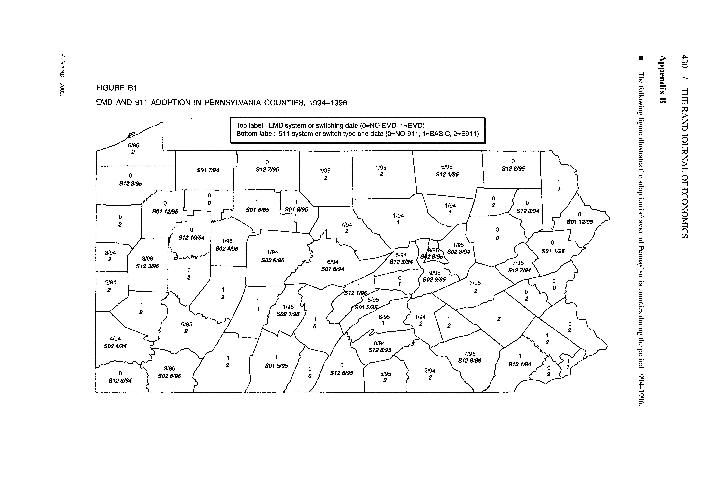
Figure 1 motivates issues. Appendix B map.

Slide 11
Statistics
Selection effects.
What is the potential issue? Statistical challenge? Why is exogenous policy decision so key?
Why a dif on dif takes care of this issue?
Severe data requirements.
Under what circumstances will this approach be feasible?
Page 406.
What does this equation say? A basic fixed effect model.
Table 5 and 6.
The basic result: E911 has all the action.

Slide 12
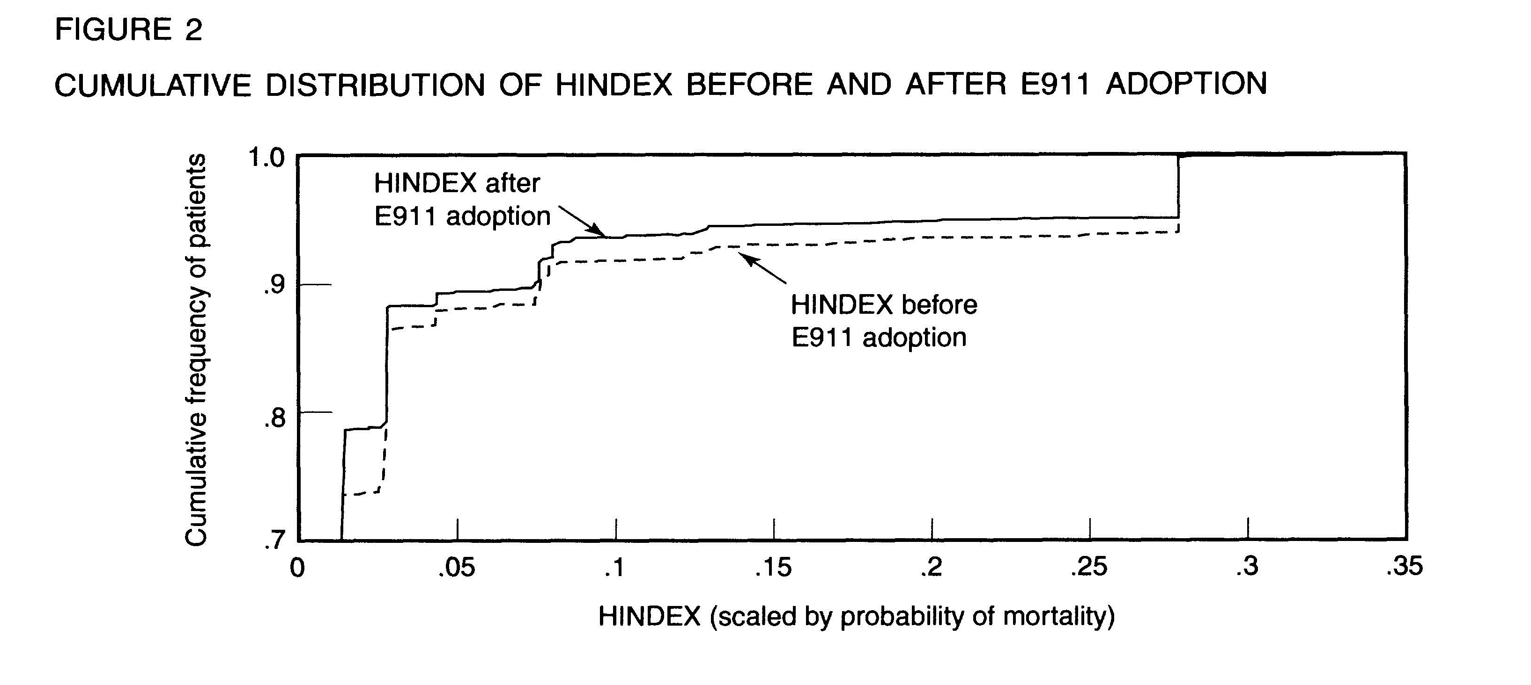
Results
The principal challenge for this paper is illustrated above – the answer leaned one way.
What if they had not found a large effect? Would “zero” have been as interesting?

Slide 13
Results
Everything else is about robustness.
For other controls.
For other selection issues.
For distribution issues.
Ends with rough calculation about economics savings. Why?
What should researchers do next?
Could this be done on other outcomes? What other economic variables would be effected? Insurance rates? Ambulance companies?
Variance in public infrastructure is a wonderful natural experiment, if you can find it.

Slide 14

McElhelran
Do Market Leaders Lead in Business Process Innovation? The Case(s) of E-Business Adoption
Management Science, 2015

Slide 15
What is the question?
Do leading firms adopt business-process innovations before rivals or vice-versa?
A comparison of e-buying/e-selling.
Why important and interesting?
Classic question about leading firms & new technology.
E-commerce a *large* amount of investment in 90s.
A lot less known about e-commerce than commonly assumed…(turning pop topic into quant topic…)
Large market share thought to matter, but distinction b/w internal/external capabilities rarely tested. Rarely observed, and easy to confuse with other factors.
Yes, this is an adoption study.
The technology was thought to be important for reshaping many aspects of industrial leadership, rivalry, and productivity. Almost reversing the direction of causation…

Slide 16
What are the key findings?
Leaders adopt incremental (e-buying), but not radical (e-selling).
External factors slow down adoption
Adoption of business process resembles what has been observed elsewhere…
Complexity drives up co-invention costs.
Interaction w/other parts of the value chain drives adoption costs.
E-buying/selling fundamentally different.

Slide 17
Background: framing the hypotheses
Why frame adoption determinants?
Theory v empirical framing.
Why does she need precise def’n for hypotheses?
Internal capabilities v external
Adoption of product v process,
Manufacturing process v business process
Co-invention
Complexity, Interdependence, Customers.
Why is an ex-ante definition, and extensive knowledge about the phenomenon so key to a durable framework?

Slide 18
Background section
E-commerce covers many activities. Why such an extensive discussion?
E-buying & e-selling often confused.
E-buying is much easier to change. Often not complex. Not massive interdependence. Rarely big changes in processes/operations.
E-selling technically complex, interdependent, tied to customer perception, etc.
Why the interaction terms in the probits?

Slide 19
Data
CNUS 10% sample of manu establishments
Side remark: Census data for dissertations, productivity, sample size, clearance, must be manu.
Special survey of ecommerce
Never before used. (Figuring out which part of survey was worth investigation.) Original = extra time.
Sample size: 35K of establishments.
Plus just about anything (practically speaking) about manufacturing to control for size, employment, skill…
Some imperfect measures of complexity, interdependence, interaction with customers….

Slide 20
Results
Buying & selling different w/r/t mkt share
Table 2. What does that show?
Table 3: selling v buying (w/ERP as comparison)
Why so many controls? EDI? Age? Skill mix?
Why such concern for interactions?
Which finding is most convincing?
Why such concern for other potential explanations?
Concern for omitted variables? Why?
Who is this directed at? Why?

Slide 21
What should research do next?
What is missing? Diffusion sitting in the background…
Just a cross section, not the time series.
Leaders are slow in selling: do they catch up later?
Very coarse measure of selling/buying
More nuances qualitative evidence from the time.
Internal/external for another setting?
Rare empirical illustrations – w/variation.
Subtle determinants of co-invention.
While market share or rank might be exogenous in short run or proxied with other controls, “leadership” becomes endogenous in long run.
Early adoption → more productive in the long run?

Slide 22



Forman, Goldfarb and Greenstein
The Internet and Local Wages, A Puzzle.
American Economic Review, 2012

Slide 23
What is the question?
Did the diffusion of the internet contribute to a change in the distribution of wages across locations in the US?
Why care?
Explain change in wage distribution? Worth any effort.
IT literature suggests biased technical change, but 1990s optimism – death of distance – suggests opposite.
No examination of Internet as key driver.
IT boom of late 90s worth hundreds of billions in GDP.
Add to the (surprisingly thin) literature on how the Internet’s diffusion changed the economy…

Slide 24
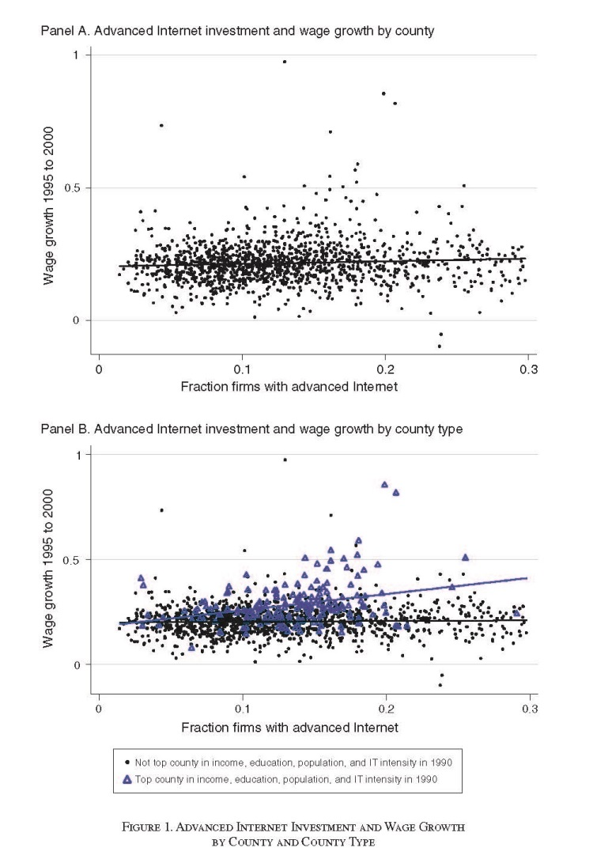
What are the key findings?
Statistical facts establish a puzzle. Internet everywhere, but payoff is not.
Most strongly associated with counties that were already doing well – in terms of income.
high income, education, population, and IT-intensive.
Importantly, NOT others without this combo.
Internet explains over one half of the difference between quadruple combo group and elsewhere.
Right timing.” Counties that later adopted did not grow faster from 1990 to 1994, also did not grow after 2000.
Robust to controls for omitted variables, & IV.
Why did the authors put such a simple picture in the introduction?

Slide 25
Data section
Why tell story about Internet in the data section?
“Surprise” sets up statistics about timing. (Academics are familiar with their own experience, and infamously unfamiliar with how everyone else lives.)
Why no model?
Is one necessary to motivate education, population size, existing infrastructure?
Why describe endogenous variable in detail?
Why did the authors use county level information?
What are the strengths and weaknesses of that choice?
What would be better in an ideal world?
What did the editor want?

Slide 26
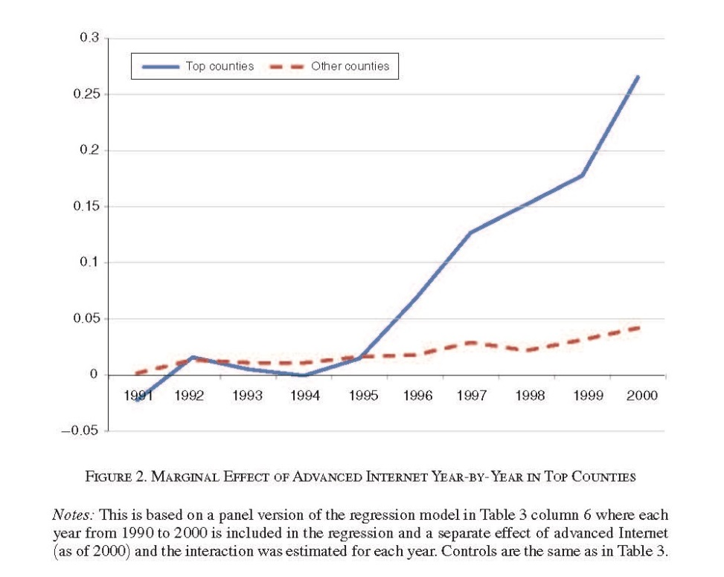
Statistics
(2) log(Yi 00) − log(Yi 95) = α1 Xi + β Interneti
+ ϕ1(Interneti × HighIncomei)
+ ϕ2(Interneti × HighEducationi)
+ ϕ3(Interneti × HighPopulationi)
+ ϕ4(Interneti × HighITIntensityi)
+ ϕ5(Interneti × HighAllFactorsi) + εi.
What are the endogeneity issues with basic estimation equations?
Why would a false positive arise? How to test for it?
How does equation (2) test for the role of the Internet in fostering inequality?
What does an instrument need to do in this setting? Why is IV challenging to execute (and never 100% satisfying)?

Slide 27
Results
Why are the results presented in this order?
Why walk through results in Table 2? Even though it does not work well? Why more than one column in table 3? Why do the instruments come last in Table 4?
Why the additional findings about employment in Table 5?
Why robustness checks at the appendix, but not the paper?
Timing. Rust belt effect. Neighboring county effect.
Why does this add up to a *puzzle*?
What is better – partial results for a novel & important question or precise incremental contribution?

Slide 28
What should research do next?
Is it interesting to know whether Internet changed income distribution in the most recent decade?
But it is not an investment from zero. Figuring out the right “diff” is the hard part. Other “natural” experiments?
Link back to biased technological change.
Introducing regional economies into discussion. Regional economies do look different, specialize in different industries and activities, etc.
Introducing occupational and skill differences and distribution within occupation in a region and b/w regions.

Slide 29




Bloom, Garicano, Sadun, Van Reenen

Slide 30
What is the question? Overview
Question: What are consequence from deployment of information processing & communications for locus of decision making within an organization?
Use theory to measure/test empirical regularities.
Empirical cross sectional evidence.
Novel data. Clever. Lots of work.
Testing/measuring under the null that the theory is correct.
Weakness: partial analysis of diffusion.
Did this result from diffusion/deployment?
Does not address plausible reverse causality and lagged endogenous/exogenous variables thoroughly.
This is – both! – the best paper on this topic for a decade, and a topic in which it is impossible to get an 100% satisfying answer.

Slide 31
Why is this challenging?
Not enough data to do a diff on diff
Where they treat diffusion as exogenous (initially), then use it to identify changes in the endogenous variable from starting point.
Why is cross section an issue?
ICT investment ALWAYS – I do mean ALWAYS! – grows on installed base in big establishments. Greenfield IT investment rare except in startups.
ICT is NOT only driver of decentralized/centralized in organizations. Initial conditions determined starting point years ago for a wide variety of reasons.

Slide 32
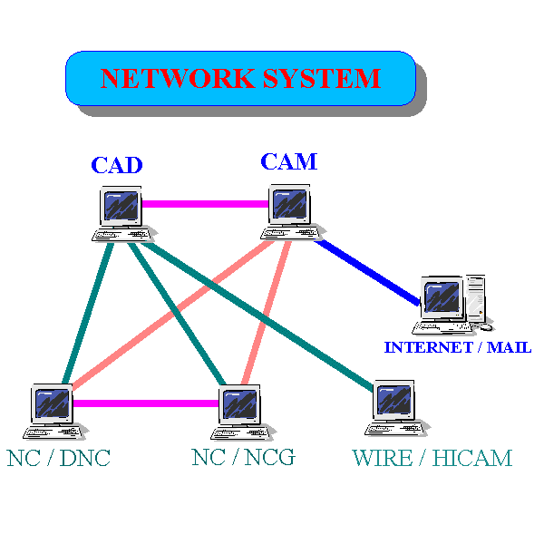
Illustration of the issues on CAC/CAM systems
Very clever place to examine decentralization.
Increasing use of digitalization to alter work flow.
But it is not new. CAD/CAM revolution dates to work station revolution.
These users got rid of mainframes earliest & move to C/S. Many had done so before we observed them in that study.
Decentralized years ago due to scientific work force.
Plausible reverse causality: decentralized organizations adopt CAD/CAM earlier.
Lagged endogenous variable. Decentralized orgs were that way a while ago and they still are.
Needs distinction b/w early/recent adopter & change in decentralization to really identify the key prediction.

Slide 33
Illustration of the issue on ERP
Very clever measure of coordination.
Endogeneity? At first things look good. ERP “seems” youngish, a early/mid 1990s innovation.
But… ERP a recent label, not a recent idea.
An amalgam of many s/w modules for manufacturing. SAP & Oracle tried to integrate.
Called Material Requirement Planning in my youth.
Then more modules added for non-materials.
Plausible reverse causality: work flow (e.g., cost of inventory) or design requirement (high interrelatedness) required use of precursors to ERP.
Organization already coordinated face lower costs adopting S/W that embeds central control?
Organizations w/centralization in past still have it today….

Slide 34
Illustration on networking
Clever approach to measuring networking.
Good idea. Good idea. Good idea.
Seems young….but…*sigh* it is not as new as it looks.
Internetworking business is very old too.
EDI (early 1990s) ran over something, after all.
TELENET, founded in 1972, sold packet switching services, billion dollar company before Internet.
Plausible reverse causality again, but this time (!) the authors have an instrument….countries differ in pricing for special access.
This is a good idea, and should hold up. Only vulnerable to endogenous political economy…? Where the local industry needs the lower costs they get the changes…

Slide 35
Open questions
Plausible reverse causality in all three cases?
Except for instrument in case of special access lines, where the authors make a good effort.
Is there any way to know incremental contribution of new ICT? In a cross section?
Maybe. Look for indicators of early/late adoption. Indirect evidence under null that infra-marginal/marginal adopter started from different place.

Slide 36
Conclusion
Look into the eye of the sun.
Go forward with courage.
And tap into your naïve enthusiasm!
And try to find some instruments.

