Slide 1
Census linkage roundtable
December 11, 2015

Slide 2
Current Grant
Is parental stress transmitted to children, and if yes, what are the mechanisms?
Link/update recruits, spouse and children of recruits to all census decades for which they are alive and find death dates and causes (VCC)
POW oversample, n=2,158
Recruits from the UA and Andersonville samples held as POWs, n=1,961
Andersonville Siblings, n=197
UA, non-POWs, n=8,500
USCT, n=4,500

Slide 3
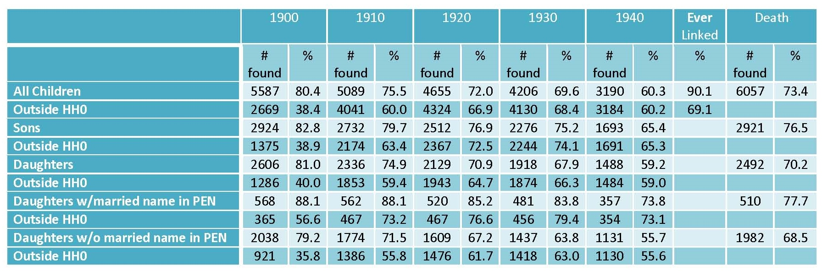
Veterans' Children Census Link Rates 8,500 white soldiers - In progress 1,639 Recruits completed as of 12/7/2015

Slide 4
Information used for Linking From Pension and Military Records
Name
Date of birth
Place of birth
Location
Family members
Parents’ birthplaces
Marital status
Race
Gender
Street name
Occupation

Slide 5
Search Methods using Ancestry.com
Family tree hints
Wildcard searches
First name only
Last name only
No name
When other search items are unique, or
Sufficient quantity of other data
Other family members
Target + other family members
When target person is thought to be living with known family members
Can use first names only

Slide 6
Explaining Our Success
Multiple sources
Family Search
Find a Grave
Use information from other found decades
Add information from additional original documents
Marriage records
Draft cards
Death records
Exact street address from pension records
Ability to correct for some of Ancestry’s indexing problems using logic and reading the actual manuscript
Given multiple possible matches, ability to determine the correct match

Slide 7
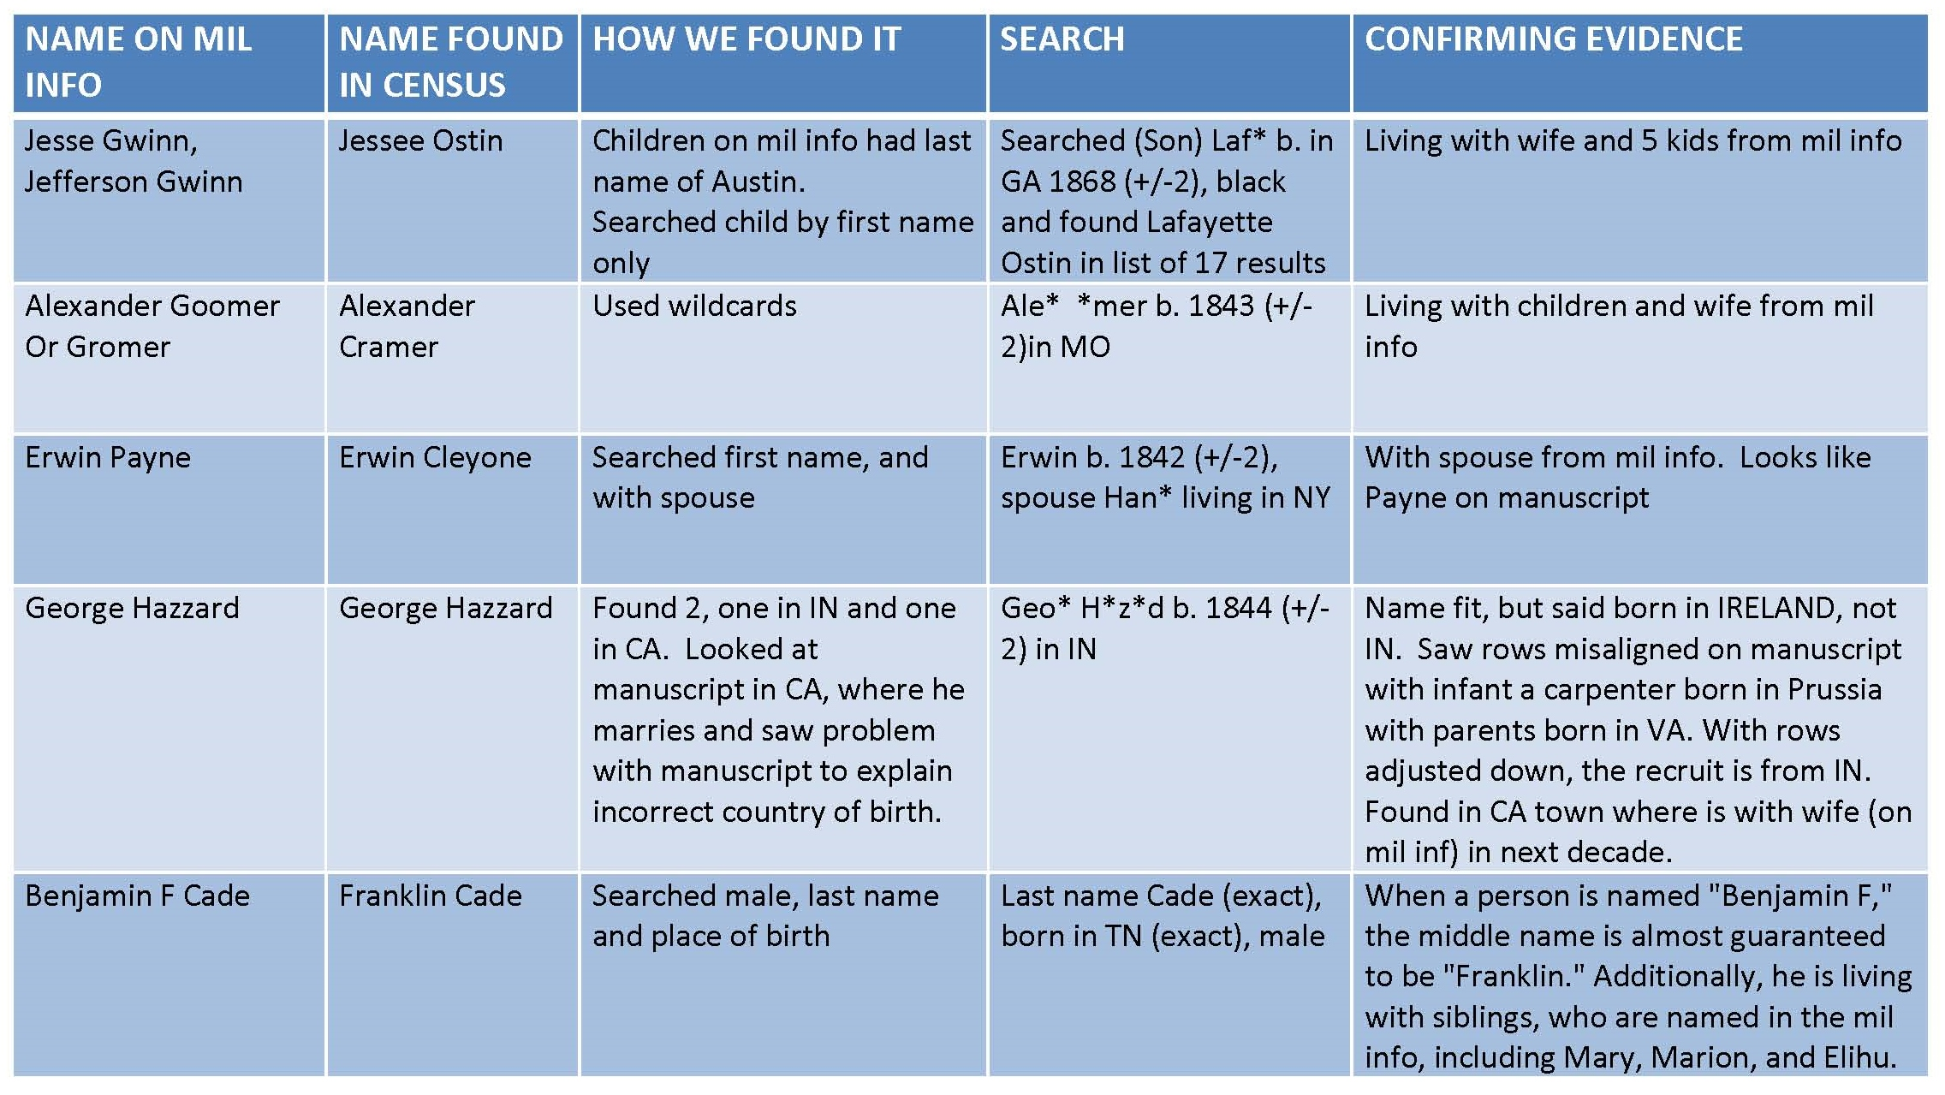
Case Studies

Slide 8
Mechanized Matching
Sample description – POW
2,000 recruits from the Andersonville and Union Army samples
Captured and imprisoned during Civil War service
Survived to 1900
Limited to recruits that researchers matched using GEDCOM files
n= 1631

Slide 9
Subsample Used for Mechanized Matching
Manually linked to 1870 and 1880, with accompanying GEDCOM* files
1870 = 1,255
1880 = 1,453
Attempted to find potential matches for these recruits based on:
A 10-year birth window
First and last name with Jaro-Winkler distance greater than .7
Exact birth state match except for German states, VA/WV, and Canadian provinces
Mechanically linked to 1870 and 1880
1870 = 784
1880 = 860

Slide 10
The Feigenbaum Algorithm
Split the manually-linked data set in half creating a training set and a testing set
Ran a probit regression with:
Difference in birth year
Multiple name-matching metrics
Number of potential matches
Used the training set to determine cutoffs for the predicted probit value (b₁)and the ratio between the predicted probit value and the second best match (b₂) that maximize efficiency and accuracy
Tested the coefficients from the regression and cutoffs on the testing set

Slide 11
Results
Drop off in true positive rate and positive predictive value is small
True positive rate is the sensitivity, or the proportion of positives the algorithm was able to correctly identify
Positive predictive value measures the precision, or the proportion of positive results from the algorithm that are true positive results
True positive rate (TPR) and positive predictive value (PPV) are very low (not good)
1870
Training – TPR = 47.5%, PPV = 82.5% (false positives 17.5%)
Testing – TPR = 43.8%, PPV = 79.4% (false positives 20.6%)
1880
Training – TPR = 44.9%, PPV = 80.9% (false positives 10.1%)
Testing – TPR = 43.7%, PPV = 88.0% (false positives 12%)

Slide 12
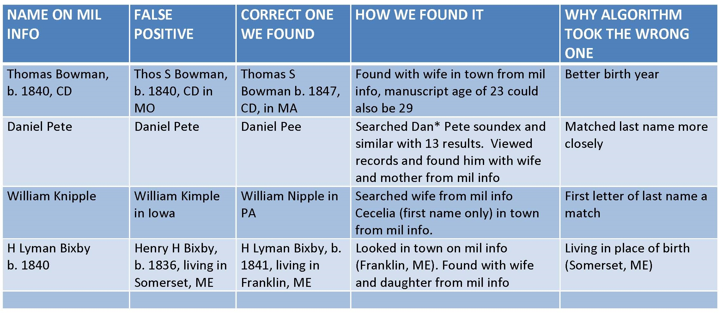
False Positives

Slide 13
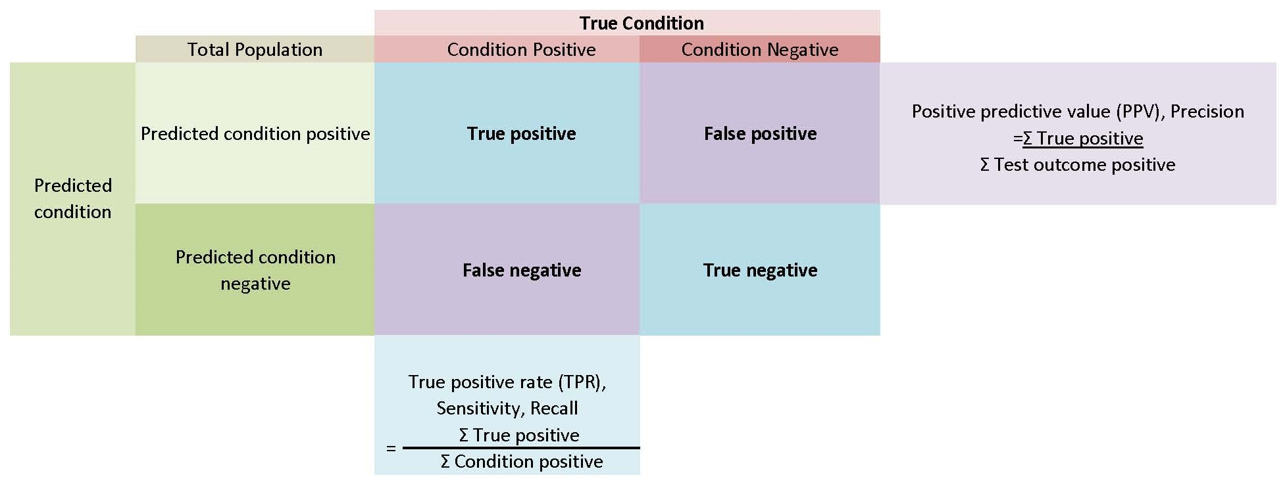
Precision

Slide 14
Sensitivity

Slide 15
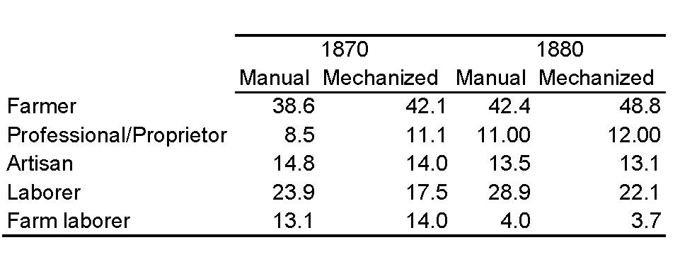
Occupational Distributions, Manual vs Mechanized Search

Slide 16
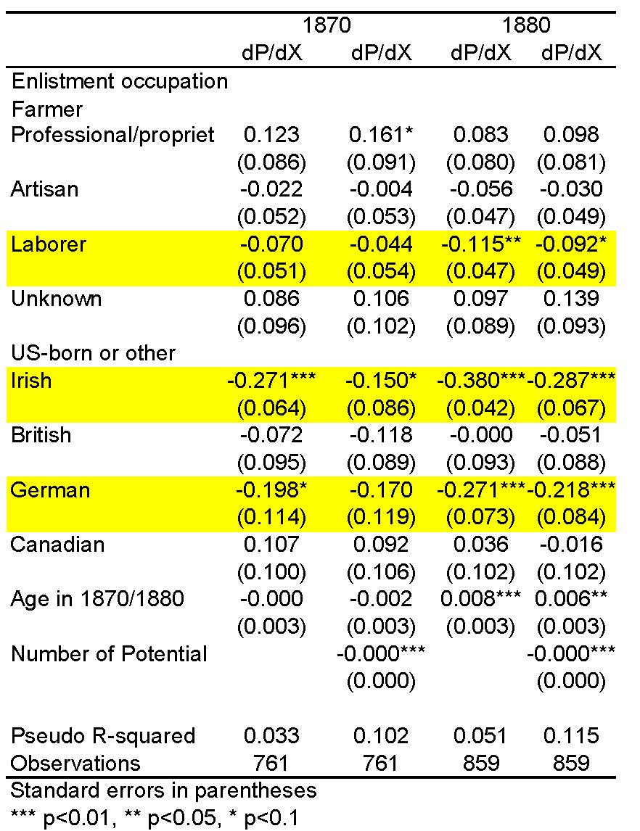
Predictors of Mechanized Matching, Enlistment Characteristics

Slide 17
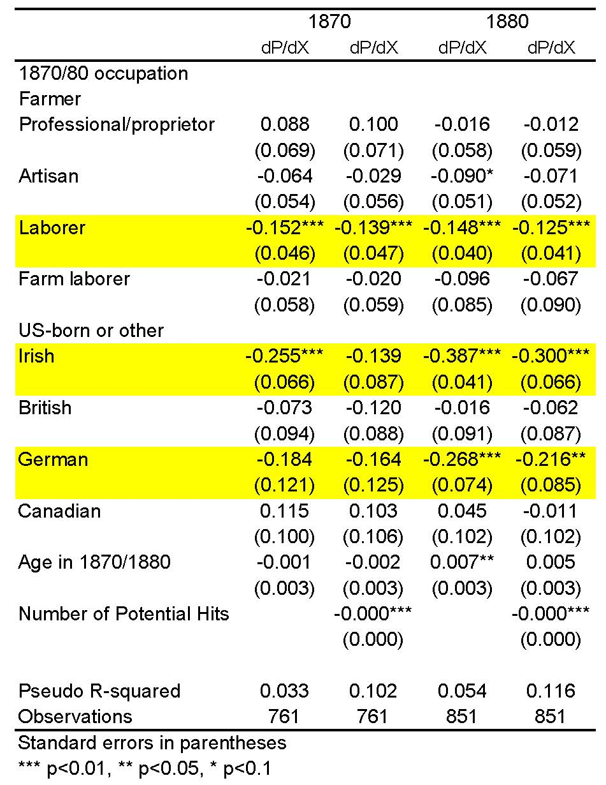
Predictors of Mechanized Matching, Final Occupations

Slide 18
Future Algorithm Work
Linkage of veterans’ children from 1880 to 1910 once the full count, full variable 1910 sample becomes available
What results do we get on occupational distributions if we include the false positives?
Running algorithm with different information sets on full variable censuses
Low linkage rates with their own biases vs bias from introducing more information
Suggestions?

