Slide 1
Avoiding Bias when Analyzing the Union Army Data
Sven E. Wilson
Brigham Young University
sven@byu.edu

Slide 2
Bias
The Union Army sample is a complex collection of administrative data from multiple sources and across long periods of time.
Without an understanding of the data, researchers may employ methods that lead to biased estimates.
Assumption for today: bias is not a characteristic of the data but a characteristics of estimates obtained from misusing the data.

Slide 3
Potential sources of bias
Event-generated data leading to survivor bias
UA sample design & collection methodology
Changing environment
Linkage failure
Collection Error
Multi-source, multi-instance data
Including retrospective data
Discrimination

Slide 4
The essential question
Researchers should continually be asking themselves:
“Why does this variable exist?”
Two crucial parts to this question
What event generates the variable?
Who is it generated for?

Slide 5
The essential question (restated)
Are there systematic reasons for why important variables might not be recorded for some of the veterans in the file?
The answer is often “yes”

Slide 6
Event-generated data
In scientific studies, most points of observation are chosen by the researcher:
Example: Longitudinal survey in which questions are asked of all participants at fixed points in time.
In the Union Army data, points of observation occur because of an event that happens in the life of the soldier.

Slide 7
Important events
Enlistment
Soldiers enter as regiments are formed by states throughout the war.
Draft begins in 1863
Battles
Exposure to battles varies considerably across companies

Slide 8
Important Events
Injuries and illnesses during war
Injuries mostly a function of battle experiences
Infectious illnesses spread across the Army, but exposure varied across companies.
Discharge from the service
Generated by injury or illness
Three-year term of service, but many served for the duration
Some served well after end of war, particularly black soldiers (a large percentage of mortality among black soldiers occurred after the war’s end.)

Slide 9
Important Events
Pension application
Motivated by a mix of causal factors:
Injuries/illness during war
Health events after war
Changes in pension law
Changes in administrative practices
Application for pension increase
Examinations by physicians
Information solicited by Pension Bureau
Surveys of Pensioners

Slide 10
Important Events
US federal census collections (1850-1940)
Numerous factors affect linkage to pension
Death
Almost always found in pension records for those in the system
For those not in system, the presence of a death date depends on:
Vital records available in states
Technology used to link to death dates
In main UA collection, death dates were not sought.

Slide 11
Participation in the pension system
Many of the bias-related questions related to analyzing the Union Army data hinge on whether (and when) the veteran was eligible for a pension.

Slide 12
Pension eligibility: law and practice
Major pension law changes
General Law (1862): Recruits who had served for a minimum of 3 months were eligible for support if their disability was “war-related”, chronic, and resulted in an inability to perform manual labor.
1890 Law: Disabilities were no longer required to be war-related, but they couldn’t be the result of “vicious habits.”
1907 Law: Universal old-age support (though was being used previously as a marker of general debility).

Slide 13
Disparities in Pension Enrollment
Source: SE Wilson. 2010. Prejudice & Policy: Racial Discrimination in the Union Army Disability Pension System, 1865-1906. American Journal of Public Health 100:S56-S65

Slide 14
The Civil War Pension: Analytical Phases
Phase 1: War & Reconstruction (1862-1878)
Phase 2: Informal Liberalization (1879-1889)
Phase 3: General Disability Pension (1890-1906)
Phase 4: Old-Age Support (1907 + )

Slide 15
Three facts about pension applications
The timing of pension applications are not random events.
The pension file contains retrospective data
Pension linkage makes census linkage much more likely (including linkage to pre-war censuses)

Slide 16
Implications
The presence and timing of a pension is an endogenous event
Thus all the variables drawn from the pension file are potentially endogenous
Retrospective data can induce considerable bias
In particular, data that occur between 1865 and 1890 are likely to exist only because the veteran lived until 1890 and applied for a pension.

Slide 17
An example
Consider two veterans, John and James
Both have moderate disability due to arthritis and are virtually identical in every observable way.
John dies suddenly in 1885 of unknown cause
James lives an additional 10 years, to 1895
Ideally, James and John would have very similar data up until 1885 and different thereafter.
What do they really look like?

Slide 18
An example
What do the stories of John and James look like in the data?
Because he lived longer, James will have more data post-1885, including health events and a death date.
James will also have more data pre-1885:
Census records from 1850-1880 & information from pension applications
Family history, labor history, residential history
Wartime experiences, including illness & injury
John will also lack the information related to his post-war health

Slide 19
An example
Implications:
Survivor bias: Because of differential survival, veterans with similar lives can look very different
Survivor bias is shaped by the nature of the life events (e.g., lifespan) and their timing
If the 10-year difference in lifespan between John and James had occurred between 1875 and 1885, it is likely that neither would have entered the pension system and would, therefore, look very similar in the data.

Slide 20
An example
Survivor bias constrains the analysis that can be done.
For example, the research question “how does household SES in childhood influence mortality?” is an important motivation for the collection of the data.
How do we constrain the analysis to eliminate or mitigate the impact of survivor bias when answering this question?

Slide 21
Sample design
The main UA collection is a cluster sample, with companies serving as clusters.
In the white sample, a collection of 331 companies were drawn randomly from infantry regiments in the Union Army
All soldiers in the company were collected, except officers
The USCT contains officers, but they were white.

Slide 22
Implications of cluster sampling in the UA
The assignment to soldiers in companies is not a random process
Strong geographical focus
Companies are more internally homogenous than they would be under random assignment of soldiers
In general, standard errors need to be adjusted to account for the cluster sampling approach
The homogeneity of companies has a statistical advantage in terms of controlling for unobserved company-level effects.

Slide 23
Implications of cluster sampling in the UA
Sampling of original companies did not weight by population size
Thus recruits in large companies are underrepresented relative to small companies
The key question (with respect to bias) is whether factors correlated with company size are also correlated with outcomes of interest
For example: Are urban recruits more or less likely to be in large companies?

Slide 24
Collection methodology
In the surgeon’s data and the census records, each record is an observation at a point in time. This a document-based collection approach.
In contrast, the military and pension file use a common set of collection screens that contain multiple documents. This is a historical life profile approach.

Slide 25
Bias and historical life profile
Generally, it is not known when a piece of information is collected
During the inputting process, data is over-written as new information is obtained.
It can be hard to know what is known at a particular point in time so that some of the observations are not “corrupted” from retrospective information in the future.
The Back to the Future problem

Slide 26
Sample representativeness
Union Army is not representative of the US population in a number of ways
Age
Gender
Nativity
SES (possibly)
The upper crust were typically selected as officers
Under the draft, it was possible to pay a substitute

Slide 27
Bias due to environmental change
Legal
Administrative Practice
Medical Knowledge and Professionalization

Slide 28
Legal changes
These were discussed earlier
1890 Law
1907 Law

Slide 29
Administrative Practice
As today, administrative practice evolves even as the law remained constant
Example: informal liberalization
Much research still remains to be done on how administrative practice might affect the data
Some things have popped up just through looking at the data.
Example: Presence of disability ratings

Slide 30
Hypothetical Ratings

Slide 31
Cardiovascular Ratings (c_rat), by year

Slide 32
“Total Rating” (a_totrat), by year

Slide 33
Lesson from this example
Look at your data
Ask questions

Slide 34
Medical knowledge and Professionalism
UA data go from 1860 to 1930+
Any longitudinal analysis needs to account for
Extensive increase and spread of medical knowledge
Increase in professionalism of Pension Bureau and physicians
A comprehensive physical exam looked very different in 1875 than in 1825.

Slide 35
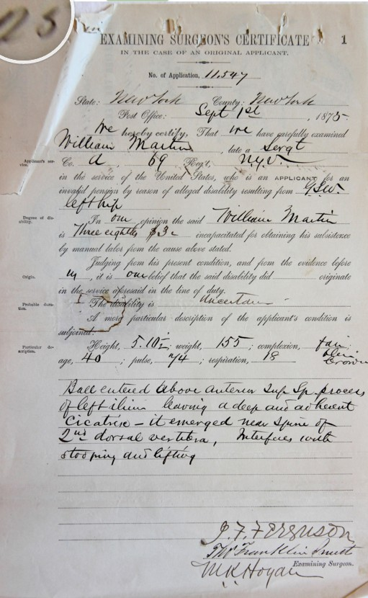
Typical exam, 1875

Slide 36
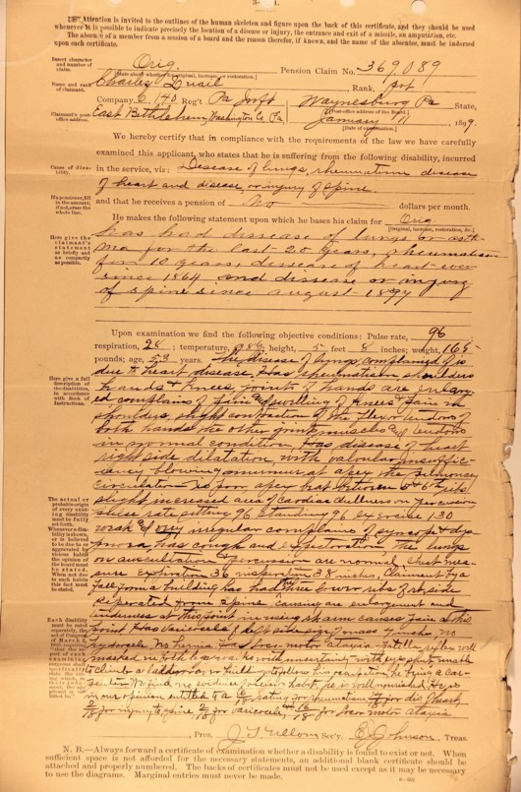
Exam, 1889

Slide 37
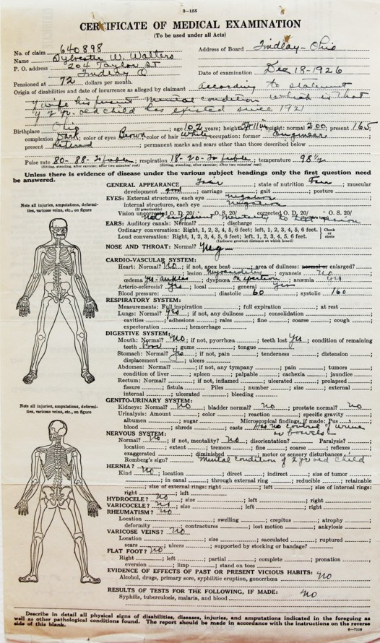
Exam, 1926

Slide 38
Lesson
Look at your data over time
Ask questions

Slide 39
Implications
How do changes in knowledge and professionalism affect the data:
Accuracy
Completeness

Slide 40
Bias due to linkage failure
Pension/Military file: This was done by the Pension Bureau
Census Records:
Urban/rural differences
Name commonality
(correlated with ?)
Availability of pension record
Backwards and forwards

Slide 41
Bias due to collection errors
Types of collection errors:
Keystroke errors
Omission errors
Interpretation errors
Standardization errors
These errors lead to imprecision but typically not bias.
Some errors of interpretation and standardization might be systematic and, hence, a source of bias.

Slide 42
Multi-source, multi-instance data
Retrospective data
Multiple sources
Multiple instances

Slide 43
Retrospective data
Contemporaneous data
Recorded at the time of observation with a clear date (most census variables, for instance)
Naturally retrospective data
Examples: birthplace, parental data
Administratively retrospective data

Slide 44
Collection of retrospective data
As data inputters enter the data, the often find redundant or conflicting data
Redundant data is ignored
Conflicting data is entered as different instance
As “better” information is obtained, the incomplete information is written over—inputters are constructing a life history
Source documents are sometimes unclear
Special military service files exist that contain data that is not “corrupted” by information from the pension file. (MSR & CMR files)

Slide 45
Multiple sources
Data sorted into three files: Pension/military, Surgeons’ Exams, Census
Common variables exist across these collections
But within the military/pension files, there are also a few examples of variables that come from different sources at particular points in time
Family status

Slide 46
Multiple instances
Some variables (e.g., occupation) are collected at many points in time, often retrospectively
For any given variable the number of multiple instances varies considerably
For a large number of variables the allowable number of instances is 20 (because there are almost always less than 20 exams).
The timing of instances is often unclear.
Whether or not there is bias depends on why the instances exist in the first place.

Slide 47
Discrimination
The pension system was a de jure color-blind system.
Basic process was the same for blacks and whites
But experiences of black and white veterans were very different
Recall significantly lower levels of enrollment, regardless of medical history during the war.

Slide 48
Drivers of discrimination
Lack of documentation
Difficulty in establishing identity
Lower rate of medical treatment during the war
Less benefit of the doubt
Conditions that required believing the statements of claimants were much less likely to be approved by the Pension Bureau
Shorter Life Expectancy
Black veterans were less likely to be alive by the time the system was formally liberalized.

Slide 49
The meaning of missing
A persistent challenge of using the UA data (and other administrative data) is that it can be very hard to determine why a variable is missing.
Good luck!

