Slide 1
On Capital Controls and Financial Stability
José De Gregorio
Universidad de Chile
Peterson Institute of International Economics
Presented at the Conference Monetary Policy and Financial Stability in Emerging
Markets, NBER and Central bank of Turkey, June 13-14 2014, Istanbul, Turkey.

Slide 2
Introduction
Financial stability has been an old concern in central banking in EMEs. Not in AE.
Capital flows and the economy
Gross flows: financial stability - vulnerabilities
Net flows: macroeconomic stability (PS-IT) - exchange rate
There are interactions between FS and PS, but good starting point to discuss policies.

Slide 3
The global financial crisis
The problem was excessive borrowing in a poorly regulated financial systems. Just like EMEs in the past.
Except for Emerging Europe, Latin America and Asia did very well. No sudden stop, no financial crisis, but turmoil, recession and rapid recovery. Are we doing economics for pre-Asian crisis?
What’s new? Not to make the mistakes of AE, but not to ignore what worked: good macro policies, strong financial systems and exchange rate flexibility.
Problem: “good” versus “bad” flows.

Slide 4
Quarterly change in cross-border banking claims, 2005Q1-2011Q4
Source: Bank for International Settlements, Consolidated Banking Statistics (immediate borrower basis).

Slide 5
Exchange rates during the GFC (domestic currency per US dollar, period average=100)

Slide 6
Private credit as share of GDP, 2000 and 2008
Source: International Monetary Fund, International Financial Statistics database.

Slide 7
Gross capital inflows to Latin America, 1985-2011
Source: International Monetary Fund, International Financial Statistics database.

Slide 8
Financial integration LATAM
Source:Lane and Milesi-Ferretti’s revised and updated EWN II database (based on Lane and Milesi-Ferretti, 2007).

Slide 9
Capital controls or prudential policies?
Many reasons to justify capital controls. Avoid appreciation of the exchange rate and affect volume and composition of flows.
But, empirical evidence: small effects if any at all.
Currency, maturity mismatches and excess borrowing: prudential regulation on exchange rate exposure and liquidity management and taxation.
Sudden Stops: reserve accumulation (also could help with the exchange rate). Or FCL?.

Slide 10
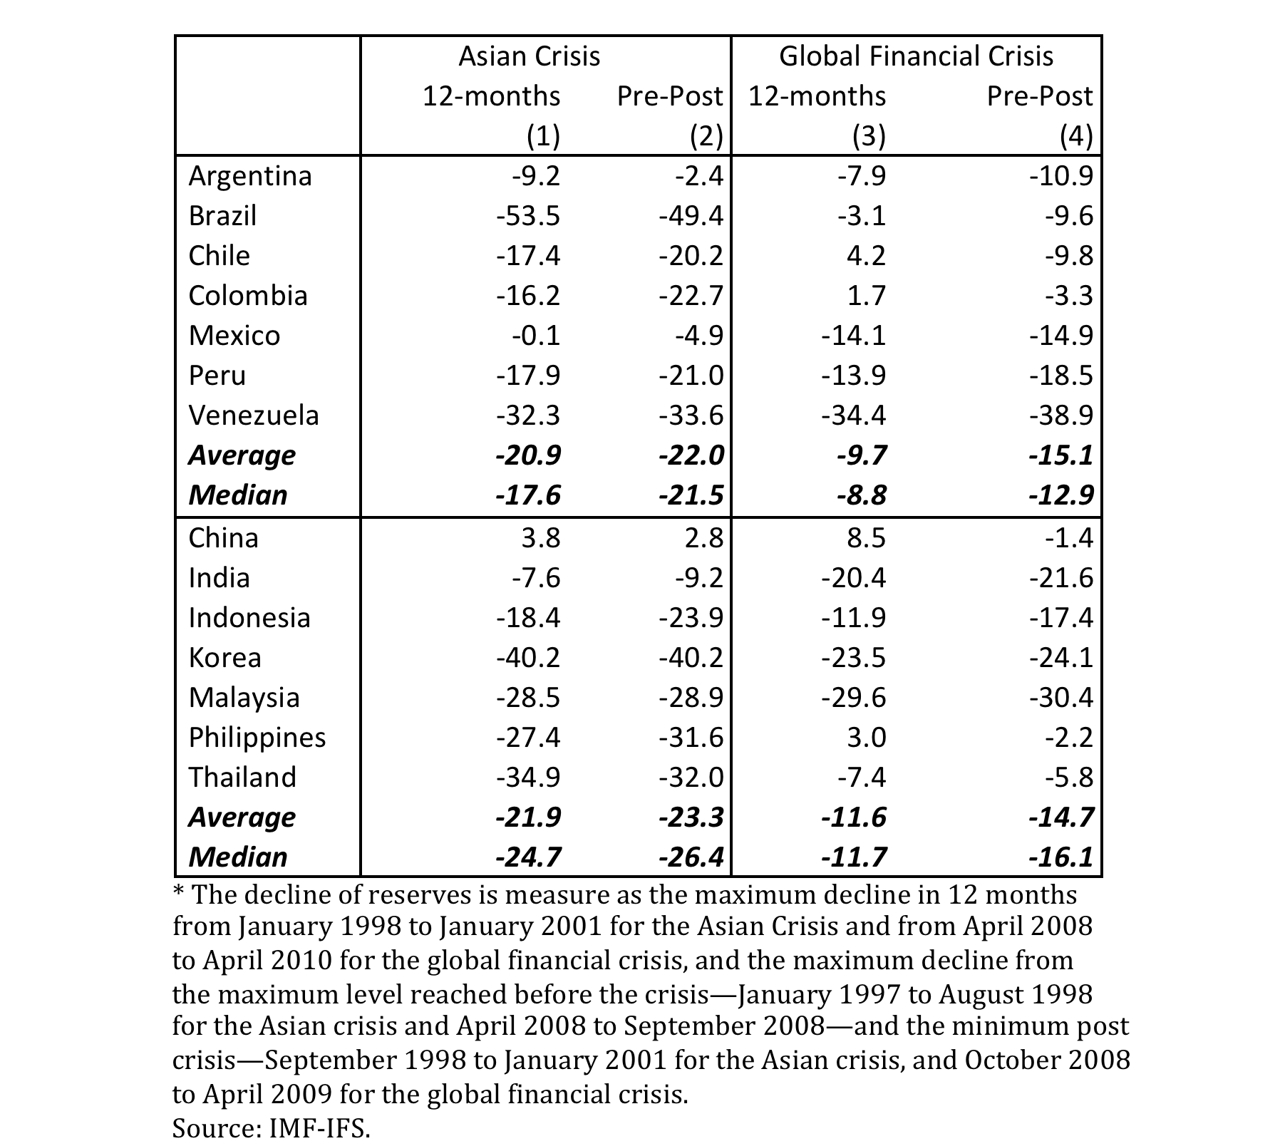
Maximum decline in reserves of Latin American and selected emerging Asian countries (percent)

Slide 11
Capital controls or prudential policies?
Overall: there are better instruments for financial stability and to avoid debt crisis. Prudential regulation (micro and macro).
If the problem are banking flows: banking regulation.
For macro purposes (exchange rate) all flows should be controlled, “good” and “bad”.

Slide 12
On the causes of capital inflows: are they truly exogenous? Or domestically induced?
Portfolio diversification from AE.
Policy distortions: high interest rates (Chile 90s, Brazil 2000s)
Accumulation of reserves.

Slide 13
Surges of capital inflows, 1990s and 2000s (percent of GDP)
 | Net capital | Current | Change in
Region/period | inflows | account | reserves
Latin America
1990s | 7.5 | -4.6 | 2.5
2000s | 6.7 | -1.7 | 4.2
Asia
1990s | 7.6 | -4.8 | 2.8
2000s | 3.7 | 3.2 | 5.6
Europe
1990s | 11.0 | -6.4 | 4.4
2000s | 17.3 | -10.5 | 3.1
Sources: Ghosh et al. (2012) for net capital inflows; International Monetary Fund, International Financial Statistics, for current account and reserve accumulation.

Slide 14
Conclusion
There are direct instruments to protect financial stability. However, open capital account does not mean unfettered financial systems.
Effectiveness of capital controls is at most weak. But do not open the capital account without strong financial system.
The first line of defense for macro stability is good policies: IT, strong fiscal and flexible exchange rates.

Slide 15
On Capital Controls and Financial Stability

