Slide 1
Reserve Requirements, Liquidity Risk, and Credit Growth
Koray Alper*, Mahir Binici*, Selva Demiralp§, Hakan Kara*, Pınar Özlü*
* Central Bank of Turkey
§ Koç University
“Monetary Policy and Financial Stability in Emerging Markets”
June 14, 2014

Slide 2
The Need for Unconventional Policy
The financial crisis necessitated the use of unconventional monetary policy
QE policies of advanced economies → Capital flows into emerging economies
Trade off between financial stability and price stability
Multiple objectives, multiple instruments are needed

Slide 3
Main Unconventional Policy Tools
Asymmetric Interest Rate Corridor (ARC)
Reserve Requirements and Liquidity Policy (RR)

Slide 4
Interest Rate Corridor and Reserve Requirements
Notes:
This paper is about the lower panel

Slide 5
Reserve Requirements as a Monetary Policy Tool
Interest rate policy may be constrained by capital flows and related financial stability concerns in emerging economies.
Reserve requirements (RR) have the potential to ease such policy trade-offs, given its widespread use among EM CBs.
Yet, our knowledge is limited regarding the transmission mechanism or effectiveness of RR as a monetary policy tool.
The literature is incomplete and inconclusive on the channels through which RR interact with bank behavior.
This paper aims to fill this gap in the literature
Notes:
We are looking into the black box..

Slide 6
Transmission of RR
(Under the Assumption of Perfect Substitution)
Change in RR
Bank Lending
RR ↑ , Cost of deposit funding ↑, deposit rate↓ , deposits↓ , central bank funding ↑ , loan rate (unchanged), loans (unchanged).
Cost channel
No Change

Slide 7
Transmission of RR
(Under the Assumption of Imperfect Substitution)
Change in RR
Bank Lending
Interest Rate Risk
RR ↑ , Interest rate risk ↑ , Deposit rate ↑ , Loan rate ↑ , Loans ↓
Small
Notes:
Following an increase in RR, banks first increase their CB borroiwng to meet their pre-committed loan contracts. But because CB borrowing is shorter term relative to deposit funding, they are exposed to interest rate risk. They try to increase their deposits as well. And they reflect the costs of higher deposits and interest rate risk
Maturity of central bank credit is typically shorter than the maturity of deposits; therefore, a larger reliance on central bank funding adds to the interest rate risk. In practice, however, we argue that the extra interest rate risk incurred by the bank through a hike in reserve requirements should be limited due to two reasons: (i) central banks fix short term interest rates between two monetary monetary policy meetings, (ii) the maturity of bank deposits are short, especially in emerging markets. For example, average weighted average maturity of deposits is 55 days in the Turkish case. When deposits are of short term nature, interest rate risk incurred from the central bank funding is relatively low, especially under a typical IT framework where short term interest rates are fixed within two MPC meetings.
While we do not rule out the existence of an interest rate risk channel, we argue that there may be alternative explanations as to why deposits and central bank funding are not close substitutes. In practice, switching bank deposits with central bank credit after a reserve requirement hike leads to a deterioration in the liquidity position of the banks. As we have shown in the previous section, a change in RR induces a shift in the composition of the bank balance sheets. When faced with a tightening in reserve requirements, banks initially resort to central bank funding to fulfill their precommitted loan contracts. However, because central bank funding is collateralized, banks are left with less liquidity buffers to use against unexpected liquidity shocks. The marginal cost of borrowing from the central bank thus increases as the banks take into account the additional liquidity risk, which, in turn, leads to higher lending rates and/or a reduction in the pace of credit growth. We call this as the “liquidity channel”.

Slide 8
Transmission of RR
(Under the Assumption of Imperfect Substitution)
Change in RR
Bank Lending
Interest Rate Risk
RR ↑ , Interest rate risk ↑ , Deposit rate ↑ , Loan rate ↑ , Loans ↓
Small
RR ↑ , Bank liquidity ↓ , Deposit rate ↑, Loan rate ↑ , Loans ↓
Liquidity Channel
Significant?
Notes:
Following an increase in RR, banks first increase their CB borroiwng to meet their pre-committed loan contracts. But because CB borrowing is shorter term relative to deposit funding, they are exposed to interest rate risk. They try to increase their deposits as well. And they reflect the costs of higher deposits and interest rate risk
Maturity of central bank credit is typically shorter than the maturity of deposits; therefore, a larger reliance on central bank funding adds to the interest rate risk. In practice, however, we argue that the extra interest rate risk incurred by the bank through a hike in reserve requirements should be limited due to two reasons: (i) central banks fix short term interest rates between two monetary monetary policy meetings, (ii) the maturity of bank deposits are short, especially in emerging markets. For example, average weighted average maturity of deposits is 55 days in the Turkish case. When deposits are of short term nature, interest rate risk incurred from the central bank funding is relatively low, especially under a typical IT framework where short term interest rates are fixed within two MPC meetings.
While we do not rule out the existence of an interest rate risk channel, we argue that there may be alternative explanations as to why deposits and central bank funding are not close substitutes. In practice, switching bank deposits with central bank credit after a reserve requirement hike leads to a deterioration in the liquidity position of the banks. As we have shown in the previous section, a change in RR induces a shift in the composition of the bank balance sheets. When faced with a tightening in reserve requirements, banks initially resort to central bank funding to fulfill their precommitted loan contracts. However, because central bank funding is collateralized, banks are left with less liquidity buffers to use against unexpected liquidity shocks. The marginal cost of borrowing from the central bank thus increases as the banks take into account the additional liquidity risk, which, in turn, leads to higher lending rates and/or a reduction in the pace of credit growth. We call this as the “liquidity channel”.

Slide 9
Liquidity Channel of Reserve Requirements
1) An increase in RR leads to an increase in central bank funding
  ↑ RR → ↑ CB funding

Slide 10
Liquidity Channel of Reserve Requirements
2) Because central bank funding is collateralized, banks experience a reduction in their liquid assets.
    ↑ CB funding ↓ Bank liquidity
3) A decline in liquid assets may induce credit slowdown through a portfolio re-adjustment process.
      ↓ Bank liquidity ↓Loans

Slide 11
Liquid Assets, Reserve Requirements and New Loans
* All series are drawn as 12-month moving average

Slide 12
Liquid Assets, Reserve Requirements and New Loans
* All series are drawn as 12-month moving average

Slide 13
Impact of RR Tightening on Bank’s Liquidity Position: A Balance Sheet Approach
BEFORE
A | L
Loans (L): 90 | Deposits (D): 100
Liquid Assets (B^{L}): 10

Slide 14
Impact of RR Tightening on Bank’s Liquidity Position: A Balance Sheet Approach
BEFORE
AFTER
A | L
Loans (L): 90 | Deposits (D): 100
Liq. Assets (B^{L}): 5
Encumbered Sec. (B^{IL}): 5 | Repo (R): 5
Deposits at CB (RR*D): 5
A | L
Loans (L): 90 | Deposits (D): 100
Liq. Assets (B^{L}):10
5 pp ↑ in RR

Slide 15
Impact of RR Tightening on Bank’s Liquidity Position: A Balance Sheet Approach
BEFORE
AFTER
A | L
Loans (L): 90 | Deposits (D): 100
Liquid Assets (B^{L}): 5
Encumbered Securities (B^{IL}): 5 | Repo (R): 5
Deposits at CB (RR*D): 5
A | L
Loans (L): 90 | Deposits (D): 100
Liquid Assets (B^{L}): 10
5 pp ↑ in RR

Slide 16
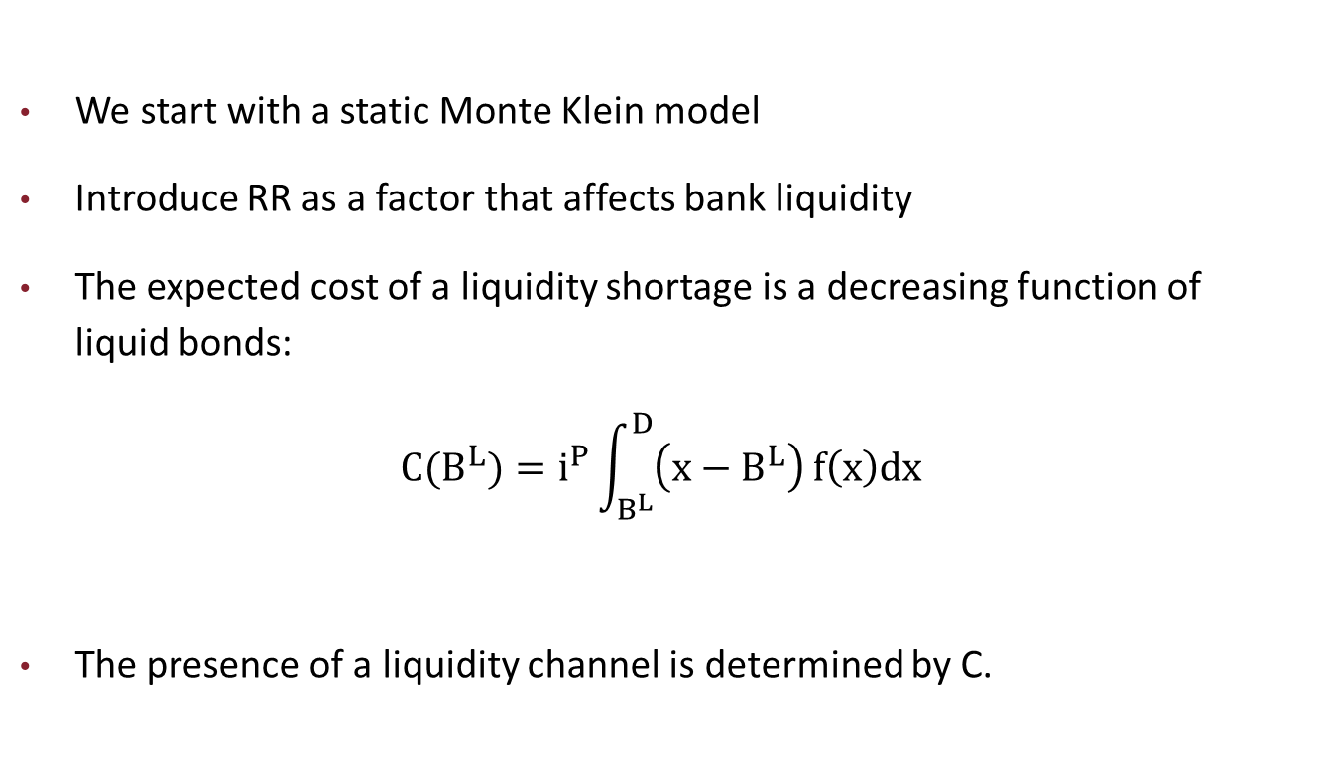
Implications of a Simple Model
We start with a static Monte Klein model
Introduce RR as a factor that affects bank liquidity
The expected cost of a liquidity shortage is a decreasing function of liquid bonds:
$$C(B^{L})=i^{P}\int_{B^{L}}^{D}{\left(x−B^{L}\right)}f\left(x\right)dx$$
The presence of a liquidity channel is determined by C.
Notes:
C is the cost of uncollateralized borrowing. Here, “x” is the magnitude of the random liquidity shock,$f\left(x\right)$ is the probability distribution of that random variable, $B^{L}$ is the volume of unencumbered securities, and D is the volume of deposits. $i^{P}$ is the penalty rate, which is the rate for unsecuritized borrowing. Banks incur a higher cost for uncollateralized borrowing which can be perceived as the wedge over the costs of collateralized borrowing. Implicit in the penalty rate is the reputational costs of uncollateralized borrowing as well.
So in additon to deposits and cb funding being imperfect substitutes, another pre-condition for the liquidity channel is that uncollateralized borrowing is more expensive than collateralized borrowing. If not, ip=0 and C(.)=0. In other words, if there is no additional cost incurred by uncollateralized borrowing, then the bank would not reduce its loans simply when its collateral goes down because it can raise uncollateralized borrowing.

Slide 17

The Model
    The loan rate implied from the FOC is:
    $$i^{L}=\frac{{ i}^{CB}+C′}{\left(1−\frac{1}{ε_{L}}\right)}$$
Meanwhile the deposit rate implied from the FOC is:
$$i^{D}=\frac{\left(1−RR\right)(i^{CB}+C′) }{\left(1+\frac{1}{ε_{D}}\right)}$$
Cost channel
Liquidity channel
where C’ is an increasing function of RR
Notes:
According to equation (11), the more elastic the demand is, the less interest rates would respond to reserve requirements. For example, in the case of perfect competition (infinite elasticity) the loan rate would not respond at all
According to equation (16), the optimal deposit rate is a function of the cost of marginal borrowing, the liquidity risk, interest rate elasticity of deposit demand, and reserve requirements. The expression reveals that there are two opposing effects of RR on the deposit rate. On the one hand, higher reserve requirements lower the deposit rates through direct intermediation cost, which can be expressed as $\left(RR\right)i^{CB}$ (the cost channel). On the other hand, higher reserve requirements lead to an increase in the deposit rate through the liquidity channel, i.e., through the additional cost of a deterioration in the liquidity position of the bank, expressed as $\left(RR\right)C^{′}$ (the liquidity channel). Therefore, the net impact of the RR on the deposit rates depends on how large the central bank funding rate is compared to the expected cost of a liquidity shortage. Note that because the latter is a decreasing function of liquidity, RR would certainly have a positive impact on the deposit rate if the liquid falls to a certain threshold level.

Slide 18
Data
Monthly bank level data from June 2010 to December 2013
Flow data on deposit and loan variables
19 major deposit banks that cover 90 percent of total deposits and lending

Slide 19
Empirical Analysis
We search answers for the following questions:
1) Is there a positive relationship between RR and loan rates?
  If the answer is yes →Interest rate risk or Liquidity channel
Table 2

Slide 20
Table 2: Interest Rate on Commercial Loans
 |  | (1) | (2)
1. | i_{i,t-1}^{commercial loan} | 0.78*** | 0.78***
 |  | (0.02) | (0.02)
2. | O/N Lending Rate _{t} | 0.19*** | 0.18***
 |  | (0.02) | (0.02)
3. | Nonperforming Loan Ratio _{i,t} | 0.22** | 0.19*
 |  | (0.11) | (0.11)
4. | Inflation rate_{t} | 0.09*** | 0.08***
 |  | (0.03) | (0.03)
5. | ∆ USD/TL _{t} | 0.04*** | 0.03***
 |  | (0.01) | (0.01)
6. | RR^{c} _{i,t} | 0.07***
 |  | (0.02)
7. | RR^{c} _{i,t-1} |  | 0.08***
 |  |  | (0.02)
9. | Constant | -0.53** | -0.27
 |  | (0.26) | (0.24)
10. | Observations | 817 | 817
11. | Number of id | 19 | 19
Sample Period: June 2010 – December 2013. Standard errors are given in parenthesis and adjusted for heteroskedasticity. *** p<0.01, ** p<0.05, * p<0.1. Dynamic panel model is estimated with one stage GMM (Arellano and Bond, 1991).
Notes:
LT coefficient estimates
Table 2 illustrates the regression results for commercial loan rates. We observe that the commercial loan rate is positively related to the upper bound of the corridor (row 2), while interbank rates are not significant in explaning the variations in the commercial loan rate (row 8), consistent with the earlier studies (see Binici et al.2013). This is an interesting result suggesting that banks, in setting their commercial loan rates, fully price the interest rate risk posed by the active use of the interest rate corridor.
Banka olabilecek en kotu durumu fiyatliyor ki bu da koridorun ust bandindan cb funding almak demek.

Slide 21
Empirical Analysis
2) Is central bank funding a perfect substitute for deposits?
  If the answer is no→ Consistent with interest rate risk or the liquidity channels
  Table 3

Slide 22
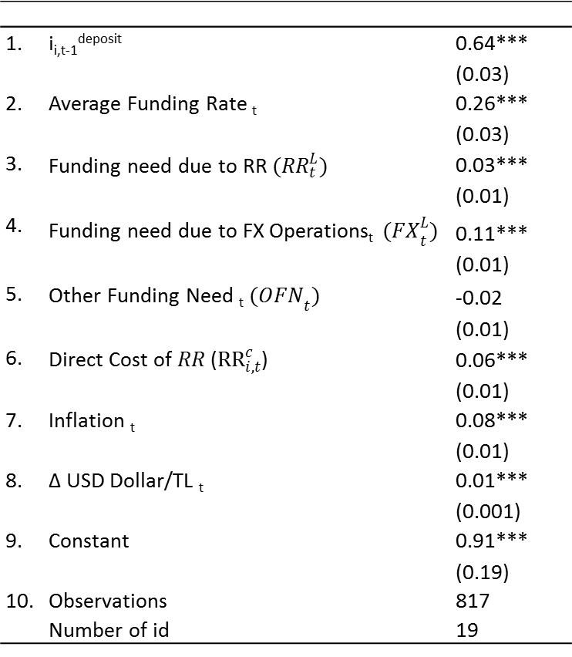
Table 3: Deposit Rates with Liquidity Components
1. | i_{i,t-1}^{deposit} | 0.64***
 |  | (0.03)
2. | Average Funding Rate _{t} | 0.26***
 |  | (0.03)
3. | Funding need due to RR $({RR}_{t}^{L})$ | 0.03***
 |  | (0.01)
4. | Funding need due to FX Operations_{t} ${(FX}_{t}^{L})$ | 0.11***
 |  | (0.01)
5. | Other Funding Need _{t} ${(OFN}_{t})$ | -0.02
 |  | (0.01)
6. | Direct Cost of $RR$(${RR}_{i,t}^{c}$) | 0.06***
 |  | (0.01)
7. | Inflation _{t} | 0.08***
 |  | (0.01)
8. | ∆ USD Dollar/TL _{t} | 0.01***
 |  | (0.001)
9. | Constant | 0.91***
 |  | (0.19)
10. | Observations | 817
 | Number of id | 19
Sample Period: June 2010 – December 2013. Standard errors are given in parenthesis and adjusted for heteroskedasticity. *** p<0.01, ** p<0.05, * p<0.1. Dynamic panel model is estimated with one stage GMM (Arellano and Bond, 1991).
Notes:
One way to test this hypothesis is to look at the relationship between deposit rates and the policy induced shifts in the liquidity need of the banking system (changes in net central bank funding).
The elevated liquidity needs that arise from a RR hike or an FX sale are initially met by more short term central bank credit provided through open market purchases. Because central bank funding depletes unencumbered assets, it heightens the liquidity risk incurred by the banking system. Going back to section 2, if central bank funds and deposits are not perfect substitutes, then, when there is an increase in central bank’s net funding to the system, banks would increase their deposits rates to attract more deposits. Because deposits are more valuable than central bank funding from a liquidity and interest rate risk perspective, an increase in borrowing needs prompts banks to increase their deposit rates to attract more deposits. Therefore we expect a positive coefficient on the liquidity need arising due to both reserve requirement decisions and foreign exchange sale/purchase operations.

Slide 23
Empirical Analysis
3) How does bank liquidity affect the transmission mechanism?
Liquidity Channel→ The positive relationship between interest rates and RR should be amplified for less liquid banks.
Table 4
Table 5

Slide 24
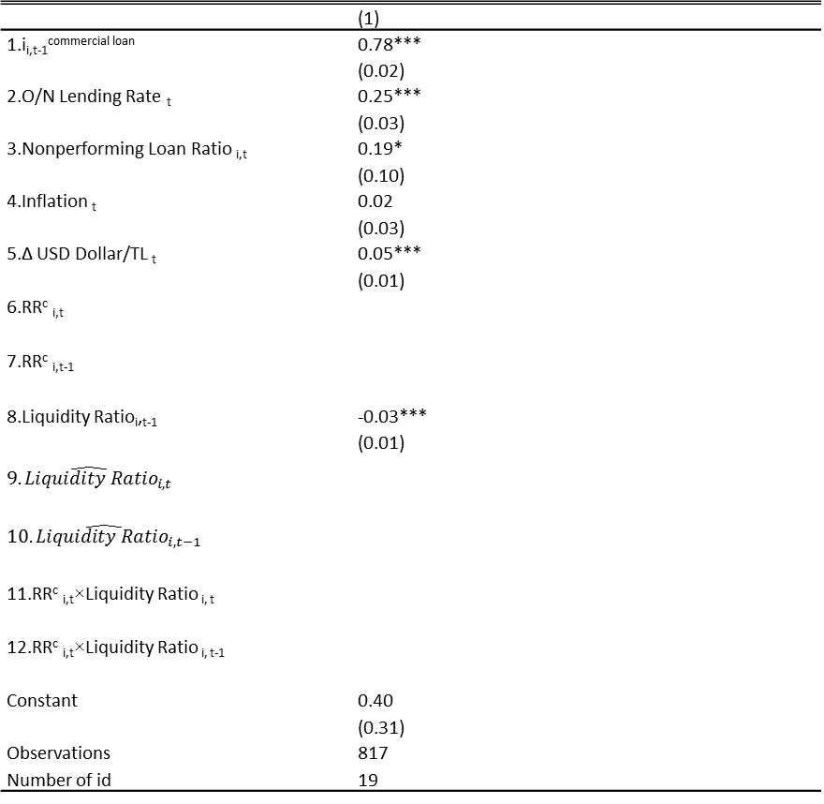
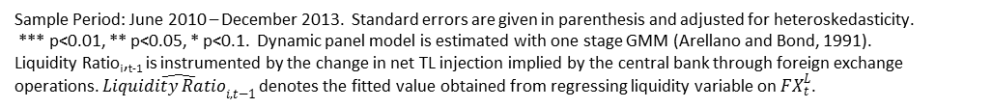
Table 4: Interest Rate on Commercial Loans
 | (1)
1.i_{i,t-1}^{commercial loan} | 0.78***
 | (0.02)
2.O/N Lending Rate _{t} | 0.25***
 | (0.03)
3.Nonperforming Loan Ratio _{i,t} | 0.19*
 | (0.10)
4.Inflation _{t} | 0.02
 | (0.03)
5.∆ USD Dollar/TL _{t} | 0.05***
 | (0.01)
6.RR^{c} _{i,t}
7.RR^{c} _{i,t-1}
8.Liquidity Ratio_{i},_{t-1} | -0.03***
 | (0.01)
$$\hat{{9.Liquidity Ratio}_{i,t}}$$
$$\hat{{10.Liquidity Ratio}_{i,t−1}}$$
11.RR^{c} _{i,t}×Liquidity Ratio _{i, t}
12.RR^{c} _{i,t}×Liquidity Ratio _{i, t-1}
Constant | 0.40
 | (0.31)
Observations | 817
Number of id | 19
Sample Period: June 2010 – December 2013. Standard errors are given in parenthesis and adjusted for heteroskedasticity.
*** p<0.01, ** p<0.05, * p<0.1. Dynamic panel model is estimated with one stage GMM (Arellano and Bond, 1991).
Liquidity Ratio_{i},_{t-1} is instrumented by the change in net TL injection implied by the central bank through foreign exchange operations. $\hat{{Liquidity Ratio}_{i,t−1}}$ denotes the fitted value obtained from regressing liquidity variable on ${FX}_{t}^{L}$.
Notes:
The first column adds the liquidity ratio to the specification in Table 2 and finds that the LR is negatively related to the commercial loan rate (row 8). Better liquidity implies lower rates because banks are more comfortable in issuing new loans, as implied by the theory. This finding is consistent with the liquidity channel of reserve requirements, given that RR policy is a major driver of bank liquidity as discussed in the context of Figure 2.
If changes in reserve requirements directly affect bank liquidity, the liquidity ratio would be correlated with RR. Hence it may not be clear whether the significance of the LR in column (1) is due to pure liquidity effects or the interaction of the cost channel of RR with liquidity effects. To address this issue, we add our cost based required reserves measure together with the liquidity ratio in column two and show that the liquidity ratio is still significant when required reserves are included in the specification. The coefficient associated with the liquidity ratio in column 2 indicates that even after we control for the effects of RR^{c} on the loan rate, there may be still additional impact due to changes in bank liquidity.
As another robustness check, we address the potential endogeneity between bank loans and the liquidity ratio. The decision to alter the fraction of liquid assets might be an endogenous choice by each bank, especially at the high frequency that we consider. Bank’s lending decisions directly feed into its liquidity while the liquidity of its portfolio directly affects the bank’s lending.

Slide 25
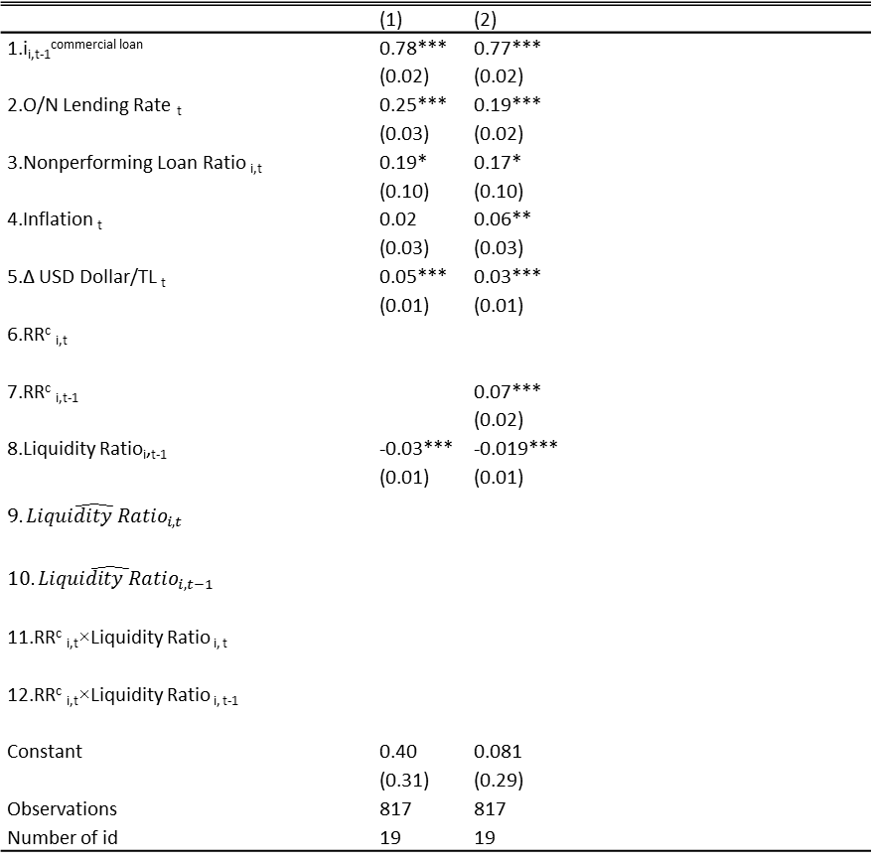
Table 4: Interest Rate on Commercial Loans
 | (1) | (2)
1.i_{i,t-1}^{commercial loan} | 0.78*** | 0.77***
 | (0.02) | (0.02)
2.O/N Lending Rate _{t} | 0.25*** | 0.19***
 | (0.03) | (0.02)
3.Nonperforming Loan Ratio _{i,t} | 0.19* | 0.17*
 | (0.10) | (0.10)
4.Inflation _{t} | 0.02 | 0.06**
 | (0.03) | (0.03)
5.∆ USD Dollar/TL _{t} | 0.05*** | 0.03***
 | (0.01) | (0.01)
6.RR^{c} _{i,t}
7.RR^{c} _{i,t-1} |  | 0.07***
 |  | (0.02)
8.Liquidity Ratio_{i},_{t-1} | -0.03*** | -0.019***
 | (0.01) | (0.01)
$$\hat{{9.Liquidity Ratio}_{i,t}}$$
$$\hat{{10.Liquidity Ratio}_{i,t−1}}$$
11.RR^{c} _{i,t}×Liquidity Ratio _{i, t}
12.RR^{c} _{i,t}×Liquidity Ratio _{i, t-1}
Constant | 0.40 | 0.081
 | (0.31) | (0.29)
Observations | 817 | 817
Number of id | 19 | 19
Sample Period: June 2010 – December 2013. Standard errors are given in parenthesis and adjusted for heteroskedasticity.
*** p<0.01, ** p<0.05, * p<0.1. Dynamic panel model is estimated with one stage GMM (Arellano and Bond, 1991).
Liquidity Ratio_{i},_{t-1} is instrumented by the change in net TL injection implied by the central bank through foreign exchange operations. $\hat{{Liquidity Ratio}_{i,t−1}}$ denotes the fitted value obtained from regressing liquidity variable on ${FX}_{t}^{L}$.
Notes:
The first column adds the liquidity ratio to the specification in Table 2 and finds that the LR is negatively related to the commercial loan rate (row 8). Better liquidity implies lower rates because banks are more comfortable in issuing new loans, as implied by the theory. This finding is consistent with the liquidity channel of reserve requirements, given that RR policy is a major driver of bank liquidity as discussed in the context of Figure 2.
If changes in reserve requirements directly affect bank liquidity, the liquidity ratio would be correlated with RR. Hence it may not be clear whether the significance of the LR in column (1) is due to pure liquidity effects or the interaction of the cost channel of RR with liquidity effects. To address this issue, we add our cost based required reserves measure together with the liquidity ratio in column two and show that the liquidity ratio is still significant when required reserves are included in the specification. The coefficient associated with the liquidity ratio in column 2 indicates that even after we control for the effects of RR^{c} on the loan rate, there may be still additional impact due to changes in bank liquidity.
As another robustness check, we address the potential endogeneity between bank loans and the liquidity ratio. The decision to alter the fraction of liquid assets might be an endogenous choice by each bank, especially at the high frequency that we consider. Bank’s lending decisions directly feed into its liquidity while the liquidity of its portfolio directly affects the bank’s lending.

Slide 26
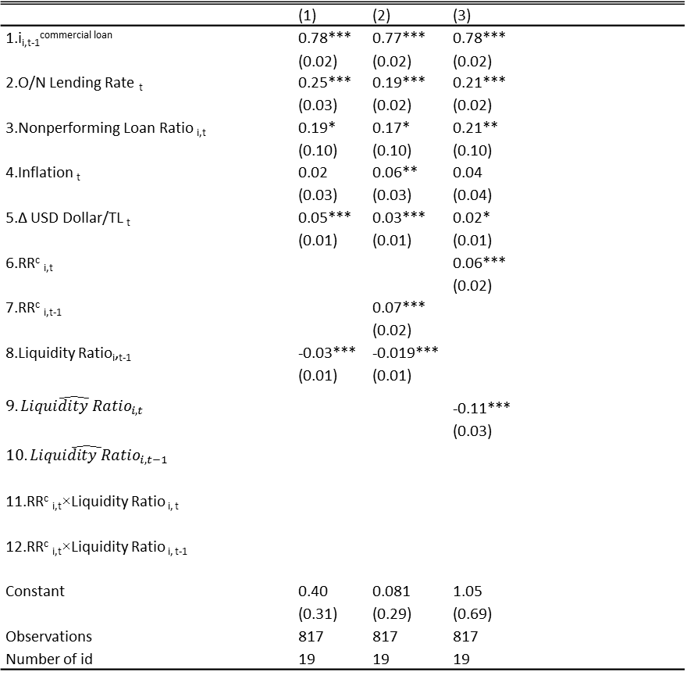
Table 4: Interest Rate on Commercial Loans
 | (1) | (2) | (3)
1.i_{i,t-1}^{commercial loan} | 0.78*** | 0.77*** | 0.78***
 | (0.02) | (0.02) | (0.02)
2.O/N Lending Rate _{t} | 0.25*** | 0.19*** | 0.21***
 | (0.03) | (0.02) | (0.02)
3.Nonperforming Loan Ratio _{i,t} | 0.19* | 0.17* | 0.21**
 | (0.10) | (0.10) | (0.10)
4.Inflation _{t} | 0.02 | 0.06** | 0.04
 | (0.03) | (0.03) | (0.04)
5.∆ USD Dollar/TL _{t} | 0.05*** | 0.03*** | 0.02*
 | (0.01) | (0.01) | (0.01)
6.RR^{c} _{i,t} |  |  | 0.06***
 |  |  | (0.02)
7.RR^{c} _{i,t-1} |  | 0.07***
 |  | (0.02)
8.Liquidity Ratio_{i},_{t-1} | -0.03*** | -0.019***
 | (0.01) | (0.01)
$$\hat{{9.Liquidity Ratio}_{i,t}}$$ |  |  | -0.11***
 |  |  | (0.03)
$$\hat{{10.Liquidity Ratio}_{i,t−1}}$$
11.RR^{c} _{i,t}×Liquidity Ratio _{i, t}
12.RR^{c} _{i,t}×Liquidity Ratio _{i, t-1}
Constant | 0.40 | 0.081 | 1.05
 | (0.31) | (0.29) | (0.69)
Observations | 817 | 817 | 817
Number of id | 19 | 19 | 19
Sample Period: June 2010 – December 2013. Standard errors are given in parenthesis and adjusted for heteroskedasticity.
*** p<0.01, ** p<0.05, * p<0.1. Dynamic panel model is estimated with one stage GMM (Arellano and Bond, 1991).
Liquidity Ratio_{i},_{t-1} is instrumented by the change in net TL injection implied by the central bank through foreign exchange operations. $\hat{{Liquidity Ratio}_{i,t−1}}$ denotes the fitted value obtained from regressing liquidity variable on ${FX}_{t}^{L}$.
Notes:
The first column adds the liquidity ratio to the specification in Table 2 and finds that the LR is negatively related to the commercial loan rate (row 8). Better liquidity implies lower rates because banks are more comfortable in issuing new loans, as implied by the theory. This finding is consistent with the liquidity channel of reserve requirements, given that RR policy is a major driver of bank liquidity as discussed in the context of Figure 2.
If changes in reserve requirements directly affect bank liquidity, the liquidity ratio would be correlated with RR. Hence it may not be clear whether the significance of the LR in column (1) is due to pure liquidity effects or the interaction of the cost channel of RR with liquidity effects. To address this issue, we add our cost based required reserves measure together with the liquidity ratio in column two and show that the liquidity ratio is still significant when required reserves are included in the specification. The coefficient associated with the liquidity ratio in column 2 indicates that even after we control for the effects of RR^{c} on the loan rate, there may be still additional impact due to changes in bank liquidity.
As another robustness check, we address the potential endogeneity between bank loans and the liquidity ratio. The decision to alter the fraction of liquid assets might be an endogenous choice by each bank, especially at the high frequency that we consider. Bank’s lending decisions directly feed into its liquidity while the liquidity of its portfolio directly affects the bank’s lending.

Slide 27
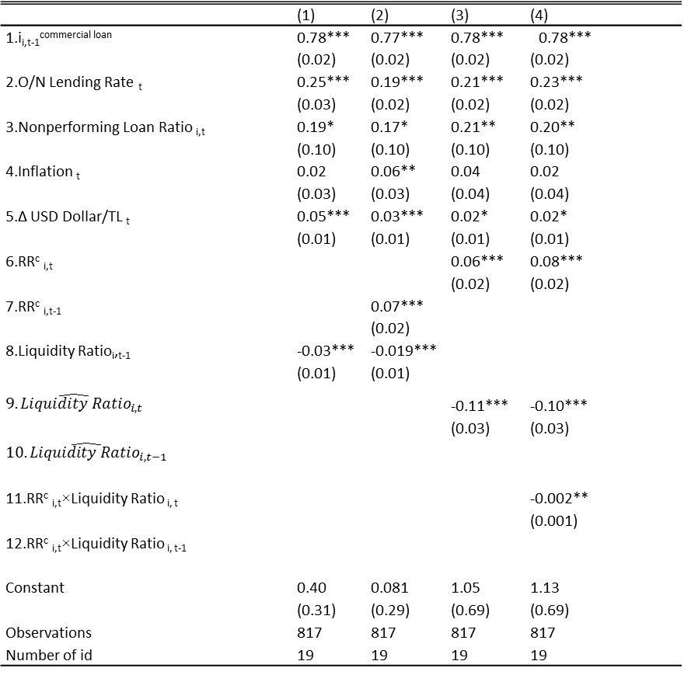
Table 4: Interest Rate on Commercial Loans
 | (1) | (2) | (3) | (4)
1.i_{i,t-1}^{commercial loan} | 0.78*** | 0.77*** | 0.78*** |  | 0.78***
 | (0.02) | (0.02) | (0.02) | (0.02)
2.O/N Lending Rate _{t} | 0.25*** | 0.19*** | 0.21*** | 0.23***
 | (0.03) | (0.02) | (0.02) | (0.02)
3.Nonperforming Loan Ratio _{i,t} | 0.19* | 0.17* | 0.21** | 0.20**
 | (0.10) | (0.10) | (0.10) | (0.10)
4.Inflation _{t} | 0.02 | 0.06** | 0.04 | 0.02
 | (0.03) | (0.03) | (0.04) | (0.04)
5.∆ USD Dollar/TL _{t} | 0.05*** | 0.03*** | 0.02* | 0.02*
 | (0.01) | (0.01) | (0.01) | (0.01)
6.RR^{c} _{i,t} |  |  | 0.06*** | 0.08***
 |  |  | (0.02) | (0.02)
7.RR^{c} _{i,t-1} |  | 0.07***
 |  | (0.02)
8.Liquidity Ratio_{i},_{t-1} | -0.03*** | -0.019***
 | (0.01) | (0.01)
$$\hat{{9.Liquidity Ratio}_{i,t}}$$ |  |  | -0.11*** | -0.10***
 |  |  | (0.03) | (0.03)
$$\hat{{10.Liquidity Ratio}_{i,t−1}}$$
11.RR^{c} _{i,t}×Liquidity Ratio _{i, t} |  |  |  | -0.002**
 |  |  |  | (0.001)
12.RR^{c} _{i,t}×Liquidity Ratio _{i, t-1}
Constant | 0.40 | 0.081 | 1.05 | 1.13
 | (0.31) | (0.29) | (0.69) | (0.69)
Observations | 817 | 817 | 817 | 817
Number of id | 19 | 19 | 19 | 19
Sample Period: June 2010 – December 2013. Standard errors are given in parenthesis and adjusted for heteroskedasticity.
*** p<0.01, ** p<0.05, * p<0.1. Dynamic panel model is estimated with one stage GMM (Arellano and Bond, 1991).
Liquidity Ratio_{i},_{t-1} is instrumented by the change in net TL injection implied by the central bank through foreign exchange operations. $\hat{{Liquidity Ratio}_{i,t−1}}$ denotes the fitted value obtained from regressing liquidity variable on ${FX}_{t}^{L}$.
Notes:
The first column adds the liquidity ratio to the specification in Table 2 and finds that the LR is negatively related to the commercial loan rate (row 8). Better liquidity implies lower rates because banks are more comfortable in issuing new loans, as implied by the theory. This finding is consistent with the liquidity channel of reserve requirements, given that RR policy is a major driver of bank liquidity as discussed in the context of Figure 2.
If changes in reserve requirements directly affect bank liquidity, the liquidity ratio would be correlated with RR. Hence it may not be clear whether the significance of the LR in column (1) is due to pure liquidity effects or the interaction of the cost channel of RR with liquidity effects. To address this issue, we add our cost based required reserves measure together with the liquidity ratio in column two and show that the liquidity ratio is still significant when required reserves are included in the specification. The coefficient associated with the liquidity ratio in column 2 indicates that even after we control for the effects of RR^{c} on the loan rate, there may be still additional impact due to changes in bank liquidity.
As another robustness check, we address the potential endogeneity between bank loans and the liquidity ratio. The decision to alter the fraction of liquid assets might be an endogenous choice by each bank, especially at the high frequency that we consider. Bank’s lending decisions directly feed into its liquidity while the liquidity of its portfolio directly affects the bank’s lending.

Slide 28
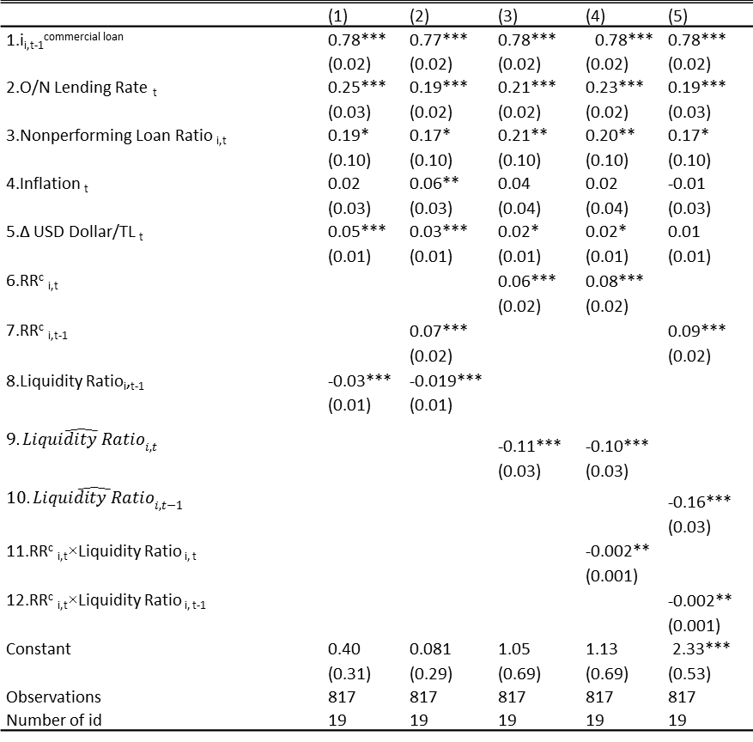
Table 4: Interest Rate on Commercial Loans
 | (1) | (2) | (3) | (4) |  | (5)
1.i_{i,t-1}^{commercial loan} | 0.78*** | 0.77*** | 0.78*** |  | 0.78*** | 0.78***
 | (0.02) | (0.02) | (0.02) | (0.02) |  | (0.02)
2.O/N Lending Rate _{t} | 0.25*** | 0.19*** | 0.21*** | 0.23*** |  | 0.19***
 | (0.03) | (0.02) | (0.02) | (0.02) |  | (0.03)
3.Nonperforming Loan Ratio _{i,t} | 0.19* | 0.17* | 0.21** | 0.20** |  | 0.17*
 | (0.10) | (0.10) | (0.10) | (0.10) |  | (0.10)
4.Inflation _{t} | 0.02 | 0.06** | 0.04 | 0.02 |  | -0.01
 | (0.03) | (0.03) | (0.04) | (0.04) |  | (0.03)
5.∆ USD Dollar/TL _{t} | 0.05*** | 0.03*** | 0.02* | 0.02* |  | 0.01
 | (0.01) | (0.01) | (0.01) | (0.01) |  | (0.01)
6.RR^{c} _{i,t} |  |  | 0.06*** | 0.08***
 |  |  | (0.02) | (0.02)
7.RR^{c} _{i,t-1} |  | 0.07*** |  |  |  | 0.09***
 |  | (0.02) |  |  |  | (0.02)
8.Liquidity Ratio_{i},_{t-1} | -0.03*** | -0.019***
 | (0.01) | (0.01)
$$\hat{{9.Liquidity Ratio}_{i,t}}$$ |  |  | -0.11*** | -0.10***
 |  |  | (0.03) | (0.03)
$$\hat{{10.Liquidity Ratio}_{i,t−1}}$$ |  |  |  |  |  | -0.16***
 |  |  |  |  |  | (0.03)
11.RR^{c} _{i,t}×Liquidity Ratio _{i, t} |  |  |  | -0.002**
 |  |  |  | (0.001)
12.RR^{c} _{i,t}×Liquidity Ratio _{i, t-1} |  |  |  |  |  | -0.002**
 |  |  |  |  |  | (0.001)
Constant | 0.40 | 0.081 | 1.05 | 1.13 |  | 2.33***
 | (0.31) | (0.29) | (0.69) | (0.69) |  | (0.53)
Observations | 817 | 817 | 817 | 817 |  | 817
Number of id | 19 | 19 | 19 | 19 |  | 19
Sample Period: June 2010 – December 2013. Standard errors are given in parenthesis and adjusted for heteroskedasticity.
*** p<0.01, ** p<0.05, * p<0.1. Dynamic panel model is estimated with one stage GMM (Arellano and Bond, 1991).
Liquidity Ratio_{i},_{t-1} is instrumented by the change in net TL injection implied by the central bank through foreign exchange operations. $\hat{{Liquidity Ratio}_{i,t−1}}$ denotes the fitted value obtained from regressing liquidity variable on ${FX}_{t}^{L}$.
Notes:
The first column adds the liquidity ratio to the specification in Table 2 and finds that the LR is negatively related to the commercial loan rate (row 8). Better liquidity implies lower rates because banks are more comfortable in issuing new loans, as implied by the theory. This finding is consistent with the liquidity channel of reserve requirements, given that RR policy is a major driver of bank liquidity as discussed in the context of Figure 2.
If changes in reserve requirements directly affect bank liquidity, the liquidity ratio would be correlated with RR. Hence it may not be clear whether the significance of the LR in column (1) is due to pure liquidity effects or the interaction of the cost channel of RR with liquidity effects. To address this issue, we add our cost based required reserves measure together with the liquidity ratio in column two and show that the liquidity ratio is still significant when required reserves are included in the specification. The coefficient associated with the liquidity ratio in column 2 indicates that even after we control for the effects of RR^{c} on the loan rate, there may be still additional impact due to changes in bank liquidity.
As another robustness check, we address the potential endogeneity between bank loans and the liquidity ratio. The decision to alter the fraction of liquid assets might be an endogenous choice by each bank, especially at the high frequency that we consider. Bank’s lending decisions directly feed into its liquidity while the liquidity of its portfolio directly affects the bank’s lending.

Slide 29
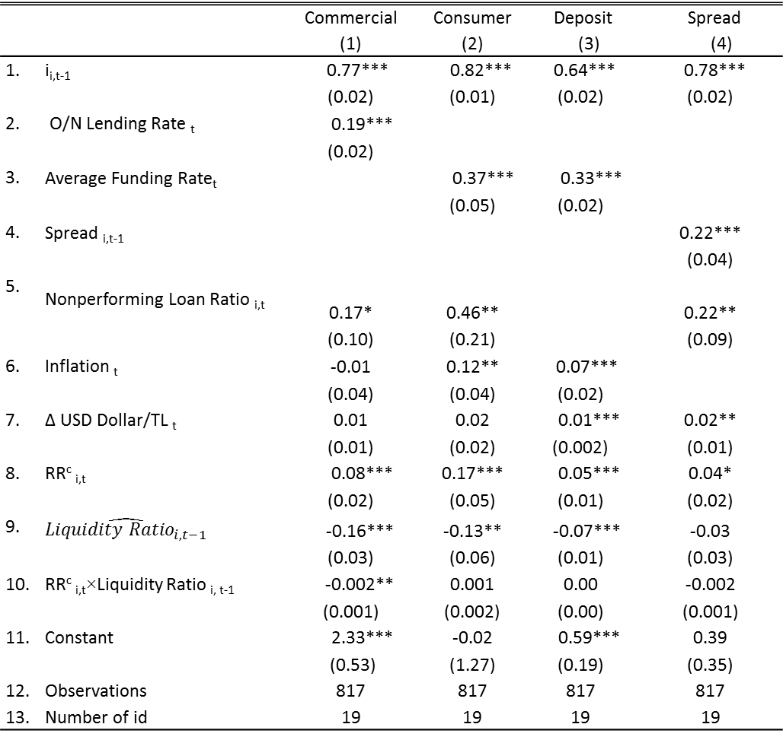
Table 5: Interest Rates on Commercial and Consumer Loans, Deposit and Spread
 |  | Commercial | Consumer | Deposit | Spread
 |  | (1) | (2) | (3) | (4)
1. | i_{i,t-1} | 0.77*** | 0.82*** | 0.64*** | 0.78***
 |  | (0.02) | (0.01) | (0.02) | (0.02)
2. | O/N Lending Rate _{t} | 0.19***
 |  | (0.02)
3. | Average Funding Rate_{t} |  | 0.37*** | 0.33***
 |  |  | (0.05) | (0.02)
4. | Spread _{i,t-1} |  |  |  | 0.22***
 |  |  |  |  | (0.04)
5. | Nonperforming Loan Ratio _{i,t} | 0.17* | 0.46** |  | 0.22**
 |  | (0.10) | (0.21) |  | (0.09)
6. | Inflation _{t} | -0.01 | 0.12** | 0.07***
 |  | (0.04) | (0.04) | (0.02)
7. | ∆ USD Dollar/TL _{t} | 0.01 | 0.02 | 0.01*** | 0.02**
 |  | (0.01) | (0.02) | (0.002) | (0.01)
8. | RR^{c} _{i,t} | 0.08*** | 0.17*** | 0.05*** | 0.04*
 |  | (0.02) | (0.05) | (0.01) | (0.02)
9. | $$\hat{{Liquidity Ratio}_{i,t−1}}$$ | -0.16*** | -0.13** | -0.07*** | -0.03
 |  | (0.03) | (0.06) | (0.01) | (0.03)
10. | RR^{c} _{i,t}×Liquidity Ratio _{i, t-1} | -0.002** | 0.001 | 0.00 | -0.002
 |  | (0.001) | (0.002) | (0.00) | (0.001)
11. | Constant | 2.33*** | -0.02 | 0.59*** | 0.39
 |  | (0.53) | (1.27) | (0.19) | (0.35)
12. | Observations | 817 | 817 | 817 | 817
13. | Number of id | 19 | 19 | 19 | 19
Notes:
RR has a positive sign
LR has a negative sign
But the interactive term cannot be generalized
One way to interpret this finding is to note that consumer loans in Turkey have higher demand elasticity of interest rates compared to commercial loans (see the discussion in the next section). Therefore, one can argue that the banks might be less flexible in changing their rates for consumer loans relative to commercial loans when they are faced with idiosyncratic liquidity shocks.

Slide 30
Empirical Analysis
So far we have shown that liquidity has a stronger impact on commercial loan rates relative to consumer loans.
  Commercial loans have shorter maturity and adjustable rates→More liquid
  Consumer loans have longer terms and fixed rate→Less liquid
  Shouldn’t we see a larger response by consumer loans?
Consumer loans have higher demand elasticity
  Banks may prefer to adjust their volumes rather than interest rates
  Table 7

Slide 31
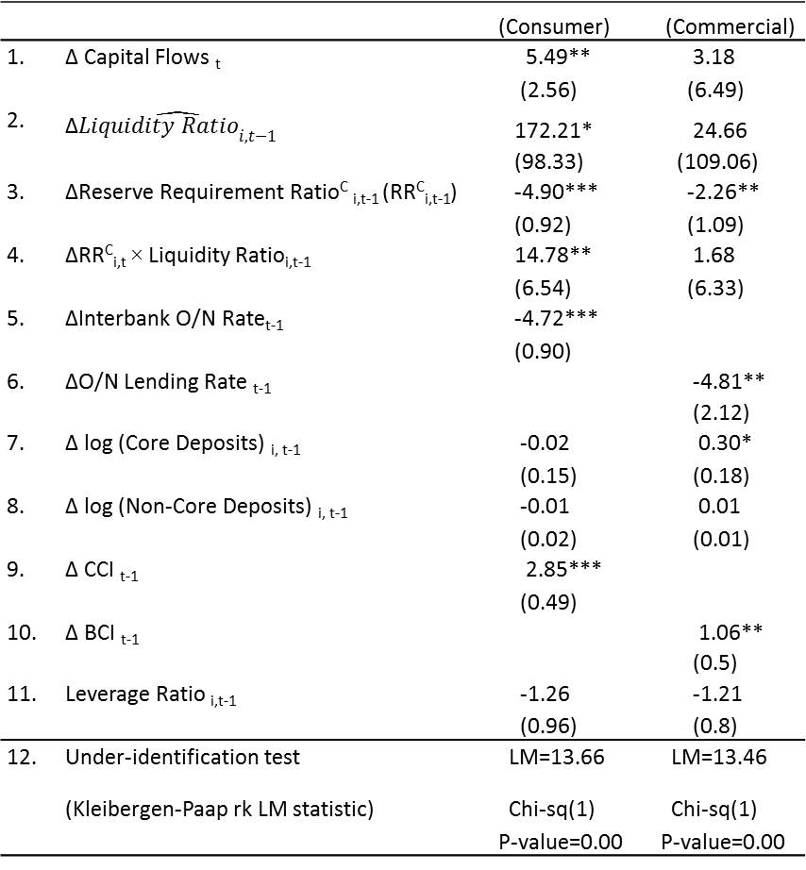
Table 7: Loan Growth
 |  | (Consumer) | (Commercial)
1. | ∆ Capital Flows _{t} | 5.49** | 3.18
 |  | (2.56) | (6.49)
2. | ∆$\hat{{Liquidity Ratio}_{i,t−1}}$ | 172.21* | 24.66
 |  | (98.33) | (109.06)
3. | ∆Reserve Requirement Ratio^{C} _{i,t-1} (RR^{C}_{i,t-1}) | -4.90*** | -2.26**
 |  | (0.92) | (1.09)
4. | ∆RR^{C}_{i,t} × Liquidity Ratio_{i,t-1} | 14.78** | 1.68
 |  | (6.54) | (6.33)
5. | ∆Interbank O/N Rate_{t-1} | -4.72***
 |  | (0.90)
6. | ∆O/N Lending Rate _{t-1} |  | -4.81**
 |  |  | (2.12)
7. | ∆ log (Core Deposits) _{i, t-1} | -0.02 | 0.30*
 |  | (0.15) | (0.18)
8. | ∆ log (Non-Core Deposits) _{i, t-1} | -0.01 | 0.01
 |  | (0.02) | (0.01)
9. | ∆ CCI _{t-1} | 2.85***
 |  | (0.49)
10. | ∆ BCI _{t-1} |  | 1.06**
 |  |  | (0.5)
11. | Leverage Ratio _{i,t-1} | -1.26 | -1.21
 |  | (0.96) | (0.8)
12. | Under-identification test (Kleibergen-Paap rk LM statistic) | LM=13.66 Chi-sq(1) P-value=0.00 | LM=13.46 Chi-sq(1) P-value=0.00
Sample Period: June 2010 – December 2013. Standard errors are given in parenthesis and adjusted for heteroskedasticity. *** p<0.01, ** p<0.05, * p<0.1. GMM Continuously Updated Estimator (CUE) is utilized.

Slide 32
Conclusions
We provided evidence in favor of the liquidity channel
  Central bank policies affect the funding needs and the liquidity position of banks
  Changes in bank liquidity affects bank lending
Reserve requirements have the potential to be used as an additional tool to affect bank lending behavior and ease the trade-off between price stability and financial stability.

Slide 33
Supplementary Material

Slide 34
Bank Lending Channel vs. Liquidity Channel
Bank Lending Channel | Liquidity Channel
Both channels operate through changes in bank reserves that lead to a consequent change in bank loans, independent of any changes in interest rates. Nevertheless, there are some differences:
Contractionary monetary policy is represented by a decrease in bank reserves, which leads to a reduction in bank deposits and a decline in loan supply. | Contractionary monetary policy is represented by an increase in required reserves, which leads to a decline in deposits and a decline in loan supply
The reason for the decline in deposits is less liquidity provided through open market operations | The reason for the decline in deposits is an increase in the opportunity cost of raising deposits
Bank loans decrease because deposits and external funding are not perfect substitutes as sources of funds. | Bank loans decrease because deposits and central bank funding are not perfect substitutes as sources of funds.

Slide 35
Expected cost of liquidity shock depends on liquid asset…

Slide 36
whereas a higher RR leads to a decline in liquid assets.

