Slide 1


Climate change in China:
Communism is cooler
I.P.L. Png
Junhong Chu
Yehning Chen

Slide 2
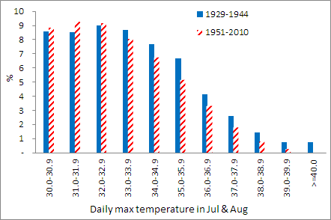
China, July and August daily max temperature:
1951-2010 vis-a-vis 1929-44
Notes:
After 1960, almost no reports of max temperature > 40 degrees

Slide 3
Findings
Frequency of extreme temperatures (⩾ 35ºC)
  decreased sharply from 1954
  increased from 2000 onward
Effect limited to summer months (June-August)
Effect more pronounced
  At stations where average summer temperature in 1929-44 relatively higher
  In provincial capitals
Robust to
  Control for aerosol effect (sunshine hours)
  Sample, specification, method

Slide 4
Findings, cont’d
Increased frequency of extreme temperatures from 2000 onward
  More pronounced in stations with higher score for environmental transparency

Slide 5
Outline
Data
Method
Results
Explanations
Hot weather policy
Discussion

Slide 6
Data sources: Historical China, 1912-49
國立中央研究院氣象研究所, 氣象月刊, Monthly Meteorological Bulletin, Academia Sinica, National Research Institute of Meteorology, Pei-Chi-Ko, Nanking, China, 1928-37
日本軍北支那氣象部, 北支那氣象月報, North China Monthly Meteorological Bulletin, North China Meteorological Department, Japanese Army, 1939-44
Other observatories and agencies
  Provinces: Fujian, Hunan, Jiangsu, Manchuria, Sichuan
  Cities: Dalian, Qingdao, Society of Jesus Kiangnan Mission, Shanghai
Notes:
, various issues, 1929-36.
53 to 68 stations across East and Central China
Interrupted by Sino-Japanese War
, various issues.

Slide 7
Data sources: Modern China, 1951-2010
China Meteorological Administration (CMA): Surface weather database, version 3.0 -- up to 824 stations
  Minimum and maximum temperature
  Sunshine
Global Historical Climatology Network (GHCN) -- up to 199 stations
  Minimum and maximum temperature

Slide 8
Data: Matching China stations
Matching criteria
  Location
    Longitude and latitude: Distance < 10 kilometres
    Difference in elevation < 100 metres
  At least 5 years of records in 1929-1944 (with at least 6 months per year)
  At least 19 stations in each year
Matched data-set
  65 stations, 1929-44 and 1951-2010
  1,539,393 observations of daily max and min temperature
  1,318,497 observations of daily sunshine duration

Slide 9
Data sources: Non-mainland/foreign, 1929-2010
Hong Kong Observatory
  One station
Japan Meteorological Agency
  6 stations in southwest
Korea Meteorological Administration
  9 stations in west
Taiwan: Central Weather Bureau
  5 stations in west
Matched data-set
    21 stations, 1929-2010
    590,083 observations of daily max and min temperature
    450,942 observations of daily sunshine duration

Slide 10
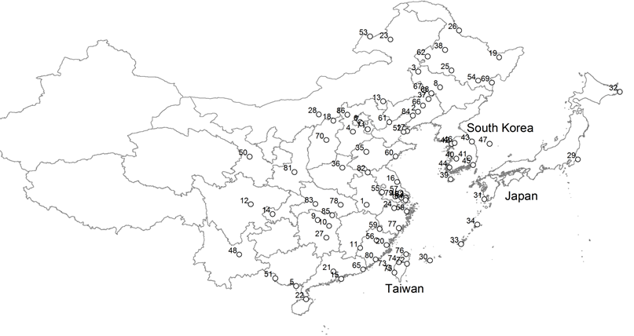
Data: Stations

Slide 11
Data
Quality
  Conventional checks
  Compared across sources
    1954 compilation of monthly averages (中国气温资料 / 中国气象局中国科学院地球物理研究所联合资料室编)
    Multiple original sources
Inhomogeneities
  Movement of stations
  Changes in technology, standards, and procedures

Slide 12
Outline
Data
Methods
Results
Explanations
Hot weather policy
Discussion

Slide 13
Empirical strategy
Difference in difference
  1929-1944: summer temperatures more extreme in China than foreign
  1954-2000: summer temperatures less extreme in China than foreign
Benchmark for extreme: Probability of daily maximum temperature ≥35ºC

Slide 14
Method: Multiple regression
Unit of analysis: Station + date
  More robust to errors in data than annual or monthly model
  More precise estimate -- annual/monthly average of daily extremes understates the effects
Dependent variable:
  Daily maximum temperature for each station
  Probability of daily maximum temperature ≥ benchmark (35ºC) -- to investigate the frequency of extreme temperatures

Slide 15
National model
Dependent variable
  Daily maximum temperature
  Probability of daily maximum temperature ≥ benchmark (35ºC)
Explanatory variables -- fixed effects
  Stations (regional differences)
  Years (average of dependent variable for year)
  Months (seasonal differences)
  China x years (average increment in dependent variable for China relative to foreign countries in each year)
Notes:
With station FE, China main effect cannot be separately identified

Slide 16
Station-specific model
Dependent variable
  Daily maximum temperature
  Probability of daily maximum temperature ≥ benchmark (35ºC)
Explanatory variables:
  Fixed effects
    Station-year: Urban heat island effect, movement of station, change in meteorological standard, change in recording procedure or personnel
    Station-month: Differences in seasonality
  Station x Post-1954 (including foreign stations)
  [Standard errors clustered by station]

Slide 17
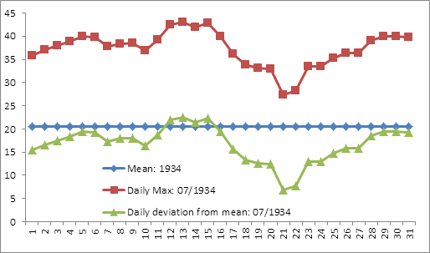
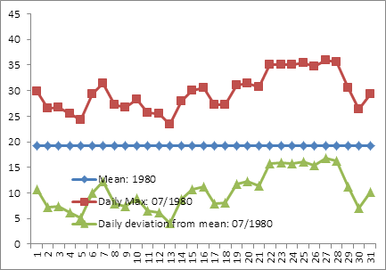
Daily max, Nanjing, July 1934 and 1980

Slide 18
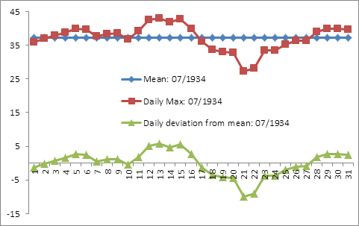
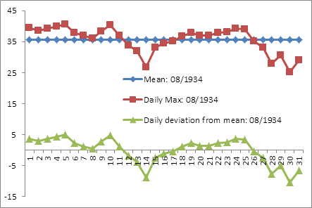
Daily max, Nanjing, July and Aug 1934

Slide 19
Outline
Data
Method
Results
  National model
  Station-specific model
Explanations
Hot weather policy
Discussion

Slide 20
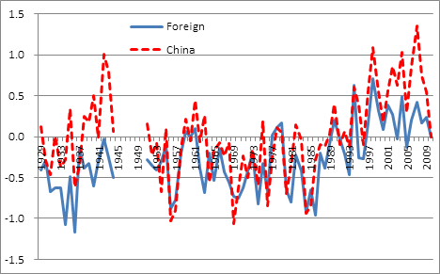
National model: Daily max temperature:
Year fixed effects (annual average)
Notes:
1929-44: Chinese weather hotter than foreign countries
1951-2000: Chinese weather similar to foreign countries
2001-onward: Chinese weather hotter than foreign countries

Slide 21
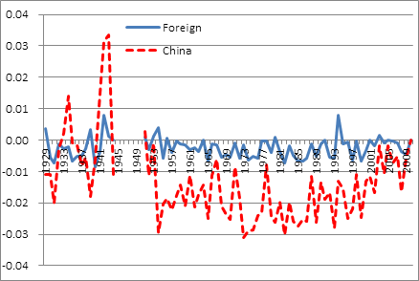
National model: Prob (daily max temp ≥ 35ºC):
Year fixed effects (annual average)
China and foreign
series normalized to 2010
Notes:
1929-44: Chinese extreme relatively more volatile than foreign countries
1954: Chinese extreme sharply lower
1955-2002: Chinese extreme systematically low
2001-onward: Chinese extreme weather

Slide 22
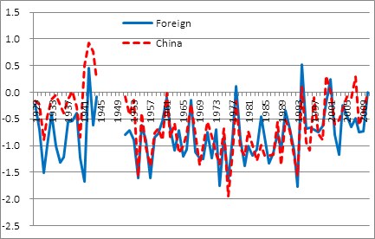
National model: Daily max temperature, Jun-Aug: Year fixed effects (annual average)
Notes:
Chinese Jun-August weather very similar to foreign

Slide 23
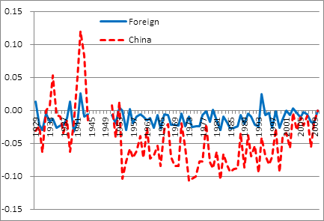
National model: Prob (daily max temp ≥ 35ºC), Jun-Aug: Year fixed effects (annual average)
Structural break 1954
Structural break 2001
Notes:
Reduction in extreme temperature concentrated in summer
Previous slide: daily max temp about same in China and foreign; so,
Stations with high extremes (above 35): Mean-preserving compression -- disproportionate increase in probability of sub-35 temperatures
Stations with moderate extremes (below 35): No change around 1954/55

Slide 24
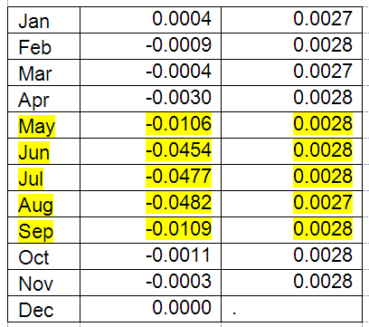
Incremental prob of daily max temp >= 35ºC in 1951-2010 relative to 1929-44 in China (relative to foreign)

Slide 25
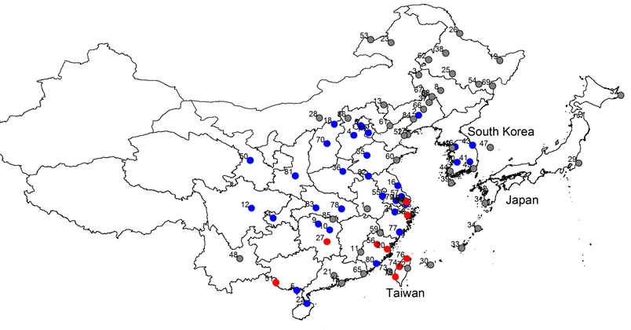
Prob of daily max temp ≥ 35ºC in July, 1954-2010 vis-a-vis 1929-1944
Notes:
Blue = prob of max temp ≥ 35ºC lower from 1954 onward than before 1949
Grey = no significant difference
Red = prob of max temp ≥ 35ºC higher from 1954 onward than before 1949

Slide 26
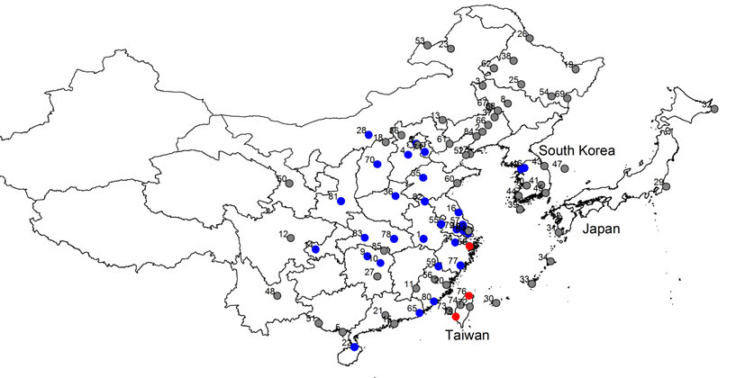
Prob of daily max temp ≥ 35ºC in August, 1954-2010 vis-a-vis 1929-1944
Notes:
Blue = prob of max temp ≥ 35ºC lower from 1954 onward than before 1949
Grey = no significant difference
Red = prob of max temp ≥ 35ºC higher from 1954 onward than before 1949

Slide 27
Robustness checks
Sample
  Distance ≤ 5km, number of years ≥ 7
  Homogeneous: 36 China + 21 foreign stations, all years, 1951-2010
Measurement
  Pre-1950 observations clustered at .0 and .5:
  Alternative benchmark: Probability of daily maximum temperature ≥ 34.9ºC
Specification: Week fixed effects
Estimation method
  Logit
  Probit

Slide 28
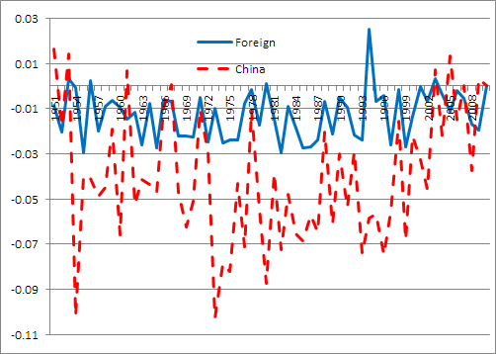
Homogeneous sample, Jun-Aug, 1951-2010
Notes:
China stations: 36 with complete data through 1951-2010
Foreign stations: 21

Slide 29
Outline
Data
Method
Results
Explanations
  Aerosol effects
  Evolution of climate: Coastal/inland
  Urbanization
  Technology, standards, and procedures
Hot weather policy
Discussion

Slide 30
Aerosol effects
Atmospheric aerosols
  Directly scatter and absorb solar radiation
  Indirectly provide nuclei for condensation of clouds or formation of ice
Sources of aerosols
  Cloud
  Water vapour
  Humidity
  Dust
  Emissions -- increase with China’s economic growth
Overall measure: daily sunshine hours
  Limited data => smaller sample
Notes:
Comment: Emissions increased with China's economic growth;
Aerosol effects due to emissions should be increasing => lower prob of extreme temperatures
Instead, we observed prob of extreme temperatures increased from 2001 onward

Slide 31
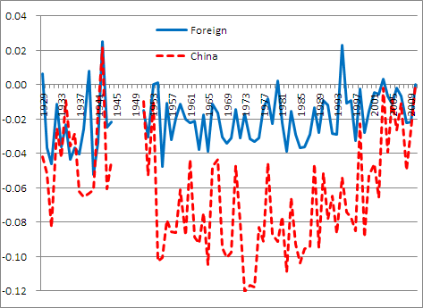
Prob of daily max temp ≥ 35ºC:
Including sunshine hours
Notes:
Pattern:
1929-44: China weather less extreme than foreign -- due to sample (see next slide)
1954 onward: China weather systematically less extreme (same result as in main estimate)

Slide 32
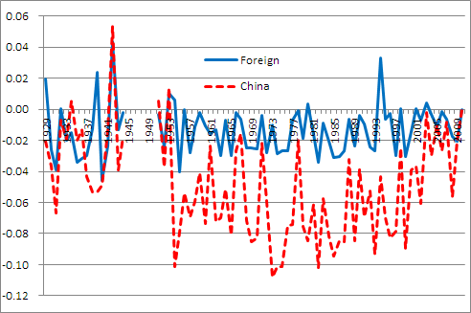
Prob of daily max temp ≥ 35ºC:
Sunshine sample without sunshine covariate
Notes:
Effects somewhat more pronounced (larger gap between China and foreign) with control for sunshine.
Why?
Note different vertical scales in two figures: Actual difference between China and foreign quite similar
Stations without sunshine data: China weather in 1929-44 much more extreme than foreign

Slide 33
Evolution of climate: Inland/coastal
Permanent regional differences -- inland climate more extreme
  Absorbed by station fixed effects
Conjecture -- time-varying regional differences:
  Perhaps climate of inland China evolved differently from coastal areas (China, Korea, Hong Kong) and offshore islands (Japan, Taiwan)
Notes:
For 1929-44:
Inland: 31 stations (14 in Northeast); 84,665 observations
Coastal: 34 stations; 102,411 observations

Slide 34
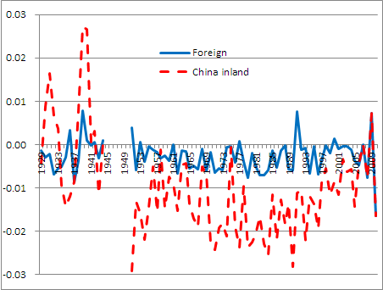
China inland: Prob of daily max temp ≥ 35ºC
Notes:
[Note for next revision: change to June-August]

Slide 35
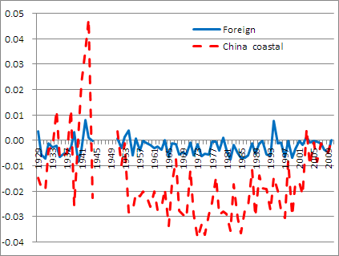
China coastal: Prob of daily max temp ≥ 35ºC
Notes:
[Note for next revision: change to June-August]
Evolution of climate of coastal China should be more similar to foreign
But, bigger discrepancy between China coastal and foreign than between China inland and foreign

Slide 36
Urbanization
Urbanization affects temperature
  Building materials absorb and release radiation
  Surface materials
  Vegetation
  Surface moisture
Southeast China (Zhou et al. PNAS 2004):
  Warming trend in minimum temperature (+0.116ºC per decade) in winter
    10x larger than effect on maximum temperature
    21% of overall warming trend in minimum temperature
  Cooling trend in maximum temperature (-0.016ºC per decade) in winter

Slide 37
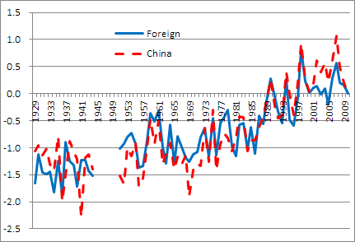
Urbanization: Daily minimum temperature
Notes:
Clear upward trend -- consistent with previous research
Liming Zhou, Robert E. Dickinson, Yuhong Tian, Jingyun Fang, Qingxiang Li, Robert K. Kaufmann, Compton J. Tucker, and Ranga B. Myneni, “Evidence for a significant urbanization effect on climate in China”, PNAS, Vol. 101 No. 26, June 29, 2004, 9540-9544.
Chinese weather similar to foreign

Slide 38
Urbanization
Urban heat island effect -- strongest effect in winter
  Our results most pronounced in summer
Station-level model: Accounted for by fixed effects for station-year and fixed effects for station-month

Slide 39
Technology, standards, and procedures
Difficult to explain observed national effect on summer extreme temperatures through changes in technology, standards, and procedures
  General -- change should uniformly affect all recorded temperatures, not asymmetrically affect higher temperatures
  Movement of stations -- specific to stations, not nation-wide

Slide 40
Technology, standards, and procedures
(Kaiser et al. 1993)
But attenuation of extreme temperatures did not reverse around 1960/61
Temperature
  Instrument height
    1950-53: 1.5 metres
    1954-60: 2 metres
    1961-onward: 1.5 metres
  Observation time
    up to 1950: 2000 hrs Beijing time
    1951-53: 2000 hrs Local Standard Time
    1954-60: 2000 hrs Local Mean Solar Time
    1961-onward: 2000 hrs Beijing time
Sunshine
  up to 1953: Jordan Photographic Sunshine Recorder
  1954-onward: Campbell-Stokes Sunshine Recorder

Slide 41
Outline
Data
Method
Results
Explanations
Hot weather policy
Discussion

Slide 42


Slide 43

Government policy
1954: Iron and Steel Bureau: “Report on hot weather measures”
  Temperatures in workshop must not exceed 30ºC
1956: State Council: “Notice to accelerate implementation of summer hot weather measures”
  Temperatures in some areas of Southern China have exceeded 100-year records
  In extremely hot weather, if remedial measures not possible, consider temporary work suspension
  No overtime work during hot weather
Notes:
List is incomplete

Slide 44
Government policy
1960: Ministry of Health, Ministry of Labor, and National Federation of Trade Unions: Interim Regulation on Hot Weather Work
Provincial governments progressively introduced detailed regulations on hot weather work
  1963: Guangzhou
  1994: Shenzhen
  2005: Hunan, Jiangsu
  2007: Chongqing, Hubei, Beijing
Notes:
List is incomplete

Slide 45
Government policy
2007: Additional measures
2012: State Administration of Work Safety, Ministry of Health, Ministry of Human Resources and Social Security, and All China Federation of Trade Unions: Final Regulation No. 89 of 2012
Notes:
List is incomplete

Slide 46
Final Regulation, No. 89 of 2012
国家安全生产监督管理总局, 卫生部, 人力资源和社会保障部,
中华全国总工会
安监总安健〔2012〕89号: 防暑降温措施管理办法
第八条 在高温天气期间，用人单位应当按照下列规定，
1.日最高气温达到40℃以上，应当停止当日室外露天作业；
2.日最高气温达到37℃以上、40℃以下时，用人单位全天安排劳动者室外露天作业时间累计不得超过6小时，连续作业时间不得超过国家规定，且在气温最高时段3小时内不得安排室外露天作业；
3.日最高气温达到35℃以上、37℃以下时，用人单位应当采取换班轮休等方式，缩短劳动者连续作业时间，并且不得安排室外露天作业劳动者加班。

Slide 47
Incentives of local government officials
天高皇帝远: The sky is high and the emperor is far away
Pre-1978 reform
  Local officials required to meet central planning targets
Post-1978 reform
  Government depends on industrial enterprises for revenues and other support
  Local officials evaluated by economic performance of their territory (Li and Zhou 2005)

Slide 48
Weather reporting
1956: “Temperatures in some areas of Southern China have exceeded 100-year records” (State Council)
  All stations: Jun-Aug temperatures lower in 1956 than 1929-44
  Conjecture: Re-writing of historical weather statistics
2010: Li Kai-le, ex senior technical officer, Guangdong Province Meteorological Office: “Some officials worry about the cost and disruption of warnings, and ask for a more conservative forecast” (Nanfang.com, 2010)
Notes:
Possible reason why "rewriting of statistics" began in 1954: Major re-organization of China provincial govts in June 1954:

Slide 49
Compliance with hot weather regulations
1954: “some enterprises did not truthfully report heat stroke incidents and workshop temperature” (Iron and Steel)
1956: “some enterprises did not prepare measures for hot weather work in summer” (State Council)
1956: Wenzhou Steel Factory concealed industrial accidents, reported 8 instead of 21 in August (“Factory manager Zheng Kezhong did not respect worker safety”)

Slide 50
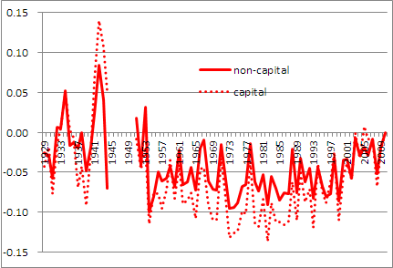
Prob of daily max temp ≥ 35ºC, Jun-Aug:
Provincial capitals vis-a-vis other stations
Notes:
Larger cooling effect in provincial capitals

Slide 51
Structural break #1:
Less frequent extreme temp, 1954-60
Major changes in 1954: Central government
  Re-organized national administration
    Abolished regional governments
    Directly administered provinces
  Transferred Meteorological Agency from military administration to civil government
Analyses
  Average daily maximum temperature, Jun-Aug, 1951-53
  Economic structure
Notes:
James Kung used the length of communist administration to measure "degree of redness" of each province. In turn, he used that to explain the extent to which the provincial govt over-reported grain production during the Great Leap Forward.

Slide 52
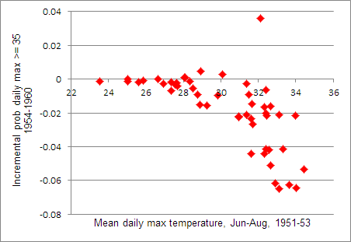
Less frequent extreme temp, 1954-60: Average summer extreme temp, 1951-53

Slide 53
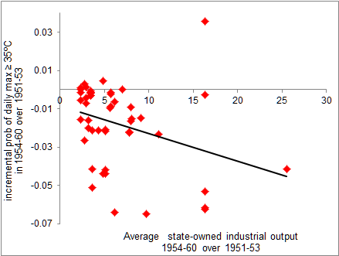
Less frequent extreme temp, 1954-60: Economic structure

Slide 54
Structural break #2:
More frequent extreme temp, 2001-10
Major events around 2001
  United Nations Framework Convention on Climate Change, Kyoto Protocol, 1997
    China signed, 29 May 1998
  China admitted to WTO, 11 December 2001
Analyses
  Average daily max temperature, Jun-Aug, 1951-53
  Pollution Information Transparency Index, 2008-onward
    Institute of Public & Environmental Affairs (China) and Natural Resources Defense Council
  Economic structure: Percent of employment in construction

Slide 55
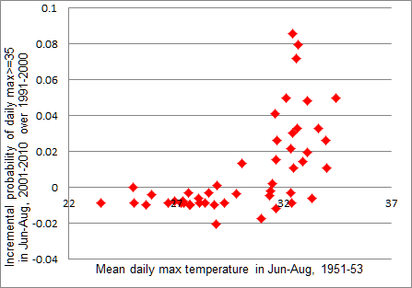
More frequent extreme temp, 2001-10:
Mean daily max temperature, 1951-53
Notes:
This refutes explanation of 1954 structural break as mean reversion -- no reason why the stations that experienced mean reversion in 1954 would exhibit “unreversion” in 2001.

Slide 56
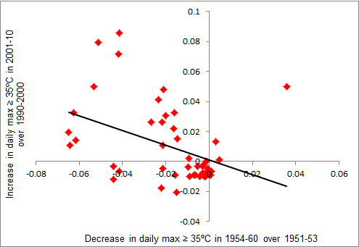
Less frequent extreme in 1954-60 /
more frequent extreme in 2001-10

Slide 57
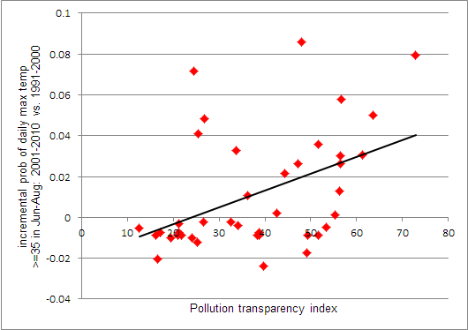
More frequent extreme temp, 2001-10: Pollution Information Transparency Index

Slide 58
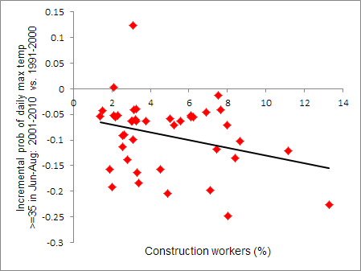
More frequent extreme temp, 2001-10: Economic structure

Slide 59
Outline
Data
Method
Results
Explanations
Hot weather policy
Discussion

Slide 60
Implications: Welfare
Welfare and health
  Businesses -- illegal in China for any organization other than CMA to publish weather
  Individuals -- can monitor hot weather themselves

Slide 61
Implications: Climate studies
Summer extreme temperatures affected by
  Global trends
  Aerosol effects -- natural and anthropogenic
  Under-reporting?

Slide 62
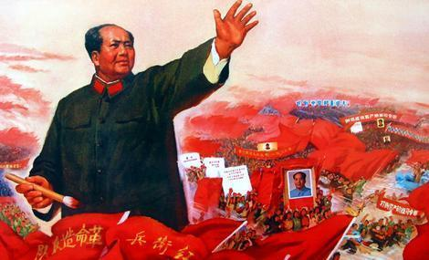
Communists reformed society, economy, and also the climate!

Slide 63
Additional presentation

Slide 64
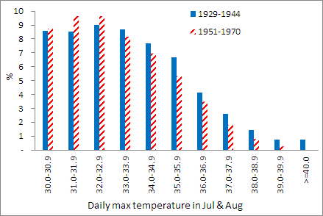
China, July and August daily max temperature:
1929-44 vis-a-vis 1951-70

Slide 65

China, July and August daily max temperature:
1929-44 vis-a-vis 1971-90

Slide 66
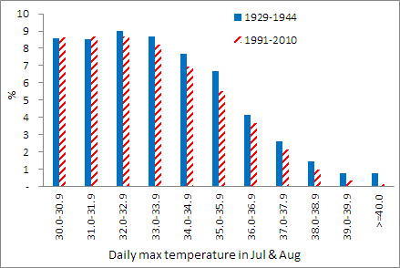
China, July and August daily max temperature:
1929-44 vis-a-vis 1991-2010

Slide 67
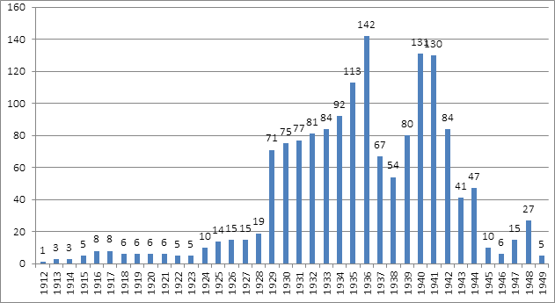
China: Station coverage, 1912-1949

Slide 68
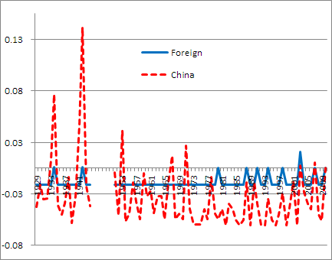
Prob (monthly average daily max temp ≥ 35ºC), Jun-Aug: Year fixed effects (annual average)
Notes:
Monthly average of daily max, not daily max: shows that effects are muted with monthly averages.

Slide 69
Daily min temperature: Annual average
Notes:
1929-2010: Chinese weather similar to foreign countries

Slide 70
National model
 | Daily max temp | Pr(max temp ≥ 35ºC)
May x post-1951 x China
Jun x post-1951 x China
July x post-1951 x China
Aug x post-1951 x China
Sep x post-1951 x China
Ratio to May x post-51 average
Ratio to Jun x post-51 average
Ratio to July x post-51 average
Ratio to Aug x post-51 average
Ratio to Sep x post-51 average
No. of observations
R²
Lower probability of extreme temperature at all levels in May-Sep

Slide 71
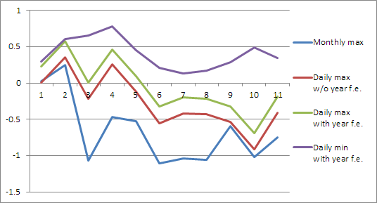
National model: Max and min temperatures

Slide 72
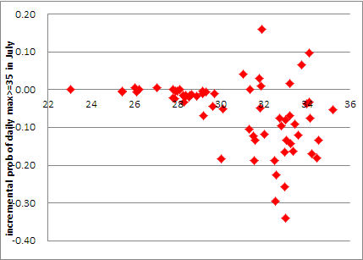
Prob of daily max temp ≥ 35ºC, July:
1954-2010 vis-a-vis 1929-44
Higher pre-1945 temperature => relatively lower post-1953 temperature

Slide 73
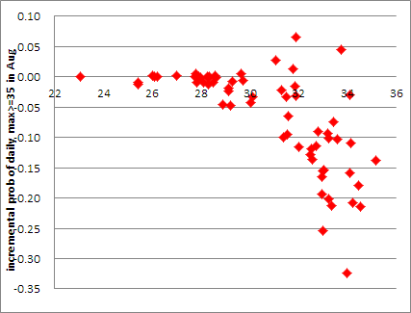
Prob of daily max temp ≥ 35ºC, August:
1954-2010 vis-a-vis 1929-44

