Slide 1
Forward guidance as a Monetary Policy Tool in Theory and Practice:
The Swedish Experience
Lars E.O. Svensson
Web: larseosvensson.se
“Lessons from the Financial Crisis for Monetary Policy”
NBER conference, Boston, October 18-19, 2013

Slide 2
Outline
The mandate?
Forward guidance as special or normal policy?
The Swedish experience: Success and failure
Consequences of a high policy-rate path?
Why such a high policy-rate path?
Is leaning against the wind effective in limiting household debt?
How to avoid publishing irrelevant policy-rate paths?
How to avoid neglecting the mandate?

Slide 3
1. The mandate for monetary policy: Riksbank
Sveriges Riksbank Act
  “The objective for monetary policy shall be to maintain price stability”
Government bill
  "In addition, as an authority under the Riksdag, the Riksbank, without prejudice to the price stability target, is to support the goals of general economic policy with the aim to achieve sustainable growth and high employment".
  High employment = highest sustainable rate of employment
Price stability and the highest sustainable rate of employment
  Highest sustainable rate of employment = the lowest sustainable rate of unemployment [participation rate!]
  Riksbank: Price stability = Inflation target, 2% CPI inflation
  Stabilize inflation around the inflation target and unemployment around an estimated long-run sustainable rate of unemployment
Same mandate as Fed!

Slide 4
Forward guidance: Special or normal?
Some info about future policy(-rate) settings
Recently: Fed, BoC, ECB, BoE
  Special: Binding Effective Lower Bound
  Implement more expansionary monetary policy
For many years: RBNZ, Norges Bank, Sveriges Riksbank, Czech NB
  Normal: Published forecast of policy rate (policy-rate path)
  RBNZ 1997-, NB 2005-, SR 2007-, CNB 2008-

Slide 5
Forward guidance in form of published policy rate path: Reasons for normal?
Transparency: Coherent forecast of target variables requires forecast of instrument. Then publish this.
Effectiveness: Management of expectations (of the future policy rate)
Informativeness: Central bank should have more info about its future policy settings. Useful info for private sector
Justification: Provides a coherent way of justifying policy choice by comparison with policy alternatives
Accountability: Simplify external evaluation of policy by comparison with policy alternatives and assessments of tradeoff between target variables

Slide 6
Developments of forward guidance as something normal
Forecasts of target variables conditional on
Constant policy rate
  If inflation forecast above (below) target, increase (reduce) policy rate
  Inconsistencies, not credible (Leitemo, Woodford)
Market expectations of policy rate – “market policy-rate path”
  CB forecasts of target variables may not “look good”
  CB policy-rate path may differ from market path
Central-bank forecast of policy rate – “CB policy-rate path”
  Consistent (inconsistent) if market path equal (differ) from CB path

Slide 7
The Swedish experience
Previously discussed by Svensson (2009, 2010) and Woodford (2012, 2013)
Success and failures
  Predictability
  Credibility
Success: February 2009
Failure: September 2011
[Brief history February 2007-April 2013: Go]

Slide 8
Success!
February 2009

Slide 9
Failure!
September 2011
Cont.

Slide 10
The Swedish experience
What were the consequences of the September 2011 discrepancy?
What were the reasons?

Slide 11
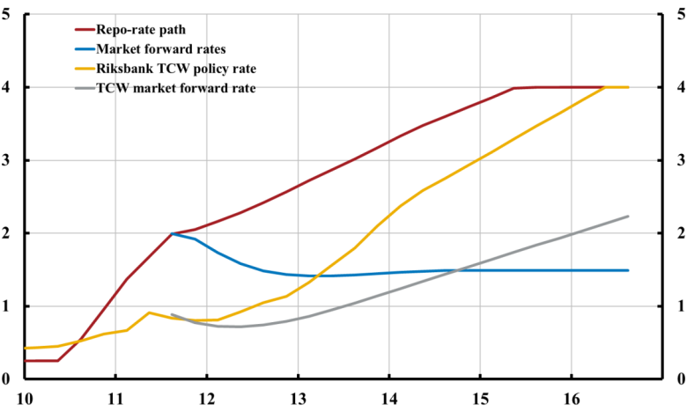
Another discrepancy: Foreign policy rates
September 2011: Riksbank forecast of foreign policy rates much above market expectations of foreign policy rate

Slide 12
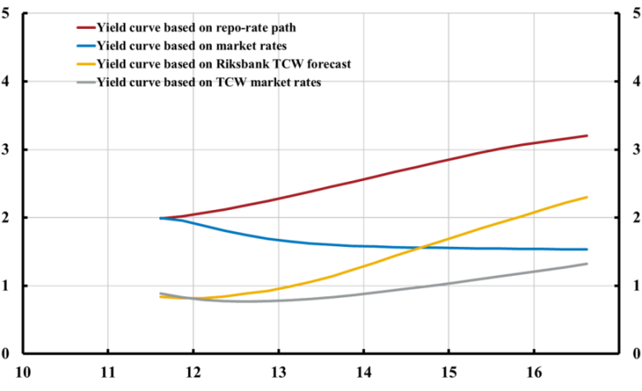
Another discrepancy: Yield curves
Yield curve discrepancies

Slide 13
Another discrepancy: Foreign policy rates
A higher Riksbank forecast of foreign policy rates supported a higher Riksbank policy-rate path
But market begged to differ
  If Riksbank would follow its policy-rate path, the krona would strengthened too much
  Export, GDP, employment, and inflation would fall
  The Riksbank would be forced to follow a lower path
Riksbank forecasts of target variables deeply inconsistent
  Asset-price inputs (exchange rates, stock market) in forecasts conditional on market path, not Riksbank path

Slide 14
Market disbelief a good thing (this time)
Actual financial conditions much easier than Riksbank path
Suppose the market would have believed the Riksbank policy-rate path
  A 5-year interest rate would have increased from 1.5% to 3.2% (1.7 p.p.)
  Not good for the economy (w/ low inflation and high unemployment)

Slide 15
High policy-rate path part of a bigger picture
Tightening in June/July 2010, in spite of low inflation forecast and high unemployment forecast
Fed and Riksbank inflation and unemployment forecasts similar…
… but policies very different

Slide 16
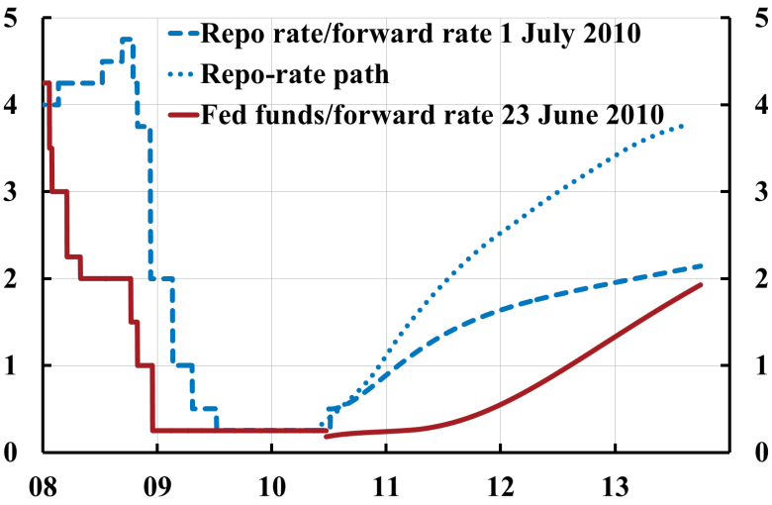
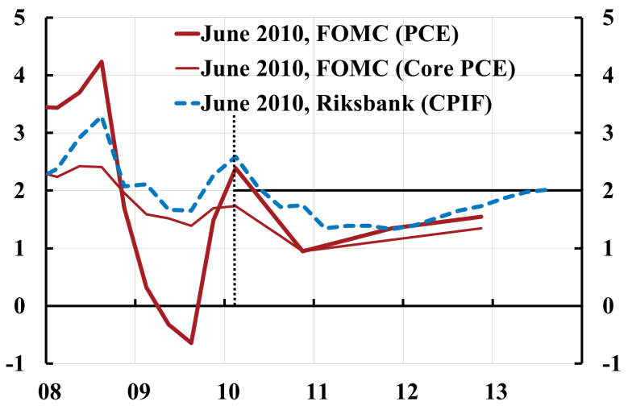
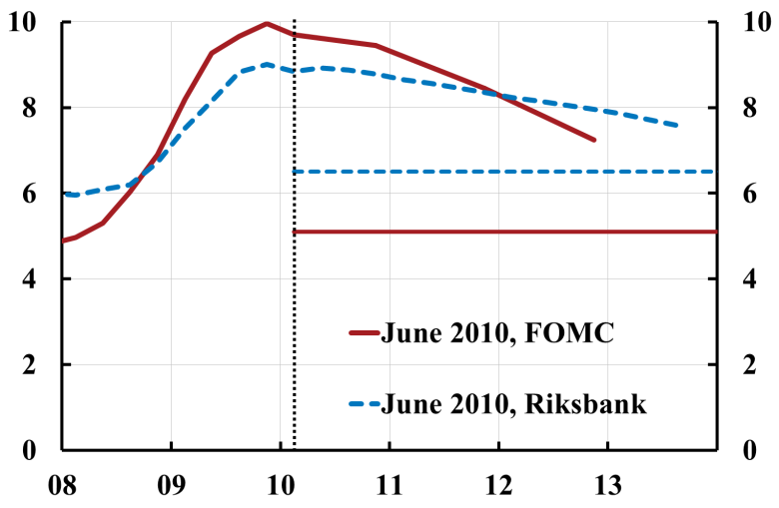
Fed and Riksbank, June/July 2010
Policy rate
Inflation
Unemployment

Slide 17
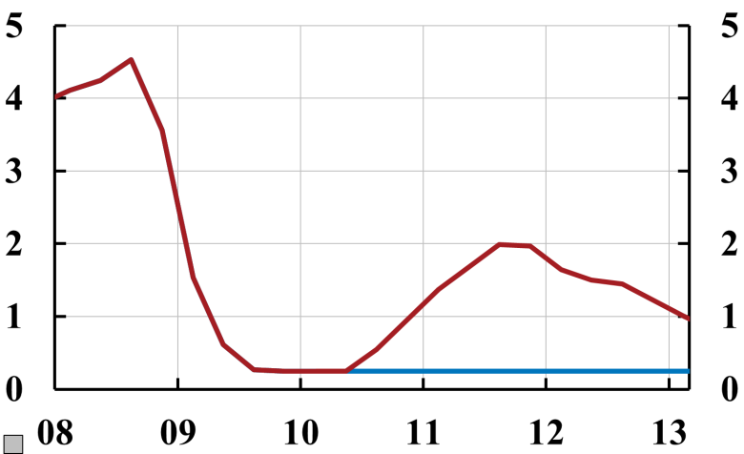
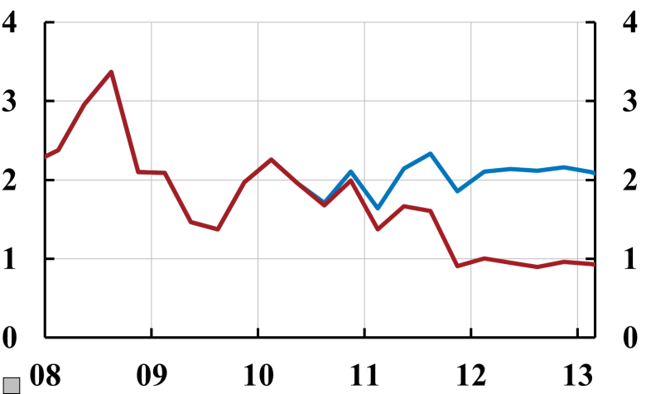
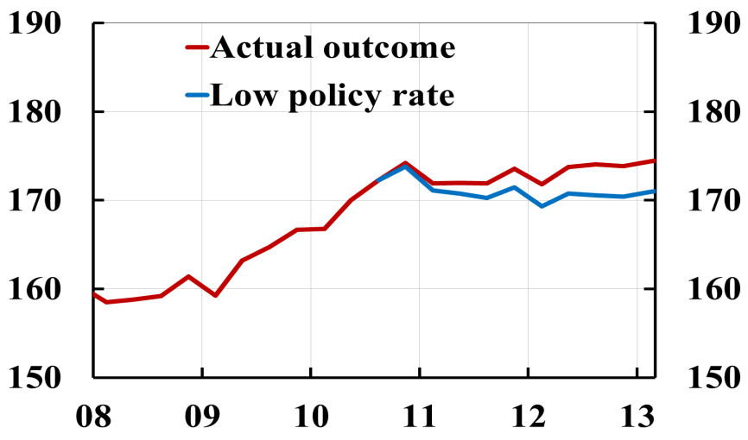
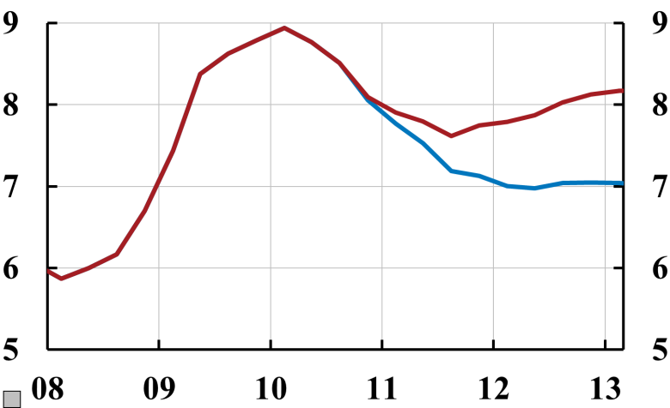
What happened: Too low inflation and too high unemployment – Note counterfactual, low policy rate
Policy rate
CPIF
Household debt ratio, % of disposable income
Unemployment
Cont.
Sources: The Riksbank, Statistics Sweden, and own calculations

Slide 18
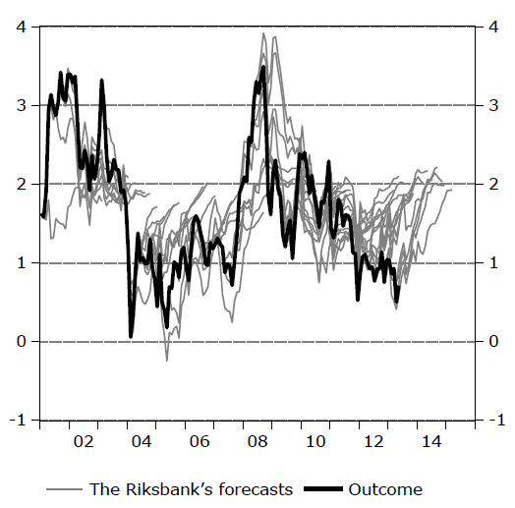
Riksbank inflation forecasts biased upwards
Riksbank inflation forecasts and actual outcome (CPIF)
Source: National Institute of Economic Research (2013)

Slide 19
Why this policy?
Concern about housing prices and household debt
“Leaning against the wind” (a higher policy rate) since 2003 (Giavazzi and Mishkin 2006)
Not clearly explained:
“Another factor [in relation to the policy-rate increase] is that household indebtedness has increased significantly in recent years” (June/July 2010 press release)
“[A]n interest rate increase was also a signal to avoid new financial imbalances from building up and that household indebtedness ought not to rise too much” (Ingves, in June/July 2010 minutes)
Limiting debt “beneficial side effect.”
Tradeoff w/ inflation and unemployment not admitted until op-ed October 2012 by Governor Ingves

Slide 20
But “leaning against the wind” as a way of reducing household debt is counterproductive
“Leaning against the wind” – a higher policy rate – actually increases (not reduces) real debt and the debt-to-GDP and debt-to-income ratios (Svensson 2013)
The policy rate affects total nominal debt very slowly – but the price level, nominal GDP and nominal income much faster

Slide 21
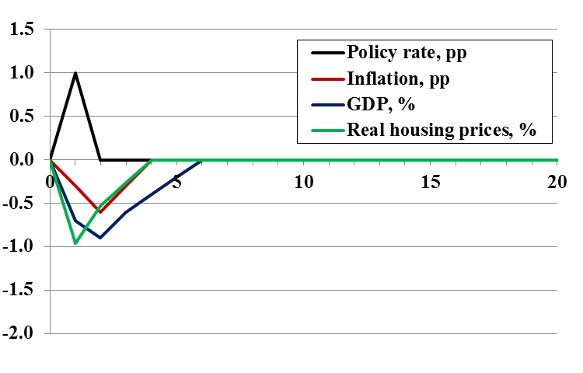
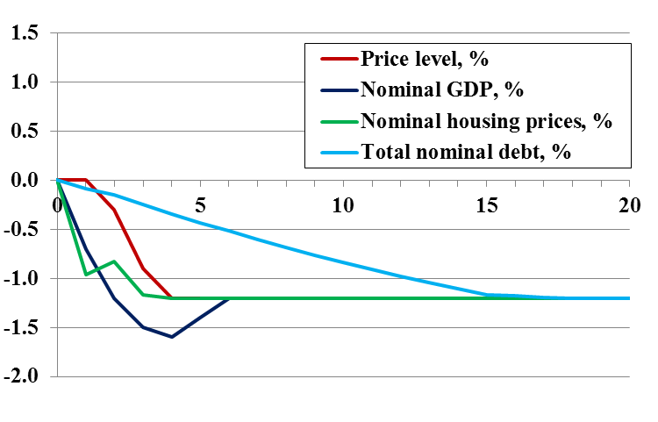
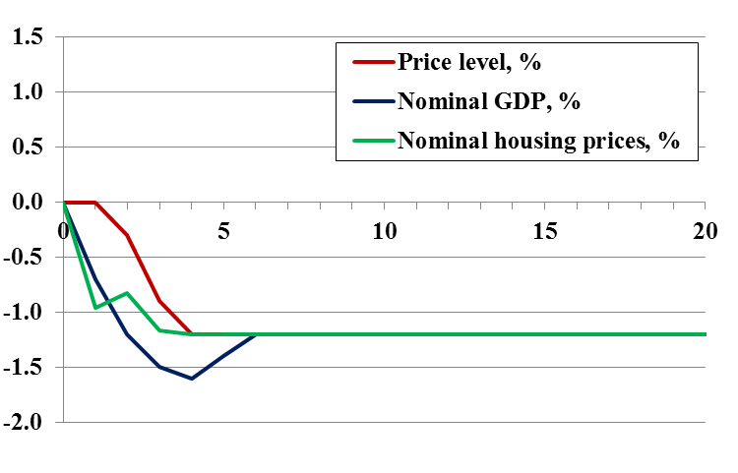
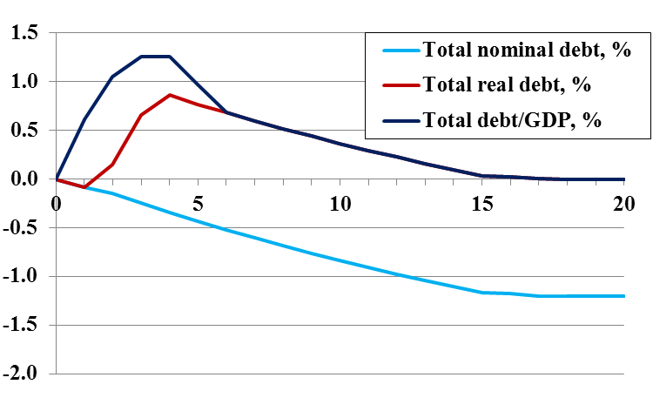
Impulse responses to 1 percentage point higher policy rate during year 1
Source: Svensson (2013), “Leaning against the wind leads to higher (not lower)
household debt-to-GDP ratio,” larseosvensson.se.
Cont.

Slide 22
In the longer run, lower inflation than target and expectations causes Fisherian debt deflation
Since 1997 shorter and longer run expectations have been close to the inflation target
Average inflation has been lower than target
The actual price level has fallen below the expected price level
Real debt has become higher than expected

Slide 23
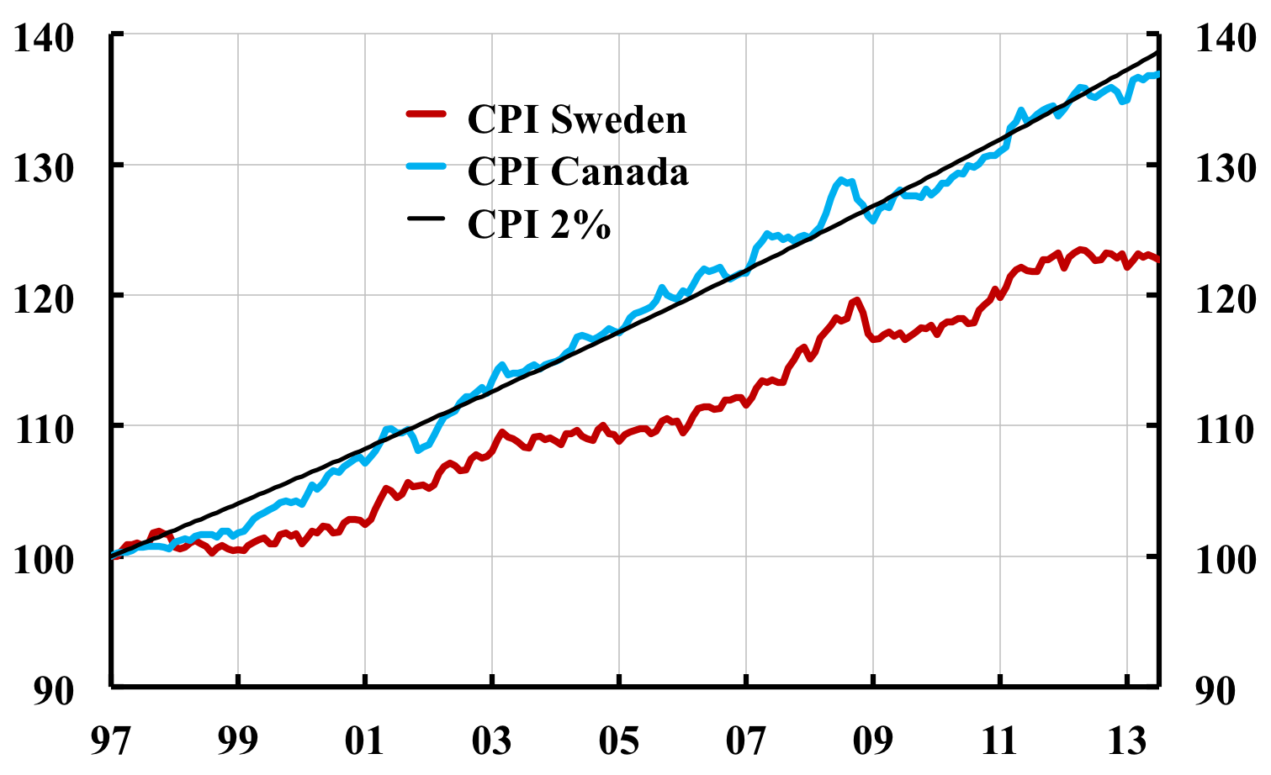
Price level ex post lower than anticipated

Slide 24
“Debt deflation”: Real debt higher than anticipated!
Unaticipated increase in real value of nominal debt in July 2013, depending on when the debt was taken on
Percent

Slide 25
How to avoid this?
How to avoid publishing a policy-rate path such as that of September 2011?
  Take framework of forecast targeting seriously
  If discrepancy between CB path and market path, construct forecasts of target variables for both paths
  Forces handling of any large discrepancy
  Actually, do this normally
  Construct forecasts of target paths for several alternative CB paths
  Distinguish immediate credibility of CB path and gradual learning

Slide 26
How to avoid this?
How to avoid neglecting the mandate (price stability and high employment) for household debt
  Thorough analysis and open debate before policy shift
    Consistent with legislated mandate?
    Household debt problem? Policy rate effective? Other better instruments?
    This could have revealed futility of “leaning against the wind”
  Good intellectual climate important:
    Encourage free and open discussion among both staff and Board
    Avoid determining conclusions before analysis
    Do not criticize staff members that find theoretical or empirical evidence against dominating views
    In contentious issues, let the side win that has the best support from theory, empirics and practical experience
  Set up thorough and detailed external scrutiny and evaluation of central bank and policy, so as to hold the independent central bank accountable for fulfilling legislated objectives

