Slide 1

April 2012 Global Financial Stability Report
The Financial Impact of Longevity Risk
Presentation at the NBER Universities Research Conference on Insurance Markets and Catastrophe Risk, Boston, May 12, 2012

Slide 2
April IMF GFSR Chapter 4:
The Financial Impact of Longevity Risk
Laura Kodres, S. Erik Oppers, Ken Chikada, Frank Eich, Patrick Imam, John Kiff, Michael Kisser, Mauricio Soto, and Tao Sun
The analysis and policy considerations discussed herein are those of the contributing staff and should not be attributed to the Executive Directors, their national authorities, or the IMF.

Slide 3
Overview
Living longer is a good thing but…
Unexpected increases in longevity have important financial impacts such as…
People outliving their financial resources, which has knock-on effects on
Private and public pension schemes, life insurers, and governments,
Which is a long term problem requiring immediate risk mitigation.

Slide 4
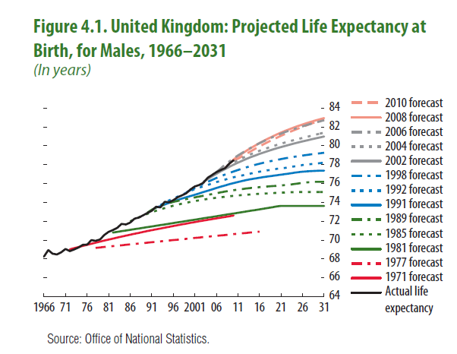
Longevity has been consistently underestimated, implying significant longevity risk
3
Notes:
Longevity has been consistently underestimated, and this underestimation is widespread across countries.
The systematic errors arise from the assumption that currently observed rates of longevity improvement would slow down .
In reality, they have not slowed down, thanks to better preventative health care and early cancer detection, and advances in treatments for cardio vascular disease .

Slide 5
Life curves and the shape of longevity improvements
(rectangularization versus expansion)
Notes:
The way that life curves reshape can be visualized with so-called life curves, which track (and project) the proportion of a population that remains alive at various ages.
The way that they reshape can have an important effect on discounted PVs of life annuity type liabilities such as pensions and social security.
For example, rectangularization can have a more significant effect on discounted annuity values than an otherwise identical expansionary increase in longevity, because it front-loads longevity increases.

Slide 6
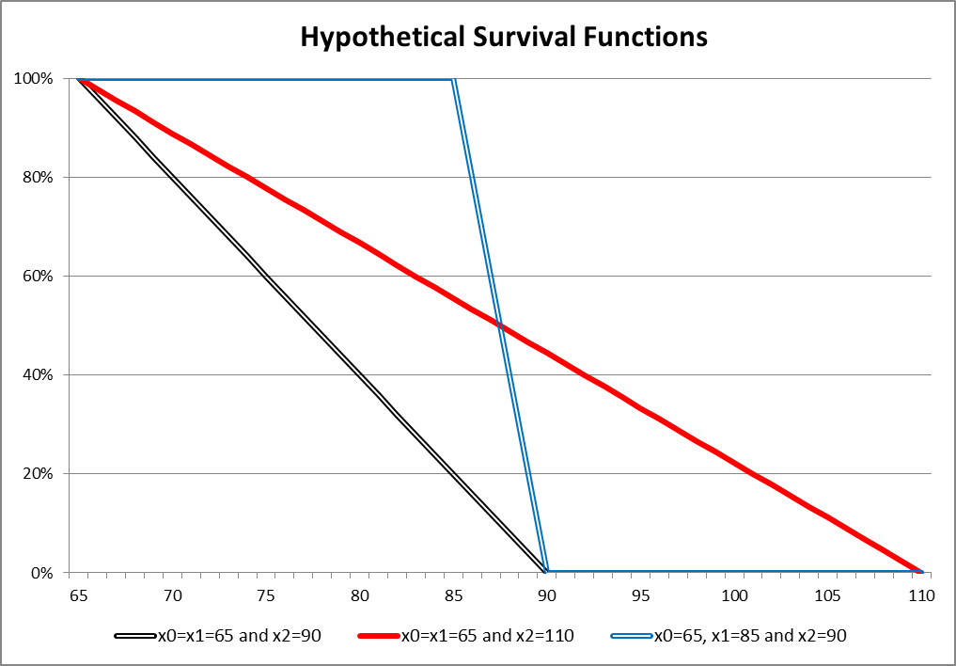
Simple example: Same life extension (10 years) but PV increases very different (+57.2% v +40.4%)
Notes:
The figure shows a simplified life curve at a given point in time, showing the number of survivors (vertical axis) versus age (horizontal axis).
The time at which mortality sets in is at x0 years (65 years) and a linear trajectory starts out with a maximum age (x2) of 90 years.
Two longevity shocks are examined, both of which increase the expected lifespan by 10 years (from 12.5 to 22.5 years). A 5% discount rate is assumed:
A linear trajectory from 65 years to a new maximum age of 110 (“expansion”) which increases the annuity PV by 40.4% (8.58 to 12.05).
Mortality onset (x1) is delayed by 20 years (from 65 to 85 years) after which there is a linear trajectory to the same 90 year maximum age (“rectangularization”). In this case, the annuity value is higher by 57.2% (13.49).

Slide 7


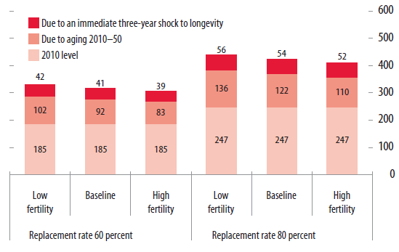
On a global scale, longevity risk is large
4
Notes:
Here the financial burden associated with an aging society is measured by estimating the cost of providing all individuals aged 65 and older with an average income necessary to keep their standard of living at its preretirement level.
That income, measured as a percentage of the average preretirement income, is called the “replacement rate.” A reasonable replacement rate may differ across countries, but the literature generally puts it in the range of 60% to 80%.
The 60% and 80% replacement rate range is coupled with UN demographic trend estimates to show that the aggregate expenses of the elderly will roughly double over the period 2010–50 in a sample of 27 advanced economies.
Keep in mind that the numbers reflect pension costs only and do not account for likely increases in health and long-term care costs, which will further increase the burden of aging.
[The 27 countries are Australia, Austria, Belgium, Canada, the Czech Republic, Denmark, Finland, France, Germany, Greece, Iceland, Ireland, Italy, Japan, Korea, Luxembourg, the Netherlands, New Zealand, Norway, Portugal, Slovakia, Slovenia, Spain, Sweden, Switzerland, the United Kingdom, and the United States.]

Slide 8
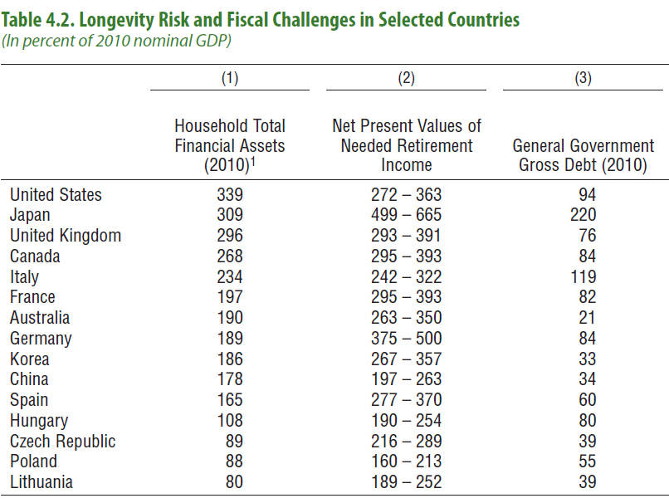
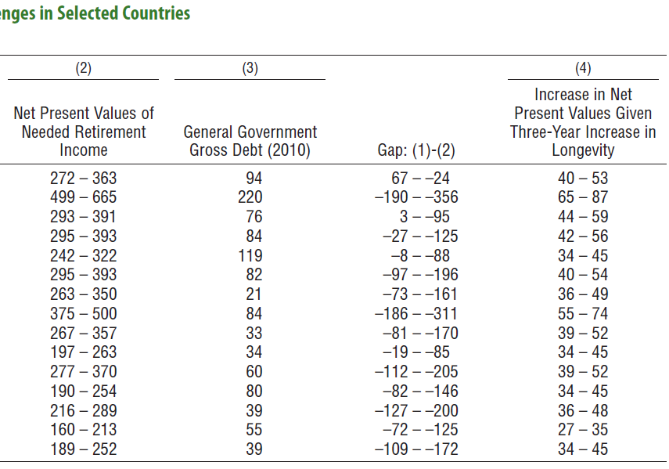
The private sector is under-saving for retirement even before considering longevity improvements
8
Notes:
This framework is then applied to a number of advanced and emerging market economies.
In many countries, the private sector does not appear to have sufficient financial assets to deal with aging-related costs, let alone with longevity risk.
In most countries, the estimated PV of required retirement income [column (2)] exceeds household total financial assets [column (1)].
Gaps vary among countries, perhaps reflecting the varying degrees to which individuals are counting on social security schemes and net housing wealth?

Slide 9
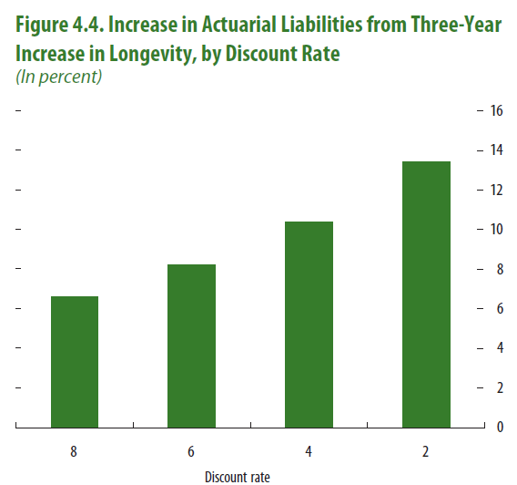
Plus lower interest rates are increasing longevity risk and pension liability present values
6
Notes:
Low interest rates exacerbate the financial impact of longevity risk. The lower the discount rate, the higher the PV of the liabilities and the cost of longevity shocks.
A stress test framework for defined-benefit pension plans developed by Impavido (2011) indicates how the impact of longevity risk is dependent on interest rates:
With a discount rate of 6 percent, a three-year extension in average life expectancy increases liabilities by 8 percent in this example;
With a discount rate of 2 percent, the same three year shock increases liabilities by almost 14 percent.

Slide 10
Policy Recommendations
Governments are the ultimate holders of longevity risk directly via social security and health care schemes, and indirectly via backstopping private sector shortfalls
They need to recognize these exposures and take measures to reduce public balance sheet vulnerabilities
Longevity risk needs to be shared across sectors
Market-based transfer of longevity risk could help
One major reform is to link the retirement age to expected longevity, mandated or voluntary

Slide 11
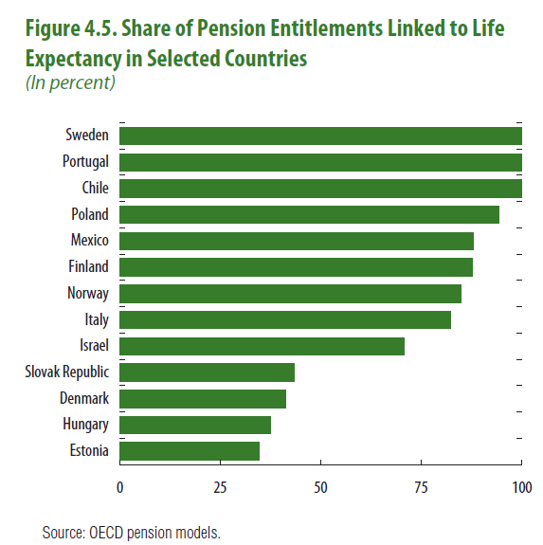
Some countries have started to link the retirement benefits and retirement ages to longevity
10
Notes:
A few governments so far have taken steps to limit their exposure to longevity risk.
Some have adjusted pension formulas to relate improvements in life expectancy to:
Benefits, or
Retirement ages.
Some governments have instituted defined-contribution plans (Chile and Sweden).
Governments could also consider increasing social security contribution rates (Canada).
Such measures effectively transfer some of the longevity risk to individuals.
Although such transfers could be an effective way to share the burden of aging and longevity risk, any measures need to be carefully designed to avoid overwhelming the retirement resources of individuals, in which case the risk would return to the government as the holder of last resort.

Slide 12
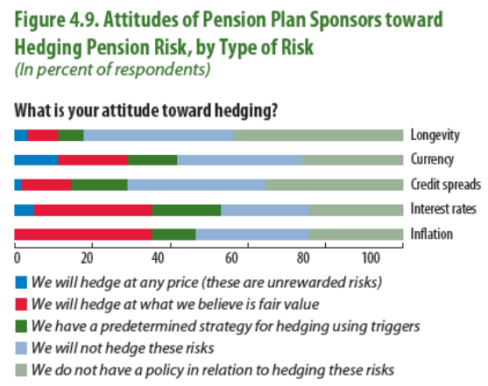

Market-based transfer of longevity risk is facing an uphill battle on the “sell” side…
11
Notes:
The use of capital market-based longevity risk management solutions has been growing, but their use remains small, with the notable exception of the swap, buy-in and buy-out markets in the United Kingdom and the Netherlands.
Explanations for the slow growth include challenges on the sell and buy sides, as well as market infrastructure issues affecting both sides of the transaction. On the “sell” side:
Few pension plan sponsors recognize longevity risk at all, and fewer still have plans to address it. Plus many plan sponsors would have to first remedy existing underfunding before transferring their longevity risk.
Longevity risk is seen as less important to hedge than other financial risks . The higher volatility of asset valuations and liability discount rates, which may mask the slower-moving effects of increases in life expectancy.
Also hindering the transfer market is a degree of moral hazard, in which pension providers may expect a government bailout if a significant longevity event threatens their financial viability.

Slide 13
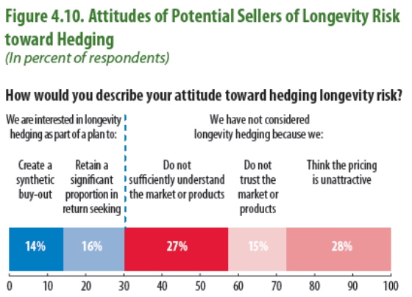
…And on the “buy” side
12
Notes:
On the buy side, obstacles include the longer terms to maturity, market illiquidity, and “lemons” problems. Given that a pension fund may have a better idea of how healthy its pension holders are likely to be, the resulting asymmetric information may create a selection bias whereby only those pension funds with the longest-living populations may want to hedge longevity risk. As the buyer of the longevity exposure has inside information that is not available to the seller, a selection bias in purchasers of longevity risk will arise.
Lack of familiarity with the market for longevity risk is another impediment. A recent survey by pension consultant Aon Hewitt suggested that potential sellers of longevity risk:
Lacked an understanding of the market,
Lacked trust in longevity products, and
Considered pricing to be unattractive.

Slide 14
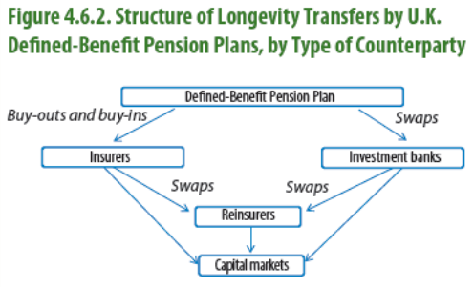
Still, some market-based transfer of longevity risk is taking place, mainly in the United Kingdom, through buy-outs, buy-ins and longevity swaps
13
Notes:
In theory, there are two main sets of capital market instruments through which longevity risk can be transferred:
Over-the-counter (OTC) bilateral contracts including pension buy-outs and buy-ins, swaps and other derivative contracts, and
Longevity bonds (but only remains a “theory”!)

Slide 15
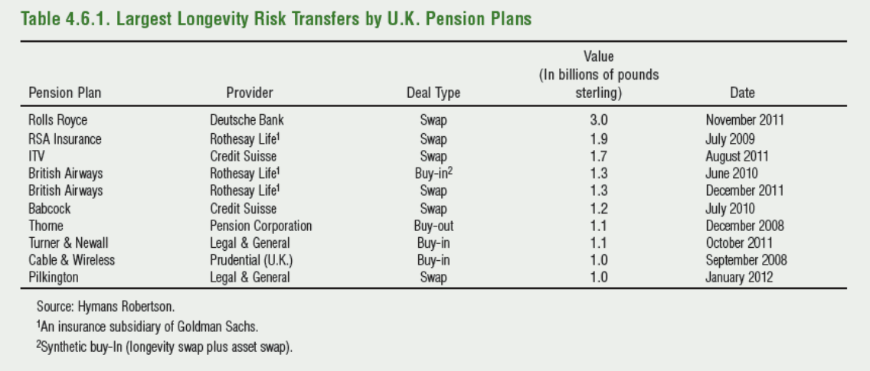
Plus a €12 billion longevity swap between Dutch insurer Aegon and Deutsche Bank in early 2012!
14
Notes:
Virtually all of such activity has occurred in the United Kingdom, where “there are many DB schemes, disclosure of pension liabilities is highly transparent and annuitization of DC schemes has been effectively compulsory” (Swiss Re, 2010).

Slide 16
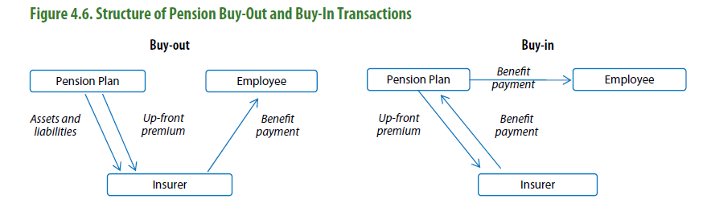
Buy-Outs transfer all the pension fund risk, but buy-ins can transfer more surgically – e.g., only longevity risk
13
Notes:
Buy-ins and buy-outs have different implications for the sponsor.
In a buy-out transaction all of the pension fund’s assets and liabilities are transferred to an insurer in return for an up-front premium. The pension liabilities and their offsetting assets are removed from the pension fund sponsor’s balance sheet and the insurer takes over full responsibility for making payments to pensioners.
In a buy-in, the sponsor pays an up-front premium to the insurer who then makes periodic payments to the pension fund sponsor equal to those made by the sponsor to its members. This “insurance policy” is held as an asset by the pension plan for which the premium is the cost of the insurance policy that guarantees payments even if retirees live longer than expected.

Slide 17
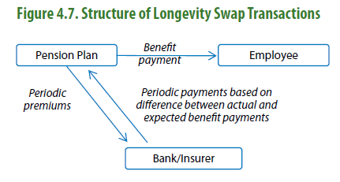
Longevity swaps are in effect synthetic buy-ins, that can also be used for “surgical” transfer…
13
Notes:
The cash flows of a longevity swap look very similar to those of a buy-in, and the sponsor still maintains full responsibility for benefit payments to its employees. However:
Instead of a single up-front payment, the plan sponsor makes periodic “premium” payments to the swap counterparty, thereby reducing counterparty risk to the pension scheme.
And the swap counterparty’s periodic payments are not equal to the full benefit payment stream, but are based on the difference between the actual and expected benefit payments.
An advantage of buy-ins and swaps is that they can be used to hedge the longevity risk associated with specific subsets of the underlying population. Longevity risk can be isolated, whereas buy-in and buy-out transactions typically also transfer the investment risk of the assets.
Longevity swaps can also be combined with other types of derivative contracts, such as inflation, interest rate and total return swaps, to create so-called “synthetic” buy-ins that do transfer all of the risks.

Slide 18
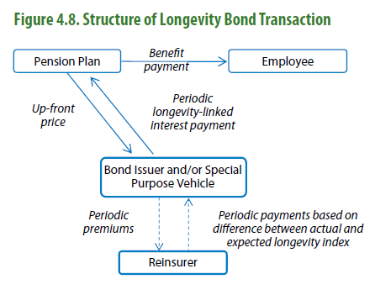
But there has yet to be a successful longevity bond transaction…
13
Notes:
The economics of a longevity bond from the pension scheme’s perspective is similar to that of a longevity index-based buy-in or longevity swap.
In the structure shown here the coupon payments to the pension scheme would depend on an index that tracks the longevity experience of a given population, so they would be proportional to the number of survivors in the population. Therefore, the bond pays more to the scheme when longevity increases.
The difference is that the issuer may be a AAA-rated government or quasi-government agency (e.g., the European Investment Bank), so that counterparty risk is minimal. Also, the issuer could be a special purpose vehicle that invests the proceeds in low risk highly liquid fixed income securities, the income from which covers the bond payouts.
Besides the counterparty risk reduction, the main supposed advantage of a longevity bond (versus a bilateral contract) is that there may be issuers who would be attracted by a potentially cheap funding option. (The idea being that pension schemes may demand a lower interest rate (versus traditional bonds) because of the longevity risk hedging benefits.) Also, the issuer could hedge away its longevity risk with longevity swap.
However, a disadvantage from the scheme’s viewpoint is that, unlike a swap, is the large up-front payment to the issuer.
To date, there has been no successful longevity bond issuance although there have been several false starts. (The EIB in 2004 and the World Bank in 2010.)
This contrasts with the much more active market for “mortality” bonds that transfer medium-term (three to five year) risk associated with catastrophic mortality events such as pandemics.

Slide 19
Life (re)insurers may be natural longevity risk buyers but their capacity is limited
For life (re)insurers longevity risk provides a partial hedge for their insurance exposure
But the hedge is not perfect because life policy cohorts are younger than the populations that pension schemes are seeking to hedge
Swiss Re’s Kortis Capital “longevity” bond is a possible prototype hedge of this basis risk
But in any case, potential (re)insurer longevity risk appetite is a small fraction of potential supply.
13
Notes:
Re-insurers and insurers exposed to life insurance risk are one class of natural longevity risk “buyers” to provide a partial hedge for their insurance exposure.
The two risks largely offset each other—life annuity liabilities increase when annuitants live longer whereas life insurance liabilities decrease.
However, reinsurer capacity to take on longevity risk may already be approaching the limit (which market participants estimate at around $15 billion per year), so a broader investment base is needed to match the large potential seller volume.
[The Kortis Capital bond resembles the longevity bond structure just described, but payouts are based on the mortality experience differential between two (index-based) male population pools – a pension-aged UK pool, and a younger US pool.]

Slide 20
Developing a broader longevity risk investor base
Some asset managers may be attracted by low correlations with traditional assets
But hedge funds may be put off by long durations
Investors prefer standardized contracts and indices
But sellers want to minimize basis risk
Insufficiently granular high frequency mortality data
Governments can help on the data front
13
Notes:
Investors should be attracted to longevity risk-based instruments because their performance is largely uncorrelated with other risk factors in their portfolios.
But the long maturities and illiquidity is a drawback, as is the absence of a defined “event” as one has in extreme mortality- and catastrophe-based instruments.
Contract standardization and the use of indices (e.g., Deutsche Bourse’s XPect and the LLMA’s Lifemetrics indices) would help. This would help liquidity and reduce information asymmetries.
But the use of indices this leaves hedgers exposed to basis risk between actual population pools. On the other hand, recent research has proposed index-based hedge methodologies to reduce such basis risk to acceptably low levels (Coughlan and others, 2011 and Li and Hardy, 2011).
However, both sides of the market would benefit from more reliable, granular and more frequently updated information about longevity developments. Life tables are not updated frequently and are only available for relatively aggregated groups in the population. Sophisticated longevity risk management and transfer would benefit from much more disaggregated demographic data (including, for example, by postal code and cause of death), which can reduce basis risk; indexes of such data would facilitate the design and trading of longevity risk transfer instruments.

Slide 21
Summary
Why worry about longevity risk now?
As with other pension issues, the longer you wait, the more difficult the solutions become
Also, markets could respond to vulnerabilities
The good news is that if tackled now, effective measures could avoid hardship and disruption
Much more difficult measures would be needed in the future

Slide 22
References
IMF, 2012, “The Financial Impact of Longevity Risk,” Chapter 4 in Global Financial Stability Report, World Economic and Financial Surveys (Washington, April).
IMF, 2011, “The Challenge of Public Pension Reform in Advanced and Emerging Economies,” IMF Policy Paper (Washington, December).
Impavido, Gregorio, 2011, “Stress Tests for Defined Benefit Pension Plans: A Primer,” IMF Working Paper 11/29 (Washington, International Monetary Fund).

Slide 23
Global Financial Stability Report
International Monetary Fund
Monetary and Capital Markets Department

