Slide 1
Taking safety and quality to the next level: The need for trans disciplinary research
Peter Pronovost, MD, PhD, FCCM
Johns Hopkins University

Slide 2
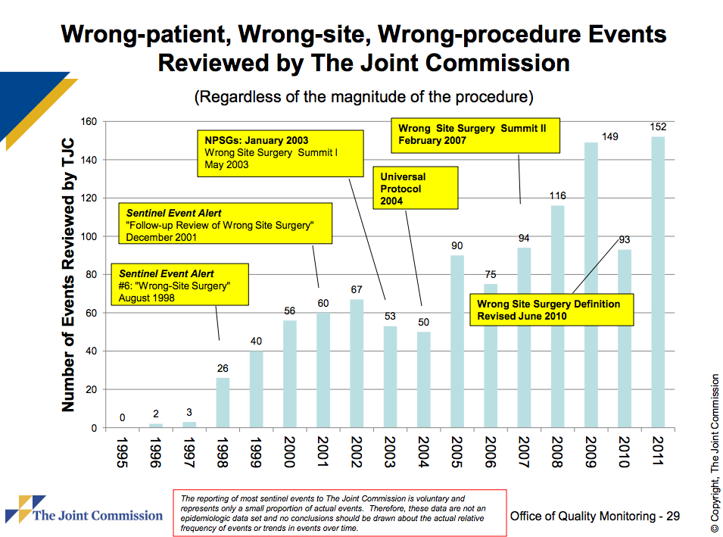

Slide 4
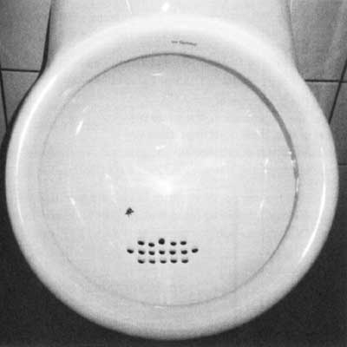
Focus and Execute

Slide 5
Social Movements: The Wave, Civil Rights, Saddleback Church
Small group with tight social bonds
Large number of groups with weak bonds
Simple Rules
Feedback
How: Dov Seidman
The power of habit: Charles Duhigg

Slide 6
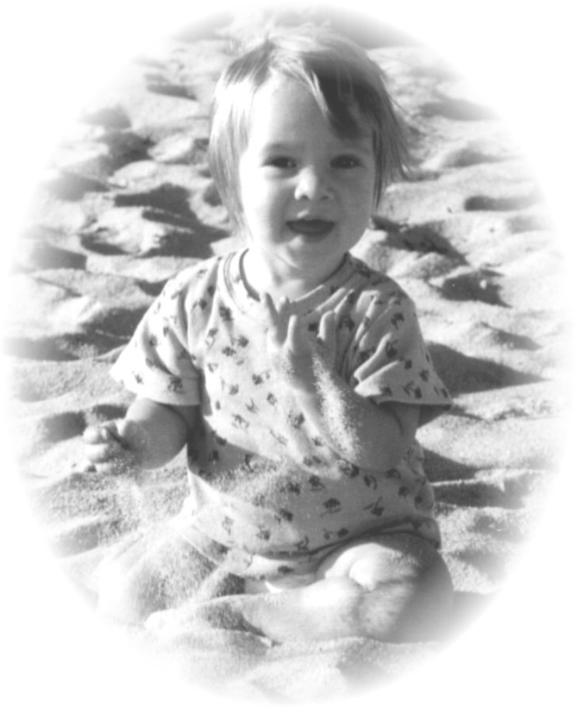

Slide 7
CLA-BSI Rate for All ICUS at JHH: 1998 - Q2 2012

Slide 8
CLA-BSI Rate for all Michigan ICUs 2004-2012 Pronovost NEJM 2006, Pronovost BMJ 2010

Slide 9
Impact of Statewide Quality Improvement Initiative on Hospital Mortality
Lipitz: BMJ 2011

Slide 10
Michigan ICU Safety Climate Improvement CCM 2011
CCM 2011
* “Needs Improvement” - Safety Climate Score <60%
Notes:
10

Slide 11
CLA-BSI Rates from 1100 Hospitals across 44 states 2008 -2012
40% reduction

Slide 12
Theories: CUSP local problems TRIP common harms
CUSP
Translating Evidence Into Practice (TRiP)
Educate staff on science of safety
Identify defects
Assign executive to adopt unit
Learn from one defect per quarter
Implement teamwork tools
Summarize the evidence in a checklist.
Wash your hand, clean skin with chlorhexadine, avoid femoral site, use barrier precautions, ask daily if you need the catheter
Identify local barriers to implementation
Measure performance
Ensure all patients get the evidence
Engage
Educate
Execute
Evaluate
www.hopkinsmedicine.org/
armstronginstitute

Slide 13
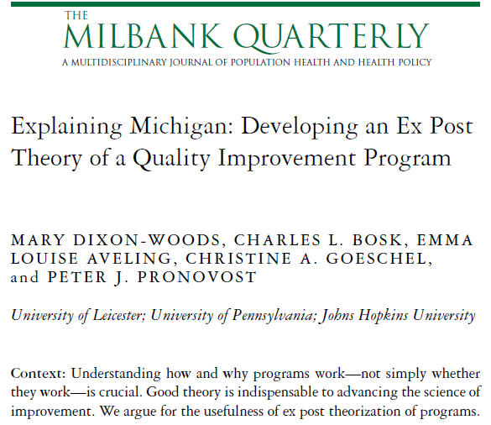
Explaining the ‘Keystone Michigan’ project
Clinical community, led by clinicians
Adaptable, evolved over time
Intrinsic motivation
peer pressure
social network
social problem capable of being solved
judicious use of harder edges
Best understood as a culture change intervention

Slide 14
Lessons
Program must be sufficiently mature prior to roll out
Program should start with the goal and work backwards, pulling as many levers as possible
Program should have goals, measures, resources, skill and accountability at each level
Program must be led by intrinsically motivated clinicians, linked in clinical communities, and modified locally
Program needs to focus on technical and adaptive work
Clinicians must believe the problem is important and they can solve it

Slide 15


Slide 16
What would it take to improve value of healthcare
SEC for healthcare
Fractal quality management infrastructure
Horizontal links
Peer to peer
Clinical communities
Vertical accountability
From heroism to safe design- eliminating all harms

Slide 17

Fractals are nearly the same at every level
of scale and create interesting opportunities
for organizational design

Slide 18
Why a Fractal Organization Model
overcomes hierarchical organizations’ innovation challenges
fosters independence and interdependence
supports innovation, learning, and accountability at every level
improves (or recognizes) common and local harms
unifies top-down with bottom-up innovation and change

Slide 19
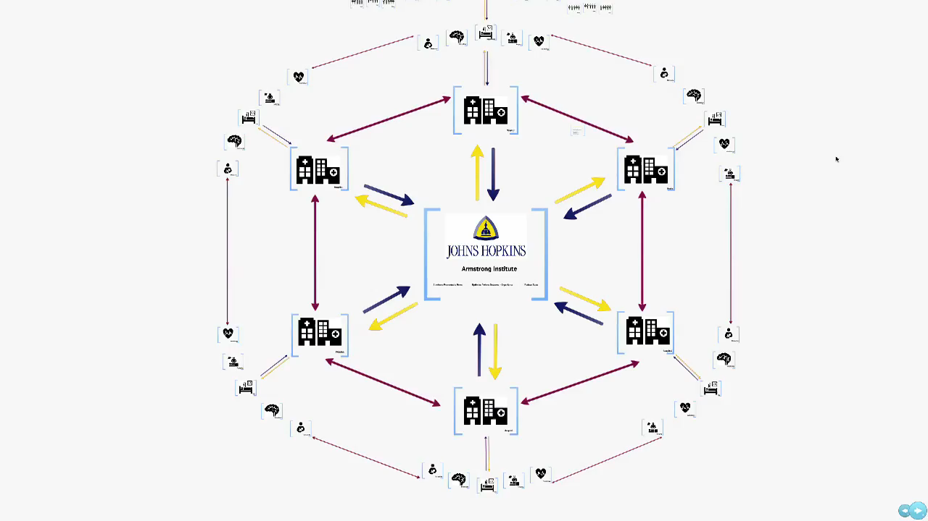

Slide 20
Creating a Fractal Quality Management Infrastructure
Goals and measures
Resources, skills, and theories
Horizontal integration for learning
Clinical communities
Peer to Peer review
Vertical integration for accountability

Slide 21
Horizontal learning Clinical Communities
Group of clinicians who partner with patients and families to eliminate preventable harm, optimize outcomes and experience, and reduce costs
Interventions done with rather than to clinicians
Supported by vertical core yet power is in horizontal links between members
Mobilize collective action, social norms, and cooperation
Encourage participatory and collaborative forms of decision making

Slide 22
Horizontal Learning Peer to Peer Review Getting to 0 CLABSi
CEO commits to 0
ICU leaders accountable, know rates, commit to 0
ICU makes it easy to comply with checklist
ICU empowers nurses to ensure compliance
ICU reviews every infection as a defect
ICU standardizes, audits, and improves catheter maintenance
ICU posts and discuss infection rates weeks without an infection
http://www.modernhealthcare.com/article/20110725/SUPPLEMENT/307259972/-1
Pronovost BMJQS 2012
15

Slide 23
Vertical Integration Accountability
Dual reporting
Each level meets with safety teams from lower levels
Build capacity and advance the science
Transparency
Escalating review for missed milestones

Slide 24
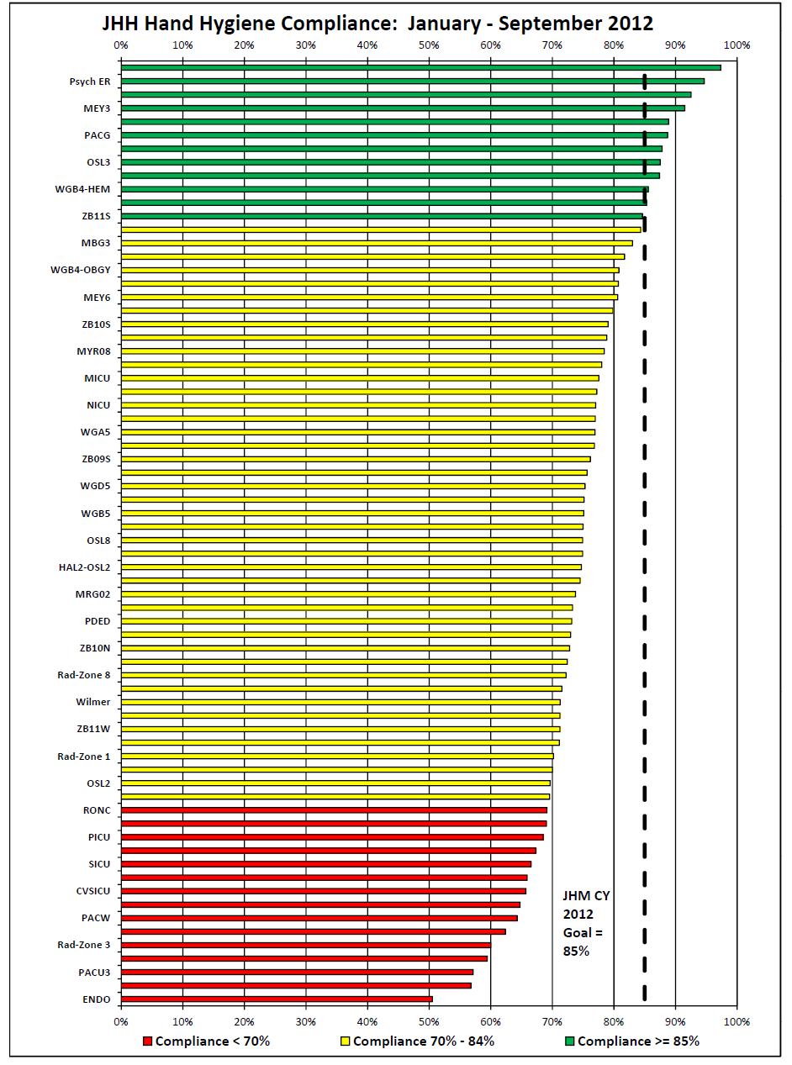

Slide 25
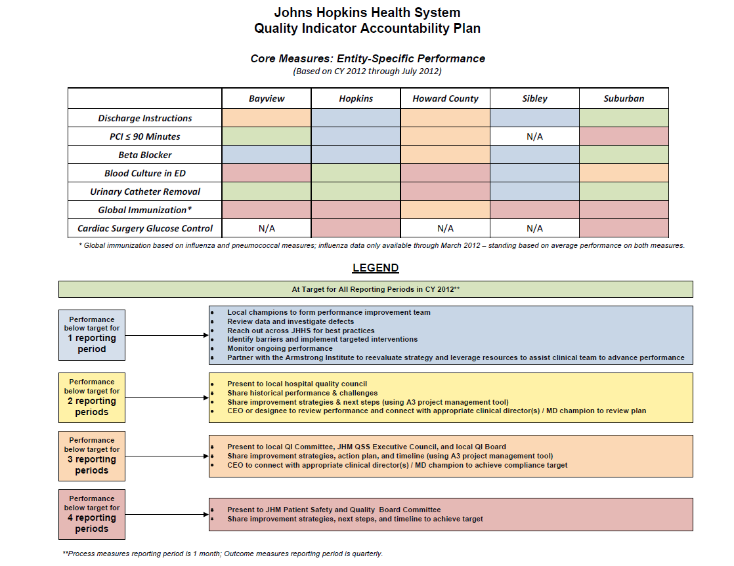
JHHS Accountability Plan: Core Measure Performance

Slide 26
From Heroism to Safe Design: eliminating all harms
Partner with patients, their families and others to
Eliminate preventable harm
Optimize patient outcomes and experience
Reduce waste

Slide 27
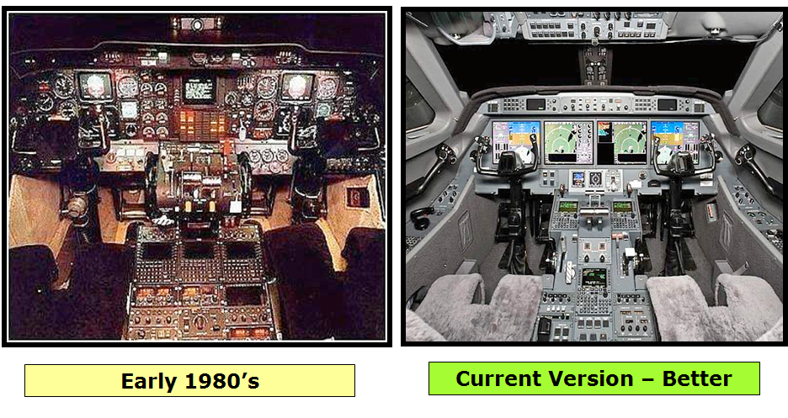
AIRPLANES

Slide 28
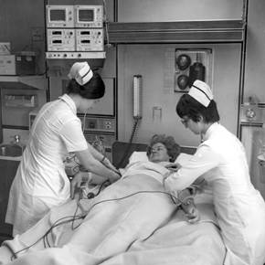
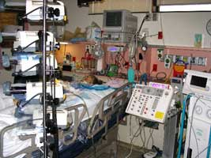
Hospitals in general, and especially ICUs
Current Version – Worse
Early 1980’s

Slide 29
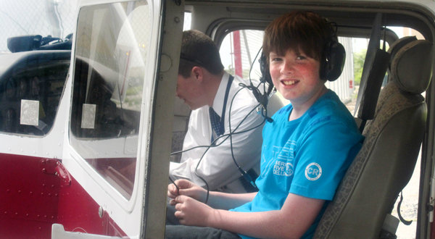
Rory Staunton 12 years old
“the most profound 12 year old I had ever met”
- Kevin Burgoyne, debate coach

Slide 30
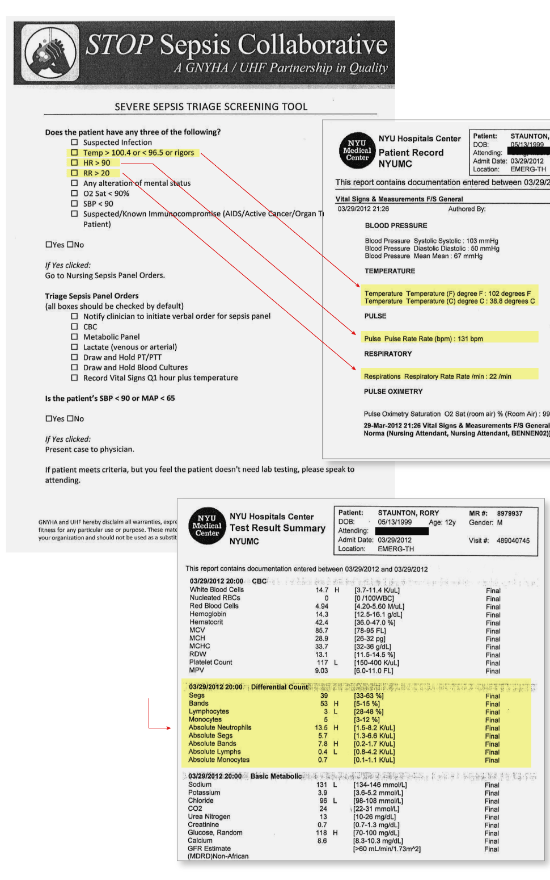

Slide 31

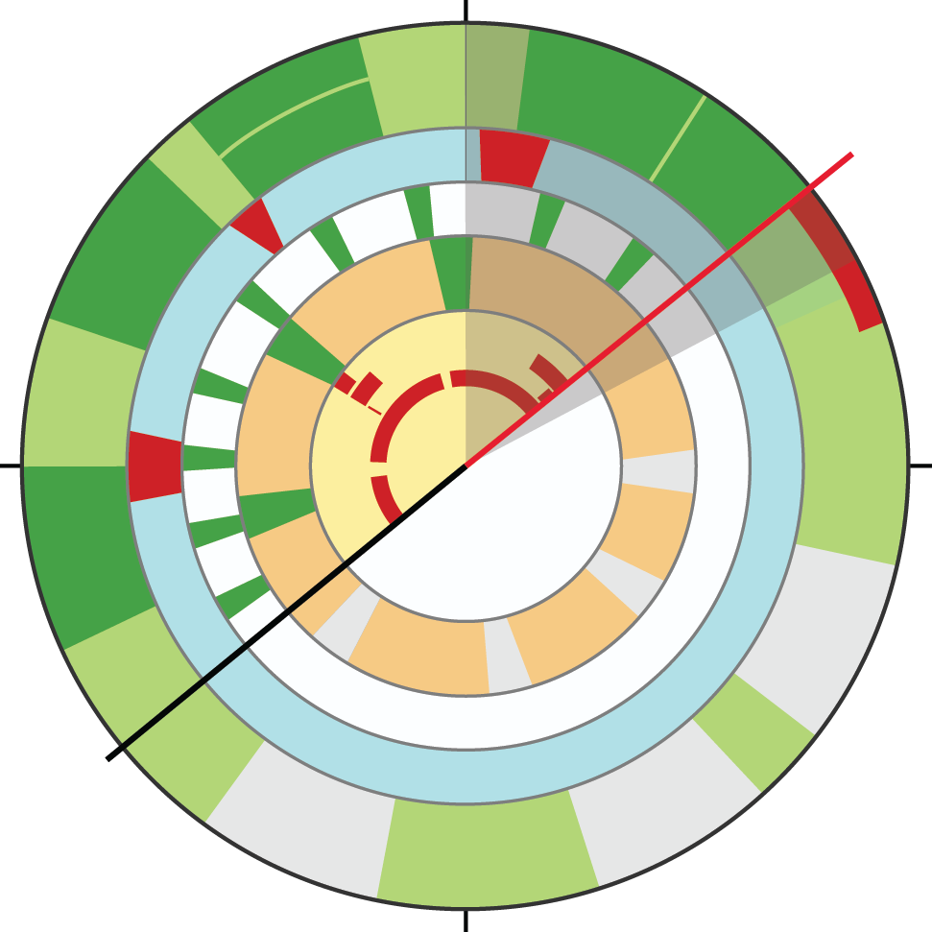
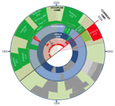
DAY 1
DAY 2
DAY 3
DAY 4
LOS DAY 4
DRUG ADMIN
Drug Administrations from the prior day
0000
Cursor slaved to start/end time on horizontal plot drill down
BED #: _____
NAME: _____
AGE: _____
WT (lbs, Kg) _____
Antibiotic
XYZ
DRUG/FLUID
ADMIN
Antibiotic
XYZ
CURRENT
TIME
0330
Annotations:_______________________________________________________________________________________________
BP Drug ABC
ACVITITY
ALLERGIES:
_____________
(2) _____________
BP Drug
ABC
NURSING
INTERACTIONS
ADD…
BP Drug
XYZ
BP Drug XYZ
BP Drug
ABC
Near term task: start BP Drug XYZ infusion
EXERCISE
BP Drug XYZ
Periods of exercise
BP
VITALS
HR
Sp0₂
Temp
BP Drug ABC continues
1800
0600
Activity monitor detects excessive movement in the bed
Future exercise windows prescribed
Antibiotic
XYZ
Additional information for this patient or Second Patient’s information
Configure what appears on the clock
DRUG ADMIN
EMAR
RADIOLOGY
ANGLE HOB
VITALS
MEDICAL SYSTEMS
TIME ON VENTILATOR
AMBULATION
AGITATION
Periodic nursing interactions – see horizontal plots for drill down re specifics
Future drug administrations planned for this patient
1200

Slide 33
Selected References
Berenholtz SM, Pronovost PJ, Lipsett PA, Hobson D, Earsing K, Farley, JE, Milanovich S, Garrett-Mayer E, Winters BD, Rubin HR, Dorman T, Perl TM. Eliminating catheter-related bloodstream infections in the intensive care unit. Crit Care Med 2004;32:2014-2020.
Pronovost PJ, Goeschel CA, Colantuoni E, Watson S, Lubomski LH, Berenholtz SM, Thompson DA, Sinopoli D, Cosgrove S, Sexton JB, Marsteller JA, Hyzy RC, Welsh R, Posa P, Schumacher K, Needham D. Sustaining reductions in catheter related bloodstream infections in Michigan intensive care units: Observational study. British Med J 2010;340:c309.
DePalo VA, McNicoll L, Cornell M, Rocha JM, Adams L, Pronovost PJ. The Rhode Island ICU Collaborative: A model for reducing central line-associated bloodstream infection and ventilator-associated pneumonia statewide. Qual Saf Health Care 2010;19:555-561.
Berenholtz SM, Pham JC, Thompson DA, Needham DM, Lubomski LH, Hyzy RC, Welsh R, Cosgrove SE, Sexton JB, Colantuoni E, Watson S, Goeschel CA, Pronovost PJ. An intervention to reduce ventilator-associated pneumonia in the ICU: Collaborative cohort study. Infect Control Hosp Epidemiol 2011, in press.
Sexton JB, Berenholtz SM, Goeschel CA, Watson S, Holzmueller CG, Thompson DA, Hyzy RC, Marsteller JA, Schumacher K, Pronovost PJ. Assessing and improving safety climate in a large cohort of intensive care units. Crit Care Med Feb 2011.
Lipitz-Snyderman A, Steinwachs D, Needham DM, Colantuoni E, Morlock LL, Pronovost PJ. Impact of a statewide intensive care unit quality improvement initiative on hospital mortality and length of stay: Retrospective comparative analysis. Brit Med J 2011;342:d219.
Pronovost, PJ, Marsteller JA, Goeschell CA. Preventing Bloodstream Infections: A Measurable National Success Story: Health Affairs 2011;20:628-634
Dixon-Woods, M, Bosk, C, Goeschel CA, Pronovost PJ. Explaining Michigan: Milbank Quarterly 2011

