Slide 1
Mendelian Randomization: Genes as Instrumental Variables
David Evans

Slide 2
CHD risk according to duration of current Vitamin E
supplement use compared to no use
RR
Rimm et al NEJM 1993; 328: 1450-6

Slide 3
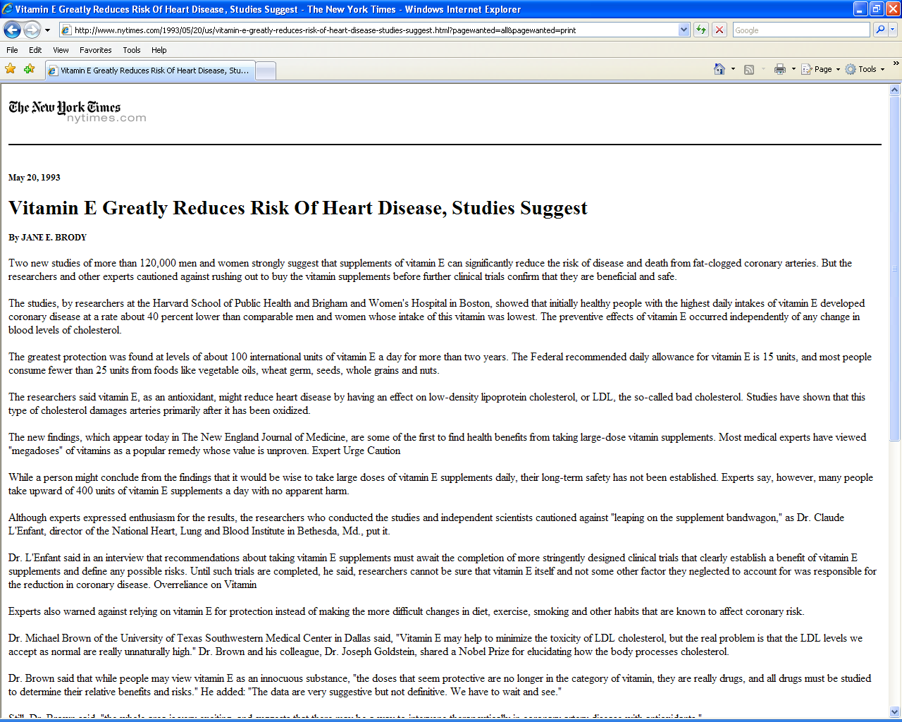

Slide 5
Use of vitamin supplements by US adults, 1987-2000
Percent
Source: Millen AE, Journal of American Dietetic Assoc 2004;104:942-950

Slide 6
Vitamin E levels and risk factors: Women’s Heart Health Study
Childhood SES
Manual social class
No car access
State pension only
Smoker
Daily alcohol
Exercise
Low fat diet
Obese
Height
Leg length
Lawlor et al, Lancet 2004

Slide 7
Vitamin E supplement use and risk of Coronary Heart Disease
1.0
Stampfer et al NEJM 1993; 328: 144-9; Rimm et al NEJM 1993; 328: 1450-6; Eidelman et al Arch Intern Med 2004; 164:1552-6

Slide 8
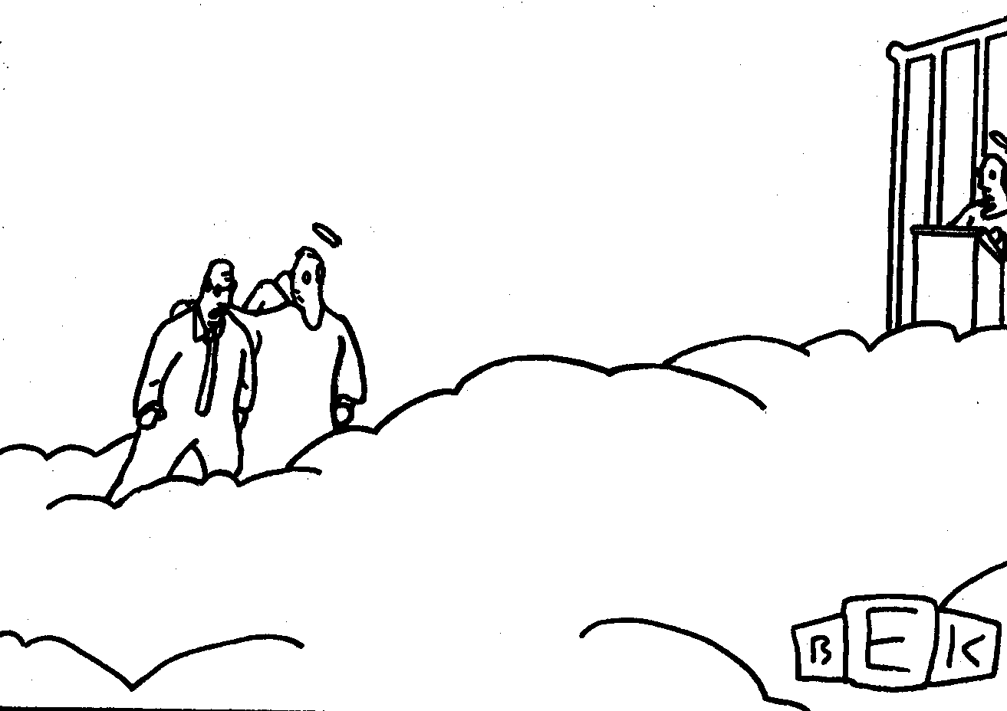
“Well, so much for antioxidants.”

Slide 9
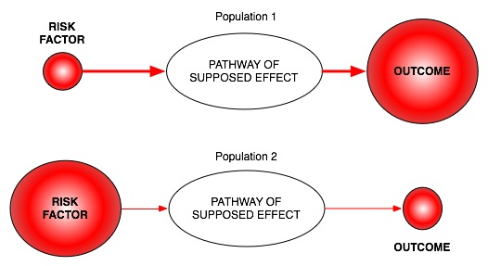
Classic limitations to “observational” science
Confounding
Reverse Causation
Bias

Slide 10
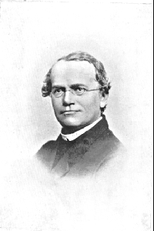
An Alternative to RCTs: Mendelian randomization
In genetic association studies the laws
of Mendelian genetics imply that
comparison of groups of individuals
defined by genotype should only differ
with respect to the locus under study
(and closely related loci in linkage
disequilibrium with the locus under study)
Genotypes can proxy for some modifiable
risk factors, and there should
be no confounding of genotype by
behavioural, socioeconomic or
physiological factors (excepting those
influenced by alleles at closely proximate
loci or due to population stratification)
Mendel in 1862

Slide 11
Mendelian randomisation and RCTs
MENDELIAN RANDOMISATION
RANDOMISED CONTROLLED TRIAL
RANDOM SEGREGATION OF ALLELES
RANDOMISATION METHOD
EXPOSED: FUNCTIONAL ALLELLES
CONTROL: NULL ALLELLES
EXPOSED:
INTERVENTION
CONTROL:
NO INTERVENTION
CONFOUNDERS EQUAL BETWEEN GROUPS
CONFOUNDERS EQUAL BETWEEN GROUPS
OUTCOMES COMPARED BETWEEN GROUPS
OUTCOMES COMPARED BETWEEN GROUPS

Slide 12
Assumptions of Mendelian randomisation analysis
U
Z
X
Y
Z associated with X
Z is independent of U
Z is independent of Y given U and X

Slide 13
Examples – using instruments for adiposity
U
Adiposity
Z
X
Y
FTO

Slide 14
Examples – using instruments for adiposity
U
Adiposity
Traits of metabolism
CRP/BMI
FTO

Slide 15
Do intermediate metabolic traits differ as one would expect
given a FTO-BMI effect?
Given the per allele FTO effect of ~0.1SD and known observational
Estimates one can derive an expected, per allele, effect on intermediates…
Phenotype | Expected Change | Observed Change | Observed Change (BMI adjusted)
Fasting insulin | 0.038 (0.033, 0.043) | 0.039 (0.013,0.064) | -0.005 (-0.027, 0.018)
Fasting Glucose | 0.018 (0.014, 0.021) | 0.024 (0.001, 0.048) | 0.006 (-0.017, 0.029)
Fasting HDL | -0.026 (-0.029, -0.023) | -0.032 (-0.057, -0.008) | -0.004 (-0.027, 0.019)
…
N~12,000 samples of European ancestry

Slide 16
Examples – using instruments for adiposity
U
Adiposity
Traits of metabolism
CRP/BMI
FTO

Slide 17
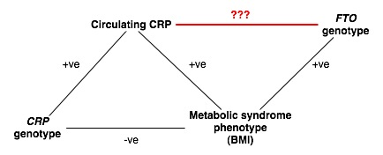
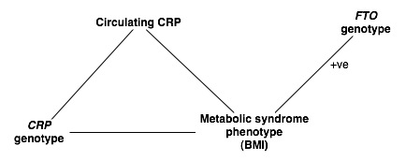
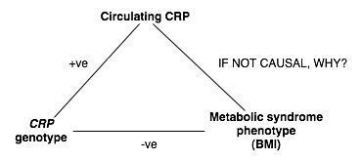
BMI/CRP & reverse causality?
What is driving the CRP/CHD risk factor association?
Relationship between circulating CRP and BMI
Have seen the relationships between circulating CRP and T2D risk profile components
With available adiposity proxy measures (I.e. FTO genotype), are we able to offer more to explain the LACK of apparent CRP > CHD risk causality… I.e.

Slide 18
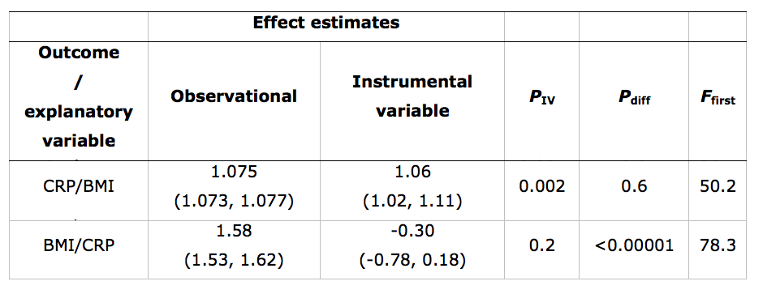
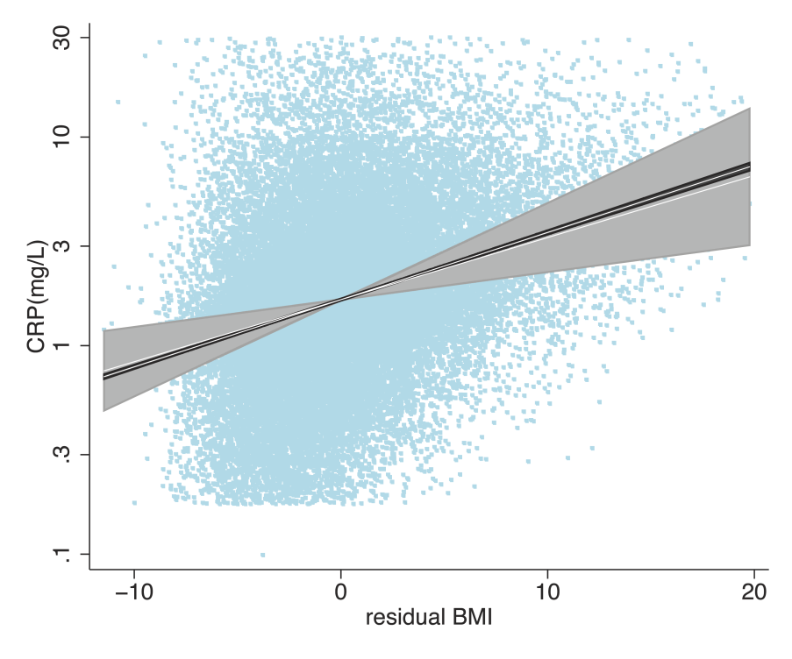
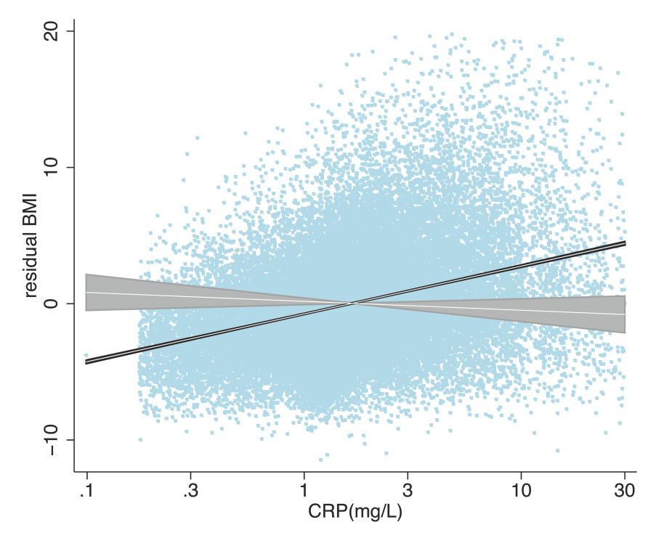

Slide 19
Limitations to Mendelian randomisation
1- Heterogeneity
- Genetic heterogenetity through linkage disequilibrium
or by pleiotrophy.
- Phenotypic heterogeneity & complexity (e.g. EC-SOD).
- Population genetic heterogeneity in instrument choice.
2- Population stratification
3- Canalisation
4- Power*
5- The existence of instruments*
C. Waddington, 1957
‘the cell can take specific permitted
trajectories, leading to different cell fates’
Notes:
-Also may not have a variant in the first place!!!

Slide 20
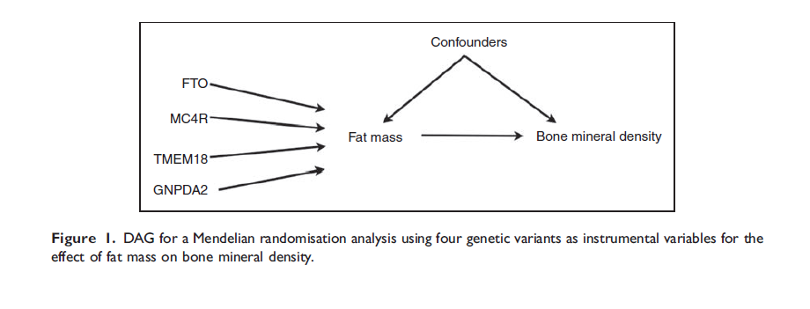
Using Multiple Genetic Variants as Instruments
Palmer et al (2011) Stat Method Res

Slide 21
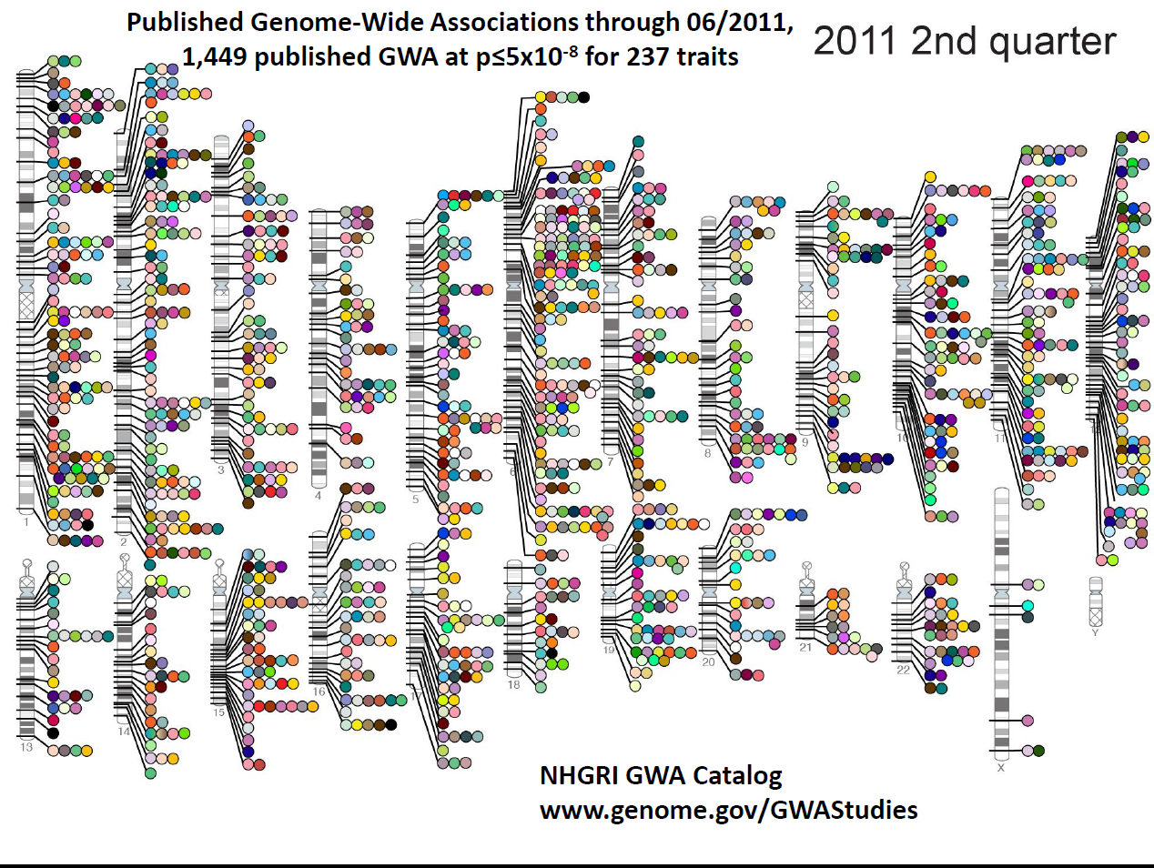

Slide 22
Common Variants Underlying Modifiable Exposures Discovered So Far...
BMI ~ 32
Smoking ~ 5
Alcohol ~ 3
Educational attainment ?
Political Preference ?
Well being ?

Slide 23
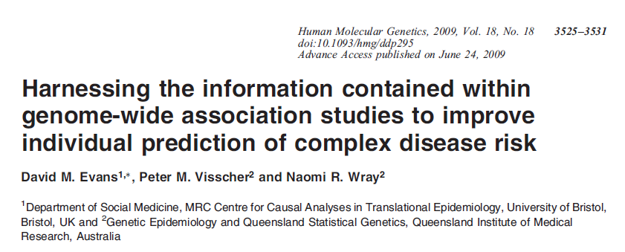
Genome-wide Allelic Scores

Slide 24
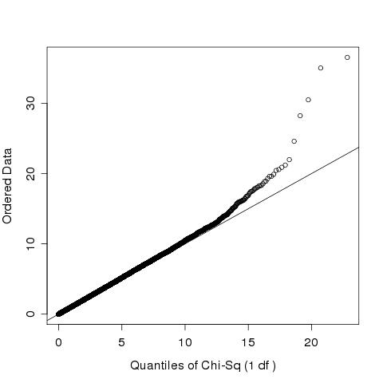
Genome-wide Allelic Scores?

Slide 25
Can Genome-wide Allelic Scores Be Used for MR?
Potentially increase instrument strength
Can use even without explicit knowledge of the variants involved... (!)
Using BMI and BMD as an example...

Slide 26
Bi-directional Genome-wide Mendelian Randomization
BMI
Variants
BMI
BMD
BMD
Variants
BMD
BMI

Slide 27
Scores for BMI

Slide 28
Scores for BMI

Slide 29
Scores for BMD

Slide 30
Scores for BMD

Slide 31
IV Analyses

Slide 32
Proposal
BMI and Educational attainment
Smoking and Educational attainment
GIANT consortium
TAG consortium
Educational attainment (?)
Run in ALSPAC mothers

Slide 33
Thanks …
Nic Timpson
George Davey Smith
GIANT Consortium (Joel Hirschhorn)
GEFOS Consortium (Fernando Rivadeneira)

