Slide 1
Progress Report from Ongoing Initiatives:
Subjective Well-being
3rd Workshop of the Social Science Genetic Association Consortium, May 19th 2012, Reykjavik

Slide 2
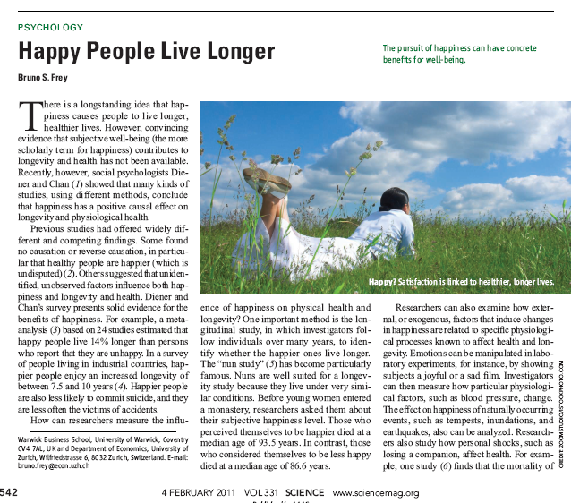

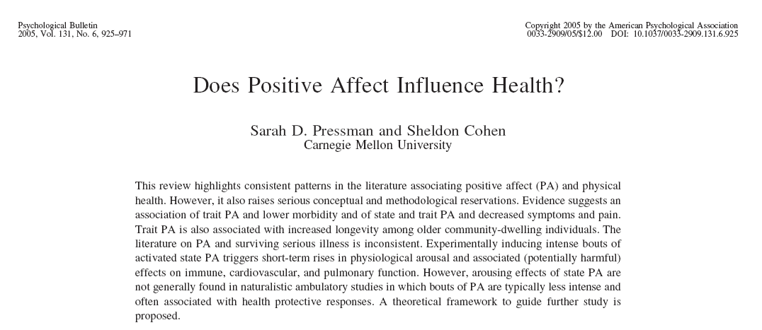
3rd Workshop of the Social Science Genetic Association Consortium, May 19th 2012, Reykjavik

Slide 3

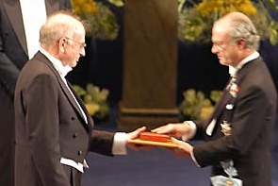

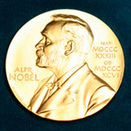
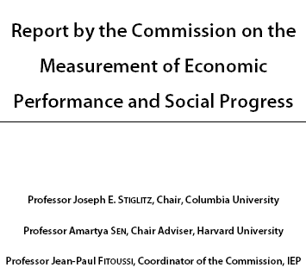


2002
1972, King of Bhutan
2008: “A great revolution is waiting for us”
2010: "It's time we admitted that there's more to life than money, and it's time we focused not just on GDP, but on GWB - general well-being”.
3rd Workshop of the Social Science Genetic Association Consortium, May 19th 2012, Reykjavik

Slide 4
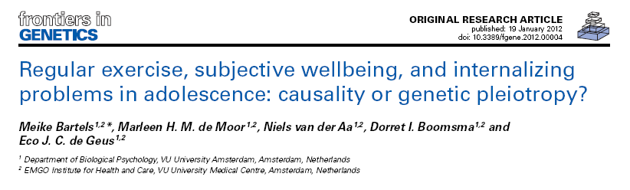
3rd Workshop of the Social Science Genetic Association Consortium, May 19th 2012, Reykjavik

Slide 5
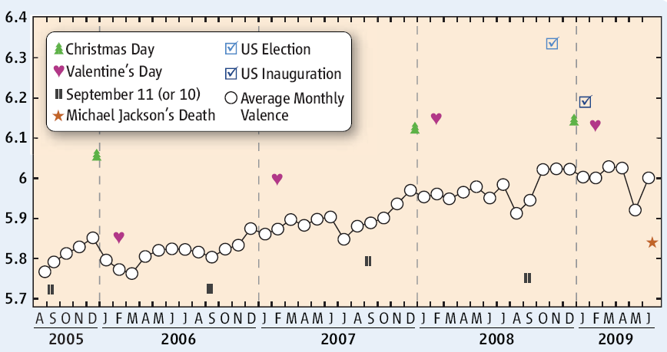
Science, Aug 2009
3rd Workshop of the Social Science Genetic Association Consortium, May 19th 2012, Reykjavik

Slide 6
How to measure Well-being?
Science January 2010
3rd Workshop of the Social Science Genetic Association Consortium, May 19th 2012, Reykjavik

Slide 7


Causes of Individual Differences

Slide 8
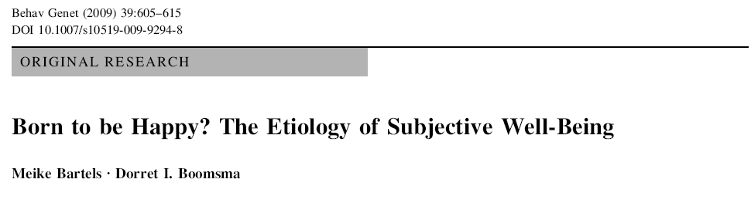

Slide 9
Different Measures
satisfaction with life, happiness, quality of life, life fulfillment
Subjective Well-being
cognitive component
satisfaction with life
(Andrews and Wilthey, 1976)
emotional component
positive affect or happiness
(Diener and Emons, 1984)
3rd Workshop of the Social Science Genetic Association Consortium, May 19th 2012, Reykjavik

Slide 10
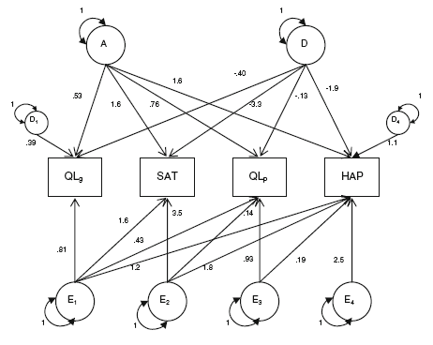
Bartels et al., 2009
3rd Workshop of the Social Science Genetic Association Consortium, May 19th 2012, Reykjavik

Slide 11
Focus of the Meta-Analysis
Pooled measure of:
Positive Affect
refers to the frequency and intensity of positive emotions
and feeling happy
Satisfaction with life
refers to a longer-term evaluation of one’s life.
Covariates: Sex, Z-score of Age, Age², first four Principal Components
3rd Workshop of the Social Science Genetic Association Consortium, May 19th 2012, Reykjavik

Slide 12
20. Nurses Health Study / Health Professionals Follow-Up Study (HPFS)
21. Ontario Health Study
22. Queensland Institute of Medical Research
23. Rotterdam Study
24. Rush Alzheimer’s Disease Center (Rush)
25. Study of Addiction: Genetics and Environment (SAGE)
26. SardiNIA / BLSA / InCHIANTI
27. Study of Health in Pomerania (SHIP)
28. Swedish Twin Registry
29. TRAILS
30. Twins Early Development Study (TEDS)
31. TwinsUK
32. Young Finns Study
33. Health and Retirement Study (HRS)
33 Cohorts with suitable data agreed to participate: >100K
1. AGES Reykjavik Study
2. ALSPAC
3. Austrian Stroke Prevention Study (ASPS)
4. CoLaus
5. Croatian cohorts
6. Dortmund Health Study
7. Erasmus Rupchen Family Study
8. Estonian Genome Center
9. Framingham Heart Study
10. Helsinki Birth Cohorts Study
11. Hunter Community Study
12. Finnish Twin Cohort
13. KORA/MONICA
14. Lifelines
15. Lothian Birth Cohorts
16. Minnesota Center for Twins and
Family Research
17. Netherlands Twin Registry (NTR)
18. Norwegian Mother and Child Cohort Study (MoBA)
19. Northern Finland Birth Cohorts (NFBC66)
3rd Workshop of the Social Science Genetic Association Consortium, May 19th 2012, Reykjavik

Slide 13
Requests:
Descriptive Sheet:
description of the phenotype, sample size
Collaboration Agreement
IP-address
to set up connection to secure server
Deadline first-pass association analyses is 16 JUNE 2012
3rd Workshop of the Social Science Genetic Association Consortium, May 19th 2012, Reykjavik

Slide 14
Questions?
Not in the list yet, but want to Participate?
Contact Info:
Meike Bartels, m.bartels@vu.nl
Niels Rietveld, nrietveld@ese.eur.nl
Jan-Emmanuel De Neve, j.deneve@ucl.ac.uk
3rd Workshop of the Social Science Genetic Association Consortium, May 19th 2012, Reykjavik

