Slide 1
Capturing international R&D trade and financing flows: what do available sources reveal about the structure of knowledge-based global production?
Conference on Research in Income and Wealth (CRIW)
9-10 March 2018, Washington DC
Fernando Galindo-Rueda, Daniel Ker
OECD Directorate for Science, Technology and Innovation
Francisco Moris, John Jankowski
National Science Foundation, NCSES
Notes:
Source side

Slide 2
Motivation
Various policy questions related to R&D globalisation – need to understand extent
New statistical guidelines, new data:
SNA, OECD IPP Handbook: R&D in capital formation
BPM6, MSITS: new detail on R&D services + IP charges
Frascati Manual: includes new chapter on R&D globalisation
First analysis bringing the revised sources together to look at R&D globalisation
Explore and compare the information available
Examine their measurement frameworks to identify (in)compatibility
Identify areas for further investigation and improvement
Focus on business R&D
Notes:
Businesses do around 70% of OECD R&D
MNEs are businesses

Slide 3
R&D is subject to globalising forces
Evolution of R&D GFCF as ratio to R&D performance, 1995-2015
Ratio as % in log scale
While there are some differences between SNA and Frascati Manual frameworks….
international trade in R&D is (or should be) a key driver of differences between spending on R&D performance (output) and R&D GFCF

Slide 4
R&D globalisation is multidimensional
Fragmentation of R&D activity across global value chains, often within MNEs (link to FDI)
International R&D financing flows
International trade in R&D services, outcomes of R&D
International flows of R&D-related income

Slide 5
Economic ownership of R&D a key organising concept
R&D performers and those owning resulting outcomes not necessarily the same
Levels of ownership:
Ownership in terms of where R&D results are used (productivity analysis)
Ownership vis a vis royalty incomes, damages, capital gains
Ultimate claimant over profits from IPP
Different “indicators” of ownership:
Who funds the R&D (R&D stats)
Who owns the company doing it (MNE stats)
Who buys it (trade stats)
Notes:
Royalties may be flowing to “real” or “artificial” units

Slide 6
Capturing R&D globalisation
R&D trade in services statistics
commonly used in adjusting from R&D output to GFCF in National Accounts
Issues:
Some IPP-related flows may be subsumed in BOP income measures
Arms length principle. As with all IPPs, can be difficult to identify economic owners
R&D services trade cover transactions relating to both current and past R&D. Frascati approach covers current production of R&D only.
→ Frascati data on funding flows provide complementary information

Slide 7
Imported R&D adds to total supply, exported R&D subtracts (use in IO)
Net imports (imports minus exports) of all R&D services (SJ1), 2016
As a percentage of GDP
Source: OECD Trade in Services by Partner Country database (http://oe.cd/2dm), OECD National Accounts database (http://oe.cd/1Fb), UK Office for National Statistics
Notes:
The extremes here are consistent with the earlier chart.
In Israel, when an R&D performer is taken over by a foreign business this is treated as an export. Soli Peleg

Slide 8
Capturing R&D globalisation
R&D trade in services statistics
commonly used in adjusting from R&D output to GFCF in National Accounts
Issues:
Some IPP-related flows may be subsumed in BOP income measures
Arms length principle. As with all IPPs, can be difficult to identify economic owners
R&D services trade cover transactions relating to both current and past R&D. Frascati approach covers current production of R&D only.
→ Frascati data on funding flows provide complementary information

Slide 9
RoW R&D funding dominated by affiliates (MNEs)
Funding of Business R&D by non-resident sources, 2015
Shares of total BERD funding from abroad, 2015
Notes:
SLOVENIA SVN!

Slide 10
Same for R&D services trade stats
Affiliate and non-affiliate R&D-based trade, United States, 2016
Shares of total trade
Notes:LicIndProc: “Licensing of Industrial Processes”; considered a proxy for licenses to use R&D outcomes.
Source: Bureau of Economic Analysis. US Trade in Services, by Type of Service and by Country or Affiliation, 2017.

Slide 11
But R&D services exports much larger than Business R&D funded by RoW
R&D services exports relative to BERD funded by the RoW, 2015
R&D services exports / BERD funded by the Rest of the World, Log10 scale
Note: When multiple is 1, R&D services exports = BERD funded by the Rest of the World. Latest year for which both export and R&D expenditure data are available: data for France 2014, Sweden 2013.
Source: OECD Trade Statistics database, OECD R&D statistics database (http://oe.cs/rds).

Slide 12
Why? 1. Trade stats R&D reporting is broader than Frascati R&D
Exports of R&D Services, 2016 or latest
Total R&D services exports as a ratio to share of GDP (left scale), breakdown of total R&D exports (right scale)
Note: Absence of bars indicates that only total exports is available. Netherlands: 2015 data.
Source: OECD Trade in Services by Partner Country database (http://oe.cd/2dm), OECD National Accounts database (http://oe.cd/1Fb), UK Office for National Statistics.
Notes:
Other R&D services…testing, some activities relating to patenting in there.

Slide 13
Why?
2. R&D services trade stats are value based, whereas FM R&D funding is input cost based
→ FM is more restrictive (e.g. excludes profit margins)
3. FM funding includes unrequited R&D funds (i.e. grants/donations etc. not related to sales)
→ FM is less restrictive
FM 2015 introduces nature of funds breakdown to distinguish sales from current/capital transfers
Available data (CHE+FIN) suggest <20% of R&D funding from RoW is of transfer nature

Slide 14
Why? 4. Both affected by MNE complexity
Both affected by intra-MNE cost sharing & other arrangements
Trade stats:
Only reflect explicit sale/purchase related flows
Frascati data:
Intra-MNE R&D funding is assumed “domestic funding” unless was explicitly received for R&D
BERD performed by FCAs and BERD funded by foreign businesses
As a percentage of BERD, 2015 or latest

Slide 15
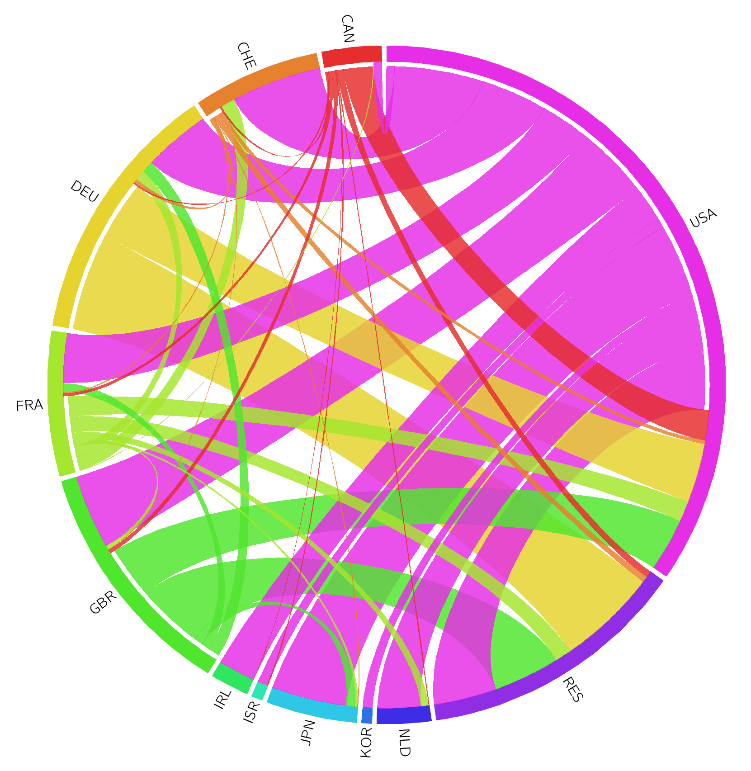
Useful further information is possible
FCAs’ R&D expenditure by country of FCA majority owner
Ribbon colour indicates FCA location (country of R&D performance)
R&D performed in USA by subsidiaries of German MNEs
Identify MNEs
Identify location of ultimate owner (e.g. from info held in business register)
→ Disclosure can be managed
R&D performed in DEU by subsidiaries of US MNEs
DEU net exports of R&D $10bn;
R&D GFCF < R&D output
FCAs in DEU R&D: $16.9bn
DEU FCAs in ROW R&D: $14.1bn
Suggests positive net income flows
→ raise GNI relative to GDP
“residual countries”
Notes:
In the US this has been done for decades but in many OECD countries this is still not done….especially the country of ultimately owner.

Slide 16
R&D employment vs expenditures in FCAs
US majority-owned foreign affiliates R&D expenditure and personnel, 2014
Shares of economy over total affiliate values, log scale
Source: US Bureau of Economic Analysis, Activities of US Multinational Enterprises: US Parent Companies and Their Foreign Affiliates: US MNE Activities: Preliminary 2014 Statistics (https://faq.bea.gov/international/xls/usdia2014p/Part%20II%20I1-I5.xls).

Slide 17
Concordance of FCA R&D data
Business R&D performed by affiliates of US companies abroad, 2014
US and partner country data sources, Million USD PPP
Country of R&D performance | R&D performed by majority owned subsidiaries of US companies* | R&D performed by FCAs ultimately owned by US companies **
Total | 52 174
Germany | 8 344 | 6 309
United Kingdom | 6 306 | 5 669
Switzerland | 4 140 | 396
Canada | 3 418 | 3 216
France | 2 395 | 2 216
Reporting source | United States | Partner country
Note: Germany, Switzerland: 2015 data.
Source: * US Bureau of Economic Analysis, Activities of US Multinational Enterprises: US Parent Companies and Their Foreign Affiliates: US MNE Activities: Preliminary 2014 Statistics (https://faq.bea.gov/international/xls/usdia2014p/Part%20II%20I1-I5.xls) **UK Office for National Statistics, Stifterverband Germany, Statistics Canada, Federal Statistical Office Switzerland.
Varying degrees of concordance between what US parent companies say their subsidiaries have spent on R&D vs what the subsidiaries report in national R&D surveys
→ systematic international comparison and investigation of differences

Slide 18
Conclusions/areas for further work
Economic ownership is a key organising concept for statistics but identifying it remains a challenge for R&D; especially wrt. MNEs
Variations in conceptual frameworks need understanding and bridging; but what are the records available to companies?
Data development needs:
Implementation of Frascati 2015 identification of nature of funding, MNE R&D; as well as R&D globalisation chapter
Microdata linking & analysis related to R&D globalisation (http://oe.cd/microberd)
Analysis of R&D globalisation can be better integrated into global innovation networks analysis → revised OECD Oslo Manual.
Administrative data on intangibles have yet to be integrated in the analysis of R&D and innovation globalisation.
Inclusion of IPPs in aggregate GVC-related measures such as extended SUTs

Slide 19
Conclusions/areas for further work
MNE activities represent the largest share of international R&D transactions
Important to understand exchanges between affiliates; parents-subsidiary links a start
Official statistics compiled at the level of MNE groups might better suit some statistical purposes
Within countries: coordinating or benchmarking data collection on MNEs, data linking across different statistical domains
Across countries: coordination between statistical agencies could help ensure a comprehensive view of R&D globalisation. Data guardianship needs managing; new tools and standards may enable this.

Slide 20
Most business R&D domestically funded
Business R&D expenditure and distribution of funding sources, 2015
Source: OECD Main Science and Technology Indicators database (http://oe.cs/msti); January 2018.

Slide 21
But RoW funding share rising
Share of BERD funded by the Rest of the World, selected countries, 2000-2015
Source: OECD Main Science and Technology Indicators database (http://oe.cs/msti); January 2018.

Slide 22
Economic ownership of R&D as key organising concept
Owners accept the risks and get the benefits associated with assets
???
Ownership for the purpose of where it is used (productivity analysis)
Where value is created
Where incomes flow to

