Slide 1
Economies of scope and relational contracts:
Exploring global value chains in the automotive industry
Susan Helper • Case Western Reserve University
Abdul Munasib • Bureau of Economic Analysis
NBER Organizational Economic Meeting
April 2021
Notes:
Very pleased to have this opportunity, and want to intro my coauthor, Abdul Munasib

Slide 2
Disclaimers
Any opinions and conclusions expressed are those of the authors and do not reflect the views of the U.S. Census Bureau, the U.S. Bureau of Economic Analysis, the U.S. Department of Commerce, or the United States government.
All results have been reviewed to ensure that no confidential information is disclosed. Any reference to named firms comes from public sources, and not from Census or BEA data. The Census Bureau DRB approval numbers are CBDRB-FY21-047 and CBDRB-FY21-CED006-0003.

Slide 3
The story of Kojima Press
Wada 1991; Wada 2020
In the late 1930s, Hamakichi Kojima, owner of a small company, made repeated multi-hour trips by train to visit Toyota, hoping for work.
  Even though “the firm had no processing technology with the precision to manufacture automobile parts”.
Eventually, his tenaciousness was rewarded with an order, for ‘sand buckets’ (for fire protection).
  Not a prestigious product, but Kojima did the best he could.
Then, Toyota ordered other parts, like washers and additional parts for a truck radiator grill.
  Toyota guided and trained manufacturers, such as Kojima, which did not have high technical capabilities.
Today, Kojima supplies a wide variety of metal and plastic parts to Toyota, from subsidiaries around the world.
Notes:
The Evolution of the Toyota Production System
Authors: Wada, Kazuo ; Springer, 2020

Slide 4
Puzzles from Kojima
Toyota offered all its suppliers a “permanent deal”, of long-term contracts and technical assistance – even for commodity parts
Toyota rewarded its suppliers with both greater volume and new products
Not a strategy that Oliver Williamson would expect
  Why give business to a firm that lacks technical capability, and pay to help them develop it?
  Why establish long-term relationships for commodity products, that have few “transaction hazards”?
  Why give new parts to an existing supplier, that does not specialize in making those parts?
Answer: think about spillovers across transactions

Slide 5
Economies of scope in supplier relations
Real products generally require more than one intermediate input
  There are spillovers across the governance of these relationships
  These spillovers increase both the clarity and the credibility of relational contracts, both within and between firms
    Example: Having all parts made by suppliers that (like Kojima) are “tenacious” in problem-solving improves Toyota’s quality
      Even if the search for a problem’s root cause leads to a simple part, Toyota can be confident that its supplier will be willing and able to solve it.
      Clarifying “tenacity” requires a per-supplier investment
      Toyota amortizes this investment by having few suppliers per part, for a long time, that make a variety of parts
Because of these spillovers, Toyota tends to use a firm-wide strategy for governance
  Collaborative governance with all suppliers, even of commodities
Notes:
Investment: Toyota incurs start-up cost (largely fixed) of organizing supplier associations so suppliers can learn Toyota’s techniques for set-up, quality control, etc. and a per-supplier cost (eg, of sending engineers to the supplier’s plant).

Slide 6
Contrast with transaction cost analysis
Most economic theories look at one transaction at a time
  Focus on attributes of individual inputs; assume all firms govern the same transactions the same way
      Use spot market for commodities, long-term for high-R&D (Williamson; Grossman-Hart-Moore; Antras-Chor)
US vehicle manufacturers look like they’ve read Williamson!
  Chrysler buys stampings from Die-matic
    Just one of many suppliers because commodity product
    No expectation of continued business
  Chrysler buys an innovative crankshaft from Mahle
    Sole source, long relationship, collaborative design because R&D-intensive product
  Still, there are spillovers across relationships
    Purchasing organized to minimize switching costs

Slide 7
Contribution
We offer new insights into the development of relational contracts by considering several transactions at once
Lead firms and suppliers experience economies of scope in developing clear and credible relational contracts
  Because of these spillovers across relationships, firms and nations have distinct and stable strategies for value chain governance, such as,
    number of suppliers per part
    degree of vertical integration, and
    length of relationship with suppliers
We analyze U.S. Customs microdata of all imports by vehicle manufacturers (VMs), 1997-2015
We find that
  transaction-based measures are statistically significant
  organization-based measures generally have much greater explanatory power

Slide 8
Why might a firm do only non-spot/collaborative buying?
Facilitates relational contracts
  Clarity
    What is “the Honda Way”?
    Functional build, compensation in bad state of nature
  Credibility
    Supplier associations monitor customers (Sako)
Spillovers across functions in buyer’s organization (next)
Complementarities in adoption of practices, development of capabilities
  JIT (Dyer), Learning to write good contracts (Argyres)
Some buyers may see attributes of two products as similar, even when others in same industry do not
  Toyota wants all suppliers to do both exploration and exploitation (Aoki/Wilhelm)

Slide 9
Spillovers within buyer’s organization
Purchasing strategy ↔ other functions
  Which functions should suppliers have access to?
    Collaborative: many, so can share ideas
    Arm’s-length: only purchasing, so engineers don’t design specs to limit the number of potential suppliers
  Which functions should teach to and learn from suppliers?
    Toyota: same group helps internal & external suppliers
    Honda, Nissan: purchasing helps external
    Arm’s-length: supplier development does not pay off
Who designs the product?
  Much in-house design, to facilitate apples: apples comparison
What is the career path for purchasing agents?
  Collaborative: rotate through a variety of functions
  Arm’s-length: rotate among commodities within purchasing to avoid capture by suppliers; don’t need engineering background
Notes:
Note: US VMs as well as J have organization-wide governance practices

Slide 10
Adding Economies of Scope to TCA
​We first test propositions on transaction cost analysis
  T1: Product attributes are a significant determinant of supply chain governance practices
    Product fixed effects
    R&D intensity of product category (measures uncertainty)
    Product differentiation or substitutability
    Upstreamness (Antras-Chor-Fally-Hillberry)
We then test theory that firms/nations have organization-wide (not product dependent) relational contracts
  O1: U.S. VMs are more likely to engage in spot buying compared to the Japanese, even after controlling for product attributes
  O2: Japanese VMs are more loyal to their suppliers than are U.S. vehicle manufacturers
      e.g., they are less likely to exit a relationship when the exchange rate rises in the supplier country

Slide 11
U.S. Customs data
Longitudinal Firm Trade Transactions Database (LFTTD)
  By firm, transaction-level data collected by the U.S. Customs and Border Protection
  For all VMs assembling cars and trucks in the U.S.
  Detailed 10-digit HTS categories (e.g., ‘Vulcanized gaskets’, ‘washers and other seals’, ‘Mountings, fittings and similar articles, of base metal’, etc.)
  Identifies related party transactions
Our sample
  All U.S. and Japanese VMs, annual transactions 1997-2015
    44 countries, 600 products
  All establishments within a country belonging to the same supplier
  We exclude purchases from the VM’s home countries
    Since we do not have data on purchases from U.S. suppliers, we also exclude purchases from Japan (does not affect results)

Slide 12
Empirical strategy and measures
Unit of analysis
  Pool all VMs into two broad VMs: ‘representative’ U.S.- and Japanese-owned VMs
  Use individual OEM-level imports as weights in above calculations
Outcome variables (for representative U.S. & Japanese VMs)
  Number of suppliers per component (HTS-10 product) per year
  Hirschman-Herfindahl Index of suppliers for a component per year
  Share of related party imports of a component per year
  Average number of years supplied by a supplier of a component
Representativeness
  Foreign sourcing at least 1/4 of sales for US-headquartered VMs, over 40 percent of sales for foreign-headquartered VMs
  Use of non-spot (collaborative) buying from suppliers in the U.S. is similar to those of foreign suppliers (Helper, Krueger, and Wial 2012)
Notes:
Robustness test: use individual OEM dummies instead of a single Japan dummy.
Finding: The sign and significance of the individual OEM dummies strongly support the sign and significance of the Japan dummy of regressions
How do we calculate standard errors of the avg?

Slide 13
Results: Vehicle Manufacturers
We find support for both theories
Transaction-based theory
  Product and country fixed effects significant
  Firms do less spot buying if products are R&D intensive, differentiated
Organization-based theory
  Japanese VMs have fewer suppliers per product, more integration, longer relationships
    Adding product controls does not reduce coefficients
    Effect sizes are much greater than those for TCA variables
      Japan effect is 10 times greater than that from 1 standard deviation change in R&D
  Japanese more loyal: less likely to drop supplier if exchange rate rises
  Significant variance of automaker strategy within national groups
    Corporate culture and national culture affect supplier governance

Slide 14
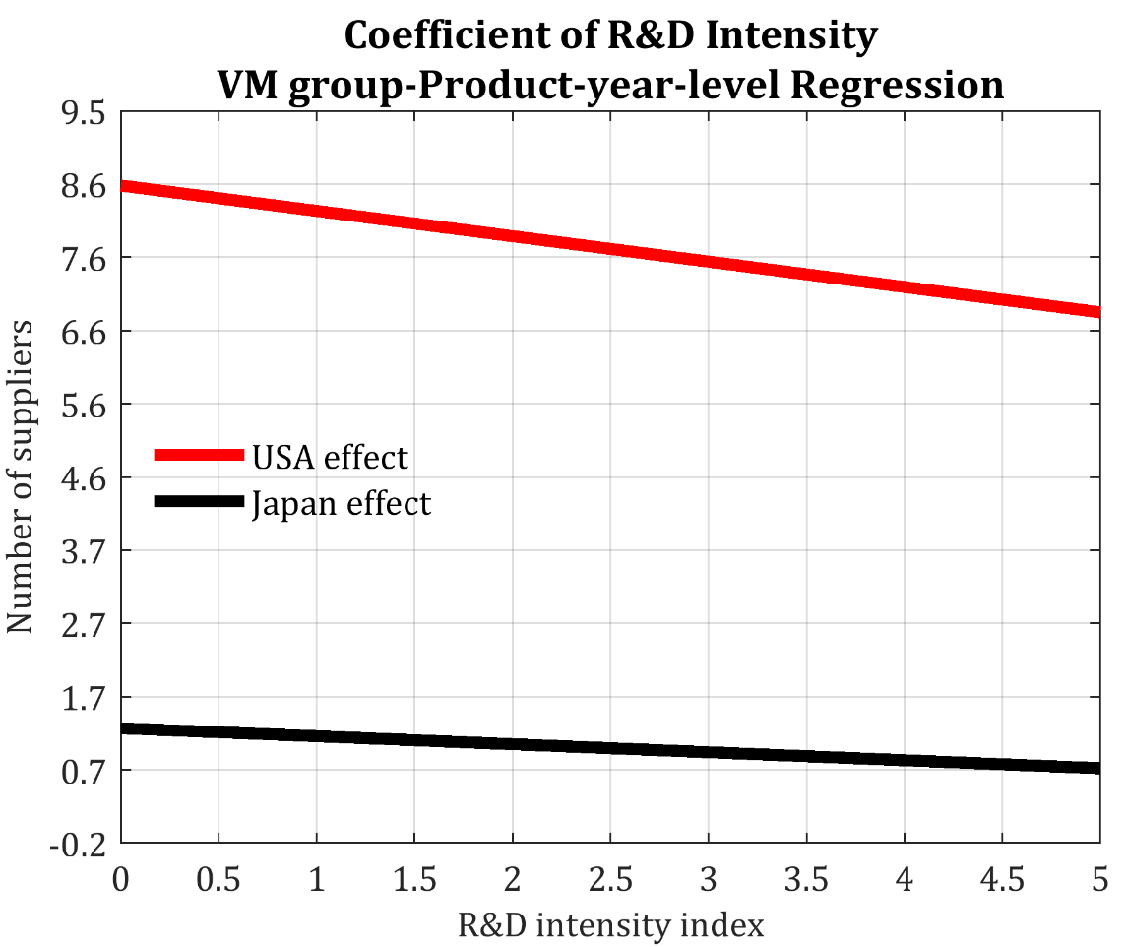
R&D and number of suppliers
Support for transaction cost theory
As R&D intensity increases from its mean to 3 times its standard deviation
number of U.S. suppliers falls from 8.2 to 6.8
number of Japanese suppliers also falls a bit – from 1.16 to 0.75
But organization-based theories have much more explanatory power
At every level of R&D intensity
U.S. VM group has at least seven times more suppliers than does the Japanese VM group
Japanese are less sensitive to R&D intensity in choosing the number of suppliers
  Even at the highest levels of R&D intensity, the US still has more suppliers per part than Japanese have for commodity products

Slide 15
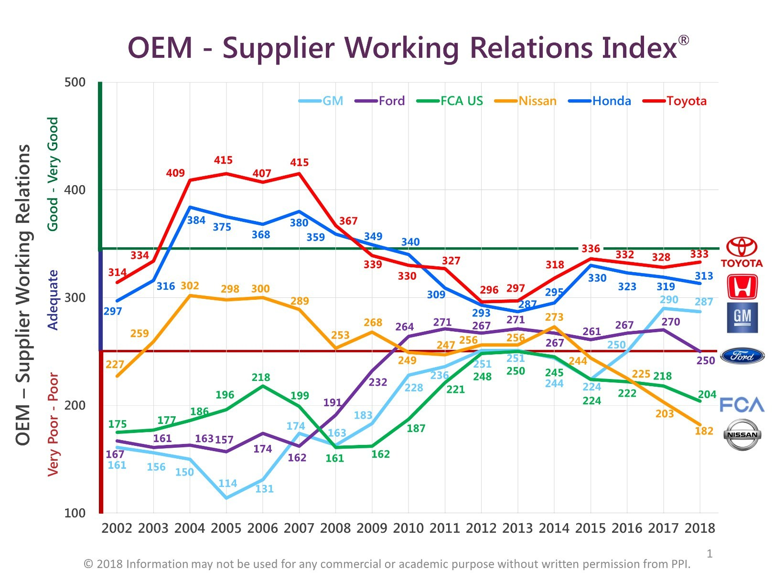
OEM-supplier working relations
Persistent differences across OEMs in supplier strategy
OEM-Supplier Working Relations Index
Notes:
Since all cars have roughly the same parts, this variance would be surprising to TC analyst
Can ‘t confirm that any of these companies are in our data set

Slide 16
Robustness check
Our main sample excludes suppliers from Japan for Japanese firms
  This is for symmetry since, using international trade data, we do not have information about suppliers from within the United States for the U.S. firms
Robustness tests
  Add all imports from Japan back into the sample
  Done for both regression setups, except for the specification with HS10*year FEs
Finding
  The coefficient of the Japan dummy across all regressions have the same sign and level of significance

Slide 17
Alternative story: product complexity
Novak and Stern show that luxury car makers with more complex products vertically integrate more
  Perhaps Japanese VMs do less spot buying because they make more luxury vehicles, vehicles that have a greater return to coordination
  i.e. final product attributes, not organization strategy, determines supplier governance
Unlikely in our case
  US VMs have more luxury vehicles in their product mix (Japanese VMs still import many of these, rather than assemble them in the US)

Slide 18
Returning to Kojima-Toyota/Chrysler-Diematic
Questions
  Why give business to a firm that lacks technical capability, and pay to help them develop it?
  Why establish long-term relationship for commodity product, one with few “transaction hazards”?
  Why give new parts to an existing supplier, that does not specialize in making those parts?
Answer
  Spillovers across transactions
  Japanese VMs: Build clear, credible relational contracts with suppliers
How would U.S. firms answer?
  Higher discount rate, more concerns about hold-up, more faith in market generation of capabilities
    establish relational contracts only with hi R&D suppliers and maintain some option to exit even from these firms

Slide 19
Conclusion
We analyze U.S. Customs microdata of all imports by vehicle manufacturers for the period 1997-2015
We offer new insights into the development of relational contracts by considering several transactions at once
We find that while transaction-based measures are statistically significant, organization-based measures generally have much greater explanatory power
Lead firms and suppliers experience economies of scope in developing clear and credible relational contracts
  Because of these spillovers across relationships, firms and nations have distinct and stable strategies for value chain governance, such as the number of suppliers per part, degree of vertical integration, and length of relationship with suppliers

Slide 20
VM group-Product level Sample – Summary Stats
 | USA (N=11,500) |  |  | Japan (N=11,500)
Variable | Mean | Std. Dev. |  | Mean | Std. Dev.
Number of suppliers | 8.155 | 18.26 |  | 1.163 | 2.585
HH Index of suppliers | 6,560.00 | 2,421.00 |  | 8,907.00 | 1,811.00
Related party trade share | 24.71 | 32.31 |  | 19.15 | 35.51
Average supplier longevity | 1.787 | 1.037 |  | 1.575 | 1.894
Length of purchase | 20.86 | 120.3 |  | 15.29 | 89.98
Log value of purchase | 11.68 | 6.17 |  | 6.433 | 6.244
RPT share – deviation from mean (RPT0) | 2.772 | 32.31 |  | -2.777 | 35.51
Japan × RPT0 | 0 | 0 |  | -2.777 | 35.51
Upstreamness | 2.138 | 0.66 |  | 2.131 | 0.659
Japan × upstreamness | 0 | 0 |  | 2.131 | 0.659
R&D intensity | 1.148 | 1.298 |  | 1.142 | 1.292
Japan × R&D intensity | 0 | 0 |  | 1.142 | 1.292
Import elasticity | 6.778 | 10.65 |  | 6.749 | 10.62
Japan × import elasticity | 0 | 0 |  | 6.749 | 10.62
Import share | 55.97 | 14.95 |  | 55.88 | 15.01
Japan × import share | 0 | 0 |  | 55.88 | 15.01
N for HHI 9,600, and 6,400, for USA, and Japan, respectively

Slide 21
Product level regression: Number of suppliers
 | (1) |  | (2) |  | (3) |  | (4)
Japan | -3.92 | *** | -3.73 | *** | -4.18 | *** | -4.45 | ***
Log value of purchase | 0.55 | *** | 0.62 | *** | 0.56 | *** | 0.62 | ***
Length of purchase | 0.04 | *** | 0.04 | *** | 0.00 |  | 0.04 | ***
RPT share: dev from mean (RPT0) |  |  | -0.04 | *** | -0.01 | *** | -0.04 | ***
Japan × RPT0 |  |  |  |  | -0.03 | *** | 0.00
Upstreamness |  |  |  |  |  |  | -0.33 | **
Japan × upstreamness |  |  |  |  |  |  | -0.08
R&D intensity |  |  |  |  |  |  | -0.34 | ***
Japan × R&D intensity |  |  |  |  |  |  | 0.23 | ***
Import elasticity |  |  |  |  |  |  | -0.11 | ***
Japan × import elasticity |  |  |  |  |  |  | 0.13 | ***
Import share |  |  |  |  |  |  | -0.01 | *
Japan × import share |  |  |  |  |  |  | -0.01
Observations | 23,500 |  | 23,500 |  | 23,500 |  | 23,500
Adj-R2 | 0.25 |  | 0.26 |  | 0.48 |  | 0.26
Year FE | yes |  | yes |  | yes |  | yes
HTS10 FE | no |  | no |  | yes |  | no
p-value: joint F - Year FEs | 0.29 |  | 0.14 |  | 0.49 |  | 0.14
p-value: joint F - HTS-10 FEs |  |  |  |  | 0.00
44 countries, 600 products
Each regression has a constant
Standard errors are clustered at VM-product-year level
Notes:
Prod fe alone are sig : last row

Slide 22
Product level regression: HHI
 | (1) |  | (2) |  | (3) |  | (4)
Japan | 1603.00 | *** | 1605.00 | *** | 2091.00 | *** | 1612.00 | ***
Log value of purchase | -294.90 | *** | -297.10 | *** | -169.10 | *** | -295.40 | ***
Length of purchase | -0.88 | *** | -0.85 | *** | -0.54 | *** | -0.89 | ***
RPT share: dev from mean (RPT0) |  |  | -1.40 | *** | -0.62 |  | -0.99 | *
Japan × RPT0 |  |  |  |  | 0.07 |  | -0.76
Upstreamness |  |  |  |  |  |  | 31.45
Japan × upstreamness |  |  |  |  |  |  | 135.70 | ***
R&D intensity |  |  |  |  |  |  | 50.02 | ***
Japan × R&D intensity |  |  |  |  |  |  | 35.39 | *
Import elasticity |  |  |  |  |  |  | 14.51 | ***
Japan × import elasticity |  |  |  |  |  |  | -8.62 | ***
Import share |  |  |  |  |  |  | 5.34 | ***
Japan × import share |  |  |  |  |  |  | -4.80 | **
Observations | 16,000 |  | 16,000 |  | 16,000 |  | 16,000
Adj-R2 | 0.35 |  | 0.35 |  | 0.49 |  | 0.35
Year FE | yes |  | yes |  | yes |  | yes
HTS10 FE | no |  | no |  | yes |  | no
p-value: joint F - Year FEs | 0.00 |  | 0.00 |  | 0.00 |  | 0.00
p-value: joint F - HTS-10 FEs |  |  |  |  | 0.00
44 countries, 600 products
Each regression has a constant
Standard errors are clustered at VM-product-year level

Slide 23
Product level regression: Related Party Share
 | (1) |  | (2) |  | (3)
Japan | 5.19 | *** | 6.56 | *** | 6.62 | ***
Log value of purchase | 2.05 | *** | 2.30 | *** | 2.08 | ***
Length of purchase | -0.006 | ** | -0.004 | * | -0.006 | **
Upstreamness |  |  |  |  | -1.52 | ***
Japan × upstreamness |  |  |  |  | -2.13 | ***
R&D intensity |  |  |  |  | 0.50 | **
Japan × R&D intensity |  |  |  |  | -0.93 | ***
Import elasticity |  |  |  |  | 0.16 | ***
Japan × import elasticity |  |  |  |  | -0.07 | *
Import share |  |  |  |  | -0.04 | **
Japan × import share |  |  |  |  | 0.08 | ***
Observations | 23,500 |  | 23,500 |  | 23,500
Adj-R2 | 0.14 |  | 0.30 |  | 0.15
Year FE | yes |  | yes |  | yes
HTS10 FE | no |  | yes |  | no
p-value: joint F - Year FEs | 0.00 |  | 0.00 |  | 0.00
p-value: joint F - HTS-10 FEs |  |  | 0.00
44 countries, 600 products
Each regression has a constant
Standard errors are clustered at VM-product-year level

Slide 24
Product level regression: Supplier longevity
 | (1) |  | (2) |  | (4) |  | (5)
Japan | 0.76 | *** | 0.73 | *** | 0.69 | *** | 0.63 | ***
Log value of purchase | 0.19 | *** | 0.17 | *** | 0.17 | *** | 0.17 | ***
Length of purchase | -0.0002 | *** | -0.0002 | *** | -0.0001 |  | -0.0001 | ***
RPT share: dev from mean (RPT0) |  |  | 0.0064 | *** | 0.0006 | ** | 0.002 | ***
Japan × RPT0 |  |  |  |  | 0.0090 | *** | 0.01 | ***
Upstreamness |  |  |  |  |  |  | 0.12 | ***
Japan × upstreamness |  |  |  |  |  |  | -0.03 | *
R&D intensity |  |  |  |  |  |  | -0.01
Japan × R&D intensity |  |  |  |  |  |  | 0.07 | ***
Import elasticity |  |  |  |  |  |  | 0.001
Japan × import elasticity |  |  |  |  |  |  | 0.004 | ***
Import share |  |  |  |  |  |  | 0.001 | ***
Japan × import share |  |  |  |  |  |  | 0.001
Adj-R2 | 0.58 |  | 0.59 |  | 0.71 |  | 0.61
HTS10 FE | no |  | no |  | yes |  | no
p-value: joint F - HTS-10 FEs |  |  |  |  | 0.00
44 countries, 600 products
Each regression has a constant
Standard errors are clustered at VM-product-year level

Slide 25
Data and sample dimensions

Slide 26
Country level regression: Number of suppliers
 | (1) |  | (2) |  | (3) |  | (4) |  | (5)
Japan | -0.02 | *** | -0.03 | *** | -0.04 | *** | -0.11 | *** | -0.03 | ***
Log value of purchase | 0.21 | *** | 0.22 | *** | 0.22 | *** | 0.23 | *** | 0.24 | ***
Length of purchase | 0.002 | *** | 0.002 | *** | 0.002 | *** | 0.003 | *** | 0.002 | ***
RPT share: dev from mean (RPT0) |  |  | -0.01 | *** | -0.01 | *** | -0.01 | *** | -0.01 | ***
Japan × RPT0 |  |  |  |  | -0.01 | *** | -0.01 | *** | -0.01 | ***
Upstreamness |  |  |  |  |  |  | -0.01 | ***
Japan × upstreamness |  |  |  |  |  |  | 0.01 | ***
R&D intensity |  |  |  |  |  |  | -0.02 | ***
Japan × R&D intensity |  |  |  |  |  |  | 0.01 | ***
Import elasticity |  |  |  |  |  |  | -0.002 | ***
Japan × import elasticity |  |  |  |  |  |  | 0.002 | ***
Import share |  |  |  |  |  |  | -0.0004 | ***
Japan × import share |  |  |  |  |  |  | 0.0004 | ***
Exchange rate |  |  |  |  |  |  |  |  | -0.0004 | ***
Japan × exchange rate |  |  |  |  |  |  |  |  | 0.0004 | ***
Observations | 1,003,000 |  | 1,003,000 |  | 1,003,000 |  | 1,003,000 |  | 1,003,000
Adj-R2 | 0.29 |  | 0.31 |  | 0.31 |  | 0.30 |  | 0.31
Year FE | yes |  | yes |  | yes |  | yes |  | yes
HTS10 FE | no |  | yes |  | yes |  | no |  | yes
Supplier country FE | no |  | yes |  | yes |  | yes |  | no
p-value: joint F - Year FEs | 0.00 |  | 0.00 |  | 0.00 |  | 0.00 |  | 0.00
p-value: joint F - HTS-10 FEs |  |  | 0.00 |  | 0.00 |  |  |  | 0.00
p-value: joint F - country FEs |  |  | 0.00 |  | 0.00 |  | 0.00
44 countries, 600 products
Each regression has a constant
Standard errors are clustered at VM-country-product-year level

Slide 27
Country level regression: HHI
 | (1) |  | (2) |  | (3) |  | (4) |  | (5)
Japan | 630.70 | *** | 776.20 | *** | 812.90 | *** | 916.90 | *** | 487.90 | ***
Log of imports | -247.40 | *** | -195.10 | *** | -194.90 | *** | -211.20 | *** | -266.20 | ***
Length of purchase | -0.06 | ** | -0.11 | ** | -0.11 | ** | -0.33 | *** | 0.02
RPT share: dev from mean (RPT0) |  |  | 1.74 | *** | 1.97 | *** | 2.06 | *** | -0.55 | ***
Japan × RPT0 |  |  |  |  | -0.95 | *** | -1.42 | *** | 3.61 | ***
Upstreamness |  |  |  |  |  |  | 2.61
Japan × upstreamness |  |  |  |  |  |  | 90.65 | ***
R&D intensity |  |  |  |  |  |  | 77.46 | ***
Japan × R&D intensity |  |  |  |  |  |  | -46.86 | ***
Import elasticity |  |  |  |  |  |  | 12.18 | ***
Japan × import elasticity |  |  |  |  |  |  | -5.30 | ***
Import share |  |  |  |  |  |  | 2.54 | ***
Japan × import share |  |  |  |  |  |  | -5.48 | ***
Exchange rate |  |  |  |  |  |  |  |  | 8.61 | ***
Japan × exchange rate |  |  |  |  |  |  |  |  | -1.91 | *
Observations | 78,000 |  | 78,000 |  | 78,000 |  | 78,000 |  | 78,000
Adj-R2 | 0.15 |  | 0.24 |  | 0.24 |  | 0.19 |  | 0.19
Year FE | yes |  | yes |  | yes |  | yes |  | yes
HTS10 FE | no |  | yes |  | yes |  | no |  | yes
Supplier country FE | no |  | yes |  | yes |  | yes |  | no
p-value: joint F - Year FEs | 0.00 |  | 0.00 |  | 0.00 |  | 0.00 |  | 0.00
p-value: joint F - HTS-10 FEs |  |  | 0.00 |  | 0.00 |  |  |  | 0.00
p-value: joint F - country FEs |  |  | 0.00 |  | 0.00 |  | 0.00
44 countries, 600 products
Each regression has a constant
Standard errors are clustered at VM-country-product-year level

Slide 28
Country level regression: Related Party Share
 | (1) |  | (2) |  | (3) |  | (4)
Japan | 0.21 | *** | 0.22 | *** | 0.29 | *** | 0.21 | ***
Log of imports | 3.04 | *** | 3.04 | *** | 3.05 | *** | 3.03 | ***
Length of purchase | 0.01 | *** | 0.01 | *** | 0.005 | *** | 0.01 | ***
Upstreamness |  |  |  |  | -0.01
Japan × upstreamness |  |  |  |  | -0.11 | ***
R&D intensity |  |  |  |  | 0.02 | *
Japan × R&D intensity |  |  |  |  | -0.01
Import elasticity |  |  |  |  | 0.01 | ***
Japan × import elasticity |  |  |  |  | -0.02 | ***
Import share |  |  |  |  | 0.00 | ***
Japan × import share |  |  |  |  | 0.01 | ***
Exchange rate |  |  |  |  |  |  | 0.003 | ***
Japan × exchange rate |  |  |  |  |  |  | -0.003 | **
Observations | 1,003,000 |  | 1,003,000 |  | 1,003,000 |  | 1,003,000
Adj-R2 | 0.36 |  | 0.39 |  | 0.39 |  | 0.37
Year FE | yes |  | yes |  | yes |  | yes
HTS10 FE | no |  | yes |  | no |  | yes
Supplier country FE | no |  | yes |  | yes |  | no
p-value: joint F - Year FEs | 0.00 |  | 0.00 |  | 0.00 |  | 0.00
p-value: joint F - HTS-10 FEs |  |  | 0.00 |  |  |  | 0.00
p-value: joint F - country FEs |  |  | 0.00 |  | 0.00
44 countries, 600 products
Each regression has a constant
Standard errors are clustered at VM-country-product-year level

Slide 29
Country level regression: Supplier longevity
Table 4
 | (1) |  | (2) |  | (3) |  | (4) |  | (5)
Japan | 0.02 | *** | 0.02 | *** | 0.03 | *** | 0.06 | *** | 0.03 | ***
Log value of purchase | 0.20 | *** | 0.19 | *** | 0.19 | *** | 0.19 | *** | 0.18 | ***
Length of purchase | 0.0003 | *** | 0.0003 | *** | 0.0003 | *** | 0.0003 | *** | 0.0003 | ***
RPT share: dev from mean (RPT0) |  |  | 0.005 | *** | 0.003 | *** | 0.003 | *** | 0.003 | ***
Japan × RPT0 |  |  |  |  | 0.01 | *** | 0.01 | *** | 0.01 | ***
Upstreamness |  |  |  |  |  |  | 0.01 | ***
Japan × upstreamness |  |  |  |  |  |  | -0.01 | ***
R&D intensity |  |  |  |  |  |  | -0.002 | ***
Japan × R&D intensity |  |  |  |  |  |  | 0.005 | ***
Import elasticity |  |  |  |  |  |  | -0.0002 | ***
Japan × import elasticity |  |  |  |  |  |  | 0.0003 | ***
Import share |  |  |  |  |  |  | 0.0003 | ***
Japan × import share |  |  |  |  |  |  | -0.0002 | ***
Exchange rate |  |  |  |  |  |  |  |  | 0.00005 | ***
Japan × exchange rate |  |  |  |  |  |  |  |  | -0.0001 | ***
Adj-R2 | 0.84 |  | 0.86 |  | 0.86 |  | 0.86 |  | 0.86
HTS10 FE | no |  | yes |  | yes |  | no |  | yes
Supplier country FE | no |  | yes |  | yes |  | yes |  | no
p-value: joint F - HTS-10 FEs |  |  | 0.00 |  | 0.00 |  |  |  | 0.00
p-value: joint F - country FEs |  |  | 0.00 |  | 0.00 |  | 0.00
44 countries, 600 products
Each regression has a constant
Standard errors are clustered at VM-country-product-year level

