Slide 1
Payments Crises and Consequences
Qian Chen
Beijing Technology and Business University
Christoffer Koch Federal Reserve Bank of Dallas
Gary Richardson UC Irvine and NBER
Padma Sharma
Federal Reserve Bank of Kansas City
— System Committee on Financial Institutions, Regulation, and Markets — September 22, 2020
The views expressed in this presentation are those of the authors and are not necessarily reflective of views at the Federal Reserve Bank of Dallas, the Federal Reserve Bank of Kansas City or the Federal Reserve System.
Any errors or omissions are the sole responsibility of the authors.

Slide 2
Central Questions
What is the macroeconomic impact of suspensions of payments?
Is the impact worth the routine and episodic costs to prevent payment suspensions?
Routine costs Regulatory agencies
Episodic costs
Post-Lehman bailouts of 2008/09

Slide 3
Motivation
Most payments made through commercial banks
In 2015, payments by value were 53% electronic, 19% check, 16% credit, and only 9% cash. Almost all payments begin, end, and/or travel through banks.
Beliefs on payments crises shape policy
Cited by Fed and regulators to justify actions and existence.
Models of payments frictions largely theoretical, not empirically quantified
Payment frictions reduce output, employment, and firm entry, while increasing unemployment and bankruptcies.
Historical experience hard to quantify — little modern empirical evidence Widespread suspensions during depressions in 1857, 1873, 1884, 1893, 1901, 1907.

Slide 4
Method
Examine suspensions of payments from banks insured at the state-level
1983 Nebraska
1985 Ohio and Maryland
1991 Rhode Island
Method of Bayesian Synthetic Control
Novel method based on Abadie and Gardeazabal (2003)
Provides unified framework for estimation and inference
Data
State-level macroeconomic aggregates
Focus on unemployment, employment, labor force participation, gross state product
Checked results with county-level.

Slide 5
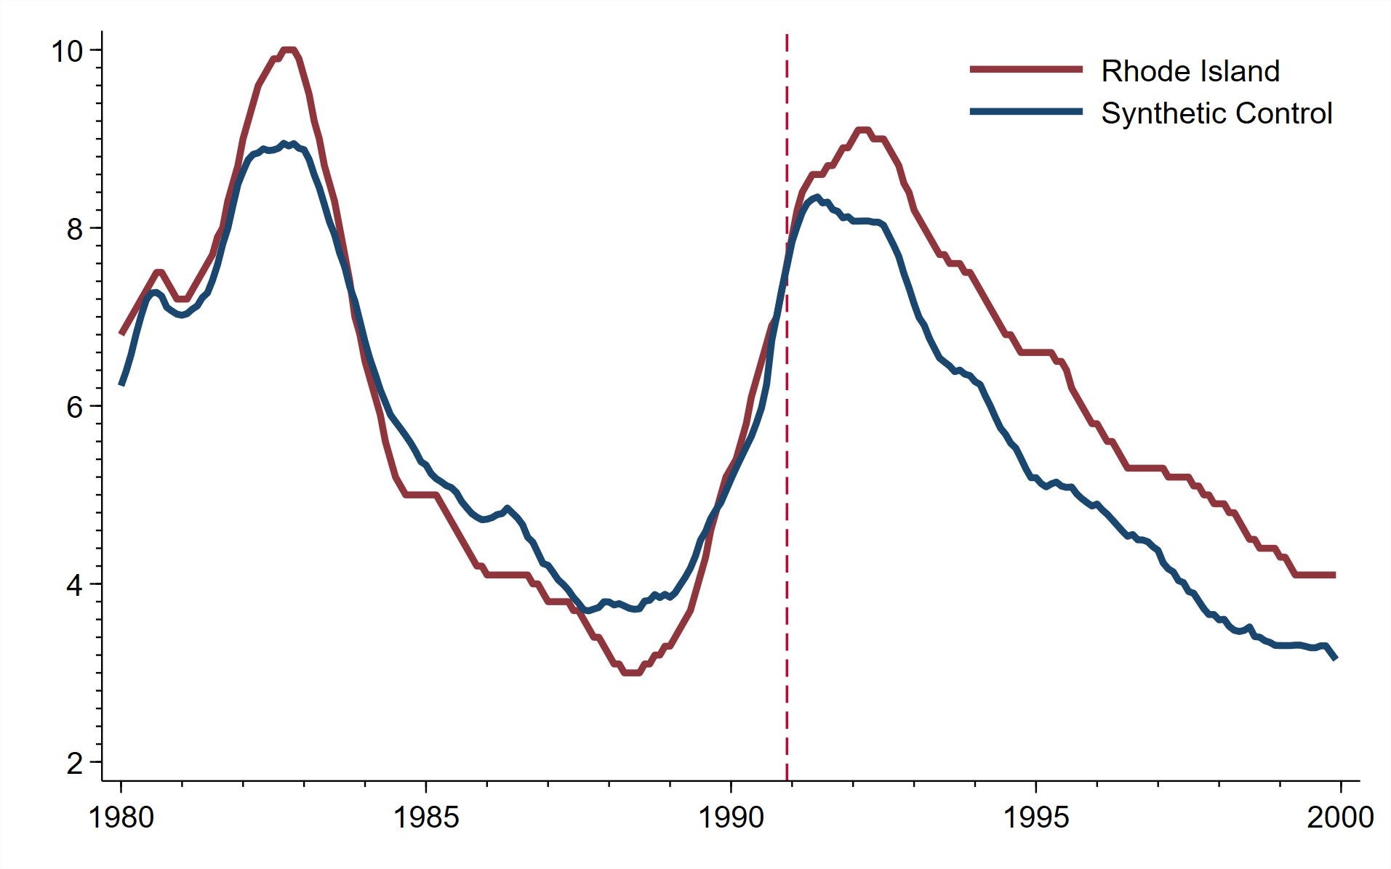
Results Preview
Findings:
larger suspensions during recession
⇒ substantial, persistent effects
smaller suspension during expansion
⇒ no measurable effect
Quantification – average outcomes
Unemployment about 0.8 percentage points higher for a full decade
Unemployment Rate versus Counterfactual
Risk management – quantify uncertainty
5% chance of persistent 1.4 percentage point rise in unemployment rate

Slide 6
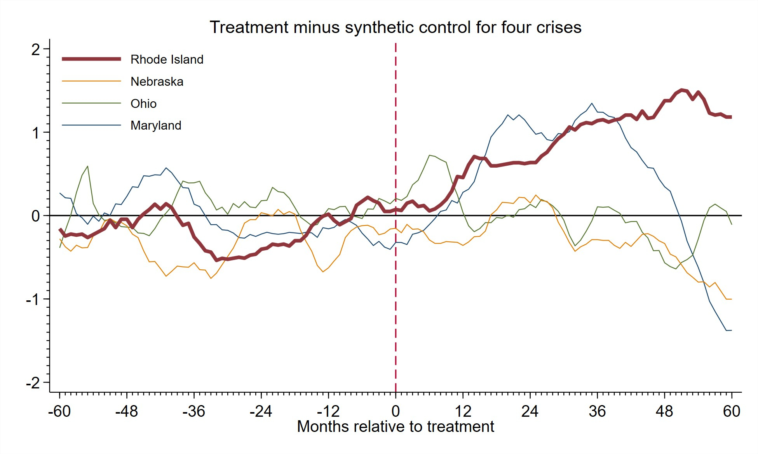
Substantial Impact of Rhode Island Crisis – But Not Others

Slide 7
Related Literature and Contribution
Macroeconomic Impact of Payment System Disruption
National Monetary Commission (1912), English (1993), Bernanke and Lown (1991), Rocheteau and Wright (2005), Lagos and Wright (2005), Lagos and Rocheteau (2009), and Richardson and Troost (2009)
Contribution: Quantify impact of payment system disruptions in modern economies.
Costs and Benefits of Financial Regulation and Bailouts
Calomiris and Gorton (1991), Calomiris (1993), Kashyap and Hanson (2010), Cochrane (2014), Lucas
(2019), Davila and Goldstein (2020)
Contribution: Quantify benefits of regulation and timely interventions to crises.
Synthetic Control in Macroeconomics
Abadie and Gardeazabal (2003), Abadie, Diamond, and Hainmueller (2010), Born et al. (2019), Born et al. (2020), Chernozhukov, Wuthrich, and Zhu (2018), and Li (2019)
Contribution: Bayesian estimation and inference for synthetic control.

Slide 8
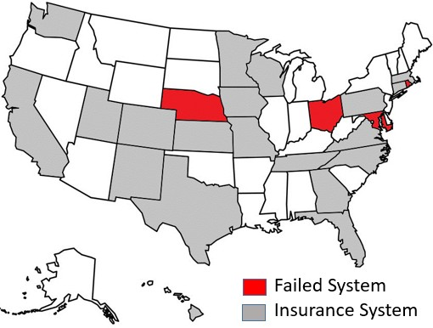
Failure of State-level Deposit Insurers Caused Payments Crises
Failed Insurance Systems
1991 Rhode Island
1985 Maryland and Ohio 1983 Nebraska
Common Causes
Low premia
Lax regulation
Large failure due to mismanagement
Runs on healthy institutions

Slide 9
Large Shock in Rhode Island during a Contraction
State
Insured Institutions
Type Number
Date of Failure
% Growth in per capita personal income
Deposits Per Household as % of Median Household Income
Year Month
Avg. 4 quarters
Maryland | SL | 102 | 1985 | May | 0.02 | 19.1
Nebraska | T, CU, SL | 60 | 1983 | Nov | 2.14 | 5.7
Ohio | SL | 70 | 1985 | Mar | 1.11 | 3.1
Rhode Island | B, CU, SL | 45 | 1991 | Jan | -1.85 | 13.9

Slide 10
Rhode Island Shock Resembles Great Depression
Share of All Bank Deposits in Suspended Banks
Great Depression Rhode Island 12.0%∗ 18.1%
∗Contraction (7.5%) + Banking holiday (4.5%)

Slide 11
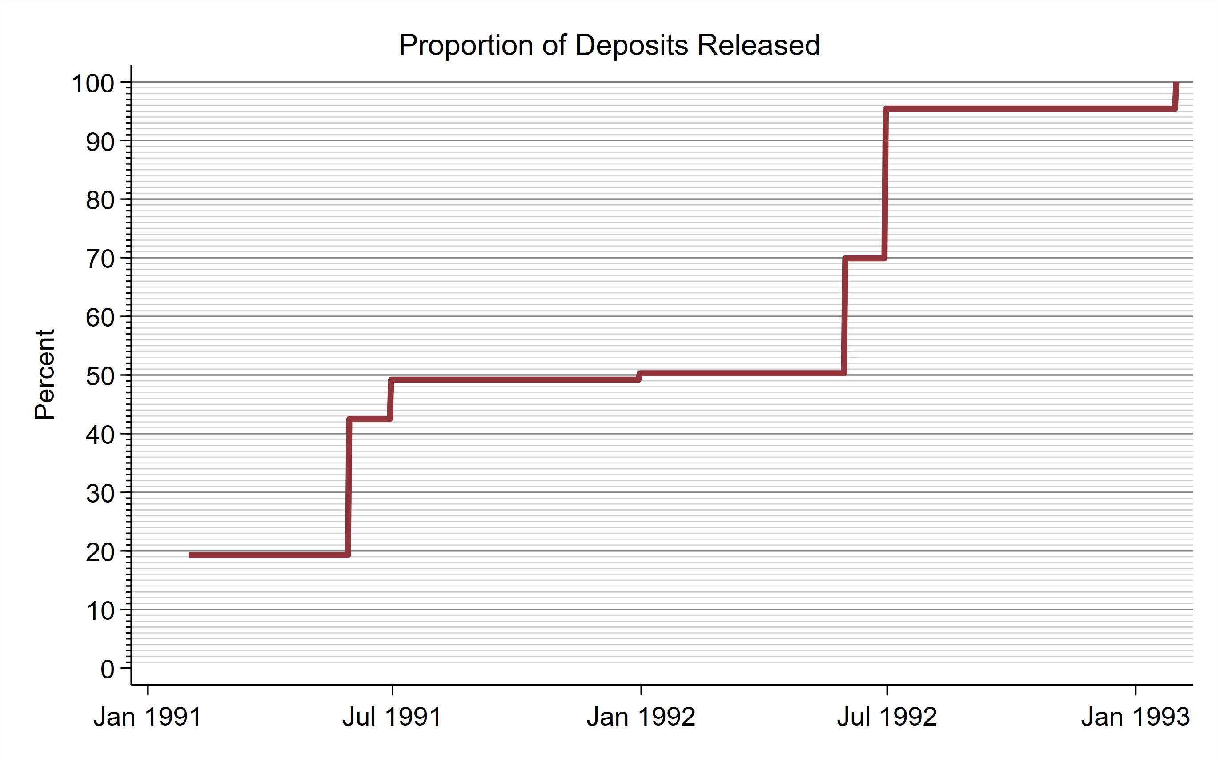
Rhode Island – Prolonged Crisis, Everyone Eventually Repaid
Jan 1991: 19% Reopened with federal insurance
May 1991 - Jun 1991: 30% Deposits paid off by Depositors Economic Protection Corporation (DEPCO)
May 1992: 20% Acquired by federally insured institutions
Jun 1992: 26% Deposits paid off by DEPCO
Sep 1993: 5% Deposits paid off by DEPCO

Slide 12
Rhode Island Resolution Delayed for Political and Legal Reasons
Crisis coincided with change of administration.
Opportunity to overturn policies of previous administration.
State government sought federal bailout, and pursued legal remedies.
Continuing crisis necessary to justify requests for federal funds, eventually denied.
Sued failed banks, and
Sued auditor of insured fund. Settled for $103 million.

Slide 13
Narrative Accounts of Financial Paralysis
Mr. McKenna, who owns a tire and auto parts business in Woonsocket, said he spent last year trying to keep his cash-strapped business afloat. With $90,000 frozen in an account in the Marquette Credit Union, one that is not expected to reopen, Mr. McKenna said he had to lay off some employees.
Jane Tinberg of Warwick, a 50-year-old native of Rhode Island and former McDonald’s franchise owner, said she had more than $300,000 tied up in four of the closed institutions....“In 1991 I did not buy one article of clothing; I did not go to the movies once. My life has changed dramatically.” Before last Jan. 1, Ms. Tinberg said, she lived off the interest from those accounts.
— New York Times, January 2, 1992

Slide 14
Methodology

Slide 15
Specifying the Causal Question: A Synthetic Control Approach
Treatment: Suspension of payments
Treated unit: Rhode Island
Control unit: unclear
Ideal control unit: hypothetical Rhode Island without payments suspension
Solution: Synthetic control created from convex combination of untreated states
Novel Bayesian method based on Abadie and Gardeazabal (2003)

Slide 16
The Synthetic Control Method
Pre-treatment
Outcome of interest: unemployment in Rhode Island Y
Predictors: unemployment in remaining J = 49 states X
Objective: Find weights wˆ so that Xwˆ approximates Y
minimize
(Y − Xw)¹ (Y − Xw)
J
w_{j} ≥ 0, j = 1, 2, ..., J, ∑ w_{j} = 1
j=1
w
subject to
Post-treatment
J
Synthetic control outcome: YSC = ∑ wˆjXj, compare with Y
j=1

Slide 17
Bayesian Synthetic Control Method
Recast problem in Bayesian framework - specify likelihood and priors
Inference on weights, control outcomes, and Average Treatment Effects (ATE)
- Abadie-Gardeazabal method only permits inference on ATE
Permits estimation, and inferences on small samples
J
Accounts for two sources of variance in YSC = ∑ wˆjXj:
j=1
Uncertainty in weights assigned to control units
Divergence among control units after treatment

Slide 18
Inferential Quantities of Interest
Posterior probability of adverse outcome
Pr(Y_{C} < Y|Y)
Average Treatment Effect
1
T
∑
t=T₀ +1
(
)
ATE = _{T − T0}
Y − Y |Y
t
SC,t
Full posterior density of weights w yields full posterior density of ATE

Slide 19
Results

Slide 20
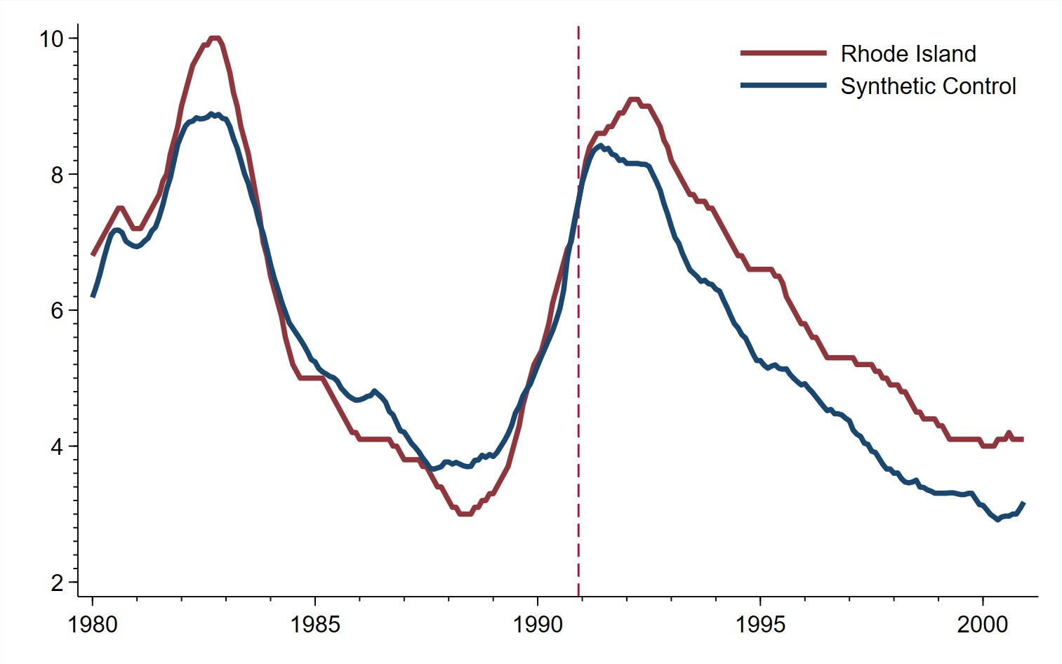
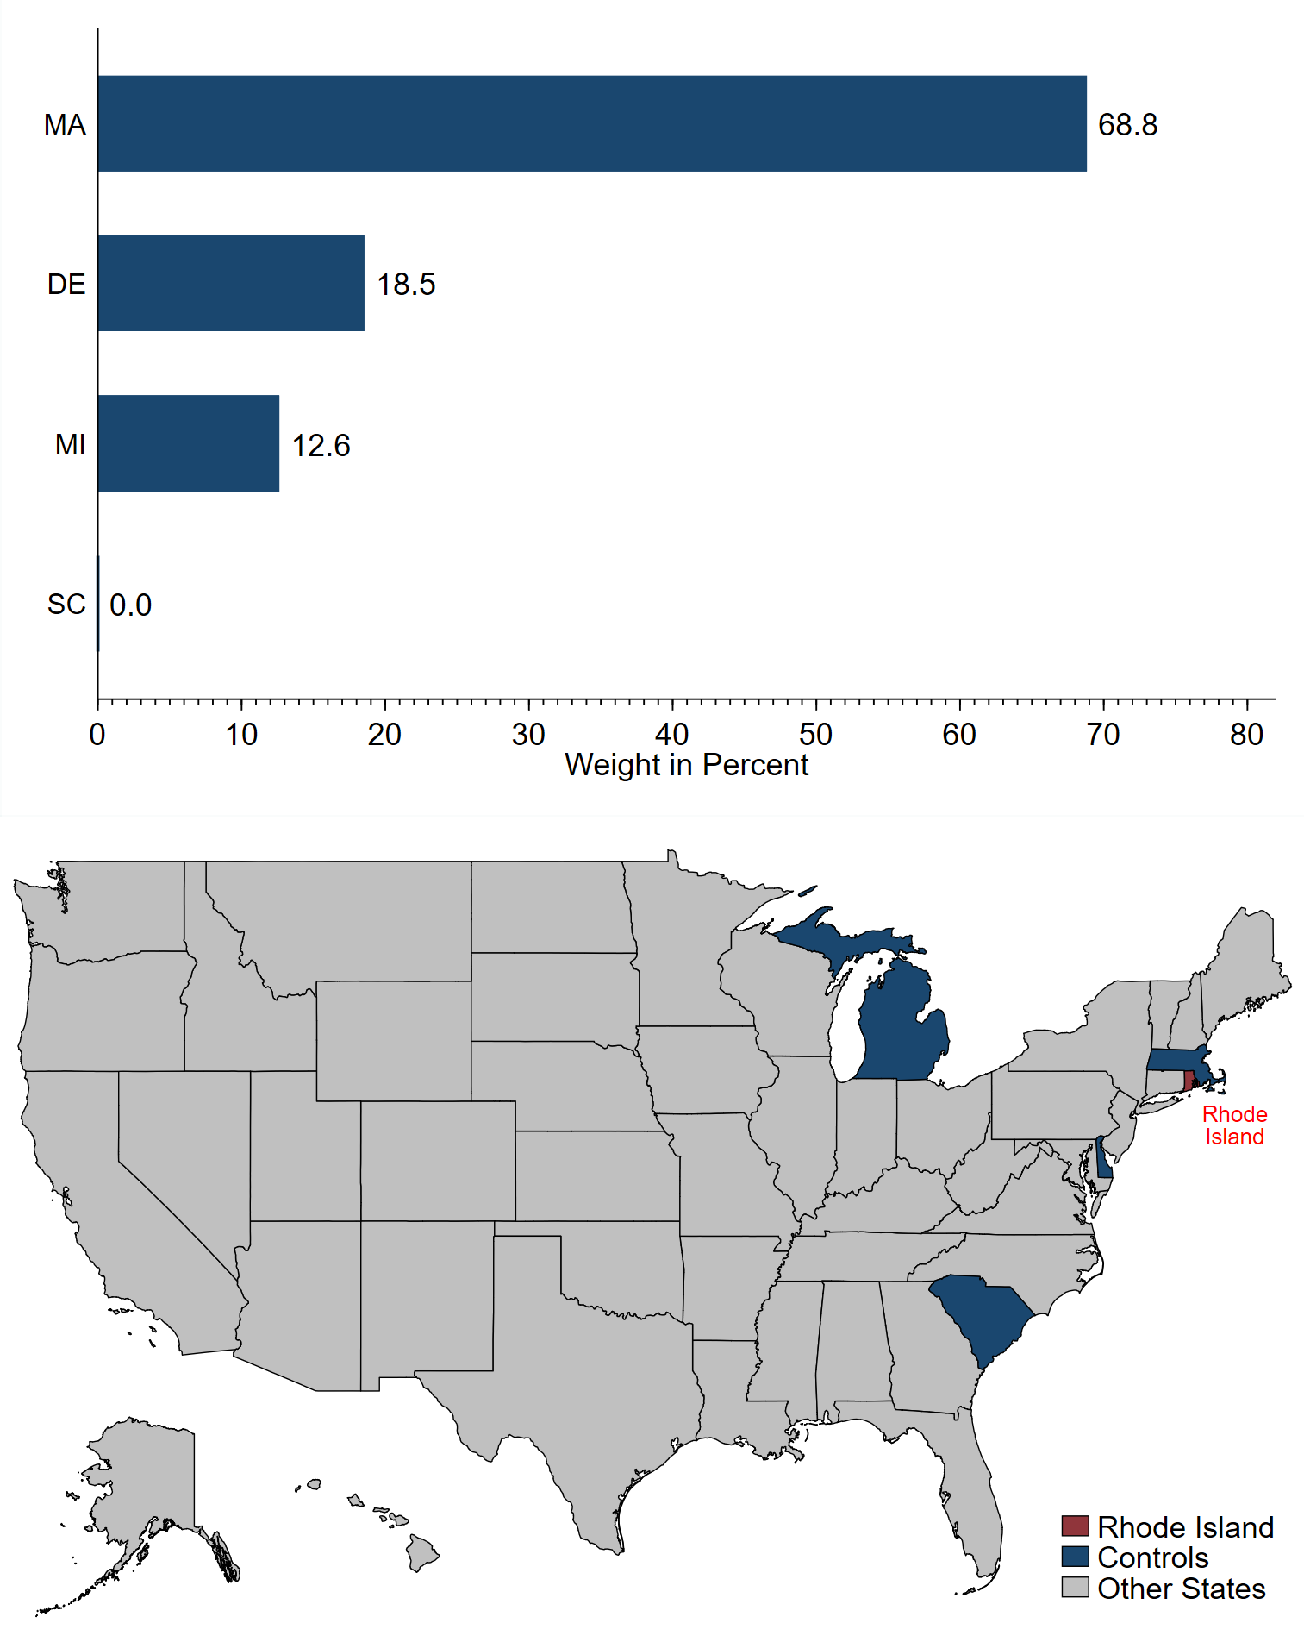
Baseline Results — Unemployment

Slide 21
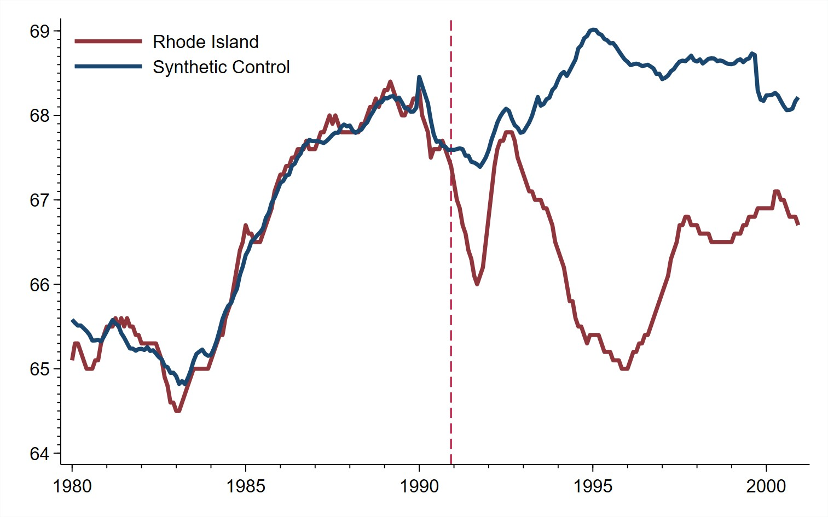
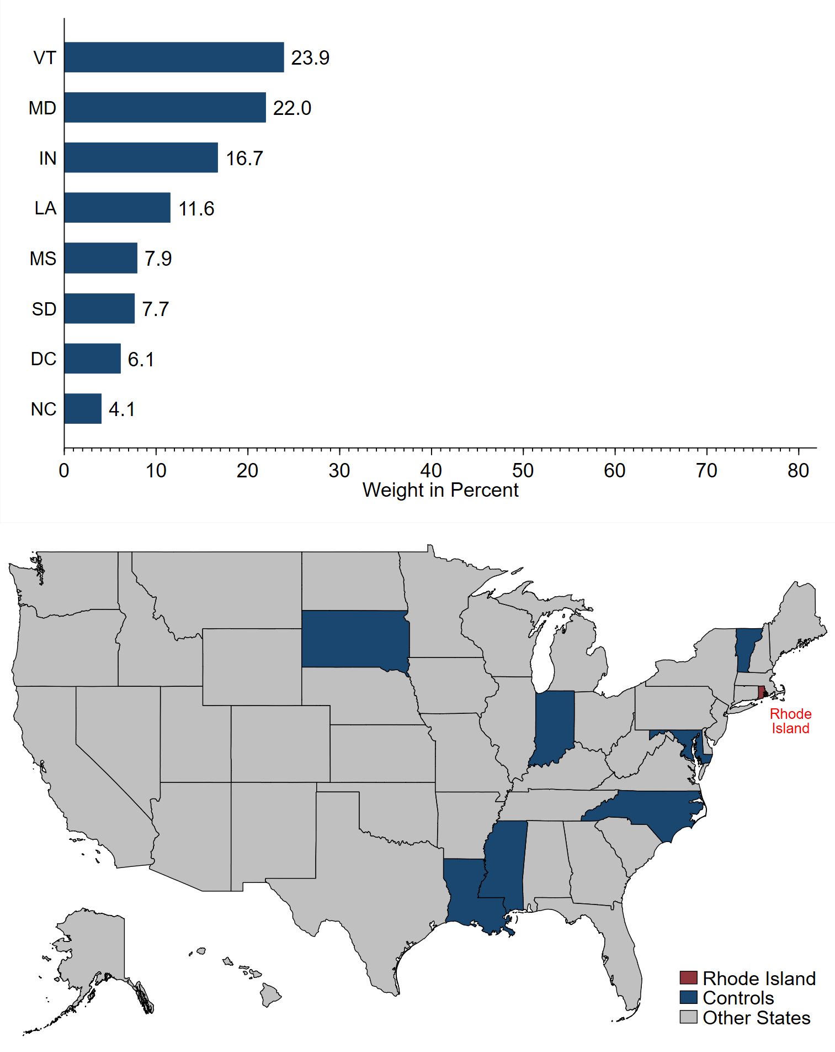
Baseline Results — Labor Force Participation

Slide 22
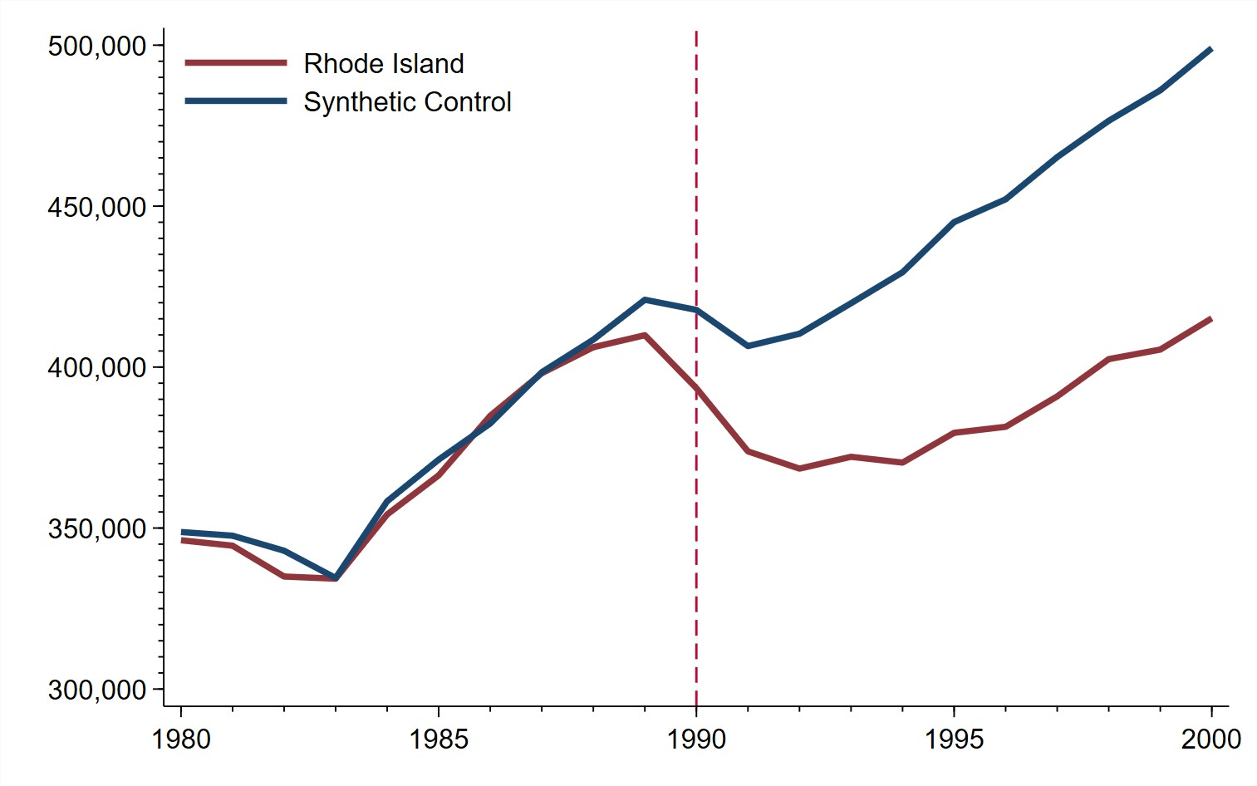
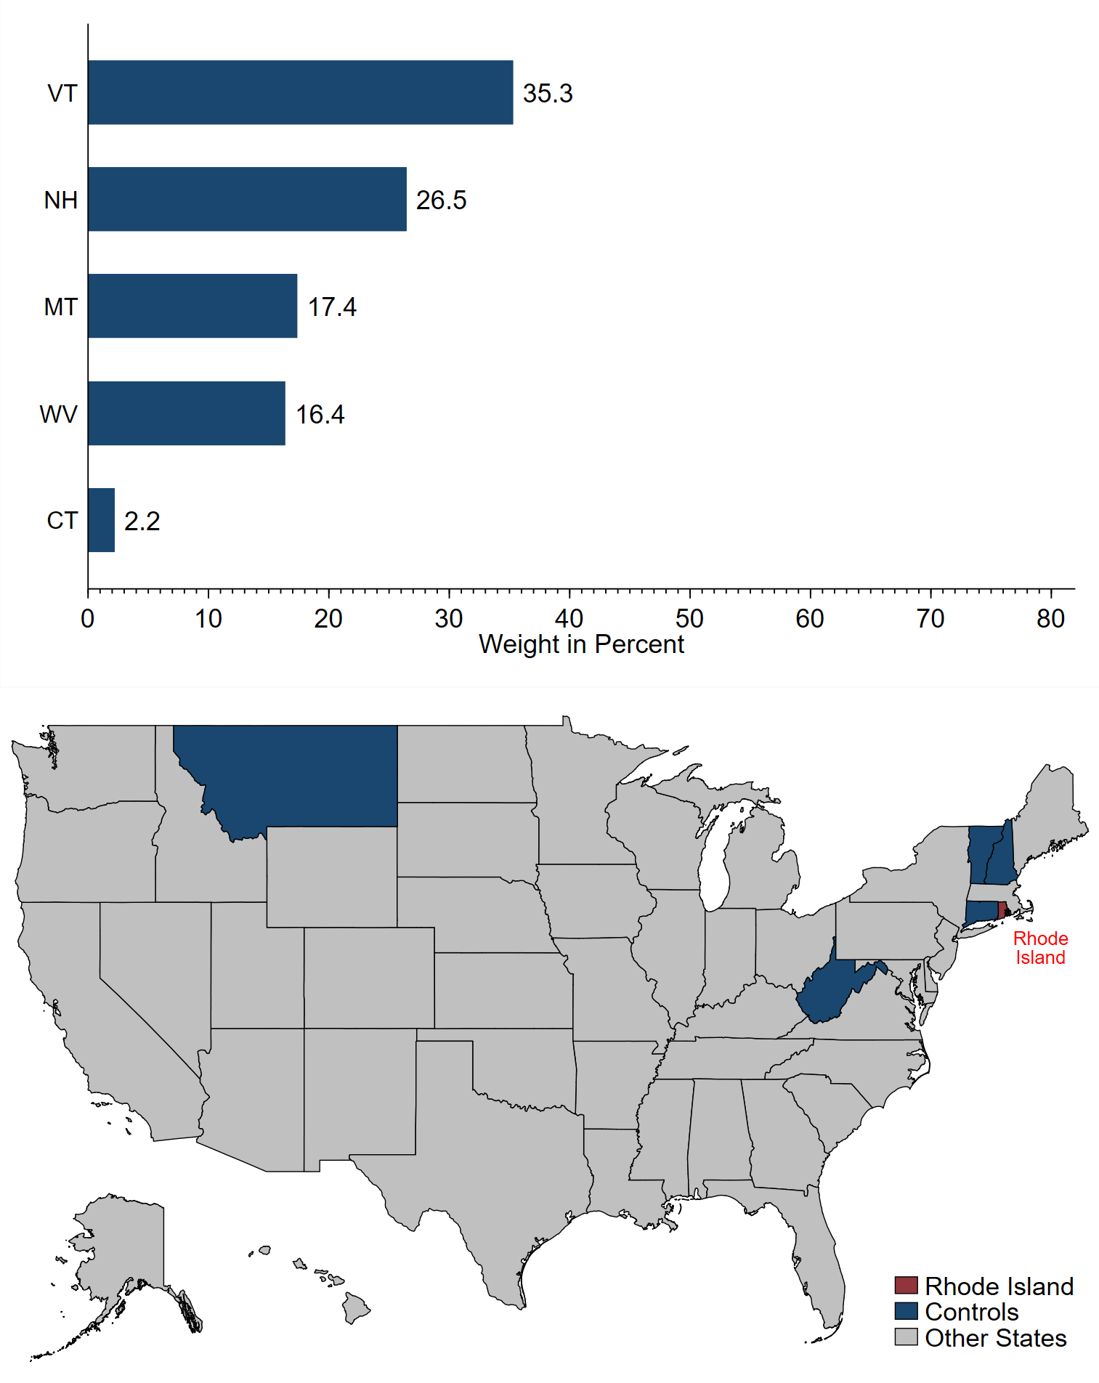
Baseline Results — Employment

Slide 23
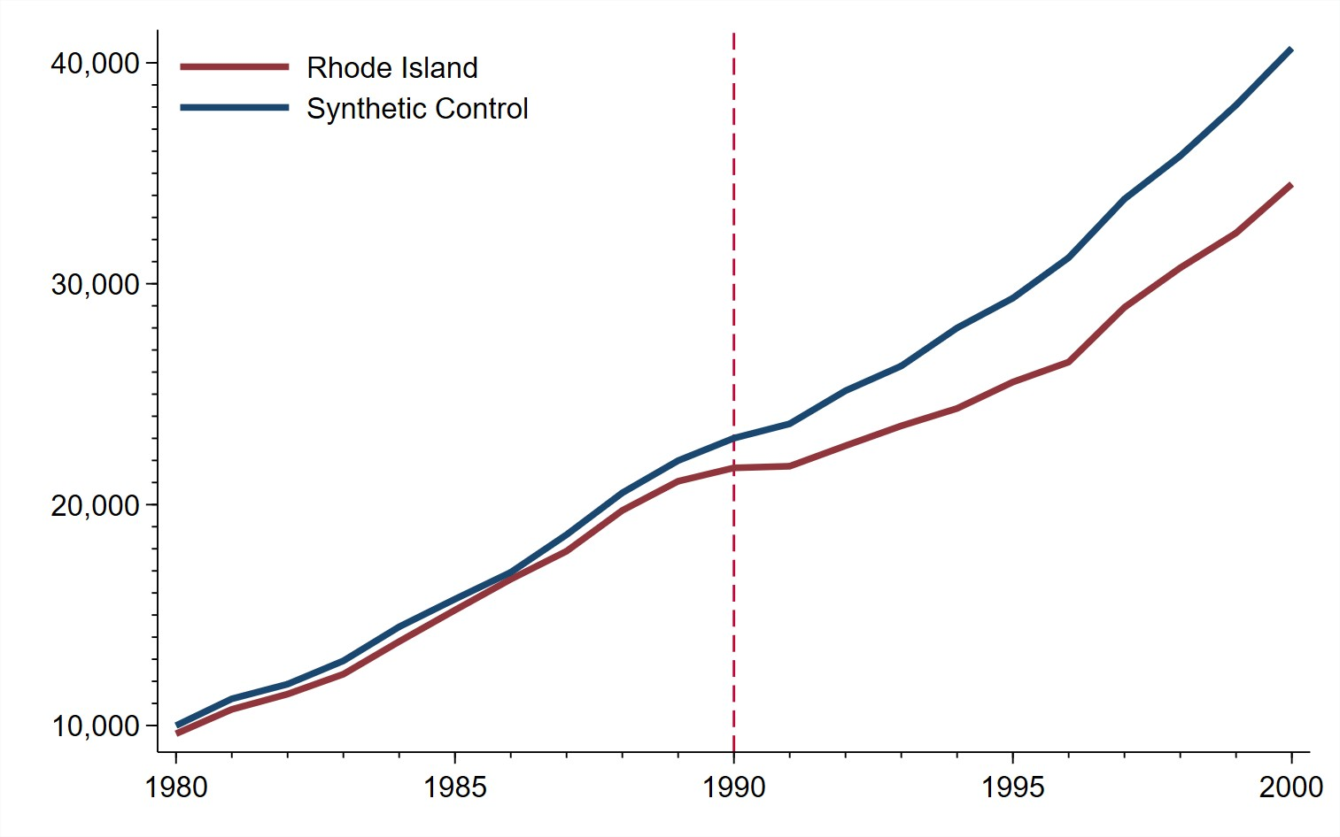
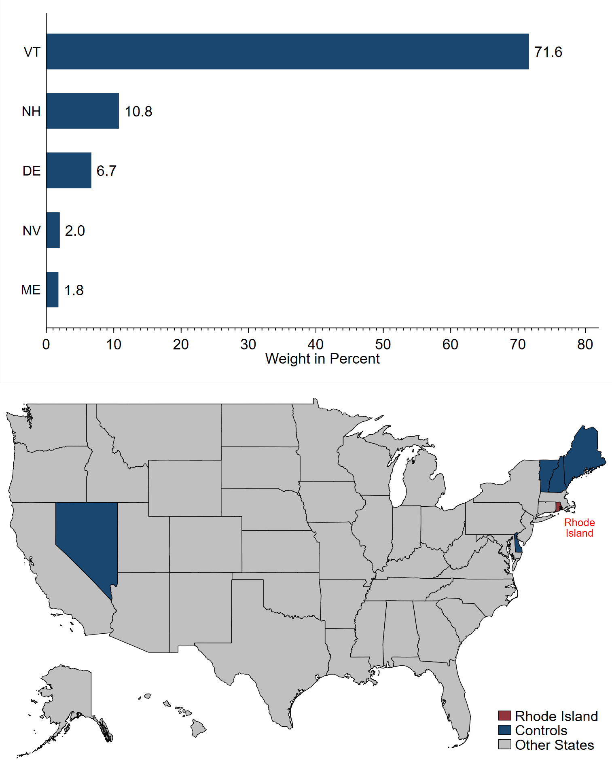
Baseline Results — Gross State Product

Slide 24
Inference

Slide 25
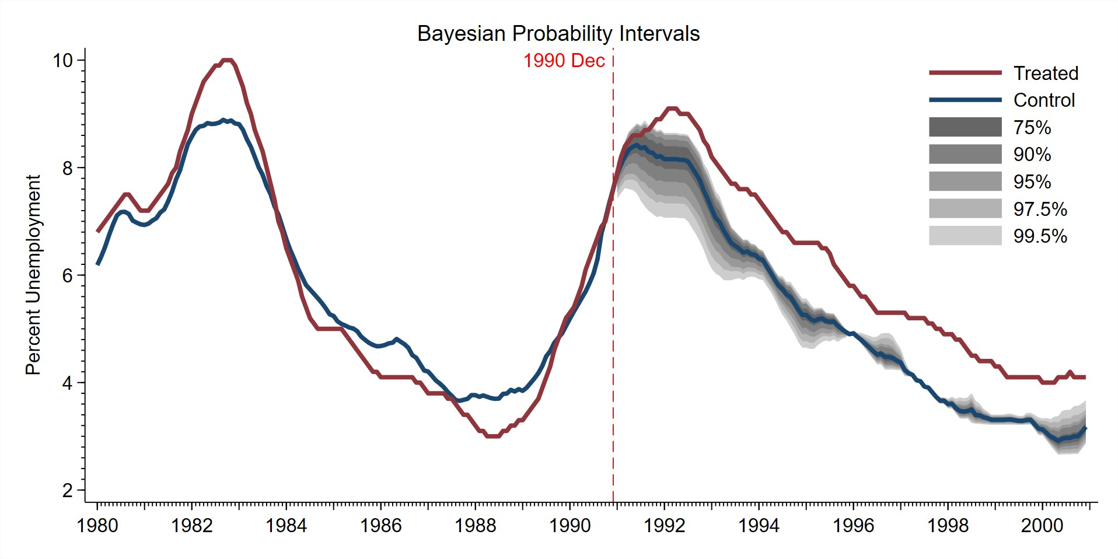
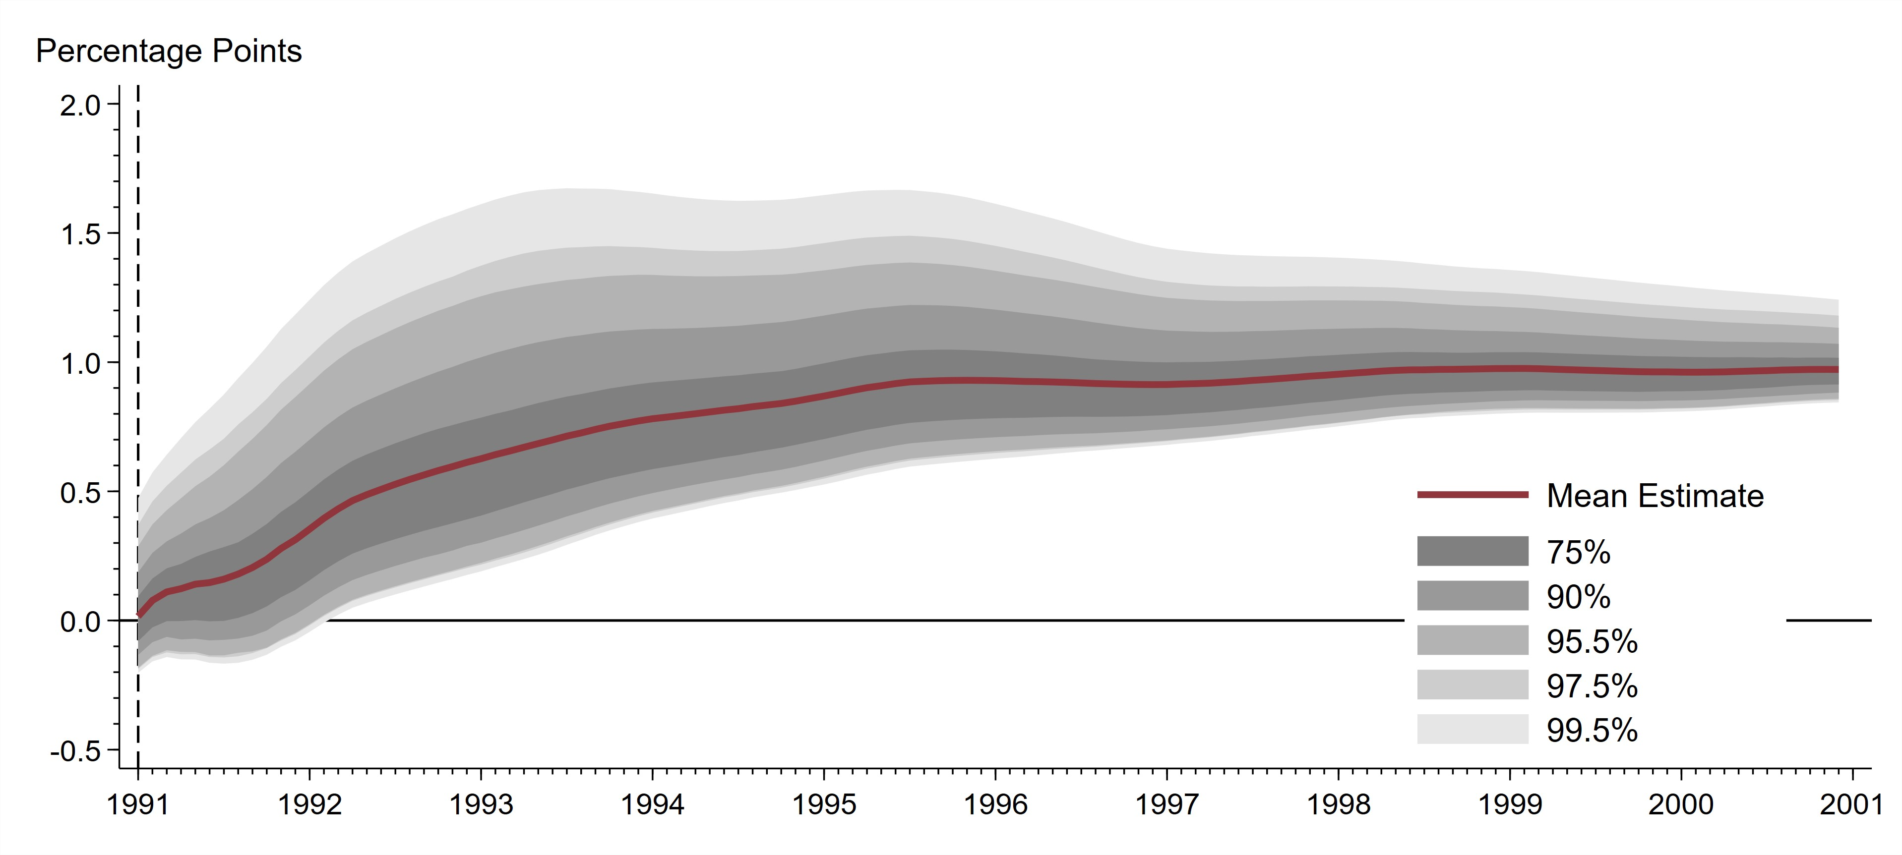
Inference – Unemployment

Slide 26
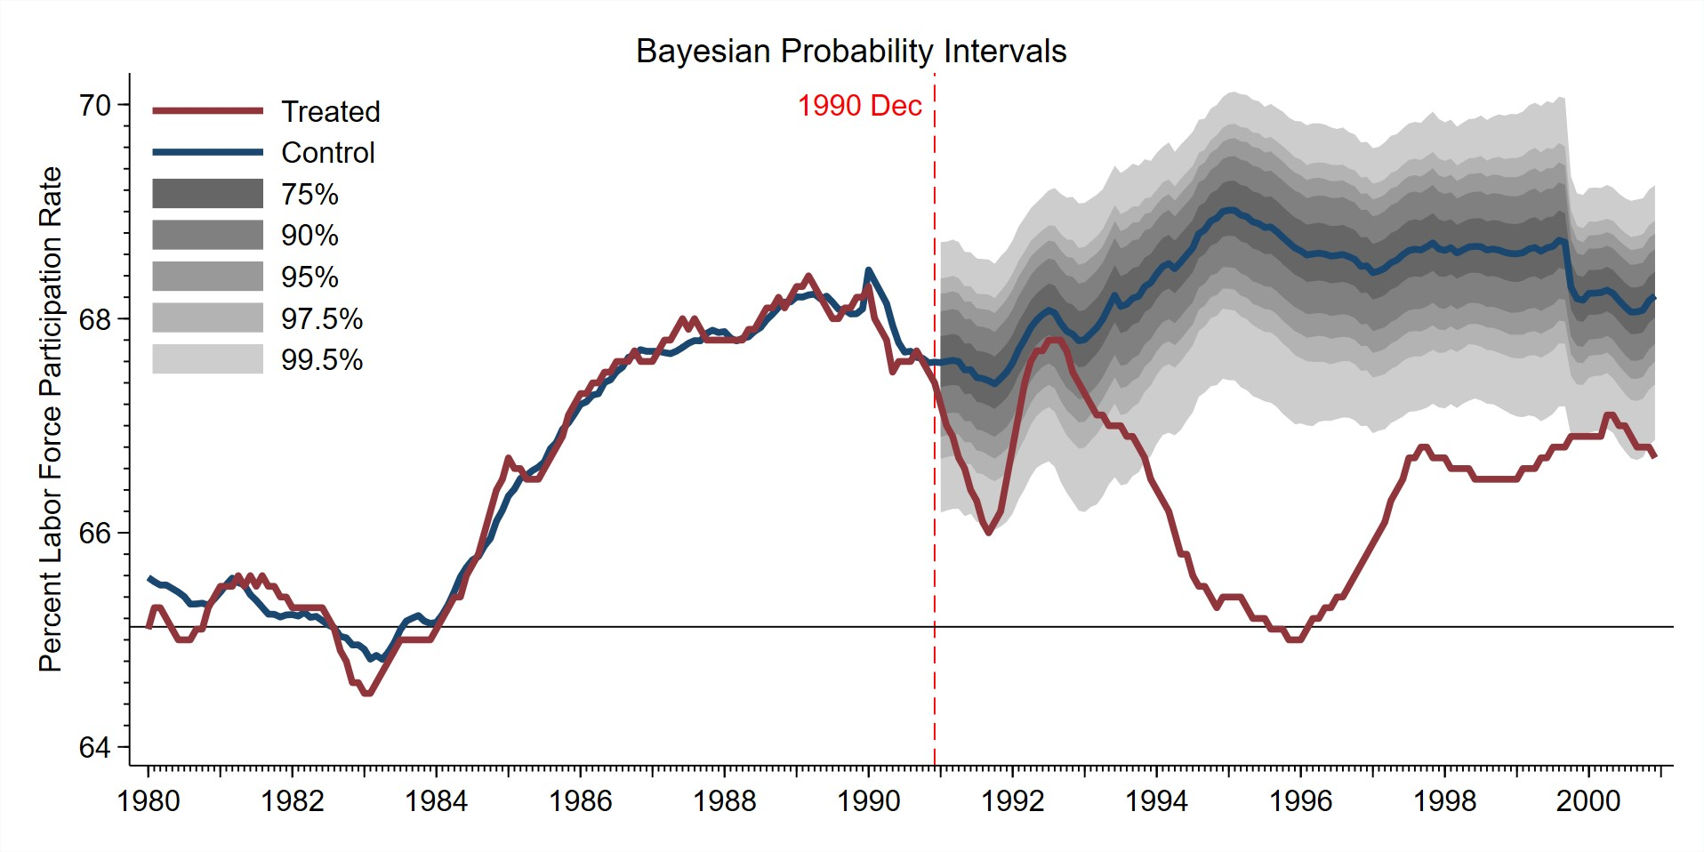
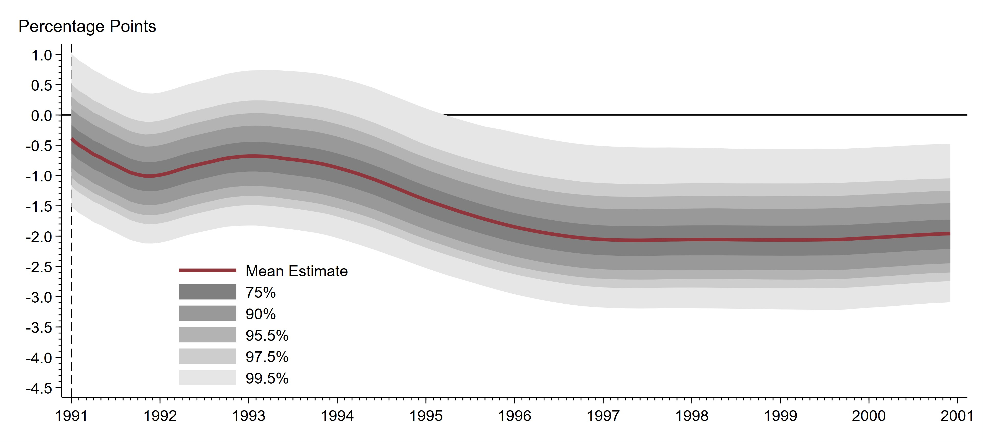
Inference – Labor Force Participation

Slide 27
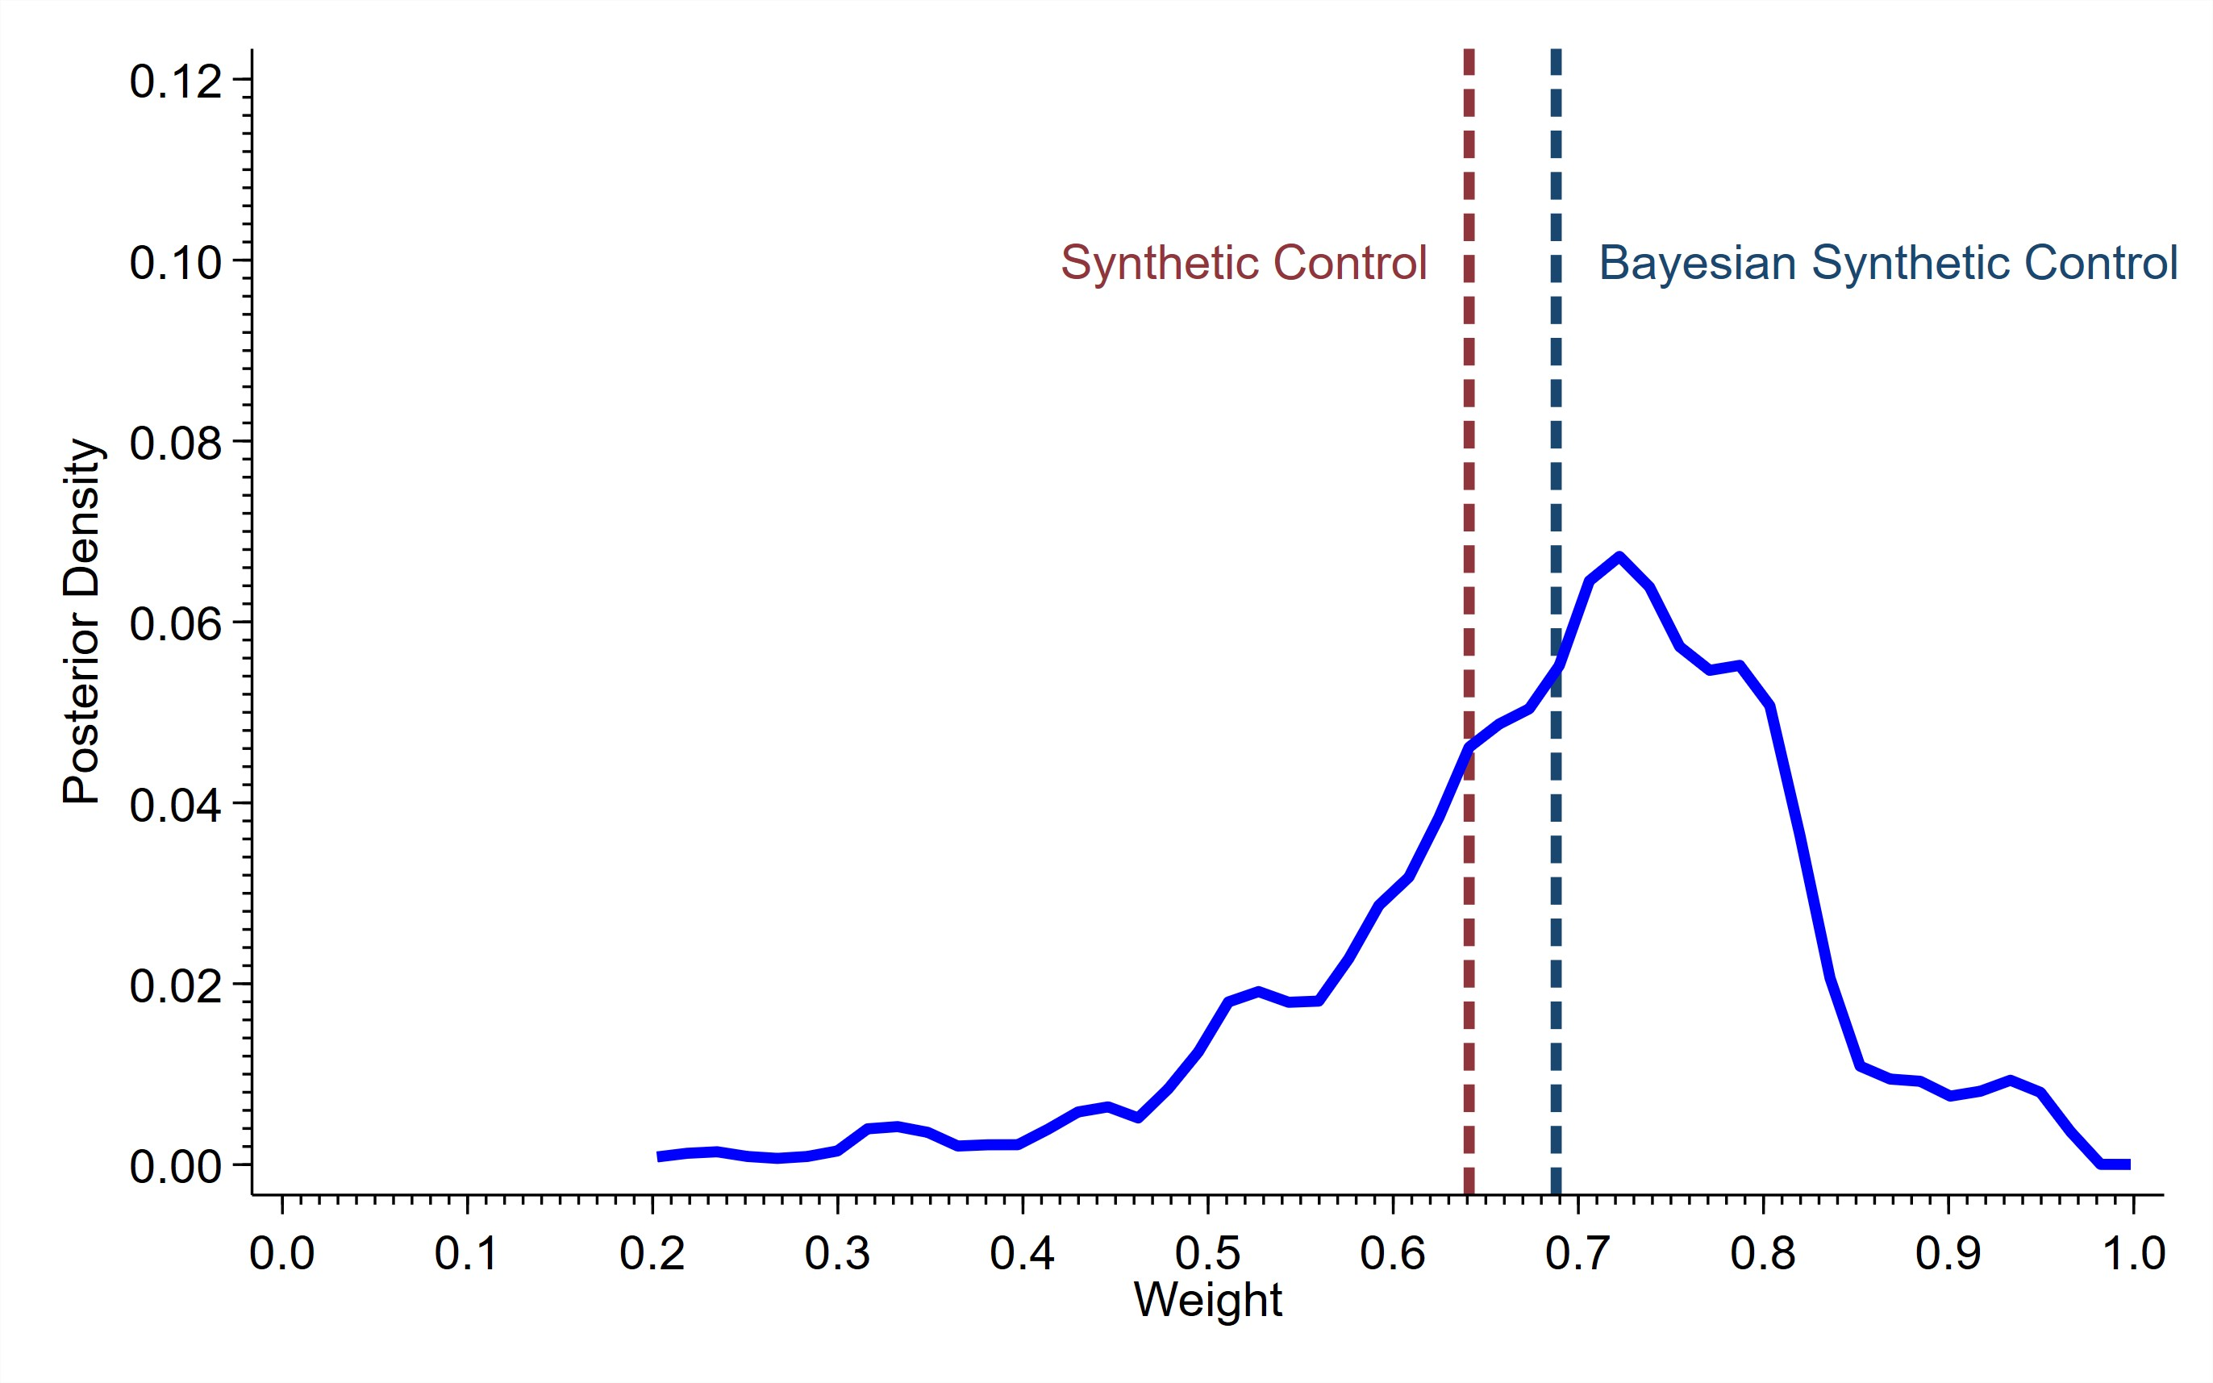
Posterior Density of Synthetic Control Weights – Unemployment
Figure: Massachussetts

Slide 28
Pervasive Effects on Rhode Island, Not Other States
Adverse Rhode Island Change
ATE Prob.
Maryland
Nebraska
Ohio
ATE
Prob.
ATE
Prob.
ATE
Prob.
Unemployment rate (%) | Rise | 0.94 100% |  | -0.03 | 44% | -0.26 | 0% | 0.01 | 50%
Labor force participation rate (%) | Decline | -1.81 100% |  | 0.61 | 6% | 0.14 | 27% | -0.03 | 55%
Employment (number) | Decline | -49,602 94% |  | 89,426 | 26% | 14,180 | 26% | 111,671 | 20%
Gross state product (mil. $) | Decline | -2,834 78% |  | 2,386 | 32% | -1,819 | 71% | -976 | 59%

Slide 29
Rhode Island Effects Suggest A Demand Shock
 | Rhode Island |  |  | Maryland |  |  | Nebraska |  |  |  | Ohio
Components of GDP ($ millions) | ATE Prob. |  |  | ATE Prob. |  |  | ATE Prob. |  |  | ATE | Prob.
Cyclical FIRE | -297 | 92% | 681 |  | 30% | -454 |  | 81% | -1154 |  |  | 82%
Services | -353 | 87% | 1127 |  | 14% | -25 |  | 57% | -729 |  |  | 55%
Manufacturing | -4686 | 100% | -365 |  | 54% | -198 |  | 64% | 3209 |  |  | 2%
Retail Trade | -225 | 96% | 487 |  | 21% | -78 |  | 65% | -178 |  |  | 77%
Wholesale Trade | -262 | 100% | -160 |  | 63% | -487 |  | 82% | -171 |  |  | 52%
Construction | 112 | 5% | 623 |  | 16% | -52 |  | 91% | -496 |  |  | 78%
Acyclical Transport/Communication/Public Utilities | 156 | 2% | 177 |  | 23% | -303 |  | 81% | -945 |  |  | 90%
Agriculture, Forestry, Fisheries | -14 | 63% | 147 |  | 0% | 170 |  | 18% | 11 |  |  | 41%

Slide 30
Robustness Checks
Common synthetic control for all series
County-level synthetic control
Alternative Explanations
Rhode Island always recovers slowly Minimum wage hikes
Credit crunch in New England
Pre-treatment matching period
First Principal Component
County-level Results
Previous Recoveries
Minimum Wage
Credit crunch
Sample Length Robustness
Skip to Conclusion

Slide 31
Great Recession 2008/09 without TARP? — Counterfactuals
Counterfactual value percentile
Actual | 75% | 50% | 25% | 5%
Unemployment Rate 6.7 | 7.5 | 7.6 | 7.6 | 7.6
Labor force participation rate 62.9 | 59.7 | 59.5 | 59.2 | 58.8
Employment
Level (millions) 144.8 | 126.7 | 118.8 | 110.8 | 96.0
Change as % of Dec 2007 value -1.0% | -13.4% | -18.8% | -24.3% | -34.4%
Gross domestic product
Level ($ trillion) 16.8 | 15.7 | 14.1 | 12.1 | 8.2
Change as % of Dec 2007 value 16.1% | 8.9% | -2.7% | -16.1% | -43.2%

Slide 32
Conclusion
Suspension of bank payments generate macroeconomic effects
Larger suspensions during recessions reduce employment, and output
Smaller suspensions during expansions have few (or no) measurable effects
Specific mechanisms not yet modeled in theoretical studies Policy Implications
Early and forceful interventions necessary during payments crises in recessions
Cost of payment disruptions justifies substantial expenditures to prevent such events

Slide 33
Thank you for your attention!
Questions?

Slide 34
Appendix
1 / 14

Slide 35
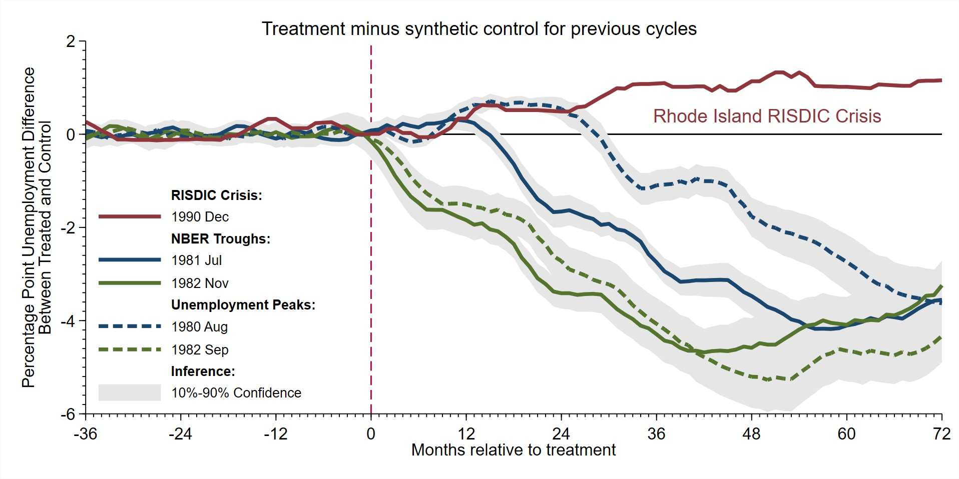
Robustness — Previous Recession Recoveries
Return
2 / 14

Slide 36
Robustness — Minimum Wage Hikes
Rhode Island
United States
Posterior Probability (Unemp._{RI} > Unemp._{syn.co})
Date | New | Change | Change vs US | New | Change |  | 1 month | 6 months | 12 months | 18 months | 24 months
1988/7 | $4.00 | $0.35 | $0.35 | $3.35 | $0.00 |  | 0.000 | 0.036 | 0.790 | 0.996 | 1.000
1989/8 | $4.25 | $0.25 | $0.25 | $3.35 | $0.00 |  | 1.000 | 1.000 | 1.000 | 1.000 | 1.000
1991/4 | $4.45 | $0.20 | -$0.25 | $4.25 | $0.45 |  | 0.293 | 0.109 | 1.000 | 1.000 | 1.000
1996/9 | $4.75 | $0.30 | $0.30 | $4.25 | $0.00 |  | 0.327 | 0.366 | 0.456 | 0.670 | 0.646
1997/1 | $5.15 | $0.40 | $0.40 | $4.75 | $0.00 |  | 0.416 | 0.561 | 0.756 | 0.824 | 0.717
Return
3 / 14

Slide 37
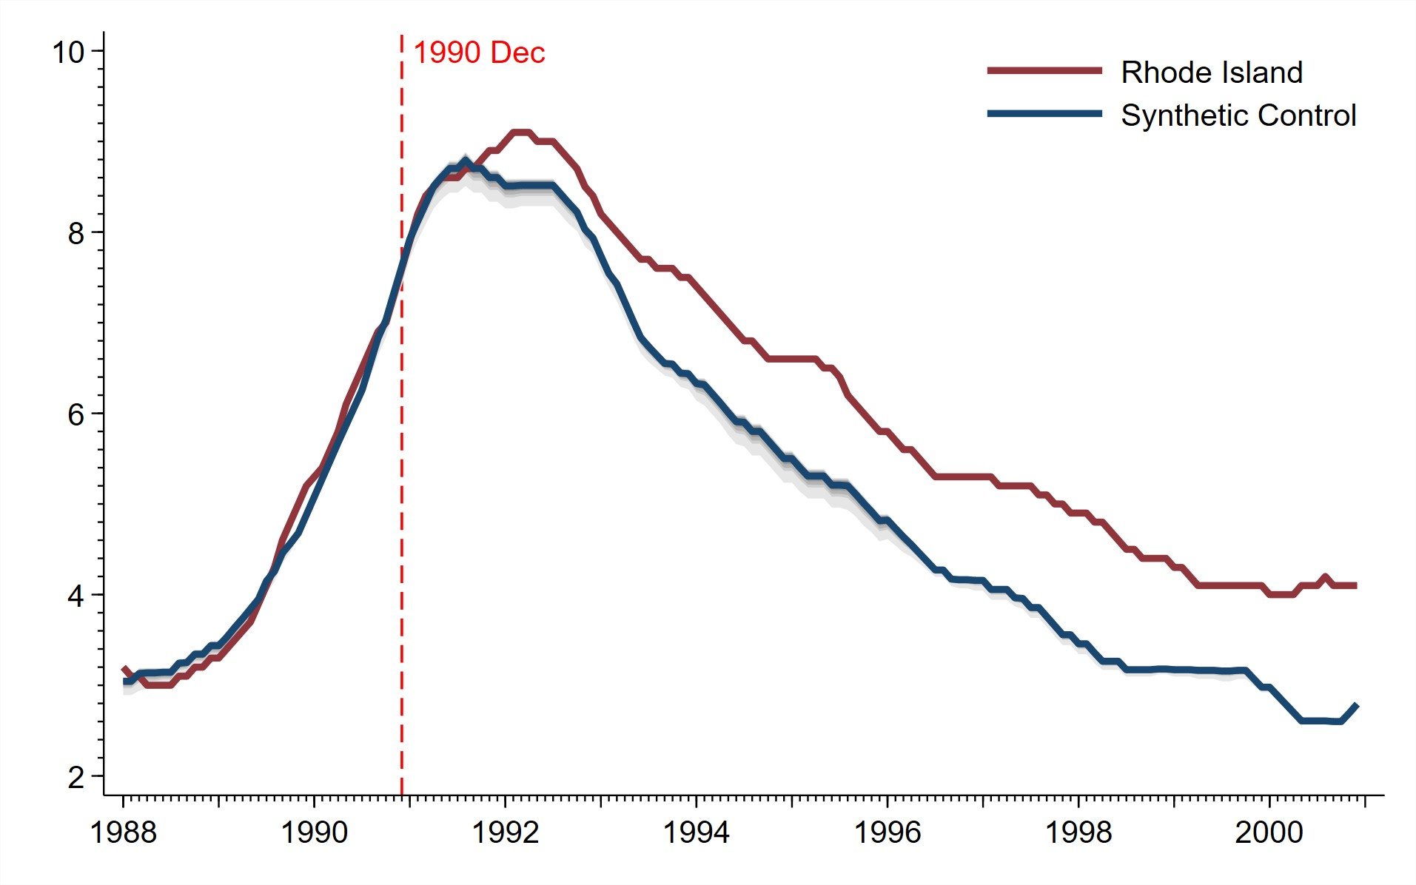
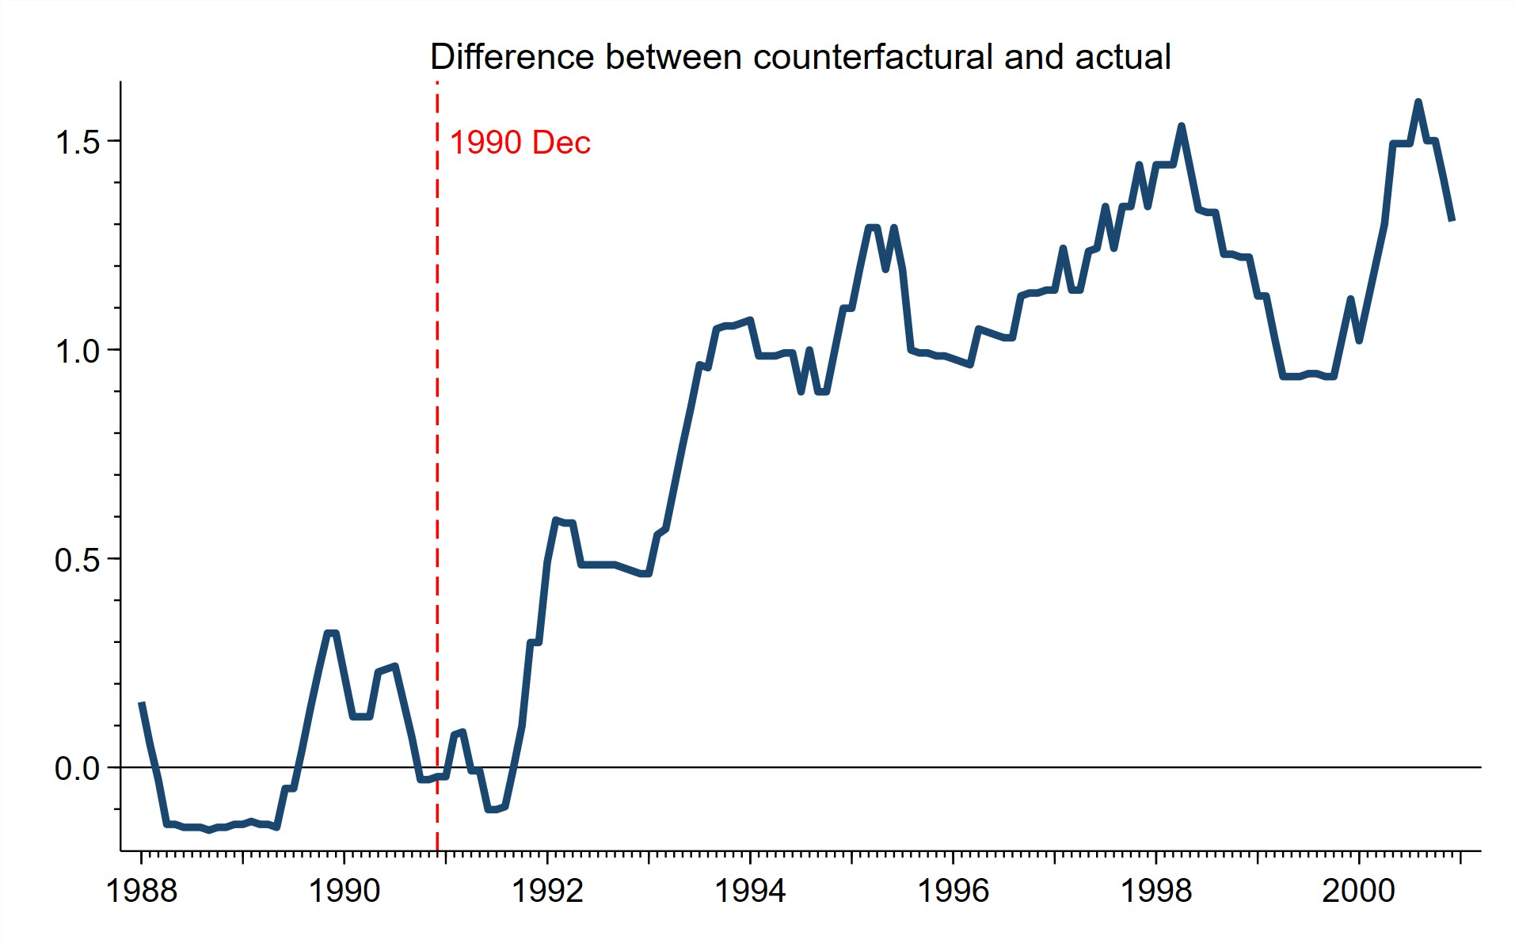
Robustness — Pre-Treatment Matching Period
Figure: Robustness – 3 Year Pre-Treatment
(a) Counterfactuals 3 Year Pre-Treatment Match
(b) Difference Treatment-Counterfactual
Return
4 / 14

Slide 38
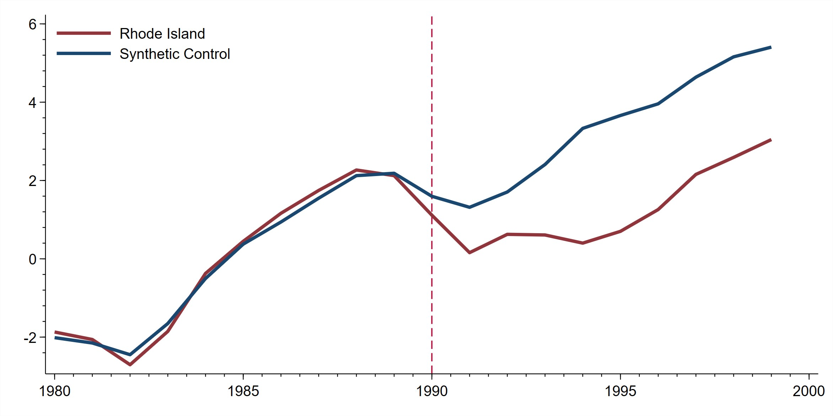
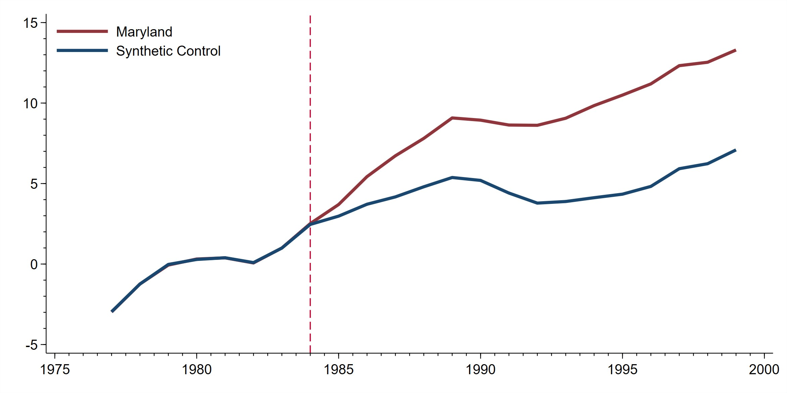
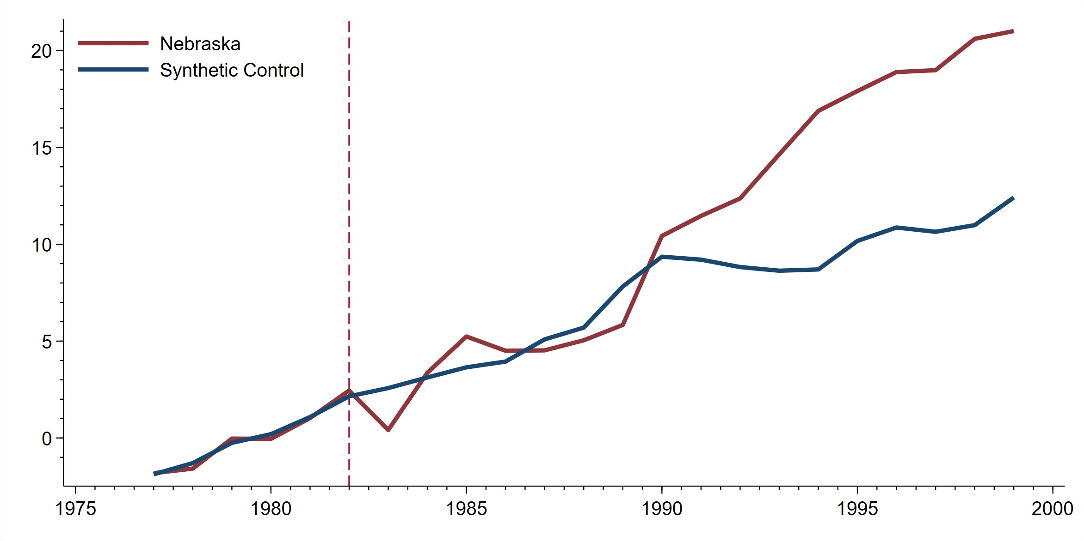
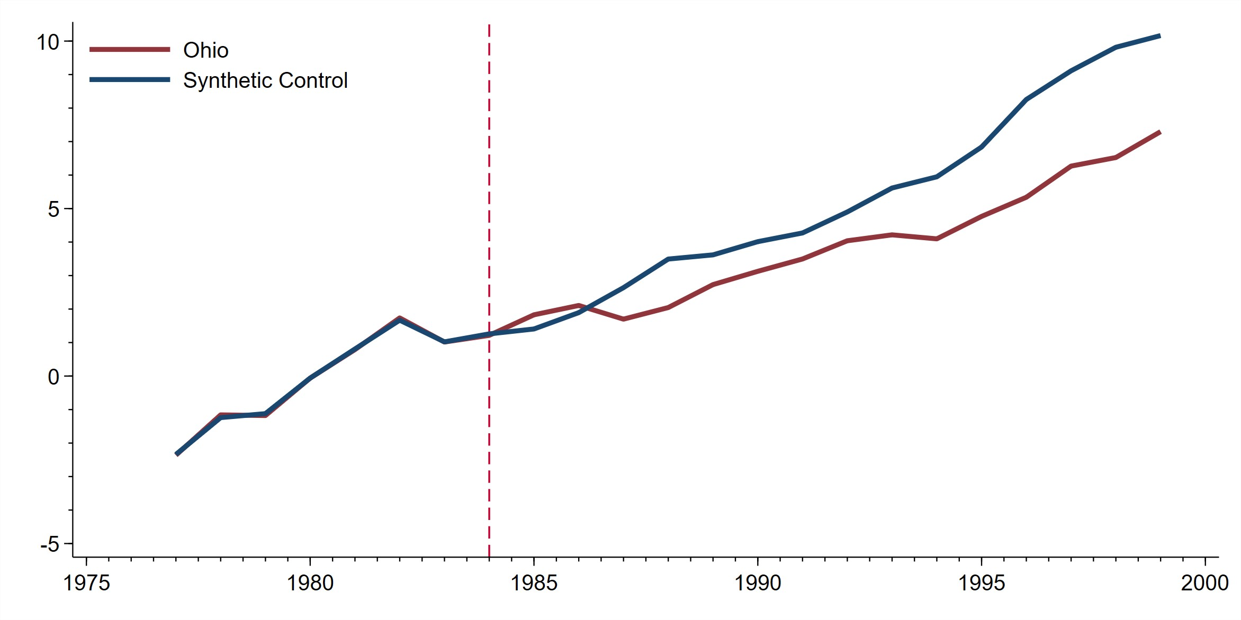
Robustness — First Principal Component
First principal component of unemployment, employment, labor force participation rate and GSP
Return
5 / 14

Slide 39
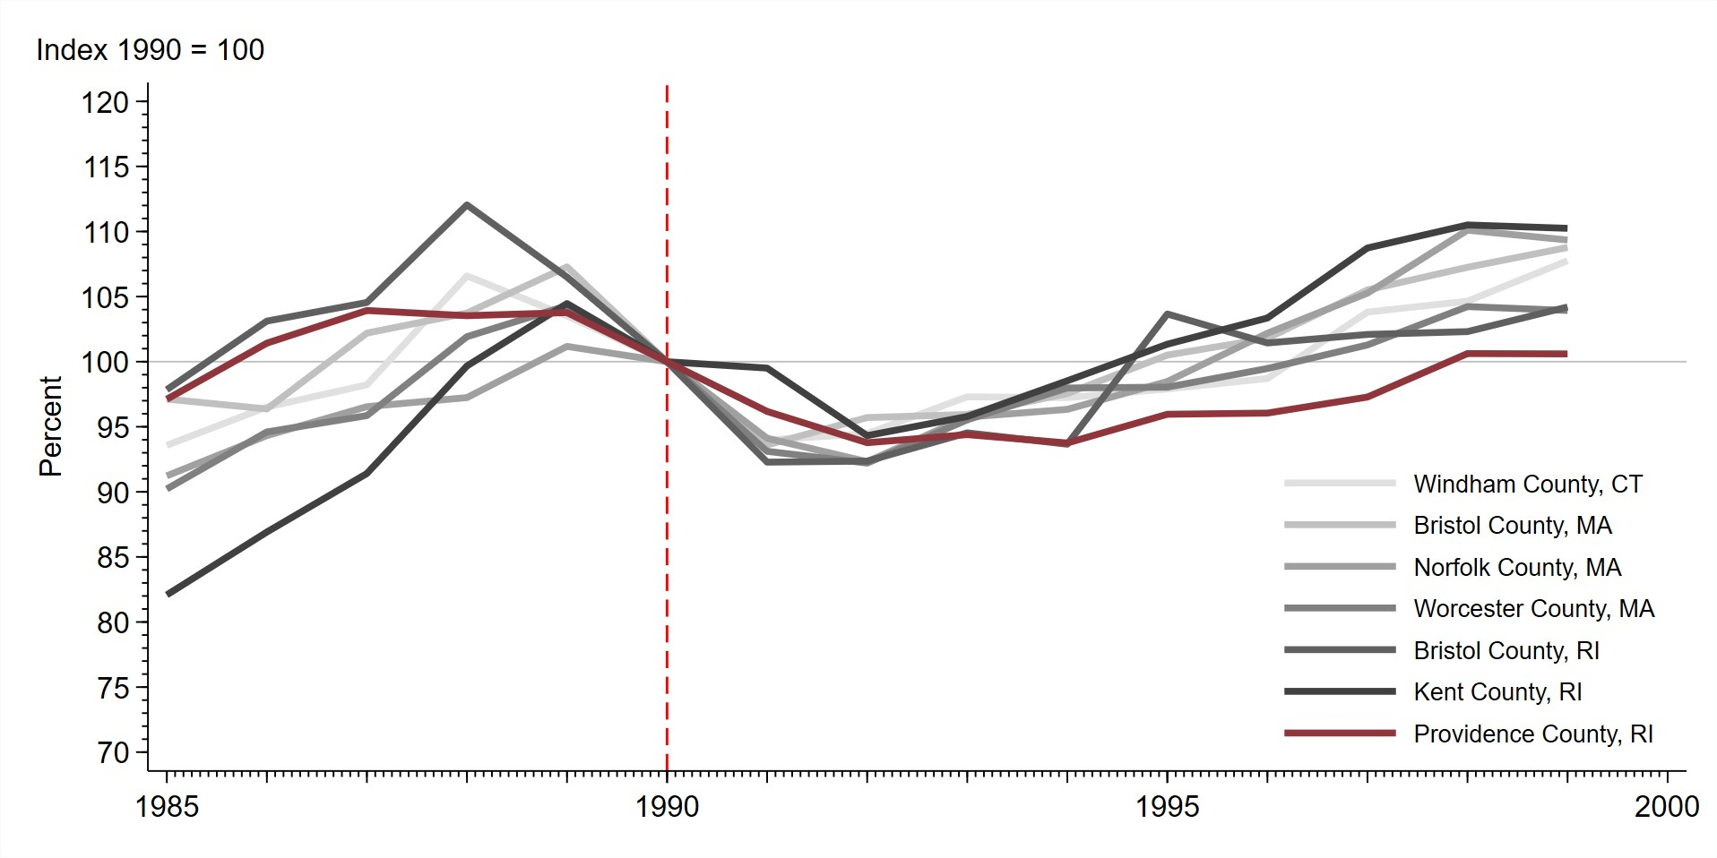
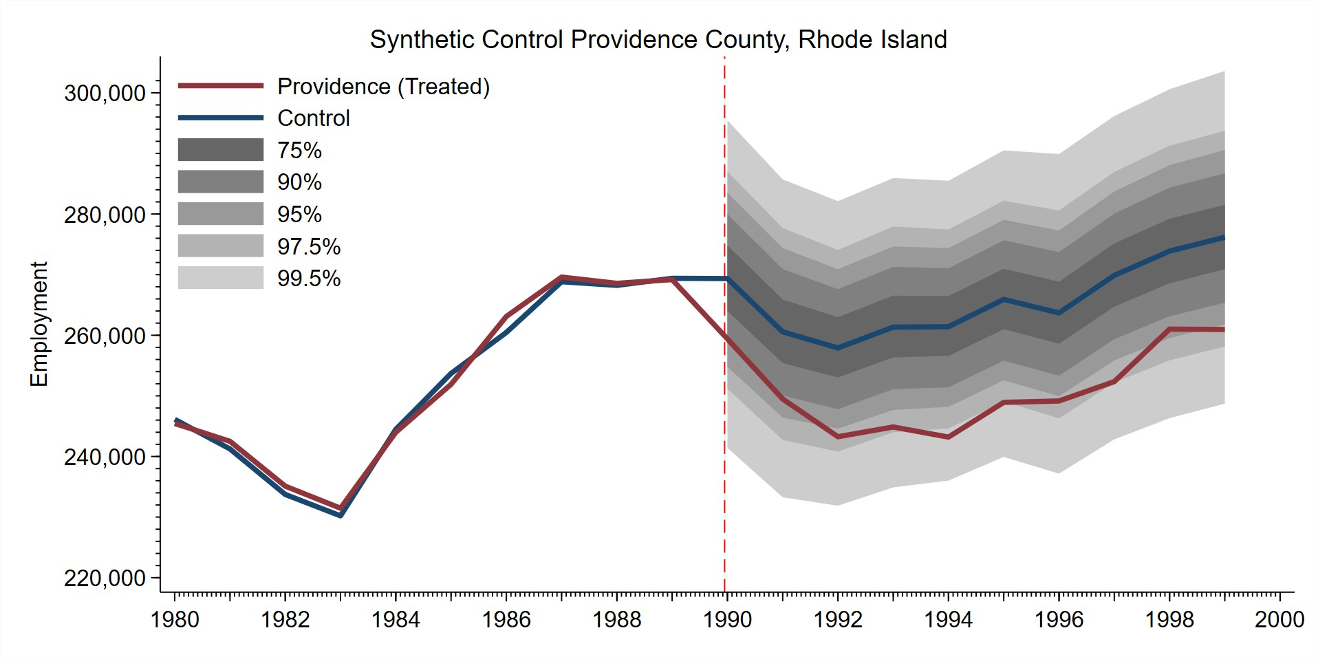
Robustness — County-level analysis
(a) County-level Border Comparison
(b) County-level Synthetic Control Results
Return
6 / 14

Slide 40
Robustness — Credit crunch in New England
Type of Lending
Total
Real Estate
C & I
Consumer
 | 1990 | 1991 |  | 1990 | 1991 |  | 1990 | 1991 |  | 1990 | 1991
Rhode Island | -7.1 | 0.7 |  | -8.0 | 20.5 |  | 6.1 | -14.8 |  | -19.6 | -26.3
Connecticut | -10.5 | -13.2 |  | -7.4 | -8.2 |  | -16.3 | -29.4 |  | -22.8 | -23.6
Maine | -5.6 | -7.5 |  | -5.1 | -5.0 |  | -5.0 | -21.8 |  | -8.6 | -2.0
Massachusetts | -13.2 | -13.3 |  | -9.9 | -11.0 |  | -16.3 | -14.7 |  | -23.0 | -18.5
New Hampshire | -11.5 | -11.1 |  | -7.4 | -11.4 |  | -20.5 | -25.8 |  | -16.4 | -0.8
Vermont | -0.1 | -4.1 |  | 4.5 | -0.4 |  | -14.6 | -10.8 |  | -2.5 | -15.0
Note:Year-over-year % growth for lending in each category on December 31.
Return
7 / 14

Slide 41
Metropolis-Hastings Algorithm
Define θ = {ψ, σ²}
Start with current draw θ^{c} from the prior f (θ)
p
ˆ
Draw the proposed value θ from the proposal density q(θ|Y ) = f (θ|θ, aH), where
tr T
ω
θ^{ˆ} = θ^{ˆ}_{MLE},
H is an identity matrix and a is a tuning parameter.
Accept θ^{p} with probability α_{MH} (θ, θ^{p}),
f
p p c
f (Y |θ )f (θ )q(θ |y)
p
tr
α_{MH} (θ, θ ) = min
^{1,} f (Y_{tr}|θ^{c})f (θ^{c})q(θ^{p}|y)
otherwise repeat the current value θ^{c}
MCMC Algorithm and Inference
8 / 14

Slide 42
Prior Hyperparameters and Tuning Parameter
Diffuse Prior distributions:
Parameter | Distribution | Prior Mean | Prior Std. Dev.
ψ | Normal | 0 | 5
_{σ}2
Gamma
90
22
a = [0.1, 0.1, ..., 0.1, 0.01]
.,
J ele m ents
MCMC Algorithm and Inference
9 / 14

Slide 43
All Other Series
Rhode Island
Maryland
Nebraska
Ohio
 | 2 year | 5 year | 2 year | 5 year | 2 year | 5 year | 2 year | 5 year
Per capita personal income | 0.765 | 0.753 | 0.071 | 0.205 | 0.083 | 0.017 | 0.684 | 0.806
All mortgages past due | 1.000 | 1.000 | 0.340 | 0.027 | 0.034 | 0.000 | 0.053 | 0.005
CredAbility Consumer Distress Index | 0.999 | 1.000 | 1.000 | 1.000 | 0.081 | 0.001 | 0.380 | 0.007
Bankruptcy filings per capita (Per thous people) | 0.999 | 0.998 | 0.172 | 0.796 | 0.985 | 0.204 | 0.003 | 0.003
Business Bankruptcy filings per capita (Per thous people) | 1.000 | 1.000 | 0.000 | 0.000 | 1.000 | 1.000 | 0.000 | 0.000
Nonbusiness Bankruptcy filings per capita (Per thous people) | 0.999 | 0.998 | 0.454 | 0.245 | 0.991 | 0.005 | 0.000 | 0.000
Rhode Island
Maryland
Nebraska
Ohio
2 year 5 year 2 year 5 year 2 year 5 year 2 year 5 year
Employment 0.892 0.939 0.304 0.256 0.228 0.261 0.316 0.200
Gross State Product 0.742 0.791 0.386 0.318 0.643 0.704 0.327 0.588
Return

Slide 44
Mechanisms in Theoretical Studies
Causes of Differential Effects in Recessions and Expansions
Theoretical models studying payment frictions: Rocheteau and Wright (2005); Bethune, Rocheteau and Rupert (2015); Silva (2016); Guerrieri and Lorenzoni (2009); Wasmer and Weil (2004), and Beaudry, Galizia, and Portier (2015)
Households pay with credit or liquid assets, endogenous credit limits:
During booms → high credit limits → limited impact of shocks to cash holdings
During recessions → credit constrained → firms and households respond strongly to payment shocks

Slide 45
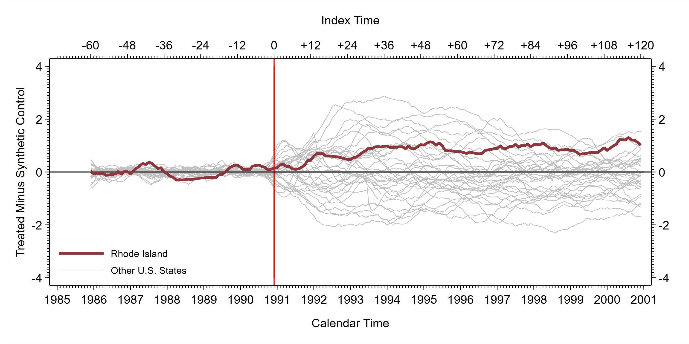
Robustness — Placebo: Other States
Return

Slide 46
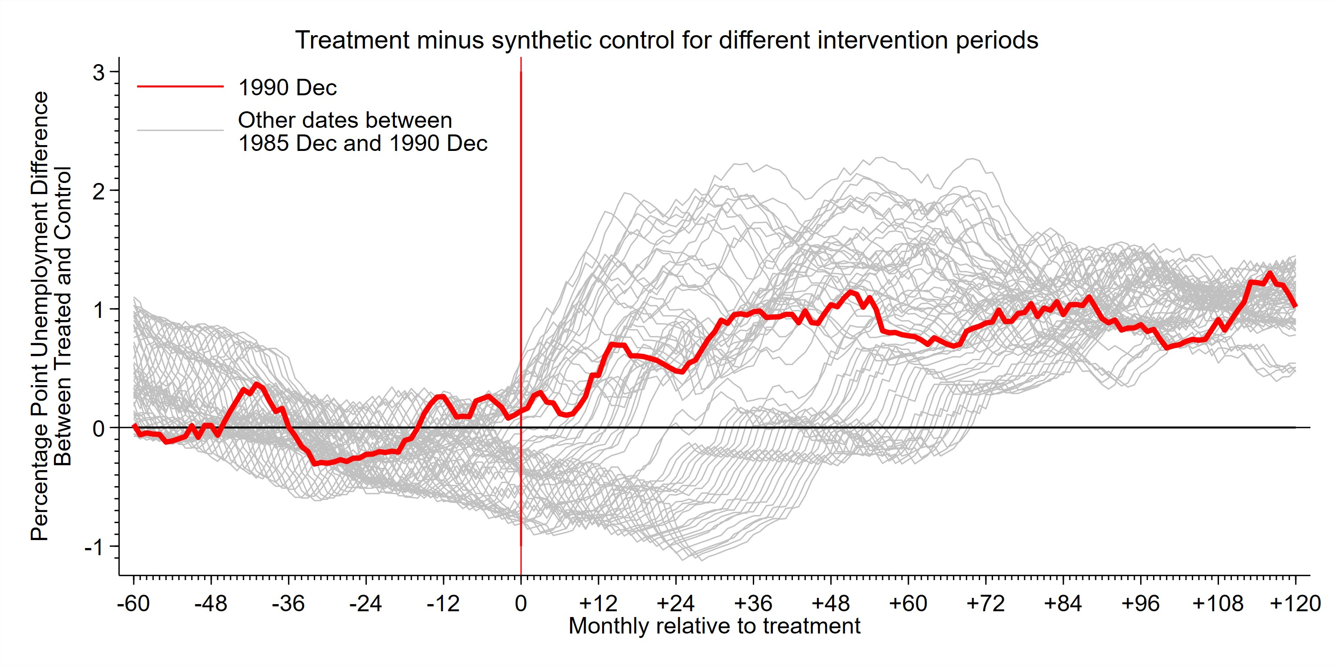
Robustness — Placebo: Other Intervention Periods
Return
13 / 14

Slide 47
References I
Abadie, A., A. Diamond, and J. Hainmueller (2010). “Synthetic Control Methods for Comparative Case Studies: Estimating the Effect of California’s Tobacco Control Program”. Journal of the American Statistical Association 105.490,
pp. 493–505.
Abadie, A. and J. Gardeazabal (2003). “The Economic Costs of Conflict: A Case Study of the Basque Country”. American Economic Review 93.1, pp. 113–132.
Born, B., G. J. Mu¨ ller, M. Schularick, and P. Sedla´cˇek (May 2019). “The Costs of Economic Nationalism: Evidence from the Brexit Experiment*”. The Economic Journal 129.623, pp. 2722–2744.
— (2020). “Stable Genius? The Macroeconomic Impact of Trump”. Journal of Money, Credit and Banking.
Chernozhukov, V., K. Wuthrich, and Y. Zhu (2018). “An exact and robust conformal inference method for counterfactual and synthetic controls”. arXiv preprint arXiv:1712.09089.
13 / 14

Slide 48
References II
Lagos, R. and G. Rocheteau (2009). “Liquidity in Asset Markets With Search Frictions”. Econometrica 77.2, pp. 403–426.
Lagos, R. and R. Wright (2005). “A Unified Framework for Monetary Theory and Policy Analysis”. Journal of Political Economy 113.3, pp. 463–484.
Li, K. T. (2019). “Statistical Inference for Average Treatment Effects Estimated by Synthetic Control Methods”. Journal of the American Statistical Association 0.0, pp. 1–16.
Richardson, G. and W. Troost (2009). “Monetary Intervention Mitigated Banking Panics during the Great Depression: Quasi-Experimental Evidence from a Federal Reserve District Border, 1929–1933”. Journal of Political Economy 117.6, pp. 1031–1073.
Rocheteau, G. and R. Wright (2005). “Money in Search Equilibrium, in Competitive Equilibrium, and in Competitive Search Equilibrium”. Econometrica
73.1, pp. 175–202.
14 / 14

