Slide 1

Revenue at Risk in Coal-Reliant Communities
Adele C. Morris, Ph.D. Senior Fellow
Policy Director, Climate & Energy Economics Project
Brookings
Noah Kaufman, Ph.D. Research Scholar & Director of
Carbon Tax Research Initiative
SIPA Center on Global Energy Policy Columbia University
May 21, 2020
Siddhi Doshi
Senior Research Assistant
Brookings
Notes:
It’s not in our title, but the backdrop of our paper is the severe risks of climate change and the need for strong public policies to address these risk
It’s widely understood that the coal industry will be hit hard by climate regulations, raising concerns about the future for industry workers
And *Corporations* have faced increasing demands by investors to disclose climate-related risks
But less attention has been paid to the risks facing coal-dependent local governments. That’s the topic of our study.
I’m going to spend a few minutes talking about coal production today and where it could be headed under climate policies
Then I’ll turn it over to Adele to speak about the dependence of a local governments on the coal industry.

Slide 2
Outline
US coal production:
Historical
Projections with and without climate policy
Fiscal implications for local governments
Municipal bonds from coal country
Policy options

Slide 3
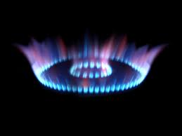
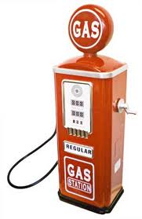
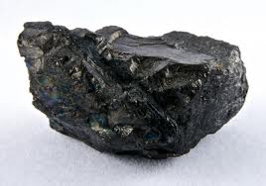
Coal is the most carbon intensive fuel and it has lots of substitutes

Slide 4
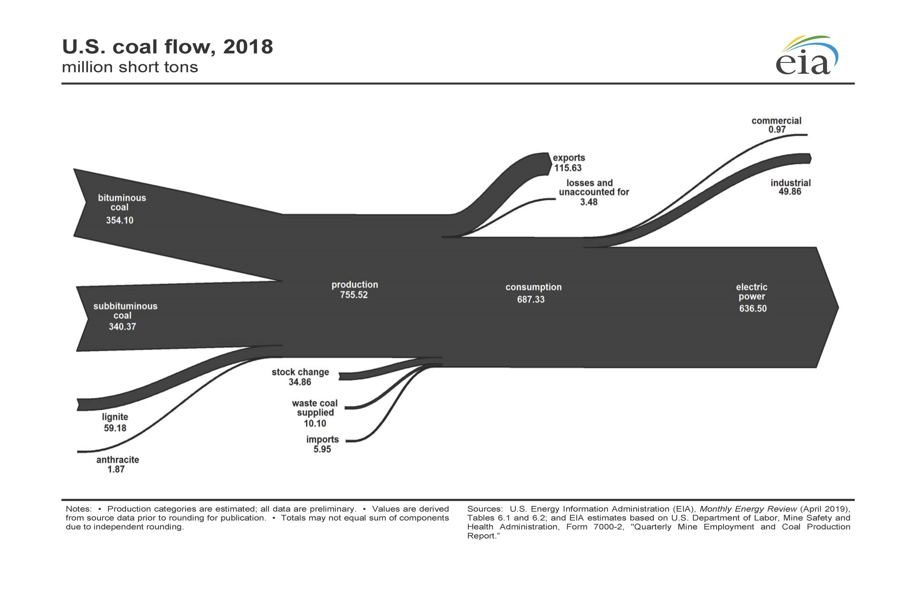
Almost all US coal is used for electricity production
Notes:
…where there are numerous cost-effective and lower-carbon alternatives to coal-fired electricity generation

Slide 5
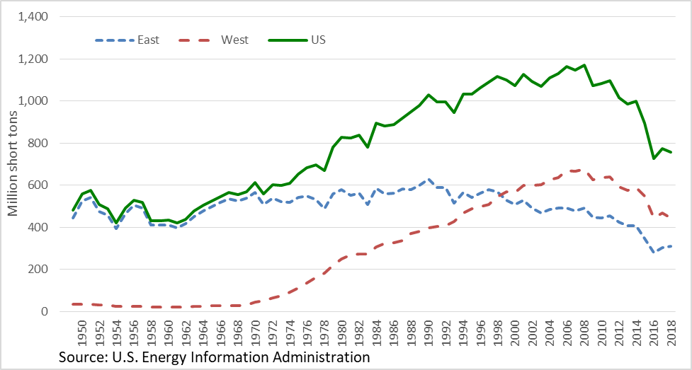
Figure 1. Annual US coal output has fallen
Million short tons of coal

Slide 6
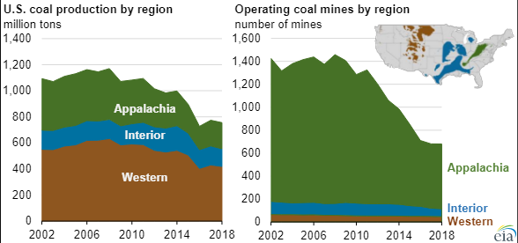
U.S. coal production has dropped
disproportionately in Appalachia
Notes:
The decline was limited primarily to Appalachia initially, but recently the Western region, like the Powder River Basin, has not been immune.

Slide 7
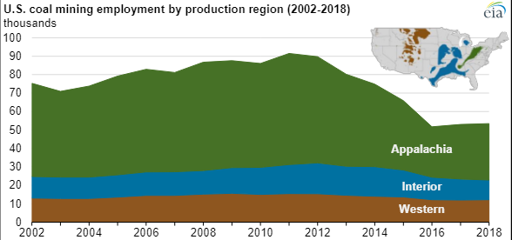
U.S. coal employment has fallen 42% since 2011

Slide 8
Fig. 3. Industrial uses are not making up for declining use in US power sector
Notes:
Coal isn’t the leading source of US electricity that it was in the early 2000s.
But the US still produces a lot of coal: about 700 million tons of coal per year makes us the worlds 2nd or 3rd largest producer behind China.
Over 90% of all US coal used is in the power sector
Coal production has fallen rapidly since 2007

Slide 9
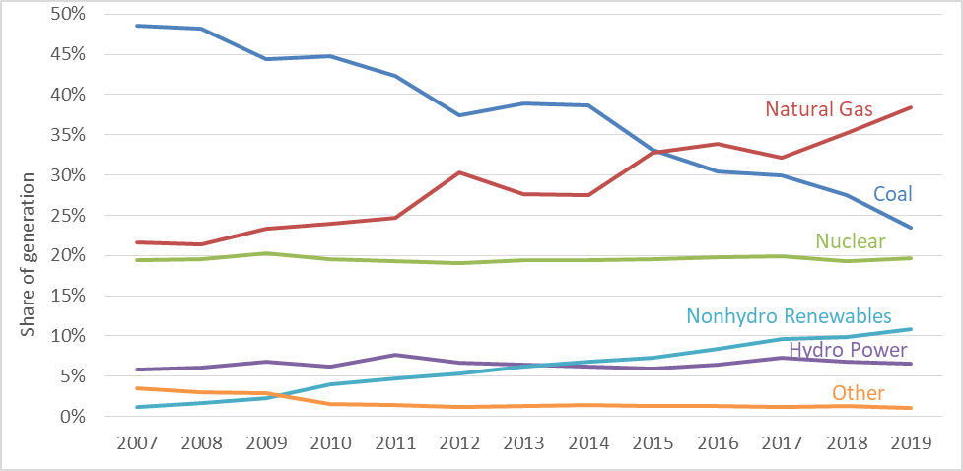
Figure 2. Natural gas & renewables are gaining share in power generation.
Percent of US power generation, by fuel
Notes:
…and the predominant cause of the decline was the fall of natural gas prices.
Because it was mostly market forces, that means it’s not certain that fall will continue, and it also means that looking backward, this idea that the government is killing coal is mostly nonsense.
However, looking forward is a different story…climate regulations are indeed an existential threat to the coal industry.

Slide 10
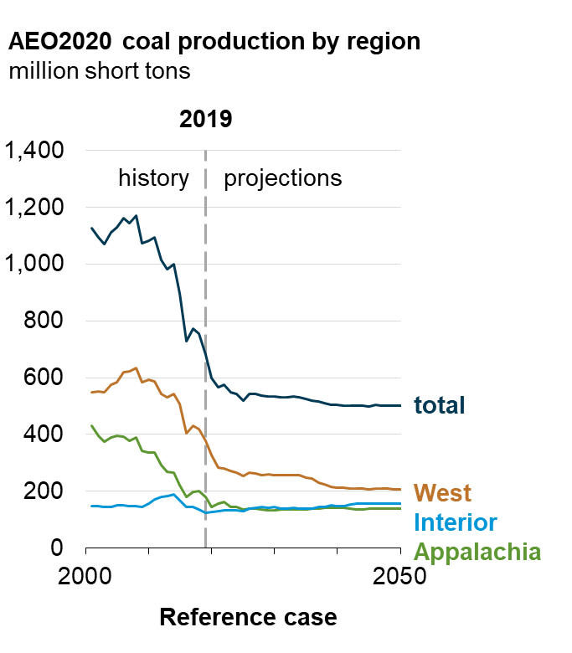
Projections with no new climate policy
Notes:
Projections do not include effects of the pandemic. (AEO projections are likely a rosy scenario)
Looking forward is a different story…climate regulations are an existential threat to the coal industry.

Slide 11
What happens to US coal production
under climate policy?
US Energy Information Administration’s Annual Energy Outlook (AEO 2018) modeled:
-- a price on CO₂ from the power sector (only)
-- $25 /ton CO₂ in 2020, rising at 5 % real annually
Projections help anticipate a range of possible outcomes
Large uncertainties around policy & model assumption/parameters
Notes:
As a proxy for the potential impacts of climate policy on the US coal industry, we used publicly available modeling from the US government, although other studies show broadly similar results.
This scenario assumes a carbon price that starts at $25/ton is applies only to power sector emissions. This policy far weaker than most of the current climate policy proposals in Congress
The purpose these types of exercises is not to make precise forecasts but rather to get a rough sense of the magnitudes of potential impacts on coal production – for our paper we are concerned about RISKS, or the distribution of possible outcomes.

Slide 12
Fig. 5. CO₂ Price Case: Total US Coal Production
Absent new policies, production may fall 15%-25% by 2030
77% reduction
from 2016 to 2030
Source: U.S. EIA’s $25+ per ton of CO₂ “side case” from Annual Energy Outlook 2018
Notes:
This figures shows US coal production, which collapses under this carbon price
Coal is the most carbon-intensive fuel: this policy would cause the price of average ton of coal to more than double. And its substitutes in the power sector—natural gas, solar, wind– are just too cheap to keep using coal in this scenario.
Note that projections suggest that under current policies coal production will continue to decline gradually over the next decade, but a climate policy scenario is a cliff. This is the fraught scenario facing coal-reliant communities that we talk about in our paper.

Slide 13
Fig. 6. CO₂ Price Case: Powder River Basin Coal Production
95% reduction
from 2016 to 2030
Source: U.S. EIA’s $25+ per ton of CO₂ “side case”
from Annual Energy Outlook 2018
Notes:
No coal producing region is immune from this. Wyoming gets hit the worst because of the type of coal it produces. Coal production is almost eliminated in the 2020s.
***
Wyoming, the largest coal-producing state in the United States, produced 41% of total U.S. coal production and 73% of the coal mined in the Western coal region.
Powder River Basin coal is overwhelmingly subbituminous coal from surface mines that is burned at power plants in the United States: the CO2 price makes this type of coal about 3x more expensive: it cannot compete with alternatives like NG and renewables

Slide 14
Fig. 7. CO₂ Price Case: Appalachia Coal Production
50% reduction from 2016 to 2030 (80% in northern Appalachia)
Source: U.S. EIA’s $25+ per ton of CO₂ “side case” from Annual Energy Outlook 2018
Includes northern, southern, and central Appalachia
Notes:
Production in the Appalachian region is somewhat better off, in part because this policy only covers the power sector and it produces coal for other uses, but coal production in Appalachia collapses also.
produces about 25% of US coal (Pennsylvania, Ohio, Maryland, West Virginia, VA, AL parts of KY and TN)
Collapse is less severe due to in part to the production of met coal which is not used in US power sector (so fewer cost-effective alternatives, and it’s not covered by this illustrative policy)

Slide 15
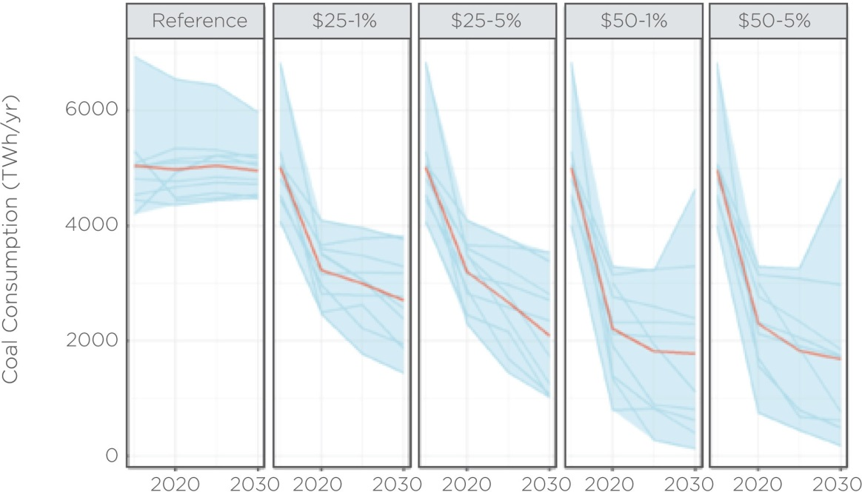
Figure 8. Four carbon tax trajectories reduce US coal consumption relative to reference in EMF 32
Initial carbon tax rates per metric ton of CO₂ in 2020 - rate of annual real increase in tax. (2015-2030)
Blue bands represent the range of model results. Darker blue lines = individual model results; red lines = average value. Source: https://www.worldscientific.com/toc/cce/09/01
Notes:
Other models show similarly severe outcomes from climate policies

Slide 16
What won’t “save” coal
Repeal of Clean Power Plan and other regulations
Carbon capture and storage
Exports
Industrial and metallurgical uses
Turning coal into high-value carbon fiber
Re-opening of retired power plants
A rapid recovery from current recession
Notes:
Coal – fiber transformation uses coal tar pitch (a by-product of metallurgical coal use) to make carbon fibre for use in aerospace, automotive, sporting goods, and other high-performance materials.

Slide 17
What will hasten coal’s demise
Federal and state climate policy
Continuing low natural gas prices and competition from renewables
Worsening credit-worthiness and retreating investors
Expensive insurance
States redressing insufficient bonding
Climate action abroad
Source: https://ieefa.org/wp-content/uploads/2020/03/US-Coal-Outlook-2020_March-2020.pdf
Notes:
Coal – fiber transformation uses coal tar pitch (a by-product of metallurgical coal use) to make carbon fibre for use in aerospace, automotive, sporting goods, and other high-performance materials

Slide 18
Local government dependence on coal is poorly measured
Local
Govt
Coal Revenue:
Severance tax
Royalties
Lease bonus & rents
Property tax
Investment income
Coal conversion tax
Waste coal tax
Sales and use tax
Reallocation tax
Business income tax
Personal income tax
Public Services:
School systems
Capital construction funds
Highways and roads
Water districts
State govt
(incl. trust funds)
Notes:
What are the fiscal implications of those climate policy scenarios in coal-producing areas?
In any given state, coal production results in a half dozen or more revenue streams.
Very hard to follow the money from there to local governments. Why?
Coal revenue comes from many instruments, each with complicated policy design – varies by state.
Coal revenue may go directly to county governments, school districts, and other local jurisdictions.
Revenue may go first to a state government or trust fund, and then back out to local governments.
States may use coal $ to pay for expenses that would otherwise have to be covered by counties, like road construction and maintenance.

Slide 19
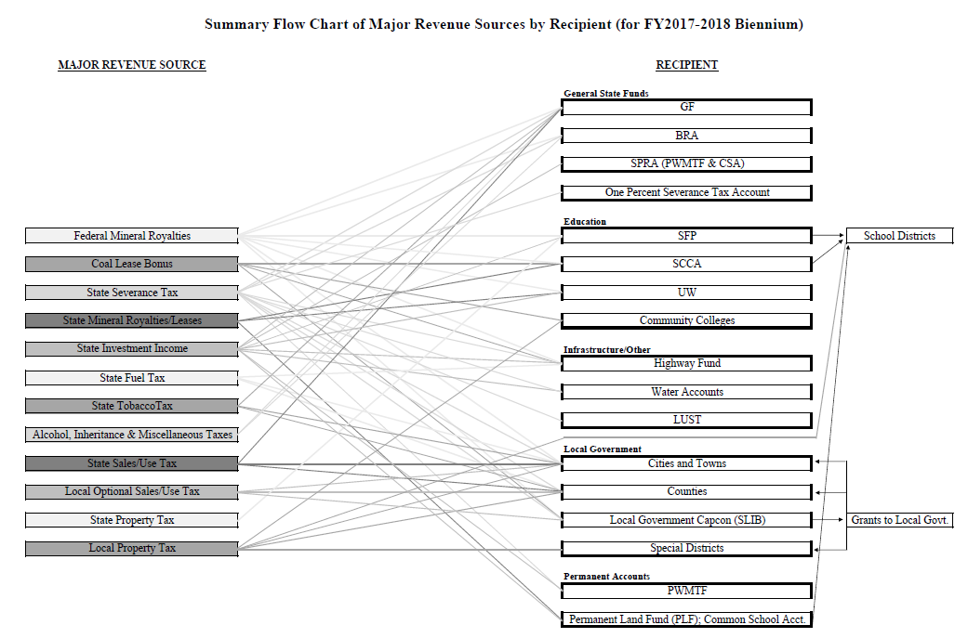
Flow Chart of Major Revenue Sources
Sources
Wyoming 2017
Recipients
Roughly 33 streams from
coal revenue to recipient
Federal royalties
Coal lease bonus
State severance
State royalties
State investment income
Source: WY 2017 Budget Fiscal Data Book
Notes:
To illustrate, this is a flow chart for the revenue sources into Wyoming government and where they go.
The top four or five boxes on the left all relate to fossil fuel production, including severance tax, federal and state mineral royalties, and coal lease bonuses. The chart shows there are about 33 distinct flows from those revenues to substate jurisdictions and special funds.
Federal royalties alone have about 8 destinations across government functions.
One problem in tracking the $ is that frequently the budget data don’t break coal out from oil and gas, so it’s hard to see into the most risky revenue source.

Slide 20
12 most coal-reliant US counties by 2015 employment share
Notes:
Since the flows are so hard to follow, we decided to zoom in on 3 illustrative coal-reliant counties in 2 different states and see what we could learn: Boone County, WV; Campbell County, WY; and Mercer County, ND. Each had at least 15% of workforce in coal mining in 2015.

Slide 21
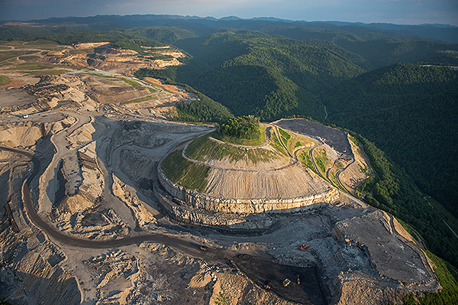
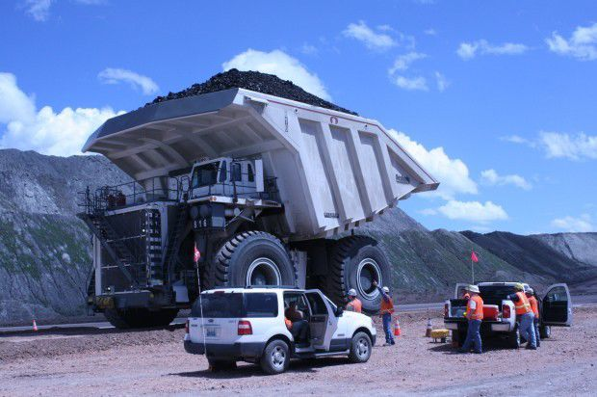
Three mining-intensive counties…
Significant data limitations
Boone County, WV (pop. 22,000)
70% decline in coal from 2012-2017;
-> 38% decline in county govt revenue.
Campbell County, WY (pop. 46,170)
Two largest revenue sources tied strongly to coal
Mine bankruptcies thwart tax collection
Mercer County, ND (pop. 8,267)
Coal severance, coal conversion, and royalties
provide around 1/2 revenue to county
government (as of 2016)
Notes:
First, all of them were hard to analyze owing to limited information on exactly what revenue comes from coal. E.g. minerals subject to severance tax, or share of property tax base
Boone County could illustrate what can hit the others. Coal production fell 70% between 2012 and 2017, resulting in a 38% decline in revenue to the county government. Key coal-related revenue sources are severance tax and property tax on mining assets. Painful cuts: closing 3 of ten elementary schools, other cuts in services. In their bankruptcy, mining companies try to discharge their reclamation liabilities.
In 2015, 57% of prop tax base was coal
Campbell County: Coal is a large share of its two largest revenue sources: property and production tax & sales and use tax. Starting to see the fiscal upheaval, with recent mine closures.
Revenue: 51% from property & production tax; 19% sales and use
59% of prop & prod tax base is coal; 29% sales & use are minerals
Mercer County, ND: local govt gets coal severance tax, coal conversion tax, and mineral royalties. Hard to tell what royalties are specifically from coal, but in 2016, half of all revenue came from those 3 sources.

Slide 22
County revenue’s relationship to coal production
Table 1. Summary statistics for 27 coal-reliant counties
All 27 Coal-Intensive Counties 2012-2017 | Mean | Standard Deviation | Minimum | Maximum
All revenue (2018 $1,000) | 95,225 | 117,124 | 7,071 | 524,884
County revenue (2018 $1,000) | 30,232 | 33,230 | 1,840 | 147,035
Coal production in short tons, lagged one year (1,000) | 22,895 | 67,457 | 654 | 389,022
Share of coal employment in labor force | .133 | .038 | .084 | .214
Note:
Total revenue includes county government revenue and revenue to special and school districts.
County government revenue is the revenue that goes directly to the county government.
Data do not include revenue to townships.

Slide 23
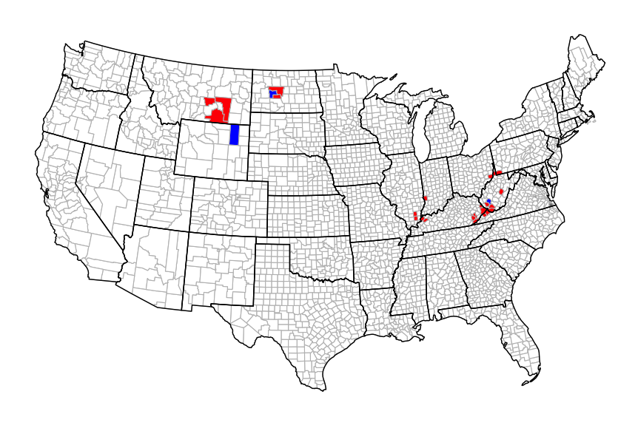
27 Coal-intensive counties
10 different states

Slide 24
Regression equation
Revenue_{it} = c + β(coal production)_{it-1} + S_{i} + Y_{t} + ε_{it}
S_{i} : state indicators for each county
Y_{t} : year indicators
ϵ_{it} : error terms
The estimated coefficient β is the relationship between lagged coal production and revenue to the county.

Slide 25
Panel regressions of government revenue on lagged coal production
 | (1) | (2)
 | Total revenue, All 27 coal-dependent counties | County govt revenue, All 27 coal-dependent counties
County-level coal production, lagged by one year | 0.812** (2.96) | 0.351** (2.97)
Constant | 65,634,720*** (3.53) | 8,476,680 (1.06)
Observations | 140 | 140
R² | 0.941 | 0.864
p < 0.05, ** p < 0.01, *** p < 0.001
(t statistics in parentheses)

Slide 26
Estimation implications
A decrease in coal production of 1,000 short tons will decrease expected total revenue by $812.
In 2018, the national avg. coal price was $36 per short ton.
The average decrease in coal production for 27 counties from 2012 to 2017 was 3.5 million short tons.
Applying β => an average decrease in total revenue of $2.8 million per county from 2012 to 2017.
Mean total revenue is over $95 million, so no big deal.
But, if relationship holds outside the sample, eliminating ALL coal production in a county with mean coal production of 22.9 million short tons
=> expected total revenue falls by $18.6 million or 20 percent of mean
Doesn’t account for potential death spiral of fiscal and economic deterioration.
Doesn’t account for mitigating policy responses.

Slide 27



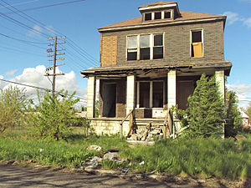
Downturn in a key industry can set off negatively reinforcing dynamic
Experience from other contexts:
Coal in South Wales, United Kingdom
Steel in Aliquippa, Pennsylvania
Automobiles in Detroit, Michigan
Textiles in Greenville, South Carolina
Notes:
Case studies show that the rapid decline of a dominant industry can lead to downward spirals and eventual collapses of local governments’ fiscal conditions, including the inability to raise revenue, repay debt, and provide basic public services. Outmigration, decline of the tax base, abandoned properties, and blight reinforce each other.
Case studies also show the limited success of steps policy makers have taken to mitigate adverse impacts.
Note: we are not claiming the rapid collapse of coal regions is certain. It may not even be likely. But even if you think the chances or 1 in 2, 1 in 5, or even 1 in 10, and the implication of that outcome are the collapse of the local economy and government, these are risks that residents need to know about, investors need to know about, and policymakers need to seriously grapple with.

Slide 28

We reviewed 7 outstanding
bonds from Campbell and Mercer Counties
Principal: $3.5 million to $445 million
Terms of 20 to 30 years;
Maturing in 2022 – 2039
Risk disclosure in official statements is limited or nil
Vague references to dependence on the economy
Only two mentioned climate/environment policy risks
One characterized coal-intensive economy as positive
Ratings arguably under-appreciate risks, especially from climate policy
Some bonds received downgrades, e.g. A+ to A
All with ratings are investment grade or higher

Slide 29
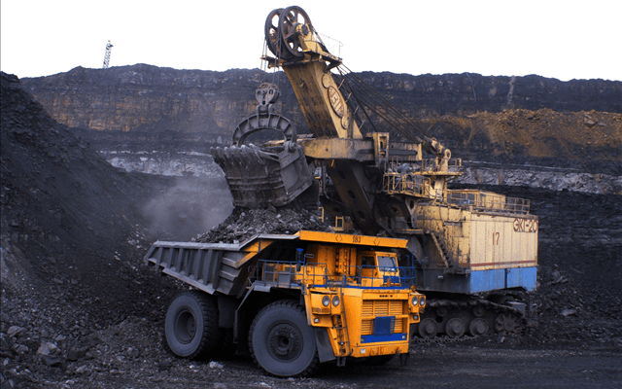
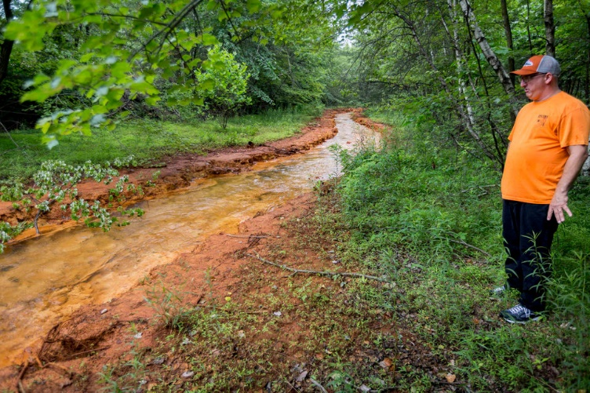
Coal country challenges and policy options
Transparent accounting of budget dependence on coal
Diversify rural economies and update tax systems
Backfill lost coal-related revenue
Miner retirement/health care benefits
Replenish black lung liability trust fund
Finance mine reclamation
Reform bankruptcy
Improve water quality
https://www.brookings.edu/research/the-risk-of-fiscal-collapse-in-coal-reliant-communities/

Slide 30
Concluding thoughts
The transition: we are already in it
Climate action will amplify economic deterioration in coal country.
A tiny share of carbon tax revenue could fund transition assistance.

Slide 31
U.S. Carbon Pricing Bills, 216th Congress
Energy Innovation and Carbon Dividend Act of 2019 (H.R.763) Reps. Deutch (D-Fla.) and Rooney (R-Fla.) Jan. 24, 2019
Healthy Climate and Family Security Act of 2019 (S.940 and H.R.1960) Sen. Van Hollen (D-Md.) and Rep. Beyer (D-Va.) March 28, 2019;
American Opportunity Carbon Fee Act of 2019 (S.1128) Sens. Whitehouse (D-R.I.), Schatz (D-Hawaii), Heinrich (D-N.M.), and Gillibrand (D-N.Y.) April 10, 2019
The Climate Action Rebate Act of 2019 (S.2284 and H.R.4051) Sens. Coons (D-Del.) and Feinstein (D-Calif.), and Rep. Panetta (D-Calif.) July 25, 2019;
The Stemming Warming and Augmenting Pay Act of 2019 (H.R.4058) Reps. Rooney (R-Fla.) and Lipinski (D-Ill.) July 25, 2019;
The Raise Wages, Cut Carbon Act of 2019 Act of 2019 (H.R.3966) Reps. Lipinski (D-Ill.) and Rooney (R-Fla.) July 25, 2019
The America Wins Act of 2019 (H.R.4142) Rep. Larson (D-Conn.) August 2, 2019
The Modernizing America with Rebuilding to Kickstart the Economy of the Twenty-first Century with a Historic Infrastructure-Centered Expansion Act of 2019 Reps. Fitzpatrick (R-Pa.) and Carbajal (D-Calif.) September 26, 2019.
Plus proposal by the Climate Leadership Council, authored by James Baker and George Shultz
Notes:
Now it’s time to deal with power plants, the biggest source of carbon pollution.

