Slide 1
WHAT WE KNOW AND DON’T KNOW ABOUT CLIMATE CHANGE,
AND IMPLICATIONS FOR POLICY
Robert S. Pindyck
M.I.T. and NBER
May 2020

Slide 2
INTRODUCTION AND OVERVIEW
What We Know and Don’t Know about Climate Change:
  Things we know.
  Things we don't know, and why we don't know them.
  Why do we think we know more than we do?
  IAMs and related models not helpful.
  Will we soon know a lot more?
A Possible Catastrophic Outcome:
  What matters for policy is the chance of catastrophic outcome.
  Why? Why don't “most likely” estimates matter?
  How to assess likelihood and possible impact of catastrophe?
Policy Implications of Uncertainty.
  Before imposing costly policies, wait until we know more? No.
  Insurance value of early action.
  Role of irreversibilities.
What to Expect. Answer: T > 2.0°C. Must prepare for this!

Slide 3
WHAT WE KNOW AND DON’T KNOW
What We Know:
  Emissions of CO₂ generated by economic activity, and accumulate in atmosphere. CO₂ concentration is increasing. But: How much economic activity to expect over next 50 years?
  CO₂ is the important GHG. Stays in atmosphere a long time. Methane less important. How much atmospheric CO₂ to expect in next 50 years?
What We Don’t Know:
  How will increase in CO₂ concentration affect temperature?
  How will higher temperatures (and sea levels, etc.) affect GDP?
  What discount rate to use to value future costs and benefits?
  Climate change on net is bad, but how bad? What is SCC?
  Can’t we use Integrated Assessment Models (IAMs) to estimate the SCC? Many have been built. They are largely useless.
Policy Implications: Stay until the end to find out.

Slide 4
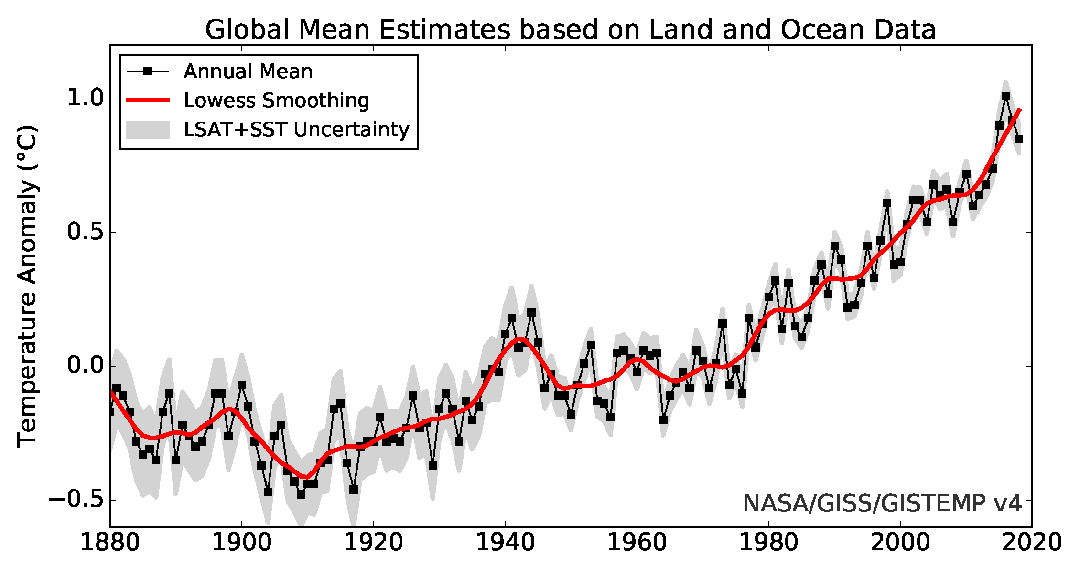
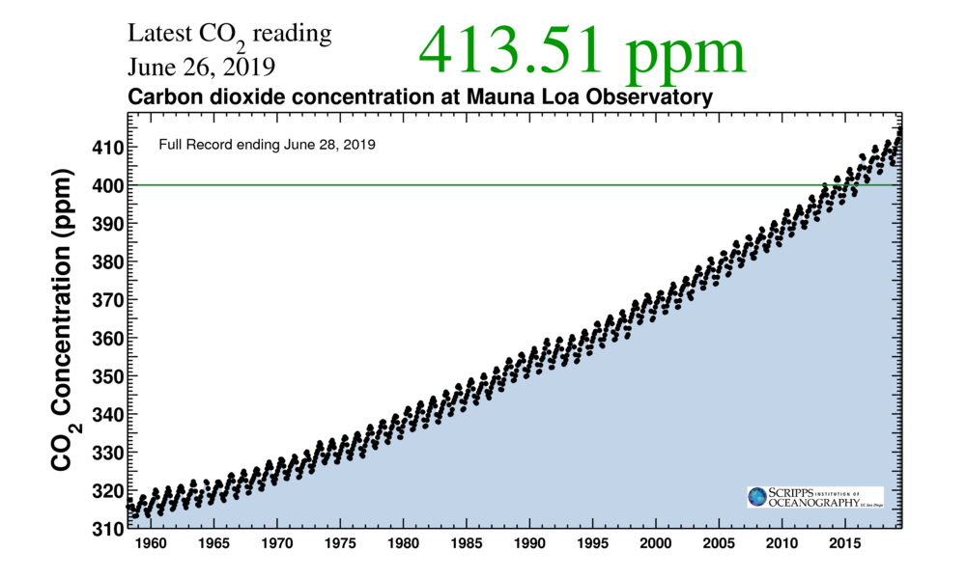
SOME BASIC FACTS
Temperature:
CO₂ Concentration:

Slide 5
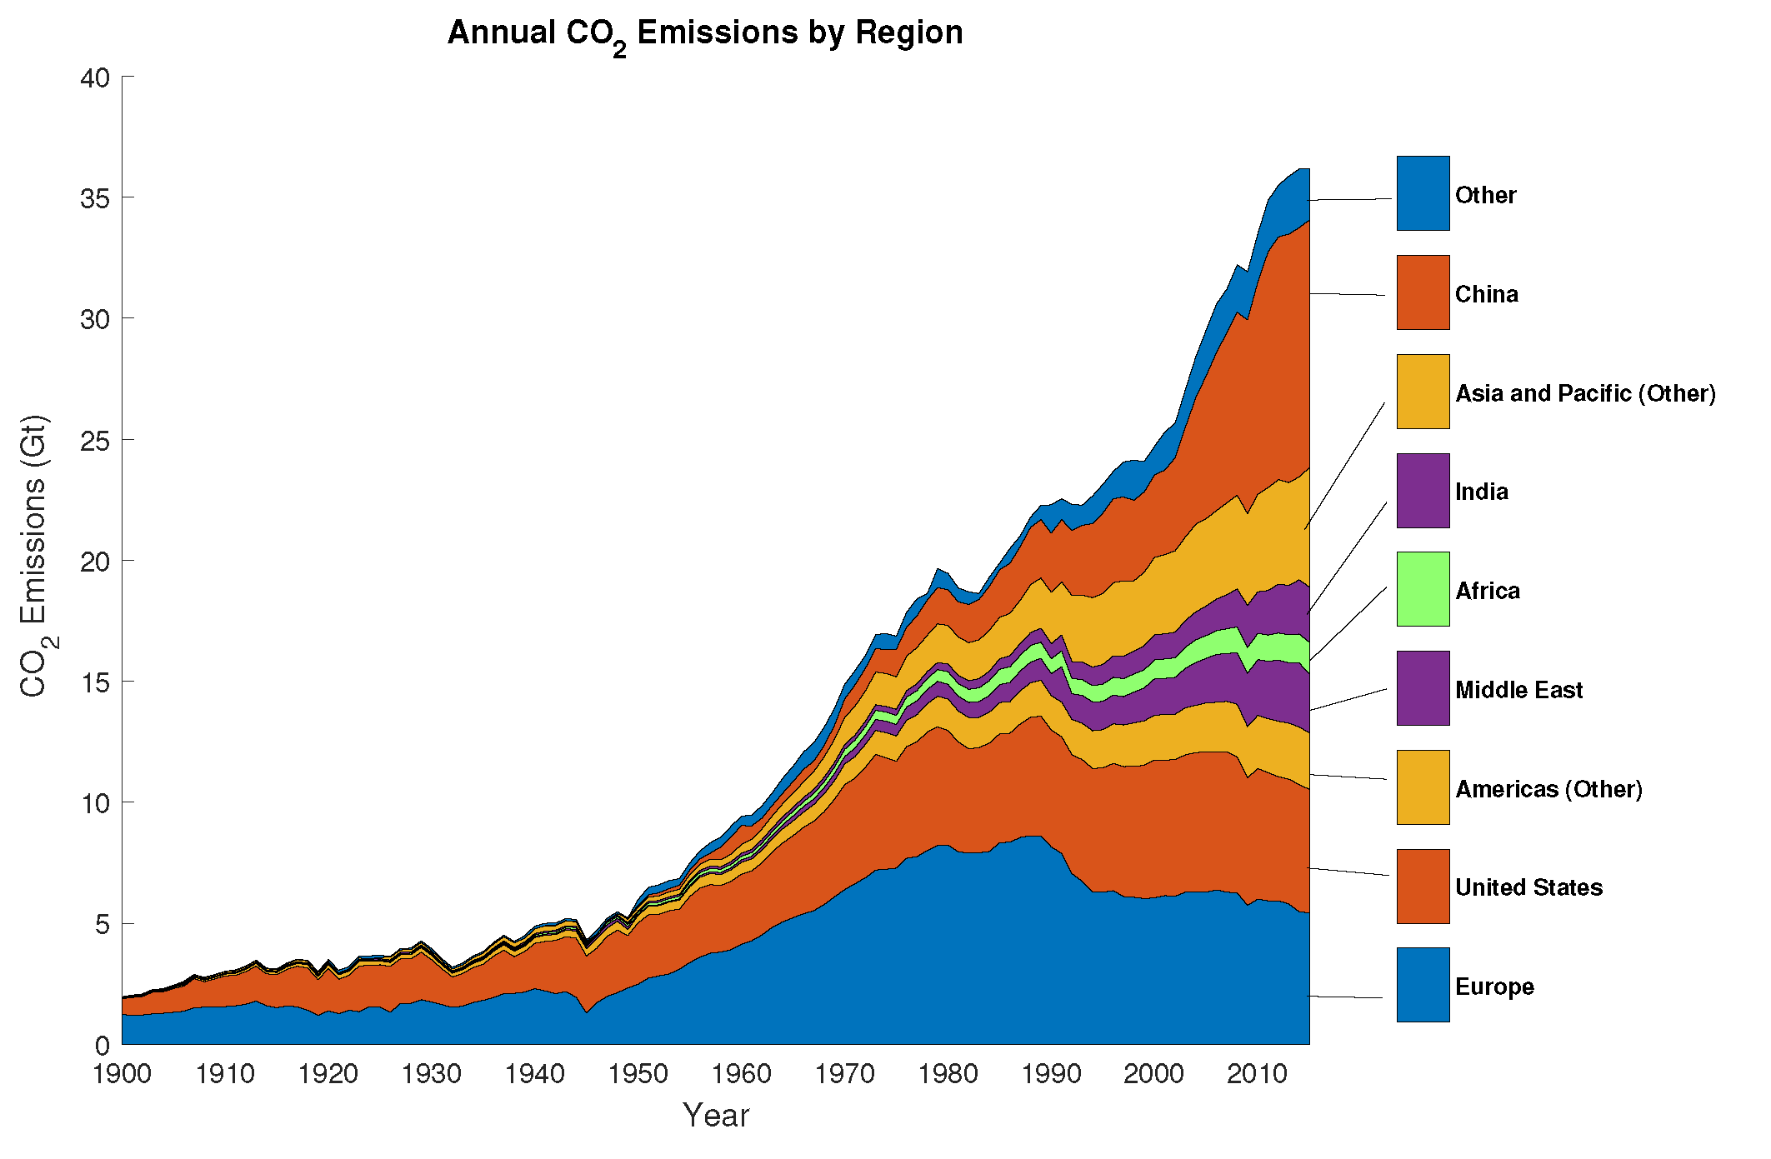
SOME MORE FACTS
CO₂ Emissions:

Slide 6
WHAT WE KNOW (OR SORT OF KNOW)
What Drives CO₂ Emissions:
  Economic activity (GDP), but how much CO₂ per $ of GDP? What will happen to GDP and to carbon intensity?
  Carbon intensity is energy intensity times energy efficiency.
    Energy intensity: Quad BTUs per $ billion of GDP.
    Energy efficiency: Mt of CO₂ per quad BTUs.
    Carbon intensity: (Quad BTUs/$ billion) X (Mt CO₂/quad BTUs) = Mt CO₂ /$ billion
  What Happened/Likely to Happen to Carbon Intensity?
  Energy intensity: Declined in US, Europe, China (because GDP was so low); but not India or other developing countries.
  Energy efficiency: Better in Europe, US. But no change in China, …
  Carbon intensity: Path similar to energy intensity. For world, 0.69 Mt CO₂ /$B in 1980 to 0.46 in 2018, about 1/3 decline.

Slide 7
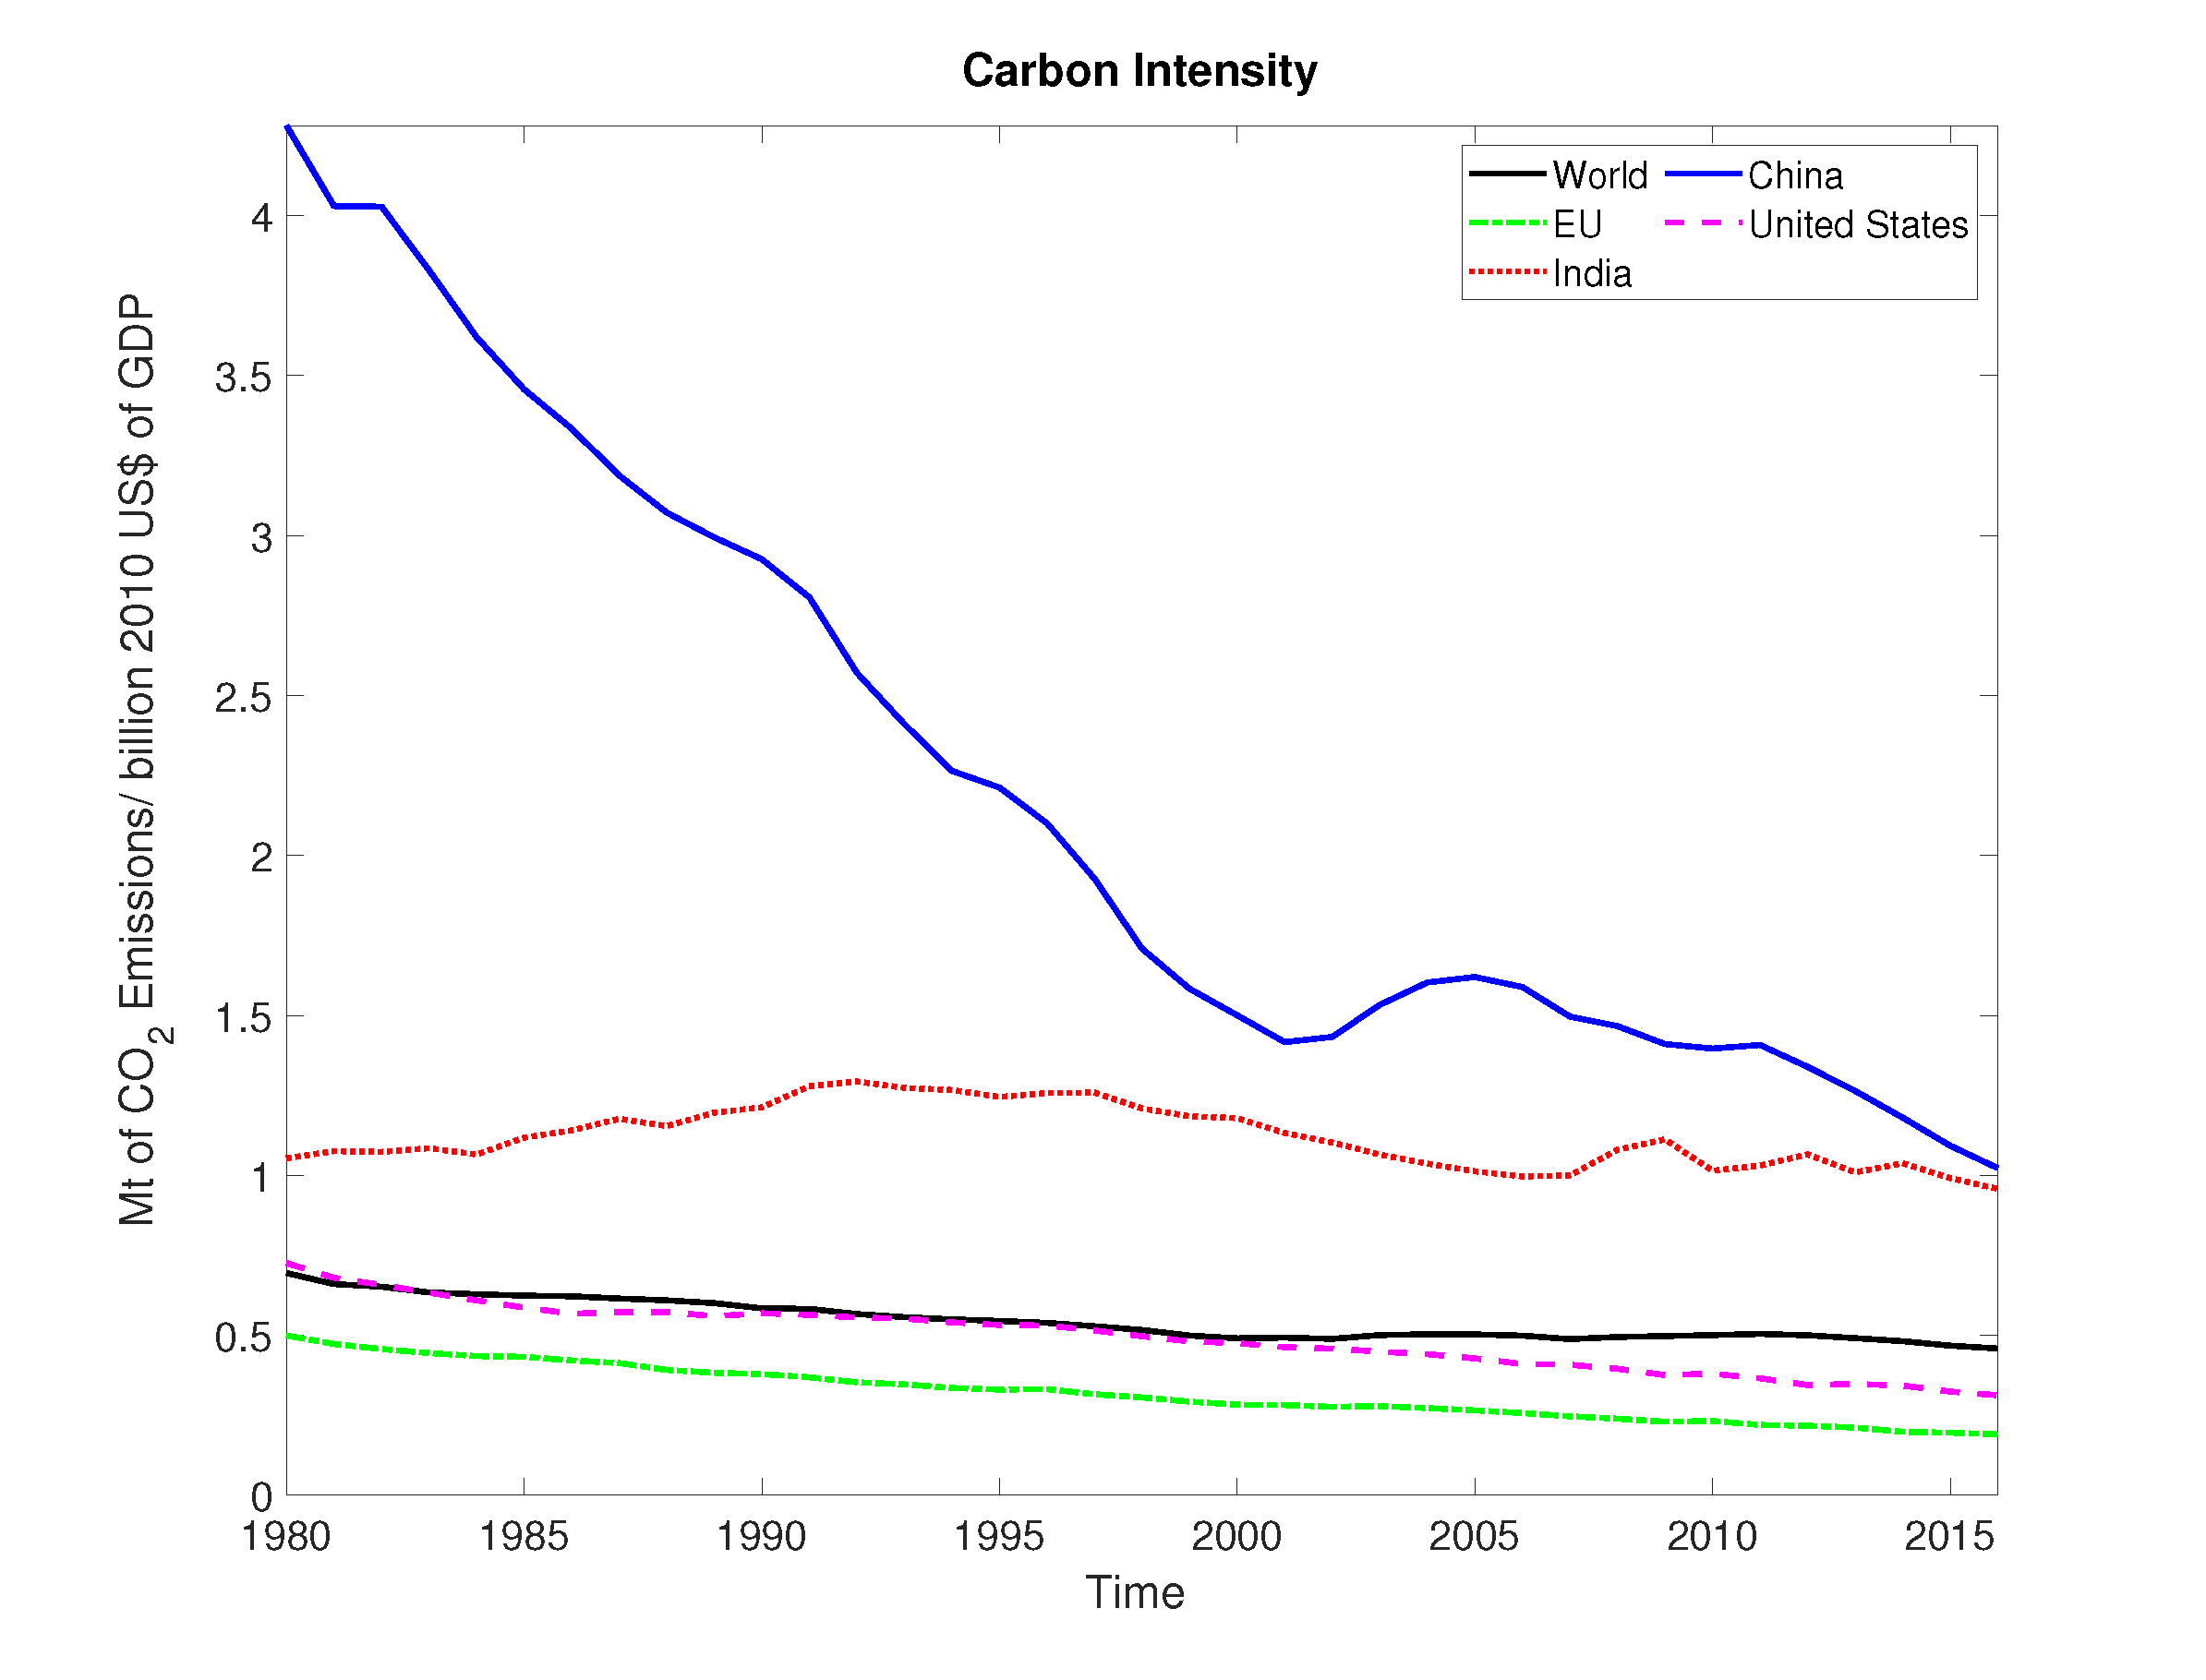
CARBON INTENSITY
  Carbon intensity: 33% decline, so if no growth in GDP, 33% decline in CO₂ emissions. But from 1980 to 2018, world GDP tripled. Hence growth in emissions.

Slide 8
WHAT WE DON’T KNOW
Temperature Change:
  Climate sensitivity – increase in T that eventually results from doubling of atmospheric CO₂ concentration.
  IPCC says “most likely” range is 1.5 to 4.5°C. “Less likely but possible” range is 1.0 to 6.0°C. Huge uncertainty.

Slide 9
WHY DON’T WE KNOW CLIMATE SENSITIVITY?
Problem: physical mechanisms that determine climate sensitivity involve crucial feedback loops. Strengths (and even the signs) of those feedback loops are largely unknown.
  Let S₀ be CS with no feedback effects. Then actual CS is
  where f < 1 is the total feedback factor. So if f is close to 1, uncertainty over f implies huge uncertainty over S.
Suppose best estimate of f is 0.95, but uncertainty is +/- .03, i.e., range is 0.92 to 0.98. Then S could be 12.5 X S₀ to 50 X S₀ .
So small uncertainty over f creates huge uncertainty over CS.
Advances in climate science show we know even less about f (and thus CS) than we thought.

Slide 10
WE DON’T KNOW THE IMPACT OF HIGHER T
We know very little about impact of climate change.
Most models relate T to GDP via “loss function,” L(T).
  GDP = L(T)GDP*, where GDP* = GDP with no warming.
  For example, Nordhaus DICE model uses
  L(T) = 1/[1 + αT + βT²]
  This is an arbitrary function, made up to describe how T affects GDP. It is not based on any theory or any data.
  Parameters α and β chosen so L(T) for T = 2 to 4°C is consistent with “common wisdom,” e.g., L(1) = 1 (no loss), L(2) ≈ 0.99 or 0.98, and L(4) ≈ 0.96. Again, no data, no theory.
Basic problem: we have no experience with T = 2° or 4° or 6°.
  Warming occurs slowly. Will adaptation occur? How much?
  Result is pure guesswork.
Integrated Assessment Models (IAMs): create perception of knowledge and precision, but illusory and misleading.

Slide 11
ANOTHER PROBLEM: THE DISCOUNT RATE
Reduction in emissions (ΔE) yields reduction in damages, and thus higher GDP over time. So benefit from ΔE is present value of gains in GDP, i.e., PV(ΔGDP_{t}), and SCC = PV(ΔGDP_{t})/ ΔE.
Problem: Need discount rate to get PV(ΔGDP_{t}). What is the “correct” discount rate? Market-based discount rate implies SCC is tiny. Need very low rate (1 – 2%) to get high SCC.
But huge disagreement over what discount rate to use.
Ramsey formula (with no uncertainty): r = δ + gη, where δ is rate of time preference, g real GDP growth rate, and η index of risk aversion.
  So we need values for δ and η. Suppose we use financial market data? Then η ≈ 2 to 5 and δ ≈ .02 to .05.
  But if δ = .02, η = 2, and g = .02, r = .06. This makes SCC tiny, and hard to justify any abatement policy.
  So some argue for δ = 0 and η = 1 on “ethical” grounds, and get large SCC. But whose ethics?

Slide 12
POLICY IMPLICATIONS OF UNCERTAINTY
Focus on possible catastrophic outcomes. That’s what matters.
  Complex models won’t help. Need something simpler.
  Use rough, subjective estimates. Essentially, “expert opinion.” Not great but probably the best we can do.
Given all the uncertainty, shouldn’t we wait? No: Insurance value, irreversibilities.
Insurance value of early action – created in two ways:
  Impact of warming highly uncertain, but we know damage function becomes increasingly steep as temperature change becomes larger. Going from 3° of warming to 4° will cause much larger reduction in GDP than going from 1° to 2°.
  There is social risk aversion – a preference for a sure outcome, rather than a risky outcome, even if the risky outcome has the same expected value as the sure outcome.

Slide 13
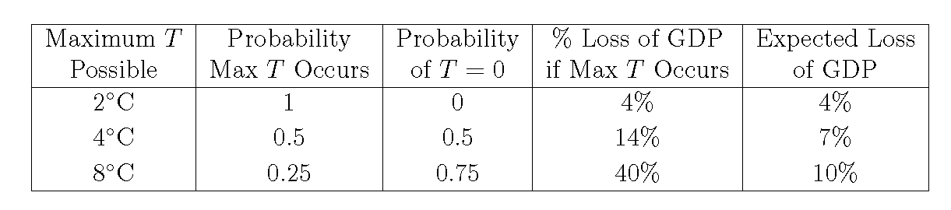
INSURANCE VALUE: RISING MARGINAL DAMAGES
Damage function increasingly steep as T becomes larger. Going from 3° to 4° will cause much larger reduction in GDP than going from 1° to 2°.
Simple numerical example. Some future time, e.g., 2050:
Suppose T = 2° for certain. We’d sacrifice up to 4% of GDP to avoid.
Suppose T = 0 or 4°, each with probability ½. So E(T) = 2° as before, but going from 2° to 4° causes more damage than going from 0 to 2°. Now we’d sacrifice up to 7% of GDP to avoid.
Suppose T = 0 with prob. ¾ or 8° with prob. ¼. Again E(T) = 2°, but now we would sacrifice up to 10% of GDP to avoid.
Insurance: We pay to avoid very bad outcome, even unlikely ones. So we insure our homes against major damage from fire, storms or floods.

Slide 14
INSURANCE VALUE: SOCIAL RISK AVERSION
We implicitly assumed a 10% loss of GDP is twice as bad as a 5% loss. But it might be more than twice as bad. Why?
Think how people value more (or less) income and consumption.
Suppose your income is $60,000, and it’s increased to $70,000. That extra $10,000 might make you very happy.
Now suppose your income is $160,000, and its increased to $170,000. The extra $10,000 will make you happy, but not as much as if your starting income was only $60,000.
We call this a “declining marginal utility of income.” Corresponds to risk aversion. You’d probably refuse a lottery giving you a 50-50 chance of winning $10,000 or losing $10,000, because (for most people) the value of winning $10,000 is less than the lost value of losing $10,000.
How risk averse is society as a whole? Financial market data says quite risk averse. If so, this pushes us further towards early action.
So how large is the value of climate insurance? We don’t know, but it is likely to be very large.

Slide 15
IRREVERSIBILITIES
Relevant only when there is uncertainty. Two kinds:
  (1) Environmental damage can be irreversible. CO₂ stays in atmosphere for more than 100 years.
  Pushes cost/benefit calculation towards protection, early action.
  (2) Environmental protection requires irreversible expenditures, i.e., imposes sunk costs on society.
  Pushes cost/benefit calculation away from early action.
These work in opposite directions. Which is more important? Probably the first, but we’re not sure.
Learning: Over coming decades, our understanding of climate change and its impact will improve. But there will still be uncertainty as we look towards the following decades.
How do these irreversibilities affect policy? A numerical example will help.

Slide 16
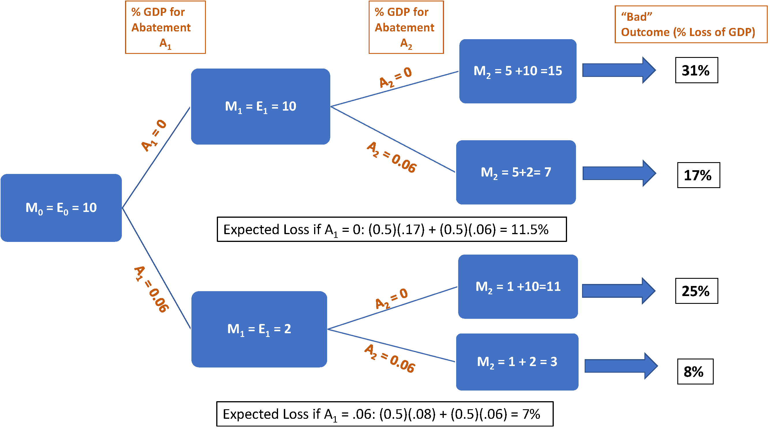
SIMPLE NUMERICAL EXAMPLE
Uncertainty over impact, half the CO₂ dissipates. Best to wait:

Slide 17
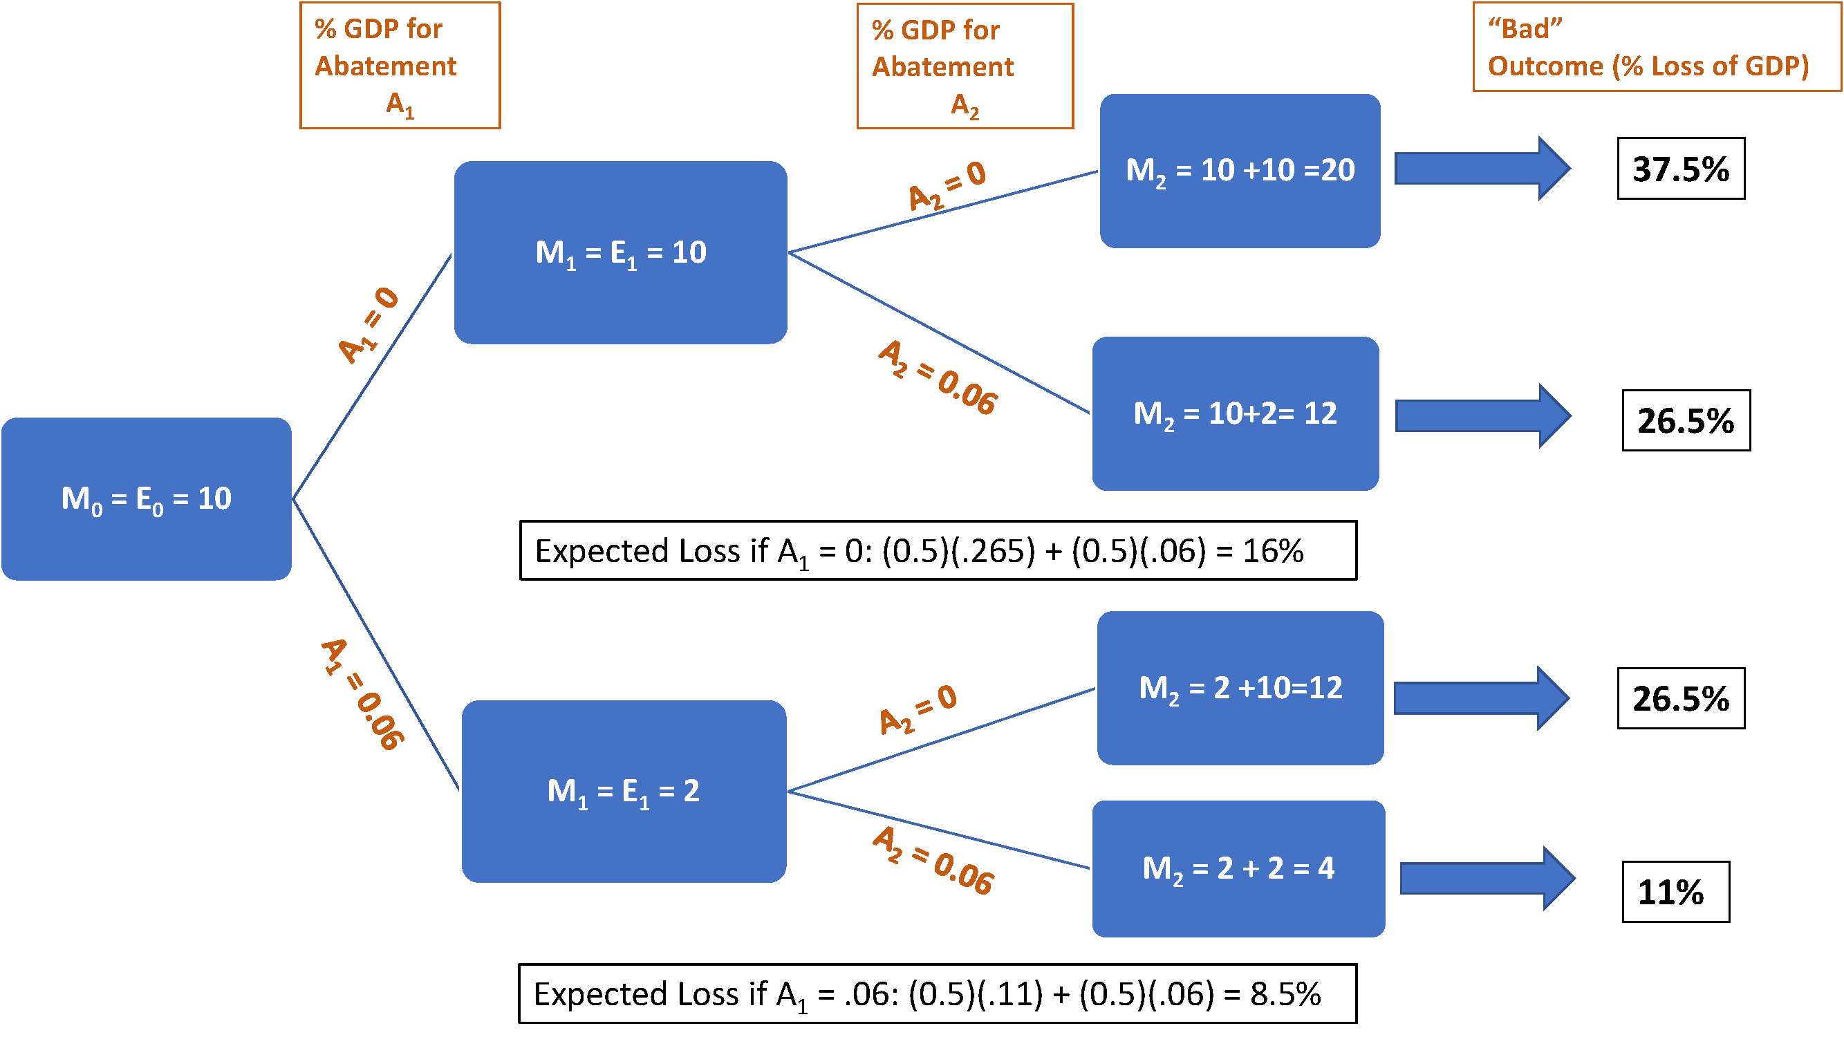
SIMPLE NUMERICAL EXAMPLE
Uncertainty over impact, no CO₂ dissipates. Best to act now:

Slide 18
SOME CONCLUSIONS
There are things we know, but subject to uncertainty.
  CO₂ emissions over next 50 years. Uncertainty over GDP growth, and over changes in carbon intensity.
  Atmospheric CO₂ concentration will continue to grow.
There are things we don’t know:
  Climate sensitivity. Critical for predicting temperature change.
  Impact of climate change. We know very, very little.
We may learn more, but not a reason to wait:
  Insurance value of early action.
  Conflicting irreversibilities.
My own projection (in forthcoming book): CO₂ emissions and concentration will keep growing. T > 2° very likely.
What to do? ADAPTATION!!!! Start planning now.

