Slide 1
Procurement choices and infrastructure cost
Boston, November 2019
Dejan Makovšek, OECD/ITF
Associate Prof. Adrian Bridge, QUT

Slide 2
What we have set out to do in our paper
We have a limited understanding how contracts beyond low-bid; Design-Bid-Build; cost-plus.
Infrastructure procurement is evolving towards alternative models.
Empirical evidence is available only on some project outcomes, creating space for perverse incentives.
Our example:
High-powered contracts do not deliver better outcomes, but higher cost at no better quality.

Slide 3

Infrastructure procurement began ages ago…
Most of the information on the evolution of infrastructure procurement comes from the Roman Empire.
Notes:
First roads were built by the army and slaves. From this the knowledge accumulated and a civil engineering profession was born. Vitruvius (~90-20 BC) – a military civil engineer was a an authority of his era and beyond. He wrote 10 books on construction and civil engineering principles, including what today we would call risk management, performance incentives etc. . Once more specific principles could be defined, contracting out started too.
Vitruvius wrote 10 books, developed construction principles, talked about risk management… and was observed well into the renaissance.
As the civil engineering profession emerged and the public sector could better define “what it want’s to have built” it started contracting out as well. It is assumed this was on a low bid basis. The contractor was a master builder – i.e. he was responsible for the design and construction – hence a design-build contract was used and incentives for his performance were introduced through the payment mechanism. In the paper I included an example of a pain/gain sharing mechanism, which was apparently already used in ancient Greece.
One of the first paved road systems was built by the Persians, around BC4000 years
The road called Persian Royal Road ran east-west across Anatolia for more than 1,500 miles (2,400 km) between the capital city of Susa, Persia (now the village of Shush, Iran), and Smyrna (now Izmir, Turkey), on the Aegean coast. But we don’t know much about contracting from those times☺.
Via Emilia, which connects Piacenza to Rimini in Emilia-Romagna, and celebrated just last year 2200 years since its foundation.
The world's oldest known paved road was constructed in Egypt some time between 2600 and 2200 BC.

Slide 4
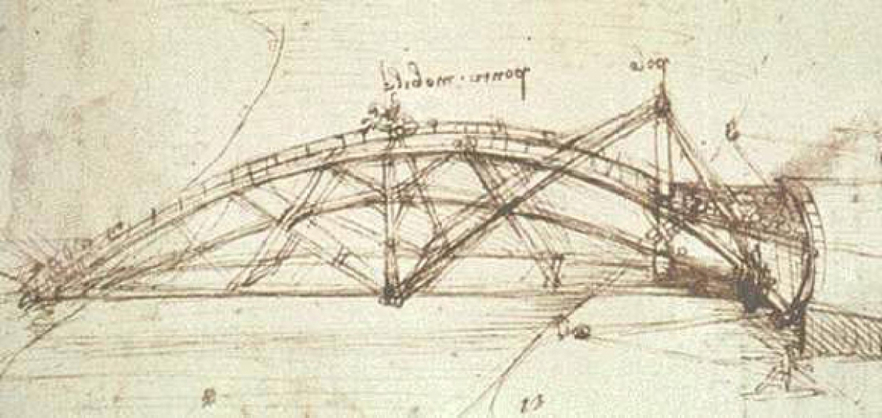
From Master builder to Design-Bid-Build…
Notes:
The master builder was responsible for making deals with specialized trades himself. What happened first, was that with the emergence of paper there was a separation of the design and construction functions. Detailed designs could be prepared in advance. Later, the builders started optimizing their portfolio in terms of what they offer and they extended the boundaries of their firms, and a “general contractor” emerged.

Slide 5
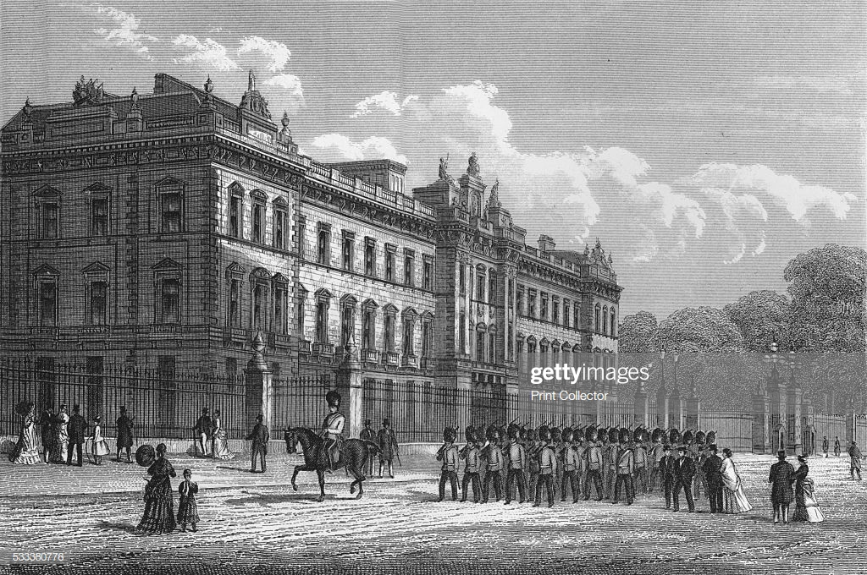
When should we use high-powered contracts?
Notes:
Questions about the cost of infrastructure were also prominent long-before today.
For example
the Office of Works … was firmly against even the limited form of contracting in gross. When in 1827 John Nash (I 752-I 835) made such a contract for joiner's work (mizarska dela) in the basement of Buckingham Palace, the Surveyor General, Benjamin Charles Stephenson (c. I 766-I 839) consented with reluctance, remarking, "I am far from thinking that a contract in gross upon so large a scale can be advantageous to the public."6 His attitude, however, was based on the opinions of the other official architects and the experience of building the Royal Mews (konjusnica), Pimlico.

Slide 6
Three procurement dimensions identified
Bidder selection
Delivery model (Contract scope)
Contract power
Low bid tenders
From master builder to Design-Bid-Build
Pain/gain sharing, cost-plus, fixed price…
Notes:
Mega projects are the biggest and most complex animals along a range of dimensions:
Physical size
Cost
Affected stakeholders
…
Complexity

Slide 7
… fast forward to 20th century
The traditional Design-Bid-Build model has been the back-bone of infrastructure procurement to date
The average project was smaller
The state retained most of the risk
Notes:
Mega projects are the biggest and most complex animals along a range of dimensions:
Physical size
Cost
Affected stakeholders
…
Complexity

Slide 8
…but major changes are underway…
Projects grew over time
On-time/ budget became an issue
Public sector transferred ever more risk out
2-3x in real terms in 20th century
Popularized by B. Flyvbjerg
Expansion of alternative contracting models after 1990
Notes:
Growth - doubling in project size two to three times per century (Bent Flyvbjerg, 2014, "What You Should Know about Megaprojects and Why: An Overview," Project Management Journal, vol. 45, no. 2, April-May, pp. 6-19, DOI: 10.1002/pmj.21409)

Slide 9
…which got us to where we are today (I)
Financing method
Publicly financed (“Traditional”)
Privately financed (“PPP”)
Contractor required to price a narrow scope
ECI (Phase 1)
Delivery models
ECI (Phase 2)
Design Bid Build (DBB)
Alliancing
Design Build (DB)
Engineering, Procurement & Construction (EPC)
.. A wide scope
Non-price competition
Contractor engaged on low-powered contract
Cost-share (e.g. costs plus a fee)
Maximum guaranteed price
Contract power
Lump sum/fixed time (“Turnkey”)
…A high powered contract
Note – Solid lines denote predominant choice, with dashed lines representing less common but observed options
Notes:
We have some empirical evidence about the speed of delivery of these different choices, a time and cost variability…. But next to nothing on total cost. There are indications that the total cost could be 20% or more precent different depending on the choice we make.

Slide 10
…which got us to where we are today (II)
Top 8 players=60% of the market
All projects
Notes:
ACR – adjusted concentration ratio
Projects >EUR 10 million
(top 8 firms hold more than 60% of the market)
+ they are organized in cliques – they always partner with the same company, when they go in consortia
Top line is major projects
Bottom line is all projects – where smaller projects dominate
Two tier market

Slide 11
…which got us to where we are today (III)
Pre-contract information exchange in the EU. Use in transport infrastructure 2006 – 2016:
Note: Rail/road infra projects above EUR 50 m.
Source: Base on data in Roumboutsos (2019).
Notes:
All others are simple auctions
In our recent work we found out that for major projects that bundle project phases (DB, DBOM variants) and all cases where a lot of risk transfer occurs, the use of competitive dialogue is a must to reduce inefficient risk pricing (inefficiently large contingencies) on the side of the contractors

Slide 12
What does theory predict?

Slide 13
The nature of any contract is risk transfer…
The basic trade-off
Incentive
Insurance
Transferred Risk
Efficiency gains
Transferred Risk
P
Value for Money
x
-
x
=
Notes:
IN any contract the risk transfer has a double effect. On one hand it drives the efficiency incentives, but on the other, risk needs to be priced when it is accepted. If the 2nd part is bigger than the first, there is no VfM. The job simply becomes to expensive.

Slide 14
… on top of that come other challenges
Auction theory
Competition
Negotiation
Bidding agressiveness
Which auction format yields max payoff?
How do I avoid renegotiation?
How do I reduce precontract uncertainty?
Tendering
Contract execution
Contract theory
Adverse selection
Contract signature
Adaptation cost
Moral hazard
How do I ensure I got the most efficient bidder?
How do I avoid quality shading?
How do I avoid renegotiation
Notes:
The orange part only plays a role in incomplete contracts
It says we should use low powered cost-plus contracts in incomplete contracts to reduce adaptation cost
High powered in complete or bundled contracts
That competition works best in complete contracts but will stifle pre-contract information exchange, negotiations might help reduce renegotiations/adaptation cost...

Slide 15
Theoretical predictions
Complete
Unbundled contracts
Auction
Lump-sum
Incomplete
Bundled contracts
Negotiation
Auction
Unbundled contracts
Cost-plus
Assumption - We can control quality shading/moral hazard (if we can’t low power prevails)

Slide 16

The relevance of uncertainty in contracts
Risk pricing
Winning bid
Competition
Tendering
Contract execution
Uncertainty
Contract signature
Circumstance “surprises”
Who should invest in risk info and when?
Notes:
Uncertainty is primarily seen as an adaptation cost challenge.
Auction and contract theory separately describe different procurement dimensions that interact with each other. Theory should be unified.
The question of risk is not just about who will bear it (incentives v insurance).
Risk variance can be reduced/increased by procurement choices! Should we create risk related info sooner in the project life cycle or later and who should do it?

Slide 17
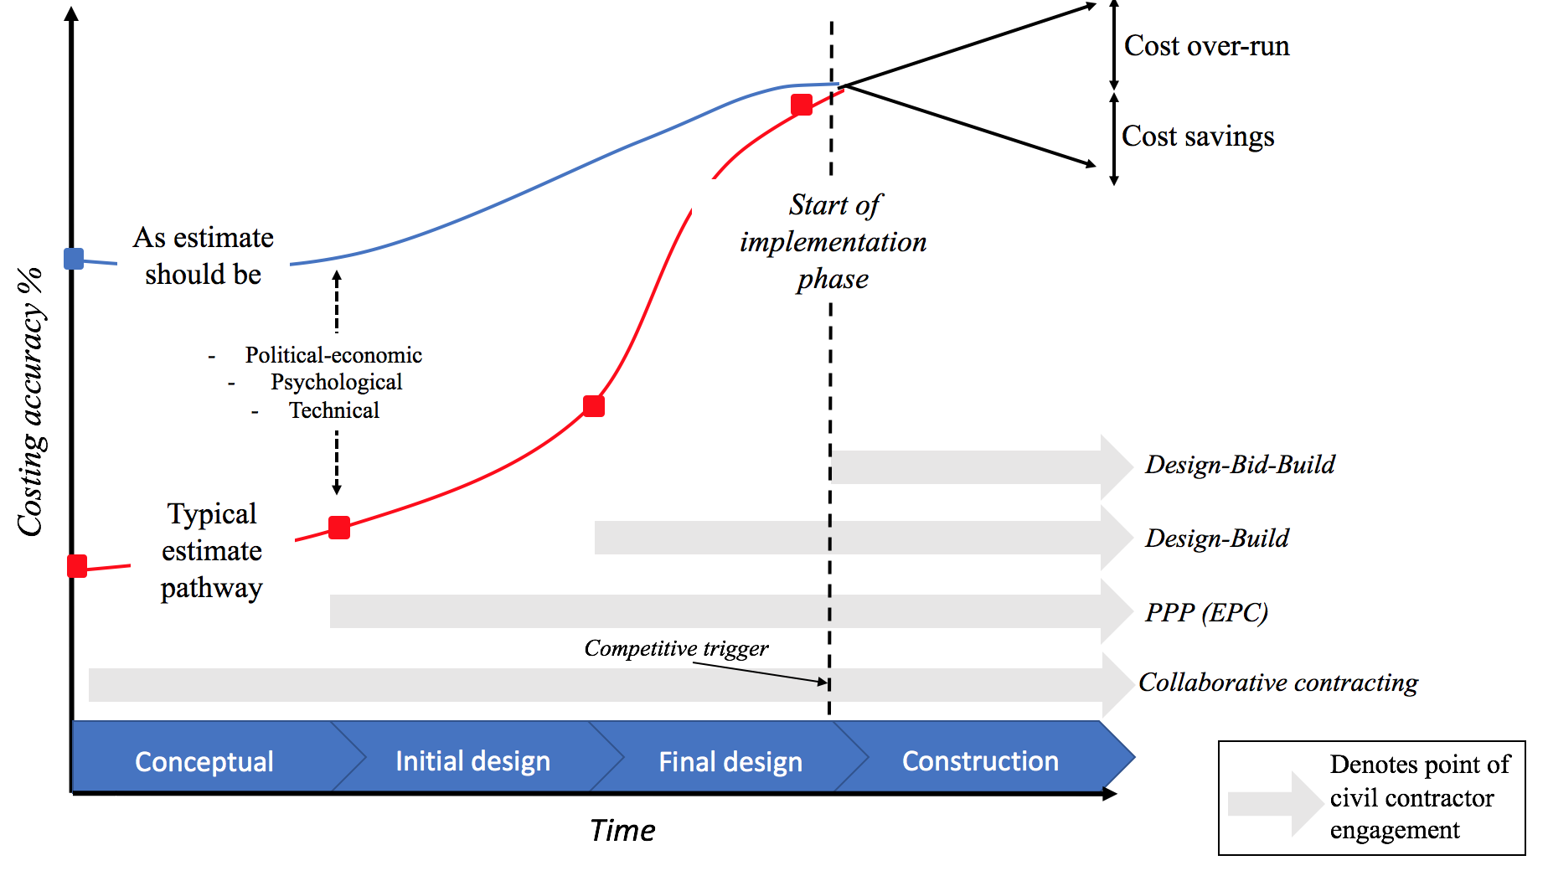
Delivery models and pre-contract info relevance
Source: Kennedy et al 2018.
Notes:
There are renegotiations/adaptation cost present in DBB
But what is the uncertainty burden in the other contracts during the bidding. Do they produce designs to the same detail before they price and submit? Against the prospect that they might loose? Against time constraints?

Slide 18
What can the evidence tell us?
The role of pre-contract information
Notes:
All focus on roads… quality implicitely controlled. Homogenous infra, long-established design standards.

Slide 19
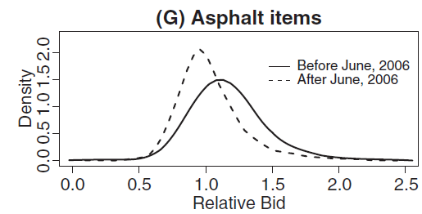
Reducing pre-contract uncertainty (I)
A non financial example – the Oklahoma DoT and road contracts!
Source: Kosmopoulou & Zhou 2014.
State had to pay 5% more on contracts but winning bids went down by 11%...
Notes:
There is a similar example, in which case the country released more detailed information on how inhouse engineering estimates were built, which lead to 9% reduction of the average bid.

Slide 20
Reducing pre-contract uncertainty (II)
An example from low powered(!) contracts with fully effective competition (De Silva et al 2008)
Price/
unit
Complex works
(a drop of 9%)
Simple works (no change)
Change in tendering protocol – release of internal cost estimate to the public
t
Notes:
These were not mega projects, they involved several 10 million dollars – so contractors may not have been that sophisticated.
On mega projects more sophisticated contractors come into play, but the projects are also more complex.
Winning bids were reduced by an average of 11% for more risky and complex projects (e.g.,
a bridge construction), but were unaffected for low-risk projects (e.g., asphalt pouring).

Slide 21
What can the evidence tell us
Performance of cost-plus Design-Bid-Build contracts

Slide 22
Small size (“simple”) contracts
Bajari, Haughton, and Tadelis (2014)
Mean contract size USD 2 million.
Competition worked (private information not an issue, profit margin 3.5%)
Adaptation cost are the key issue (7-14% of winning bid; USD 0.5 – 2 for every USD 1 of change).
Bidders can predict, where in the Bill of Quantities items will overrun, i.e. pre-contract uncertainty low.
Notes:
Super complicated derivation of Goeree and Offerman (2003) how ex ante information about common value of the tendered object matters.
They explain, in private value auctions, bidders know their own value for the commodity but are unsure about others' valuations. In contrast, common value auctions pertain to situations in which the object for sale is worth the same to everyone, but bidders have different private information about its true value. The standard textbook example for a private value auction is the sale of a painting. A well-known example for a common value auction is the sale of oil drilling rights, which, to a first approximation, are worth the same to all competitors. In the real world most auctions a mix of both. If for example the competitors for the oil drilling rights used different technologies (=their cost structures would be different), their private valuations of the rights would be different. Hence, if the common value of the object is uncertain a bidder with a moderate private value and an overly optimistic estimate of the common value may outbid a rival with a superior private value but more realistic conjectures about the common value. If the common value were less uncertain, then bidders with superior private values (=the most efficient bidders) would consistently prevail, leading potentially to an even higher auction result

Slide 23
Small size (“simple”) contracts
Bolotny & Wasserman (2019)
Mean contract size USD 2.7 million.
Same type of procurement design as above.
If switch to lump-sum contract were made, 128% premium was estimated.
And this in a Design-Bid-Build case, where detailed design is fully developed and main risk for the contractors is the missestimation, in which items of the Bill of quantities overruns will occur!
Notes:
No similar analysis exists for large contracts. Can we expect the same outcomes?

Slide 24
Can we assume the same for large contracts?
No similar precise analysis exists.
But the following is possible:
We can assess, whether adaptation cost in larger projects will be larger (if contract power is increased, premium will be higher)
There is a single study that examined relative cost of major road projects, which provides some insight on the premium.
Notes:
No similar analysis exists for large contracts. Can we expect the same outcomes?

Slide 25
Large contracts and cost overruns
If cost overruns grow, so do adaptation cost!
Source | Project type | Time period* | N | Project size (mean in million) | Average Cost overrun (%) | SD (in %) | Geography
(Ellis et al., 2007) | Roads & bridges | 1998–2006 | 1908 | USD 2.8 | 9.36 | N/A | USA, Florida
(Bordat et al. 2004) | Roads | 1996-2001 | 599 | <USD 5 | 5.6 | N/A | USA, Indiana
(Bordat et al. 2004) | Bridge | 1996-2001 | 621 | <USD 5 | 8.1 | N/A | USA, Indiana
(Bhargava et al., 2010) | Roads | 1995-2001 | 1862 | USD 0.9 | 6.1 | 24.4 | USA, Indiana
(Hintze and Selstead 1991) | Roads | 1985–1989 | 110 | <USD 5 | 9.2 | 1.22 | USA, Washington
(Bajari,Houghton, and Tadelis 2014) | Roads | 1999-2005 | 819 | USD 2.7 | 5.7 | 11.8 | USA, California
(FHWA 2016) | Roads | 2004-2015 | 134 | USD 21.6 | 4.1 | 9.1 | US
(ITF 2018a) | Roads and bridges | 2008-2017 | 28 | EUR 75 | 9.3 | 8.1 | Slovakia
(Love et al. 2019) | Roads | 1999-2017 | 18 | USD197 | 5.7 | 12 | Hong Kong
Notes:
All low-bid, Design-Bid-Build, cost-plus contracts. No significant difference with DB contracts which rely on a negotiated process, which is arguably supposed to ensure greater pre-contract information exchange.
Adaptation cost do grow with size but not linearly, they will be bigger for very large, mega projects, but those do not exist in large numbers for a good statistical analysis.

Slide 26
What can the evidence tell us
Performance of Engineering-Procurement-Construction contracts

Slide 27
Large EPC contracts do perform better
Observed median construction risk is zero, average is 2%. 54/75 projects were exactly on time.
Median
Source: Blanc-Brude & Makovsek (2013).
Notes:
To bring down the cost of financing, investors seek insurance again risks they are not comfortable bearing.
No statistically significant drivers:
geography (exception – Middle East)
sector;
time.

Slide 28
Relative cost of high v low power contracts
Construction risk: risk premium in roads above ex-post risk (~20% in EU), LCC does not explain diff.)
Based on Blanc-Brude et al 2009.
Unexplained cost difference?
Traditional procurement
Cost at contract signature
Cost overrun
Public-Private Partnership
Source: Makovšek & Moszoro 2018.
Total cost
Notes:
The same evidence that we would need to investigate procurement choices for large projects is accidentally also the evidence that would allow us to tell if and why the cost of a motorway in country A is different from country B.

Slide 29
Key points in summary
Bundled procurement design increases cost per physical unit. We can’t say, whether this is because competition was sacrificed and/ or ex-ante uncertainty for the bidders had increased.
Raising contract power on this base makes the outcome disproportionately costlier.
The role of pre-contract information and uncertainty as a risk pricing challenge are grossly underappreciated.
Notes:
Why we can’t explain this better and why we can’t say whether and why motorways in one country are more expensive than in another have the same root cause. The resistance of countries to pursue infrastructure benchmarking.

Slide 30

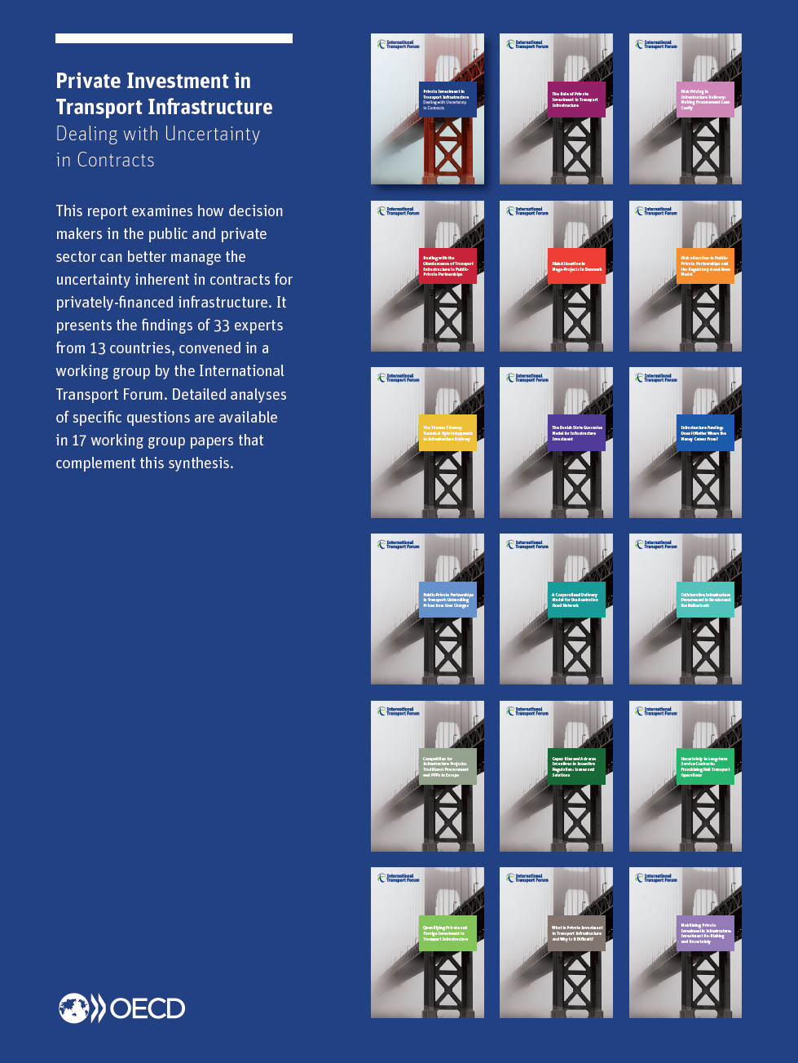
Dealing with uncertainty in contracts…
https://www.itf-oecd.org/private-investment-infrastructure
Notes:
Here we said everything there was to say about private investment in Infrastructure, but by definition that required a heavy excursion into the area of procurement of infrastructure in general and contracting.

Slide 31
A future for procurement
Notes:
Broadly inadequate use of the procurement models (e.g. competitive dialogue is rarely applied in complex projects)
Inadequate competition on the construction market for major projects.
In the pursuit of a lean public sector in-house technical capacities tend to be eroded.
At the same time more responsibility is transferred to the market through complicated contracts, assuming the market will “figure stuff out”.
Projects grow in size (also because less and less staff on the public client side can better manage one, rather than several contracts/projects)

Slide 32

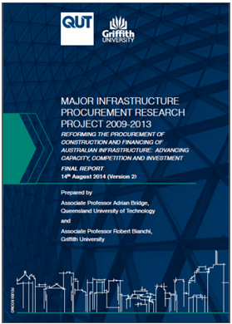

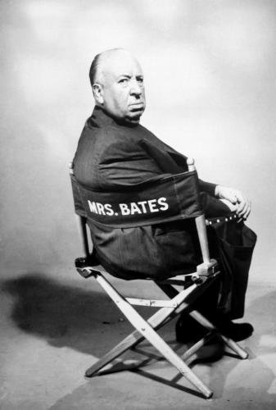
How are major projects procured today?
Road at junction of rail involving third party works
“Simple” on-grade road and elevated sections of road
Cut and cover tunnel
Procurement?
Driven tunnel
“The overall project is complex and so we’ll use a procurement approach that allows us to adapt as we go and deal with complexity as it emerges - an alliance mode”
This statement is a tautology… the cause (read procurement) is assessed in same terms as effect (read outcomes to end of construction/start of operations) i.e. adapting to complexity. It does not really inform how to procure and is not defensible if asked in detail why this approach.
Notes:
First say a word how countries make procurement decisions today
Then show example on a real case like this one
This above is (a real) example of the tautological nature of current practice and was a multi billion AUD single alliance contract and one of the case studies from the Australian Research Council grant Major Infrastructure Procurement/ARC MIP that was led by Adrian: available at: https://eprints.qut.edu.au/76520/
And this case study…

Slide 33

Promoting a new approach to procurement
Procurement design process
Dealing with:
risk pricing issues (pre-contract market failure)
hold-up opportunities (post-contract market failure)
Tautological
Subjective
=>
No ex-post analysis
Chosen contract scope and type
Risk management (too late)
Contract scoping
Collaborative, competitive, or hybrid
Notes:
Project specific “risk management” considerations begin when the scope of the contract (=project) and the contract exchange type (based on competition or collaboration) are already determined.
Engineers have already determined that the greatest value/cost optimisation can occur during the design stage.
The same is not true for economists, when we consider procurement design. We need to start thinking about it at the beginning – first make or buy, then which activities into how many contracts, then contract type, and then project specific risk allocation…

Slide 34
What theory says about planning the contract…
New Institutional Economics
→ Contract Theory
Applications
Outcomes
Coase Internal and general external transaction costs
Sourcing (Make-or-Buy) decision
Avoiding costly mistakes by government arising from organizational incompetence
Avoid high prices and hold-up by creating efficient bundles
Avoid hold-up and reduce contract price by selecting efficient contract power (depending on contract completeness)
Williamson Transaction Cost Economics
Contract scope (Bundling) decision
Hart
Property Rights Theory
Contract power (Exchange Relationship) decision
(many)
Principal Agent Theory

Slide 35
Completing the NIE/contract theory view
Capabilities Perspective
Applications
Outcomes
Sourcing (Make-or-buy) decision
Allocating activities to party with superior organizational and/or product/ion capability to manage risk
Avoiding bundles that create thin competition
Avoid contract power that increases risk of hold-up
Avoid contract power that increases contract price
Barney
Resource-Based Theory
Contract scope (Bundling) decision
Contract power (Exchange Relationship) decision

Slide 36

Integrative framework –re-crafting planning the contract/s in the case of the single alliance contract into 4 contracts…
Contract #2
(Design of remainder)
Contract #4
(Construction of remainder)
Contract #3 (Construction of driven tunnel and cut & cover tunnel)
Contract #1 (Design of driven tunnel)
Cut & cover tunnel
Third party rail alignment
Simple road-on-grade and elevated structures
Driven tunnel
O&M same, in technological terms, to rest of road network and procured as part of a range of network activities and not procured as a project-based activity in this case

Slide 37
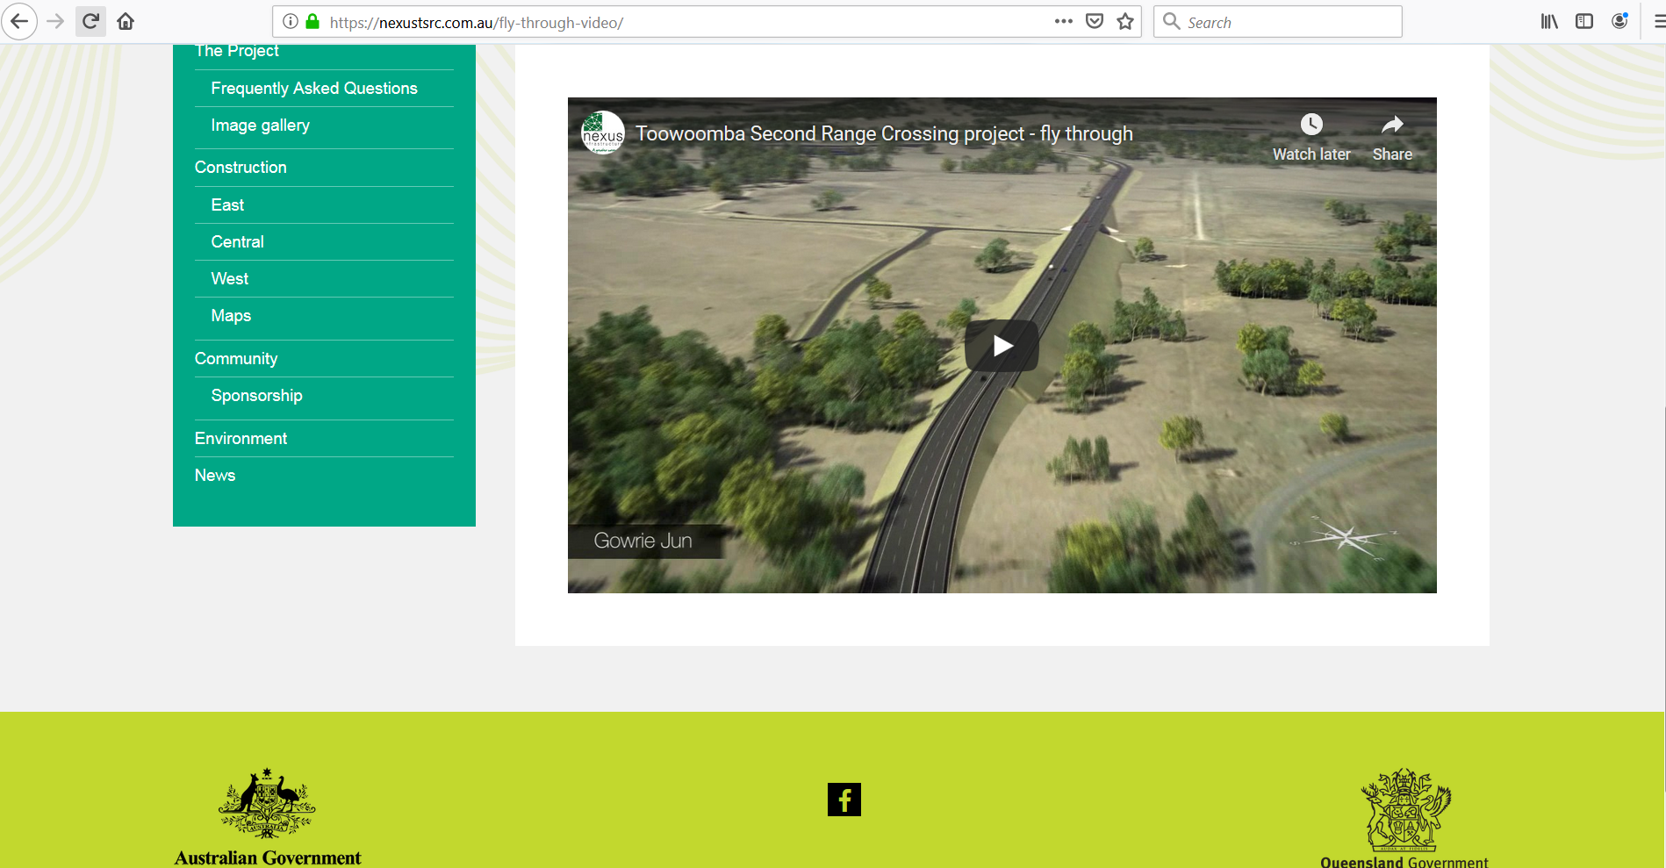

Live trials of new Procurement Decision Tool (funded by Infrastructure Australia and Austroads)

Slide 38
For more information contact
Dejan Makovšek E dejan.makovsek@itf-oecd.org
Adrian Bridge E a.bridge@qut.edu.au

Slide 39
Reserve slides
Notes:
Broadly inadequate use of the procurement models (e.g. competitive dialogue is rarely applied in complex projects)
Inadequate competition on the construction market for major projects.
In the pursuit of a lean public sector in-house technical capacities tend to be eroded.
At the same time more responsibility is transferred to the market through complicated contracts, assuming the market will “figure stuff out”.
Projects grow in size (also because less and less staff on the public client side can better manage one, rather than several contracts/projects)

Slide 40
Contract theory predictions in a nutshell (I)
If contracts are complete, lump-sum contracts are best (Bajari and Tadelis 2001).
In incomplete contracts, cost-plus contracts lead to lower adaptation cost (Williamson 1985; Bajari and Tadelis 2001)
+ to select the best bidder, a menu of contracts should be used (Laffont and Tirole 1993)
Contract A
Contract B
Input specification
Design
Construction
What the infra should be
If quality shading is under control!
Notes:
If contracts are complete, lump-sum leads both to the selection of best bidder and maximises incentives. Because there is no ex-post renegotiations revenue expectations need to be fully expressed in advance.

Slide 41
Contract theory predictions in a nutshell (II)
If you could transfer property rights/residual control, you could resolve (some) renegotiations issues (Heart 1995, 2003).
With a more complete contract/efficiency benefits, you can shift to lump-sum again (Martimort and Iossa 2015).
ONE contract
Functional specification
Design
Construction
What the infra should do
Notes:
Now the contract theory take the tendering phase and what people know about risk as a given. They focus on how to select the best guy and what problems could occur after the contract was signed.

Slide 42
Auction theory
In complete contracts, competition always yields the best contract outcome (Bullow and Klemperer 1996).
Competition also stifles communication (Goldberg 1977), but focus is again on reducing ex-post adaptation cost.
Limited stream of theory proposes that if the common value of the tendered object is uncertain, cost will be higher and competition will be reduced (Goeree and Offerman 2003).
Notes:
Super complicated derivation of Goeree and Offerman (2003) how ex ante information about common value of the tendered object matters.
They explain, in private value auctions, bidders know their own value for the commodity but are unsure about others' valuations. In contrast, common value auctions pertain to situations in which the object for sale is worth the same to everyone, but bidders have different private information about its true value. The standard textbook example for a private value auction is the sale of a painting. A well-known example for a common value auction is the sale of oil drilling rights, which, to a first approximation, are worth the same to all competitors. In the real world most auctions a mix of both. If for example the competitors for the oil drilling rights used different technologies (=their cost structures would be different), their private valuations of the rights would be different. Hence, if the common value of the object is uncertain a bidder with a moderate private value and an overly optimistic estimate of the common value may outbid a rival with a superior private value but more realistic conjectures about the common value. If the common value were less uncertain, then bidders with superior private values (=the most efficient bidders) would consistently prevail, leading potentially to an even higher auction result

Slide 43
High-powered incentives and risk?
What if we place a very strict requirement (e.g. 100 % insurance) on an agent (contractor) with limited risk info?
Pr(x)
Median (full diversification)
Winning bid for a fixed price contract?
EUR 70 m
EUR 100 m
EUR 190 m
Impact

Slide 44
Auction theory v conventional fin. economics
Bidding “aggressiveness” v risk pricing efficiency
Return/Risk
High returns
Two conditions for efficiency:
Credible commitment
Competition
+
-
Information (about risk)
High losses
t
Uncertainty
Risk
Notes:
There is competition between suppliers
Investors are rational
Capital markets are complete
Investors use “all available” information → Efficient Markets Hypothesis (EMH) holds =and this last point is of key importance.
That competition is a requirement is self evident so no further explanation is needed on that.
That the markets are complete basically means that on the capital market there is a security that represents each and every state of risk and return, every state of the world. In theory it means you could insure yourself against any event. More simplistically explained however it means there is technical means available that allows arbitrage.

