Slide 1
Geographic Inequality in Social Provision and Redistribution in the U.S. States
Sarah K. Bruch
University of Delaware
Janet C. Gornick
Graduate Center – City University of New York
Joseph van der Naald
Graduate Center – City University of New York
2020 NBER Conference on Research in Income and Wealth
March 5, 2020

Slide 2
motivation
Cross-state variation in social provision and redistribution (poverty reduction) are meaningful forms of inequality – inequality in the treatment of similar needs and claims by people who happen to live in different states.
Social Provision
Decentralized policy designs (financing, administration, rulemaking)
Key dimensions of provision (generosity and inclusion)
Redistribution
Distinguish between centralized (federal) and decentralized (state) redistribution mechanisms (federal transfers, state transfers, federal taxes, and state taxes)

Slide 3
Cross-state Inequality In social provision & redistribution
Social Provision
What is the magnitude of cross-state variation in the generosity of benefits and the inclusiveness of safety net provisions across the U.S. states?
How does the magnitude of cross-state policy variation within the U.S. compare to cross-national policy variation among a set of high-income countries?
Redistribution (Poverty Reduction)
Considering the U.S. as a whole, how much poverty reduction is attributable to each of the redistributive mechanisms?
How does the poverty reduction attributable to the redistributive mechanisms vary across the U.S. states?

Slide 4
Social provision State Safety net Policy data (SSNP)
Include programs in which states have some policymaking authority, or financial or administrative responsibility.
Program Funding
Partial, joint or matching funding, block grant
Program Administration
Partial or full administration, regulations and guidelines for administration
Rule/Policymaking
Authority to make rules regarding eligibility and conditions for receipt and benefit levels or duration
Include 10 programs that provide support for
economically vulnerable families with children.
cash assistance (AFDC/TANF)
food assistance (Food Stamps/SNAP)
health insurance for children (Medicaid and SCHIP)
child support (enforcement and collections)
child care (subsidies – CCBG/CCDF and TANF)
early childhood education (Head Start and public pre-k)
unemployment insurance
targeted work support (JOBS w/ AFDC and TANF work support)
disability assistance (SSI for disabled children)
state income taxes (liability threshold and credits)
Key Dimensions of Social Provision
Generosity of benefits = average amount received by clients
Inclusiveness of receipt = proportion of potentially eligible receiving assistance

Slide 5
Extent of cross-state inequality
GENEROSITY INCLUSION

Slide 6
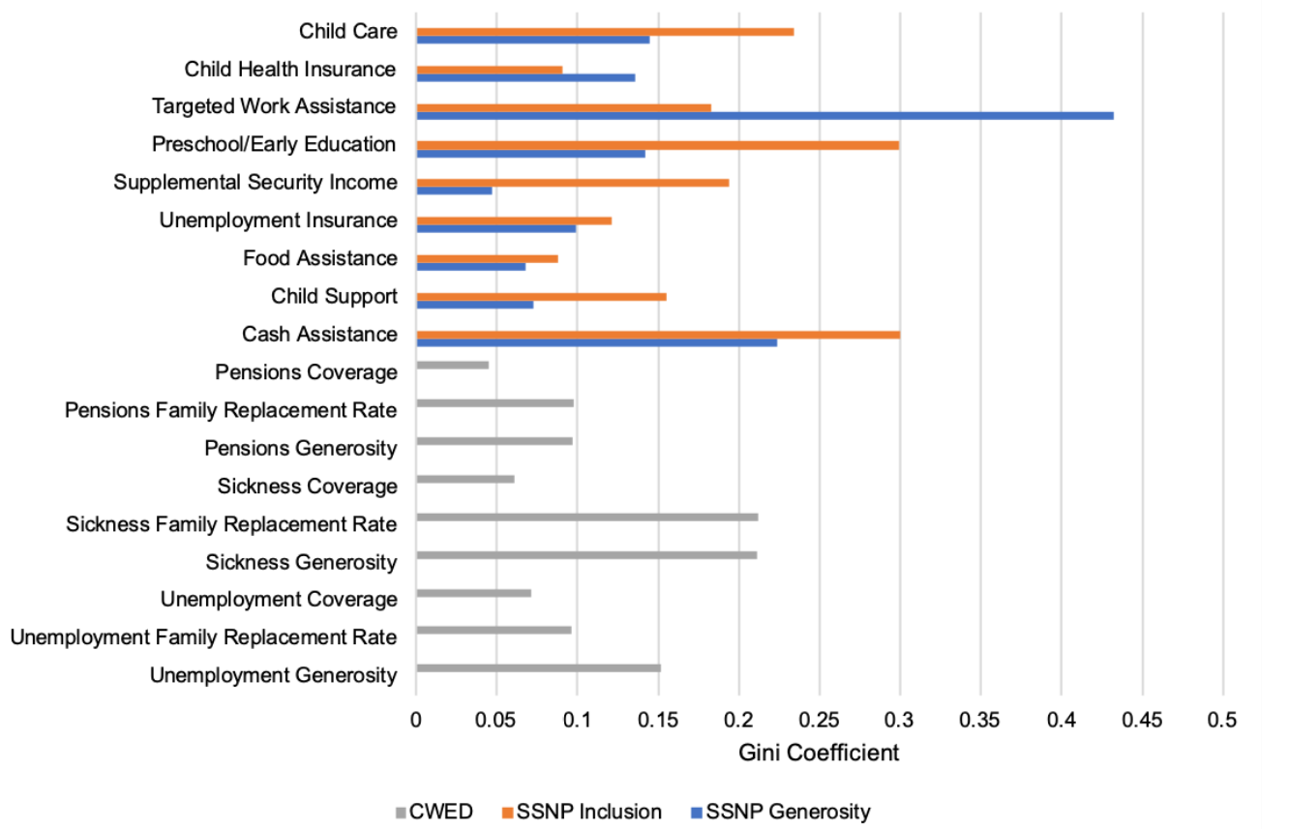
Cross-national comparison

Slide 7
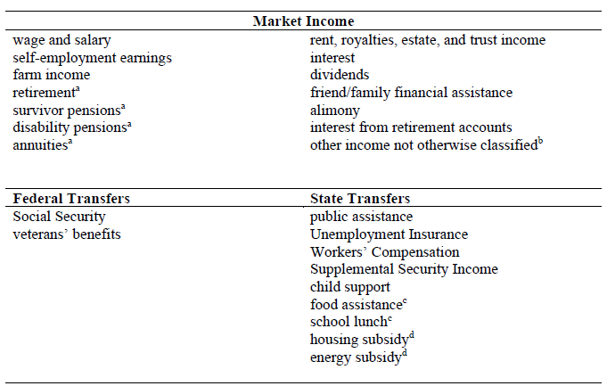
Redistribution (poverty reduction)

Slide 8
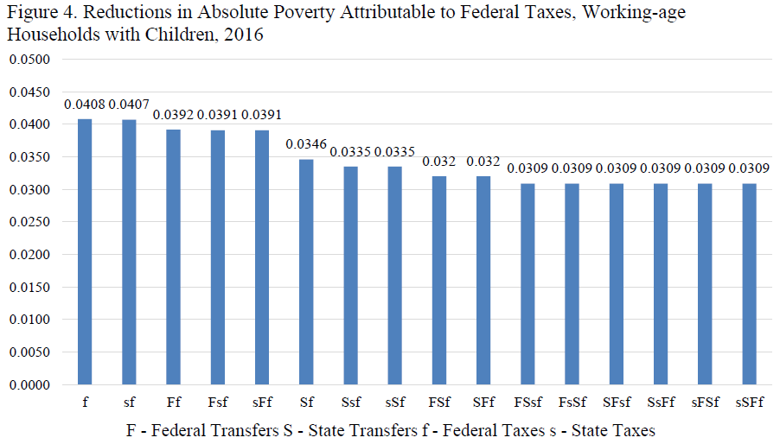
Redistribution (poverty reduction)

Slide 9
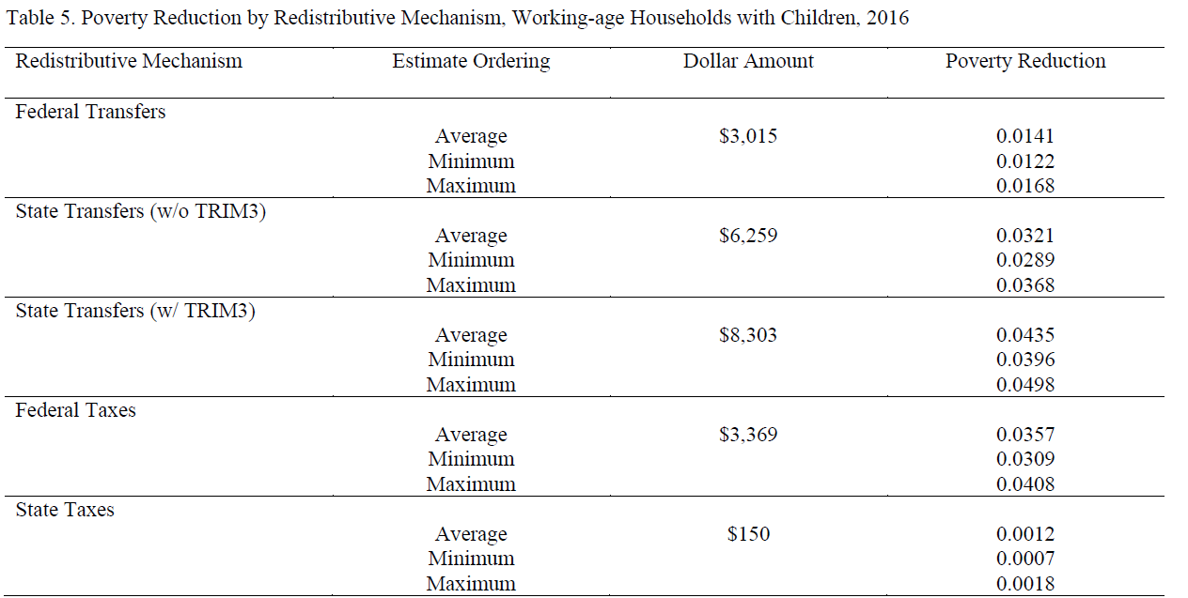
Redistribution (poverty reduction)

Slide 10
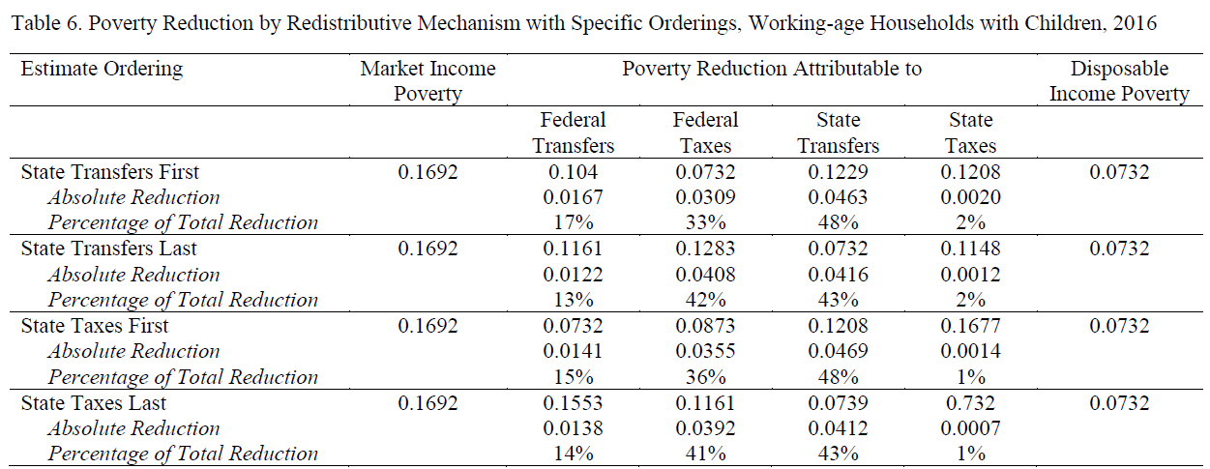
Redistribution (poverty reduction)

Slide 11
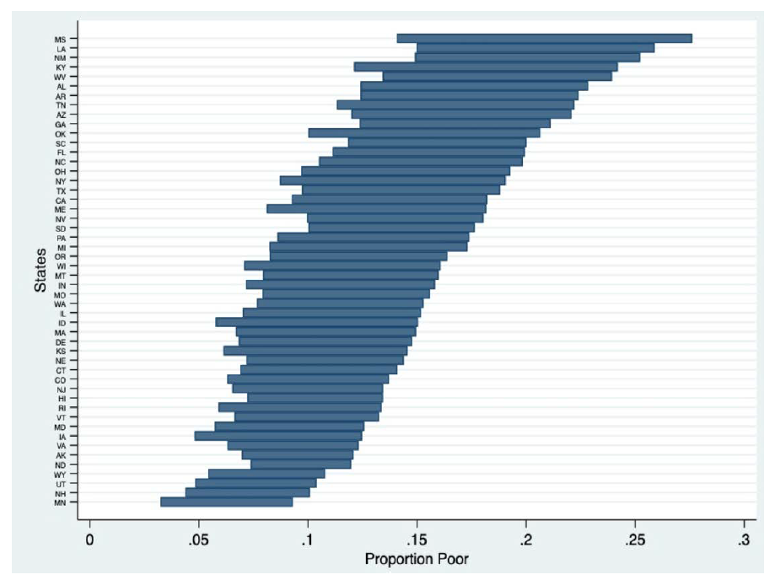
Market and disposable poverty u.S. states 2016

Slide 12
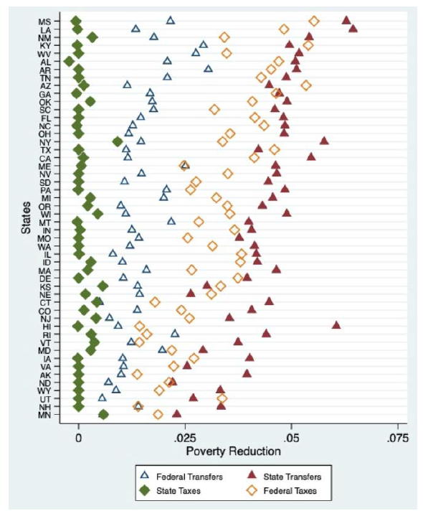
Poverty reduction by redistributive mechanism

Slide 13
conclusion
Subnational variation in social provision and redistribution are important forms of inequality.
Important for families – substantively large differences
Important for policy – decentralized policy designs allow for inequality in assistance

