Slide 1
Presence and Persistence of Poverty in U.S. Tax Data
  Jeff Larrimore
  Jacob Mortenson
  David Splinter
  March 2020
  The views in this paper reflect those of the authors and should not be attributed to the Board of Governors of the Federal Reserve System or their staff. This paper embodies work undertaken for the staff of the Joint Committee on Taxation, but as members of both parties and both houses of Congress comprise the Joint Committee on Taxation, this work should not be construed to represent the position of any member of the Committee.

Slide 2
Background
Administrative tax data are important for accurately measuring income distributions
Most tax-based research has focused on the upper tail of the distribution¹
This paper focuses on the lower tail of the distribution, estimating poverty trends in tax data:
  During and after the Great Recession
  Duration of poverty over that time
¹Piketty and Saez (2003), Auten and Gee (2009)

Slide 3
Preview of results
Pre-tax and after-tax poverty trends differ greatly:
    Tax policies during the Great Recession alleviated much of the pre-tax increase in poverty
    Focusing on after-tax income shrinks the gap between child poverty and working-age/elderly poverty
A sizeable minority experience poverty at some point: 42 percent spent at least one year in after-tax poverty between 2007 and 2018
Many exit poverty each year, although many remain, and some exit only to return
    One-third of those in poverty in 2007 were poor for at least half of the dozen years (2007-2018)

Slide 4
Potential limitations of using tax data
Non-filers
  About 10-15% adults do not file a tax return¹
Narrow “tax-unit” sharing unit
Young adults in higher-income families may appear poor if looking just at their tax return if filing separately
Missing non-taxable cash income
¹Molloy, Smith, & Wozniak (2011)

Slide 5
Solution to these limitations
Solution to Non-filers
Use information return incomes, consistent with Chetty and Hendren (2018)¹
Solution to tax-unit sharing unit
The Tax Household Sample
  Previously completed for 2010²
  Extended here to cover 2007-2018
Link all individuals with the same physical address on tax forms into the same household
Solution to missing non-taxable income
Anchor 2007 poverty rates to preserve poverty level despite different income definition
Excluding taxes actually matters more for trends than excluding non-taxable cash income
¹Includes Forms W-2, SSA-1099, 1099-DIV/MISC/K/R, 5498 & K-1 ²Larrimore, Mortenson, & Splinter (Forthcoming)

Slide 6
Zero-income households
Most people appear in IRS data
  Tax returns (Form 1040) or information returns (Form W-2)
  IRS population is almost always within 2 percent of ACS
Reasons individuals might not appear:
  No income
  Only black-market income
  Invalid data: missing date of birth or addresses
How to account for them:
  Our upper bound assumption: assume the CPS count of people in zero-income households is correct
  Impute 4 to 5 million additional people in zero-income households each year to match CPS zero counts
  Consistent with Chetty and Hendren (2018) who assume people not in tax data are true zeros

Slide 7
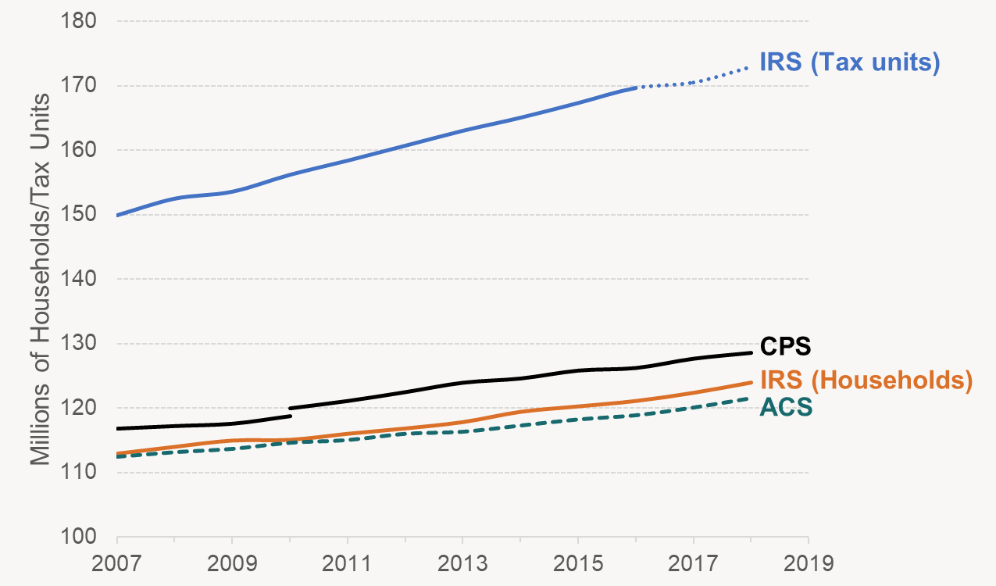
Household Creation

Slide 8
Poverty Measurement: Resources
Tax return income: both pre-tax and after-tax income
  Note: misses non-taxable cash transfers
  (matters for levels, not trends)
Measure at the household level
  Consistent with approach of PSID researchers
Adjust for household size using square-root of size equivalence scale

Slide 9
Poverty Measurement: Needs
IRS captures more income at the bottom of the distribution than the CPS
Policy question whether this should change rate of poverty
Anchor thresholds such that our poverty rate matches the official rate in 2007
  Similar approach to Burkhauser et al. (2019)
  Consistent with Citro and Michael (1995) suggestion to change resources and needs together
Adjust threshold in subsequent years using CPI-U (consistent with the Official Poverty Measure)

Slide 10
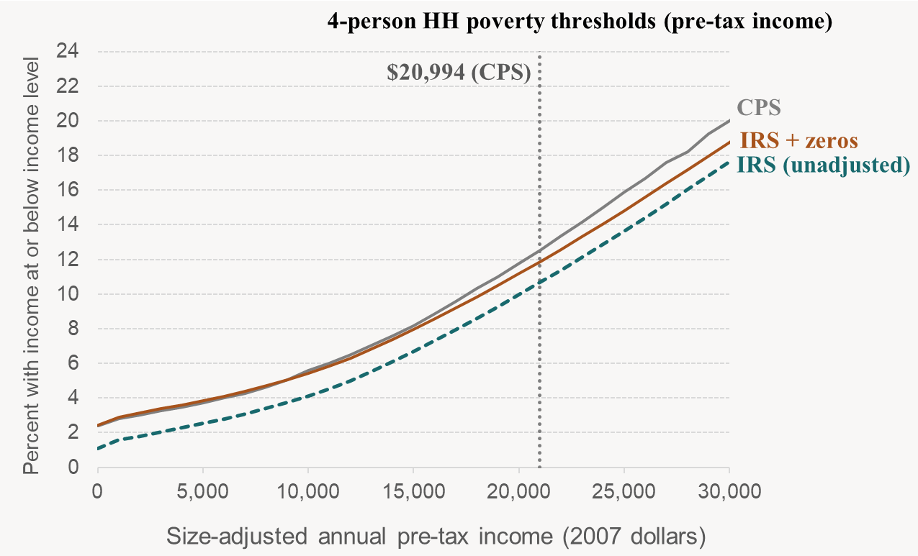
Poverty Thresholds (pre-tax taxable income)

Slide 11
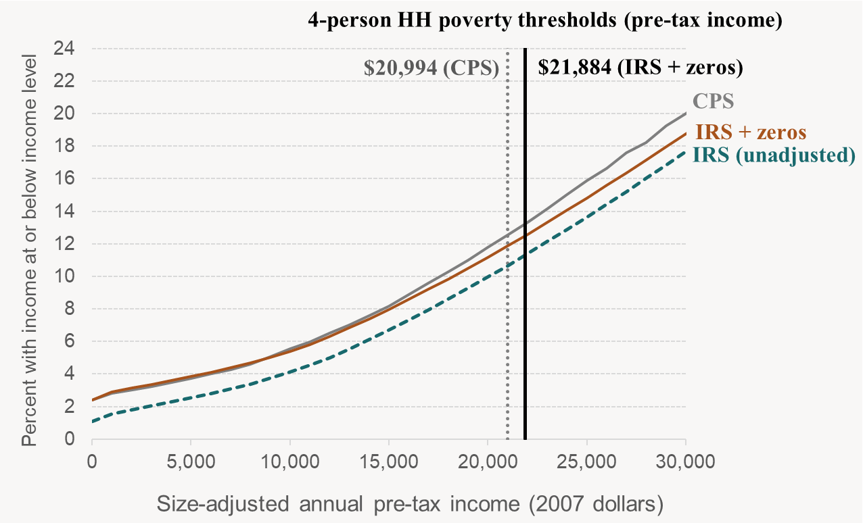
Poverty Thresholds (pre-tax taxable income)

Slide 12
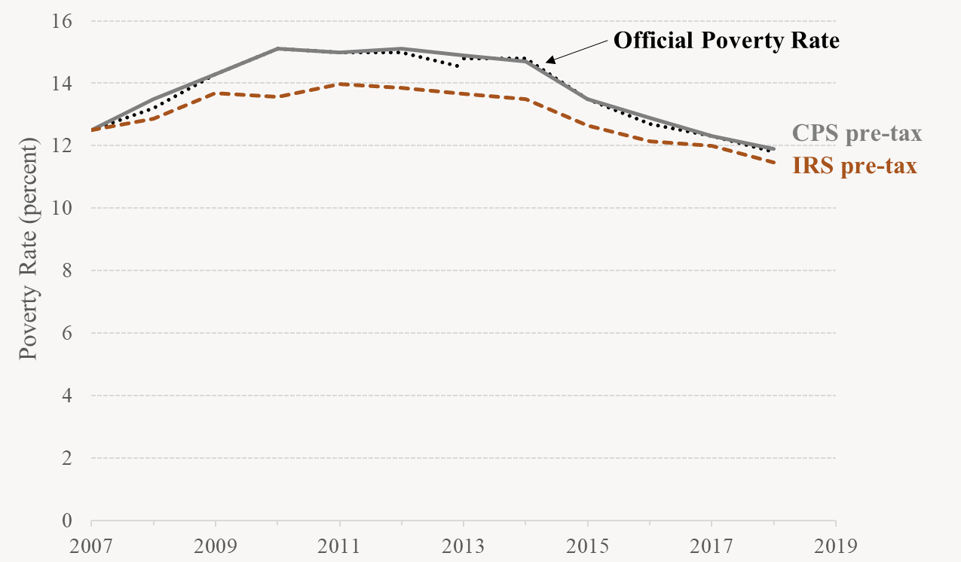
One-Year Poverty Rates (pre-tax income)

Slide 13
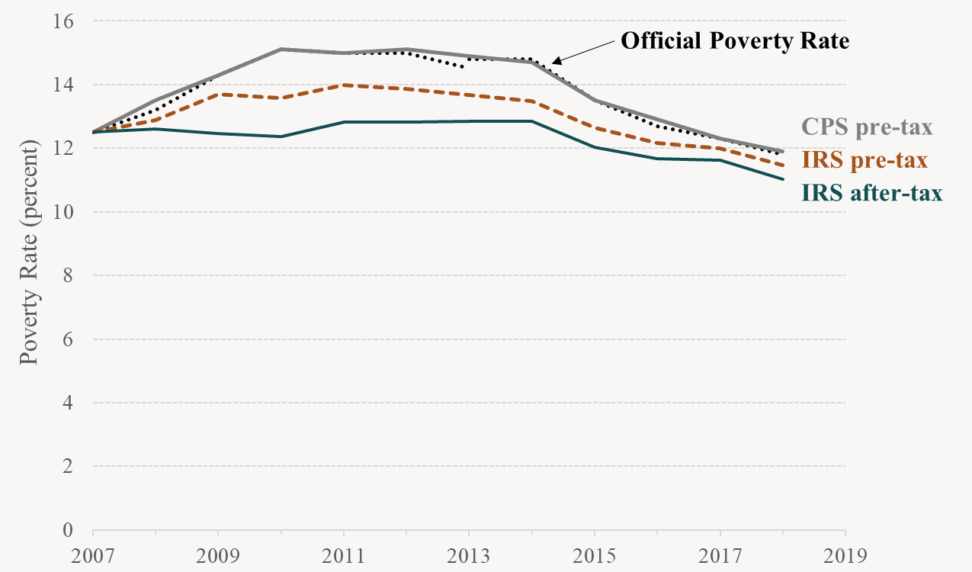
One-Year Poverty Rates

Slide 14
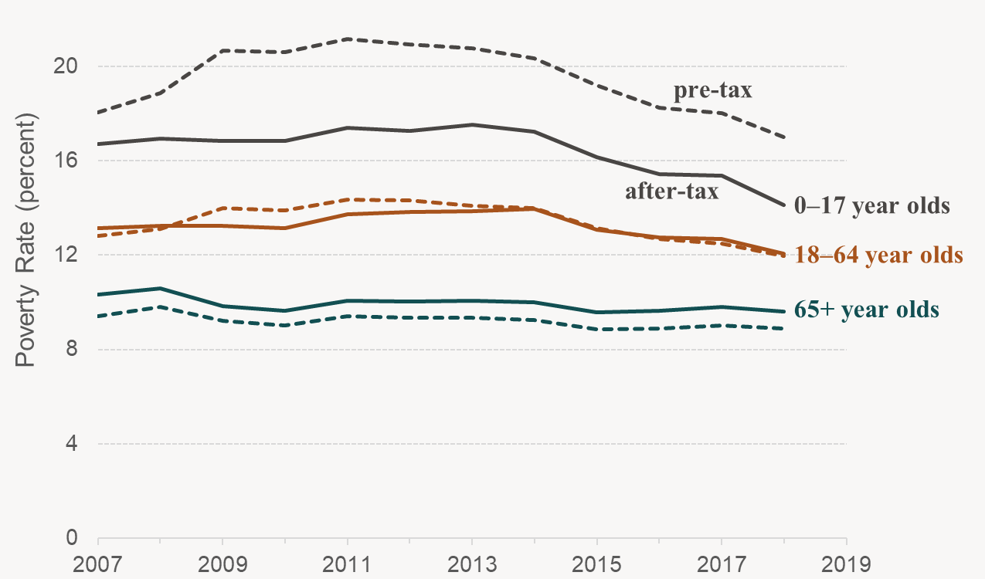
Pre-tax and After-tax Poverty Rates by Age

Slide 15
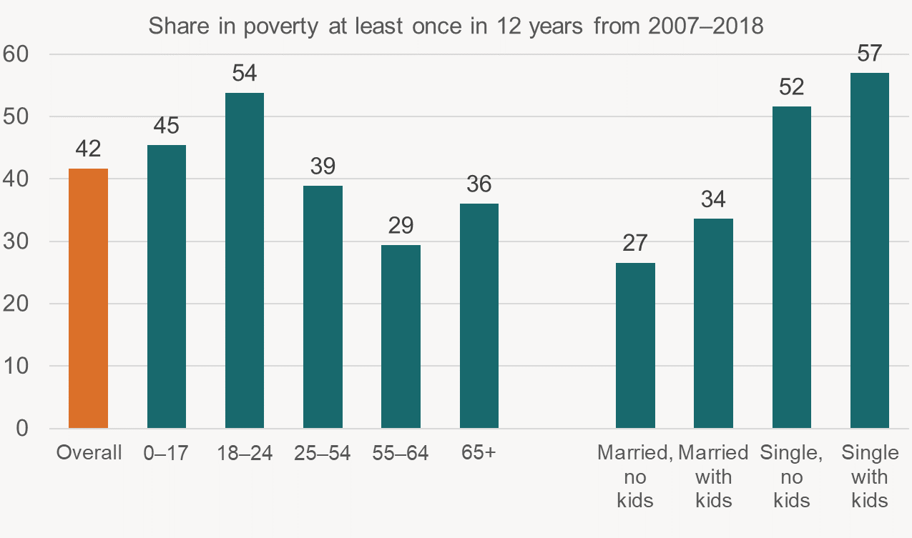
Frequency of ever experiencing poverty by age and marital status (2007-2018)
Age
Family Status

Slide 16
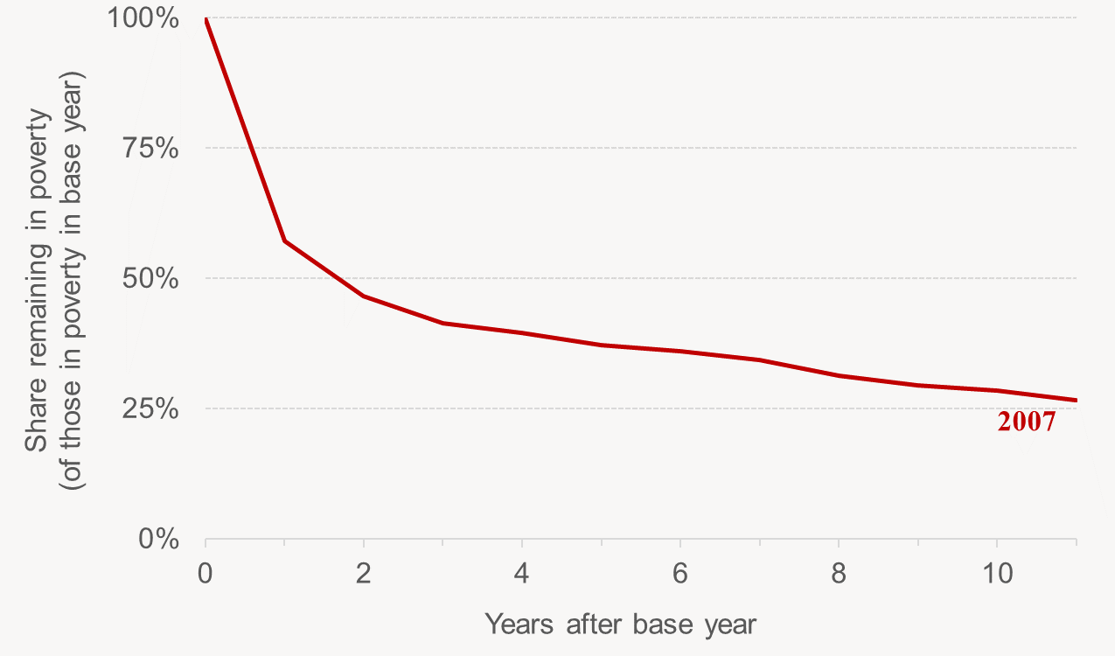
Poverty Persistence: Share of those in poverty in 2007 who are poor in later years

Slide 17
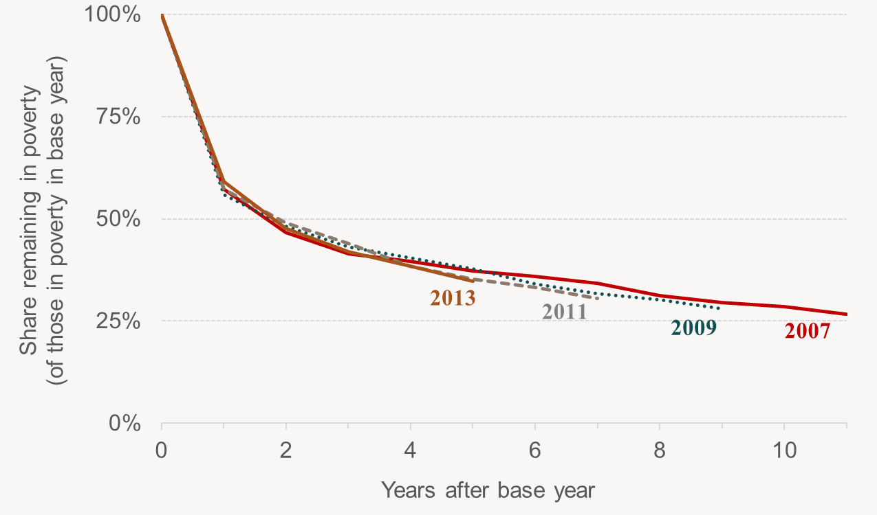
Poverty Persistence

Slide 18
Poverty Persistence: Years in poverty through 2018 if poor in 2007
 | Share by years in poverty 2007–2018 if in poverty in 2007 |  |  |  |  |  | Average years
Demographic Characteristic | 1 | 2 | 3–5 | 6–9 | 10+
All Individuals | 19 | 15 | 33 | 24 | 9 |  | 4.5
Age (2007)
0–17 | 15 | 15 | 37 | 27 | 6 |  | 4.5
18–24 | 20 | 17 | 37 | 22 | 4 |  | 3.9
25–54 | 19 | 15 | 33 | 24 | 9 |  | 4.5
55–64 | 21 | 14 | 27 | 23 | 16 |  | 5.0
65+ | 23 | 13 | 25 | 21 | 17 |  | 5.0
Family Status (2007)
Married, No Children | 20 | 15 | 31 | 23 | 11 |  | 4.3
Married, Children | 21 | 17 | 35 | 22 | 6 |  | 4.6
Single, No Children | 16 | 14 | 33 | 26 | 10 |  | 4.1
Single, Children | 17 | 16 | 38 | 25 | 5 |  | 4.8

Slide 19
Conclusions
Extended the Tax Household Sample: 2007-2018
    Household Identifiers now available in the IRS’ CDW for researchers with access to those data
Taxes matter for poverty trends – especially during periods (like the Great Recession) with temporary tax provisions.
    After-tax poverty increased by 0.3 percentage points from 2007 through 2011, compared to 1.5 percentage points for pre-tax poverty in the tax data
Forty-two percent of people spent at least one year in after-tax poverty between 2007 and 2018
Among those in poverty in 2007, 40 percent were non-poor in 2008 and 19 percent were never poor again through 2018. However, one-third of those in poverty in 2007 were poor for at least half of the dozen years

Slide 20
Appendix Slides

Slide 21
Zero-income households
Year | IRS Population Estimate (1) | CPS Population Estimate (5) | ACS Population Estimate (2) | Percent difference from ACS [(1)-(2)]/(2) |  | IRS, Non-GQ Estimate (4) | IRS, Non-GQ + Zeros (7) | Percent difference from CPS [(7)-(5)]/(5)
2007 | 299,726 | 298,935 | 301,621 | -0.6 |  | 292,148 | 296,148 | -0.9
2008 | 301,754 | 301,356 | 304,060 | -0.8 |  | 293,513 | 297,485 | -1.3
2009 | 303,548 | 304,139 | 307,007 | -1.1 |  | 295,339 | 300,005 | -1.4
2010 | 306,308 | 306,435 | 309,350 | -1.0 |  | 297,413 | 303,068 | -1.1
2011 | 308,381 | 308,668 | 311,592 | -1.0 |  | 299,511 | 305,070 | -1.2
2012 | 310,037 | 310,936 | 313,914 | -1.2 |  | 301,671 | 307,189 | -1.2
2013 | 312,169 | 313,101 | 316,129 | -1.3 |  | 303,869 | 309,040 | -1.3
2014 | 313,731 | 315,988 | 318,857 | -1.6 |  | 305,947 | 311,300 | -1.5
2015 | 315,981 | 318,580 | 321,419 | -1.7 |  | 308,382 | 313,310 | -1.7
2016 | 317,669 | 320,026 | 323,128 | -1.7 |  | 310,140 | 314,677 | -1.7
2017 | 319,132 | 323,024 | 325,719 | -2.0 |  | 311,910 | 316,547 | -2.0
2018 | 319,049 | 324,204 | 327,167 | -2.5 |  | 312,009 | 316,226 | -2.5

Slide 22
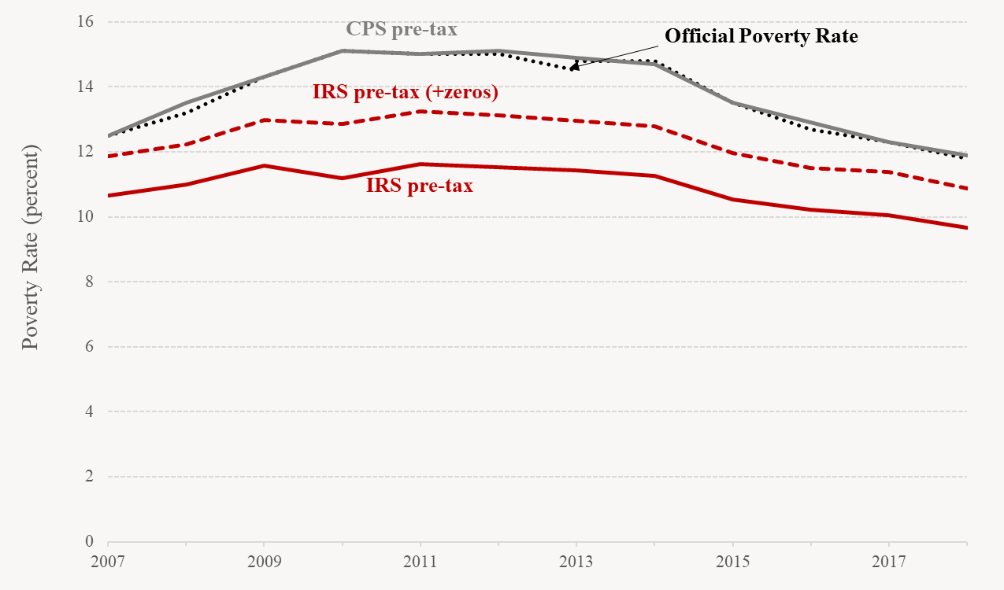
Unanchored poverty rates

