Slide 1

Megafirms and Monopsonists:
Not the same employers,
not the same workers
Matthew Dey and Elizabeth Weber Handwerker
NBER Summer Institute July 15, 2019
Conference on Research in Income and Wealth
  All views expressed in this presentation are those of the authors and do not necessarily reflect the views or policies of the U.S. Bureau of Labor Statistics.

Slide 2
Background
Great interest in the falling labor share of income and declining returns to work in very large employers: i.e. Autor, Dorn, Katz, Patterson, & Van Reenan (2017); Song, Price, Guvenen, Bloom, & Von Wachter (2018)
Explosion of recent empirical work using labor market concentration to measure explicit oligopsony power: Azar, Marinescu, & Steinbaum (2017); Benmelech, Bergman, & Kim (2018); Azar, Marinescu, Steinbaum, & Taska (2018); Lipsius (2018); Rinz (2018); Hershbein, Macaluso, & Yeh (2019); Sojourner & Qiu (2019); Berger, Herkenhoff, & Mongey (2019); Schubert, Stansbury, & Taska (2019); Azar, Marinescu, & Steinbaum (2019)

Slide 3
Outline
Measuring Labor Market Power in 3 ways
Comparing results across geographic areas
Comparing results across occupations
Conclusion: Limited overlap between very large employers and employers with explicit monopsony power
  Overlap of very large employers with explicit monopsony power is disproportionately a story of government employment
  Oligopsony happens (on average) in small markets
  Employment in very-large-employers has different patterns

Slide 4
Data Construction
Use the confidential microdata of the Occupational Employment Statistics (OES), a very large employer survey, for May 2005 – May 2017
  occupational distribution (6-digit) for responding employers
Measuring labor market concentration requires universe data on employment by occupation by employer for each geographic area
  Use OES sample frame: Quarterly Census of Employment and Wages (QCEW)
    The QCEW includes location, industry, & total employment size by quarter for nearly all civilian establishments in the U.S., with EIN as best-available employer identifier
    We borrow the geography of the OES sample: MSAs and “Balance-of-State” areas
  Use QCEW information to impute OES responses for all non-responding and non-sampled establishments

Slide 5
Impute with nearest neighbor matching
Impute occupation and wage distribution for non-responding establishments and similarly for non-sampled establishments
  If available, use OES response from the previous two and a half years, as long as industry is unchanged and size is similar (8% of establishments, 28% of employment)
  Otherwise, use establishments with the same EIN, same detailed industry, similar size, and same MSA or Balance-of-State-Area, (7% of establishments, 3% of employment)
  Otherwise … same detailed industry, similar size, and same MSA or Balance-of-State-Area (52% of establishments, 31% of employment)
  Otherwise … same detailed industry and similar size within the same state (27% of establishments, 22% of employment)
  Otherwise … same detailed industry and similar size from out of state (6% of establishments, 17% of employment)

Slide 6
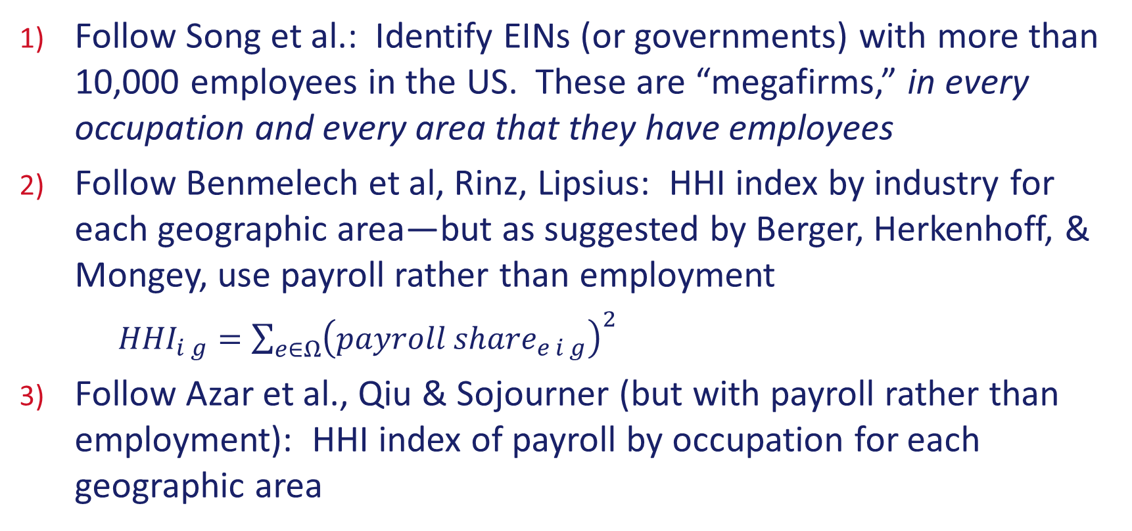
Measures of Employer Power
Follow Song et al.: Identify EINs (or governments) with more than 10,000 employees in the US. These are “megafirms,” in every occupation and every area that they have employees
Follow Benmelech et al, Rinz, Lipsius: HHI index by industry for each geographic area—but as suggested by Berger, Herkenhoff, & Mongey, use payroll rather than employment
  ${HHI}_{i g}=\sum_{e∈Ω}{{\left({payroll share}_{e i g}\right)}^{2}}$
Follow Azar et al., Qiu & Sojourner (but with payroll rather than employment): HHI index of payroll by occupation for each geographic area

Slide 7
Comparison to other estimates
(Song et. al., 2018) share of employment in “Megafirms” in Social Security Administration data in 2013: 23%
  Average in QCEW data for May 2013: 17% for the private sector
(Rinz, 2018) average HHI of employment by area and industry, in Census LDB data for 2005-2015: ~0.15
  Average HHI of employment by area & industry in QCEW data, 2005-2017: 0.19; Trends over time are also similar
(Qui & Sojourner) average HHI of employment by area and occupation, using Dunn & Bradstreet data mapped to occupations using national distributions of 3-digit occupation by industry for 2005-2014: 0.05
  Average employment-HHI in OES/QCEW data (for 6-digit occupation and area), 2005-2017: 0.10

Slide 8
Comparisons by
Geographic Area
(MSAs and Balance-of-State Areas)

Slide 9
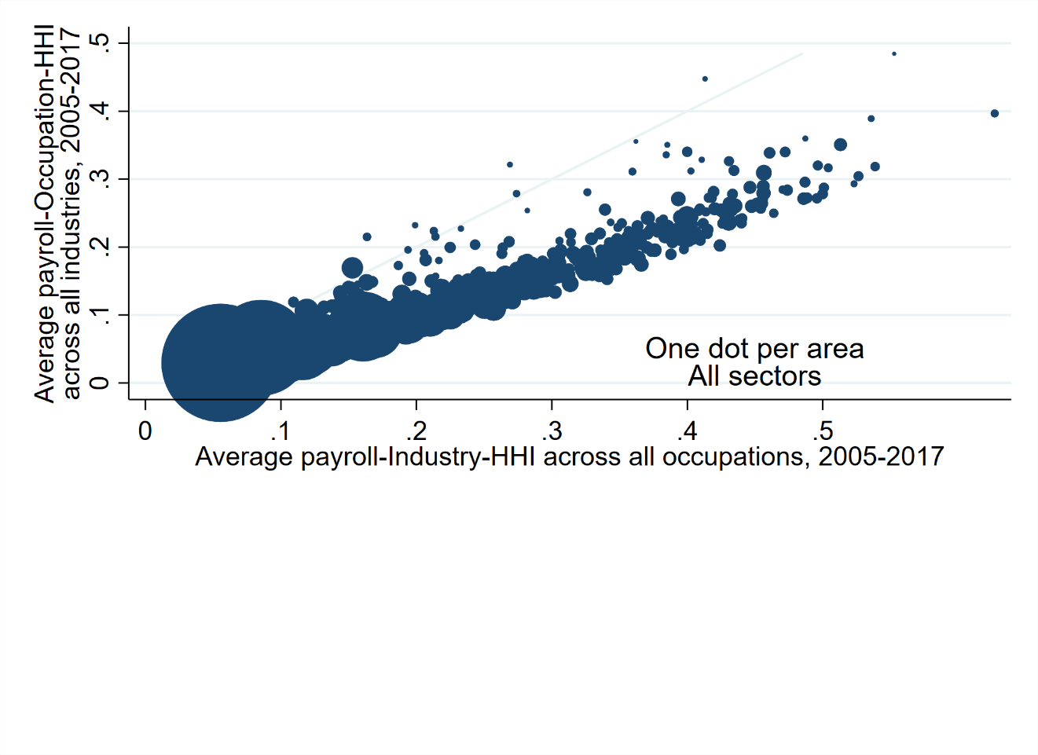
Industry & Occupation-level HHIs are highly correlated for areas
ρ=.96

Slide 10
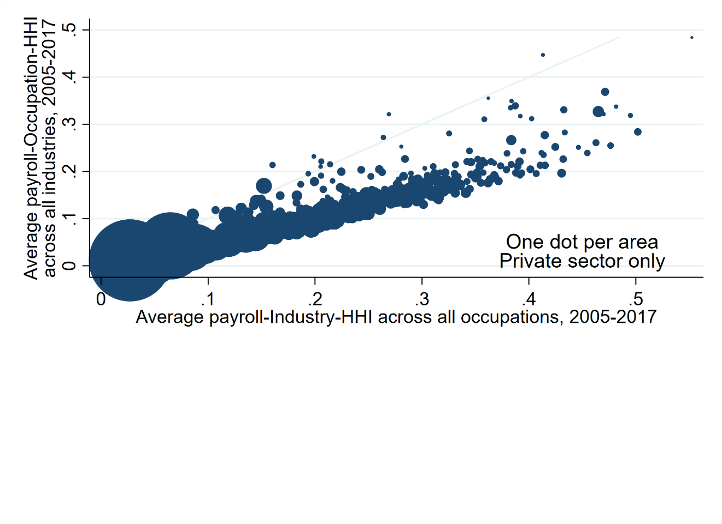
Very similar results for the private-sector only
ρ=.95

Slide 11
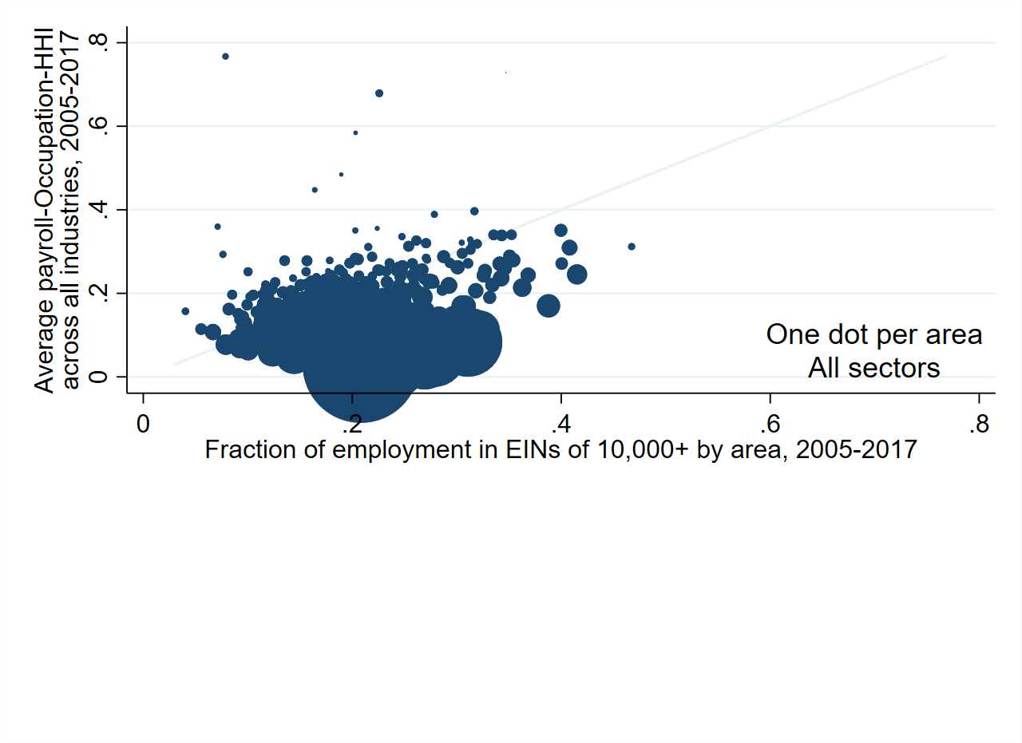
Little relationship between concentration and “megafirm” employment in an area
ρ=-0.003

Slide 12
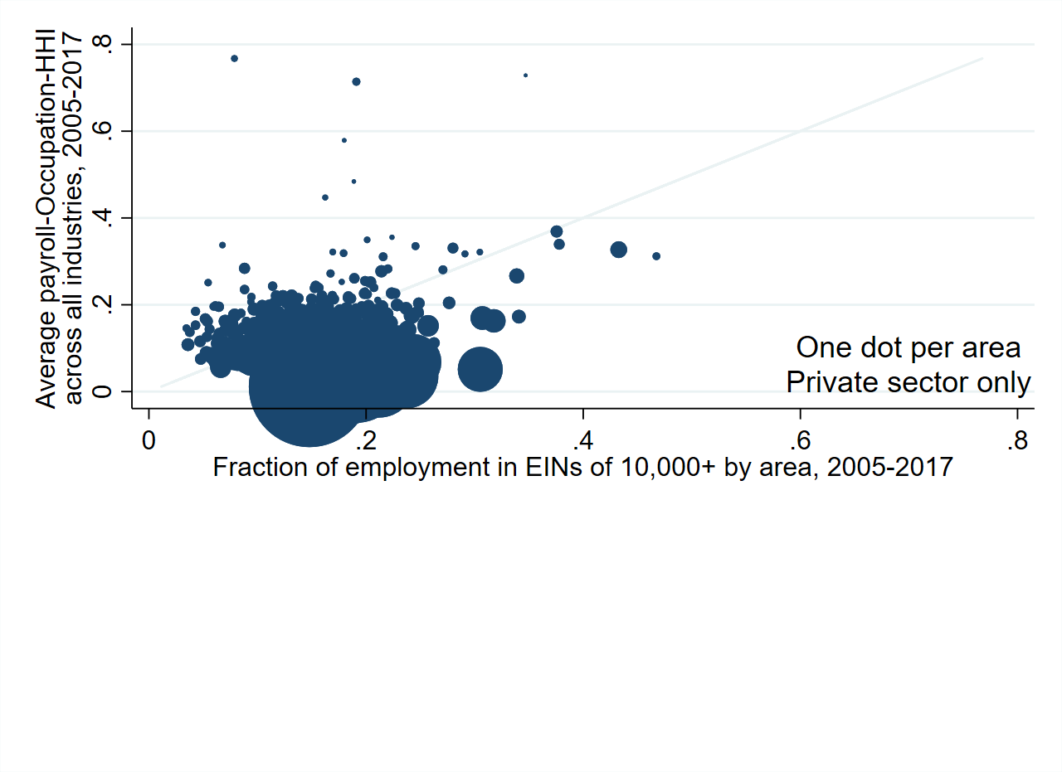
Again, similar results for private-sector only
ρ=-0.14

Slide 13
Identifying Oligopsonists (and their employees)
In large labor markets (area-occupation pairs of 100+ workers), order employers by size
  Sum squared payroll shares
  Once the sum reaches anti-trust thresholds 0.15 or 0.25, included employers are “Oligopsonists” in that geographic area-occupation
  Examples for the 0.25 threshold:
    If one employer employs half the labor market, it’s the sole oligopsonist (monopsonist) in that area-occupation
    If two employers each employ 35.4% of the labor market, both are oligopsonists in that area-occupation

Slide 14
Number of “Megafirm” and “.25 Oligopsonist” Employer-Tax-ID-Numbers, May 2017
(Examining Large Markets only)
“Oligopsonist” EINs (in any market) 12,663
Neither EINs
(Anywhere)
5,053,992
2,782 Local
Governments
22%
82,536 Local
Governments
2%
“Megafirm”
EINs
298
Both
625
33
Governments
11%
115 Governments
18%

Slide 15
Employment in “Megafirms” and “.25 Oligopsonists” in May 2017 (Large Markets only)
“Megafirm” Employment 26,116,329 19%
Neither
Employment
103,110,584
76%
“Oligopsonist”
Employment
2,804,992
2%
Local
Governments:
11%
10,952,434
Both
Employment
2,943,355
2%
Local
Governments:
33%
922,655
Government:
22%
5,711,847
Government:
94%
2,776,854

Slide 16
Number of “Megafirm” and “.15 Oligopsonist” Employer-Tax-ID-Numbers, May 2017
(Examining Large Markets only)
Neither EINs
(Anywhere)
5,053,992
“Oligopsonist” EINs (in any market) 27,460
“Megafirm”
EINs
132
80,556
Local
Governments
2%
Both
791
14
Governments
11%
4,762
Local
Governments
17%
134
Governments
17%

Slide 17
Employment in “Megafirms” and “.15 Oligopsonists” May 2017 (Large Markets only)
“Megafirm” Employment 24,922,903 18%
Local
Governments:
31%
1,387,338
Neither
Employment
101,441,897
74%
“Oligopsonist”
Employment
4,473,679
3%
Both
Employment
5,636,781
4%
Local
Governments:
10%
10,487,751
Government:
21%
5,122,890
Government:
60%
3,365,811

Slide 18
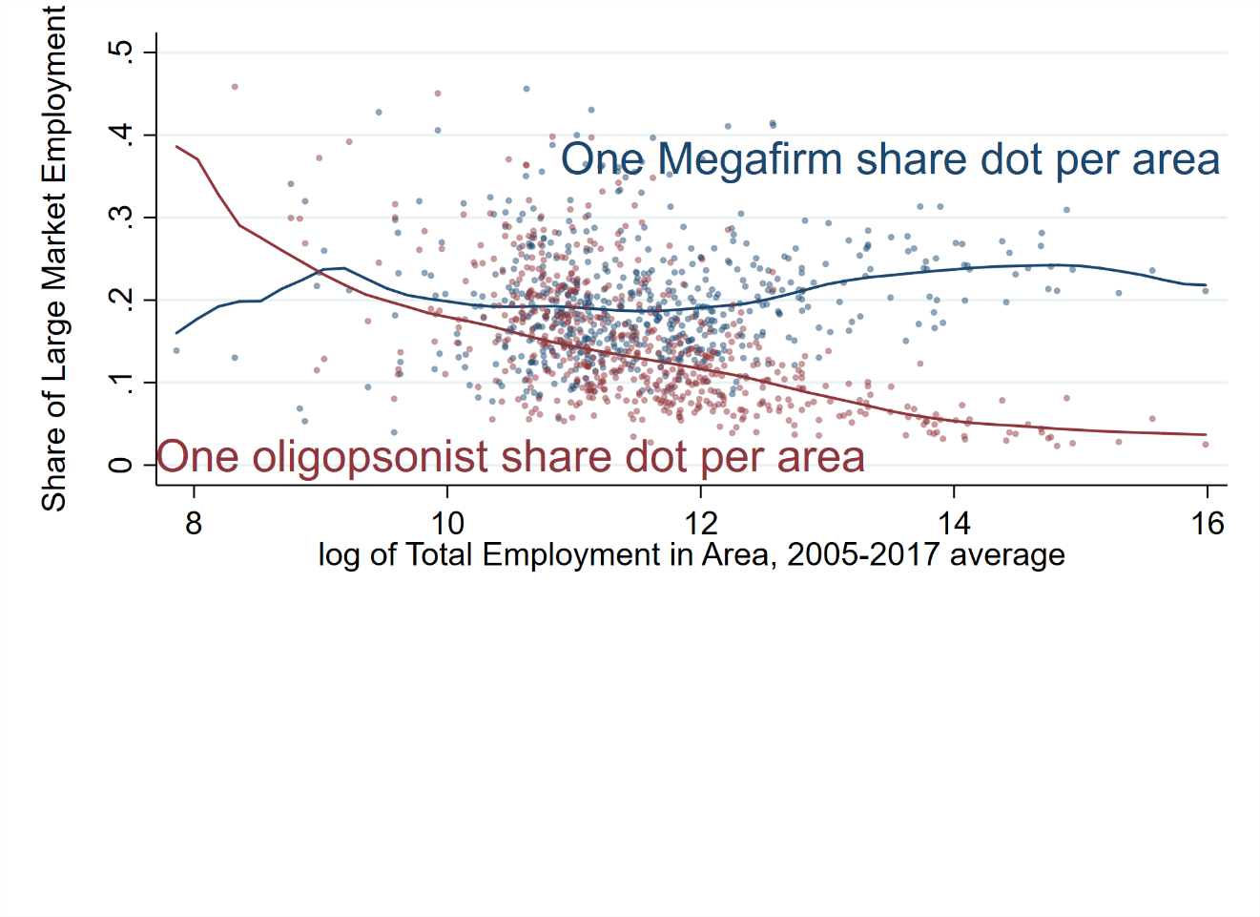
In these large markets, Oligopsonist employment shares are related to area size
Regressing area size
and its square on
employer type shares
gives an R² value of
.33 for monopsony
and .03 for megafirm

Slide 19
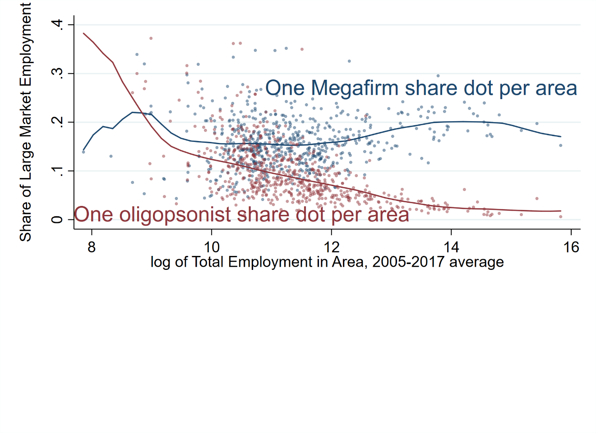
Very similar for private sector only
Regressing area size
and its square on
employer type shares
gives an R² value of
.33 for monopsony
and .04 for megafirm

Slide 20
Comparisons by
Occupations

Slide 21
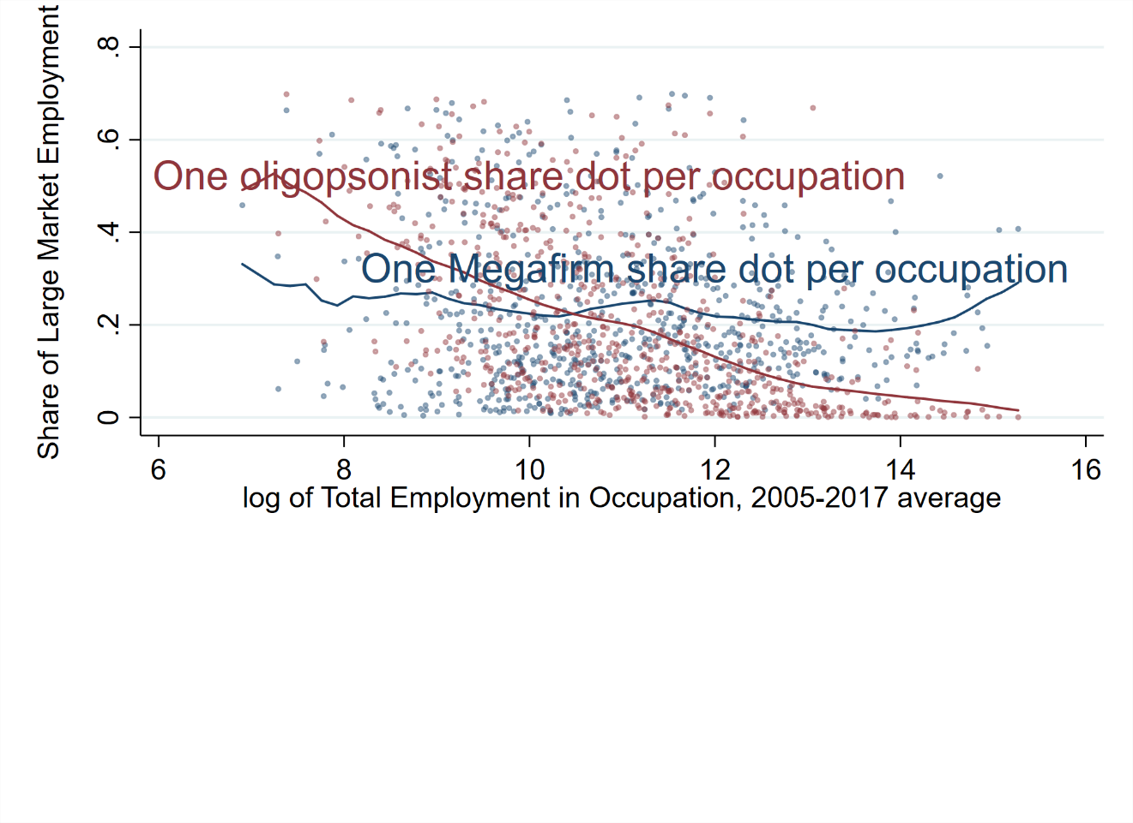
Oligopsonist shares of occupation are related to occupation size
Note that occupation size
explains only a very
small amount of
variation between
occupations
Regressing occupation size
and its square on
employer type shares
gives an R² value of
.24 for monopsony
and .01 for megafirm

Slide 22
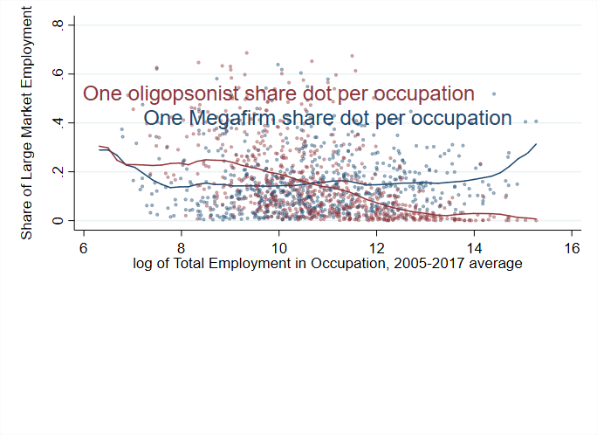
Very similar for the private sector only
For the private sector
only, regressing
occupation size
and its square on
employer type shares
gives an R² value of
.18 for monopsony
and .01 for megafirm

Slide 23
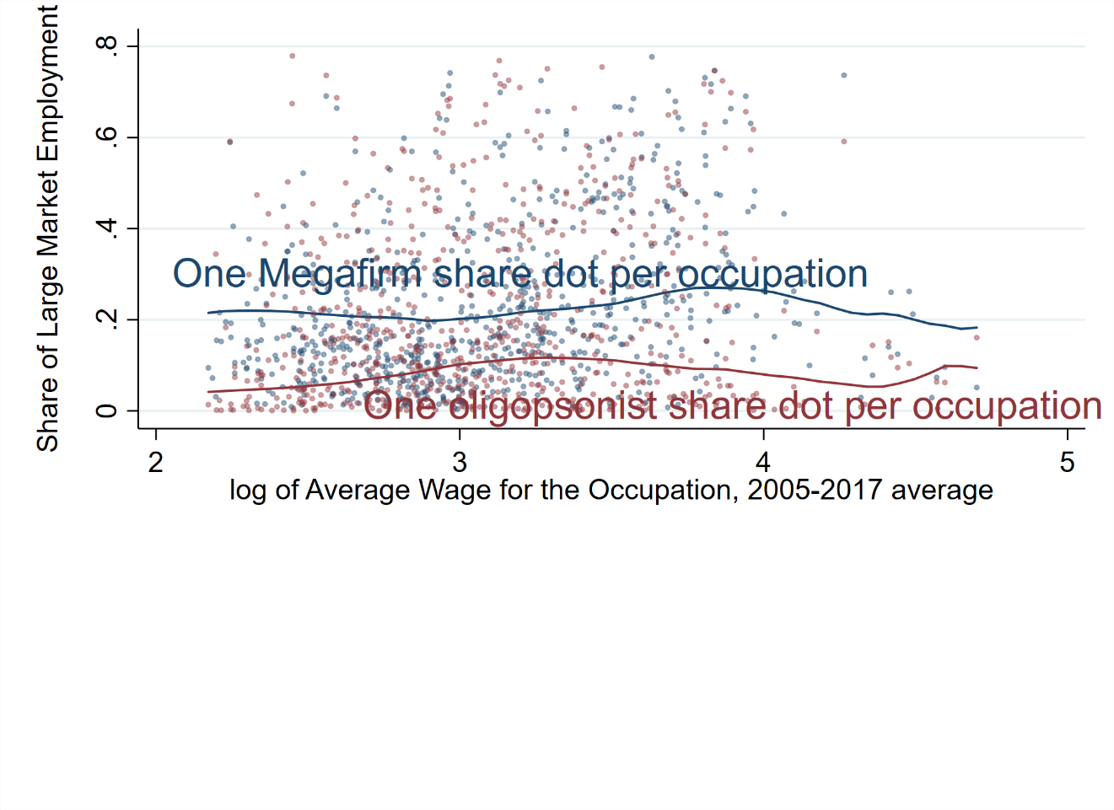
Wage explains little occupational variation
Regressing occupation wage
and its square on
employer type
gives an R² value of
.04 for monopsony
and .09 for megafirm

Slide 24
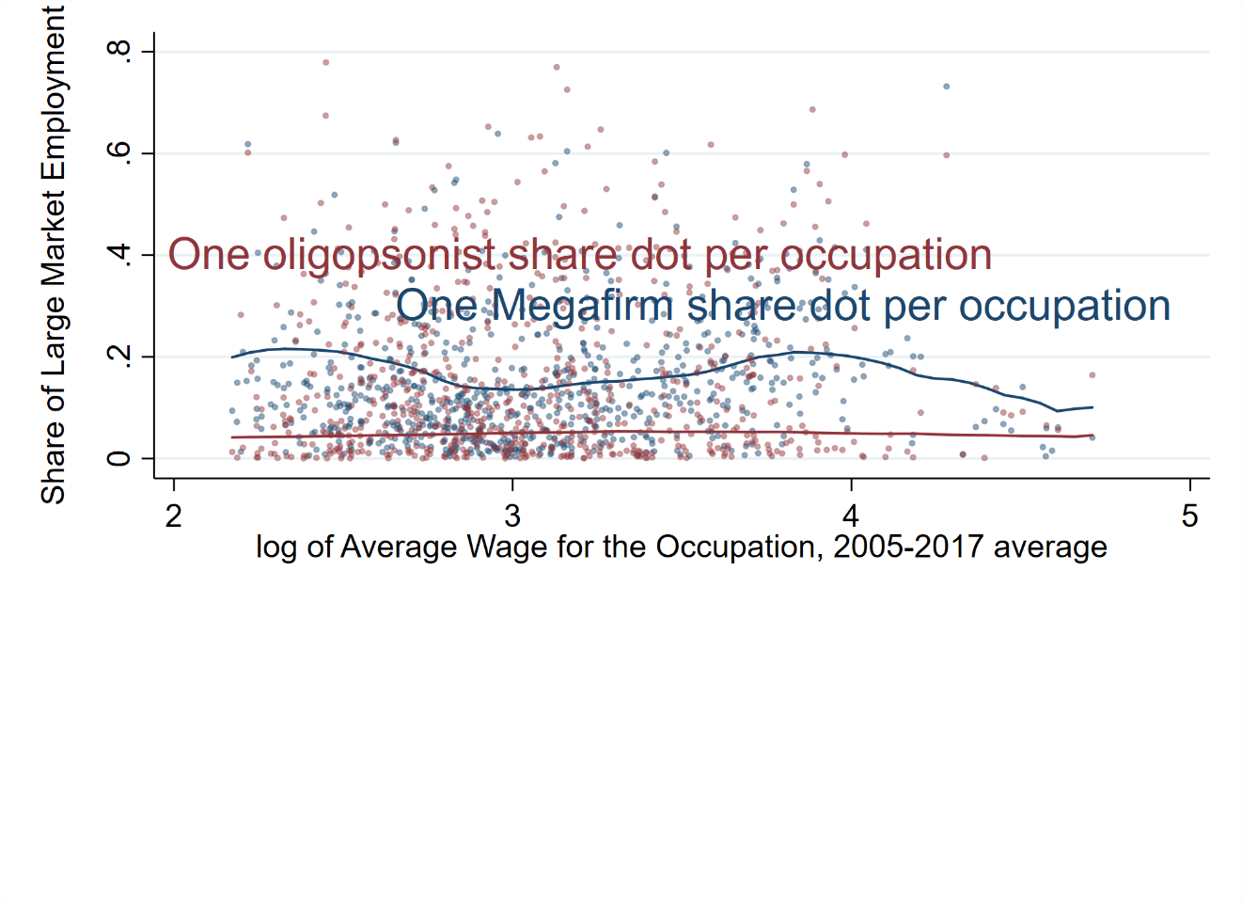
Wage explains even less in the private-sector
Regressing occupation ln(wage)
and its square on
employer type
gives an R² value of
.01 for monopsony
and .02 for megafirm

Slide 25
Does anything explain variation between occupations?
In the private-sector microdata, regress large-market employer-type (local oligopsonist or megafirm dummies) on occupation and observable establishment characteristics (industry, area, size, date)
  For employment in local oligopsonists, some variation between occupations is explained by area and industry
  For employment in megafirms, most of the variation between occupations is explained by industry
Examine whether residual variation between occupations can be explained by occupational characteristics
  We rely on Dey & Lowenstein (2019), who condense scores of O*NET variables into 21 occupational characteristics

Slide 26
Occupational characteristics & residual variation
Occupational characteristics
that predict employment in
megafirms are not the same
characteristics that predict
employment in mega-EINs

Slide 27
Conclusions and Next Steps
Megafirms and Monopsonists: Not the Same
  (Except for governments)
Next Steps:
  Over time, employment is shifting into less oligopsonistic megafirms. Is this explained by changes in industry, occupation, geography, or employer agglomeration?
  Which occupations are affected most by labor market power? What are their characteristics?

Slide 28
Thank you
Although the OES and QCEW microdata cannot leave BLS, BLS welcomes visiting researchers. More information is available at https://www.bls.gov/rda/home.htm

