Slide 1
Influence of scientific research on policy: a funder’s perspective
Chonnettia Jones, Ph.D.
Director of Insight & Analysis

Slide 2
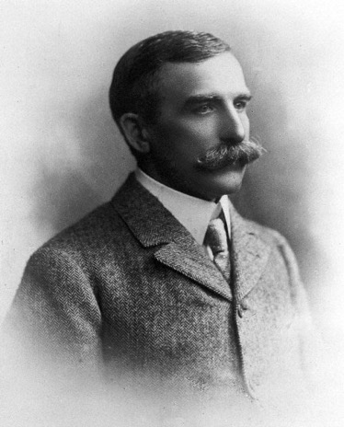
Our origins
Founder Sir Henry Wellcome was an entrepreneur, collector and philanthropist.
On his death in 1936, his will established a charity for "the advancement of medical and scientific research to improve mankind's wellbeing".
2

Slide 3
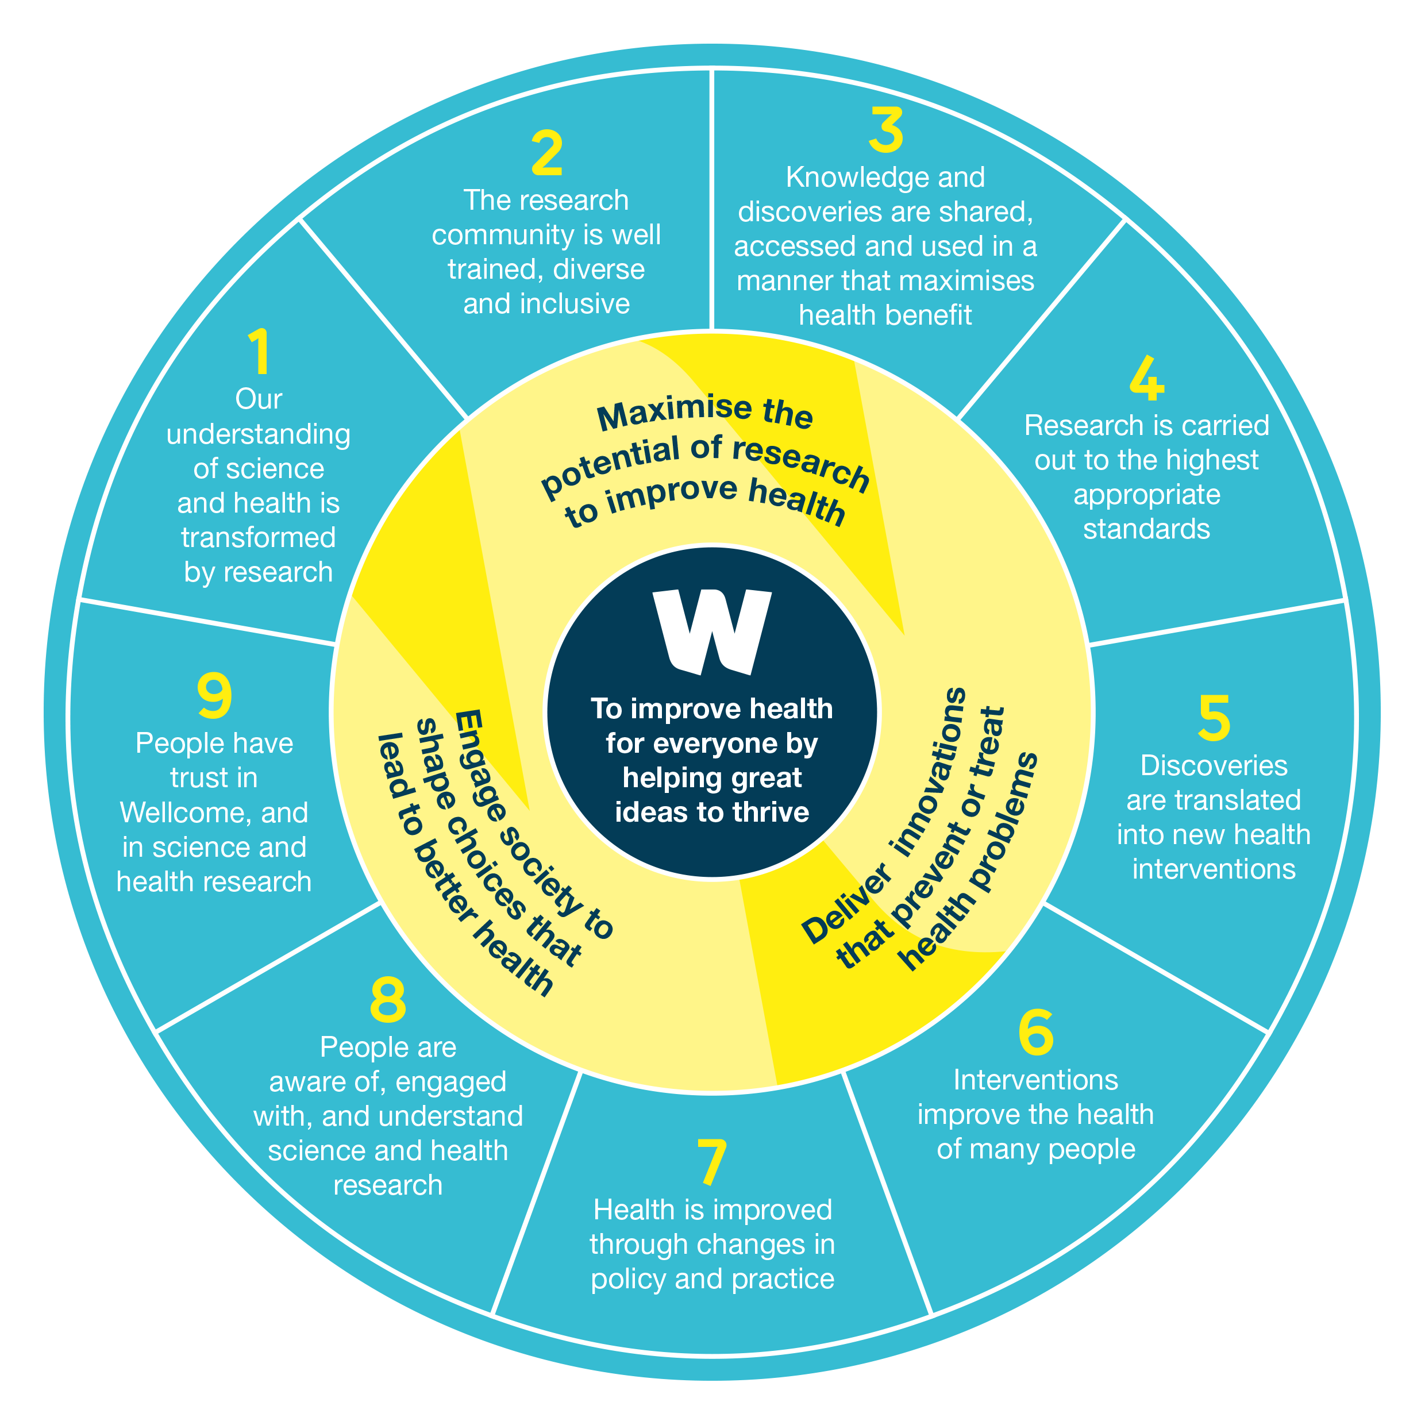
Wellcome Success Framework
  The framework sets out 9 shared ambitions that express ‘what success looks like’ to Wellcome.
  We aspire to improve health for everyone by helping great ideas to thrive.
  We will achieve this by:
  Maximising the potential of research to improve health.
  Delivering innovations that prevent or treat health problems.
  Engaging society to shape choices that lead to better health.
  We hold ourselves accountable to society for delivering Wellcome’s mission, while using our independence for public benefit.
3

Slide 4
Case Study:
Treatment for Malaria

Slide 5
Artesunate-based Malaria Mono-
and Combination Therapy
WHO revise malaria guidelines to extend recommendation of artesunate monotherapy as first-line treatment in management of severe malaria to include children, citing AQUAMAT.
1979
1994-8
2006
2010
Trial (SEAQUAMAT) to assess artesunate monotherapy as treatment for severe malaria shows 35% reduction in deaths vs quinine. Trial supported by Wellcome through grant awarded to Prof. Nick White and core funding of MORU.
The Global Fund and Affordable Medicines Facility bankrolls or subsidises distribution of artemisinin combination therapies in public and private sectors.
First evaluations of artemisinin derivatives in Africa supported by Wellcome as part of Mahidol Oxford Tropical Medicine Research Unit (MORU).
Clinical Trial
Clinical Trial
Clinical Trials + Prospective study
Clinical Trial
Policy
Implementation
Clinical Trial
Policy
Trial shows artemisinin compounds to be capable of treating malaria.
MORU studies show that artemisinin derivatives act extremely rapidly and reduce transmission potential of malaria. MORU pioneers use of combination therapies (ACT) to reduce risk of treatment failure, parasite resistance and side effects in patients, compared with monotherapy.
First edition WHO malaria treatment guidelines recommend artesunate as first-line treatment, in combination therapy for uncomplicated falciparum malaria, as monotherapy for severe falciparum malaria in adults.
Trial (AQUAMAT) in African children with severe malaria shows artesunate monotherapy reduces mortality by 22% vs quinine. Trial supported by Wellcome through Project Grants to Prof. Nick White and core funding of MORU.
1992
2005
2008
2011
Wellcome contribution
Contributions of others
Outcomes
Impact

Slide 6
What have we learned?
Wellcome’s contributions to health have primarily been the funding of research and early development of health interventions, including drugs, devices, diagnostics, and cognitive behavioural therapies.
The average time that has elapsed between first research findings and improved health outcomes has been 10-15 years. Greater focus on the implementation of interventions reduced the time to health impact.
Wellcome has played a ‘passive’ funder role in supporting research that could have policy relevance – that is, while Wellcome has provided funding, the responsibility for pushing for policy reform required to improve health outcomes has fallen to the investigators.

Slide 7
What could we do differently?
Diversify Wellcome’s contributions to health-related research beyond just funding – including convening and brokering multi-lateral conversations, advocating for reform, and actively seeking to influence policy.
Develop an implementation strategy that involves early policy engagement alongside health-related research to facilitate the rapid uptake of research into policy and practice and ensure health interventions can reach the people who could benefit.

Slide 8
Data science methods to assess the influence of scientific research on policy
Dr. Danil Mikhailov
Founder and Head of Wellcome Data Labs

Slide 9
Contents
Context
Part I: Using ML to understand Reach and Influence
Problem Definition
Methodology
Results
Issues
Future Development
Part II: Practical Ethics in Product Development
Our Ambition
What have we achieved?
The challenges
Acknowledgements

Slide 10
Context

Slide 11
Contextualising this research
This report is intended as a meta analysis of the approach Wellcome Trust has taken.
As such, the results are presented unvarnished, following a pilot run of a set of ML tools that are collectively known as the Wellcome Reach tool.
The results purposefully include errors and duplicates to enable analysis of the cause of the issues and discussion of possible ethical challenges.

Slide 12
Problem

Slide 13
Ambition 7 indicators
Ambition 7: “Health is improved through changes in policy and practice”
Objectives and Indicators:
a. Policy and practice are informed by research and researchers
  Number of policy cases that reference WT funded research
  …
b. Decision makers take up Wellcome’s position on policy and practice
  Number ..

Slide 14
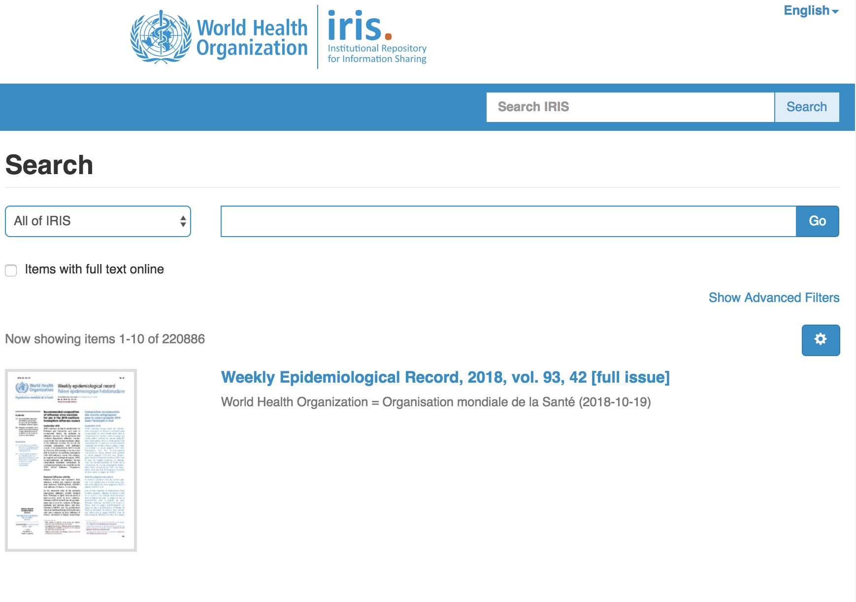
Finding policy cases: scale justifies use of ML & automation
220,886 documents on WHO website

Slide 15
Methodology

Slide 16
Data Science Method
Step 1: We created software tools to automatically scrape policy documents from WHO, Unicef, NICE and MSF’s publicly accessible online portals.
Step 2: Then we developed ML tools using Naïve Bayes to:
Find citation sections in the doc
Split them into individual citations
Parse them into constituent buckets of “title”, “author”, “date” etc
Match them with a structured dataset of Wellcome funded publications derived from Digital Science’s Dimensions tool.
Step 3: We built a pipeline to automate the process.
Please see our tech documentation on GitHub for more details and to review code

Slide 17
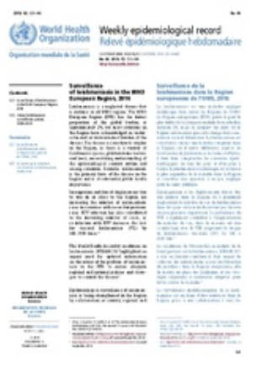
Data Science Pipeline
WHO
NICE
Unicef
Digital Science
EPMC
Machine learning

Slide 18
ML accuracy by stage
Find
Split
Parse
Match
85%
57%
87%
96%

Slide 19
Going from Reach to Influence
The data science work produced a signal which indicates a potential connection between a Wellcome funded publication and a policy document that we define as “reach”.
To get from the weaker claim of “reach” to a stronger claim of “influence” we do a number of follow up steps of more qualitative analysis to validate the claim:
timeline review
documentation review
consideration of alternative explanations for the observed influence
review of other independent sources of information.

Slide 20
Preliminary results of Wellcome Reach Tool
1st trial run

Slide 21
Citations of Wellcome funded publications by policy source
Organisation | Documents | WT References*
WHO | 7,484 | 867
NICE | 289 | 5
Unicef | 189 | 33
MSF | 69 | 1
* Results include errors and duplicates, see Issues Section

Slide 22
Issues

Slide 23
Split function causes accuracy issues
Find
Split
Parse
Match
85%
57%
87%
96%

Slide 24
Example: 10 ‘most cited’ papers
It was initially assumed that the highest cited papers would be best candidates for follow on evaluation.
But:
  8 out of 10 had duplicate issues (the most striking example is the publication ID 1054751447 – it is supposed to have 56 policy citations and 55 were duplicates).
  4 out of 10 are false matches (the policy docs do not seem to cite the publication)

Slide 26
10 most cited papers (continued)
It is clear that there is a problem with initial hypothesis: many of the highest-cited papers may actually be those with most duplication and accuracy issues.
Nevertheless the Reach tool is finding a significant number of real targets for further evaluation.
The analysts confirmed 6 of the top 10 highest-cited papers as verified cases of “reach” and suitable for qualitative evaluation.
The evaluation analysis is instrumental in catching errors and feeding back into the design of the machine learning method to improve it.

Slide 27
Future

Slide 28
Improvements to ML
We are working to build a productionised data pipeline that will automatically clean the data coming out of the Reach tools analysis to remove duplicates
We are working to increase the accuracy of the 4 stages of ML and have already increase accuracy of the Split step from 57% to 67%. We expect to get this to c. 85% accuracy with current ML approach
In a parallel track another member of the team is working on replacing the current Naïve Bayes approach with Neural Nets for all steps, which we will expect to push accuracy of all steps above 90-95%

Slide 29
Adding Functionality
Add all text analysis function to find e.g. researchers and institutions using Lucene Search
Add ability to analyse against sub-categories, such as disease types and document types
Expand to other Funders and other sources of policy documents and other types of documents like white papers, conference proceedings and panel proceedings
Integrate with patent and publications analysis tools
Create a usable front end interface and make tools available as an open service

Slide 30
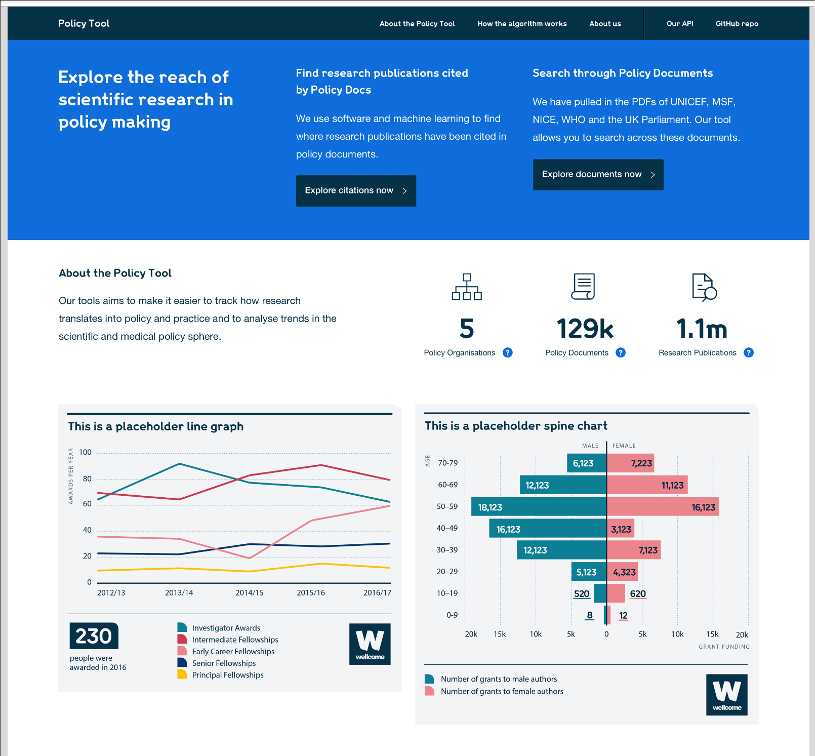
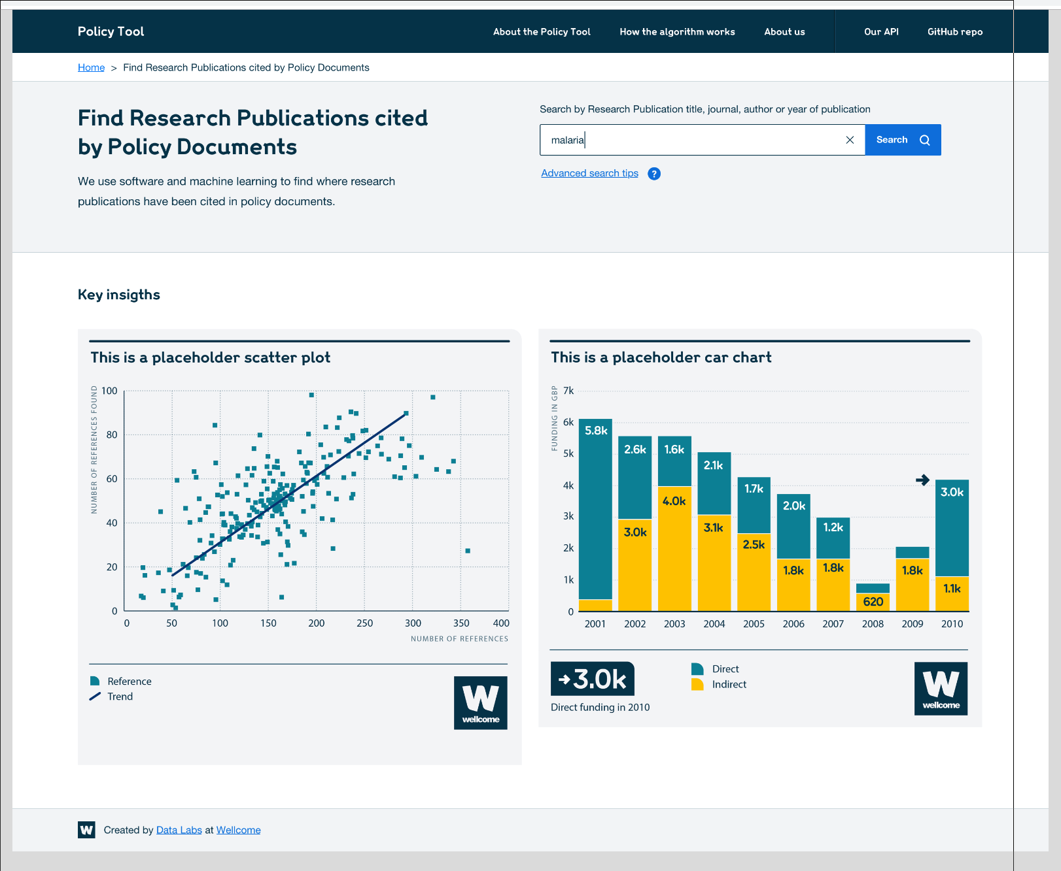
Releasing the Wellcome Reach Tool as an Open Service

Slide 31
Practical ethics in product development

Slide 32
Our ambition
Blend ethical analysis with data science in practical, lean way that keeps up to speed with product development.

Slide 33
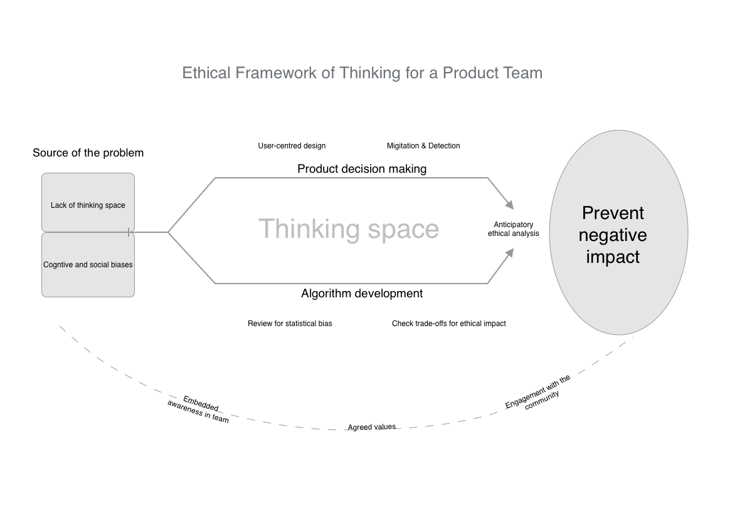

Slide 34
What have we achieved?

Slide 35
Evolving methodology
Pairing of user researcher and social researcher
Anticipatory analysis: uses, edge cases, misuses, abuses
Prioritisation using likelihood vs severity
Agreeing a set of principles, like transparency
Creating space for ethical thinking
Using Github to discuss and prioritize concerns

Slide 36
The challenges

Slide 37
A few challenges
How do we balance improving the product with assuring ourselves that we have sufficiently thought about unintended consequences?
How do we communicate to the user what a responsible interpretation of the outputs is?
If you release a public tool you lose control over how it can be used, but what responsibility do you still have for misuse?

Slide 38
With thanks to Dr Chonnettia Jones, Jessica Romo, Nick Sorros, Dr Elizabeth Gallagher, Marta Moratti, Sam Depardieu, Hunter Blanks, Aoife Spengeman, Dawn Duhaney, Natalie Leach and Andy Lee.
Please check out our blog at medium.com/wellcome-data-labs

Slide 39


