Slide 1
Challenges for SSF researchers when studying risk taking in SF
Some lessons learned from studying the ERC
Reinhilde Veugelers (KULeuven, former ERC Scientific Council Member)
Joint with Paula Stephan (Georgia State & NBER) and Jian Wang (ULeiden)
SSF Workshop NBER Summer institute, july 2019,

Slide 2
Challenges for SSF researchers to study risk taking by funding agencies, beyond the usual challenges…
Selection versus/and treatment
Examine who the funding agency selects: any bias or favor for risk taking applicants?
Examine “treatment”: does funding promote risk taking by selected researcher
Risk taking as part of the overall objectives: high risk for high gain;
Identifying the various levels of risk bias: researchers, evaluators, funding agencies, hosting institutions, scientific communities…
Finding good “cases”
Risk taking is a relevant characteristic of the “case”
Objectives of the program/funding agency
Identification of risk taking: proper comparison group: Randomization: ??, Change in programs, procedures,
Variance in risk taking across scientific disciplines, across time,
Finding proper measures for assessing risk;
Dealing with the truncation problem: do we observe the failure cases
….
Notes:
Usual:
Getting access to the data needed; Counterfactual non-applicants & non-granted, scores, …
Methodology: causal interpretation;

Slide 3

ERC as a good ‘case’ ?
Program within EC funding for basic research,
Set up in 2007 as EC’s instrument for bottom-up individual researchers
Sizeable/increasing budget: €13 billion budget for 2014-2020;
ERC explicitly designed to support “high risk/high gain”
Mission statement:
“Scientific excellence is the sole selection criterion. In particular, high risk/high gain pioneering proposals which go beyond the state of the art, address new and emerging fields of research, introduce unconventional, innovative approaches are encouraged”
“its grants will help to bring about new and unpredictable scientific and technological discoveries”.
Support for research in all fields of science and humanities: 25 panels (9 Life Sciences, 10 Physical Sciences & Engineering, 6 Social Sciences & Humanities)
3 main grant schemes:
Starting grants: 2-7 years after PhD; 5 years grant; up till 1.5 mill euro;
Consolidator grants: 7-12 years after PhD; 5 years grant; up till 2 mill euro;
Advanced grants: last 10 years track record; 5 years grant; up till 2.5 mill euro
Over 60,000 applications received since 2007 and around 7,000 projects funded

Slide 4
ERC’s Two Stage Selection Process
Panel Members selected by scientific council of ERC
Panel Members are informed of ERC’s mission to promote “high risk/high gain”
Panel Members decide on who gets grant.
Stage One
Five page summary with cv of applicant
Reviewed and scored by panel members before meeting;
Decision to pass to stage Two after panel meeting
Stage Two
Fifteen page proposal with cv
Reviewed by external experts and panel members
Interviews scheduled for “starter” grant applicants who pass stage two;
Rank proposals and decision to grant after panel meeting
2 year panel rotation; panel members with max panel tenure (4 rounds);
about 375 PMs and 2000 referees per call

Slide 5
Bias against novelty by funders? The case of ERC
Examine whether ERC selects applicants who have exhibited a pattern of high gain/high risk research in past.
Underlying rationale for positive selection on risk (or at least not bias against) is goal of ERC to promote risk taking, together with/as source of high gain (excellence)
Examine whether “treatment” by receipt of grant promotes high risk/high gain research
Underlying rationale for treatment effect is longer length of time grant provides researchers to pursue more risky avenues (5 years) and freedom associated with a large sum (up to 2,5 million euro) awarded to conduct research
Examine whether selection and treatment different across panels:
Differences by scientific fields
Differences by career age of applicants: junior vs seniors
Differences by panel procedures: first-second stage; with/without interviews

Slide 6
Measure of Risk Taking Used
Wang, J., Veugelers, R., & Stephan, P. E. (2017). Bias against novelty in science: A cautionary tale for users of bibliometric indicators. Research Policy, 46(8), 1416-1436.
Measure of combinatorial novelty.
The creation of any sort of novelty in art, science, or practical life-- consists to a substantial extent of a recombination of conceptual and physical materials that were previously in existence (Nelson and Winter (1982))
Publications that contain new combinations of referenced journals are said to be “novel,”
Finds novelty is “rare” and has properties associated with “risk”, such as
a higher mean citation performance with a higher variance, i.e., a higher likelihood to score as a breakthrough but at the same time a higher likelihood to be a “missed”,
the high impact takes a longer time to realize;
Impact more likely to be outside own field
Bias against novelty in classic bibliometric indicators using JIF & short citation windows (3 years)
Recognizes that this is just one measure of riskiness, and a measure requiring a successful publication to be able to measure

Slide 7
Main features from Novelty Measure consistent with “risky” profile
non-novel, if a paper has no new journal combinations; 89%
moderately novel, if a paper makes new combinations but has a novelty score lower than the top 1% of its subject category; 10%
highly novel, if a paper has a novelty score among the top 1% of its subject category and year; 1%
Wang, J., Veugelers, R., & Stephan, P. E. (2017). Bias against novelty in science: A cautionary tale for users of bibliometric indicators. Research Policy, 46(8), 1416-1436.

Slide 8
Does ERC select and enable risky research using novelty as a proxy of risky research: Estimating strategy
Sample includes all applicants who are successful plus sample of those who were unsuccessful
For selection, estimate model of probability of being selected
Stage 1 & Stage 2
Explanatory variables of particular interest
Researcher has at least 1 novel paper in its pre-application stock
Researcher has at least one top cited (1%) paper in its pre-application stock
Interaction of two variables
Control for other influencing variables
Stock of publications;Female;Advanced vs Starting;Fixed effects for year of call and panel (field)
For Treatment: Impact of funding on likelihood to produce novel papers;
Difference-in-Difference; compare the before/after of the grantees (treatment group) with the before/after of the control (matched) group

Slide 9
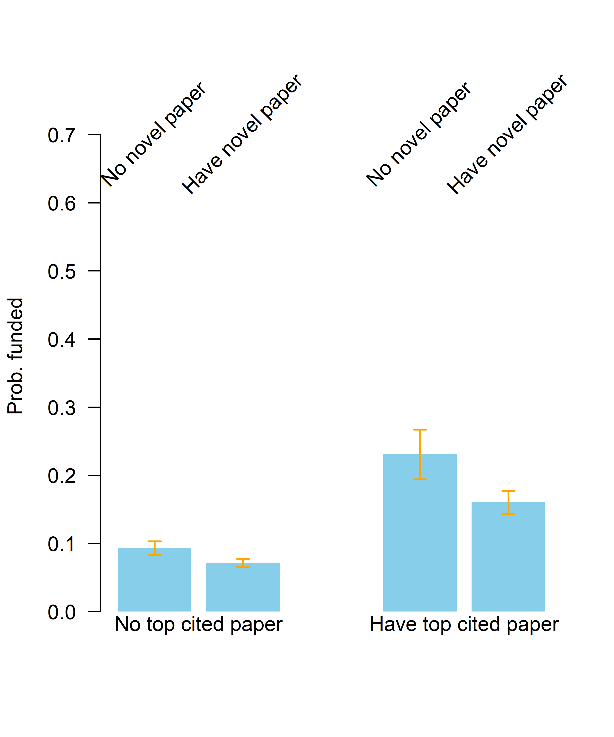
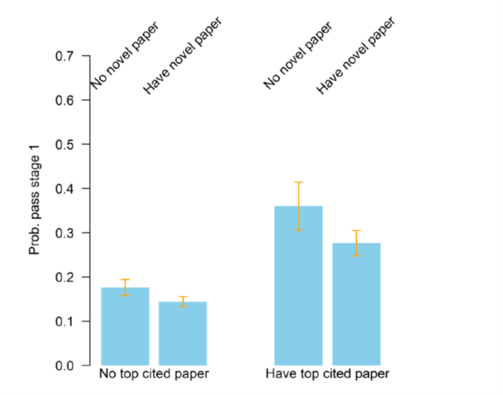
Results for Selection: Does ERC select risky research using novelty as a proxy of risky research?
Controls for nr publications, gender, panel, year, advanced
Notes:
First: overall: right is higher than left: having top cited paper given higher sr than non-top: selection on high-gain/excellence; strong;
Novel papers score lower; and this holds in both groups; penalty for novel paper holders; even somewhat stronger in the top cited group (interaction is negative, but not significant)
This overall picture comes from Stage 1;
(Stage 1: right is higher than left: having top cited paper given higher sr than non-top: selection on high-gain/excellence; strong;
Novel papers score lower; and this holds in both groups; penalty for novel paper holders; even somewhat stronger in the top cited group (interaction is negative, but not significant))
In Stage 2: sr are higher; difference between top cited and not are much smaller: consistent with proposal being more important than track record; but higher sr for excellence is still significantly higher;
Novel papers still score lower in both groups, but the difference is no longer significant; in both groups & no significant differences between the groups.

Slide 10
Controls for nr publications, gender, panel, year, advanced
Notes:
Excellence/TOPCITED more important for SR for SG than for AdG: because of stage 2; in stage 2 StG get significantly stronger selected on TOPCITED than AdG:
Is this because of age profile difference? Or because of difference in evaluation process, with interviews for StG;
For novelty: negative sr effect for StG; in both stages (although less sign in stage 2 because of larger standard errors)
For AdG: also negative but much smaller and with larger conf intervals, so overall not significant;
And although bias is somewhat higher for topcited profiles, this difference is not significant (interaction effects)

Slide 11
Interpretation of the findings on selection
Selection away from novelty/risk takes places in the first stage;
Stage one negative selection results consistent with screening model. PI track record more important at this stage;
Panels strongly prefer highly cited profiles and eschew selection of those with novel/risky profile
Stage two smaller selection on highly cited and non-significant negative selection on novelty/risk;
PI track record plays smaller role; panel focuses more on content of proposal;
Selection away from novelty/risk for Starting Grants ;
Starter: negative selection at stage one; not mitigated by having top 1% publications; negative selection persists into stage two
Advanced: non-significant negative selection on novelty/risk at both stages;
Panels eschew selection of those with novelty/risky profile when candidates are junior

Slide 12
Treatment Effects: Does ERC enable risky research using novelty as a proxy of risky research?
Analyzed by estimating a DiD
Dependent variable: presence of novel research
Control for selection (stage two) and trend: after or before award period; also estimate for stage one selection
Treatment effect : selection*after award
We control for number of publications (which increase the likelihood of getting a novel publication)
Also control for year, panel, gender, advanced

Slide 13
Methodological note: assessing the causal impact
Difference-in-Difference
Compare the before/after of the grantees (treatment group) with the before/after of the control (matched) group
Eliminates fixed individual effects (eg talent)
Eliminates common trends
The key "identifying" assumption is that the development of the potential for scientific output is similar for those that eventually receive funding and those who don't (common trend), so that the DiD is due to treatment.
If the program’s aim is to select exactly those PIs with most potential for impact research (which is not a fixed effect), then the fundamental assumption behind DID is violated (common trend assumption violated);
NB: even if this would jeopardize the assessment of causality of the funding, it is nice to know for the ERC that it managed to select those PIs with most potential for impact research, ie DiD effect may not be because of the funding but because of the selection of high potentials;

Slide 14
Results for treatment
Find no indication of treatment effects: DiD (coefficient on interaction term) is insignificant in all specifications
Funded compared to non-funded
Funded compared to those failed in Stage 2
Juniors
AdG
Gender
Field

Slide 15
Risk taking in SF: Lessons from ERC and novelty as case
Bias against PI with novel profile is definitely an issue, even when agency’s mission is high gain/high risk; SELECTION
Inducing more novel research cannot be taken for granted, even when agency’s mission is high gain/high risk; TREATMENT
Heterogeneity in bias against novelty:
Age profile of PI

Slide 16
A future research agenda
Exploring novelty measure of risk further;
Novelty when new combination crosses a longer distance
Successful novelty: ie novelty which becomes a big hit;
Novelty that is combined with conventionality: see Uzzi’s measure
New combinations of key components through text mining;
…
Exploring other measures of risk :
A PI profile with higher variance in success : Low scoring and high scoring publications
(New) crossing of disciplines
New/emerging topics
…

Slide 17
A future research agenda
Exploring the influence of panel members
We can use information on panel members and their profiles
Use of project proposal information & text mining to assess risk in proposal rather than PI profile
Use of information from panel member evaluation reports of applicants & text mining;
…

