Slide 1
US-China Rivalry: The Macro Policy Choices
Rod TYERS
Business School , University of Western Australia
Centre for Applied Macroeconomic Analysis
Australian National University
Yixiao ZHOU
Crawford School of Public Policy
The Australian National University
NBER Asia Seminar
Bank of Thailand, 6-7 June 2019

Slide 2
Paper summary

Slide 3
Summary 1
  Issues and approach:
  The rise of populism and authoritarian politics sees multilateral agreements resisted and increasingly frequent “beggar thy neighbor” actions and disputes over trade and macro policy.
  The US-China conflict is one of many but it is central.
  A calibrated global macro model is used to simulate the strategic macro policy rivalry.
  Emphases:
  roles of monetary policy and tax and import tariff instruments
  strategic policy choices
  effects on financial markets, bond yields and capital accumulation
  effects on income distribution

Slide 4
Summary 2
  What has been happening
  Trade:
  The US imposes new tariffs on about 50% of imports from China.
  US exports to China are smaller than Chinese exports to the US.
  China responds by taxing most imports from the US, less trade ammunition.
  China is the comparative loser from the trade conflict by the standard of proportional change in GDP.
  Tax and industrial policies:
  Tax reforms that reduce capital income tax in both countries.
  Regulatory concessions that advantage US firms.

Slide 5
Summary 3
  Capital income tax:
  “Race to the bottom” conditions prevail in our analysis (capital mobility but no significant migration).
  Reduced corporate taxation is dominant strategy for US and China.
  Fiscal balance for both is sustained by higher skill taxation – alliance between the working class and capital-owners.
  Tariff conflict with long run fiscal balance through tax mix switches:
  Long run US unilateral protection is “beggar thy neighbor” policy.
  Proportional losses to welfare and GDP are largest for China.
  Third regions experience loss in both output and welfare, especially Australia.
  Tax mix switches are important.
  Dominant US strategy is new tariffs with tariff revenue granting consumption tax relief (transfers to states).
  Best Chinese response is reduced tariffs (liberalization) with loss of revenue covered by reduced spending.

Slide 6
Preamble

Slide 7
Genesis
  Bilateral trade imbalances are not appropriate targets for policy.
  Even the CA is a dubious target, given that deficits imply strong financial performance.
  Likely triggers
  China’s threat to US leadership in the markets for hi-tech goods and services – Made in China 2025
  Strategically driven trend in restricted commerce between the two countries: a bamboo curtain
  Schism between US reservations toward open trade with China vs claimed leadership in the “global rules-based order” saps confidence in multilateralism
  Rising inequality in the US and other advanced economies
  Poor labour market performance of the low-skilled in the US and other advanced economies

Slide 8
Scope for Improved Vision of Macro-Trade Conflicts
  Published trade & macro studies
    Trade models capturing intra-industry trade by region-specific product differentiation, with or without firm heterogeneity
    but they are weak on
    In trade models open capital accounts, investment flows and the determinants of real exchange rates
    Sources of revenue and fiscal balance
    Tax mix switches in response to new tariff revenue
    Distributional effects of tax and trade distortions in global conflicts

Slide 9
Developments
Direct taxation
US 2018: general tax reform featuring decline in effective federal tax rate on capital income, here approximated as a decline in the power of capital tax by 5%
China 2019: changes to arrangements to tax firm profits that also reduced the effective rate of capital taxation. It is possibly larger but here it is approximated also at 5%.
Tariffs
Escalating tariff rates applied to trade in goods from early 2018 on both sides
China more dependent on exports to US than US on exports to China; limited potential to retaliate.

Slide 10
Sources: FRED, IMF.

Slide 11
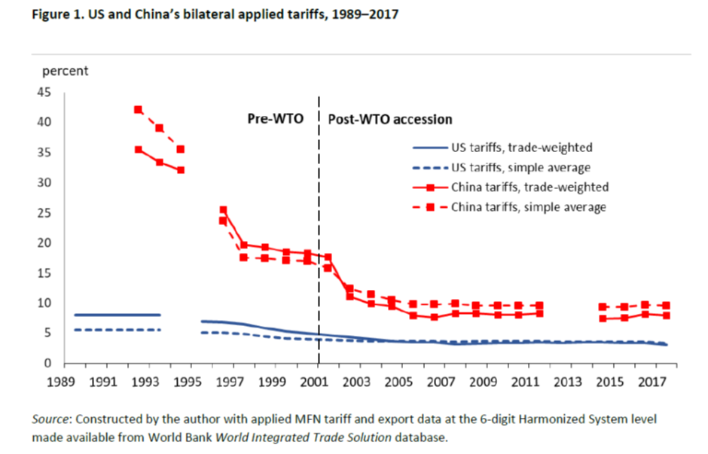
Source: Brown, C.P. (2019), “The 2018 US-China trade conflict after 40 years of special protection”, PIIE.

Slide 12
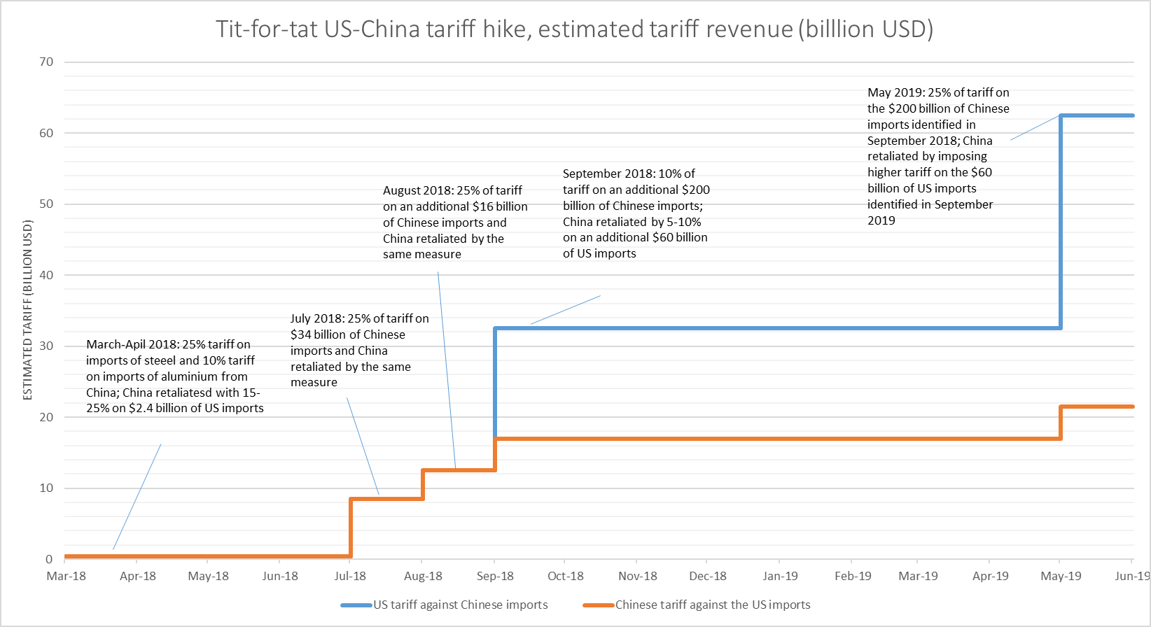
Notes:
Up until Sept 18 tariff changes are matching revenue effects. After that China runs out of additional imports to levy them on and only increases rates in March 19. On all goods traded bilaterally the average additional tariff rate is about 10%.

Slide 13
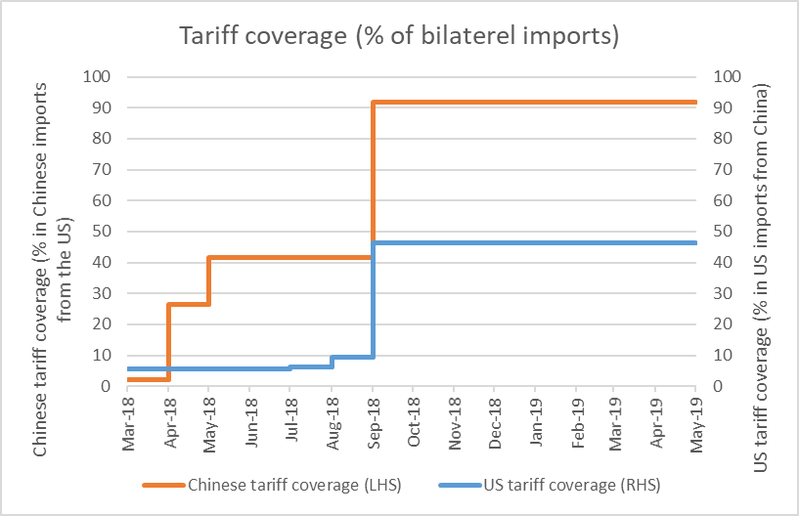
Notes:
Up until Sept 18 tariff changes are matching revenue effects. After that China runs out of additional imports to levy them on and only increases rates in March 19.

Slide 14
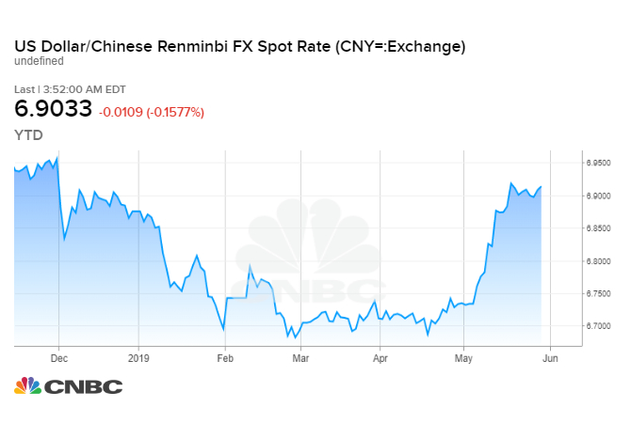
Source: CNBC.

Slide 15
Modelling the changes

Slide 16
The model
Global general equilibrium with money and financial asset markets
    Technology Cobb Douglas in relative quantities to separate TFP from factor share changes
    Intermediate inputs separately traded and employed
    Taxation on consumption, imports, exports and incomes to low-skill labour, skilled labour and capital
    Three household groups with factor specific incomes: low-income, professional and capital-owning
    Regions: US, EU, Japan, China, Australia, Rest of World.
Financial market structure
    Regions maintain global asset portfolios with augmentation from new saving and rebalancing to maximize expected portfolio rates of return
    Saving –consuming (heterogeneous) households are influenced by the market clearing long interest rate, current real disposable income and expected future real disposable income
    Government deficits are bond financed with large fiscal deficits raising an interest premium
    Money demand depends on regional long yield, financial portfolio size and transactions volume (real GDP)

Slide 17
Prices, Targets and Expectations
For each region
    Final consumption (P^{C}), production (factory gate, P^{P}), intermediates (P^{Q}), value added (P^{V}), GDP (P^{Y})
    Nominal exchange rates against US$ (E), nominal effective exchange rates
    Real exchange rates against US (e), real effective exchange rates
    Long bond yields (r), from domestic financial balance for each region
    Policy (short) interest rates are not represented explicitly, rather they are embodied in regional monetary bases that are endogenous to the targets of monetary policy
  Monetary targets
  Advanced economies – P^{C}, China and rest of world – E
  Price level expectations
  Advanced economies – anchored at zero inflation, China and rest of world, surprise deflations.
    Capital goods prices are fixed at today’s nominal level in each region.

Slide 18
Lengths of Run
Short run
    Nominal low-skill wage levels fixed
    Capital stocks fixed
    Government expenditure on goods and services fixed
  Long run
  Wages flexible so unemployment rates fixed
  Capital stocks flexible to keep constant expected net after tax rates of return (capacity adjusts)
  Government fiscal balances retained, so tariff revenue increase causes change in
  Government expenditure on goods and services
  Tax rate on consumption
  Tax rate on low-skill wage income
  Tax rate on capital income
  Calibration
    The model database is built on national accounts, international trade and financial data for the global economy in 2016.

Slide 19
Economic Welfare
Real purchasing power at home consumer prices of disposable income and government spending on goods and services as public goods, allocated equally per capita.

Slide 20
Capital taxation games

Slide 21
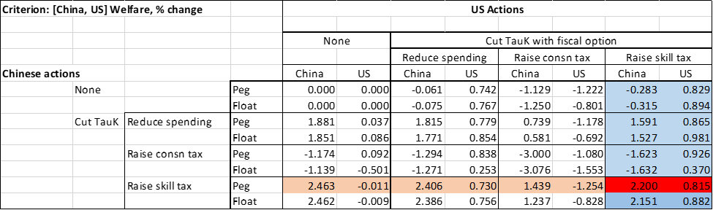
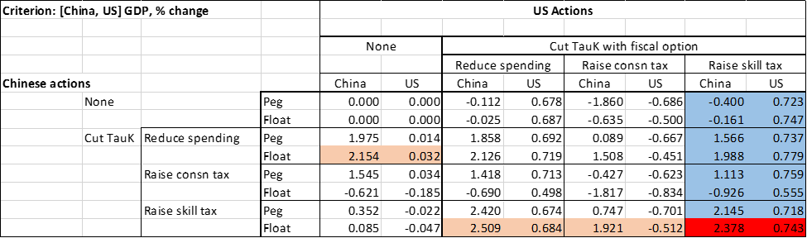

Slide 22
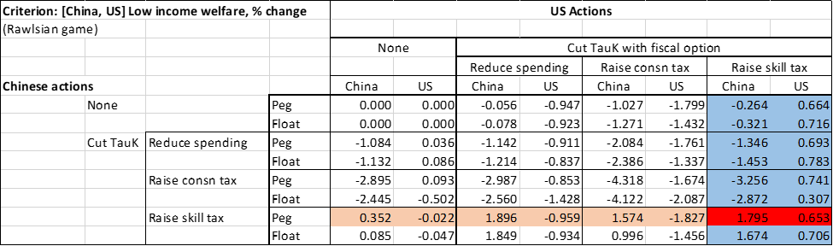


Slide 23
Bilateral tariff games

Slide 24

Protection Macro Stories
Simplified price relationship for a single region:
  Protagonist:
  τ^{M}↑↑ then E↑.
  If monetary policy targets P^{C} and τ_{C} is constant, then P^{P}↓ and this is contractionary if wage costs are constant (short run) or if P^{P}↓ constrains capital expansion in the long run.
  Counterintuitive; although there is a demand shift toward home products but only a P^{P}↑ if τ_{C} ↓.
  Trading partner with P^{C} target:
  Foreign τ^{M}↑↑ causes E↓. This leads in the short run to P^{P}↓ and contraction.
  Trading partner with E target (China) requires monetary contraction to defend E:
  Foreign τ^{M}↑↑ causes P^{P}↓↓ and P^{C}↓.

Slide 25
Simulated US Unilateral Combined Tariff and Tax Changes
% changes | Short run |  | Long run
 |  | Govt exp (public goods) adjust | Consn tax adjusts | Labor income tax adjusts | Skill income tax adjusts | Capital income tax adjusts | With capital tax reform^{b}
Shock to power of import tariff vs China | 5.00 | 5.00 | 5.00 | 5.00 | 5.00 | 5.00 | 5.00
Endogenous fiscal effects
Government expenditure on goods | 0.00 | 0.96 | 0.00 | 0.00 | 0.00 | 0.00 | -6.02
Power of consumption tax rate | 0.00 | 0.00 | -0.31 | 0.00 | 0.00 | 0.00 | 0.00
Power of tax rate on low-skill wage income | 0.00 | 0.00 | 0.00 | -0..68 | 0.00 | 0.00 | 0.00
Power of tax rate on skilled wage income | 0.00 | 0.00 | 0.00 | 0.00 | -0.26 | 0.00 | 0.00
Power of tax rate on capital income | 0.00 | 0.00 | 0.00 | 0.00 | 0.00 | -0.67 | -5.00
Change in fiscal position, %GDP | 0.11 | 0.00 | 0.00 | 0.00 | 0.00 | 0.00 | 0.00

Slide 26
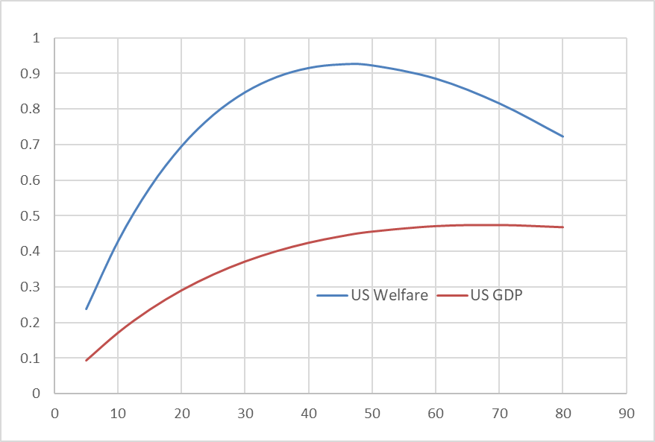
US Welfare and GDP Effects (% change) due to Bilateral Tariffs vs China
Unilateral implementation, fiscal adjustment via capital income tax
Proportional change in power of bilateral tariff

Slide 27
Bilateral tariff games: short run

Slide 28
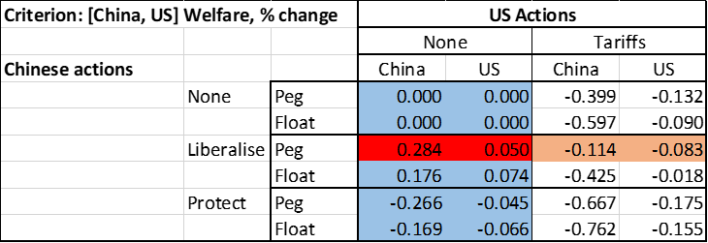
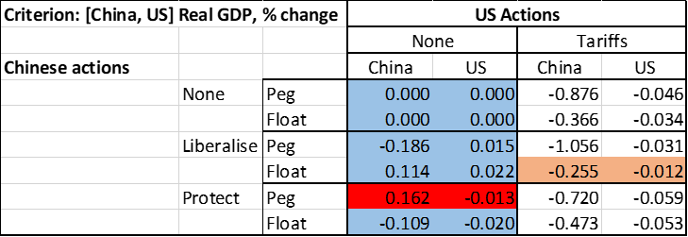
Short Run Protection Games

Slide 29
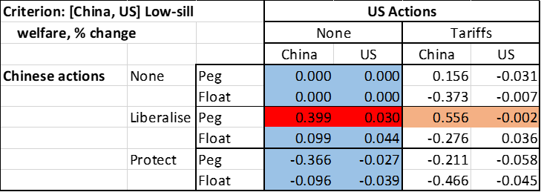
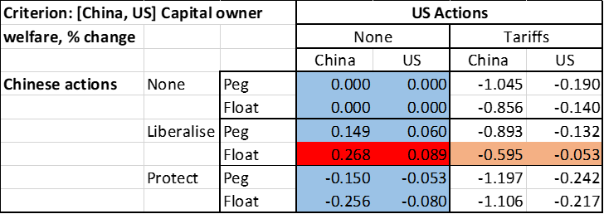
Short Run Protection Games

Slide 30
Bilateral tariff games: long run

Slide 31
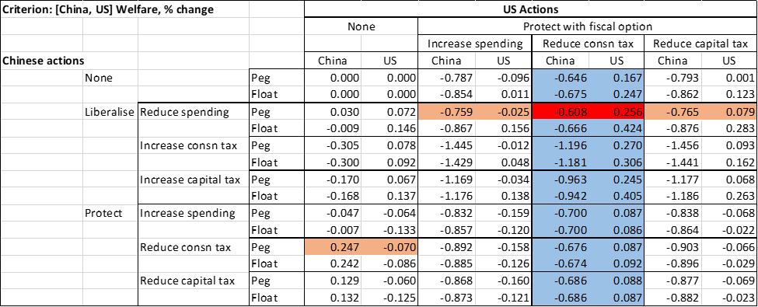
Long Run Protection Game – Welfare Max

Slide 32
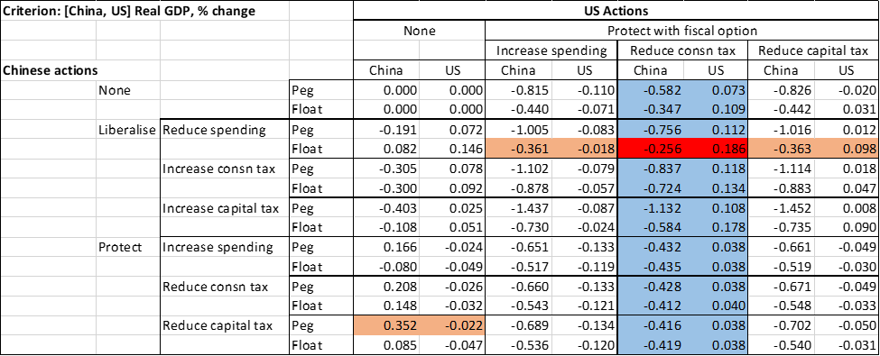
Long Run Protection Game – GDP Max

Slide 33
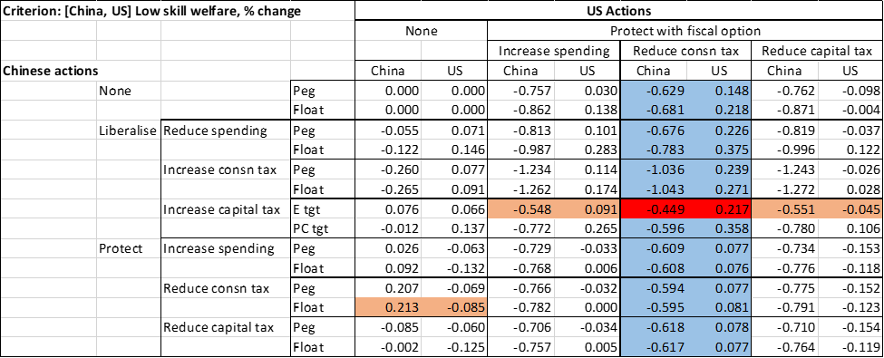
Long Run Protection Game – Low-Skill Welfare Max

Slide 34
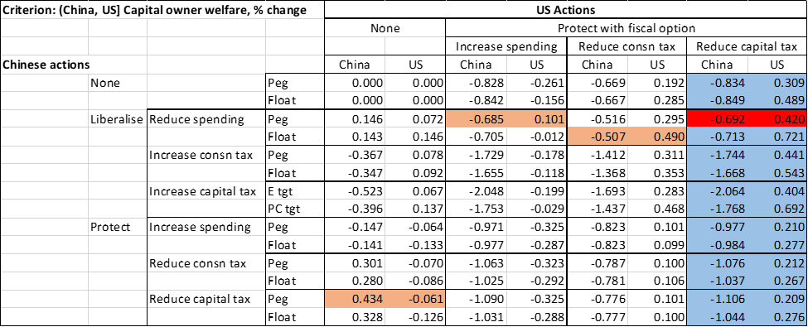
Long Run Protection Game – Capital Owner Welfare Max

Slide 35
Conclusion
A calibrated global macro model is applied, accounting for monetary policy and changes in fiscal positions or tax rates.
Long run outcomes depend on “tax mix switches”.
“Race to the bottom” on capital tax emerges with fiscal balance conserved in both the US and China by taxing the skilled in an alliance between working class and capital owners.
Tariff games also have mostly dominant strategies.
In the long run the US imposes tariffs, preserving fiscal balance by cutting consumption tax (transfers to the states).
China’s best response is to liberalise (reduce existing tariffs or other assistance to its industry).

Slide 36
Annexures

Slide 37
Annexure 1
Supplemental background

Slide 38
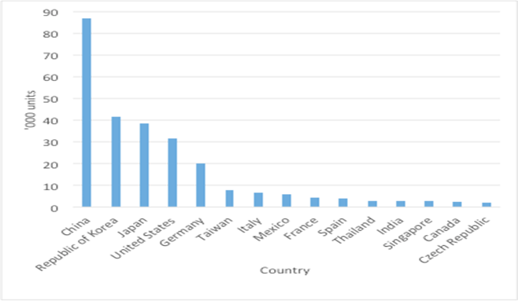
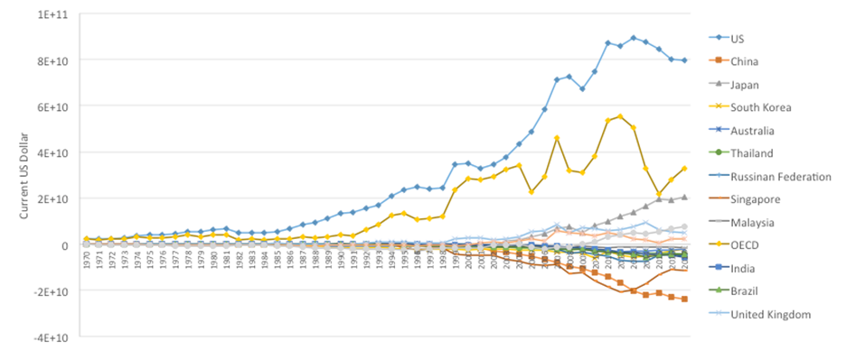
Annual supply of industrial robots in 2016
Net receipts from use of intellectual property, current USD
Source: International Federation of Robots.
Source: Authors’ calculations based on data from the World Bank’s World Development Indicators.

Slide 39
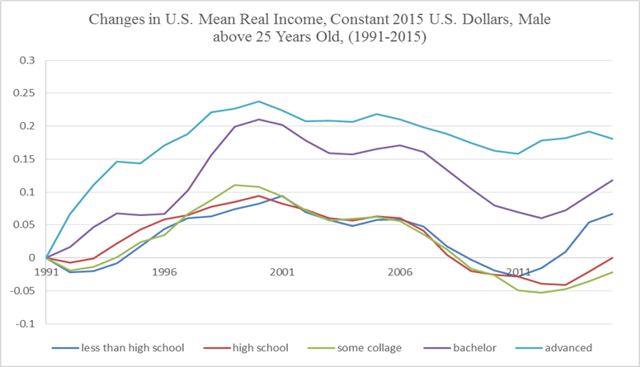
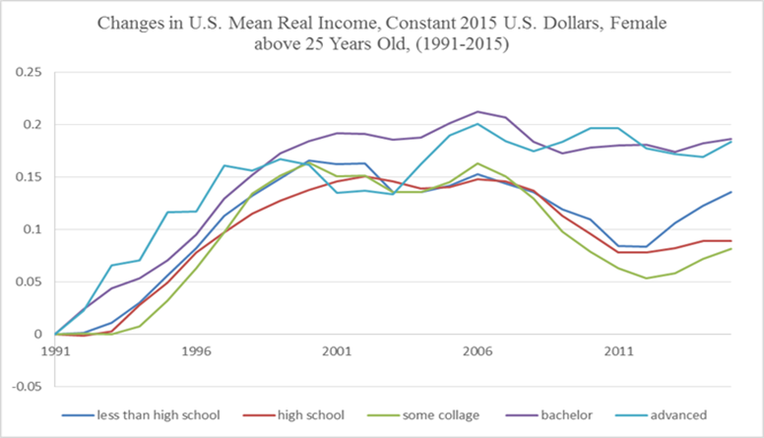
Real Worker Income in the US
Source: Mean incomes in constant 2015 US dollars by educational attainment based on Table P-18— Educational Attainment, People 25 Years Old and Over by Mean Income and Sex, 1991 to 2015, the US Bureau of the Census.

Slide 40
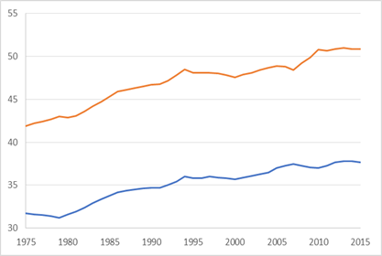
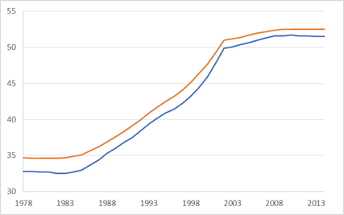
Gini Coefficients, US and China
US China
Source: SWIID database.
Note: The orange line is Gini index of inequality in equivalized household market (pre-tax and pre-transfer) income. The blue line is Gini index of inequality in “equivalized” household disposable (post-tax and post-transfer) income.

Slide 41
Annexure 2
Recent trade conflict studies

Slide 42
Prior Studies of the US-China Trade Conflict
Studies | Measure of effects | US | China | EU | Japan | Australia | World
Bouët and Laborde (2017) | Equivalent variation in income | -0.3% | -1.0% |  | 0.1%
Rosyadi and Widodo (2018) | Real GDP | -1.22% | -5.4% | 0.85% | 1.52% | 1.18%
Dong and Whalley (2012) | Equivalent variation in income | 60 $bn | -19 $bn | -1 $bn | -5 $bn |  | 4 $bn
Bollen and Rojas-Romagosa (2018) | Real GDP | -0.3 % | -1.2% | 0.4% | 0.4% |  | -0.1%
Li et al. (2018) | Real GDP | 0.3% | -1.0% | -0.001% | 0.003% |  | -0.04%

Slide 43
Annexure 3
Third country effects not covered in this analysis.

Slide 44
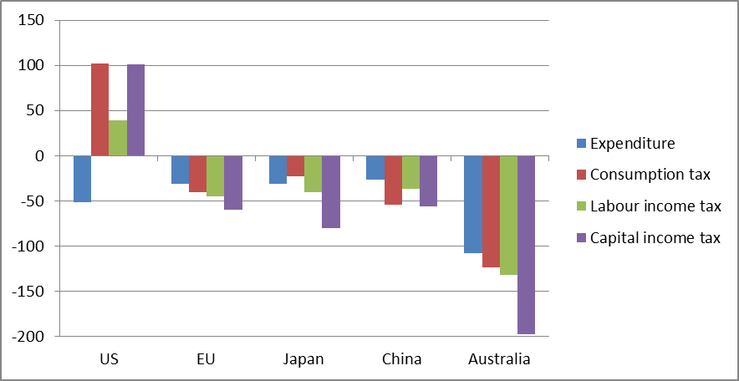
Long Run Welfare Effects of Unilateral 5% US Tariffs vs China
By fiscal adjustment type (US$ per capita)

Slide 45
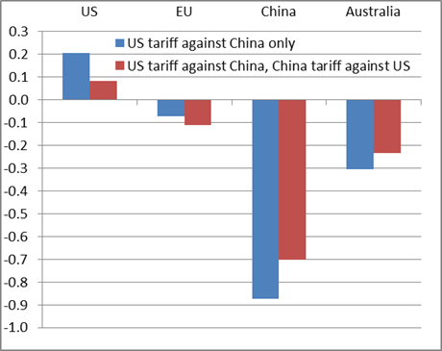
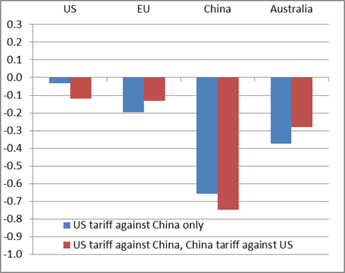
Real Consumption Wage Effects with Capacity Adjustment and Full Employment, %
Consumption tax adjusts Capital income tax adjusts
Source: Model simulations.

